Slide 1
Multiscale Analysis Methods
Fionn Murtagh
www.cs.qub.ac.uk/~F.Murtagh
Jean-Luc Starck
jstarck.free.fr
(1) Image and Vision Systems,
Computer Science, Queen's University Belfast
(2) Astrophysical Service, CEA Saclay, France
Notes:
Click to add notes

Slide 2
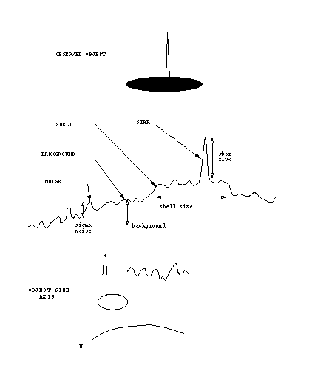
WHY MULTIRESOLUTION ?
Notes:
Click to add notes

Slide 3
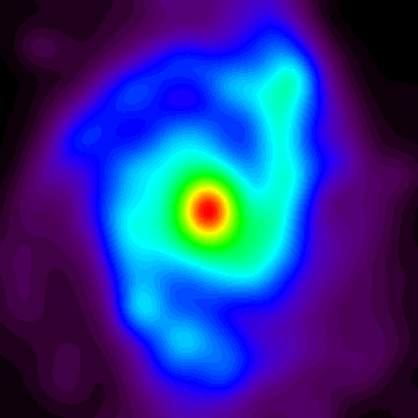
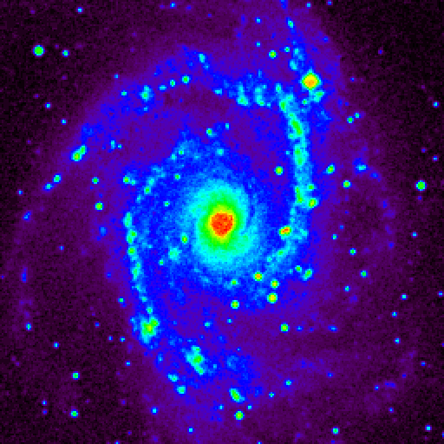
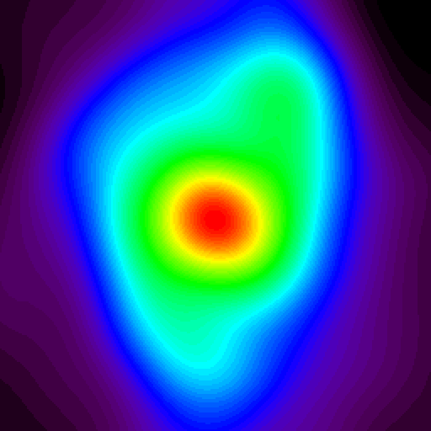
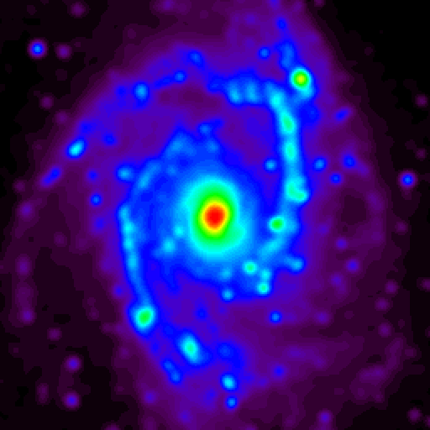
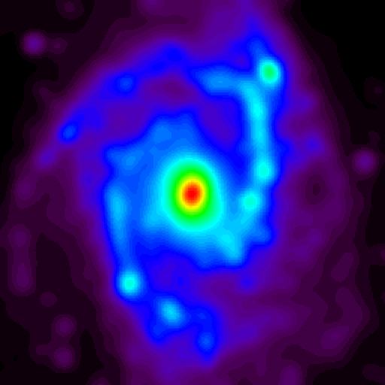
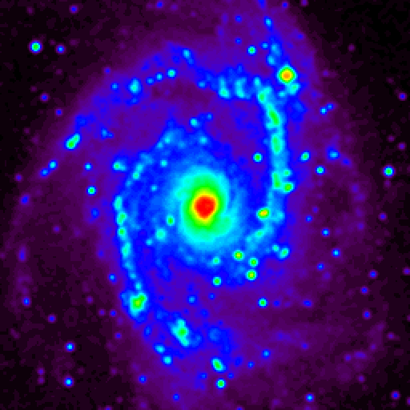
NGC2997
Notes:
Click to add notes

Slide 4
Notes:
Click to add notes

Slide 5
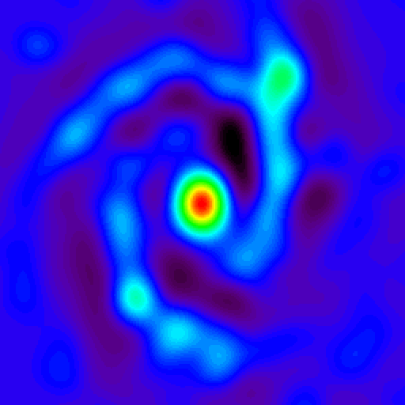
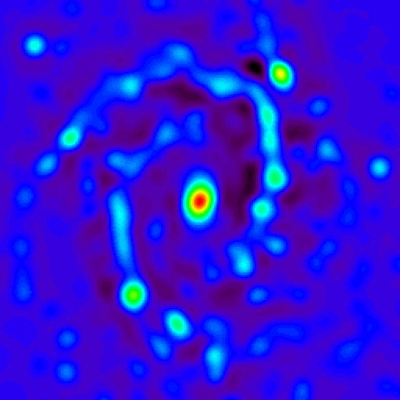
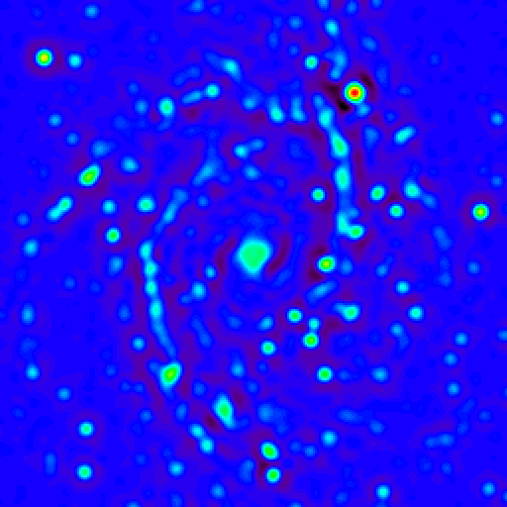
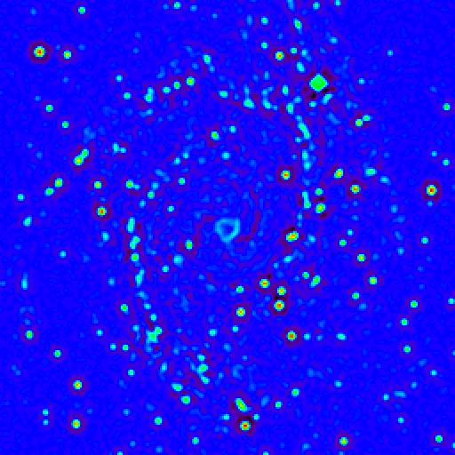
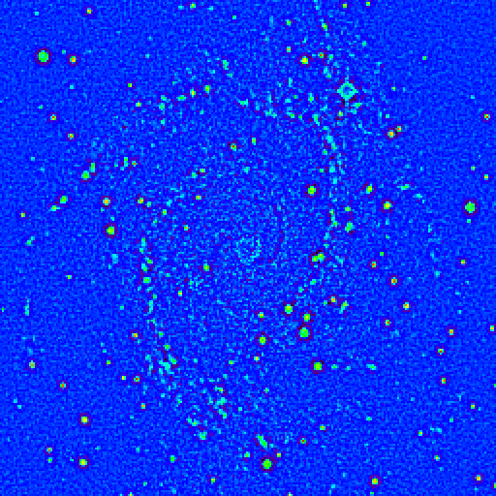
Scale 5
Scale 4
Scale 3
Scale 2
Scale 1
Notes:
Click to add notes

Slide 6
Notes:
Click to add notes

Slide 7
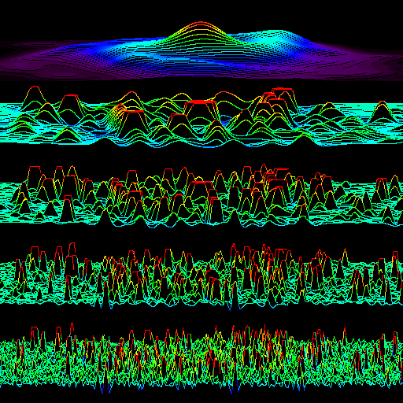
Notes:
Click to add notes

Slide 8
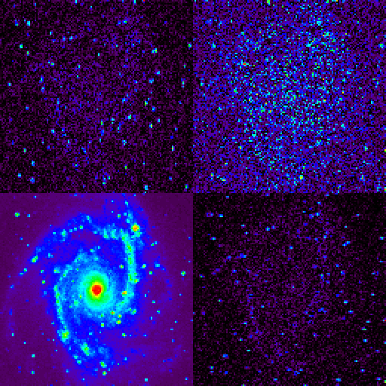
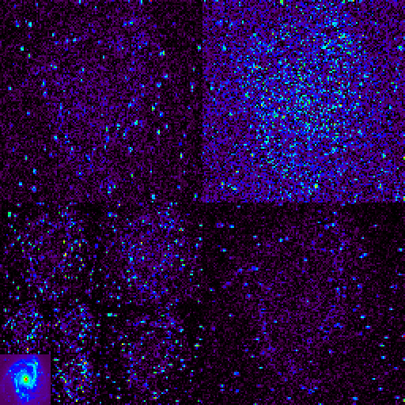
Notes:
Click to add notes

Slide 9
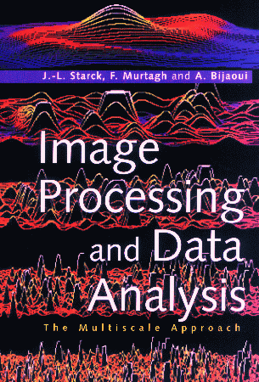
J.-L. Starck, F. Murtagh, and A. Bijaoui, "Image Processing and Data Analysis: The Multiscale Approach", Cambridge University Press,
Cambridge (GB), 1998.
And - new: J.-L. Starck and F. Murtagh, Astronomical Image and Data Analysis, Springer-Verlag, 2002.
Notes:
Click to add notes

Slide 10
A range of pattern recognition applications
Next:
Pattern recognition –
comets,
ecstasy tablets,
SEM images of concrete,
biomass in the Gulf of Aden,
retinal vessel tracking,
financial prediction

Slide 11
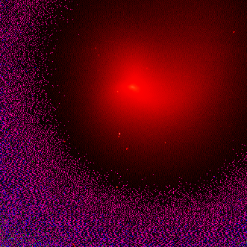
Periodic comet P/Swift-Tuttle observed with the 1.2m telescope at Calar Alto Observatory in Spain in October and November 1992. (Data courtesy of Dr K Birkle, Max-Planck-Institut für Astronomie, Heidelberg).
Irregularity of nucleus is indicative of the presence of jets in in the coma.

Slide 12
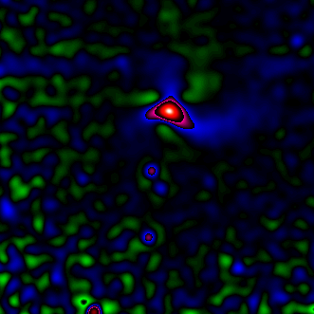
Wavelet (B₃ spline à trous) transform,
resolution scale 4

Slide 13
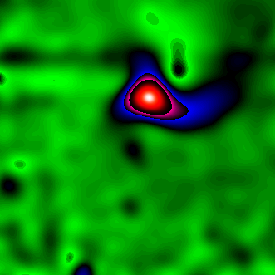
Wavelet (B₃ spline à trous) transform,
resolution scale 5

Slide 14
Find the galaxy, separate from the stars

Slide 15
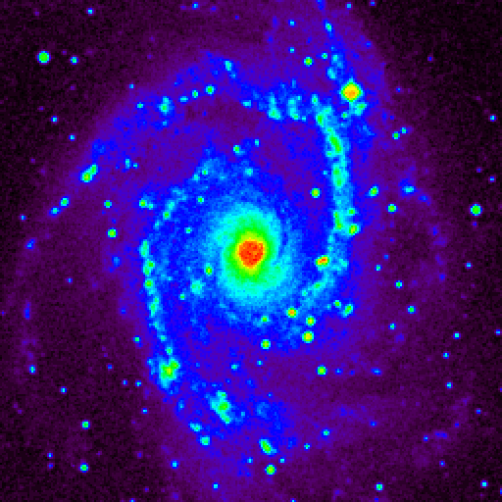
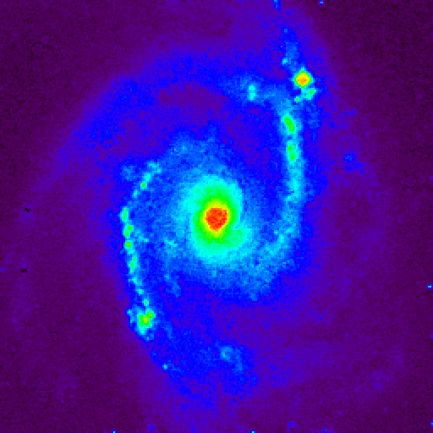
Notes:
Click to add notes

Slide 16
Intelligent “background” removal

Slide 17
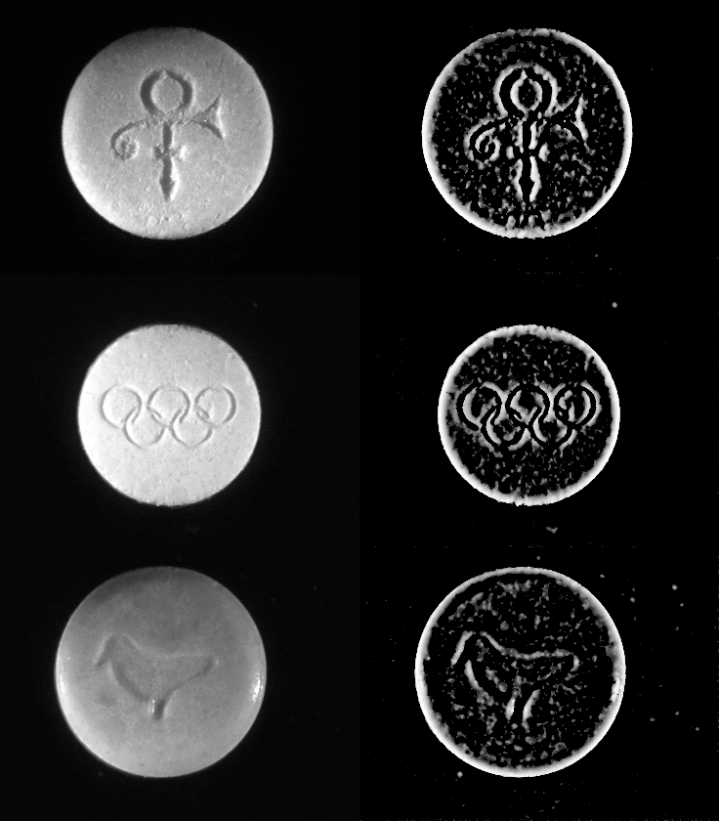

Slide 18
Speckle removal
Cross-sections of concrete using Scanning electron microscope

Slide 19
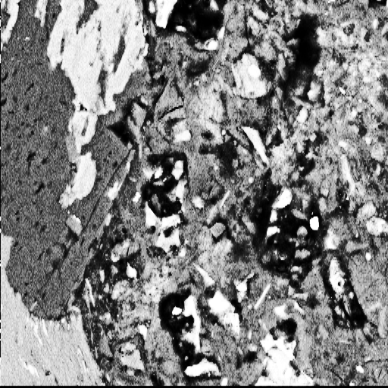
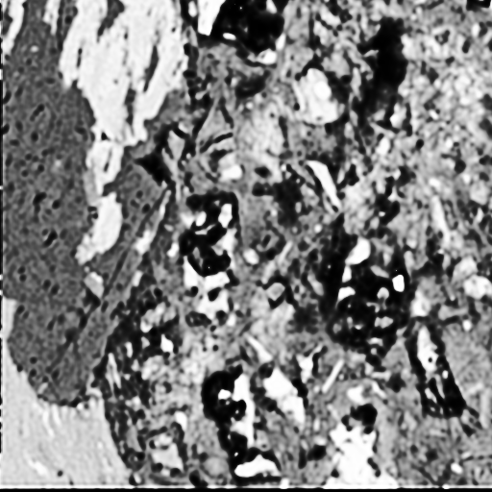



Slide 20
Ocean color data
Gulf of Aden
SeaWiFS image
Find: eddies, currents

Slide 21
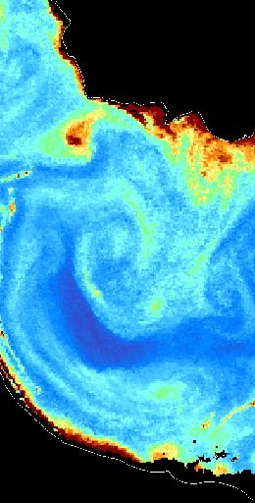
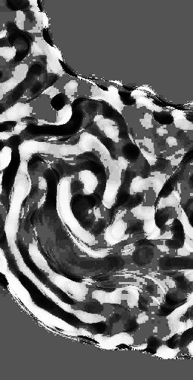

Slide 22
Tracking blood vessels in the retina
Based on:
Product of wavelet scales to show up edges,
Stochastic starting points for robustness,
Track following, and mathematical morphological clean-up

Slide 23
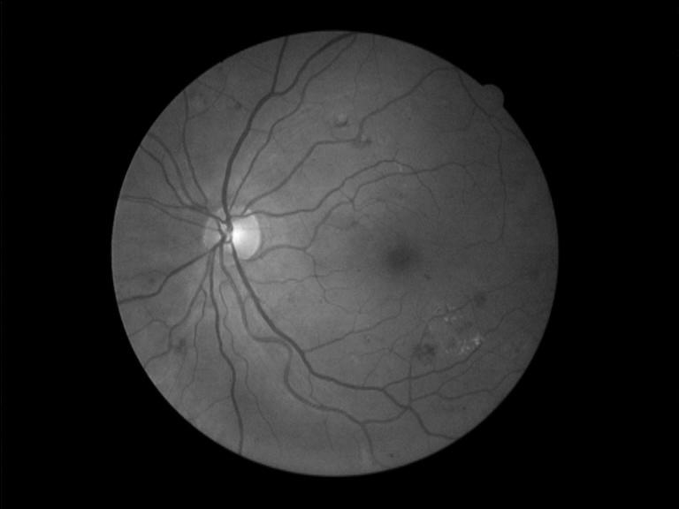

Slide 24


Slide 25
On the web…
Financial modeling, nowcasting, forecasting

Slide 26
