Slide 1
NOISE MODELING IN WAVELET SPACE
- Gaussian distribution
- Poisson distribution
- Poisson + Gaussian distribution (CCD)
- Poisson noise with few events (galaxy counting, X-ray images, ...)
- Root mean square map
- Speckle noise
If the noise does not follow any of these distributions, we can derive
a noise model from any of the following assumptions:
- it is additive, and non-stationary
- it is multiplicative and stationary
- it is multiplicative and non-stationary
- it is undefined but stationary
If none of these assumptions can be applied, the only way to derive a noise
model in wavelet space is to consider that the local variation of the
wavelet coefficient follows a given distribution (Gaussian).
Notes:
Click to add notes

Slide 2
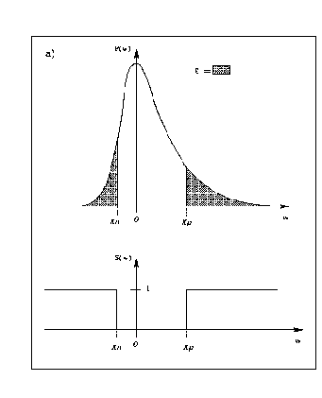


NOISE MODELING
For a positive coefficient:
For a negative coefficient
Given a threshold t, if P > t, the coefficient could be due to the noise.
On the other hand, if P < t, the coefficient cannot be due to the noise,
and a significant coefficient is detected.
Notes:
Click to add notes

Slide 3
MULTIRESOLUTION SUPPORT
M(j,x,y) = 1 if w(j,x,y) is significant
0 if w(j,x,y) is not significant
1) Compute the wavelet tranform of the image
2) Booleanization of each scale leads to the multiresolution support
3) A priori knowledge can be introduced by modifying the support
Notes:
Click to add notes

Slide 4
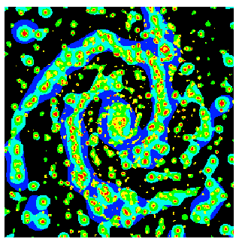
NGC2997 MULTIRESOLUTION SUPPORT
Notes:
Click to add notes

