Slide 1
Hubble Space Telescope –
Algorithms for Tackling Myopia
Concept of space telescope advanced by Lyman Spitzer Jr. (Princeton) in 1940s.
First official mention by NASA in 1962, four years after NASA founded. Science team established by NASA in 1973. From 1975 ESA involved. Congress approved in 1978. Marshall (Huntsville) – construction, Goddard (Greenbelt) – science and ground control.
Lockheed – basic spacecraft, Perkin-Elmer – primary mirror, ESA (BAe) – solar panels.
1986/1/26 – Challenger disaster.
HST deployed in low Earth orbit – 600 km – by Discovery (STS-31) on 1990/4/25.
First refurbishment mission Endeavour STS-61 in December 1993.

Slide 2
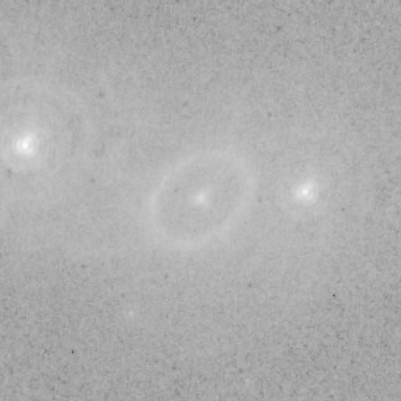

Slide 3
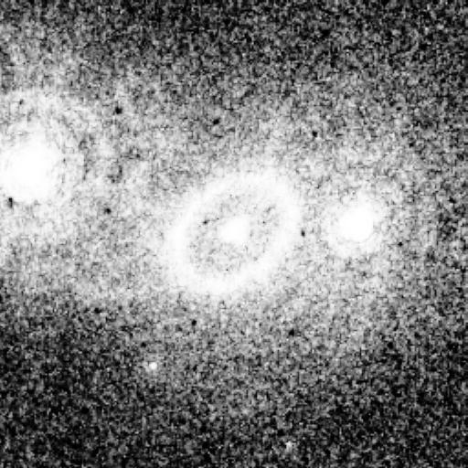

Slide 4
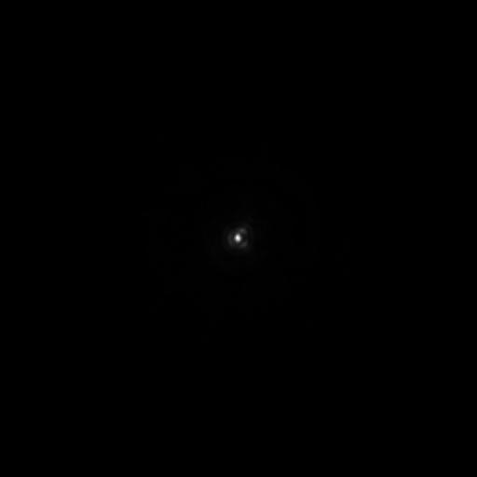

Slide 5
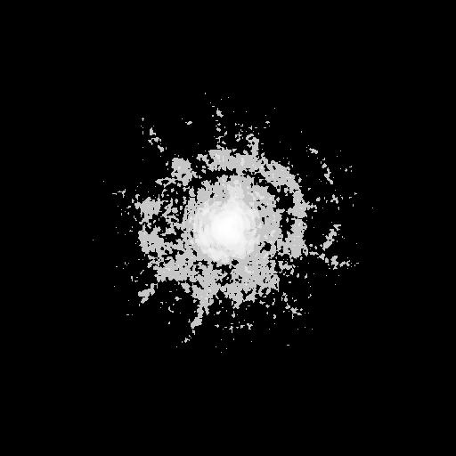

Slide 6
Deconvolution
Observed data: I(x,y)
Real image: O(x,y)
Assume: linear, shift-invariant imaging system
Then:
I(x,y) = (O * P)(x,y) + N(x,y)
where P is point spread function, N is noise,
and * is convolution
Solve for O using coupled relations:
O^{n+1} ← O^{n} [ (I/I^{n}) * P* ]
I^{n} ← P * O^{n}
where P* is conjugate of PSF
Richardson, 1972, optical engineering literature
Lucy, 1974, astronomy literature
Shepp and Vardi, 1982, medical imaging literature
Maximum likelihood solution, formally EM algorithm

Slide 7
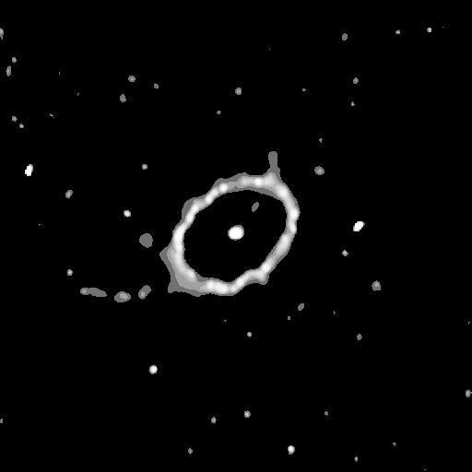

Slide 8
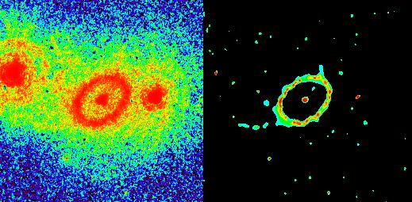

Slide 9
Novelty – regularization through wavelet-based denoising
The problem with the traditional way of doing this is that the algorithm thinks that each and every noise spike is deserving of getting flux back, which has been blurred in its vicinity.
“Regularization” is the term used for an imposed constraint to stop the algorithm doing this.
Wavelet-based noise filtering: take R^{n} = I – (P * O^{n}) i.e. the residual at each iteration. Take R^{n} into wavelet space (known for its energy compacting properties). Denoise in wavelet space and inverse transform into direct space. Continue iterations.
Simple, painless intervention at each iteration, based on noise model of image. (E.g. widely-used CCD detectors have Gaussian read-out noise, together with Poisson photon noise.) Effective and efficient.

Slide 10
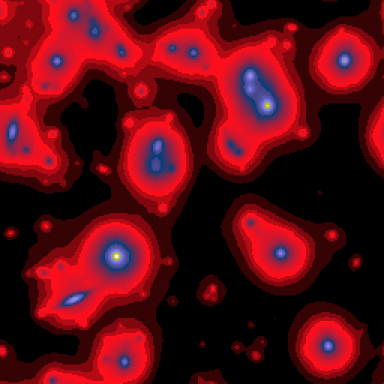
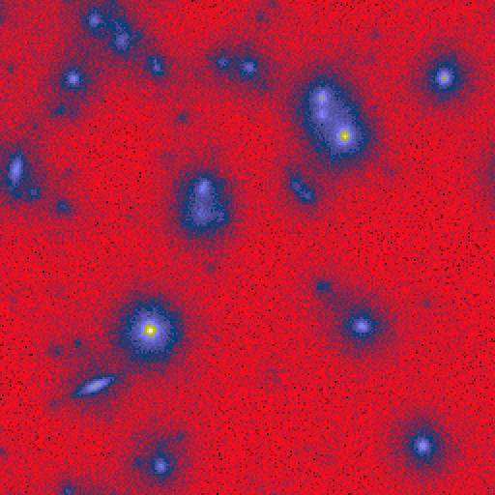
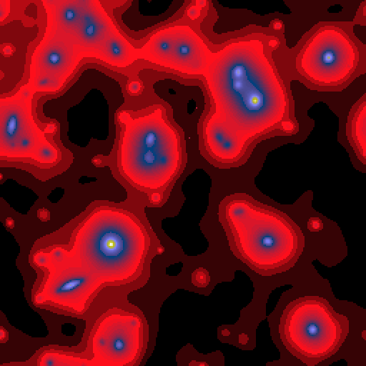

Notes:
Click to add notes

Slide 11
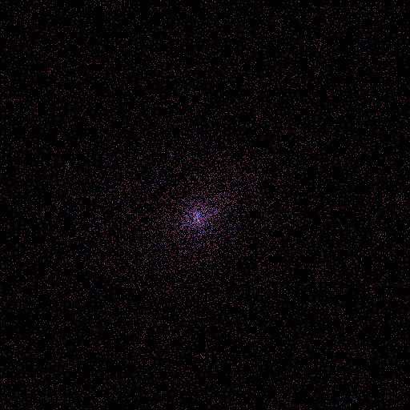
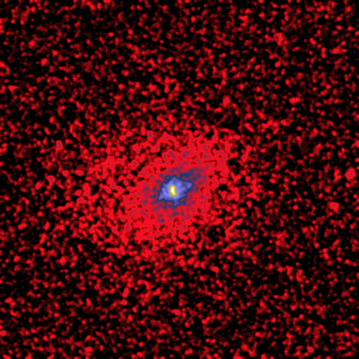
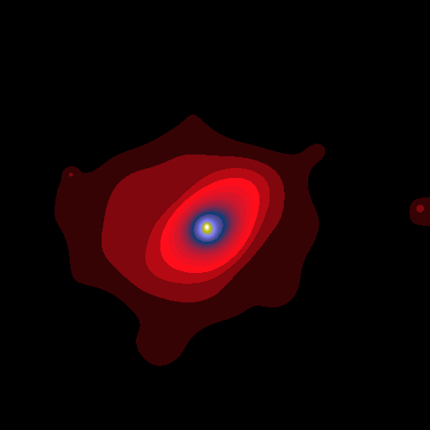
Notes:
Click to add notes

Slide 12
DECONVOLUTION
The object-image relation:
I(x,y) = O(x,y) * P(x,y) + N(x,y)
where * is convolution.
P is point spread function, PSF.
I is observed signal, O is ideal signal, N is noise.
We want to determine O knowing I and P.
The main difficulties are the existence of
i) a cut-off frequency of the point spread function
ii) the noise
This is an ill-posed problem, - no stable and unique solution.
Notes:
Click to add notes

Slide 13
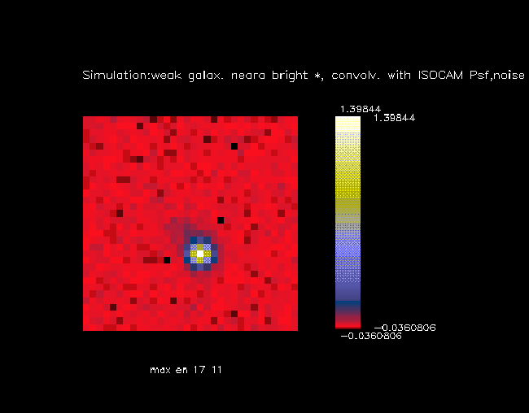
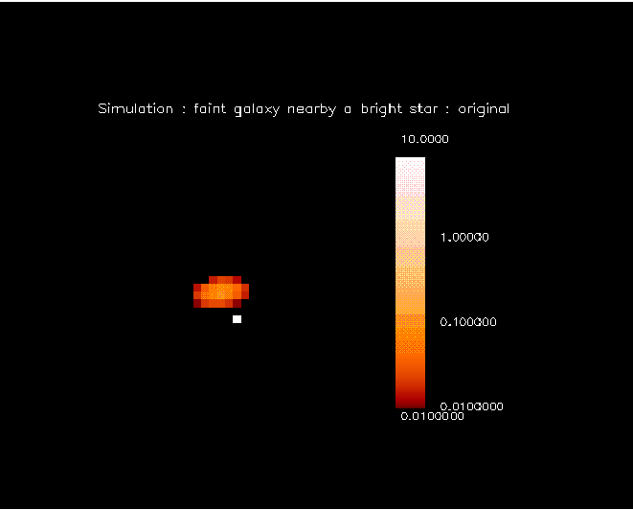
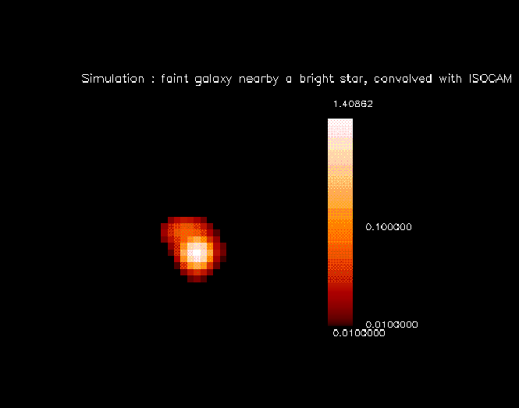
Notes:
Click to add notes

Slide 14
DECONVOLUTION METHODS
WITHOUT REGULARIZARION:
Richardson-Lucy method:
Iterative, ML, EM
Richardson, optics literature, 1972
Lucy, astronomy literature, 1974
Shepp and Vardi, medical imaging literature, early 1980s
Noise amplification
WITH REGULARIZARION:
CLEAN
Problem to restore extended objects
MEM
Problem to restore stars
Notes:
Click to add notes

Slide 15
RL Regularized RL method:
a) Take the WT of R, the “residual” at each iteration
b) Update the multiresolution support
c) Multiply the WT by the multiresolution support
d) Reconstruct a filtered version of R
CLEAN Multiresolution CLEAN:
Apply the CLEAN method at each scale by using the
wavelet transform of the data and the wavelet transform
of the PSF.
MEM Multiscale entropy
Principle: avearage information (i.e. entropy) is the sum of information at different resolution scales.
Notes:
Click to add notes

Slide 16
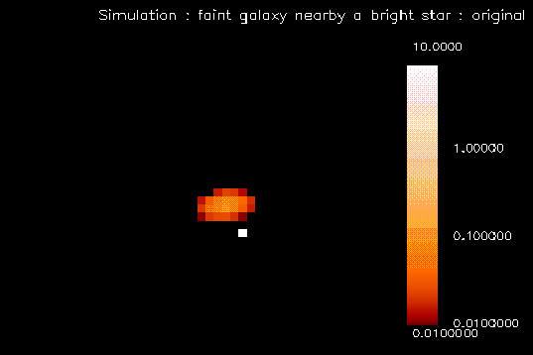
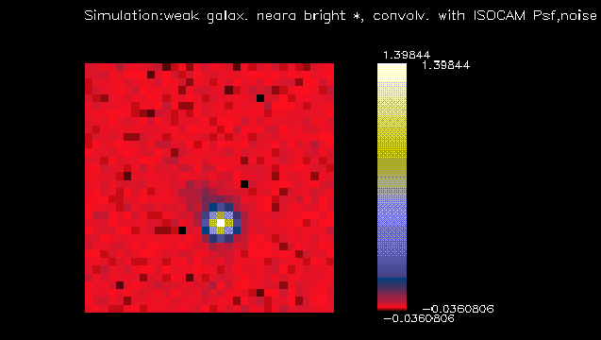
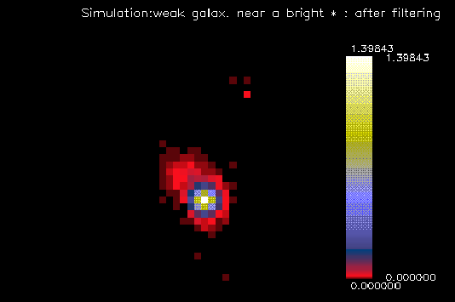
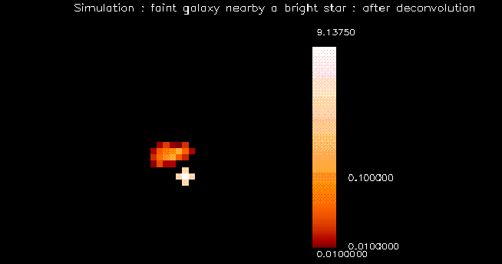
Notes:
Click to add notes

Slide 17
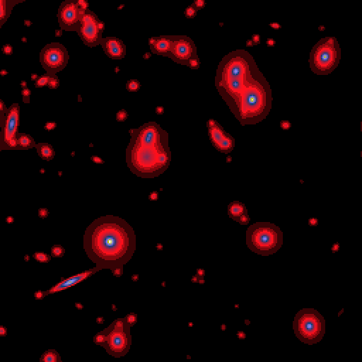
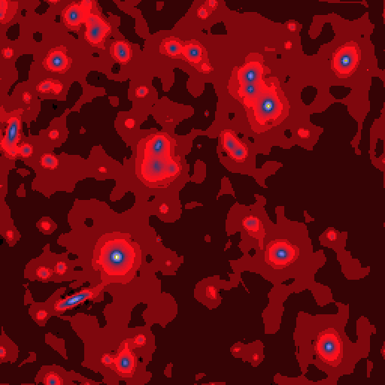

Notes:
Click to add notes

Slide 18
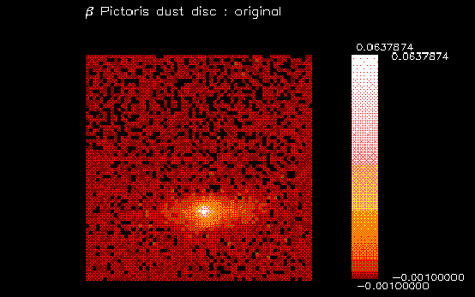
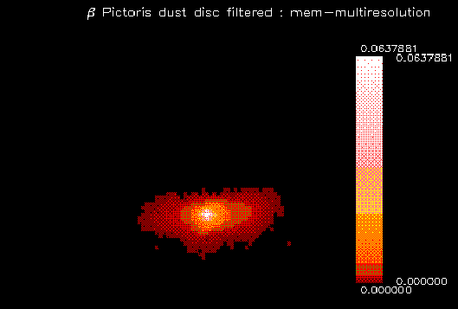
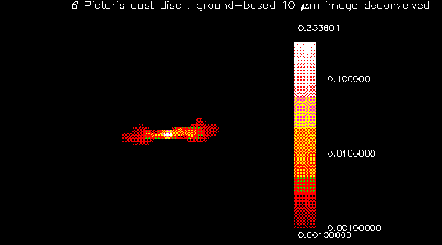
Notes:
Click to add notes

