Slide 1
Multiscale Analysis Methods
Fionn Murtagh
f.murtagh@qub.ac.uk
http://www.cs.qub.ac.uk/~F.Murtagh
Jean-Luc Starck
jstarck@cea.fr
http://www-stat.stanford.edu/~jstarck
(1) Centre for Image and Vision Systems,
Computer Science, The Queen's University of Belfast
(1) Observatoire Astronomique, Strasbourg
(2) Statistics Department, Stanford University
(2) Astrophysical Service, CEA Saclay, France
Notes:
Click to add notes

Slide 2
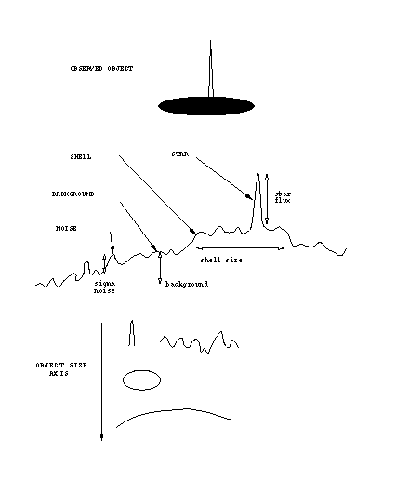
WHY MULTIRESOLUTION ?
Notes:
Click to add notes

Slide 3
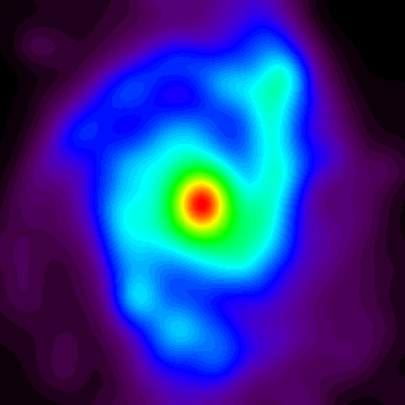
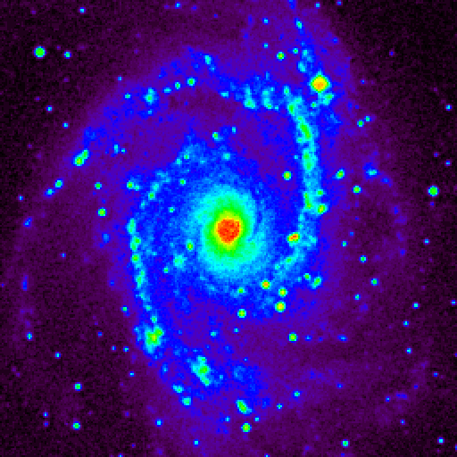
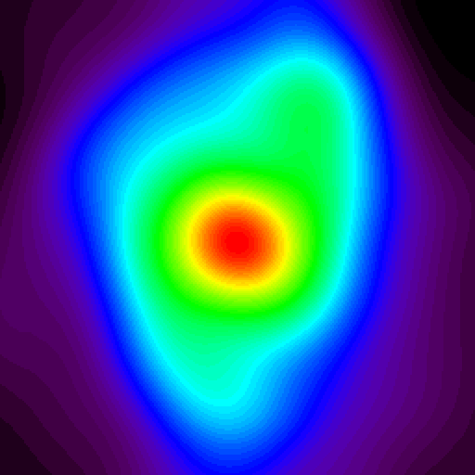
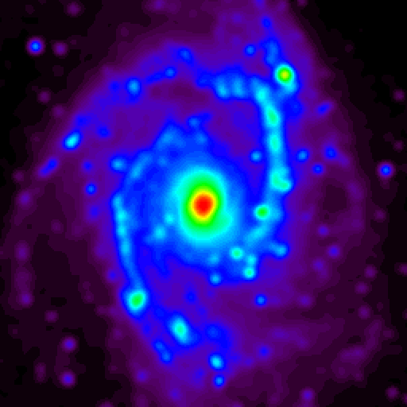
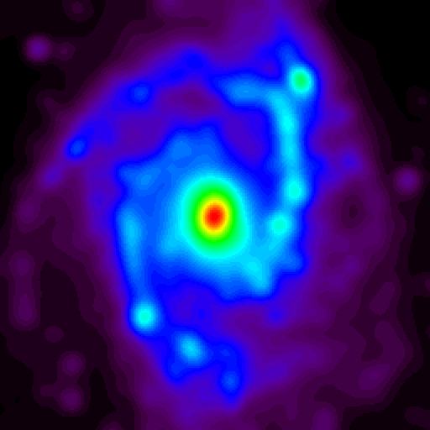
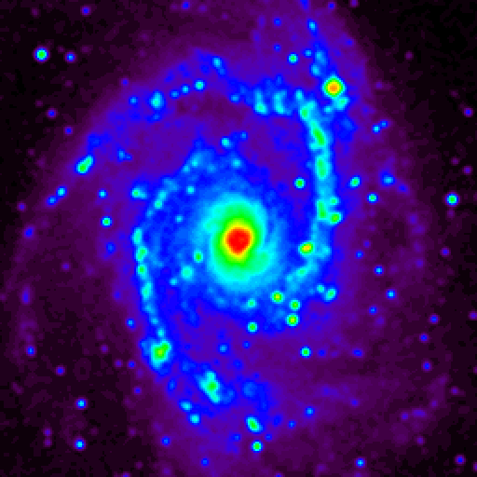
NGC2997
Notes:
Click to add notes

Slide 4
Notes:
Click to add notes

Slide 5
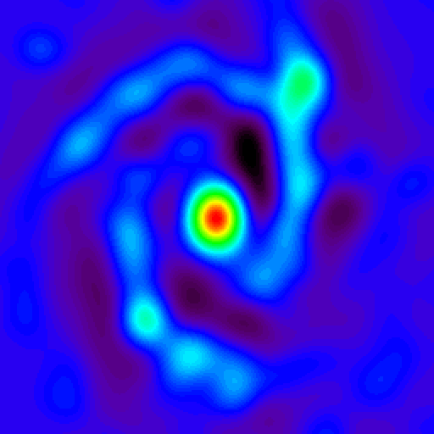
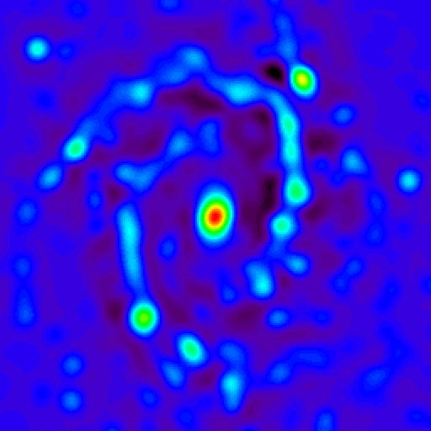
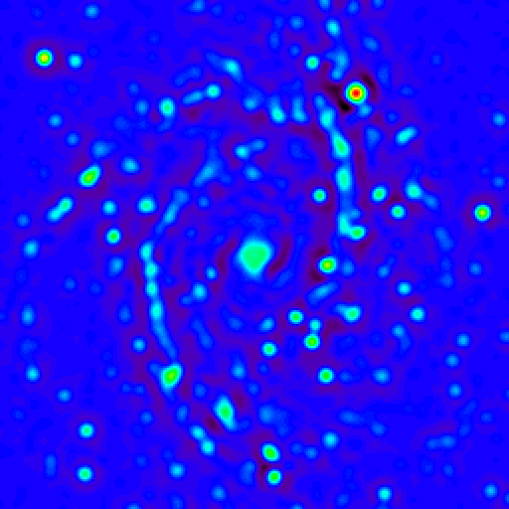
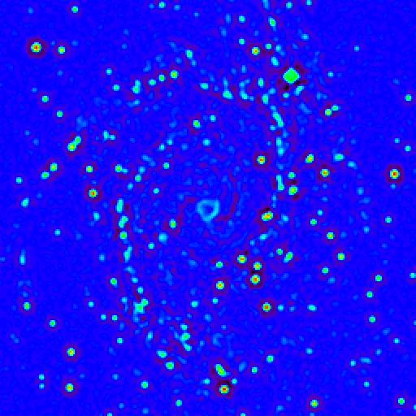
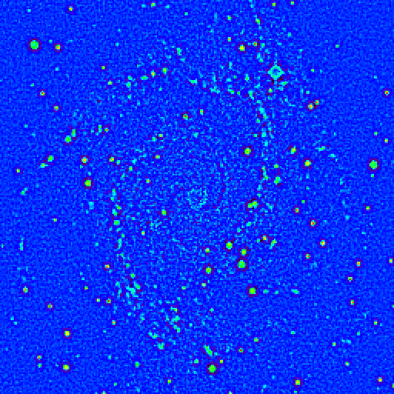
Scale 5
Scale 4
Scale 3
Scale 2
Scale 1
Notes:
Click to add notes

Slide 6
Notes:
Click to add notes

Slide 7
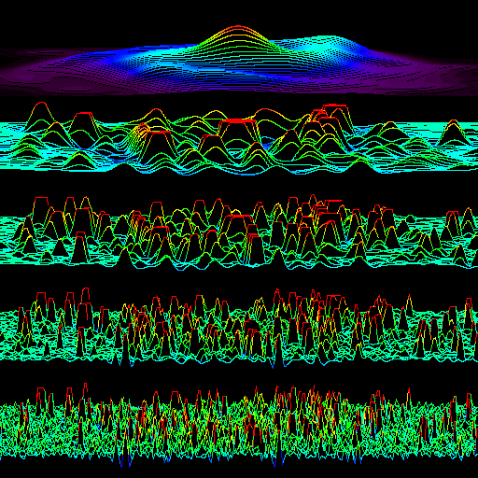
Notes:
Click to add notes

Slide 8
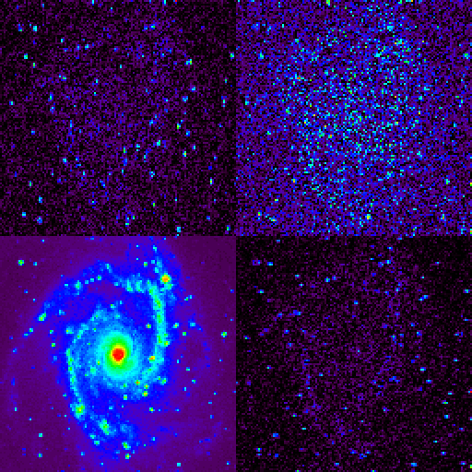
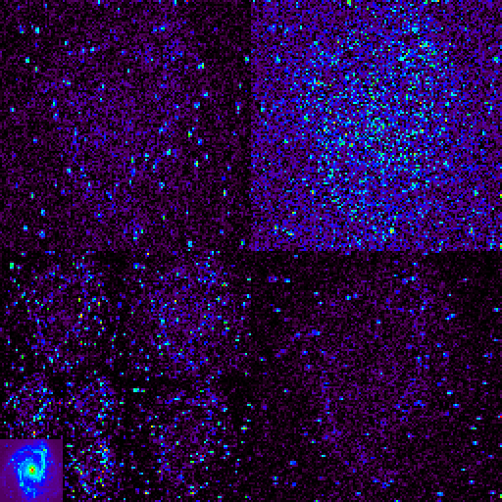
Notes:
Click to add notes

Slide 9
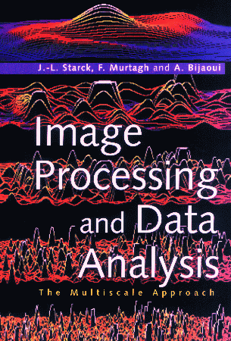
J.-L. Starck, F. Murtagh and A. Bijaoui,
"Image Processing and Data Analysis:
TheMultiscale Approach",
Cambridge University Press, 1998.
Notes:
Click to add notes

Slide 10
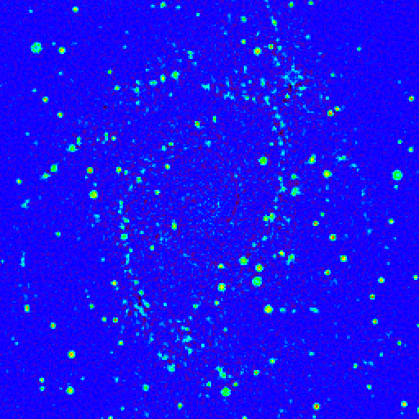
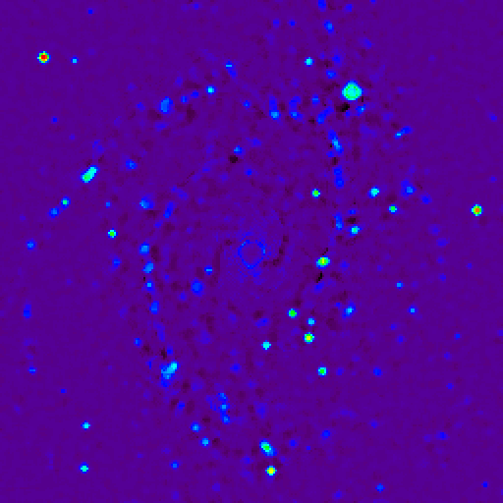
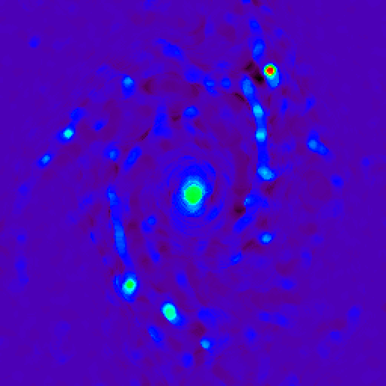
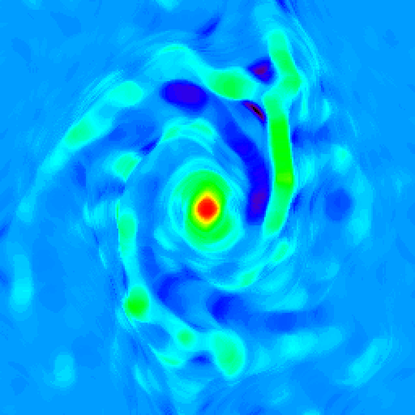
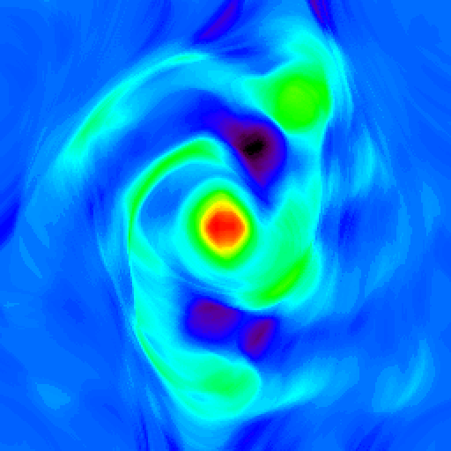
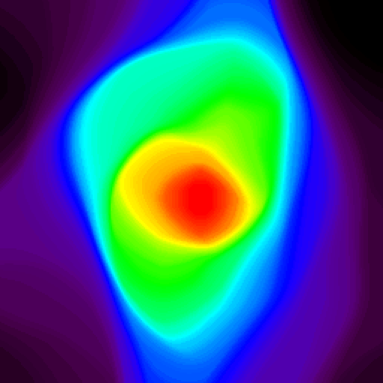
Notes:
Click to add notes

Slide 11
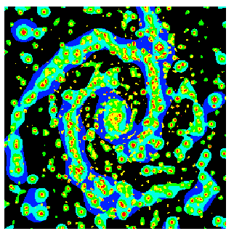
NGC2997 MULTIRESOLUTION SUPPORT
Notes:
Click to add notes

Slide 12
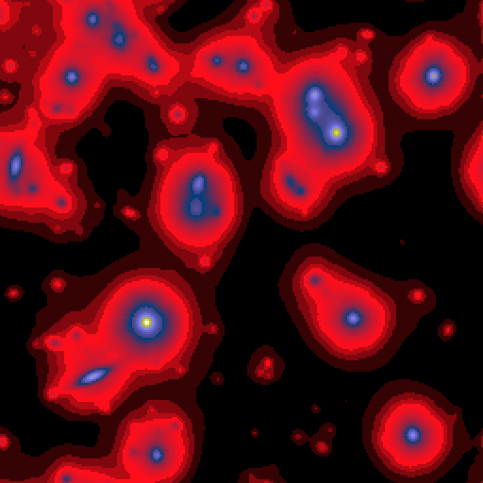
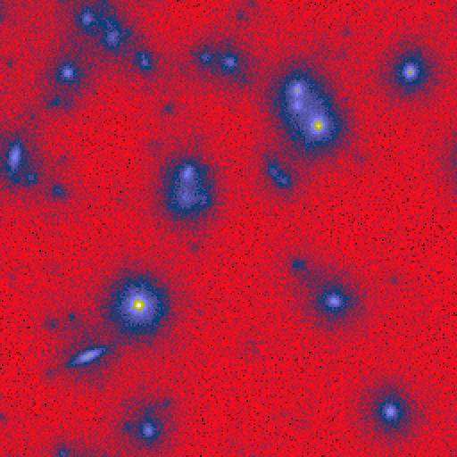
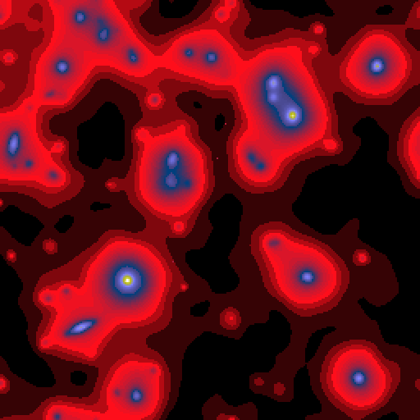

Notes:
Click to add notes

Slide 13
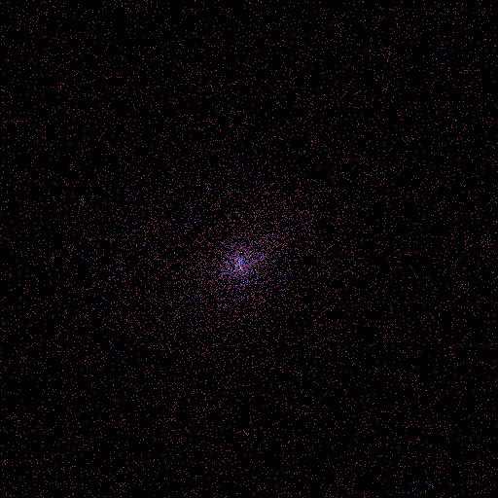
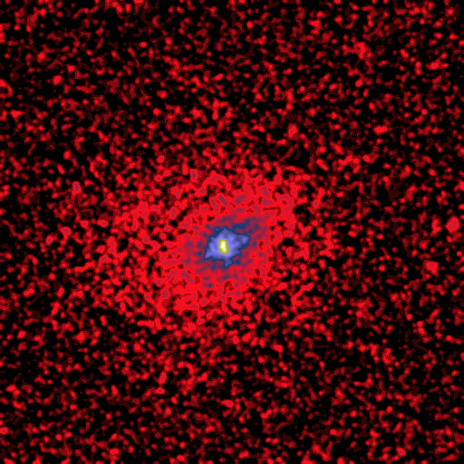
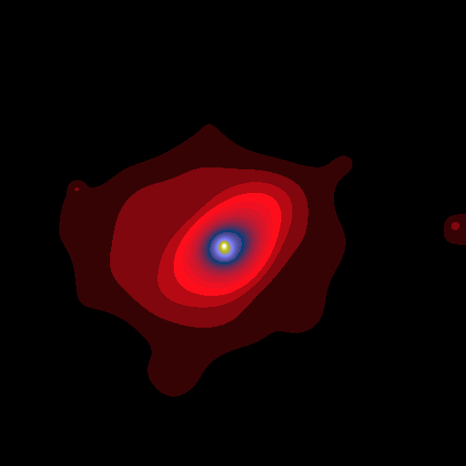
Notes:
Click to add notes

Slide 14
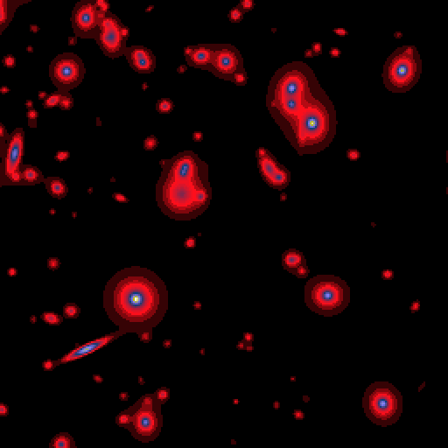
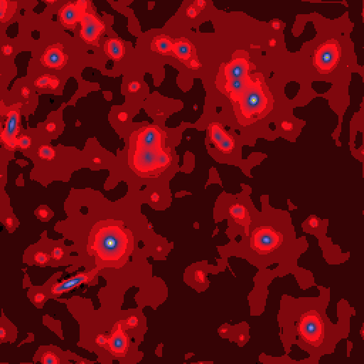

Notes:
Click to add notes

Slide 15
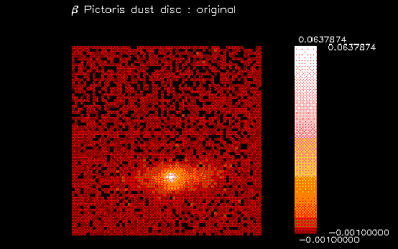
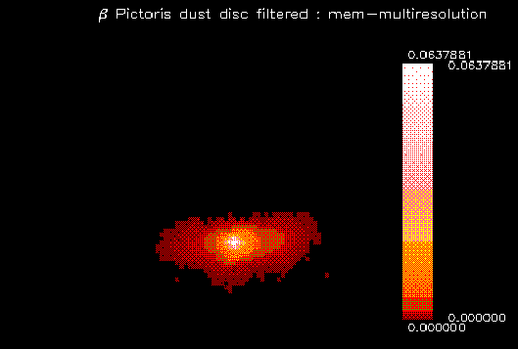
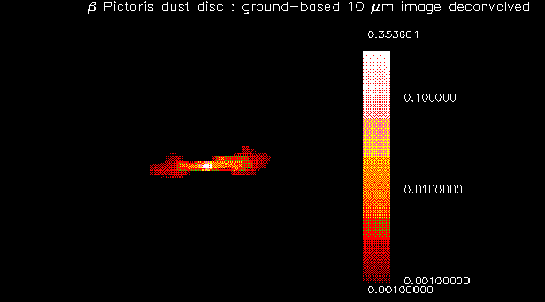
Notes:
Click to add notes

Slide 16
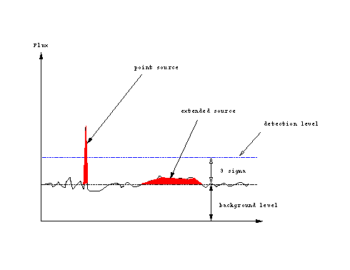
Notes:
Click to add notes

Slide 17
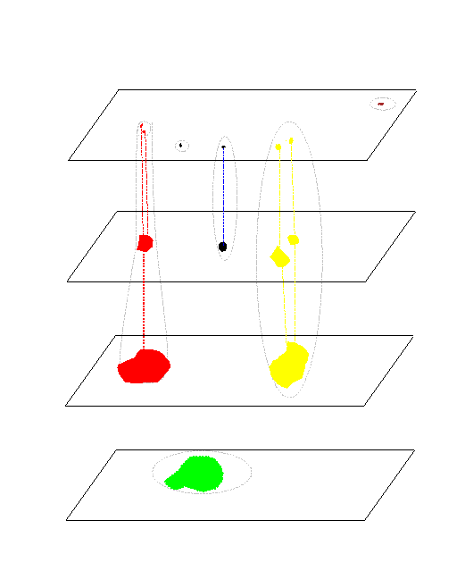
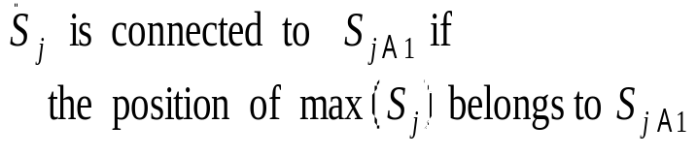
Structure: set of significant connected
wavelet coefficients at a given scale.
Object: set of structures.
Object scale: the scale of an object is given
by the scale of the maximum of its wavelet
coefficients.
Interscale-relation: relation to group
several structures into a single object.
Notes:
Click to add notes

Slide 18
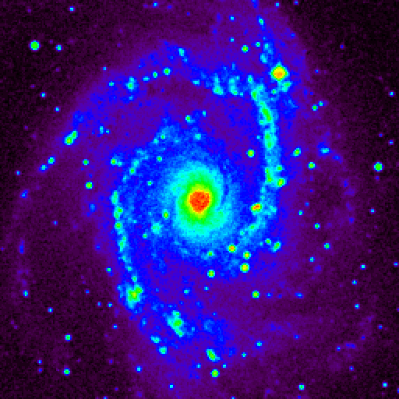
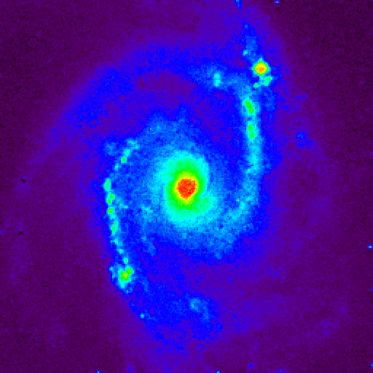
Notes:
Click to add notes

Slide 19
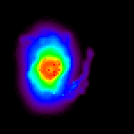
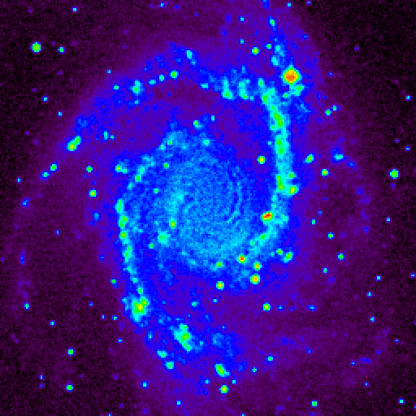
Notes:
Click to add notes

Slide 20


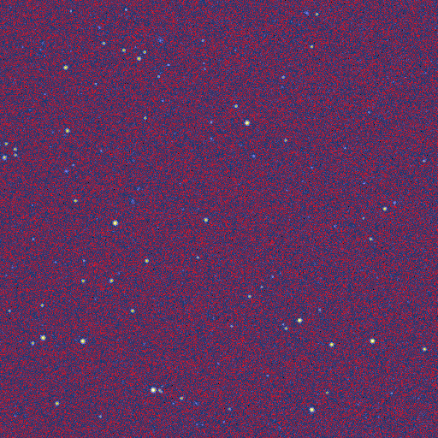
Notes:
Click to add notes

Slide 21
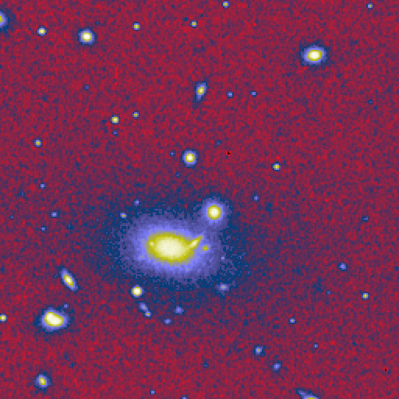
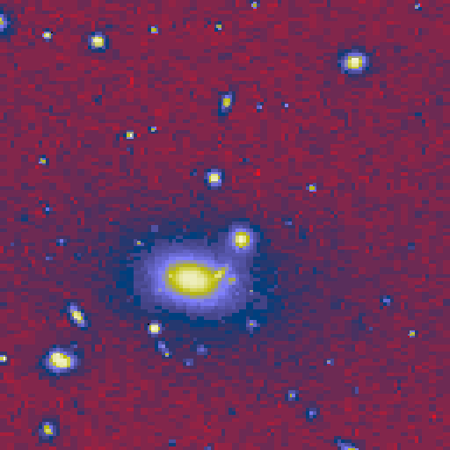
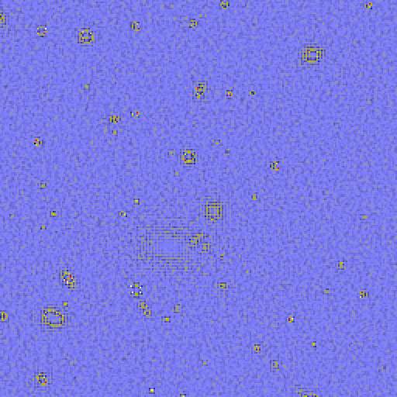
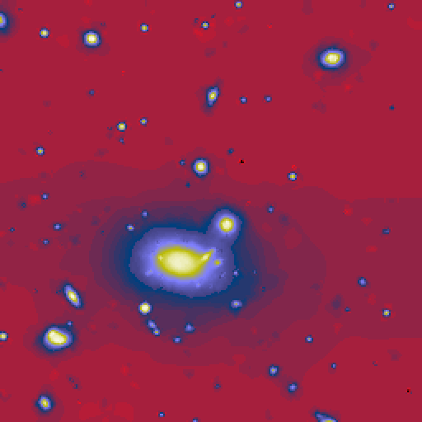

Notes:
Click to add notes

Slide 22
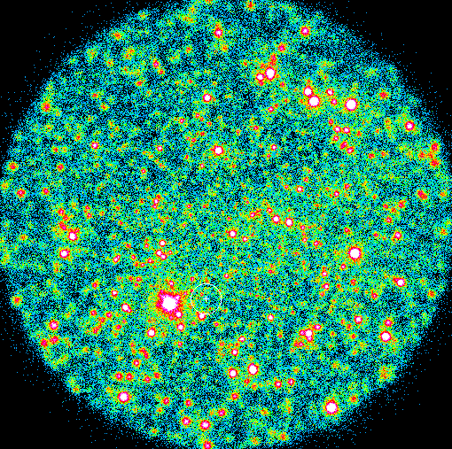
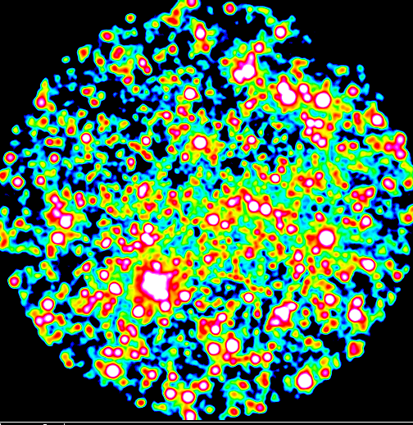
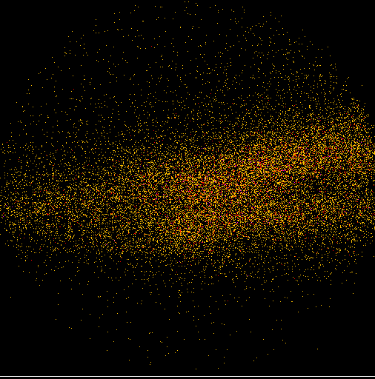
Notes:
Click to add notes

Slide 23
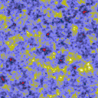













CMB
Thermal SZ
Synchrotron
Free-free
Dust
Sky components
Linear combination + PSF + Noise
Observations
Notes:
Click to add notes

Slide 24


Slide 25





Slide 26



Slide 27





Slide 28




Slide 29




Slide 30


Slide 31


Slide 32


Slide 33


Slide 34


Slide 35


Slide 36


