Slide 1

MDA Info Session
General Meeting: Information & Recruitment
Sept 19, 2011: 6-8p
BA3008
Mechatronics Design Association
General Info Session Sept 2011

Slide 2
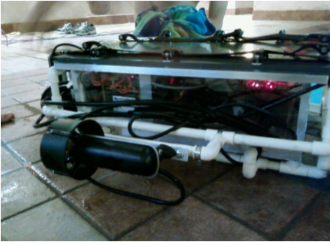
Who are we?
  Mechatronics Design Association
    Multi-Disciplinary Club
  Design U of T’s entry for Autonomous Underwater Vehicle Systems International (AUVSI) Competition
Mechatronics Design Association
General Info Session Sept 2011

Slide 3
RoboSub Competition
  Annual competition between Int'l University Teams
    Held in San Diego, CA in July
  Autonomous Submarine must:
    Pass through starting gate
    Follow a marked path through water
    Hit a Buoy
    Drop a Marker in a Bin
    Etc
Mechatronics Design Association
General Info Session Sept 2011

Slide 4
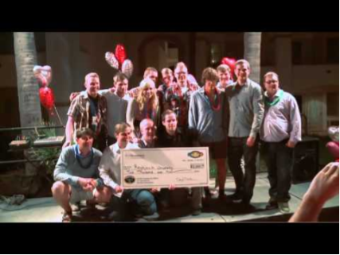
RoboSub Competition
  Video of Competition:
Mechatronics Design Association
General Info Session Sept 2011

Slide 5
Technical Stuff
  Overview of tasks/obstacles/projects for 2011-12
    Pinger -> SONAR
      Explanation
    Thrusters/Motors
      Explanation
Mechatronics Design Association
General Info Session Sept 2011

Slide 6
Technical Stuff
  Overview of tasks/obstacles/projects for 2011-12
    Mechanical Hull
      Explanation
    Power
      Explanation
Mechatronics Design Association
General Info Session Sept 2011

Slide 7
Structure of Sub
Mechatronics Design Association
General Info Session Sept 2011

Slide 8
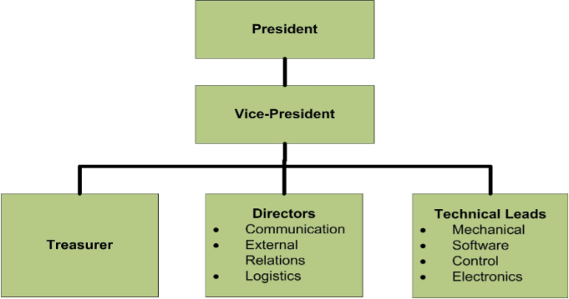
MDA Team Structure
Mechatronics Design Association
General Info Session Sept 2011

Slide 9
MDA Club Operation
Technical Group Work
  RoboSub competition in July
  Team meets weekly, usually Saturday afternoon
  Depending on interest, you can work with a team on specific project
  Technical leads are there to help you learn
  Commitment? We're flexible!
Mechatronics Design Association
General Info Session Sept 2011

Slide 10
MDA Club Operation
Administrative Team Work
  Communication Director (website, posters, ads, events)
  External Relations Director (funds & sponsors)
  Logistics Director (event planning, booking pool time and competition accomodations, shipping sub)
  Interested? Let us Know!
Mechatronics Design Association
General Info Session Sept 2011

Slide 11
What's In It For You?
  Hands-on experience with things you WON'T learn in Skule!
  Meet new people, get a break from Skule
  Great experience for job interviews
  Fun that comes along with building a sub!
Mechatronics Design Association
General Info Session Sept 2011

Slide 12
Fun Stuff
  Club Events Throughout Year
    Fundraising
    MDA Day
    MDA Night Out
    Go to RoboSub Competition in July!
Mechatronics Design Association
General Info Session Sept 2011

Slide 13
Vision Code
Ritchie Zhao – Engsci 1T3
Vincent Lu – ECE 1T3
Mechatronics Design Association
General Info Session Sept 2011

Slide 14
Vision Code
What is it?
  This is a programming-based sub-team
  We write real-time machine vision code
  Turns input images into numerical data the control systems can work with
  Written in C++
  Uses OpenCV (Open Source Computer Vision Library) to implement machine vision
Mechatronics Design Association
General Info Session Sept 2011

Slide 15
Vision Code
What will you do on the vision team?
  Learn many important tools that OpenCV offers
  Become acquainted with abstract image processing concepts
  Write programs that
    Filter out targets from background and noise
    Recognize features (lines, corners, circles, etc)
  Test those programs in a simulator and in real life
General Info Session Sept 2011
Mechatronics Design Association

Slide 16
Vision Code
Image Processing Basics
  Color Filtering – Rejecting pixels of the incorrect color.
  Feature Detection – Finding lines, circles, etc in the filtered image.
  Calculations – Finding the center of the gate/buoy/bin etc.
Mechatronics Design Association
General Info Session Sept 2011

Slide 17
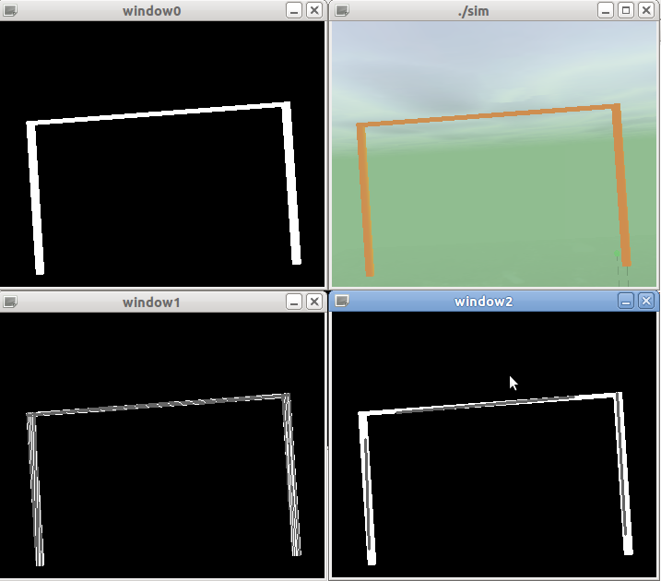
Color filter
Line Finding
Line Accumulation
1
2
3
Mechatronics Design Association
General Info Session Sept 2011

Slide 18
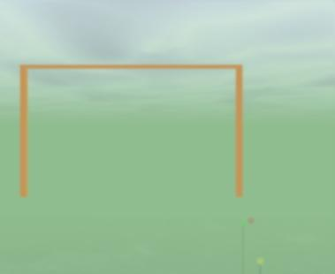
Simulator
  As you can see, we also have a simulator to help test vision and control systems
Simulates a pool with contest objects.
Allows user to swim around, similar to a game
Mechatronics Design Association
General Info Session Sept 2011

Slide 19
Demonstrating the Simulation!
Mechatronics Design Association
General Info Session Sept 2011

Slide 20
Vision Code
Where to start?
  You will get a Linux virtual machine with OpenCV preinstalled
  Learn about machine vision and the OpenCV library
  Write programs to process images
  Test your programs with simulator and actual webcams
Mechatronics Design Association
General Info Session Sept 2011

Slide 21
Vision Code
Final Notes
  You will have an opportunity to take a programming course in first year.
  There is a lot of learn and master in vision code, but time and effort will bring results.
  Vision code is an exciting way to advance your programming skills!
  Not in curriculum, so you have a lot to impress your classmates!
  Get to work with other sub-teams
Mechatronics Design Association
General Info Session Sept 2011

Slide 22
FPGA
Victor Zhang- ECE1T2+PEY
Mechatronics Design Association
General Info Session Sept 2011

Slide 23
FPGA
About the team
  Victor Zhang
    So far, I am the 1-person “FPGA” team
  Finished 3rd year ECE
  PEY at Altera
Mechatronics Design Association
General Info Session Sept 2011

Slide 24
FPGA
What the team does
  I think it as the “Interface” team
    Vision -> ??? -> Electronics
  Translates what the computer vision “sees” to electrical signals that control the electronics
  Involves software, embedded programming and hardware
Mechatronics Design Association
General Info Session Sept 2011

Slide 25













FPGA – The big picture of how things fit
Old Design
New Design
Computer
Netbook
Micro
Controller
Micro
Controller
FPGA
...
Motor
...
Motor
Motor
...
Motor
Mechatronics Design Association
General Info Session Sept 2011

Slide 26
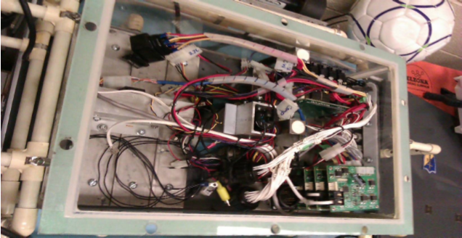
FPGA
Result of the big picture
  Better integration
  Less wiring
Mechatronics Design Association
General Info Session Sept 2011

Slide 27
FPGA
So what is it???
  A programmable chip that can mimic both hardware and software
    Can be programmed to control electrical signals
    Can also be programmed to run compiled C code
  Many of you will learn these in 2nd year if you haven’t already
Mechatronics Design Association
General Info Session Sept 2011

Slide 28
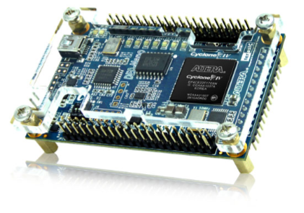
FPGA
Recruitment Pitch
  Learn a broad spectrum of systems
    C/C++ programming, assembly, hardware, operating systems
  Get to work with other teams
  Get to play with cool devices
Mechatronics Design Association
General Info Session Sept 2011

Slide 29
Next Steps
  Check out MDA Website (mda.skule.ca)
  Browse the MDA wiki (mdawiki.skule.ca)
  Sign-up on our GoogleGroup!
  Existing group members will stick around. Come by and have a chat!
Mechatronics Design Association
General Info Session Sept 2011

