Slide 1
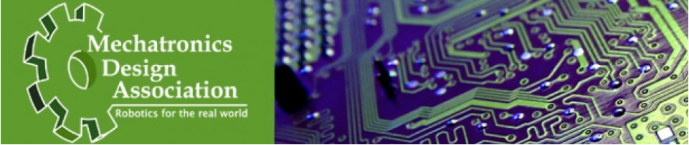
MDA Info Session
General Meeting: Information & Recruitment
Sept 19, 2012: 7-8pm
Mechatronics Design Association
General Info Session Sept 2012

Slide 2

About MDA
  We design an autonomous submarine for the RoboSub Competition
  This is a prestigious event held by the AUVSI Foundation
Say Hi to AquaTux!
Mechatronics Design Association
General Info Session Sept 2012

Slide 3
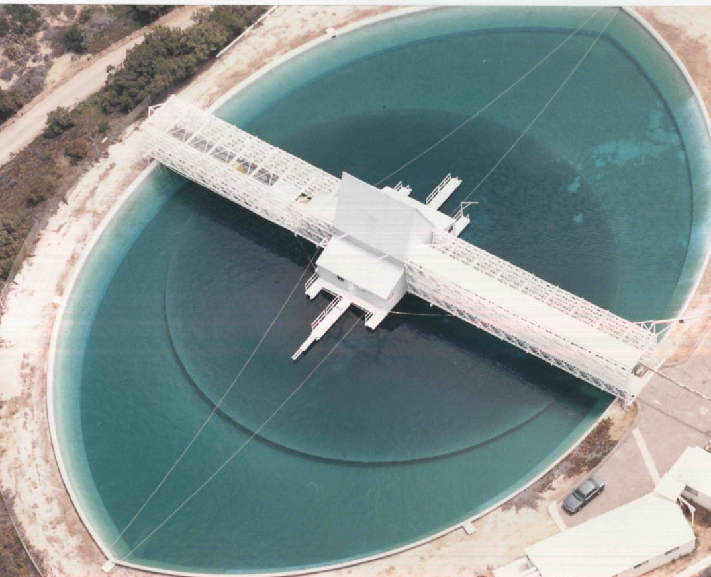
RoboSub Competition
  Takes place in San Diego in July each year
  Draws teams from all over the world
  Takes place in a US Office of Naval Research Pool
Mechatronics Design Association
General Info Session Sept 2012

Slide 4
Competition Rules
  The sub is fully autonomous (no remote control)
  It must navigate an obstacle course and complete several tasks:
    Pass through a gate
    Follow marked paths
    Hit buoys
    Shoot torpedoes
    Follow sonar signal
Mechatronics Design Association
General Info Session Sept 2012

Slide 5
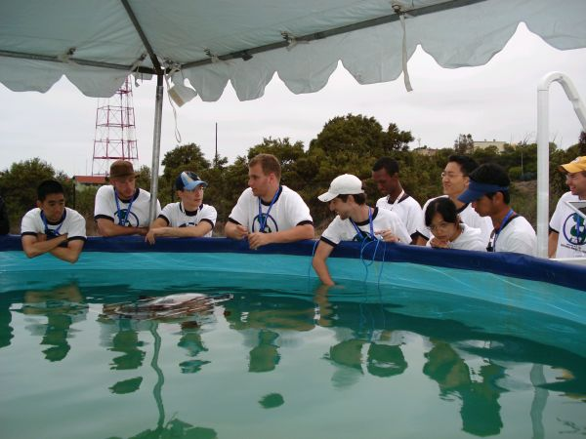
Our History
  MDA was started over 7 years ago and entered competition three times
  Won a “Best New Entry” award in 2006
  Original leaders graduated in 2010, current members worked on the sub over the last year
Mechatronics Design Association
General Info Session Sept 2012

Slide 6
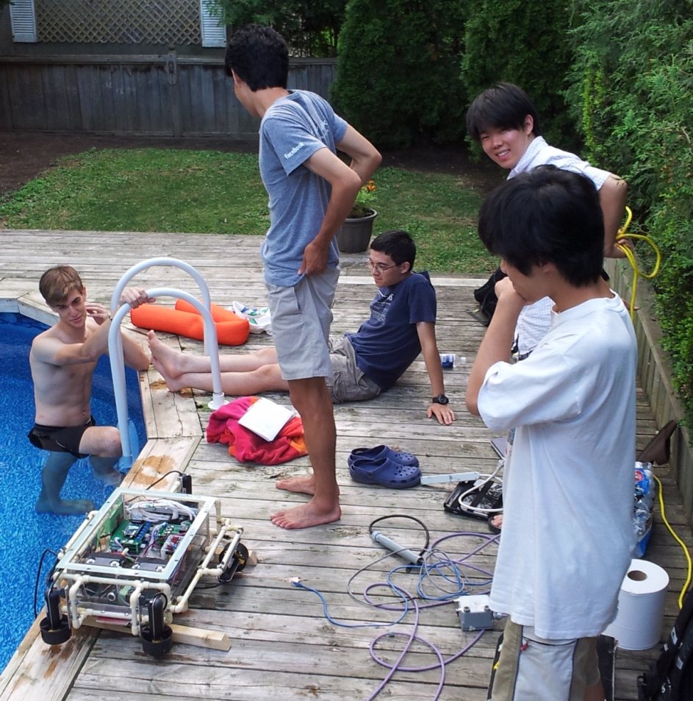
Plans for the Year
  Finish writing the AI program that controls the sub’s movement
  Complete the torpedo launcher and sonar systems
  Chill at the pool (you’ll hear us refer to it as Water Testing)
  Go to competition!
Pictured: Water Testing
Mechatronics Design Association
General Info Session Sept 2012

Slide 7
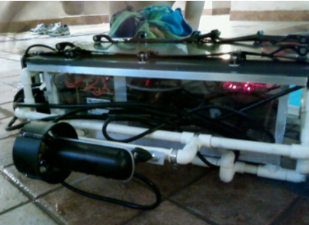
What’s in it for you?
  Hands-on experience with TONS of things you won’t learn in courses
  Meet new people and work on a cool project!
  Great experience for job interviews (we’re serious. Ask us where we’ve worked)
Mechatronics Design Association
General Info Session Sept 2012

Slide 8
Mechanical System
  Team:
  Shun Harada – Mech 1T3
  Kevin Lim – Mech 1T4
  Steven Gaspar – Mech 1T4
  Tony Viola – Mech 1T4
Mechatronics Design Association
General Info Session Sept 2012

Slide 9
Components
  Hull
  Motors
  Torpedo Launcher
  Marker Droppers (Under Construction)
  Grabbers (Under Construction)
Mechatronics Design Association
General Info Session Sept 2012

Slide 10
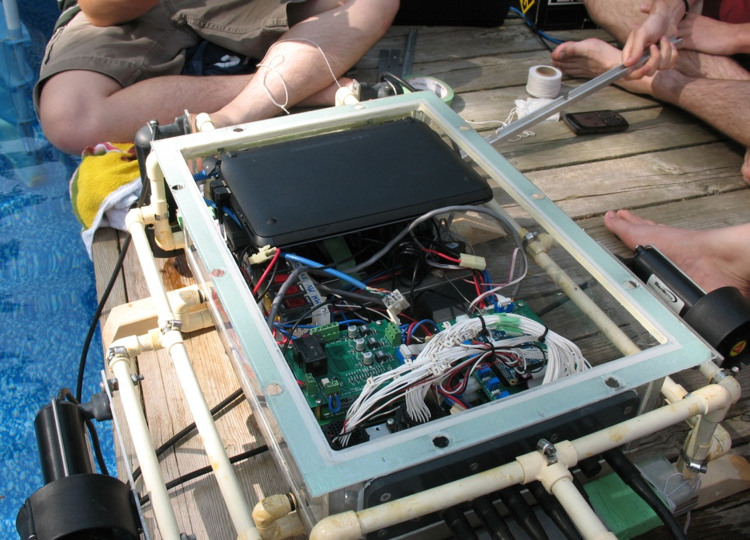
Hull
  Waterproof enclosure for electronics
  Internal mounts to keep electronics in place
  Ballast for neutral buoyancy
  External frame for mounting motors and other devices
Mechatronics Design Association
General Info Session Sept 2012

Slide 11
Marker Droppers
  Task:
  Drop two marked objects into specified containers when an electronic signal is given
  Currently uses magnets to hold markers in place and displaces magnets to drop
  What you can do:
  Help us redesign the marker dropper since the current system is dated and not very elegant
Mechatronics Design Association
General Info Session Sept 2012

Slide 12
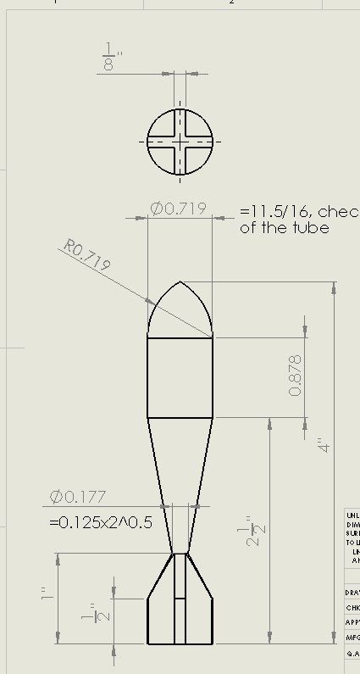
Torpedo Launcher
  Goal:
  Shoot two projectiles underwater at least 1 meter
  Currently being developed and close to completion
  What you can do:
  Make the current design more compact
  Help build a waterproof container to house the launcher
Mechatronics Design Association
General Info Session Sept 2012

Slide 13
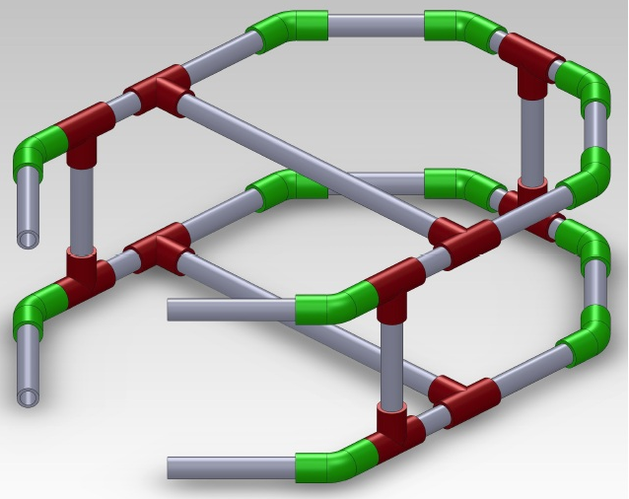
Grabbers
  Goal:
  Grab onto a PVC pipe octagon while restricting 3 degrees of freedom
  Grabbers have not been made yet.
  You can help us get this important
  task done!
Mechatronics Design Association
General Info Session Sept 2012

Slide 14
Electronics Subsystem
  Team:
  David Biancolin – EngSci ECE 1T3 + PEY
Mechatronics Design Association
General Info Session Sept 2012

Slide 15
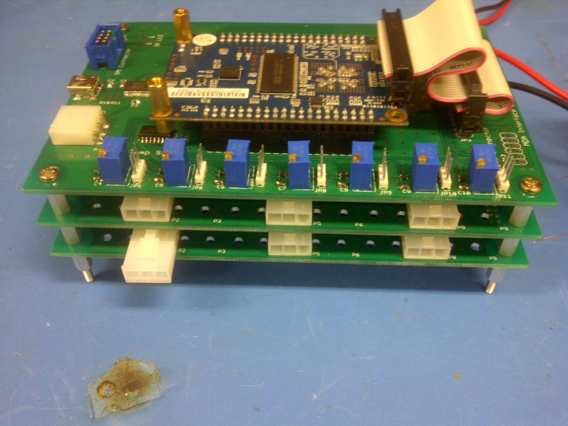
What it covers
  All electrical components excluding the FPGA and Netbook
  Printed circuits
  Power management
  Instrumentation
  Wiring and harnessing
Mechatronics Design Association
General Info Session Sept 2012

Slide 16
Skills you’ll develop
  How to use CAD tools for:
    Schematic Capture
    PCB layout
    Simulation
    Hands-on skills:
    PCB etching, population
    The art of circuit debugging*
Mechatronics Design Association
General Info Session Sept 2012

Slide 17
Software System
  Team:
  Victor Zhang – ECE 1T2
  Ritchie Zhao – EngSci 1T3
  Vincent Lu – ECE 1T3
Mechatronics Design Association
General Info Session Sept 2012

Slide 18
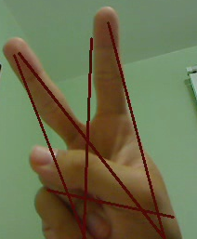
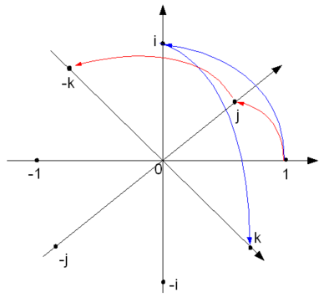
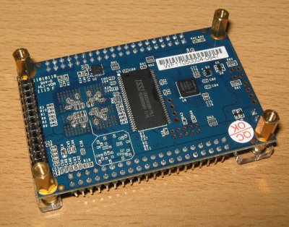
Software
Vision Control Embedded
Mechatronics Design Association
General Info Session Sept 2012

Slide 19
Vision – The Eyes
  The Goal:
  Interface with the sub’s cameras to take live video
  Perform image processing to extract useful information from video frames
  Pass this information to Control
Mechatronics Design Association
General Info Session Sept 2012

Slide 20
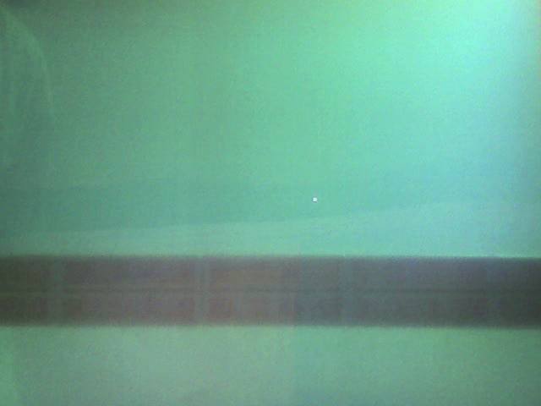
Vision
  Input Image Output Data
Height = 32 pixels
Angle = 2.3 degrees
Mechatronics Design Association
General Info Session Sept 2012

Slide 21
Control – The Brain
  The Goal:
  Maintain a model of the sub’s orientation and movement
  Make decisions on what the sub should do based on data from Vision, Sensors, and IMU
  Give commands for the sub to accelerate/stop, sink/rise, or turn
  Simulator:
  To help test the controls, we have a physics simulator program
Mechatronics Design Association
General Info Session Sept 2012

Slide 22
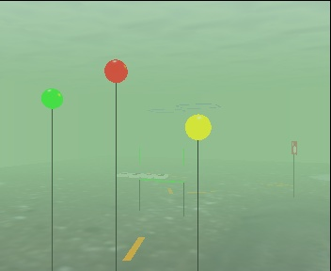
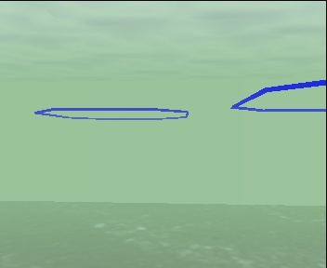
Simulator
  A graphical game-like environment where we can test our code as if it was actually running the sub underwater
Mechatronics Design Association
General Info Session Sept 2012

Slide 23
Embedded – The Nerves
  The Goal:
  Read data from Sensors and the IMU and pass it in a readable form to Control
  Accept high level orders from Control and send appropriate signals to hardware like the motors
  Stabilize the sub in the background
Mechatronics Design Association
General Info Session Sept 2012

Slide 24


Embedded Interface
IMU
Motors
FPGA
(Embedded Code)
Netbook
(Vision and Control)
Depth Sensor
Mechatronics Design Association
General Info Session Sept 2012

Slide 25
How You Can Help
  You’ll get a Virtual Machine with all the software and utilities preinstalled – you’ll have access to all our tools right away
  Depending on your interests, you may learn image processing using OpenCV, control theory and models, or embedded programming
  We can walk you through stuff during weekly meetings
Mechatronics Design Association
General Info Session Sept 2012

Slide 26
Questions?
  Talk to any of us to hear more about our systems and current projects
  Ask the software team for a demonstration of the code
  Watch videos
Mechatronics Design Association
General Info Session Sept 2012

