Slide 1
Welcome To Our Presentation

Slide 2
Presented By
Md. Abdul Halim(171-15-1408)

Slide 3
Student Result Management System
Topic

Slide 4
Content
Objectives
Expected Outcome
Apparatus
Important Function
Working Procedure
Future Development
Advantage & Disadvantage

Slide 5
Objective
To observe result of a student
Store information
To take transcript

Slide 6
Expected Outcome
Smart Management of students result
Avid student performance
Generate report card

Slide 7
Apparatus
jFrame
jPanel
jField
jLebel
jTextarea
jButton
jTable
Combobox

Slide 8
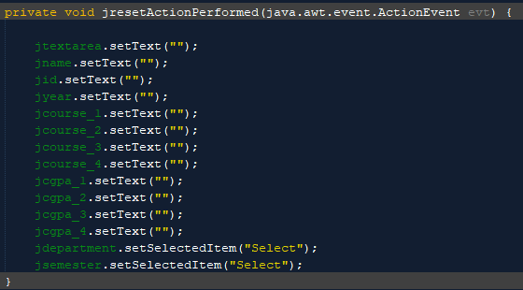
Important Function
We can clear all jField using Reset Button.

Slide 9
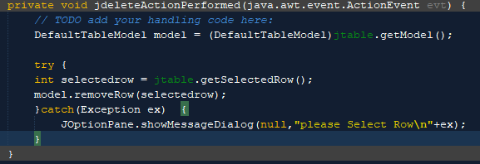

We can delete a row from the table using this this method.
Delete & Exit
We used System.exit(0); for exit

Slide 10
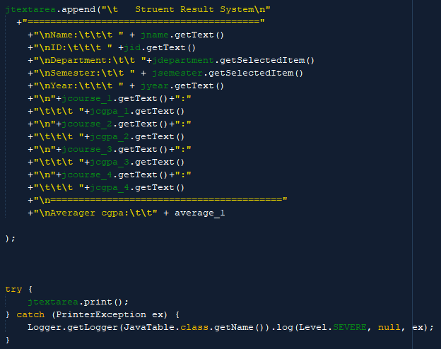
Print
To take transcript we use print method

Slide 11
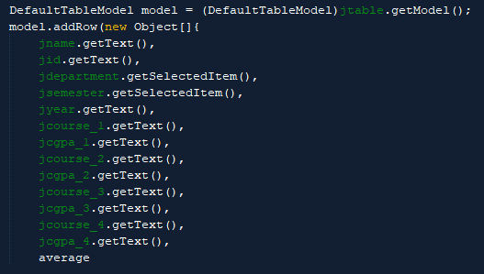
Process
For process all data we used this method

Slide 12

Future Development

Slide 13
Advantage
Easy to handle and implement
Time efficiency
Calculate average CGPA
To take result card
Get PDF

Slide 14
Disadvantages
Has no database
Can not store data permanently
All data erase if the program is crash

Slide 15


