Slide 1

Data Types

Slide 2
What is data type in ?
Why data types are used for?
What are the data types?

Slide 3
Example: int a=20;
float b=10.5;
char ch=‘A’;
Here int, float, char are data types

Slide 4
Why data types are used for?
Data Types are used to:
Identify the type of a variable when it declared
Identify the type of the return value of a function
Identify the type of a parameter expected by a function

Slide 5
What are the data types?
There are the following data types
Types Data Types
Basic Data Type
Derived Data Type
Enumeration Data Type enum
Void Data Type void

Slide 6
Data Types Memory Size Range
char 1 byte −128 to 127
signed char 1 byte −128 to 127
unsigned char 1 byte 0 to 255
short 2 byte −32,768 to 32,767
signed short 2 byte −32,768 to 32,767
unsigned short 2 byte 0 to 65,535
int 2 byte −32,768 to 32,767
signed int 2 byte −32,768 to 32,767
unsigned int 2 byte 0 to 65,535
short int 2 byte −32,768 to 32,767
signed short int 2 byte −32,768 to 32,767
unsigned short int 2 byte 0 to 65,535
long int 4 byte -2,147,483,648 to 2,147,483,647
signed long int 4 byte -2,147,483,648 to 2,147,483,647
unsigned long int 4 byte 0 to 4,294,967,295
float 4 byte
double 8 byte
long double 10 byte

Slide 7
How Computers Represent Negative Binary Numbers?
The simplest method to represent negative binary numbers is called
Signed Magnitude.
If the leftmost digit (also called the most significant digit or most significant bit)
is 0 the number is positive,
if it’s 1 the number is negative.
For example:
00001010 = decimal 10 (positive value)
10001010 = decimal -10 (negative value)

Slide 8
Prove that 2’s compliment is the negative value
binary of +10 is 0010
1’s compliment of 0010 is 1101
2’s compliment of 0010 is
1101 (1’s compliment)
+ 1
1110 (2’s compliment)
prove that 1110 is the negative value of 0010
+2-2 = 0 that means
0010 (+2)
+ 1110 (-2)
1 0000
calculating 4 bits, that means 0010+1110 = 0000

Slide 9
How to calculate range of a data type?
Minimum Range- It is the minimum value that can be stored in a data type.
Maximum Range- It is the maximum value that can be stored in a data type.
The minimum range is calculated by -2^{(bits-1)} and for the maximum range it is 2^{(bits-1)}-1, while bits = size of a data type. For example, A short variable of size takes at least 2 bytes(16 bits) in size.
And, as per formula above. The minimum range is -2¹⁵(-32768) and the maximum range is 2¹⁵-1(32767).
Hence, the range of values for short data type is -32768 to 32767.
for minimum range 1000000000000000 (-32768 )
for maximum range 0111111111111111 (32767)
First bit is the sign bit, 1 means negative value and 0 means positive value

Slide 10
char data type
char data type used to store character values.
The char data type could be signed and unsigned
for a char variable of 1 byte,
minimum range is 2⁸⁻¹ and the maximum range is 2⁸⁻¹-1.
Ranging from -128 to 127 values.
for minimum range
128 64 32 16 8 4 2 1
for maximum range
128 64 + 32 + 16 + 8 + 4 + 2 + 1 = 127
1 | 0 | 0 | 0 | 0 | 0 | 0 | 0
0 | 1 | 1 | 1 | 1 | 1 | 1 | 1

Slide 11
for minimum range 10000000
1 is the sign bit ,
that means 1’s compliment of 0000000 (7 bits ) is 1111111( 7 bits)
2’s compliment of 0000000 is
1111111
+ 1
10000000

Slide 12
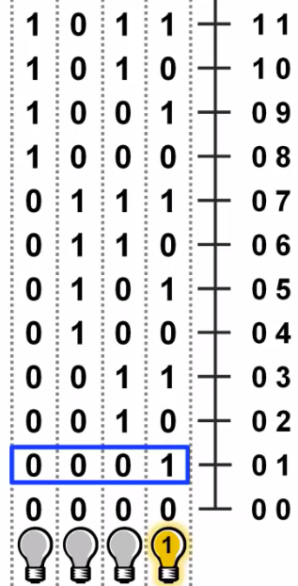
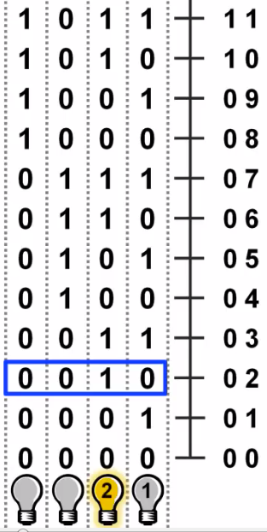
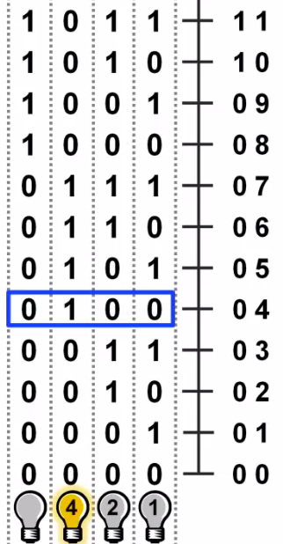
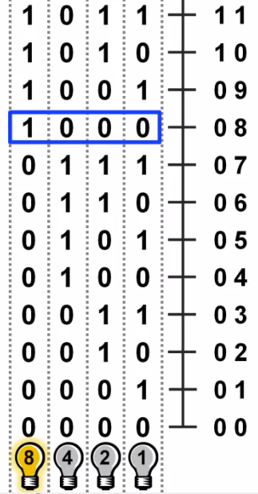
1 | 1 | 1 | 1 | 1 | 1 | 1 | 1
128 + 64 + 32 + 16 + 8 + 4 + 2 + 1

Slide 13
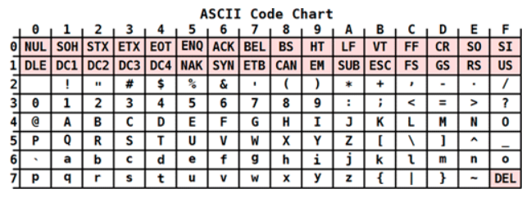
How a character can be signed(positive or negative signed)?
Well, when you store a character value using char data type, what gets stored is not the character but the binary equivalent of ASCII value of the character.
For example : char c= 'A';
This code stores the binary equivalent of ASCII value of A i.e. 65 in the system.
And if 65 could be stored using a char data type then even a negative integer value could be stored using a char data type.

Slide 14
Format specifiers
The format specifiers are used for input and output purposes.
Using this concept the compiler can understand that what type of data is in a variable during taking input

Slide 15
Format Specifier Type
%c Character
%d Signed integer
%e or %E Scientific notation of floats
%f Float values
%g or %G Similar as %e or %E
%hi Signed integer (short)
%hu Unsigned Integer (short)
%i Unsigned integer
%l or %ld or %li Long
%lf Double
%Lf Long double
%lu Unsigned int or unsigned long
%lli or %lld Long long
%llu Unsigned long long
%o Octal representation
%p Pointer
%s String
%u Unsigned int
%x or %X Hexadecimal representation
%n Prints nothing
%% Prints % character

Slide 16
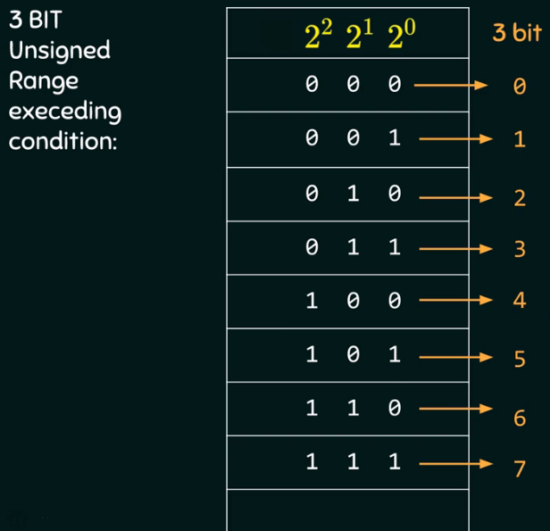
What if we try to exceed the valid range of data types

Slide 17
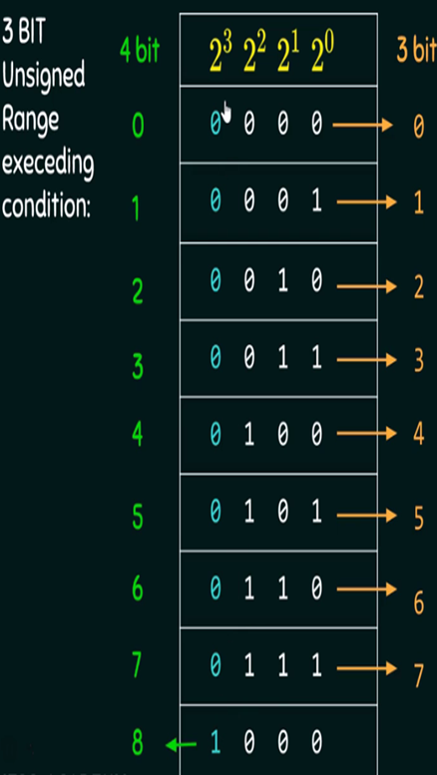
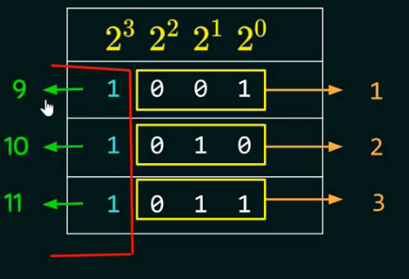
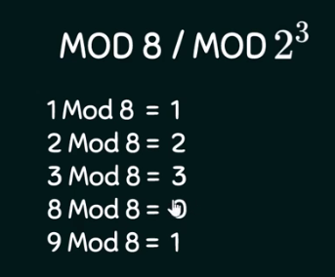

Slide 18
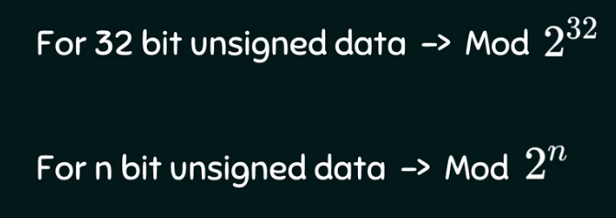
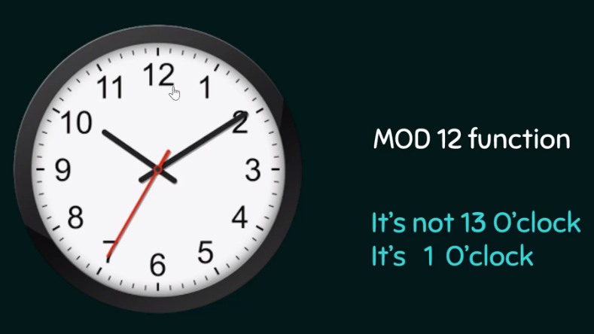

Slide 19
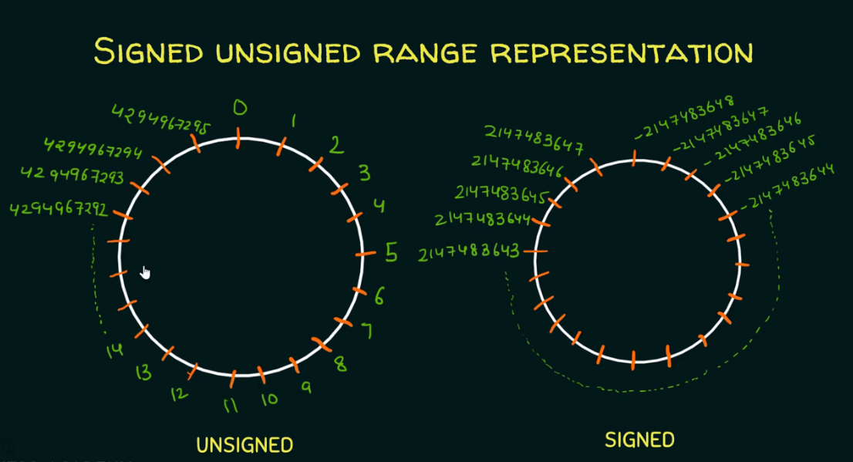

Slide 20
The End

