Slide 1

ABOUT US
SSVEP Detection

Slide 2

01
INTRODUCTION
You could enter a subtitle here if you need it

Slide 3
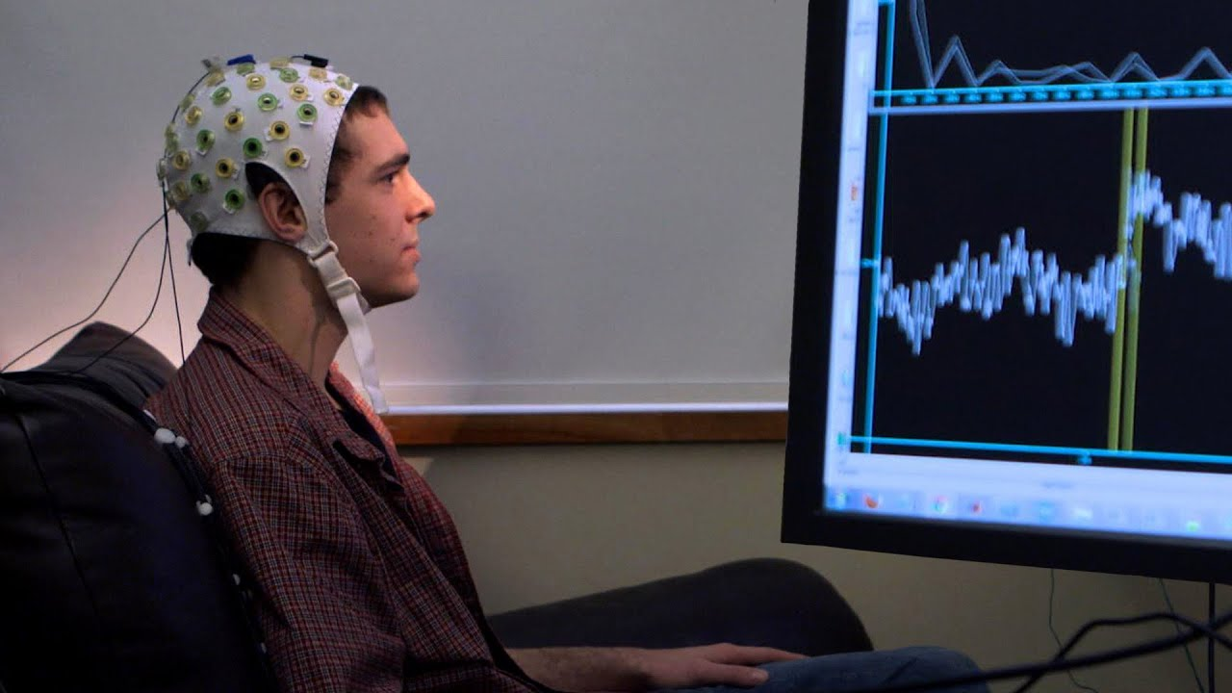
EEG systems capture information about many different aspects of our cognition, behavior, and emotions. The technology not only helps to study the brain, but also has applications in health, in affective and emotional EEG monitoring, and in human improvement. However, EEG data is not easy to interpret: it has a lot of noise, varies significantly between individuals and, even for the same person, changes substantially over time. In this post, we will discuss how AI and machine learning are used to process data and how new trends, ie. deep learning, are changing the way EEG will be analyzed in the future.

Slide 4
WHAT DO WE DO?
Analysis
Model
EEG Extracted
SSEVP Detection

Slide 5
HOW DO WE DO IT?

Slide 6
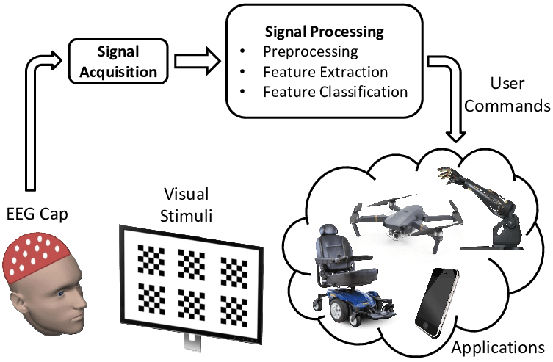
SSVEP:Small amplitude stable VEP were generated which were entitled “steady-state” visually evoked potentials (SSVEPs) of the human visionary system. There hence, steady-state visual evoked potentials (SSVEPs) are defined as the potential elicited by the change in the visual field with the frequency higher than 6 Hz.

