Slide 1
DPEX Marketplace

Slide 2
TARGET CLIENT
DPEX Worldwide is an established Express and E-Commerce service provider in Asia. With a history dating 30 years and a comprehensive network spanning the region, They have extensive local knowledge to serve into and throughout Asia well.
They are widely acknowledged as “Knowing Asia Delivering Asia”

Slide 3
TEAM MEMBERS
MEMBERS’ NAME | ROLES
Acha, Marie Antonette | Team Leader/ Developer
Balutan, Evan Antone | Developer
Manalang, Patrick Alfred | Documentation
Reyes, Audrey Rence | Quality Assurance

Slide 4
PROBLEM DEFINITION
E-commerce is fast gaining ground as an accepted and used business paradigm. More and more business houses are implementing web sites providing functionality for performing commercial transactions over the web. It is reasonable to say that the process of shopping on the web is becoming commonplace. The objective of this project is to develop a general purpose e-commerce store where any products can be bought from the comfort of home through the Internet.

Slide 5
RECOMMENDED SOLUTION
The group’s solution is to develop an e-Commerce Marketplace Website for the client with the use of Magento as the software development tool. The project covers four (4) main modules but the group shall only focus on the three main modules, namely, Customer, Merchant, and Station.

Slide 6
SOLUTION (CONT’D)
The system will provide means by which customer can view products browse for more information about the products, select items and collect them in shopping cart then order or buy products online.
The system will be able to manage customers’ data, data about products instore and transaction made by the customers. Merchants will be able to add, edit and view the products in the store.
Administrator of the system can view transaction made edit and even remove the transaction from the system. Customers’ information will be kept confidential by system and online administrator can view them

Slide 7
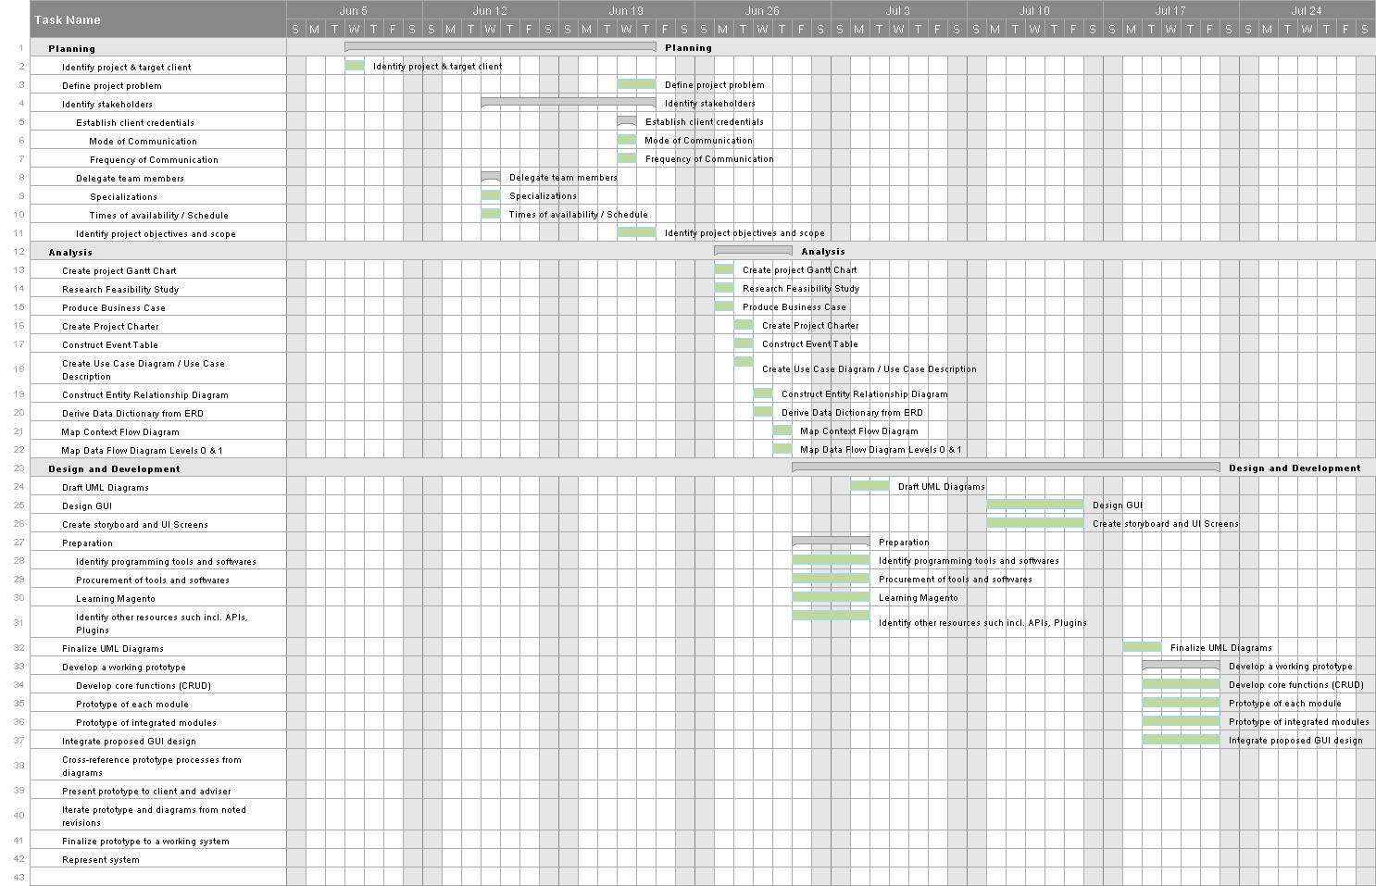
DEVELOPMENT TIMELINE
Planning Phase

Slide 8
DEVELOPMENT TIMELINE (CONt’d)
Analysis Phase

Slide 9
DEVELOPMENT TIMELINE (CONt’d)
Design and
Development Phase

