Slide 1

BIAM Feedback and Hostel Management
15/02/2026

Slide 2






High Level Overview (Updated: 15/02/2026) – Stable
Home (/) 308
Check-in (/admin/hostel/check-in)
Checkout (/admin/hostel/checkout)
Create
(POST /admin/check-in/plus
Login (/login)
Feedback Form (/)
Hostel (/admin/hostel)
Update
(POST /admin/check-in/{id}/refresh
Report (/admin/report)
Guest Feedback Report
(POST /admin/report/generate)
Delete
(POST /admin/check-in/{id}/minus)
Admin
Occupancies
(GET /admin/report/{query}{msg})
SMS
Vacancies
(GET /admin/report/{query}{msg})
feedback
Cache
Users
Request Filters
Update Status:
Checked out
Checkout
Transection
Create Checkout
Update Users
Roll back if fail
Verify Guest (With phone)
Status != checked out
(GET /admin/hostel/checkout/{phone})
Calculate Stayed, Discount, VAT & Tax, Total Bill
History
Confirm
(POST /admin/hostel/checkout/{phone})
An event listener monitors for specific events and executes a response—such as storing data—whenever that event is triggered by an action.

Slide 3
High Level Overview (Updated: 15/02/2026) – Proposed v1 (BIS)
Home (/) 308
Check-in (/admin/hostel/check-in)
Checkout (/admin/hostel/checkout)
Create
(POST /admin/check-in/plus
Admin
Login (/login)
Hostel (/admin/hostel)
Seat Management
(/admin/hostel/seats)
Update
(POST /admin/check-in/{id}/refresh
Report (/admin/report)
Delete
(POST /admin/check-in/{id}/minus)
Guest Feedback Report
(POST /admin/report/generate)
Occupancies
(GET /admin/report/{query}{msg})
Users
Vacancies
(GET /admin/report/{query}{msg})
Request Filters
Update Status:
Checked out
Checkout
Transection
Create Checkout(DBT: checkout)
Update Users status (DBT: checkout)
Store Feedback(DBT: feedback)
Update Sms Status (DBT: feedback)
Roll back if fail
Verify Guest (With phone)
Status != checked out
(GET /admin/hostel/checkout/{phone})
Calculate Stayed, Discount, VAT & Tax, Total Bill
Show feedback form with filled data
Confirm
(POST /admin/hostel/checkout/{phone})
feedback
SMS
sync

Slide 4
High Level Overview (Updated: 23/02/2026) – v1 Stable
Home (/) 308
Check-in (/admin/hostel/check-in)
Checkout (/admin/hostel/checkout)
Create
(POST /admin/check-in/plus
Admin
Login (/login)
Hostel (/admin/hostel)
Seat Management
(/admin/hostel/seats)
Update
(POST /admin/check-in/{id}/refresh
Report (/admin/report)
Delete
(POST /admin/check-in/{id}/minus)
users
Guest Feedback Report
(POST /admin/report/generate)
Occupancies
(GET /admin/report/{query}{msg})
guest
Vacancies
(GET /admin/report/{query}{msg})
Request Filters
Update Status:
Checked out
Checkout
Transection
Create Checkout(DBT: checkout)
Update Users status (DBT: checkout)
Store Feedback(DBT: feedback)
Update Sms Status (DBT: feedback)
Roll back if fail
Verify Guest (With phone)
Status != checked out
(GET /admin/hostel/checkout/{phone})
Calculate Stayed, Discount, VAT & Tax, Total Bill
Show feedback form with filled data
Confirm
(POST /admin/hostel/checkout/{phone})
feedback
SMS
sync

Slide 5

Hostel (/admin/hostel)
Seats
(/admin/hostel?tab=seats)
Add Seat
(/admin/hostel?tab=add_seat)
Edit Seats (/admin/hostel?tab=edit_info)
Check-in (/admin/hostel?tab=edit_info)
Check-in request (/admin/hostel?tab=requests)
Local Service
Update Data
Query Seats
Verify PIN Form
Full Duplex
Valid
?
gRPC
Seats
No
Add New Record
MR
<10
?
Update/Delete Records
Yes
Yes
Remote Service
Check-in Form
Collect Data
No
Check-in
Submit
Lock 60s.
Warning: Maximum Retry (MR) = 10
Transection
Create New record > Table: check-in
Update Seats to Booked > Table: seats
Rollback if fails & Notify
Yes
Avail
?
No
Initial design
Users
U_Pin
One-One
Hostel (/admin/hostel) – [Protected Routes]

Slide 6

High Level Overview (Updated: 23/02/2026) – v2 Current (Booking system- github branch (develop-v2)
Search Seats
Already checked in?
View Seats
Booking (Next)
Verify Data (GEMS)
Confirm Booking
Officer
Officer’s Login
GAPI
View Dashboard
Notice
yes
Verified
Transection
Create Officer (DBT: officers)
Change status to booked (DBT: checkins)
Remember login with device id.
Session validity update checkout data
Logged out other devices automatically
Extension
Failed to Verify
Meals
Report
Officers
Notice: Global Notices for all types of guest.
Extension: Booking extension features
Meals: Stop/Continue meals
Report: User statistics

Slide 7
High Level Overview (Updated: 23/02/2026) – v2 Current (Booking system)- Terms
Details
Search Seats | Checkin Date(Fetch Current Date if date < 10:59 set it to 11:00, date > present date time > present time if present time > 11:00 checking date = +1 Chekout date = no particular limit. Checkout date > checkin date
Officers login | Check this cadre id and phone already checked in. if yes show login using gems >> send post request >> get info and show dashboard else error no booking info found. Authen

Slide 8
Models (Part-01)
Table Name | Columns | Relationship | Table Name
feedback | Stores all feedback.
users | Master log for storing all users including authentication and roles
officers | Check-in information. (id,Cadre ID, Name, Phone, booked_room, booked_seats(csv), checkin_date, checkout_date, required_extension(yes/no))
check_in_req | Check-in-request information.
check_out | Checkout information with payment id. (id, officers_id(FK), Cadre ID, Amount) have One to one relation with Officers
seats | All seat information with rent. (id, room_no, seat_no, type(ac/non_ac), rent, building_no, status(booked, available, unavailable), comment
U_Pin | Id, pin(Hashed), status(active, reset, blocked), created_at, updated_at | One-One | users

Slide 9
Relationship
Feedback
Int id, string phone, string roll, datetime roll

Slide 10
Deployment in Production (Part-01)
Reconfigure guzzle http in SmsGateWay Class. Crutial for security in production

Slide 11
Commands | Action
php artisan cmd:pin –help | Show all options for pin management
php artisan cmd:pin admin@biam set 1234 --admin | Set pin for specific user
php artisan cmd:pin admin@biam verify 1234 –admin | verify pin for specific user
php artisan cmd:pin user@email status | Change Status (Choose from option)
php artisan cmd:users –help | Show all options for user management
php artisan cmd:users create “Email" “Password" “Name" | Create new user account
php artisan cmd:users delete "user@example.com" | Delete a specific users
php artisan cmd:users update “email“ “password“ | Change Password

Slide 12
BIAM Feedback and Hostel Management
15/02/2026

Slide 13
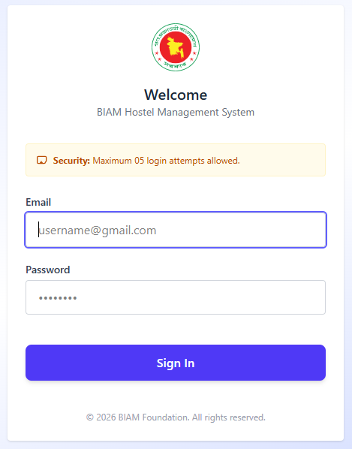
BIAM Hostel Management System
Secure authentication system based on email and password.
System is protected from brute force attack. Maximum retry level is 05

Slide 14
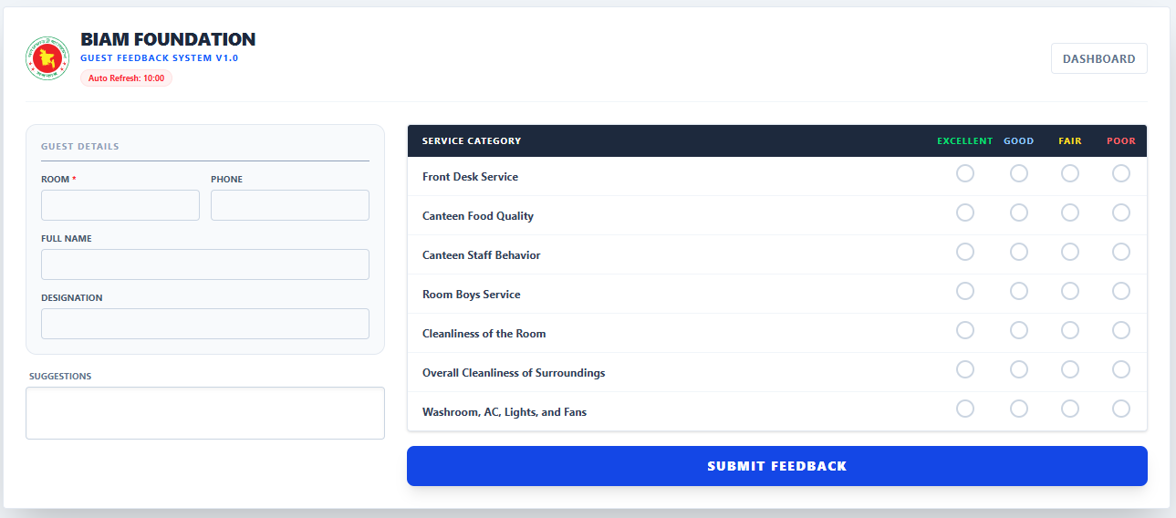
Optimized Feedback system. SMS alert is enabled by default. Multiple number can be added to sms list

Slide 15
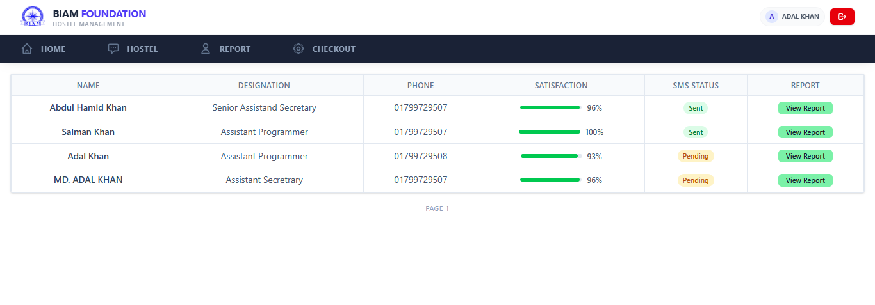
Provides a concise overview of all feedback received from our guests.

Slide 16
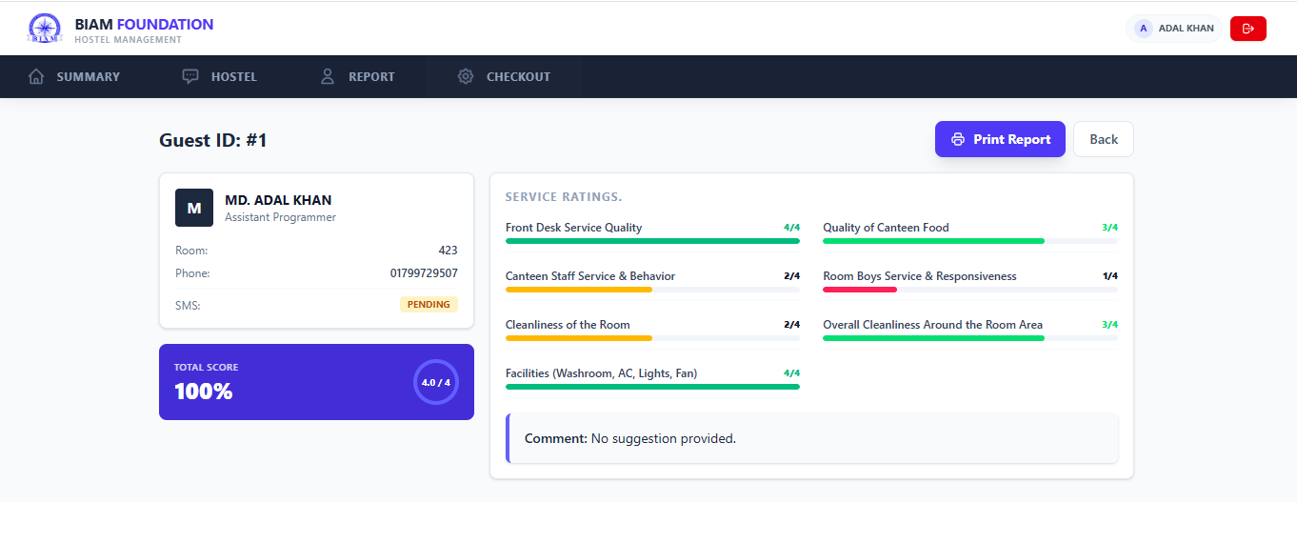
Feedback details including reporting printing feature

Slide 17
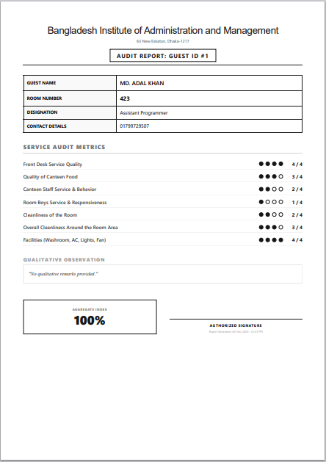
Generated Feedback Report

Slide 18
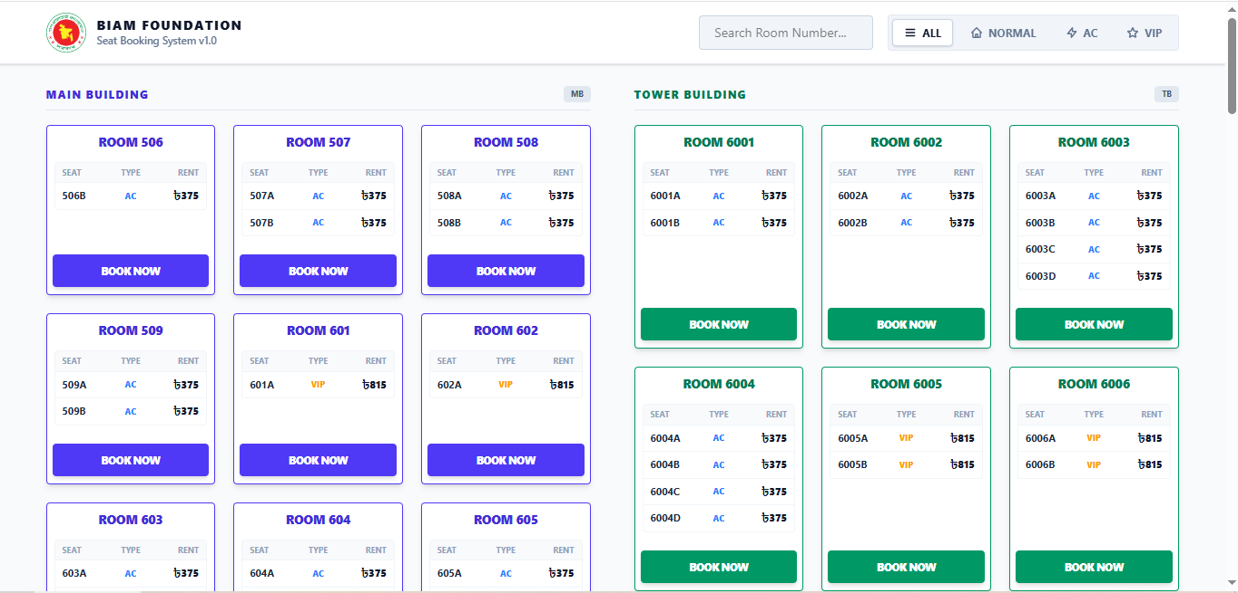
Here is a list of available seats for booking, which can be sorted by AC, Non-AC, and VIP types

Slide 19
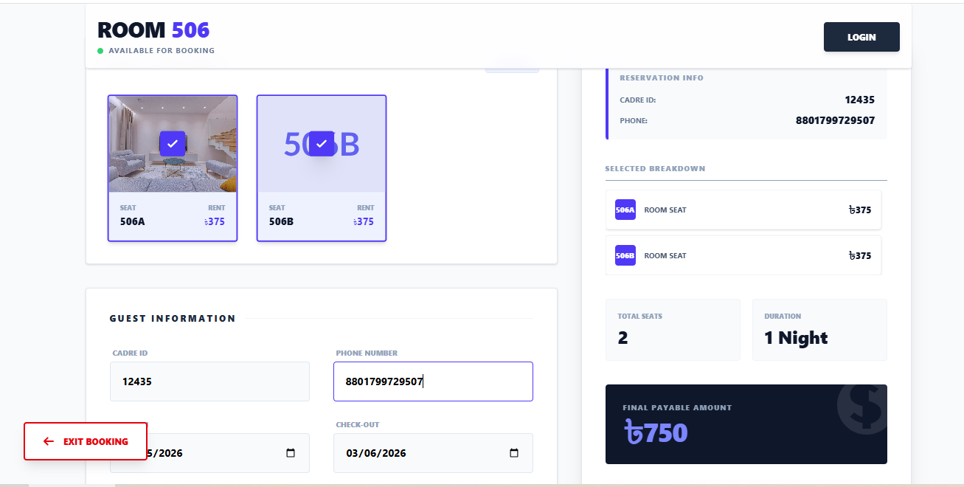
Here is a quick look at your booking window and the estimated total for your stay.

Slide 20
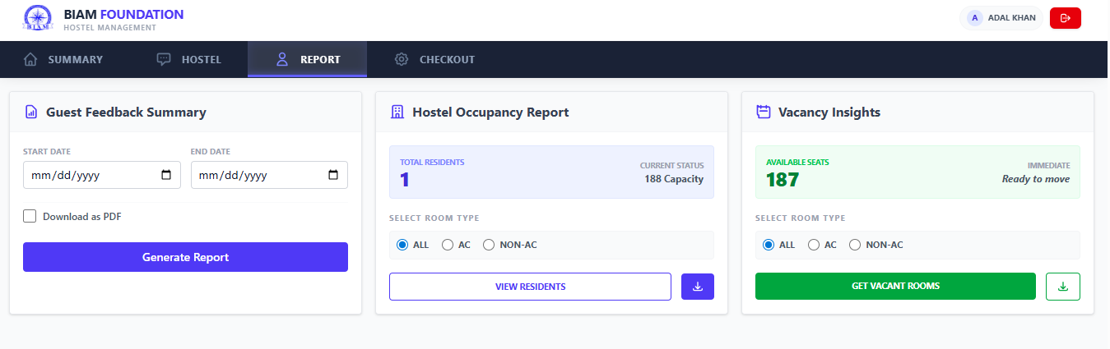
Different types of report generation

Slide 21
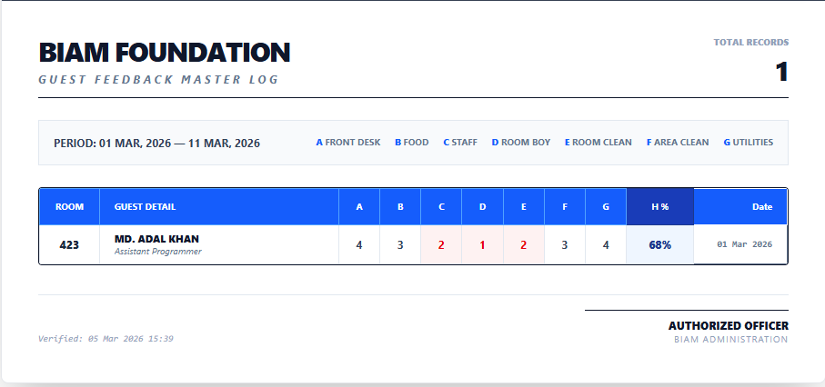
Guest Feedback summary

Slide 22
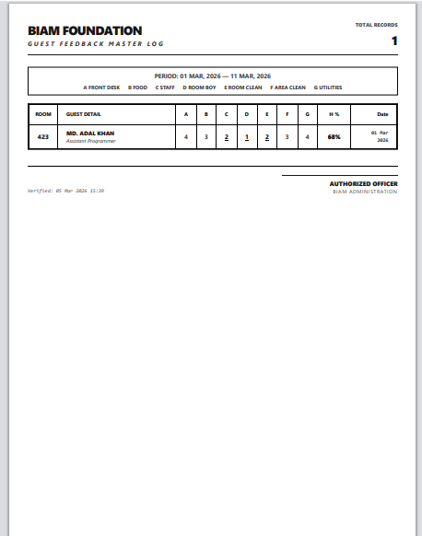
Guest feedback Summary as printable format

