Slide 1
JsonPowerDB
"This project is all about basics of JsonPowerDB (JPDB) and how to use JPDB for CRUD operations."

Slide 2
About JsonPowerDB
JsonPowerDB is a Real-time, High Performance.
Lightweight and Simple to Use.
Rest API based Multi-mode DBMS.
JsonPowerDB has ready to use API for Json document DB.
JPDB supports and advocates for true serverless and pluggable API development.

Slide 3
Benefits of using JsonPowerDB
Simplest way to retrieve data in a JSON format.
Schema-free, Simple to use, Nimble and In-Memory database.
It is built on top of one of the fastest and real-time data indexing engine - PowerIndeX.
It is low level (raw) form of data and is also human readable.
It helps developers in faster coding, in-turn reduces development cost.

Slide 4
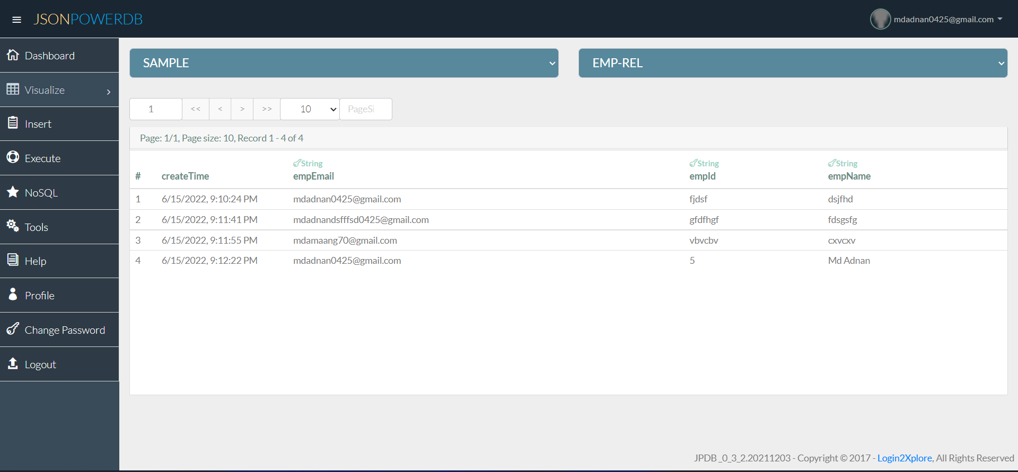

Slide 5
