Slide 1


MAJOR PROJECT PRESENTATION
GRADPATH
An Intelligent Academic Command Center for BCA Students
Bachelor of Computer Applications | Session 2025-26 | BCA 6th Semester
Kailash Institute of Management, GIDA, Gorakhpur
Affiliated to Deen Dayal Upadhyaya Gorakhpur University, Gorakhpur
Submitted By
Submitted To
Mohammad Afsar | Roll No. 2614058580039
Ravi | Roll No. 2614058580045
Gaurav Yadav | Roll No. 2614058580030
Priyanshi | Roll No. 2614058580042
Shivanshu Shahi
Project Guide
Department of Computer Application
GradPath major project report presentation

Slide 2
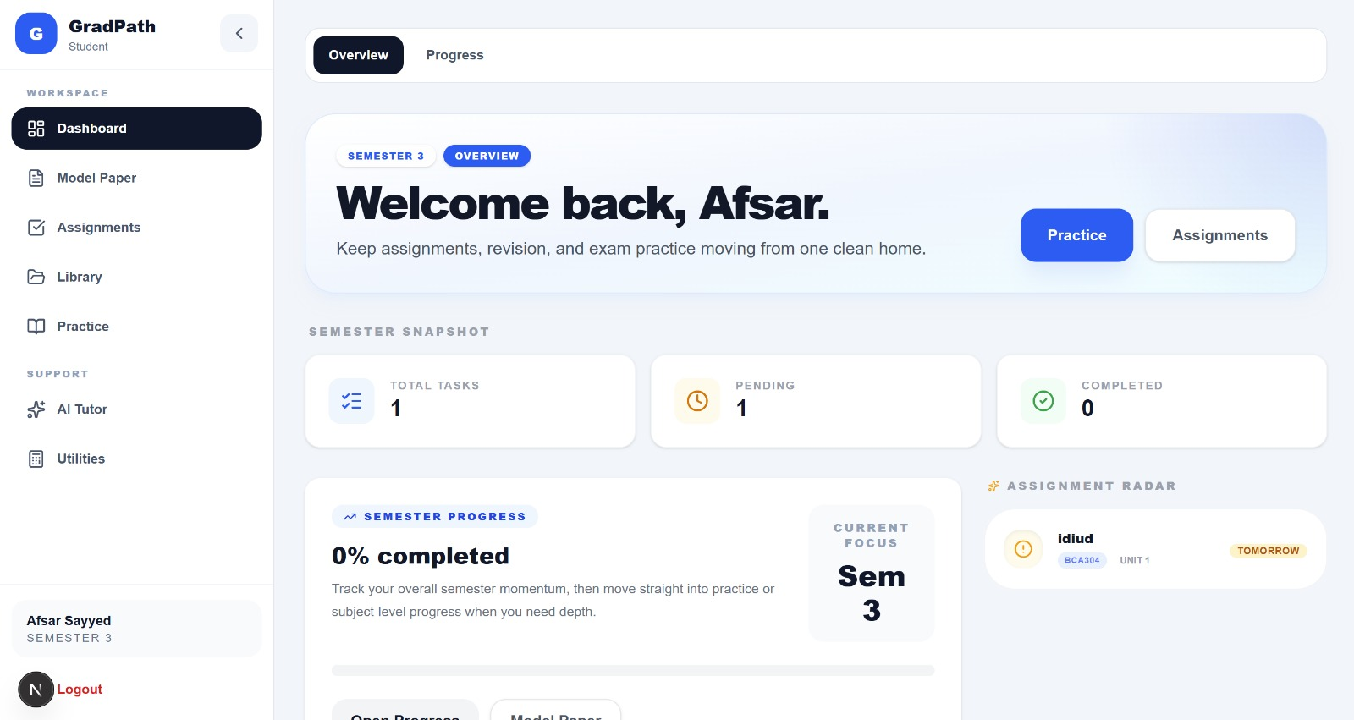
Project Overview
Introduction
GradPath is a full-stack academic management and study-support platform developed to keep the BCA student workflow in one place.
It connects semester subjects, unit progress, assignments, study resources, previous-year questions, AI tutoring, practice tools, and result planning in one authenticated workspace.
Student Dashboard
- Student dashboard for progress, assignments, and quick actions
- Curated study material, PYQs, quizzes, flashcards, and model papers
- Role-based access for students and admins with secure authentication
GradPath | BCA Major Project Presentation
2/20

Slide 3
Need Analysis
Problem Statement
The current academic workflow is fragmented, manual, and difficult to track during the semester and before examinations.
BCA students often depend on notebooks, PDF folders, classroom reminders, messaging groups, and university websites at the same time. That scattered flow reduces study efficiency and weakens revision planning.
Key Pain Points
Scattered study material causes time loss and low productivity.
Students lack one clear view of assignments, syllabus progress, and revision gaps.
PYQ analysis, model-paper planning, and answer practice stay mostly manual.
Admins need a simpler way to upload, organize, and review academic content.
GradPath | BCA Major Project Presentation
3/20

Slide 4
Need Analysis
Objectives Of The Project
The project aims to reduce academic confusion and create a clearer semester workflow from syllabus coverage to exam preparation.
- Provide secure student and admin authentication.
- Organize BCA subjects, units, and topic lists semester-wise.
- Create a student dashboard for progress, assignments, and academic actions.
- Track unit completion and topic confidence for better revision planning.
- Offer a curated resource library for notes, PDFs, PYQs, videos, and links.
- Enable admins to upload, manage, and analyze academic resources.
- Generate AI-assisted tutor answers, quizzes, flashcards, PYQ support, and model papers.
- Provide result utilities such as marks profile, target planner, and CGPA support.
- Demonstrate modular full-stack development, API design, database modeling, testing, and deployment readiness.
- Keep the architecture extensible for future mobile and multi-course expansion.
GradPath | BCA Major Project Presentation
4/20

Slide 5
Scope
Scope Of The Project
GradPath covers the academic support workflow for BCA students while keeping the product focused on study planning, resources, practice, and productivity.
Student Side
Admin Side
System Boundary
- Dashboard, semester subjects, and unit progress
- Assignments, practice center, flashcards, and AI tutor
- Model paper generation and result planning utilities
- User directory and resource upload
- Resource management and review workflow
- Coverage visibility and basic analytics
- REST APIs, MongoDB persistence, JWT security
- Cloudinary storage and Gemini integration
- Not intended to replace a full LMS, attendance, or fee system
Future expansion can add mobile access, notifications, PDF text indexing, richer analytics, and teacher-side workflows without changing the core project direction.
GradPath | BCA Major Project Presentation
5/20

Slide 6
Current State
Existing System And Its Limitations
The present academic workflow depends on disconnected sources and does not provide one structured command center for planning, study, and practice.
Existing Workflow
Why It Falls Short
- Manual notebooks, WhatsApp groups, PDFs, Google Drive folders, and class announcements
- Progress often tracked mentally or on paper instead of in a central dashboard
- Assignments and revision planning handled through reminders and scattered notes
- Generic apps do not connect units, resources, PYQs, quizzes, and results in one academic flow
- No centralized student dashboard for deadlines, progress, and weak areas
- Folder-based sharing lacks analytics, topic mapping, and practice linkage
- Manual result planning leads to rough estimates and inconsistent tracking
- There is no integrated AI tutor, automated model-paper support, or structured admin insight
GradPath | BCA Major Project Presentation
6/20

Slide 7
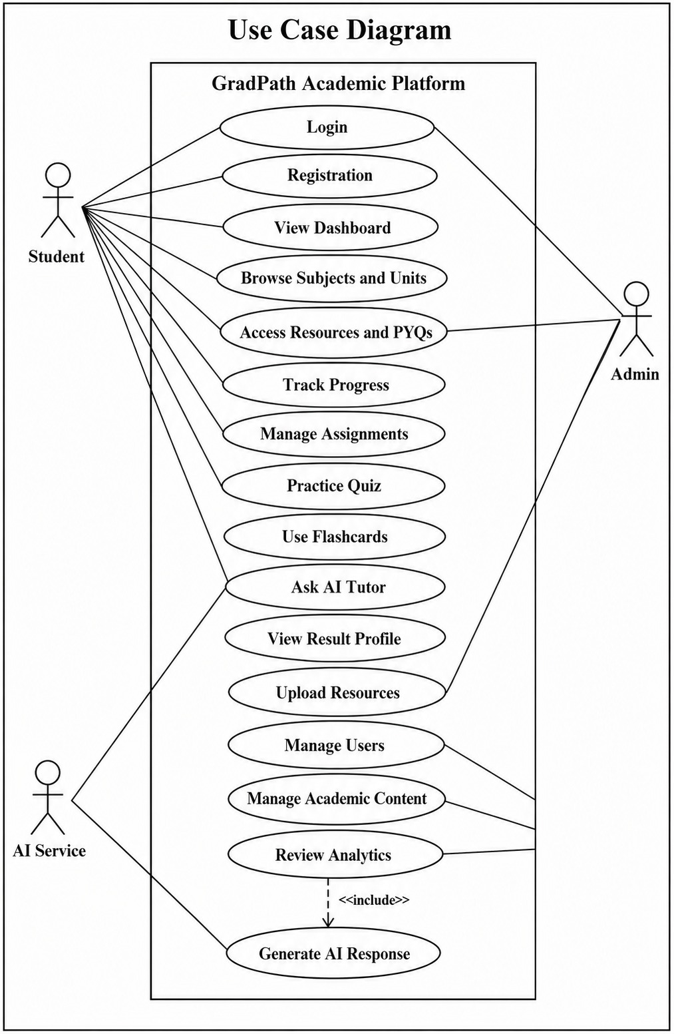
Solution
Proposed System
GradPath proposes a centralized BCA academic platform that connects study planning, resources, practice, AI support, and result utilities through role-based access.
Students use the system to move from overview to action: open the dashboard, choose subjects, study resources, practice topics, ask AI, generate model papers, and update progress without changing platforms.
Use Case View
- Unified dashboard for academic status and semester flow
- Semester-wise subject and unit navigation
- Curated resources with admin upload and review controls
- AI tutor, quizzes, flashcards, PYQ support, and model-paper generation
- Progress, assignment, and result planning utilities
GradPath | BCA Major Project Presentation
7/20

Slide 8
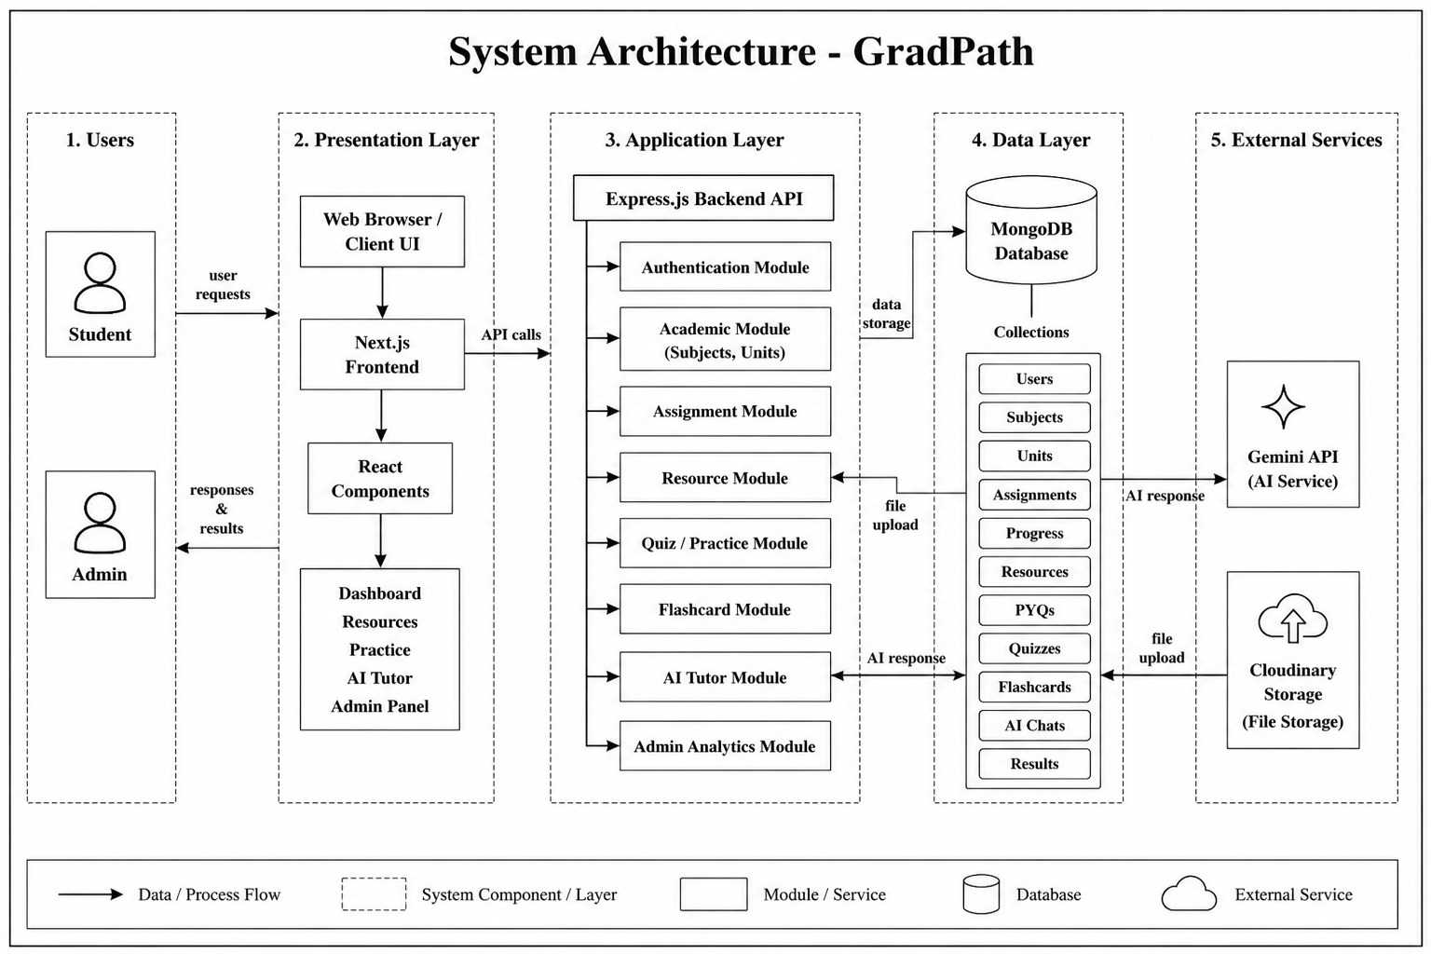
Design
System Architecture
The project follows a layered architecture that keeps the interface, application logic, data layer, and external services clearly separated.
GradPath uses a Next.js frontend, an Express API layer, MongoDB data persistence, and service integrations for file storage and AI-assisted academic features.
Presentation Layer: browser UI, Next.js frontend, React components, dashboard and practice surfaces.
Application Layer: authentication, academic catalog, assignments, resources, quizzes, flashcards, AI tutor, and admin analytics.
Data Layer: MongoDB collections for users, subjects, units, resources, progress, quizzes, chats, and results.
External Services: Cloudinary for file storage and Gemini API for intelligent responses.
GradPath | BCA Major Project Presentation
8/20

Slide 9
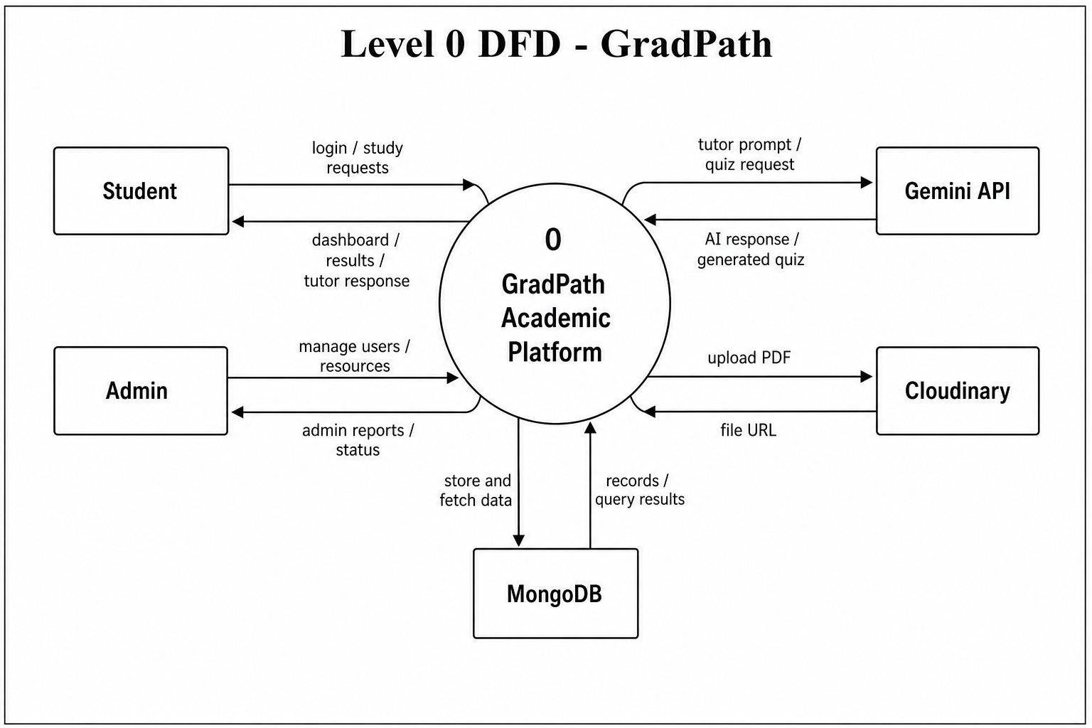
Design
Data Flow Diagram (DFD)
The level 0 DFD shows how student requests, admin actions, database records, file storage, and AI responses move through the platform.
Level 1 further decomposes the platform into Authentication, Content Management, Study Tracking, Practice System, AI Tutor, and Admin Analytics processes.
GradPath | BCA Major Project Presentation
9/20

Slide 10
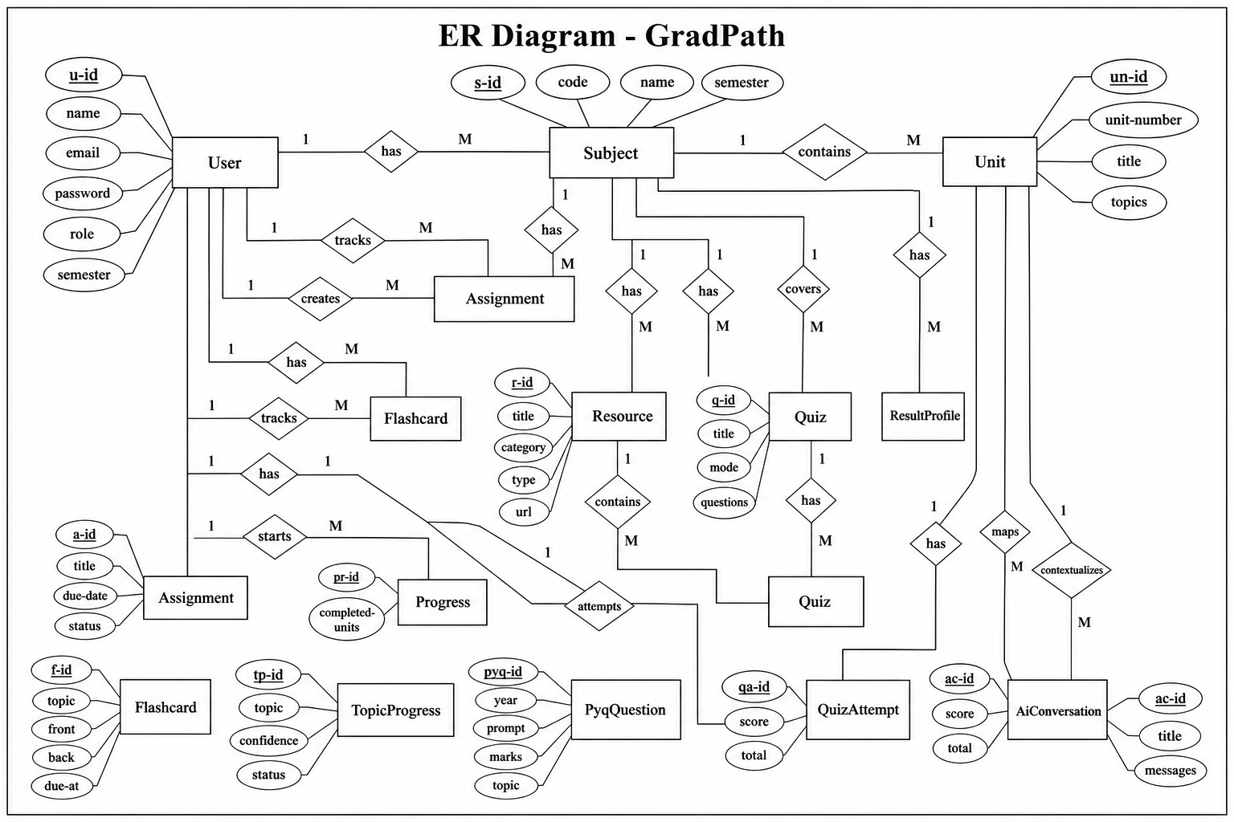
Design
Entity Relationship Diagram (ER Diagram)
The database model connects core academic entities such as users, subjects, units, resources, quizzes, progress, and result profiles.
GradPath | BCA Major Project Presentation
10/20

Slide 11
Build Stack
Technology Stack
GradPath uses a modern JavaScript-based stack with cloud storage and AI integration to support both student and admin workflows.
Frontend
Backend
Data Layer
Services & Tools
- Next.js 16
- React 19
- TypeScript
- Tailwind CSS
- Node.js
- Express
- REST APIs
- JWT Authentication
- MongoDB
- Mongoose
- Structured Collections
- Progress & Result Data
- Cloudinary
- Gemini API
- Git
- VS Code & Browser
This stack supports modular development, responsive UI delivery, secure APIs, flexible document storage, and AI-assisted academic features in a single web platform.
GradPath | BCA Major Project Presentation
11/20

Slide 12
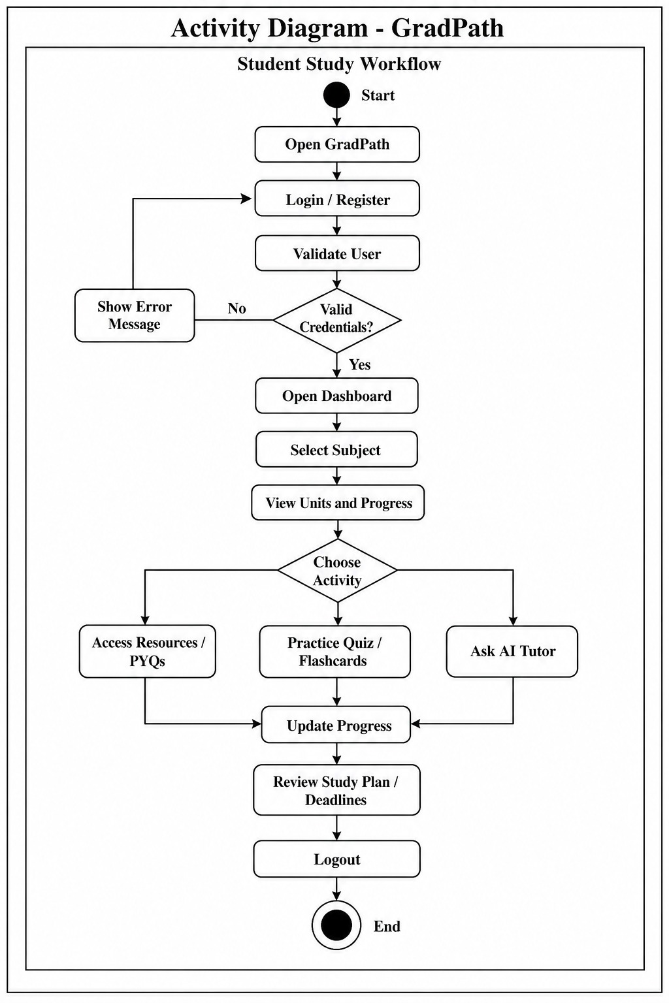
Working Model
Methodology / Working
The project was developed incrementally so each academic module could be designed, implemented, tested, and then integrated into the larger platform.
01
Requirement analysis and module planning
Student Working Flow
02
UI, database, and route design
03
Module-wise development and testing
04
Student workflow integration
05
Output verification and documentation
GradPath | BCA Major Project Presentation
12/20

Slide 13
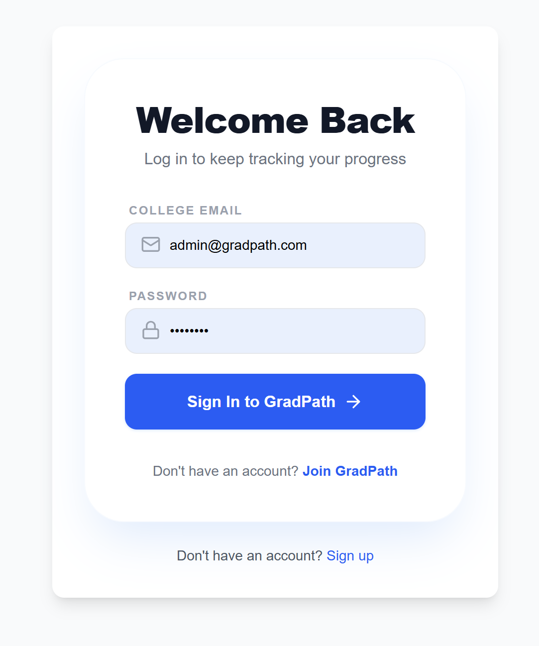
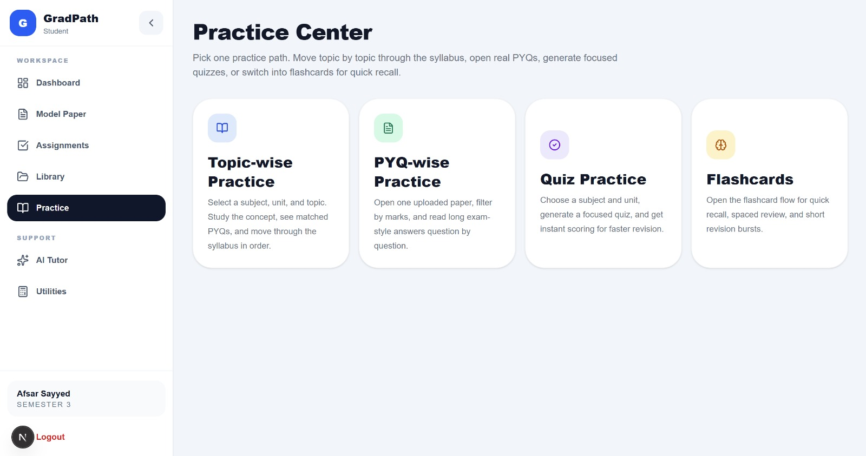
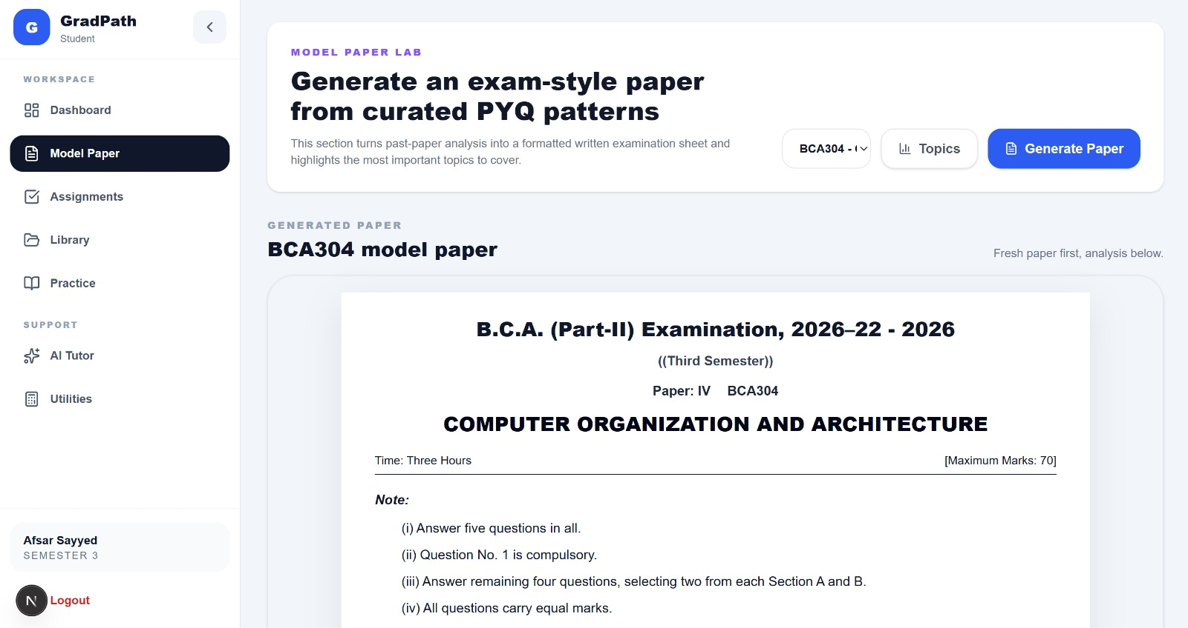
Application View
Implementation (Screenshots)
The implementation combines student-facing workflow screens with academic generation and practice support inside one consistent interface.
Login
Dashboard
Practice Center
Model Paper
GradPath | BCA Major Project Presentation
13/20

Slide 14
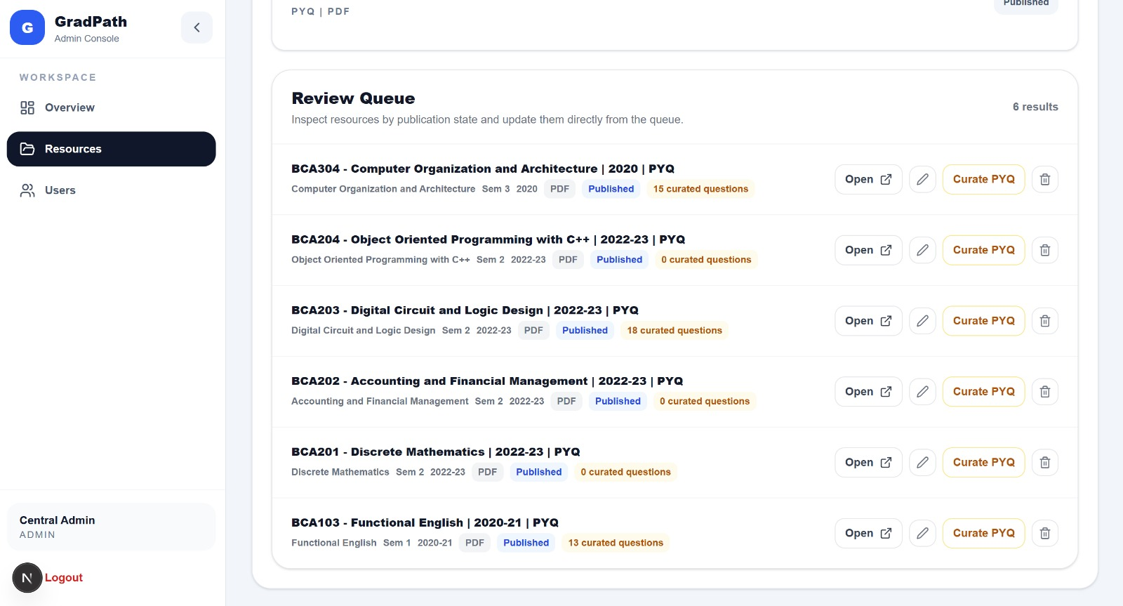
Outcome
Results / Output
The final build behaves as an integrated academic platform rather than a disconnected collection of pages, files, and reminders.
Generated Model Paper
Admin Resource Console
- One authenticated workspace for dashboard, study material, and practice
- Semester-wise organization of subjects, units, and PYQ resources
- AI-backed tutoring, quizzes, flashcards, and paper generation support
- Controlled admin workflow for resource upload, review, and visibility
GradPath | BCA Major Project Presentation
14/20

Slide 15
Value
Advantages Of Proposed System
GradPath improves academic coordination by turning scattered study activity into one guided digital workflow.
The key advantage is continuity: students can move from overview, to study material, to practice, to revision planning without changing tools or losing context.
1.
Centralized access to dashboard, resources, assignments, and results
2.
Better visibility of progress, pending tasks, and weak academic areas
3.
Faster revision using quizzes, flashcards, PYQs, and model papers
4.
Secure role-based workflow for both students and admins
5.
Extensible architecture for future mobile, analytics, and teacher features
GradPath | BCA Major Project Presentation
15/20

Slide 16
Current Constraints
Limitations
The current implementation is functional and extensible, but it still has clear boundaries that define the present project scope.
GradPath is focused on academic support for BCA students rather than a complete institutional LMS.
- AI features depend on internet access and Gemini API availability.
- The current build does not include attendance, fee handling, or exam enrollment workflows.
- Deep semantic indexing of uploaded PDF content is still limited in the present version.
- Mobile offline access, notifications, and teacher-side monitoring are not yet implemented.
These limitations do not weaken the project objective. Instead, they define the next logical expansion areas while keeping the current system academically relevant and technically manageable for a major-project scope.
GradPath | BCA Major Project Presentation
16/20

Slide 17
Roadmap
Future Scope
The project already has a modular base, so future work can grow the platform without redesigning its core structure.
01
Mobile app with push notifications and offline resource access
02
PDF text indexing and semantic search over uploaded notes
03
Teacher or guide dashboard for monitoring student progress
04
Automated timetable, reminder, and deadline notifications
05
Deeper analytics for PYQ trends and weak topics
06
Support for multiple departments and universities
GradPath | BCA Major Project Presentation
17/20

Slide 18
Close
Conclusion
GradPath successfully demonstrates the design and implementation of a modern academic command center for BCA students.
The platform brings together dashboard monitoring, assignments, academic resources, PYQ practice, AI tutoring, quizzes, flashcards, model papers, progress tracking, and result planning in one structured environment. It solves the core problem of scattered academic information by giving students one authenticated workspace for planning, study, and revision.
From a technical perspective, the project demonstrates full-stack development, secure APIs, database modeling, cloud integration, testing, and AI-assisted functionality in a way that is both practical and extensible.
GradPath | BCA Major Project Presentation
18/20

Slide 19
Sources
References
The presentation and project report were prepared using the following technical references and the local GradPath project source code.
1. Next.js Documentation
2. React Documentation
3. Express.js Documentation
4. MongoDB Documentation
5. Mongoose Documentation
6. Cloudinary Documentation
7. Google Gemini API Documentation
8. Tailwind CSS Documentation
9. JWT Introduction
10. Node.js Documentation
11. GradPath Local Project Source Code
GradPath | BCA Major Project Presentation
19/20

Slide 20
Thank You
Questions and suggestions are welcome.
Presented by
Mohammad Afsar | Ravi | Gaurav Yadav | Priyanshi
Major Project Presentation
Kailash Institute of Management, GIDA, Gorakhpur

