Slide 1
IMDB movie assignment
Prepared By:
Mohammad Aftab Alam

Slide 2
About IMDB movie assignment
You have the data for the 100 top-rated movies from the past decade along with various pieces of information about the movie, its actors, and the voters who have rated these movies online. In this assignment, you will find some interesting insights into these movies and their voters, using Python Language, Jupyter Notebook (you can use other but I used Jupyter Notebook as it is easy to operate.),Various Python Libraries (Like Matplotlib, Pandas, Numpy, Seaborn)
This is a compulsory individual assignment wherein you will download a movie dataset, check my Python code to explore the data, gain insights into the movies, actors, votes, ratings and collections, and submit the code.
Where do I get the data from?
You can download the movie dataset which is named as “Movie+Assignment+Data.csv”.
How do I check the code?
Download the “IMDb+Movie+Assignment.ipynb” file and keep this file in the download folder and after that open it in Jupyter Notebook. It is a commented Jupyter Notebook file in which all the instructions and tasks which are performed by me are mentioned.

Slide 3
Some tips before starting the assignment:-
1. Go through the data dictionary thoroughly before starting with the assignment. It will give you a good sense of what all the columns represent which is a good practice to follow before proceeding with the analysis.
2. Always keep inspecting your data frame after you have performed a particular set of operations.
3. Always run the cells of the notebook sequentially/restart the kernel and run all the cells to avoid runtime error.
4. There are some checkpoints given in the Jupyter Notebook provided. They're just useful pieces of information you can use to check if the result you have obtained after performing a particular task is correct or not.

Slide 4
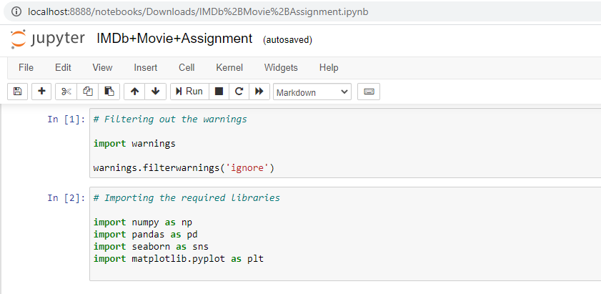
Import Required Libraries and Warnings

Slide 5
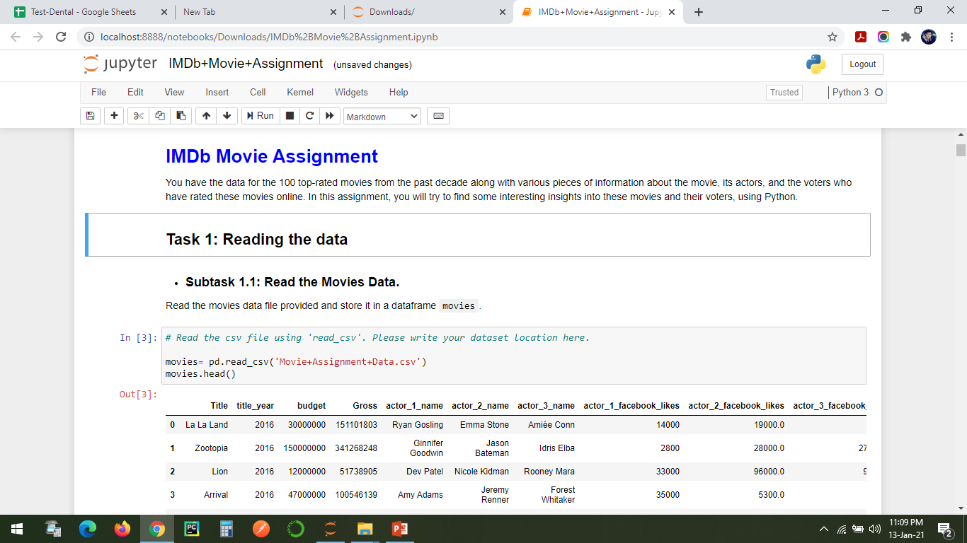
Import And Read the CSV Files

Slide 6
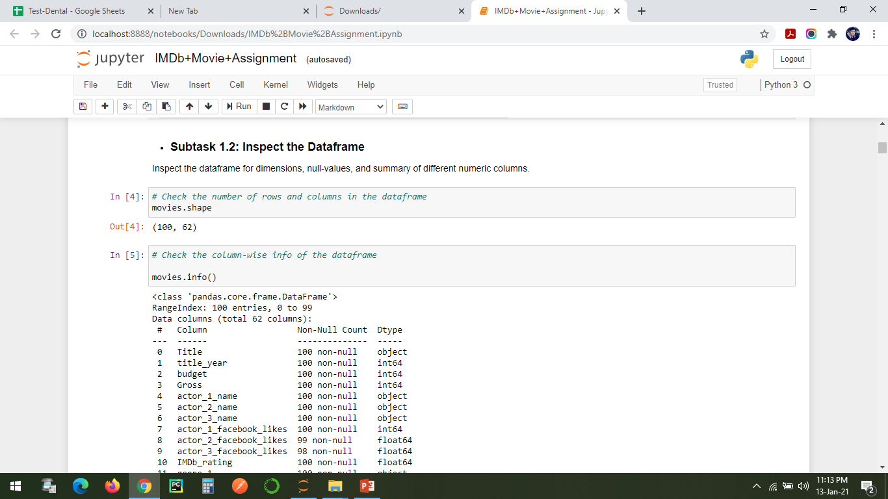
Structure of the Data

Slide 7
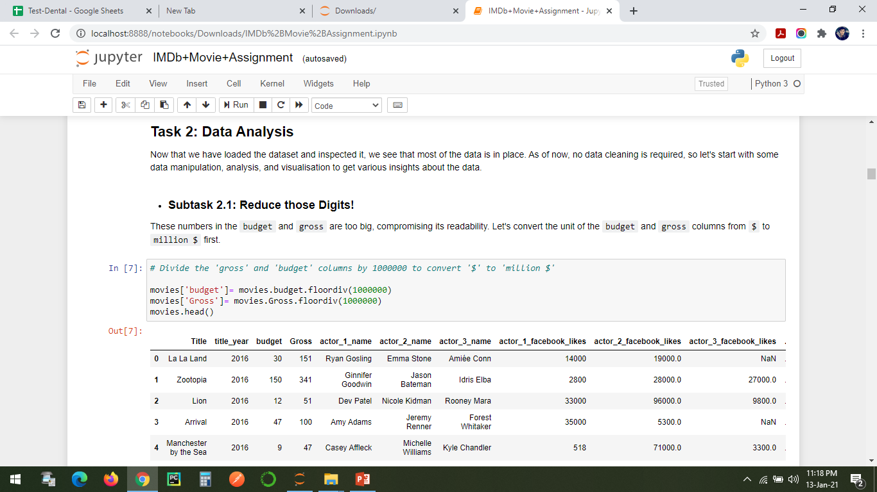
Data Analysis

Slide 8
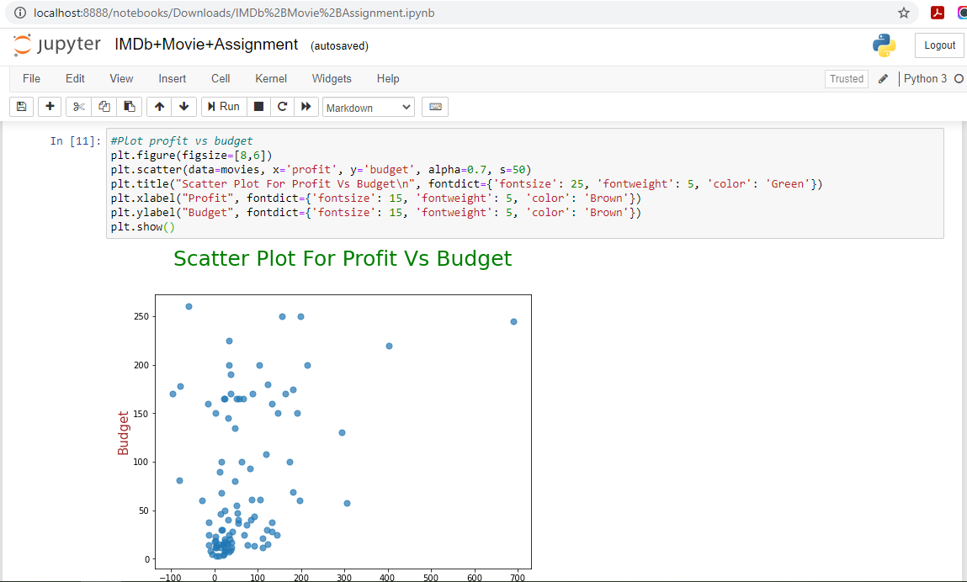
Scatter Plot For Profit Vs Budget

Slide 9
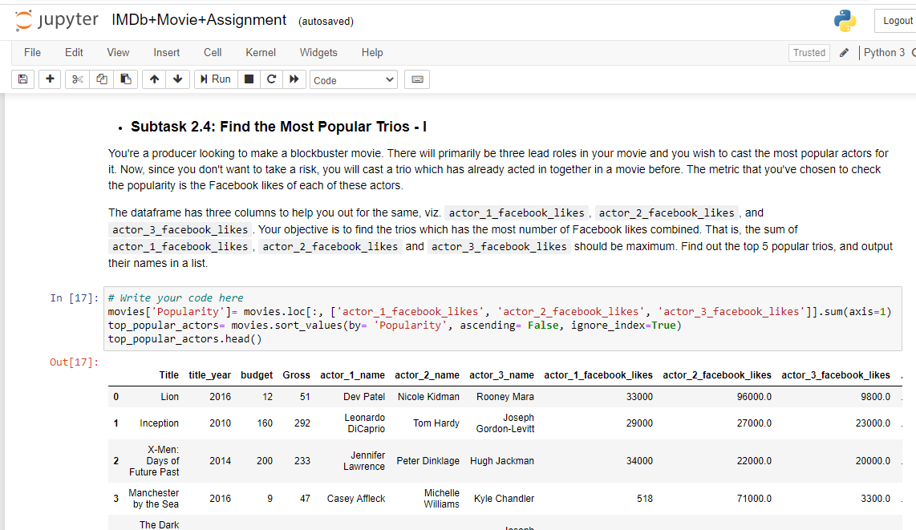
The Most Popular Trios - I

Slide 10
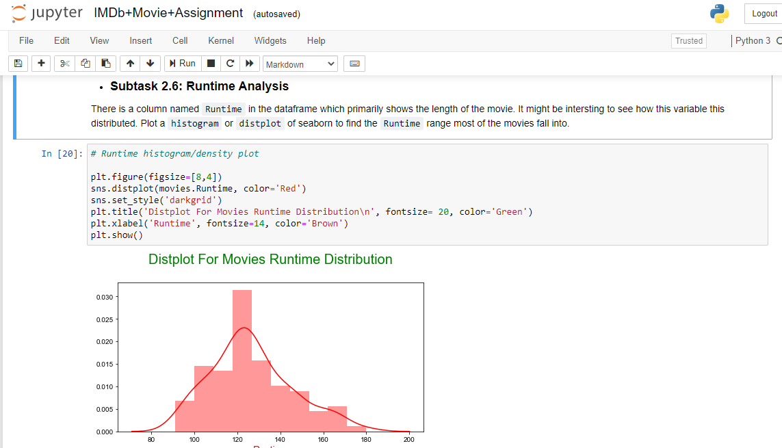
Runtime Analysis

Slide 11
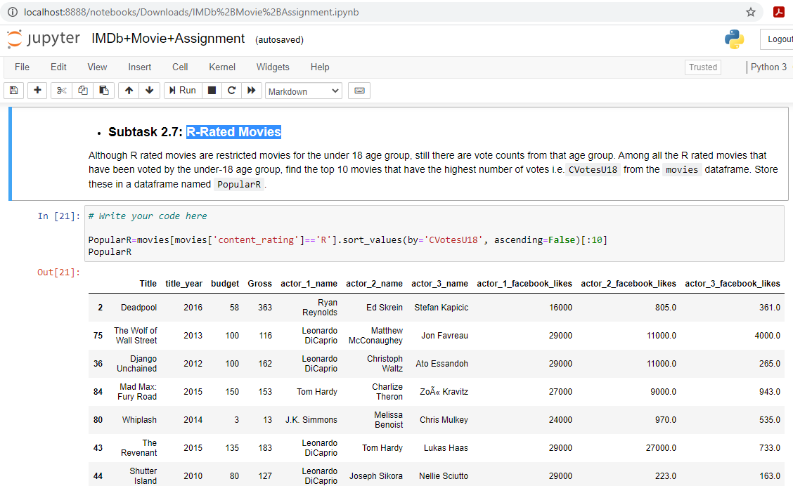
R-Rated Movies

Slide 12
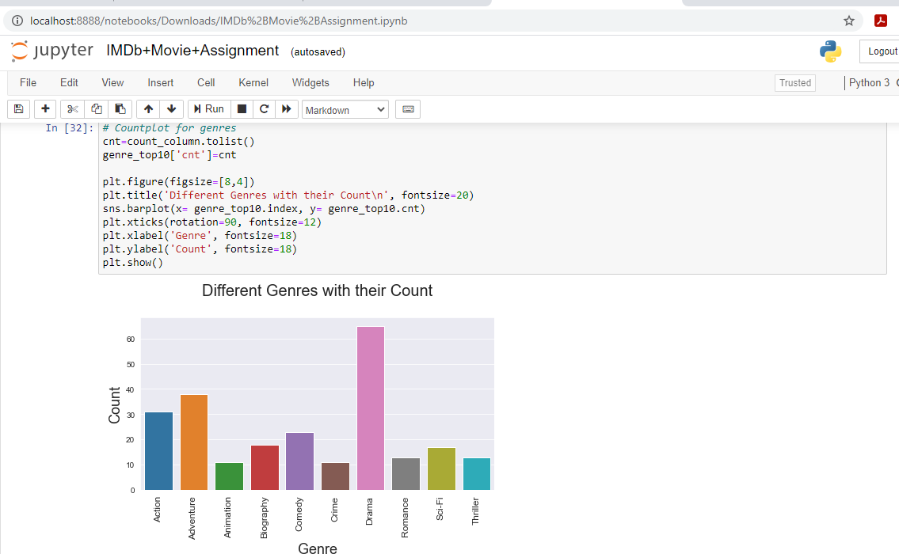
Genre Counts!

Slide 13
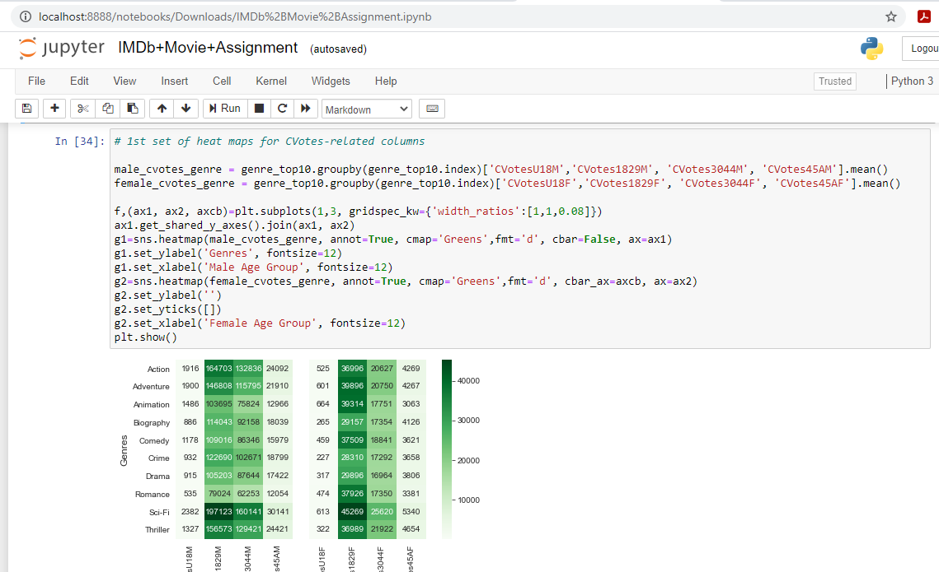
Gender and Genre
1st set of heat maps for CVotes-related columns

Slide 14
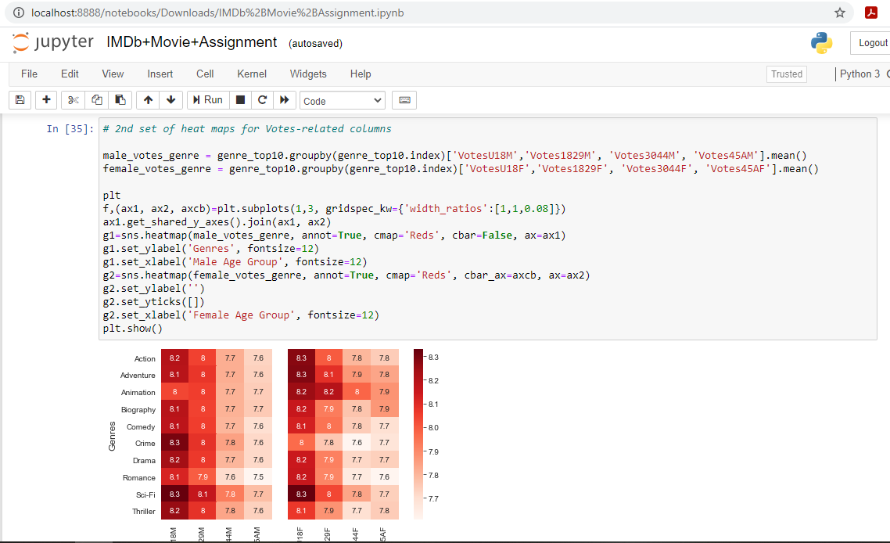
2nd set of heat maps for Votes-related columns

Slide 15
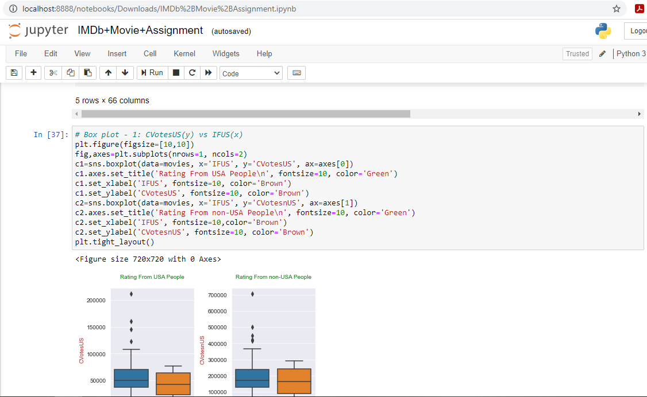
Box plot - 1: CVotesUS (y) vs IFUS (x)

Slide 16
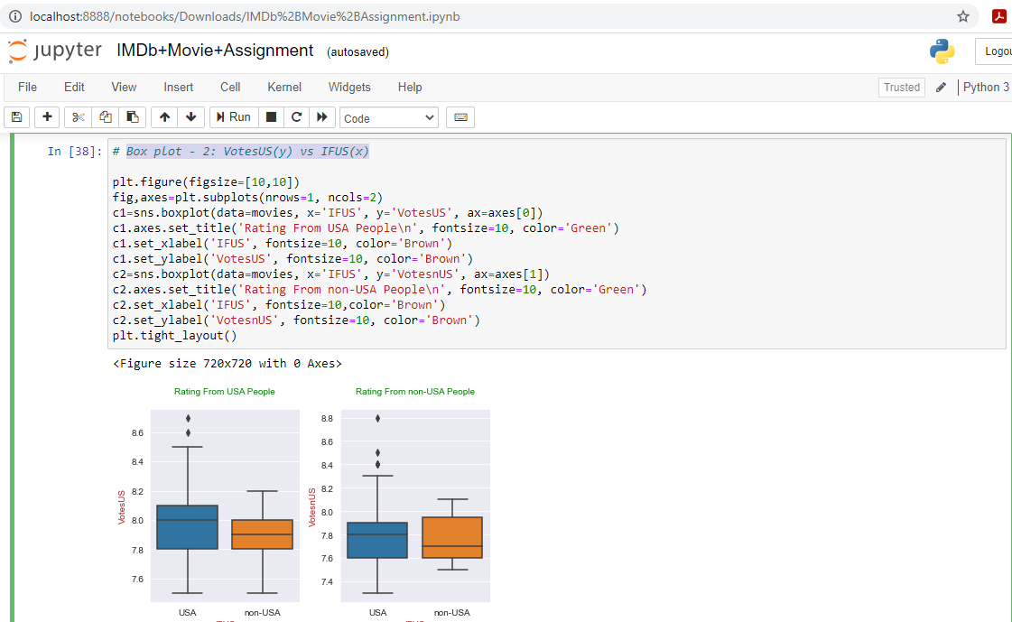
Box plot - 2: VotesUS (y) vs IFUS (x)

Slide 17
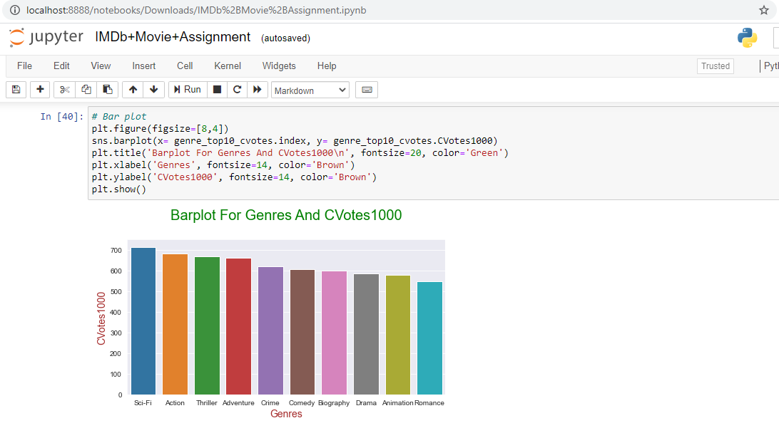
Barplot For Genres And CVotes1000

Slide 18
Thanks

