Slide 1
Poisson Rouge
Maria Dahman
HCI 450
November, 2011
Assignment 4
A Children’s Website

Slide 2
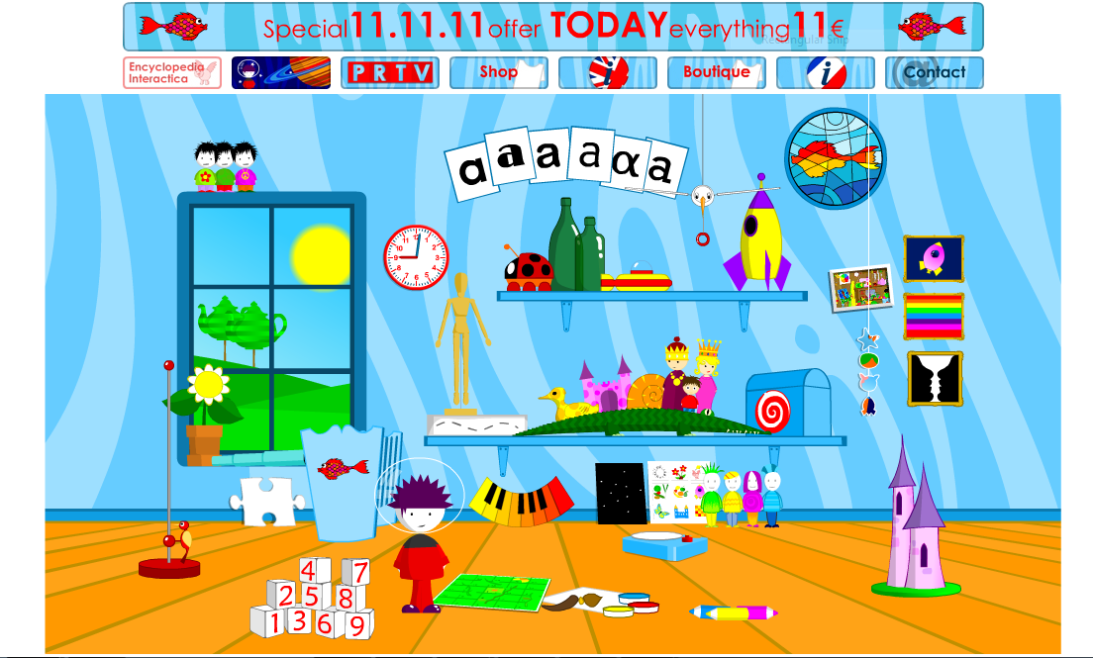
PoissonRouge.com Home Page
Notes:
PoissonRouge.com is an interactive website aimed at children. The site hosts games, puzzles and art/creative spaces, and it has especial appeal to children who are pre-literate (ages 2-6). As the discussion in the information tab on the site explains, even children who can read, often don’t read instructions on websites, so the makers of the site have purposefully worked to make the interface simple and intuitive. In addition to being intuitive, they strive to make it flexible. To quote from the site:
When small children pick up objects, they invent new ways of holding and using them. Thus there is no right or wrong way of using anything on this site. It's up to the children to find what they want and to grow their naturally exploring mind. We found that what they don't discover straight away, they'll find later, what they don't know how to do at first, they'll learn when they are ready and, as many of you know and/or have found out, that is extremely powerful and confidence building. [7]
[7] Poisson Rouge (2011). User Guide. Retrieved 11/15/11 from http://www.poissonrouge.com/bigfish/en/userguide.html

Slide 3
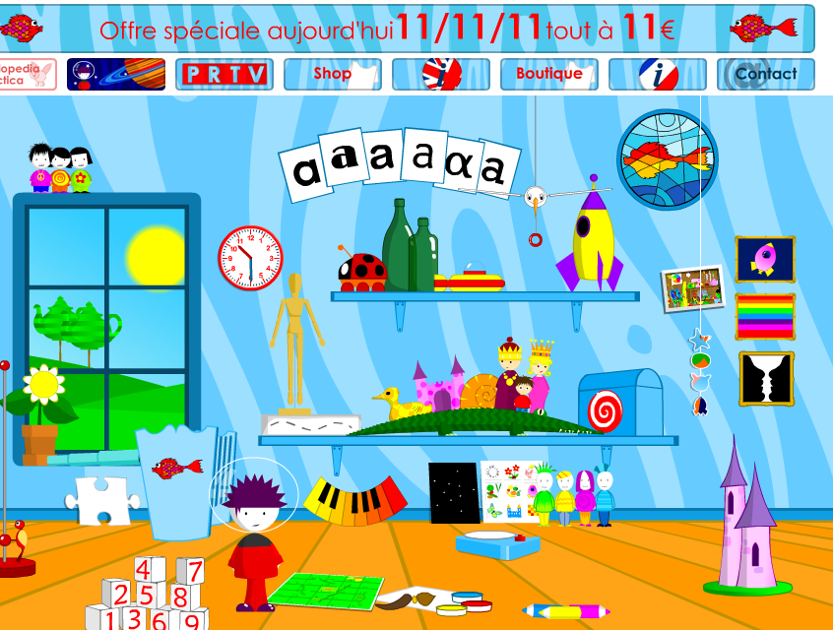

Strength Guideline: When designing for pre-operational children, allow children to move objects physically with the mouse.
Notes:
This is the home screen of the site, where children can select their desired application. Most objects on the main screen are a link, though a couple (including the one I’ve circled in red) are merely for manipulation with the mouse.
It is useful to allow children in the 2-6 year age range to physically move objects with the mouse. Pre-operational children require visual feed back, such as an object moving across the screen. Because of their stage of cognitive development, they need to see operations visually to understand them [2, 8]. For example, while a 2-6 year old child might be able physically to line up a row of toy cars in order of size, he would be unable to do such an operation mentally. (This is a general statement of development, as it is known that individual children develop at different rates [2, 8].)
The guideline is illustrated in the above screen, and is a strength of the site. In this instance, I have pulled the toy bird down by its string in a click-and-drag style interaction, moving it across the screen.
[2] Gelderblom, H., Kotze, P. (2008, October). Designing Technology for Young Children: What we can Learn from Theories of Cognitive Development. ACM, 68-75.
[8] Purchase, H., Wyeth, P. (2003). Using Developmental Theories to Inform the Design of Technology for Children. ACM.

Slide 4
Strength Guideline: Allow children to go directly to their favorite parts of an application.
Notes:
As stated in the previous slide, most of the objects on the home page of the website are a clickable link to a different game. The child can go to a favorite game with a single click. Children often discover aspects of a system that they especially enjoy, and will want to get to that part easily to play it repeatedly [3]. By allowing easy access to favorite applications, the website reduces frustration of the users and enhances the user experience.
[3] Gelderblom, H., Kotze, P. (2009, July). Ten Design Lessons from the Literature on Child Development and Children’s Use of Technology. ACM, 52-60.

Slide 5
Strength Guideline: Create a target audience that is narrow in age range.
Notes:
Poisson Rouge is enjoyable for many ages, but is designed for children who have the dexterity to operate a mouse (about age 2 or 3) to pre-readers (about age 6). In wide brush strokes, these are the “pre-operational” years, where children’s cognitive development is such that they require visual feedback, and are not as capable of merely mental operations [2, 8]. By designing a web page with a narrow age range, the makers of the site are able to support the cognitive development of that specific age group. In this case, the icons, layout and games support the learning style and interaction style of preschoolers.
The importance of a narrower age range was highlighted in a study in 2005, where sites which claimed to be helpful for grades K-12 were really only helpful for the older children [5].
[2] Gelderblom, H., Kotze, P. (2008, October). Designing Technology for Young Children: What we can Learn from Theories of Cognitive Development. ACM, 68-75.
[5] Naidu, S. (2005, July). Evaluating the Usability of Educational Websites for Children. Usability News. Retrieved 10/08/11 from http://www.surl.org/usabilitynews/72/pdf/Usability%20News%2072%20-%20Naidu.pdf
[8] Purchase, H., Wyeth, P. (2003). Using Developmental Theories to Inform the Design of Technology for Children. ACM.

Slide 6
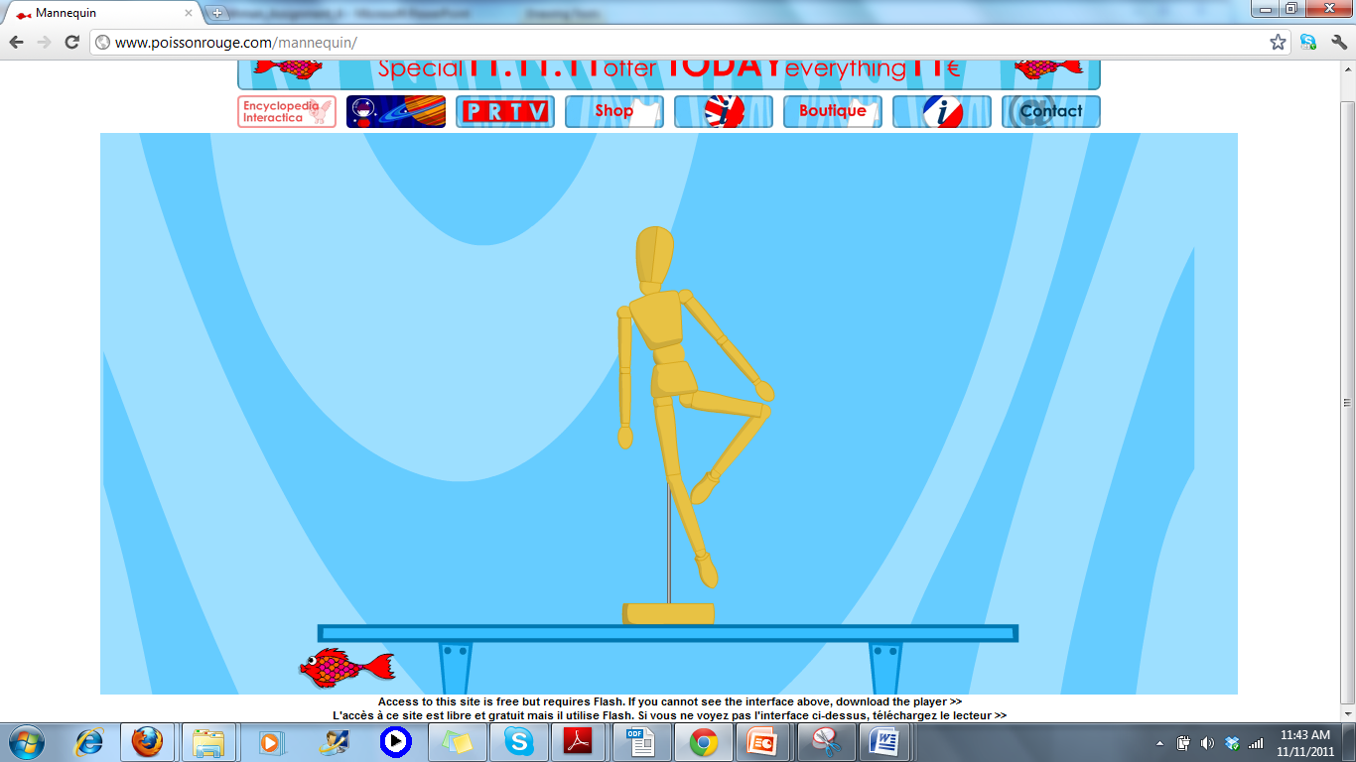
Weakness Guideline: Avoid drag-and-drop interaction styles for children; point-and-click is preferred.
Notes:
As I mentioned, I pulled the toy bird on the home page down by its string in a click-and-drag style interaction. Many of the games on the site depend on this interaction style. Another example is the wooden model game (circled in red), where the user manipulates the model into different poses using the click-and-drag interaction.
While the strength of this interaction is that children can move objects physically with the mouse, so that they have visual feedback, the draw-back is that click-and-drag requires a dexterity and finger-strength that children don’t have, especially pre-school children [3, 4]. While one might argue that this is of pedagogical use—after all, the children eventually will have to learn drag-and-drop, right?—a potential alternative is point-click-point-click-click. While arguably not as efficient, three clicks (select object, select object path, initiate move) is easier for children in terms of muscle development, and still allows them to watch the object move [3].
[3] Gelderblom, H., Kotze, P. (2009, July). Ten Design Lessons from the Literature on Child Development and Children’s Use of Technology. ACM, 52-60.
[4] Girard, S., Johnson, H. (2009). Educational software for children: analysis of interaction techniques for direct manipulation. Proceedings of the 21st International Conference on Association Francophone d'Interaction Homme-Machine. pp 259-262.

Slide 7
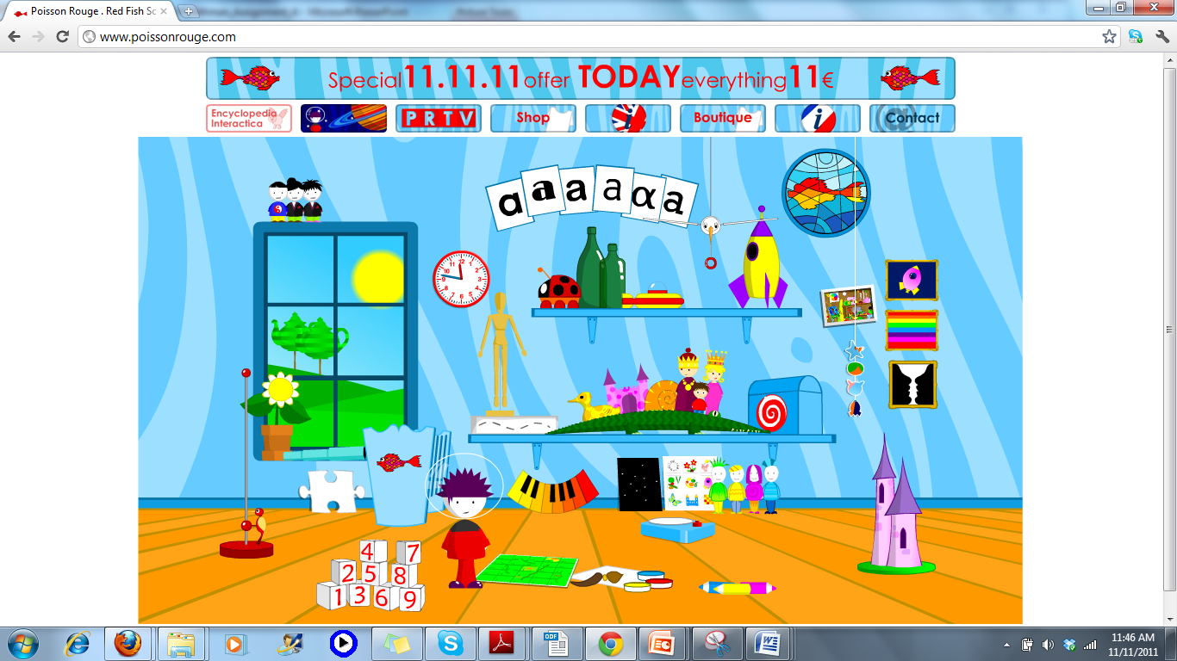
Strength Guideline: Do not require children to scroll for information; keep pages short.
Notes:
This screen shot shows the home page in the entire browser window, and, as seen, neither this nor any of the other pages require users to scroll. (This is also the view from a laptop screen, which is shorter than a standard screen, so the makers have clearly taken different use cases into consideration.)
In a 2005 study, even when children were reminded that they may scroll to find information on the site, they almost never did [5]. By keeping all information “above the fold,” children can access all of the applications and information without frustration or error.
[5] Naidu, S. (2005, July). Evaluating the Usability of Educational Websites for Children. Usability News. Retrieved 10/08/11 from http://www.surl.org/usabilitynews/72/pdf/Usability%20News%2072%20-%20Naidu.pdf

Slide 8
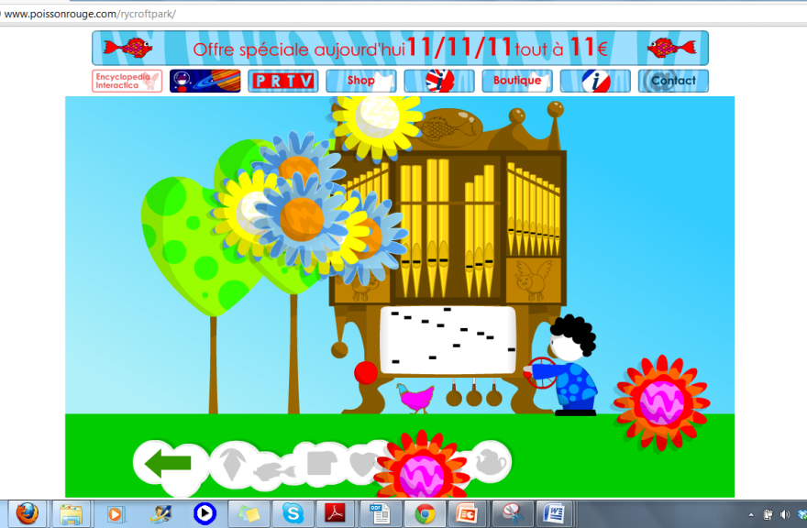
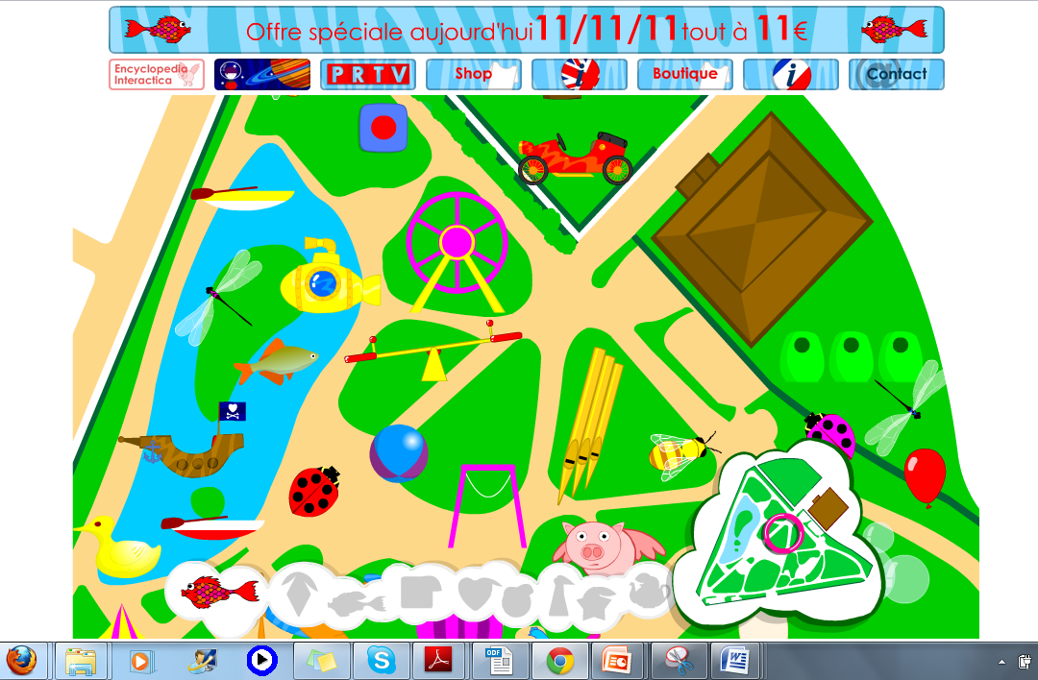
Strength Guideline: Keep depth of pages shallow. Do not require children to go more than two or three pages away from the home page.
Notes:
Pictured here is the furthest path that a child would have to travel to get to a game. The picture window (circled in red) leads to the outdoor park, which leads to multiple games. The pipe organ game (circled) was selected from the park.
Keeping the depth of pages shallow helps to ensure that children do not get lost when navigating the site. If children have to go too far from the home page for information, as Naidu pointed out in a 2005 study, they are much more likely to get lost or frustrated [5]. They are not as familiar with the idea of a “fast path” that leads them directly back to the home page, so often will navigate with the back button.
[5] Naidu, S. (2005, July). Evaluating the Usability of Educational Websites for Children. Usability News. Retrieved 10/08/11 from http://www.surl.org/usabilitynews/72/pdf/Usability%20News%2072%20-%20Naidu.pdf

Slide 9
Strength Guideline: Use stationary advertisements on sites for children. Do not use pop-up or blinking ads.
Notes:
PoissonRouge has ads and information at the top, but they are consistent and stationary, and if a child would accidentally select it, he could easily return to the home page. When the ads are too good at attention capture, the children become distracted and accidentally navigate away from the page. Children also have difficulty with the fine dexterity required to close a pop-up window, and often miss the small “x” that closes the pop-up window, thereby inadvertently navigating to another site [5].
As stated in the information page of the site, all of the Poisson Rouge ads are internal, meaning the site does not accept ads from outside sources (it’s largely supported by donations). This allows the makers of the site to keep the ads small, consistent and subtle.
The “shop” and “boutique” links on the top of the page are the same, except that one is in English and the second is in French. The ad that specifies everything is 11 Euros at the top of the screen is stationary and not blinking. A child would not mistakenly click on it, believing it to be a game, though if he did, he would remain on the poissonrouge.com site, since they are internal ads.
[5] Naidu, S. (2005, July). Evaluating the Usability of Educational Websites for Children. Usability News. Retrieved 10/08/11 from http://www.surl.org/usabilitynews/72/pdf/Usability%20News%2072%20-%20Naidu.pdf

Slide 10
Strength Guideline: Use simple and expressive words, typically of Germanic rather than Latinate origin, to describe menu items.
Notes:
This is the pipe organ game, from the park, which is selected from the picture window (see slide 8). As it is two clicks from the home page, it is the furthest depth a child would travel on the site, and so is the most important to be able to navigate back from. The menu and navigation is clear, expressive and simple.
Children choose menu and navigation items that are simple, descriptive, and are words (or images) that they understand [5]. Shop, Contact, and ‘Back Arrow’ are the menu and navigation items I have circled in red. They are each simple and straightforward. Since this is a bilingual site, the designers have even able to do this with the redundancy necessary for two languages. (“Shop” for English or “Boutique” for French; “i” (information) on a British flag for English, or a French flag for French.)
In the cited study by Naidu, children had problems with words of Latin origin, like “Biography” or “Almanac,” but easily understand words of Germanic origin, such as “Word Wise.” In the case of PoissonRouge, they have used the Germanic “Shop” instead of the Latinate “Purchase.” For English speakers, words of Germanic origin tend to be more expressive and direct. There are some exceptions, however. “Contact” is of Latin origin, but the Germanic option of “Call” is more ambiguous, and “Contact” has become the conventional word for a website’s contact information.
Since the audience for the website is pre-reading age, the menu/navigation icons must be especially clear, which PoissonRouge has done. The game that the child might want is clearly represented by a graphic from the game, and the graphics are consistently represented in the same place on the home screen. There is clear, simple navigation through descriptive icons, such as a large back arrow in the lower left corner, which reduces frustration and increases efficiency.
[5] Naidu, S. (2005, July). Evaluating the Usability of Educational Websites for Children. Usability News. Retrieved 10/08/11 from http://www.surl.org/usabilitynews/72/pdf/Usability%20News%2072%20-%20Naidu.pdf

Slide 11
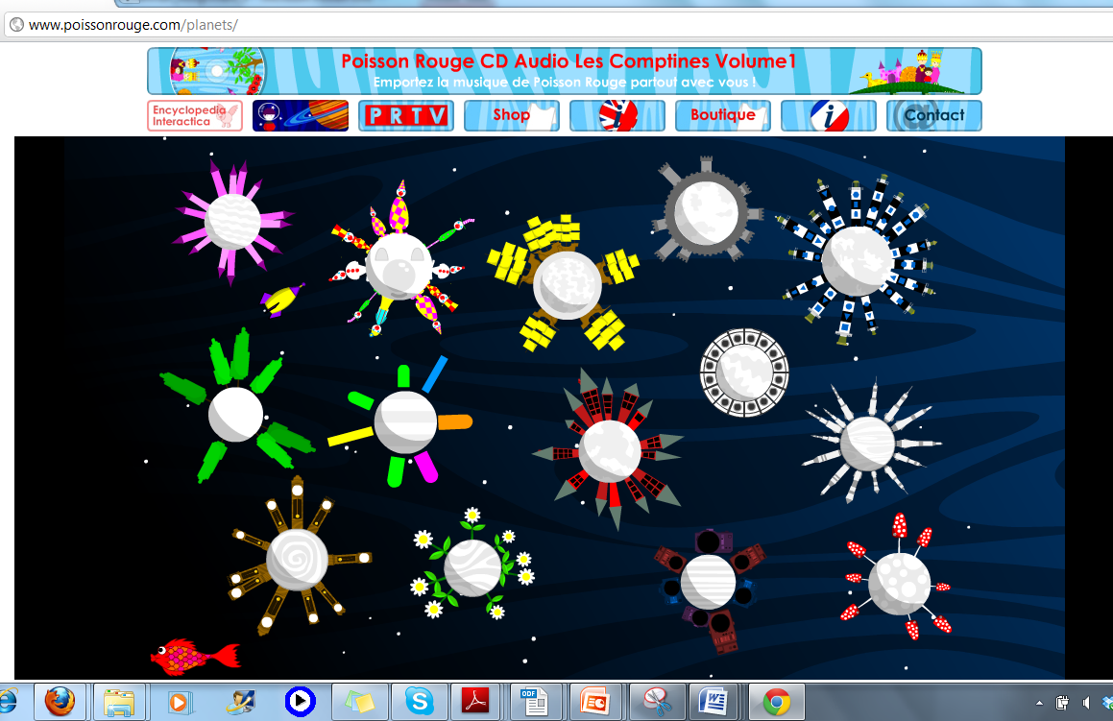
Strength Guideline: Keep location and layout information consistent.
Notes:
Shown here is the home page (left) with two different paths—the picture window (lower right) and the rocket ship (upper right). I’ve selected these two games--different in content, graphics, and feel-- to illustrate the consistency of the site.
As the 1971 study by Noton and Stark study describes, users tend to look in the same places when presented with the same picture multiple times. This implies that if the location and layout information remains constant, users will become more efficient in using the site [6]. As the screens above show, each of the games which users might select has consistent navigation back to the home page by way of the red fish in the lower left hand corner (circled in yellow). The menu bar at the top is the same for every page and game. Additionally, the home page remains consistent. Users will always find the same game in the same location.
When location and layout are consistent, users are more easily able to find the information they are after. This is especially the case with non-literate users, who rely on graphical (or audio) cues for information. By keeping game icons consistent and in a consistent location on the main page, users can easily access their desired applications.
[6] Noton, D., & Stark, L. (1971). Scanpaths in eye movements during pattern perception. Science, 171, 308‐311.

Slide 12
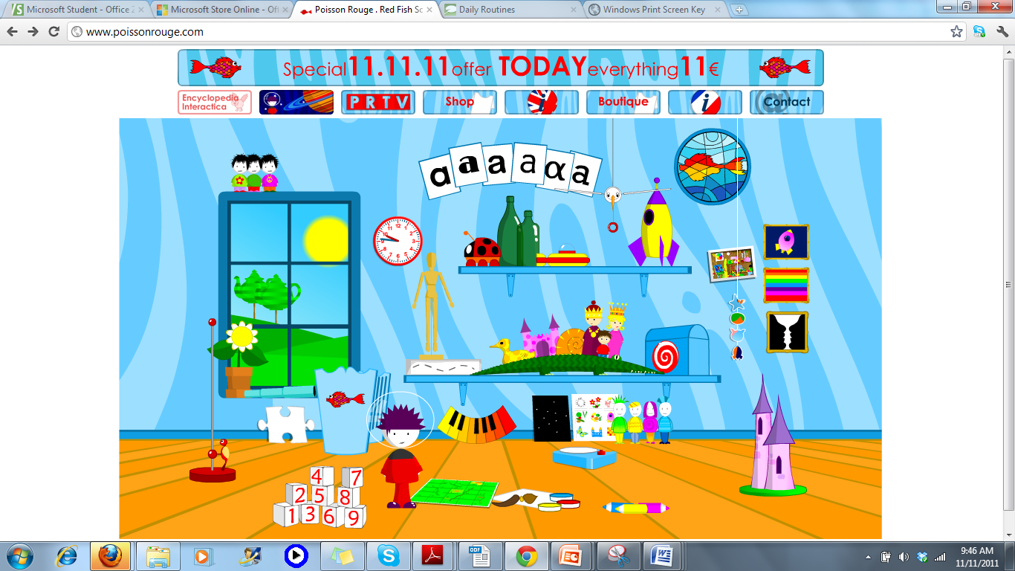
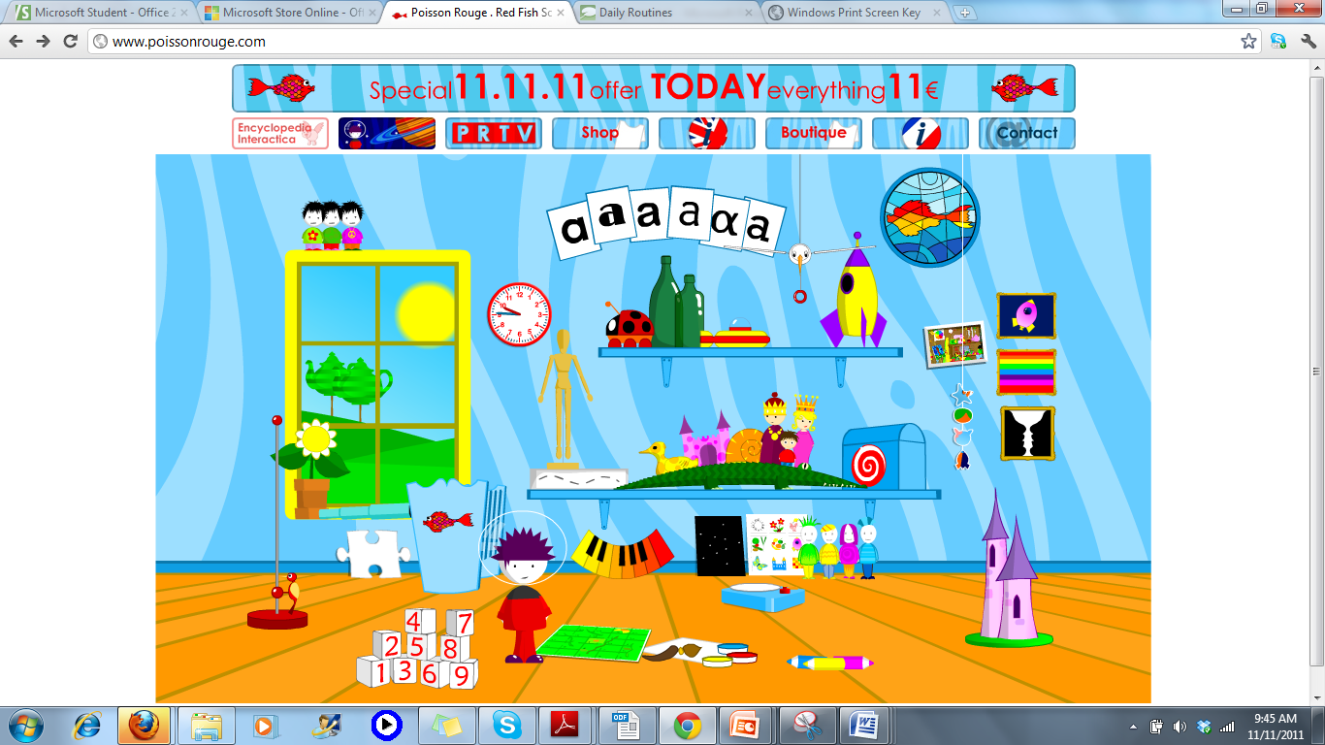
Strength Guideline: Content of a menu item needs to be evident without roll-overs.
Notes:
In this slide, I have rolled my cursor over the picture window on the home page, which turns it from blue to yellow. However, the content of menu items need to be evident without roll-overs, as a 2003 study by Chen, Anderson and Sohn indicates that the mouse movement follows after the eye moves [1]. So, a child would look at the picture window, and then move his cursor toward it.
Roll-overs are especially tricky in creating interfaces for young children, because, while a designer wants to provide feedback, at the pre-operational cognitive stage, children might see the change as an entirely different application, rather than simply a selected or changed application. Therefore, the changes that a roll-over produces should be subtle, or, in the common parlance, a “just-noticeable difference.”
Fortunately, the items on this page make sense without roll-overs. Once the child understands the basic idea that everything he clicks is a game, and that the objects in the game relate to an icon on the home page, he can navigate easily. The designers have been clever in their use of a representative toy or object to indicate each game. In the case of the picture window, it over-looks the park, and a child will make the association. In other cases, the icons relate more directly, as in the case of the wooden model, which takes the user to the wooden model game (see slide 6).
[1] Chen, M., Anderson, J. R., Sohn, M. (2003). Eye‐hand coordinatin during web browsing. In J. Ratner (Ed.), Human factors and web development (Second ed.). Mahwah, NJ: Erlbaum.

Slide 13
References
[1] Chen, M., Anderson, J. R., Sohn, M. (2003). Eye‐hand coordinatin during web browsing. In J. Ratner (Ed.), Human factors and web development (Second ed.). Mahwah, NJ: Erlbaum.
[2] Gelderblom, H., Kotze, P. (2008, October). Designing Technology for Young Children: What we can Learn from Theories of Cognitive Development. ACM, 66-75.
[3] Gelderblom, H., Kotze, P. (2009, July). Ten Design Lessons from the Literature on Child Development and Children’s Use of Technology. ACM, 52-60.
[4] Girard, S., Johnson, H. (2009). Educational software for children: analysis of interaction techniques for direct manipulation. Proceedings of the 21st International Conference on Association Francophone d'Interaction Homme-Machine. pp 259-262.
[5] Naidu, S. (2005, July). Evaluating the Usability of Educational Websites for Children. Usability News. Retrieved 10/08/11 from http://www.surl.org/usabilitynews/72/pdf/Usability%20News%2072%20-%20Naidu.pdf
[6] Noton, D., & Stark, L. (1971). Scanpaths in eye movements during pattern perception. Science, 171, 308‐311.
[7] Poisson Rouge (2011). User Guide. Retrieved 11/15/11 from http://www.poissonrouge.com/bigfish/en/userguide.html
[8]Purchase, H., Wyeth, P. (2003). Using Developmental Theories to Inform the Design of Technology for Children. ACM.

