Slide 1
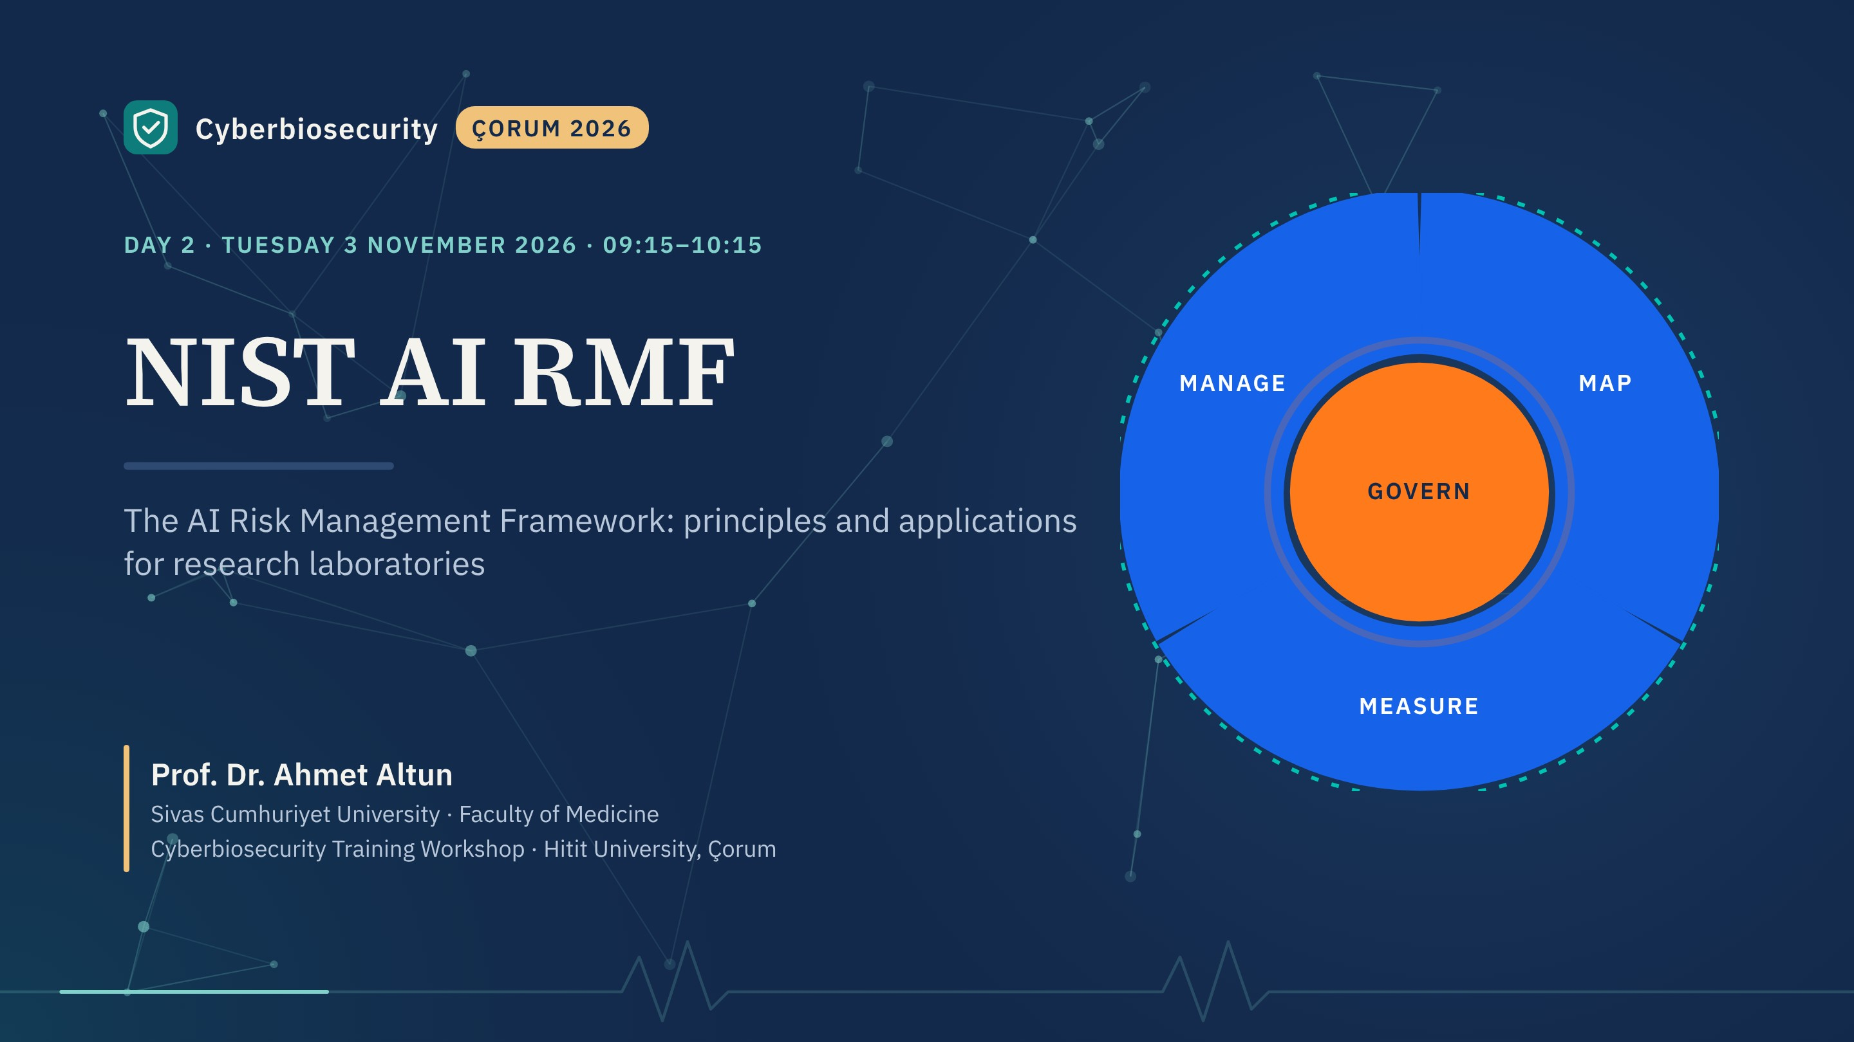
Notes:
Good morning. Yesterday we built a shared language for cyber risk. This morning we do the same for a newer kind of risk: AI systems that are now part of research workflows.
Plan: one hard example, why AI risk is different, the AI RMF itself (trustworthiness and the four functions), the Generative AI profile, AI as an attack target, and a worked laboratory case.

Slide 2
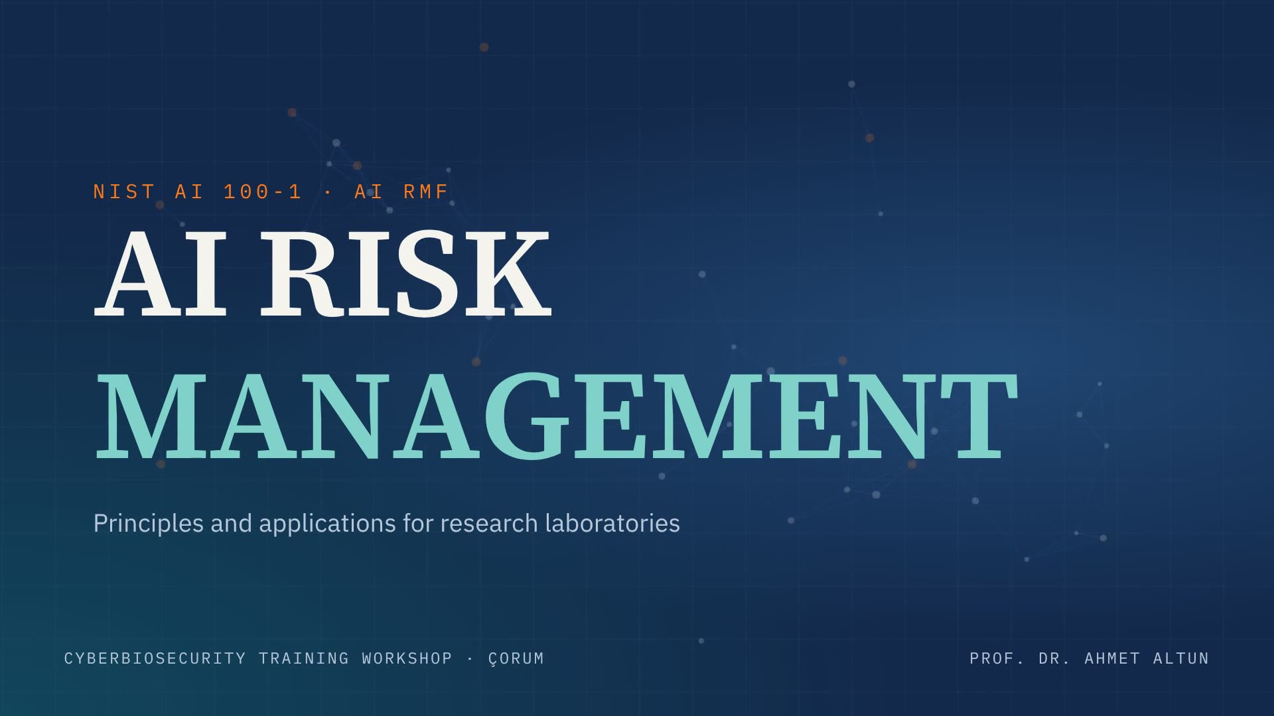
Notes:
Opening film, about 13 seconds; it loops while shown. Advance when it reaches the title card.

Slide 3
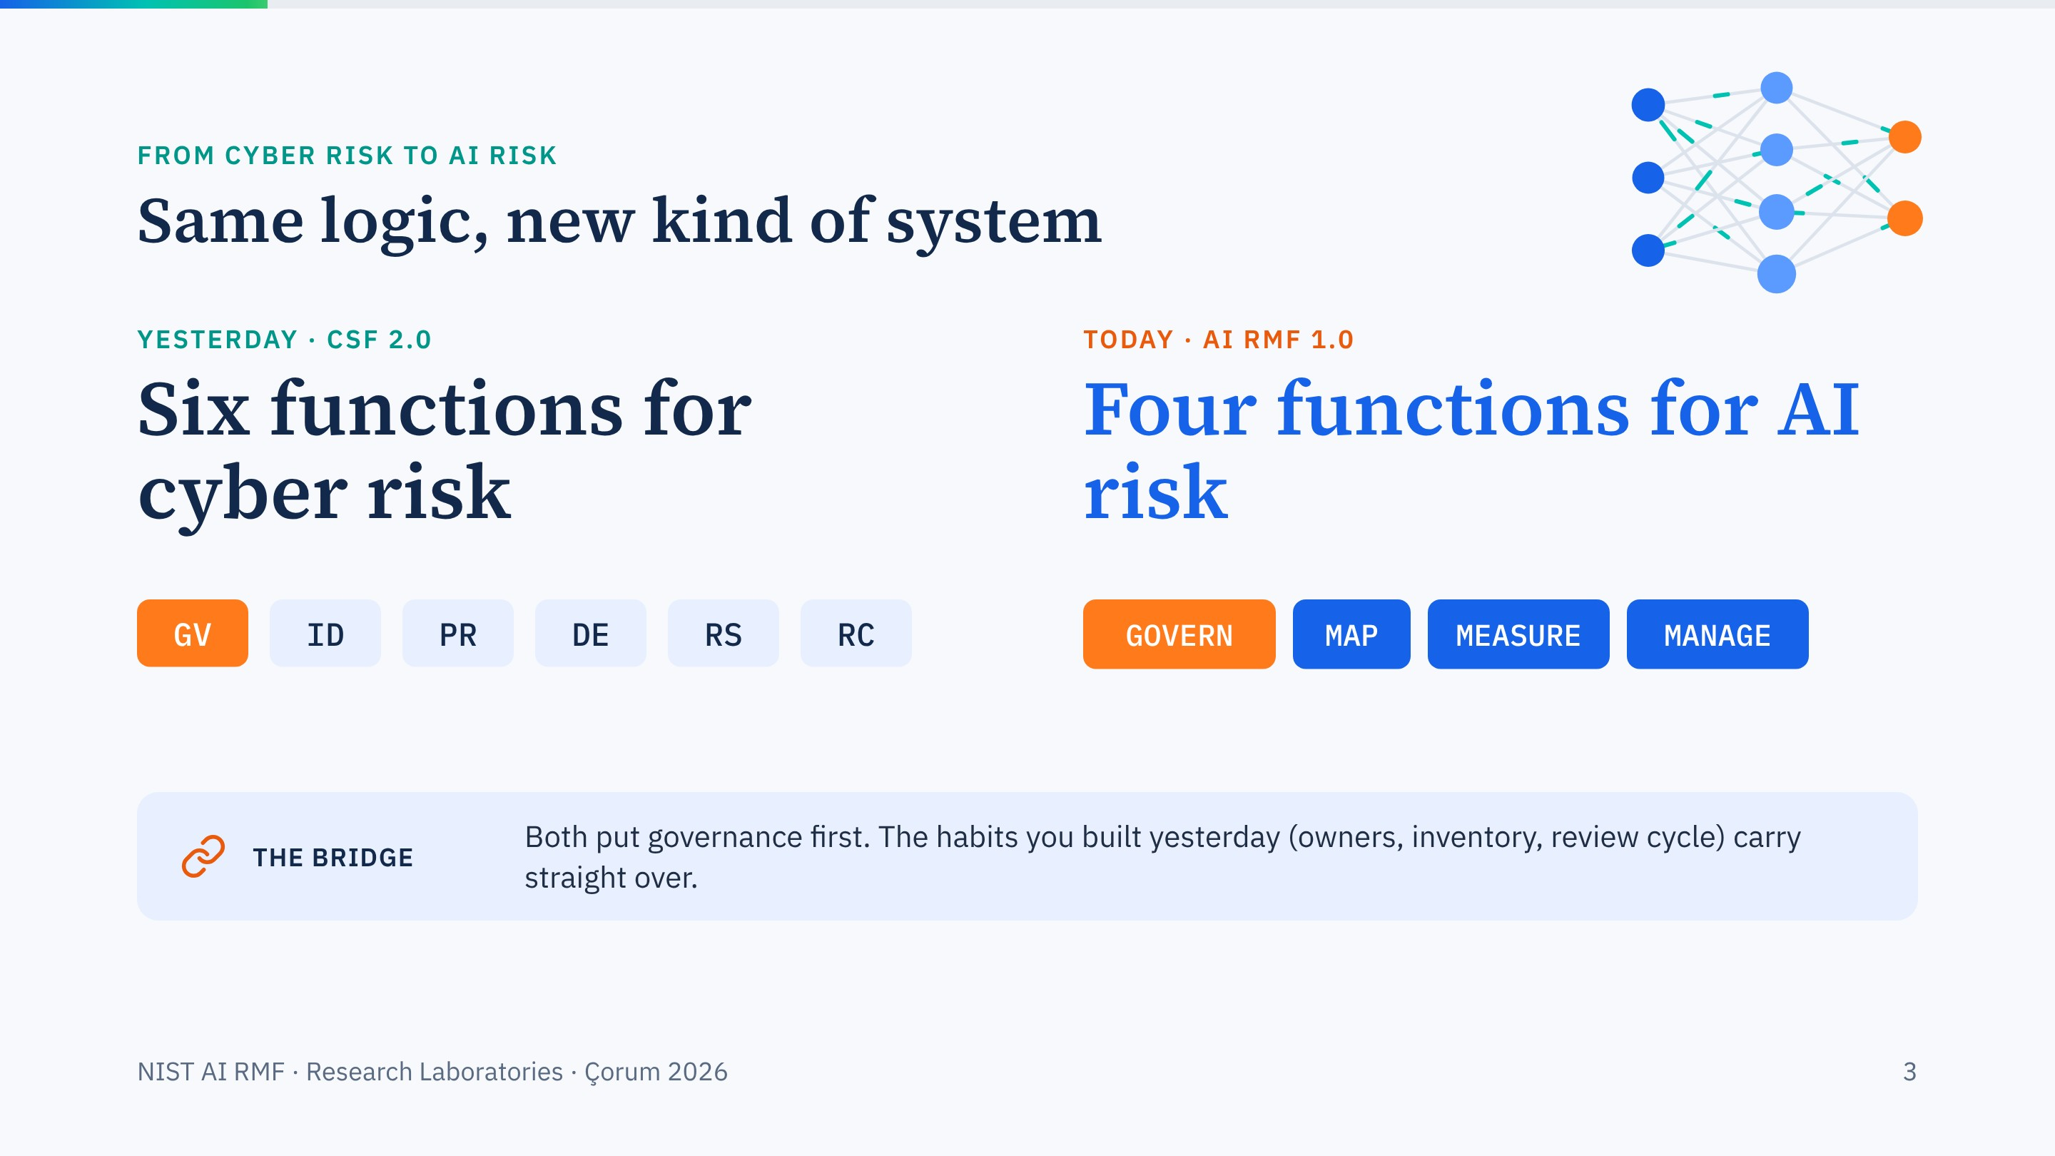
Notes:
A deliberate bridge. Both NIST frameworks start from governance. If a lab has done the CSF work, it already has the owners, the inventory habit and the review cycle that AI risk management needs.

Slide 4
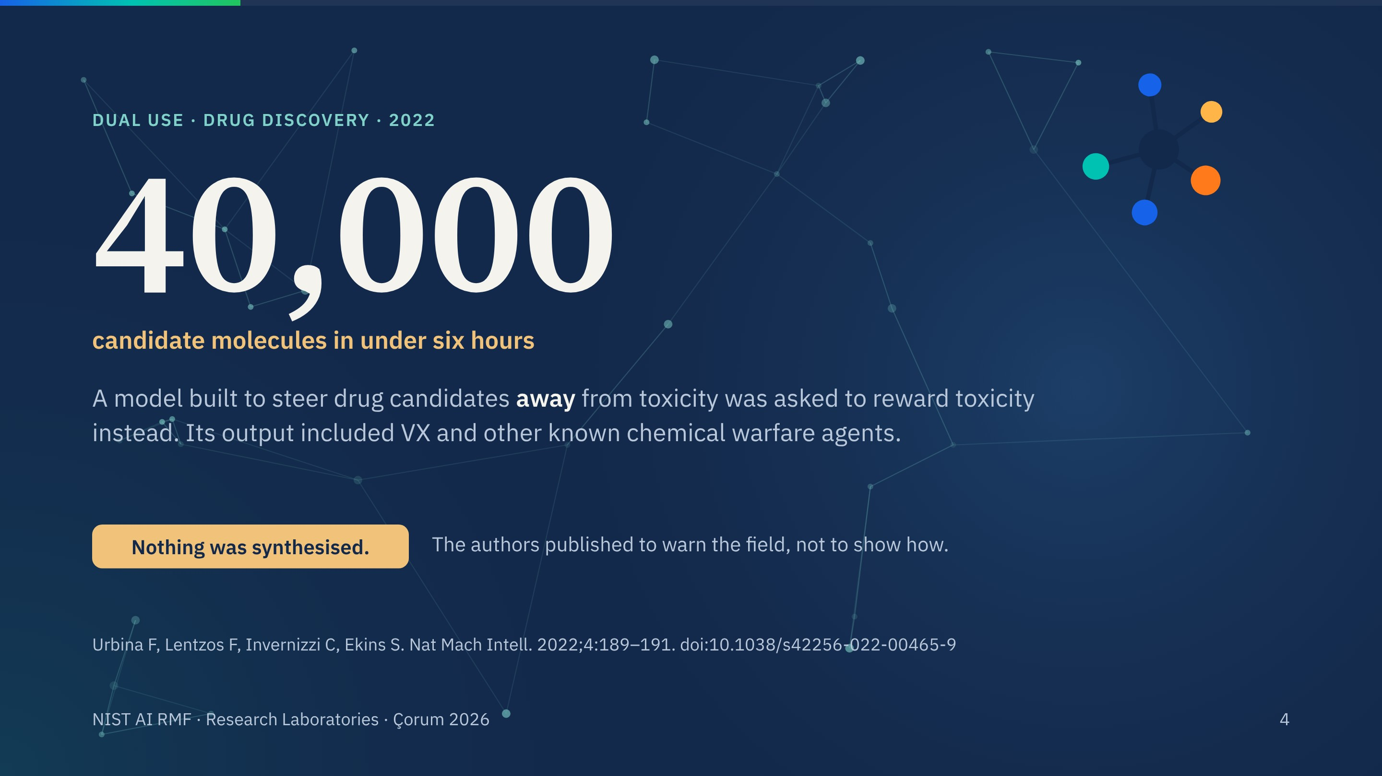
Notes:
Urbina and colleagues, 2022. Their company builds machine-learning models that predict toxicity so that drug candidates avoid it. For a biosecurity conference they inverted one objective. In under six hours the model proposed 40,000 molecules scoring as highly toxic, including VX.
They synthesised nothing, and they deliberately withheld details. The lesson for us is not about chemistry: a capability built for good can be repurposed by changing one line, and nobody in the lab had thought about it before.

Slide 5
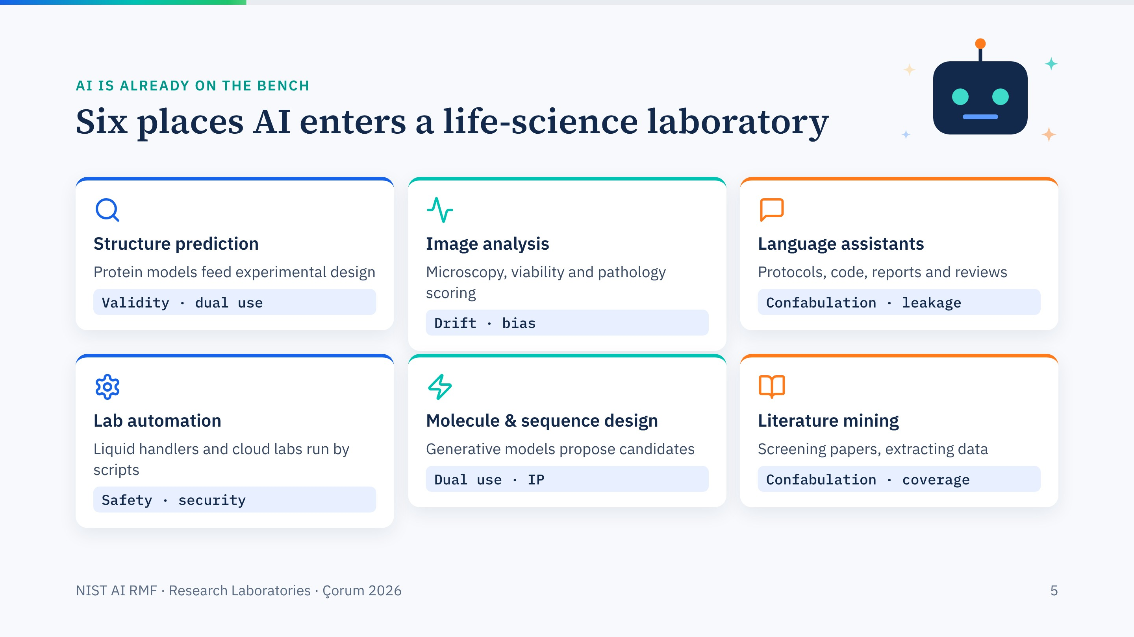
Notes:
Ask the room: how many of you used one of these last week? Usually most hands go up for language assistants.
Each card names the risks we will meet again in the framework: confabulation, drift, bias, data leakage, dual use.

Slide 6
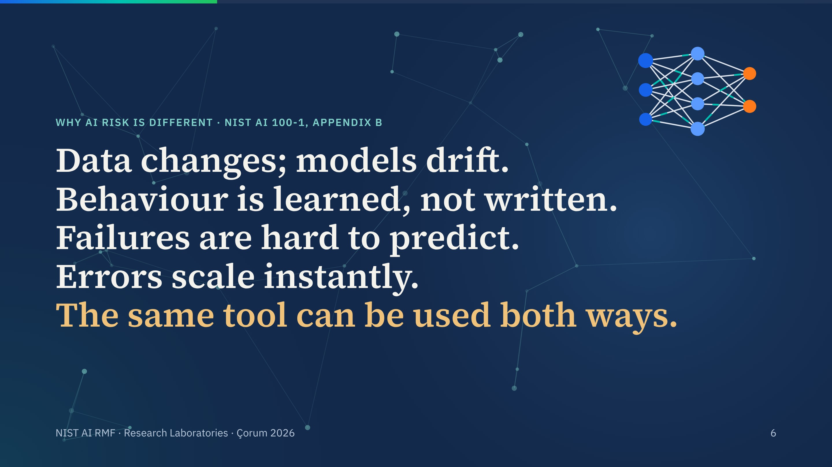
Notes:
Five lines, one each, summarising NIST's own appendix on how AI risks differ from traditional software.
Traditional software does what its code says. A trained model does what its data taught it, and the data can change under it. That is why we need a framework that keeps measuring after deployment.

Slide 7
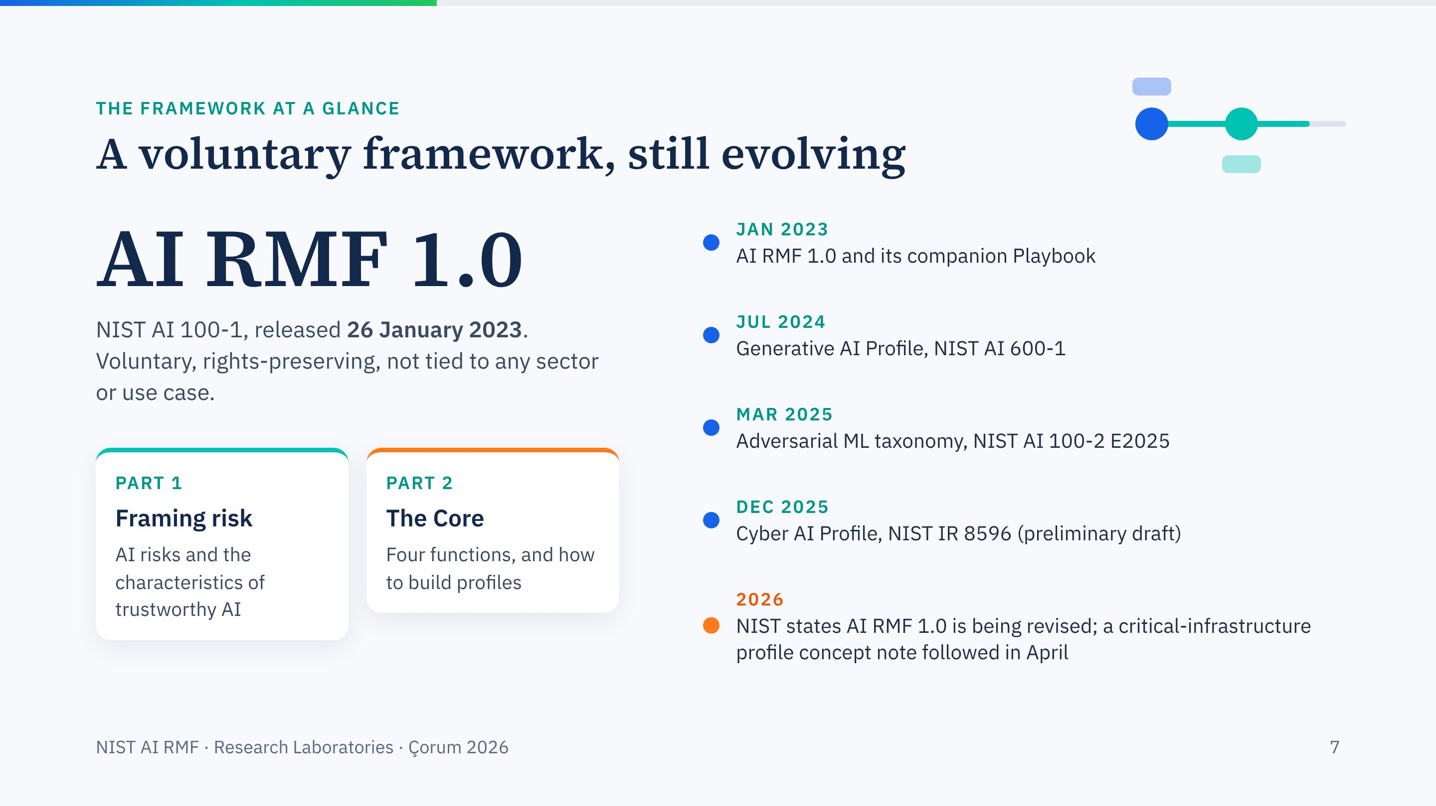
Notes:
The essentials. Version 1.0 since January 2023, a Playbook with suggested actions for every subcategory, and a growing family of profiles.
Be explicit about status: NIST's page now says version 1.0 is being revised as part of the U.S. AI Action Plan. What you learn today, the functions and the trustworthiness characteristics, is expected to carry over, but check for a new version before you write institutional policy.

Slide 8
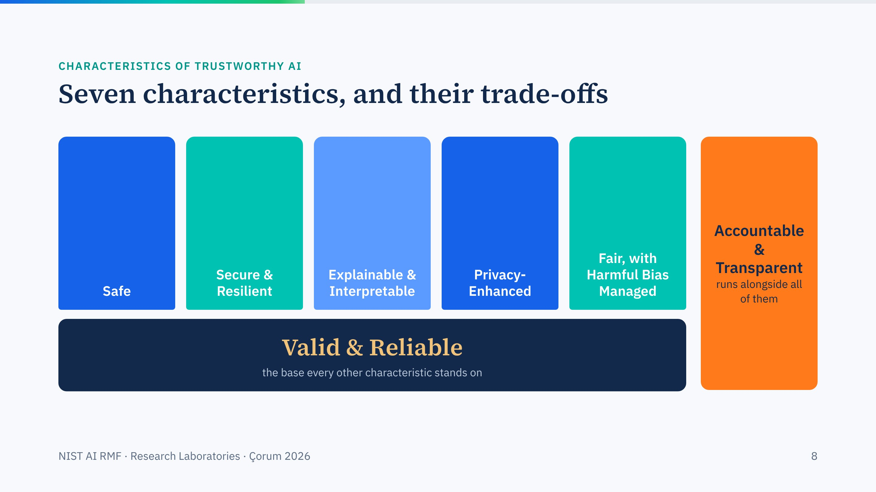
Notes:
The figure builds as NIST draws it. First the foundation, valid and reliable: a model that is wrong is not made trustworthy by anything else. Then the five pillars. Then accountability and transparency, which run alongside all of them.
Example of a trade-off: privacy enhancement can reduce accuracy, and explainability can cost performance. The framework asks you to make those trade-offs consciously.

Slide 9
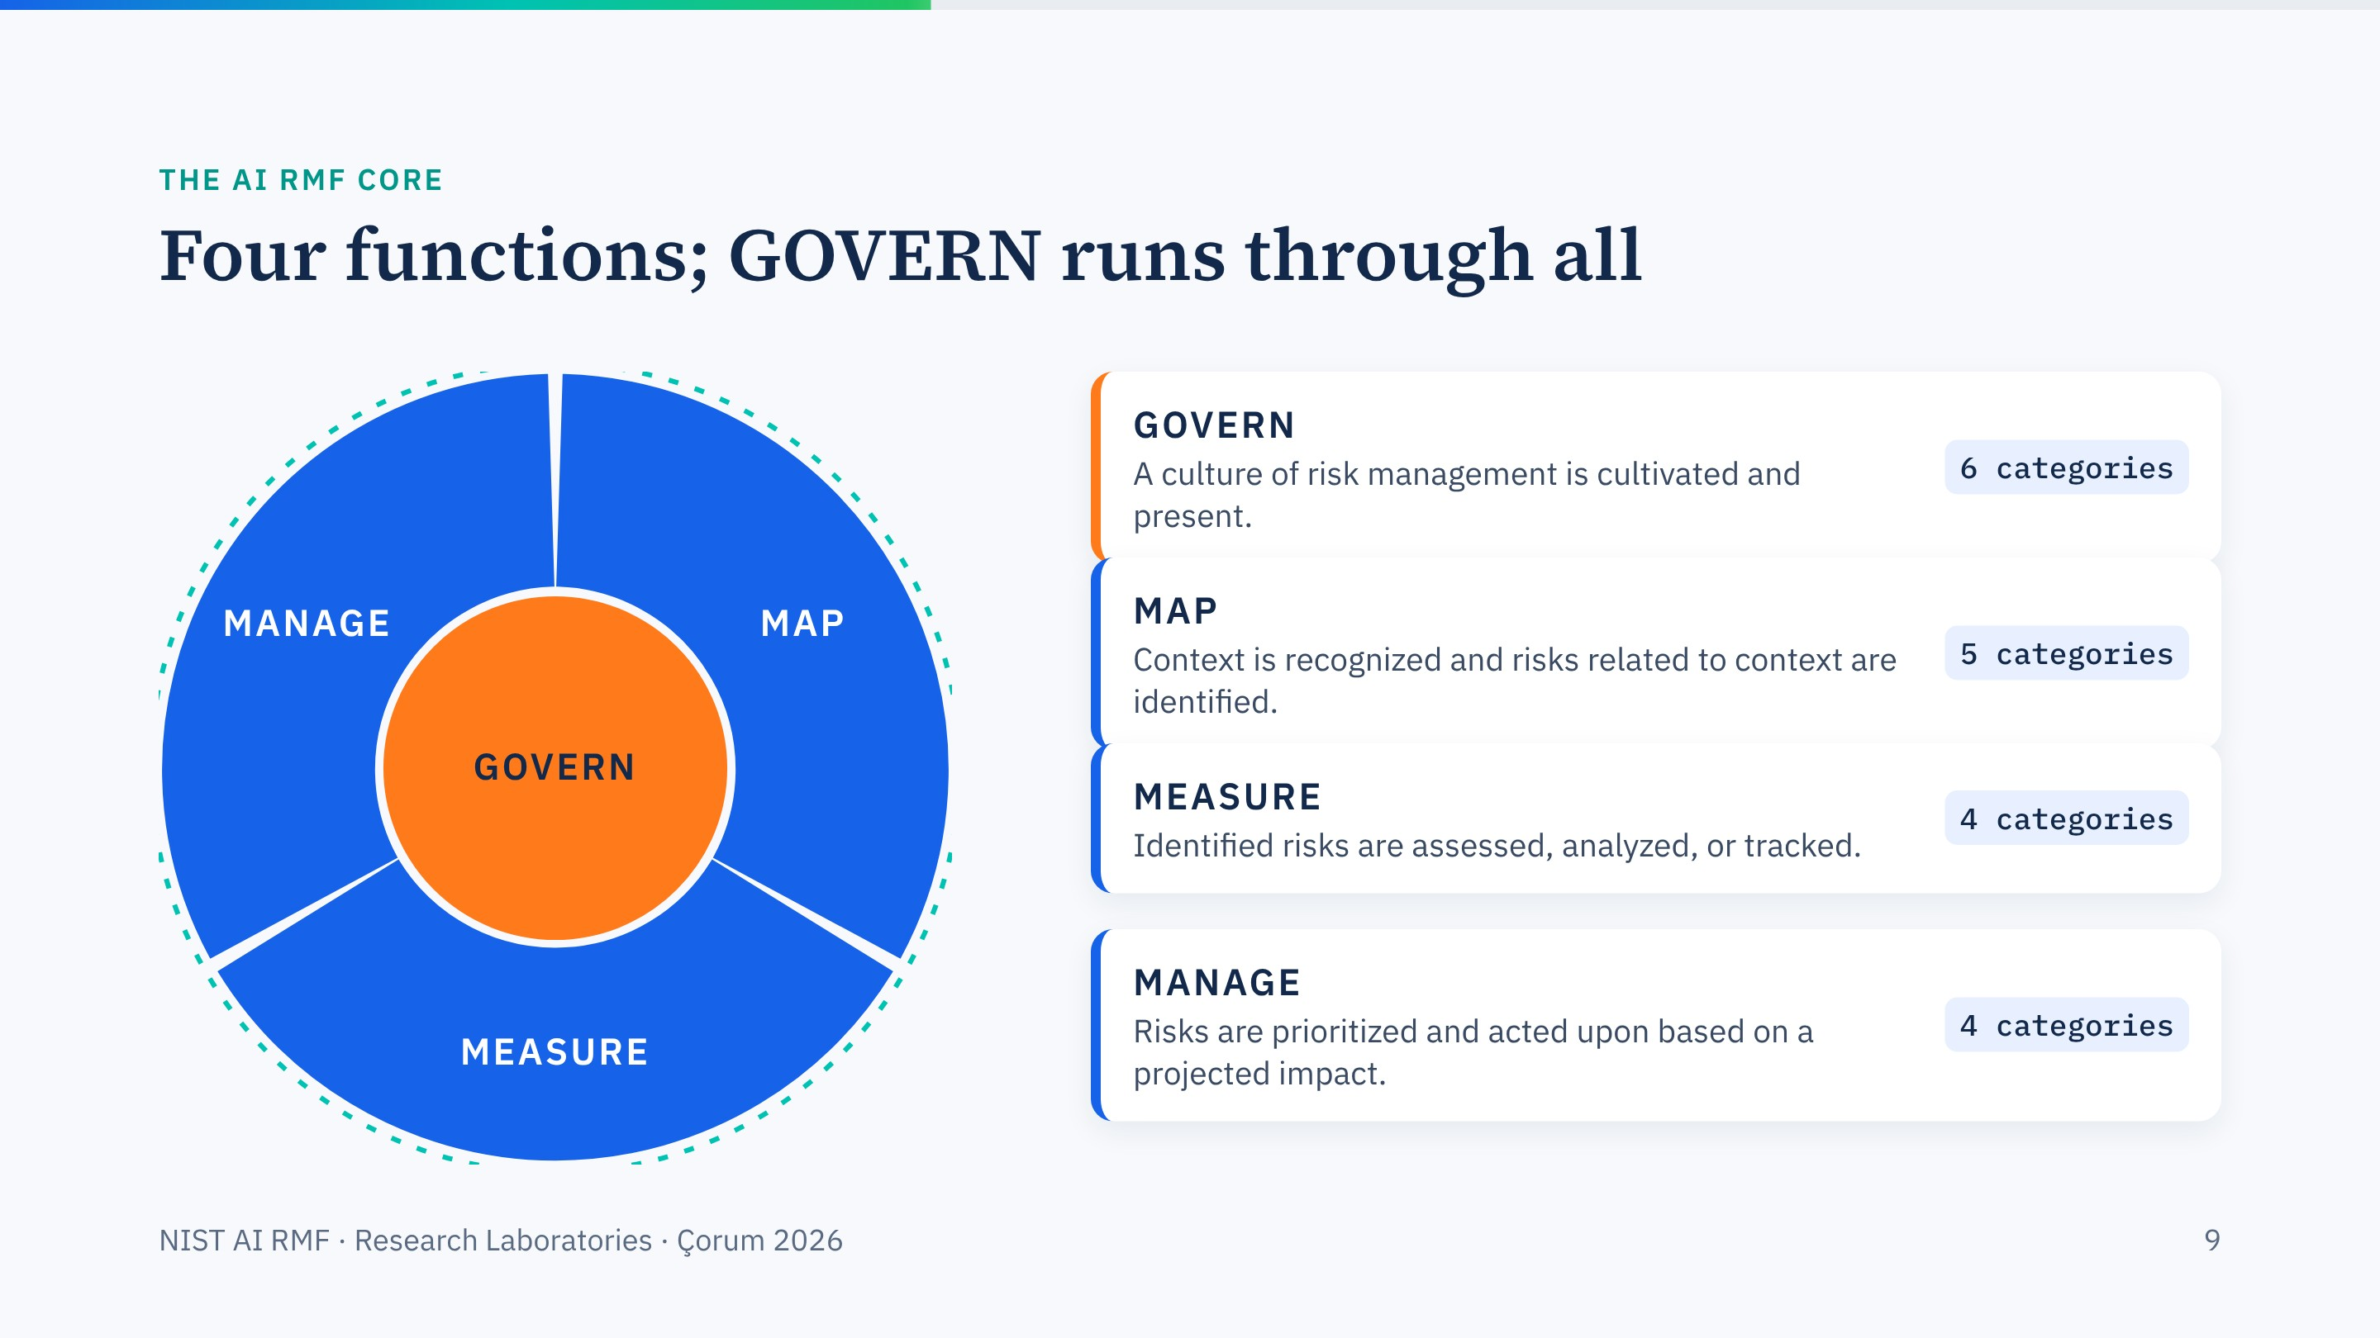
Notes:
Walk the four functions, one row per click, with NIST's one-line definitions. GOVERN is cross-cutting; the other three form a cycle you repeat whenever a system, its data or its use changes. The dashed teal ring is that cycle.
The next slides zoom into each function with laboratory questions; the ring follows into the corner.

Slide 10
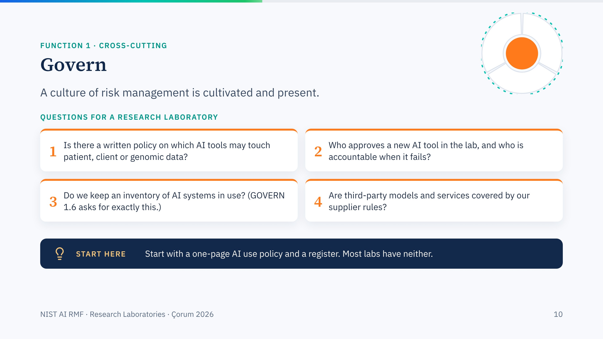
Notes:
GOVERN in a laboratory is mostly about ownership and policy. The inventory point is GOVERN 1.6 in the framework: mechanisms to inventory AI systems, resourced according to risk.
A one-page policy plus a register is a realistic first step for any department represented here.

Slide 11
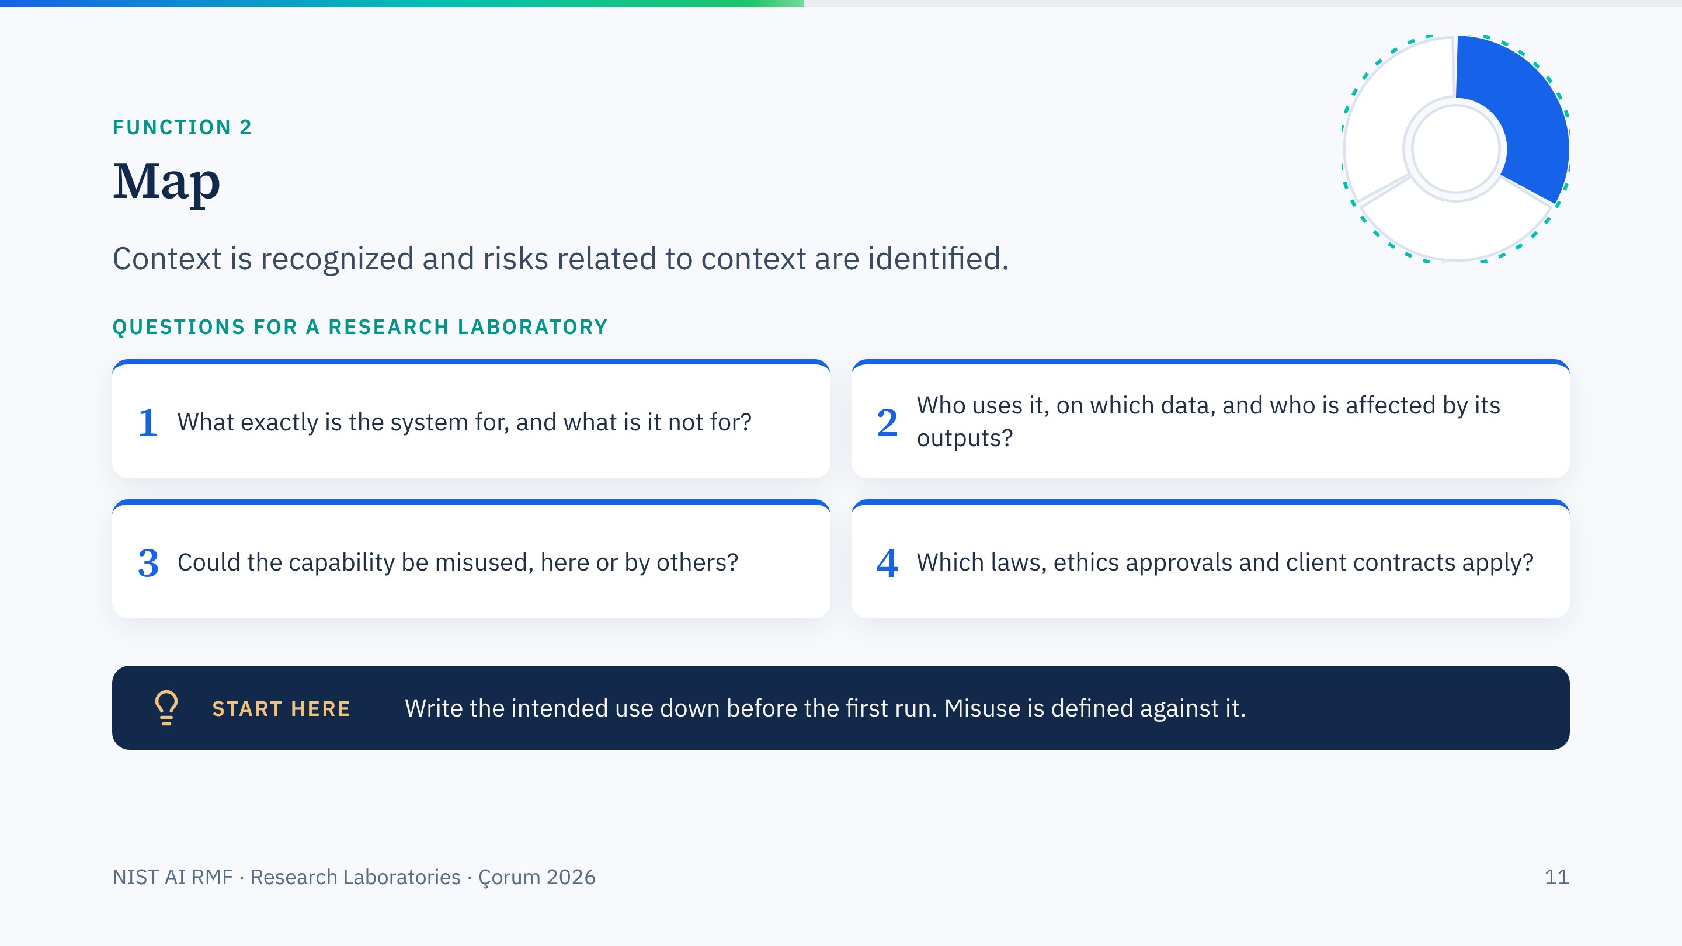
Notes:
MAP is about context. The single most useful artefact is a short intended-use statement. Without it, you cannot say when a use has gone beyond what was approved.
Dual use belongs here: the MegaSyn example was a mapping failure; nobody had asked how the model could be turned around.

Slide 12
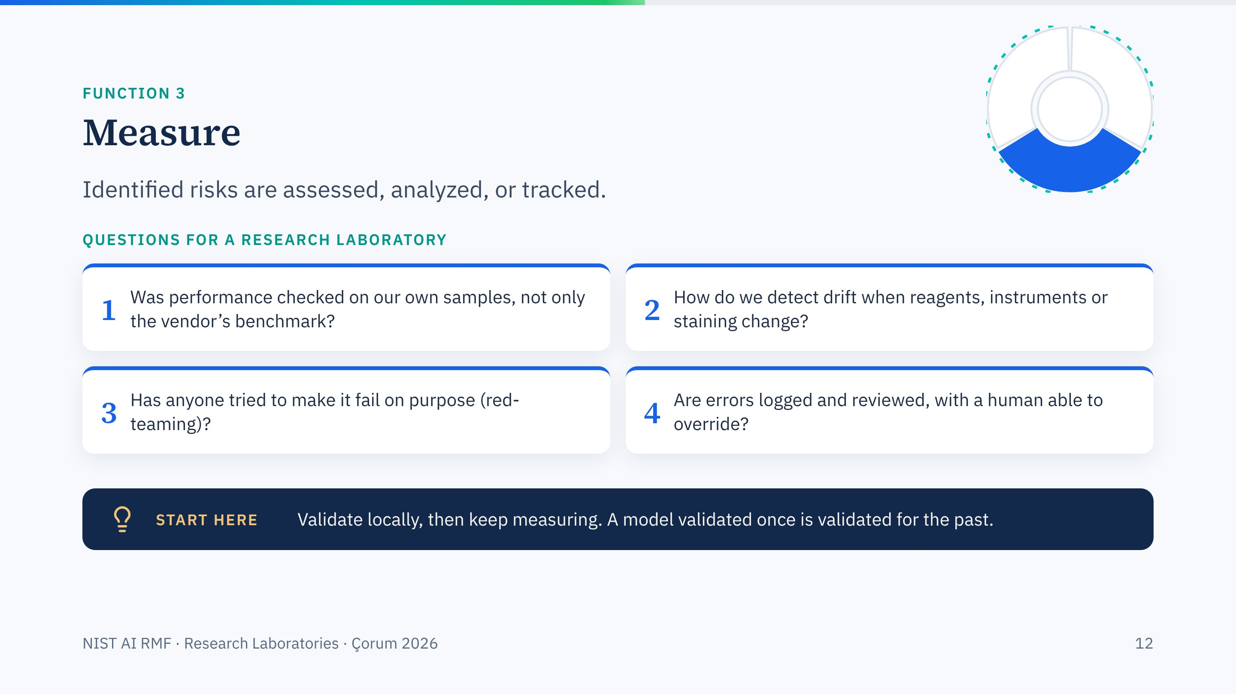
Notes:
MEASURE is where scientists feel at home: validation, error rates, controls. The point to stress is that measurement continues after deployment, because data and conditions change.
Red-teaming in a lab can be simple: give the tool deliberately difficult or out-of-scope inputs and record what happens.

Slide 13
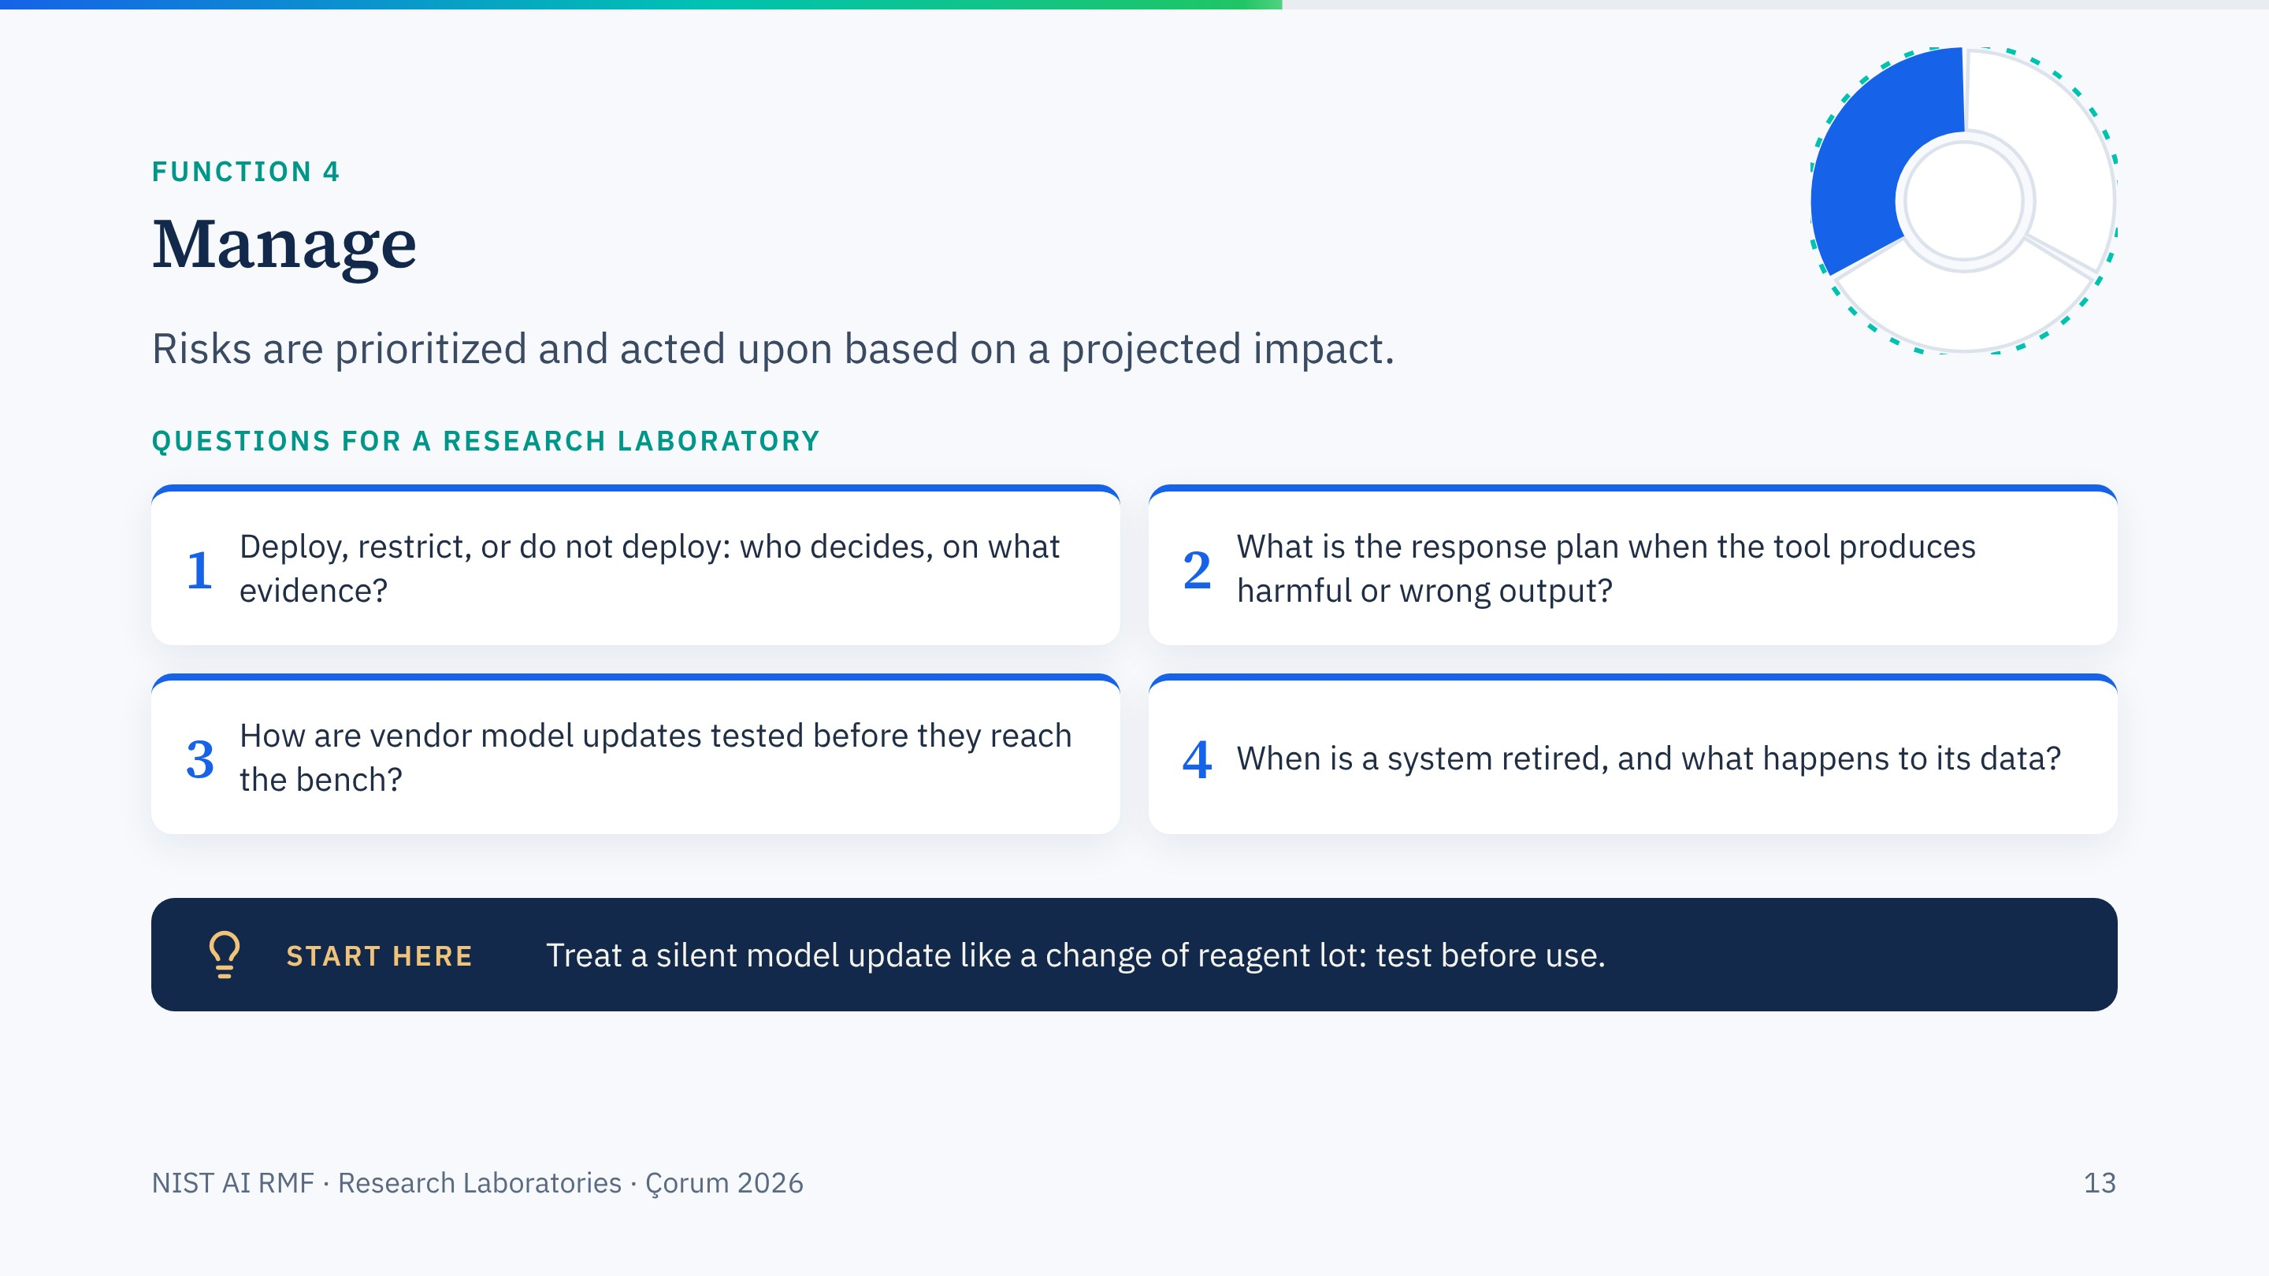
Notes:
MANAGE turns measurements into decisions and keeps them current. Vendor updates are a practical risk: a cloud model can change overnight without notice.
The reagent-lot analogy usually lands well with laboratory scientists.

Slide 14
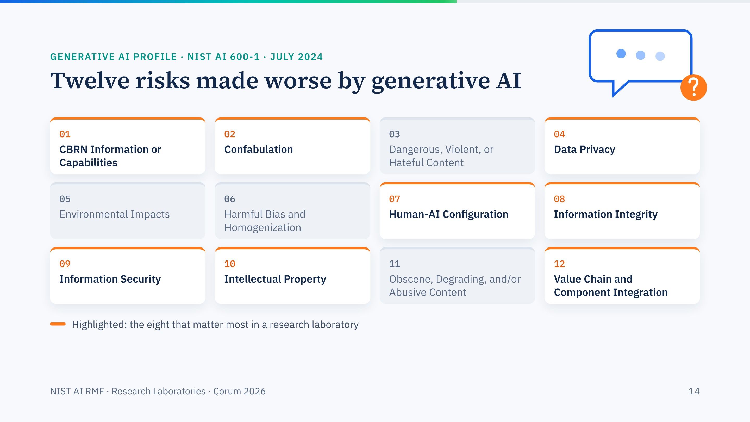
Notes:
The Generative AI Profile lists twelve risks; they pop in one by one. The eight with orange tops matter most to us: CBRN information, confabulation, data privacy, human-AI configuration (over-reliance), information integrity, information security, intellectual property, and the value chain, meaning the third-party models and plug-ins you build on.
The first one, CBRN information or capabilities, is the one this workshop exists for.

Slide 15
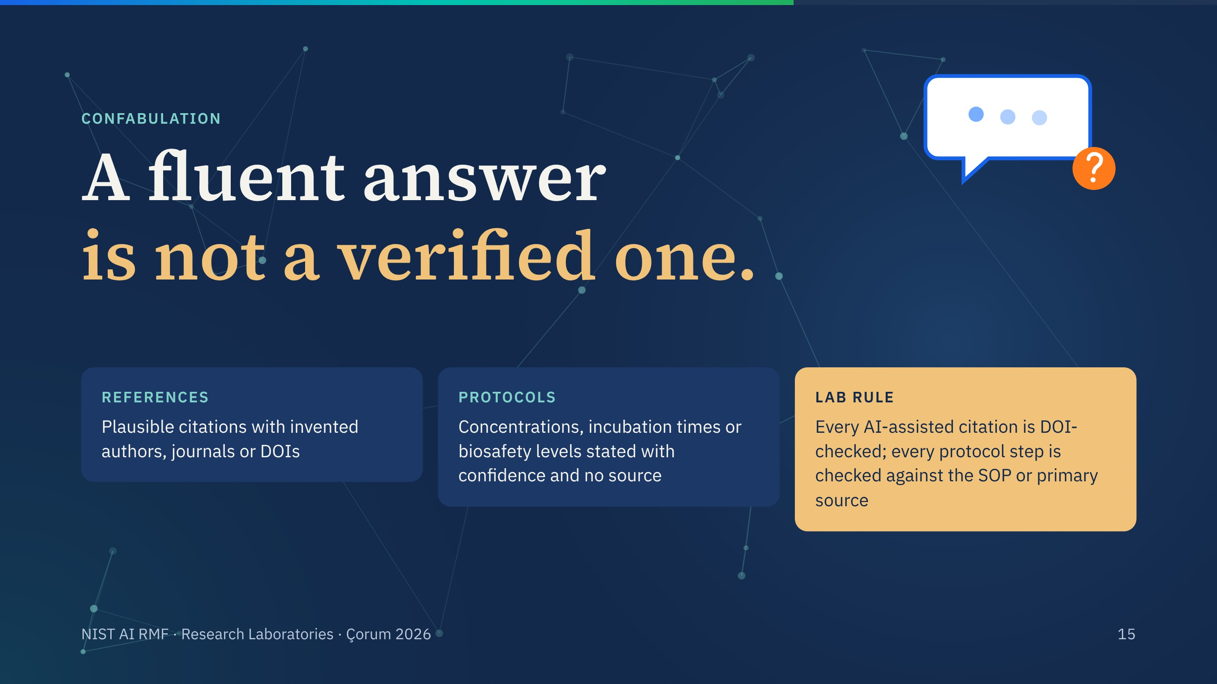
Notes:
Confabulation is NIST's term for what people call hallucination. In research it shows up as fake references and as invented protocol parameters.
The lab rule on the last card is simple and enforceable. It also protects research integrity, which is a cyberbiosecurity outcome in its own right.

Slide 16
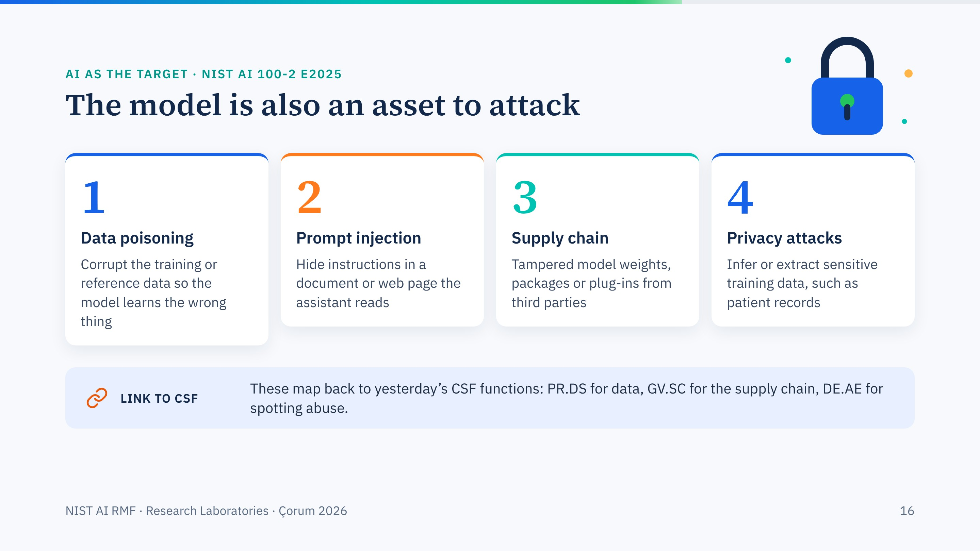
Notes:
So far the AI was the source of risk. Here it is the target. NIST's adversarial machine learning taxonomy names the classes of attack; four are enough for a lab audience.
Prompt injection deserves a minute: an assistant that reads a supplier's PDF or a web page can be instructed by text hidden inside it. Anyone connecting an assistant to email or files should know this.

Slide 17
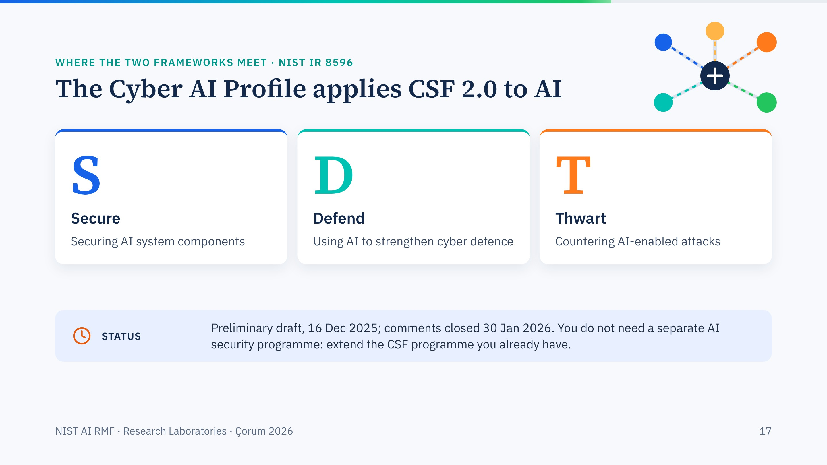
Notes:
This is the bridge we promised yesterday. The Cyber AI Profile is a CSF 2.0 community profile for AI, with three focus areas: secure, defend, thwart.
It is a preliminary draft, so cite it as such. For an institution, the practical message is that you extend the CSF programme you already have.

Slide 18
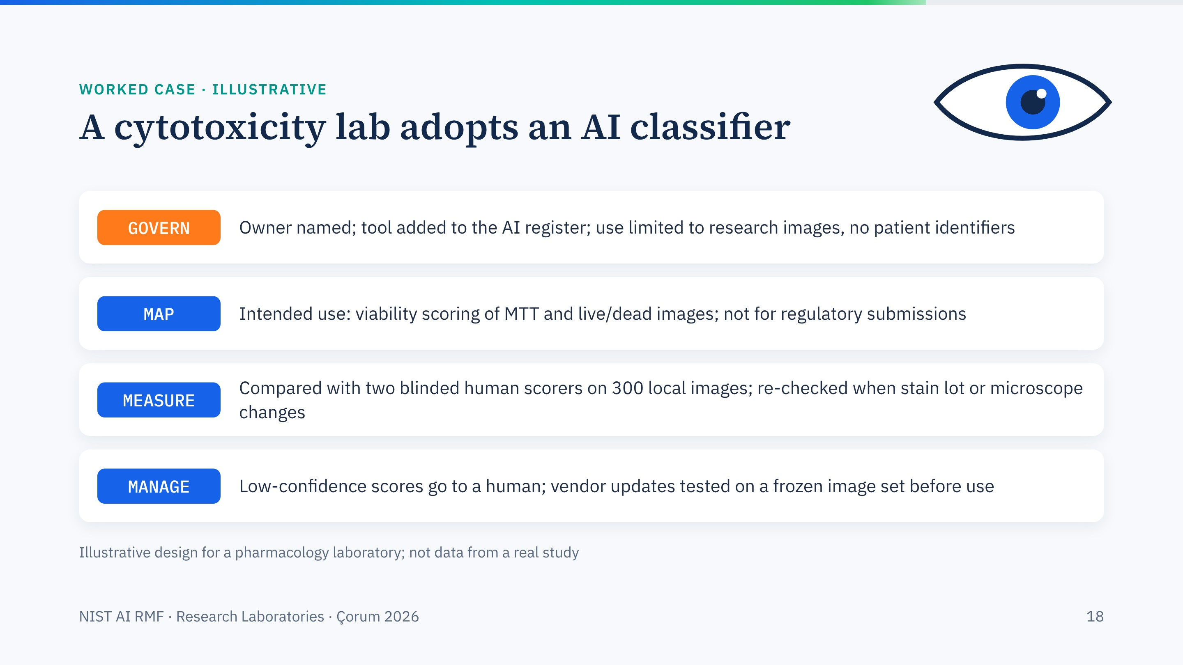
Notes:
An illustrative case from our own kind of work: a pharmacology lab that scores cell viability images with an AI classifier. One row per function.
Note how concrete each line is. That is the test of a good AI RMF implementation: each function produces a decision or a record someone can check. The numbers here are an example design, not a real study.

Slide 19
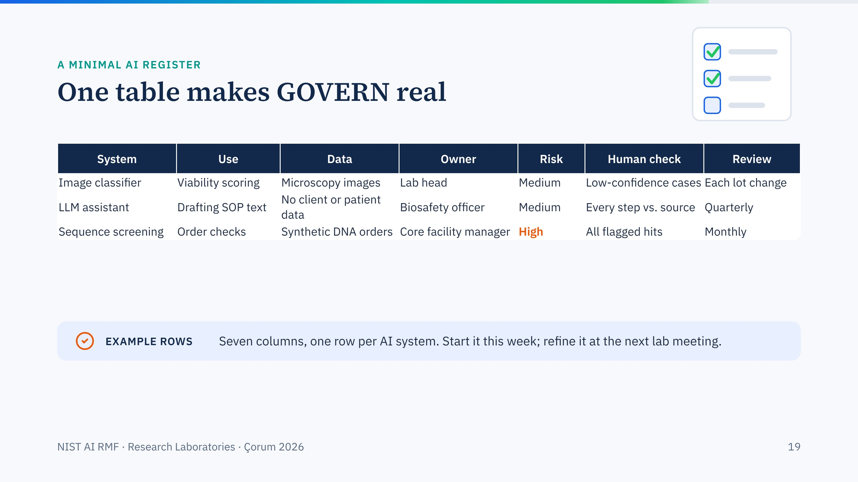
Notes:
Example rows only. The register is the smallest artefact that makes GOVERN real: it names the system, its purpose, its data, its owner, a risk level, where a human checks, and when it is reviewed.
Encourage participants to start one for their own group this week.

Slide 20
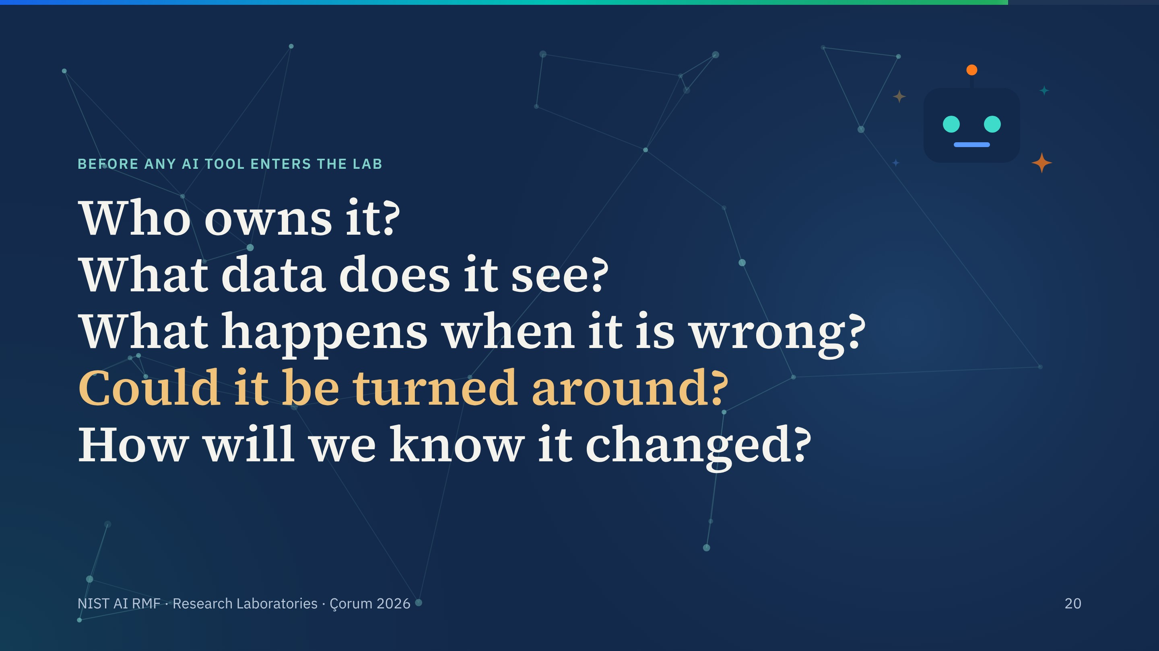
Notes:
Five questions, one per click. They map to the functions: ownership is GOVERN, data and misuse are MAP, being wrong and changing are MEASURE and MANAGE.
If participants remember only one slide from this session, this should be it.

Slide 21
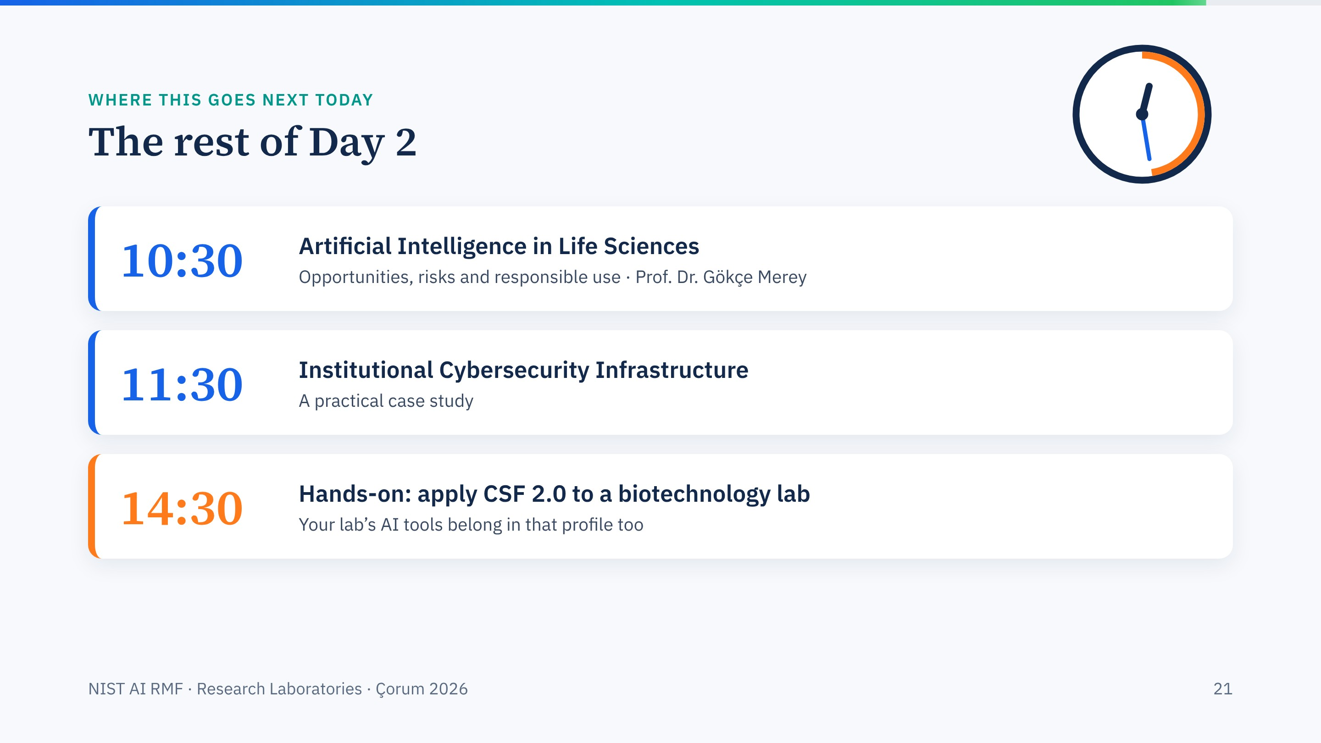
Notes:
Hand over to Prof. Merey's session on AI in the life sciences, which takes the applications side. Remind groups that the afternoon exercise includes AI tools in the scenario.

Slide 22
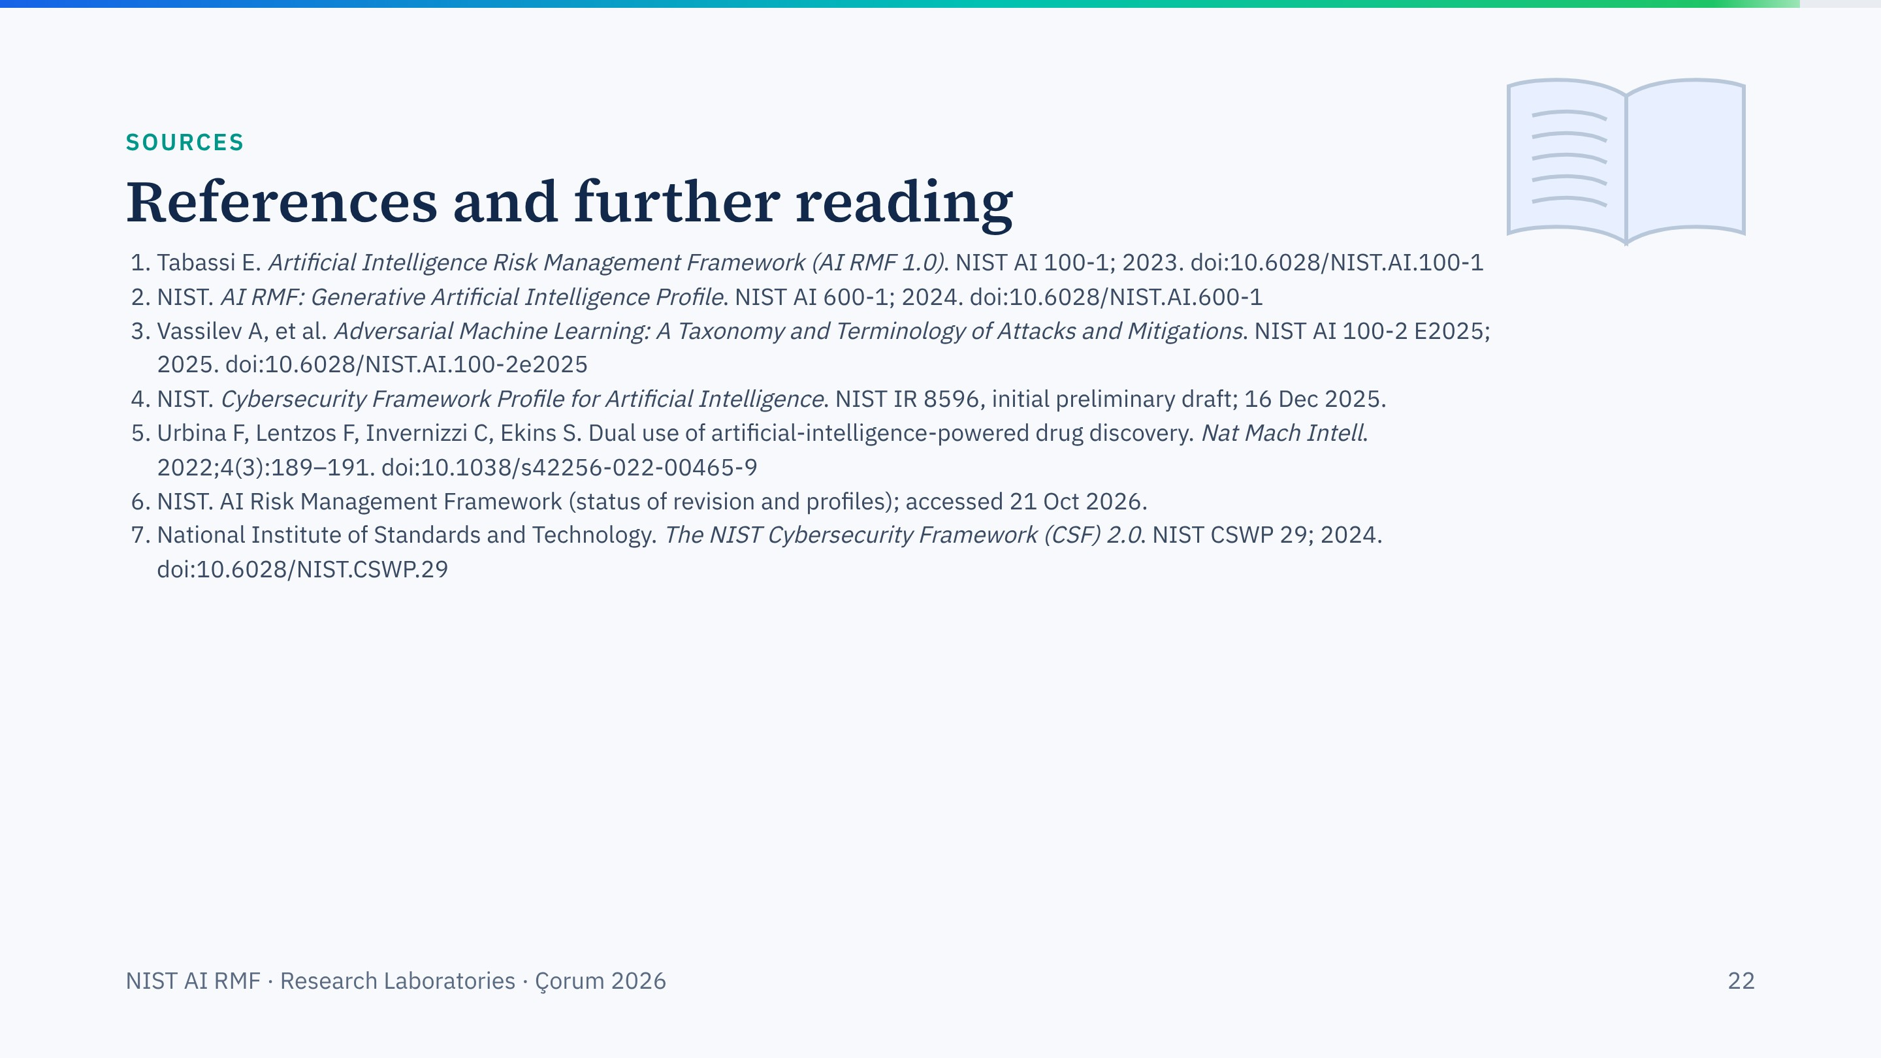
Notes:
Sources for this session. Every DOI on this slide was checked against Crossref.

Slide 23
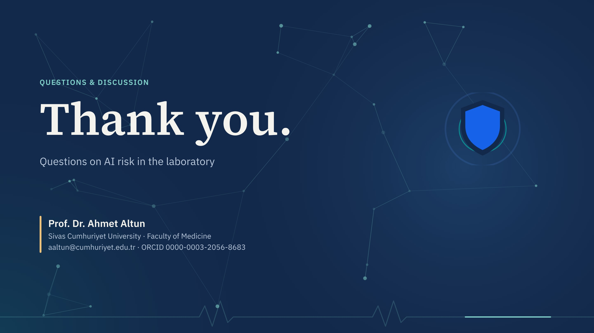
Notes:
Take questions. If someone asks whether a specific AI tool is allowed, route it to the five questions and the register.

