Slide 1
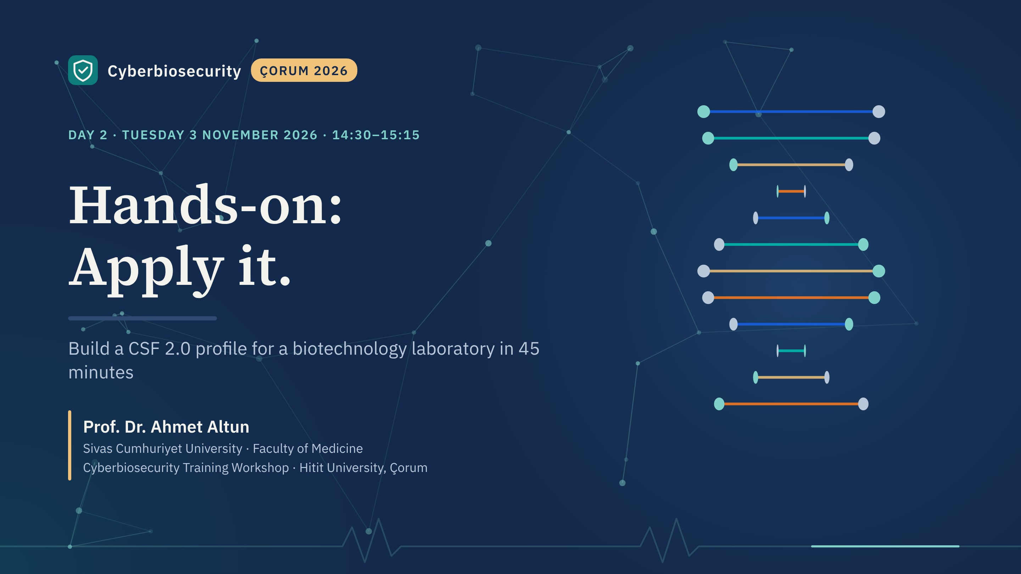
Notes:
This is where the two days come together. Each group becomes the cyberbiosecurity working group of a fictional laboratory and produces a small Organizational Profile and a three-item action plan. Group presentations follow at 15:30. Ideally five or six groups of four to six people, mixing institutions and roles.

Slide 2

Notes:
Opening film, about 10 seconds. Advance when it reaches the title card.

Slide 3
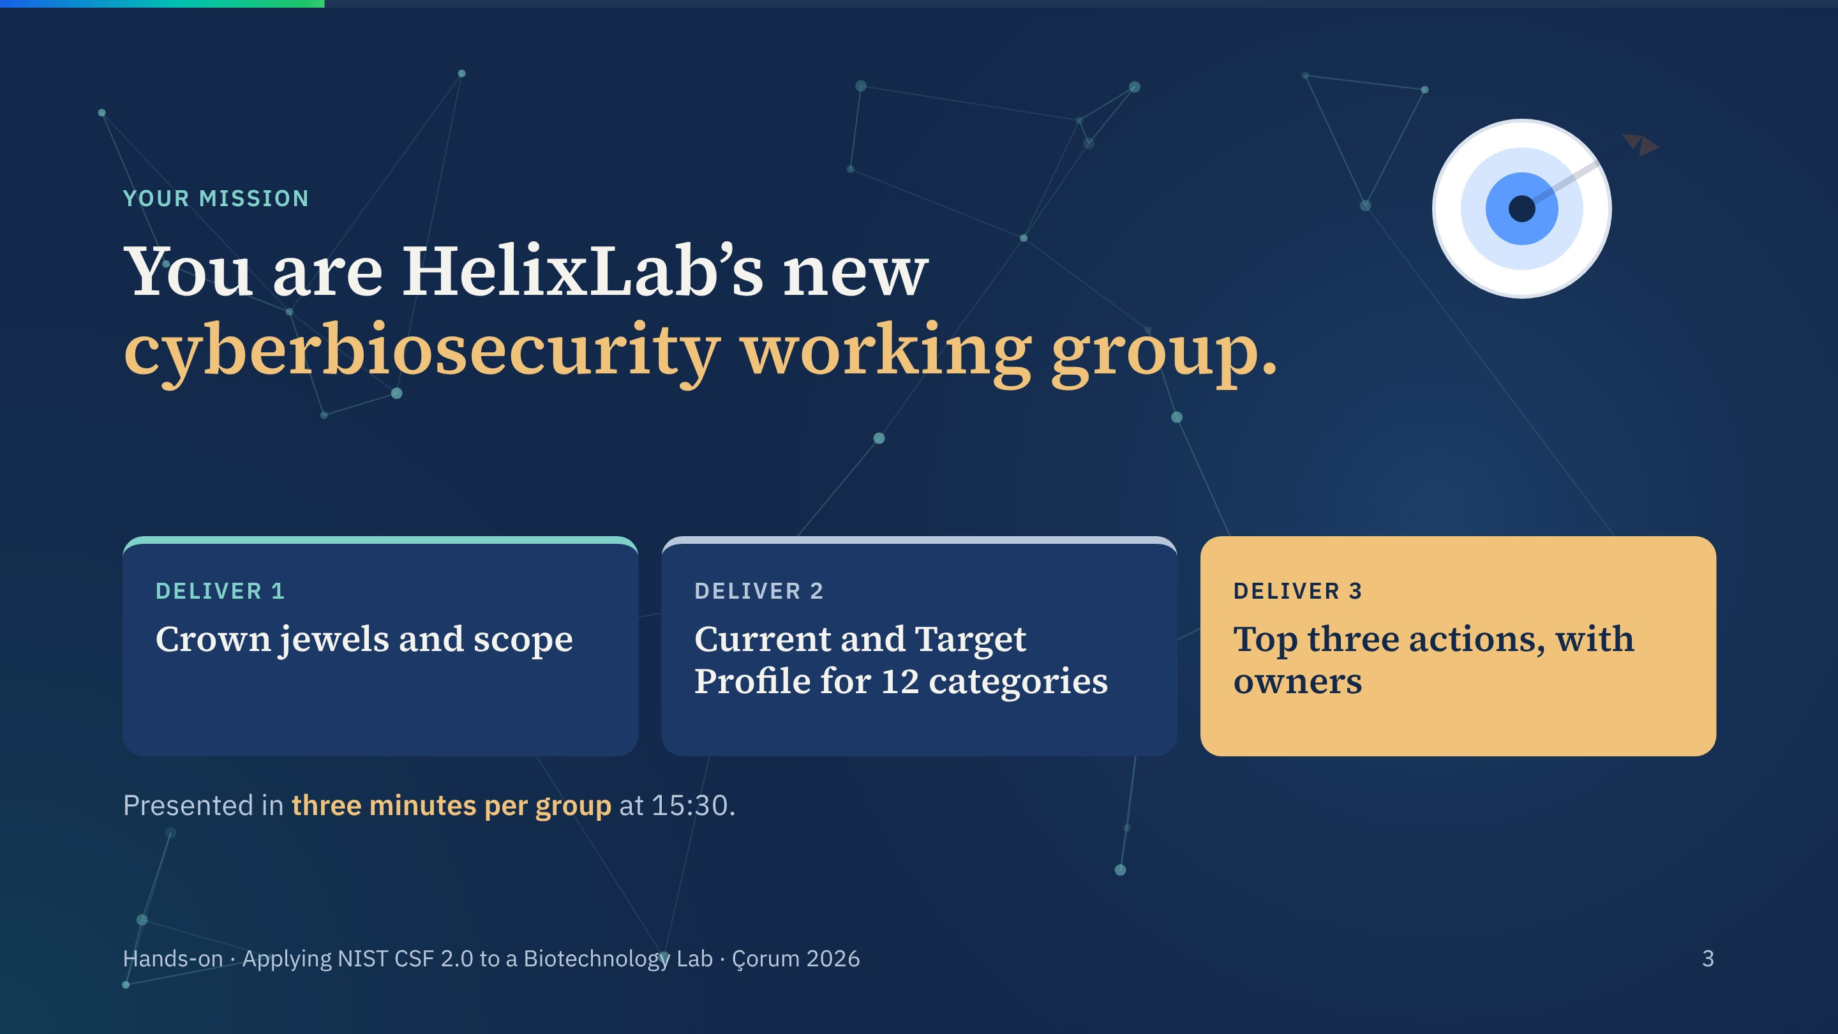
Notes:
Read the mission aloud. The three deliverables mirror steps 1 to 4 of NIST's quick-start guide from yesterday: scope, gather, create, analyse and plan.

Slide 4
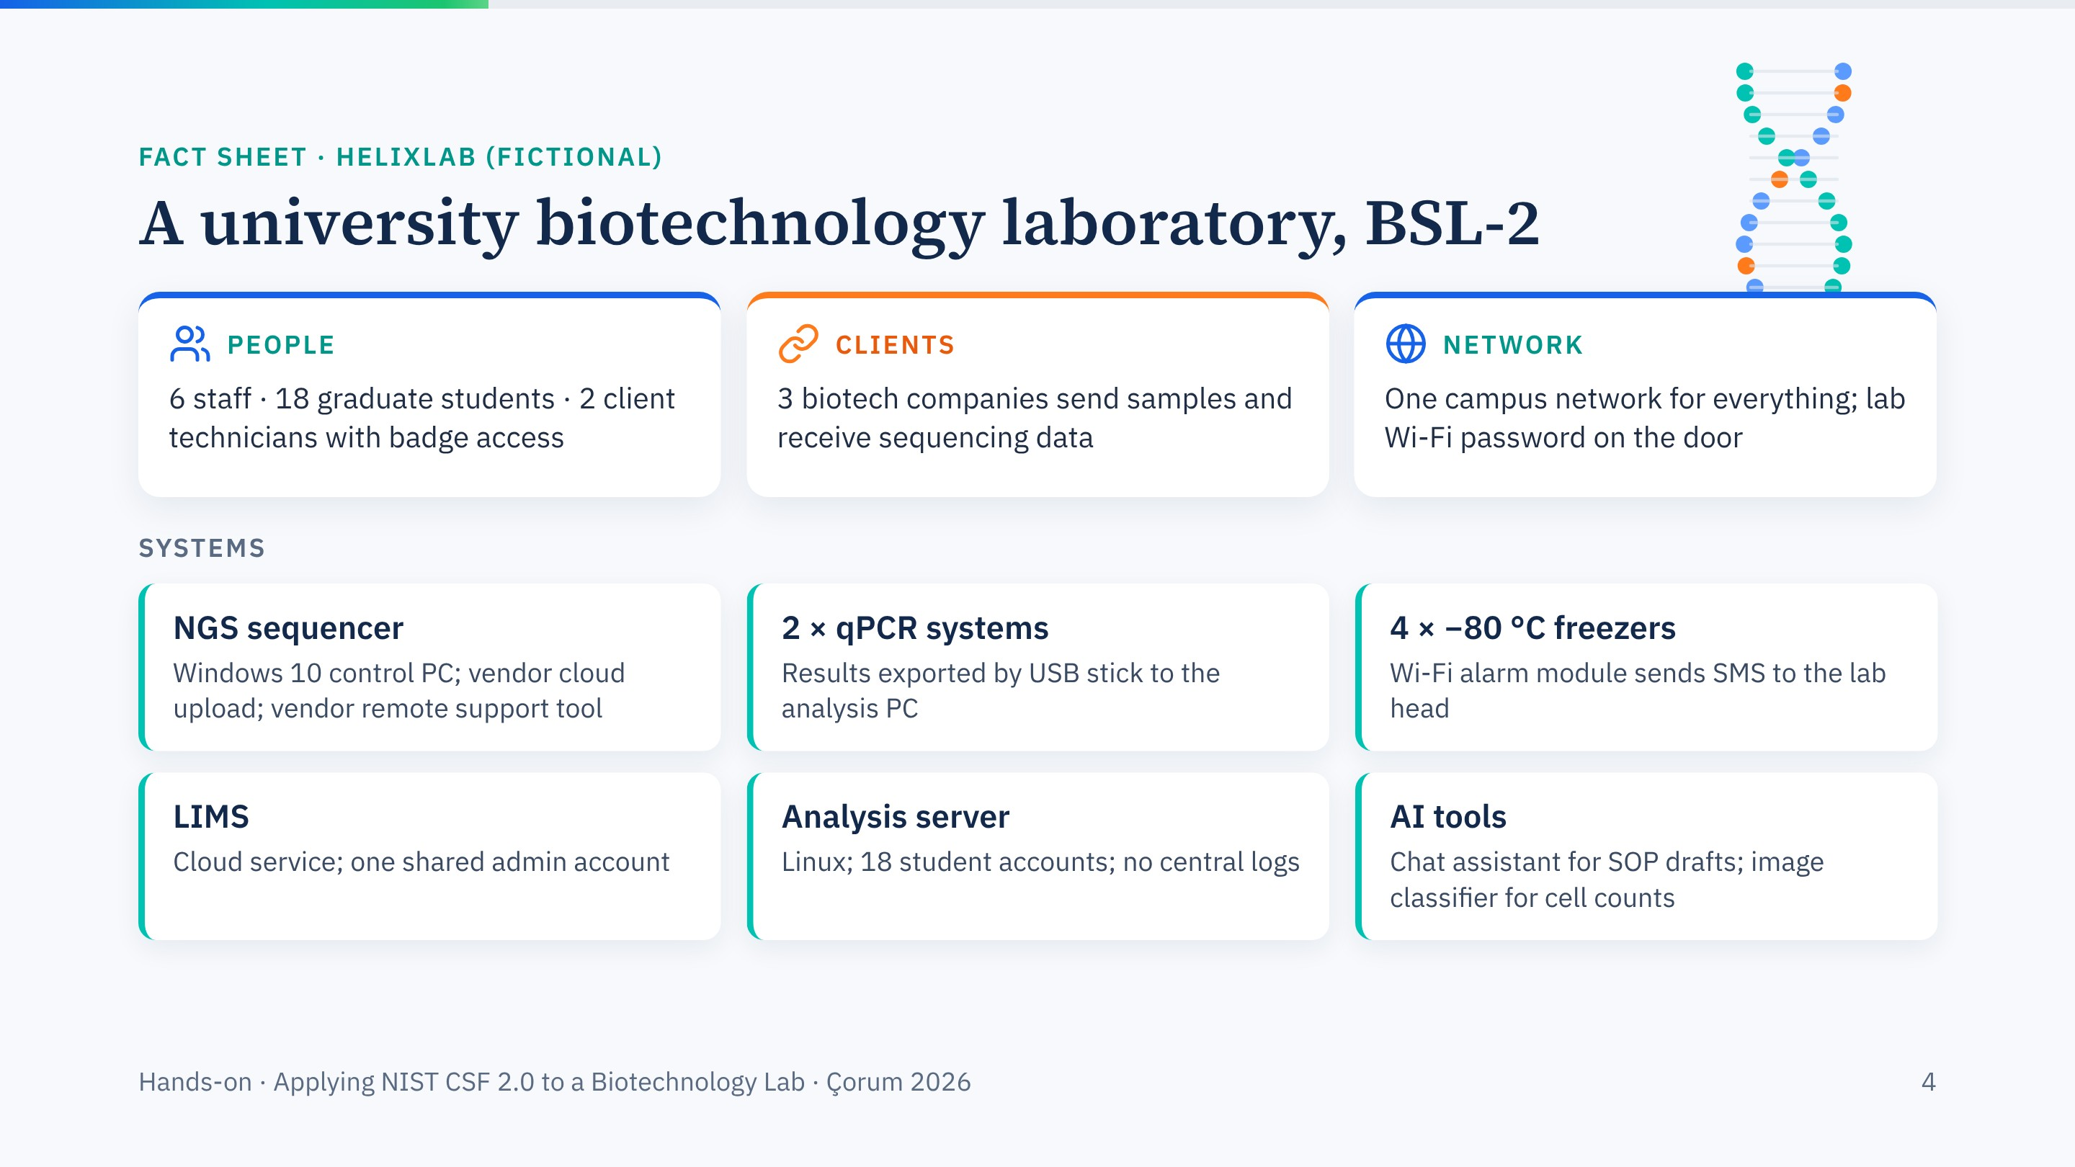
Notes:
The fact sheet is deliberately realistic: every detail is something seen in real laboratories. Give groups two minutes to read it. The three client companies make supply-chain governance relevant, and the AI tools link back to this morning.

Slide 5
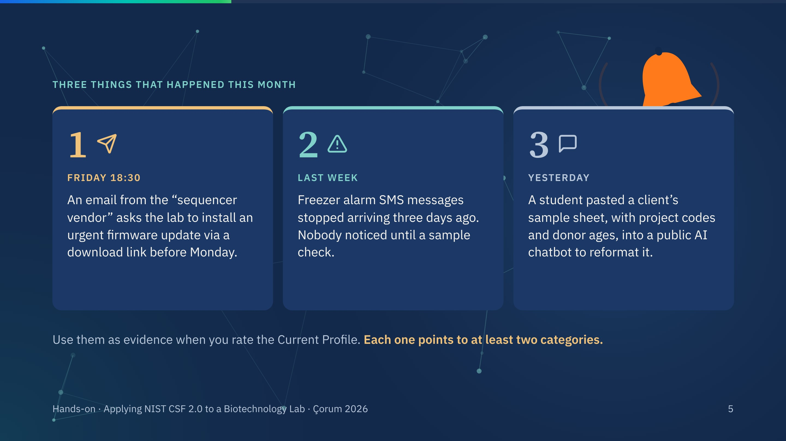
Notes:
Reveal the three events one at a time. They are the evidence groups should use. Don't tell them which categories each maps to; that is in the debrief slide.

Slide 6
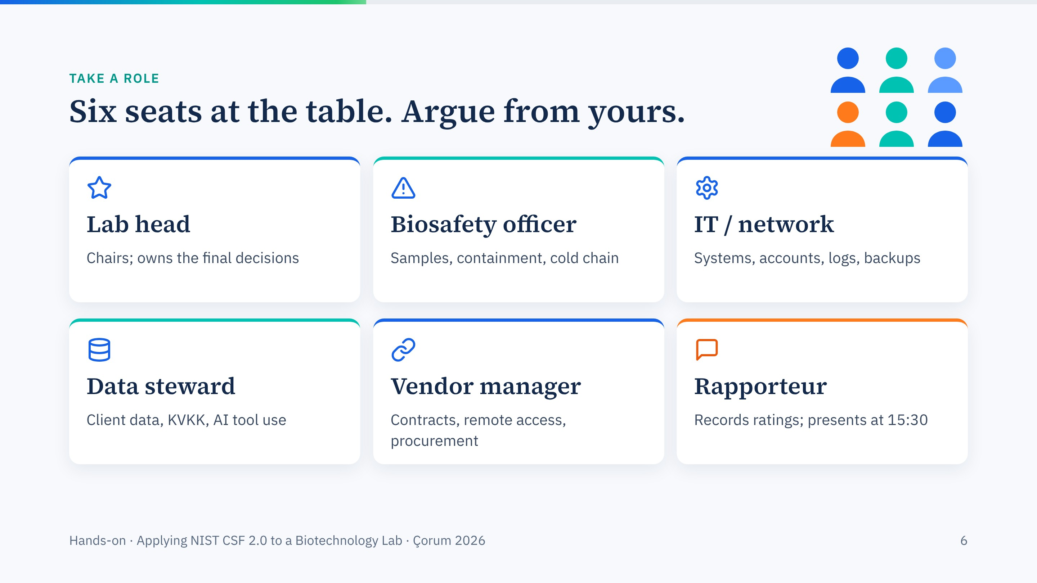
Notes:
Ask each group to assign roles now; with fewer than six people, combine vendor manager with data steward. Role-play creates productive disagreement, especially between IT and the biosafety officer.

Slide 7
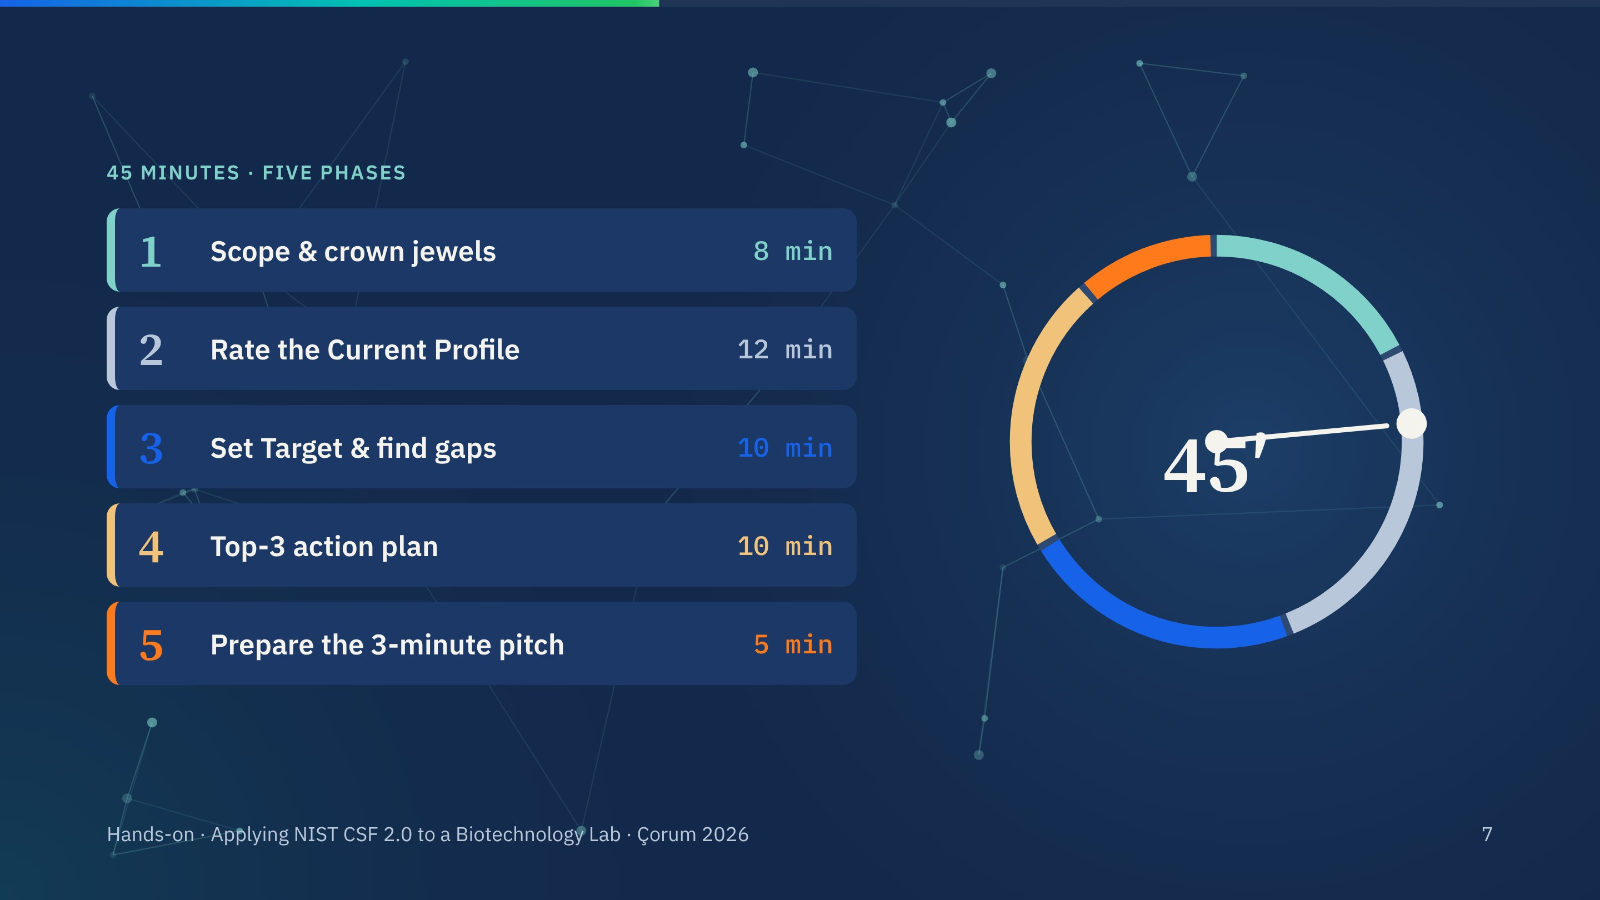
Notes:
Five phases, 45 minutes. The ring shows the share of time per phase.
For a live countdown, open the interactive tool (https://claude.ai/artifact/1LZkxgu56oodvpnb2BBqLr) on a second tab: its timer slide counts each phase down and moves on automatically.

Slide 8
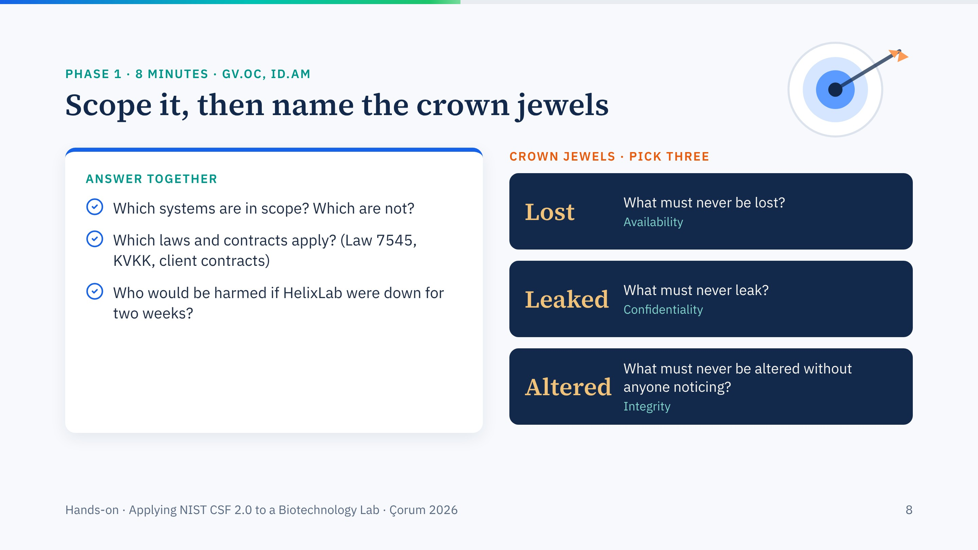
Notes:
Eight minutes. Lost, leaked, altered: those three questions map to availability, confidentiality and integrity, the CIA triad from yesterday's introduction. Good answers usually include the client data, the freezer contents and the sequencing results.

Slide 9
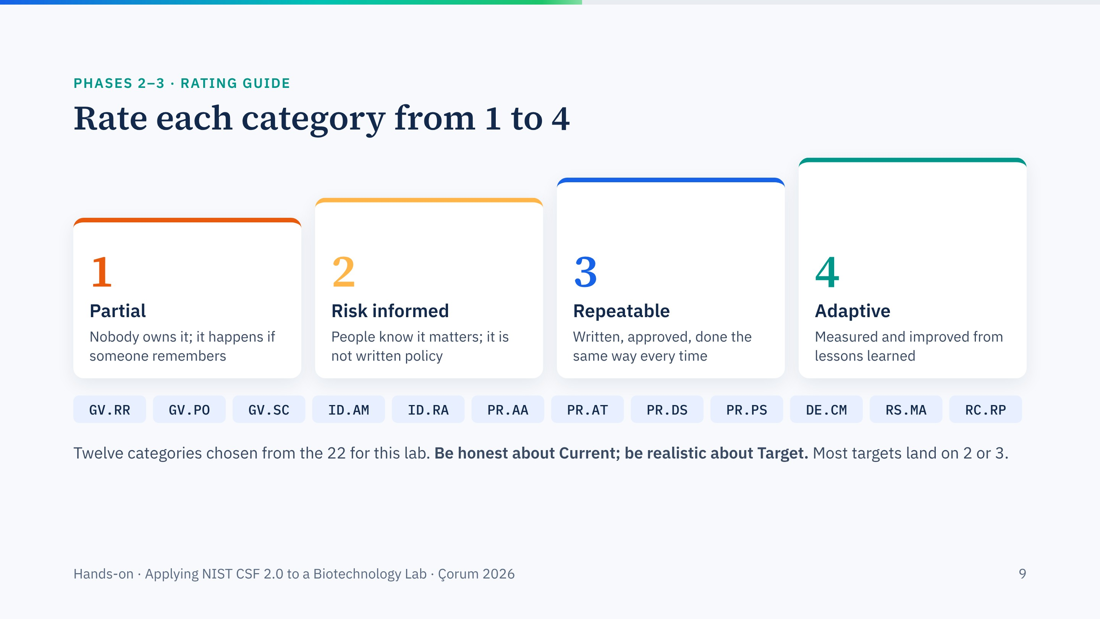
Notes:
A plain-language version of the CSF tiers for rating categories. Remind groups: tier 4 everywhere is not a sensible target for a teaching-and-research lab. Most targets land on 2 or 3.
Twelve categories keeps it achievable in the time; they are the ones the fact sheet and the three events give evidence for.

Slide 10
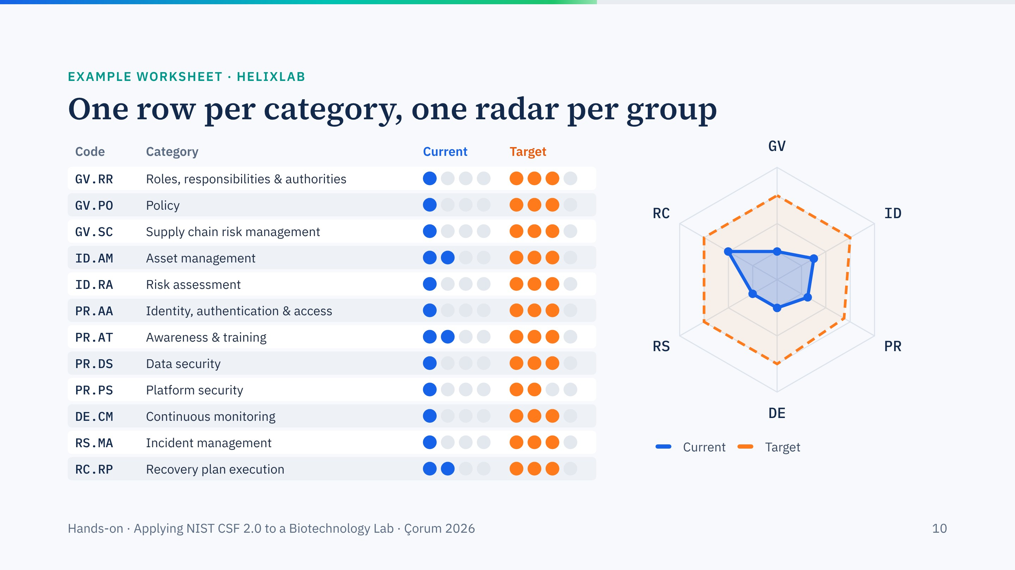
Notes:
An example of a finished worksheet, so groups see the target format. The radar averages categories per function.
For live rating during the session, the interactive profile builder with group tabs and automatic gap ranking is in the HTML tool: https://claude.ai/artifact/1LZkxgu56oodvpnb2BBqLr

Slide 11
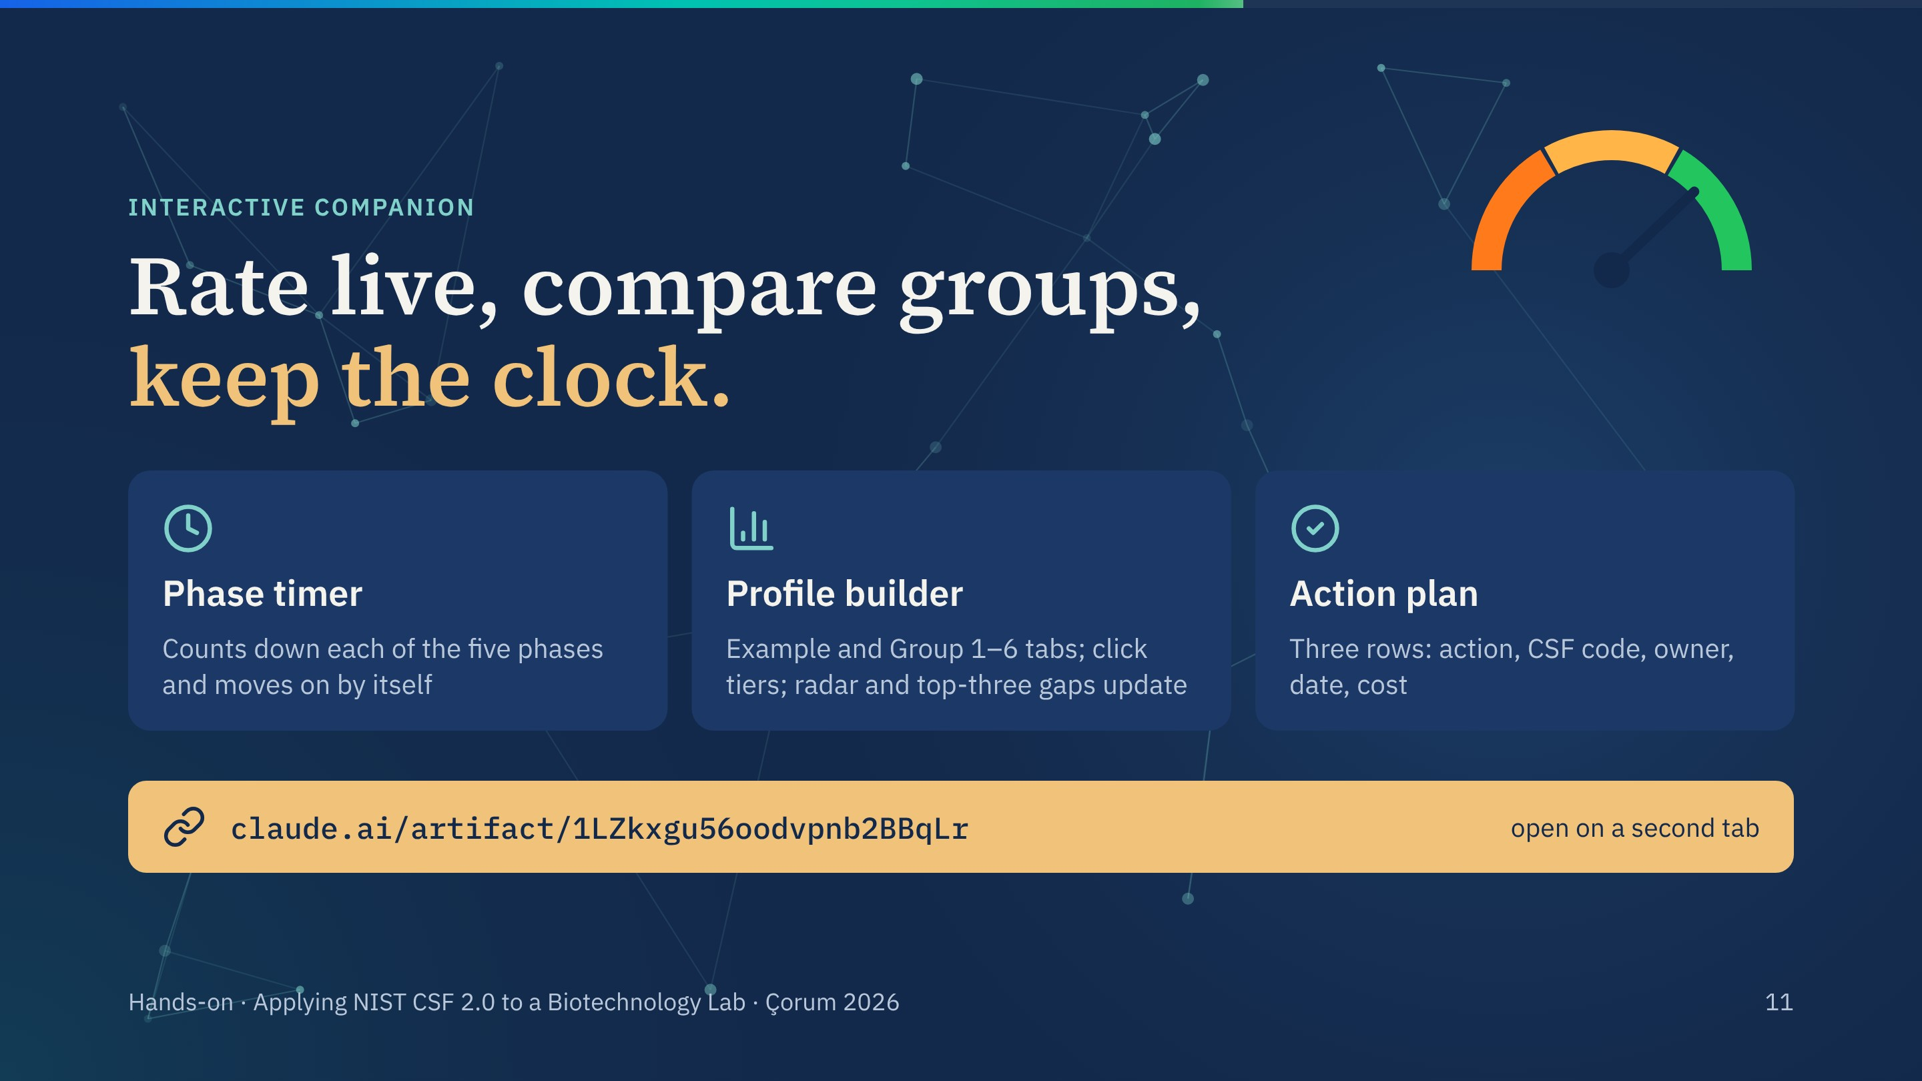
Notes:
This slide points to the interactive companion: https://claude.ai/artifact/1LZkxgu56oodvpnb2BBqLr
It has the live 45-minute phase timer, the profile builder with Example and Group 1–6 tabs (click tiers; the radar and the top-three gaps update), and the action-plan form. Ratings stay in the browser it is opened in, so use one laptop for the whole session.

Slide 12
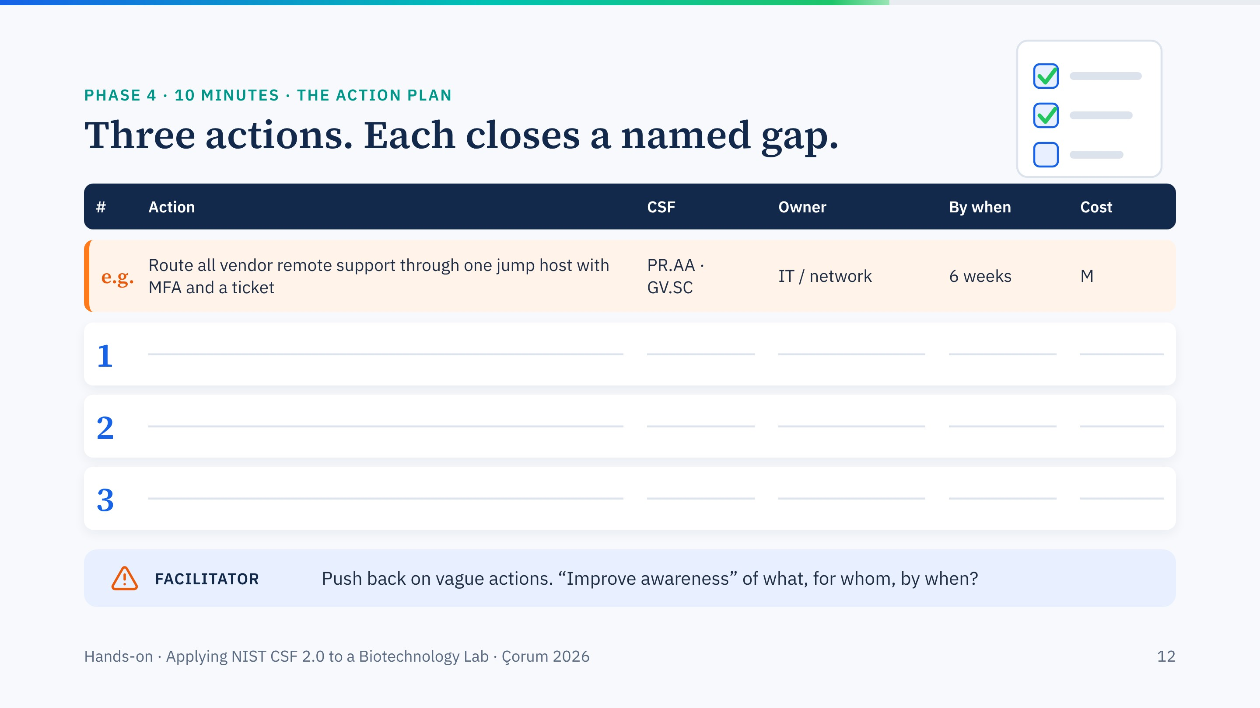
Notes:
Groups fill this on paper or in the interactive tool. A good action names the gap it closes, an owner by role, a date and a rough cost. Vague actions such as "improve awareness" should be pushed back: awareness of what, for whom, by when?

Slide 13
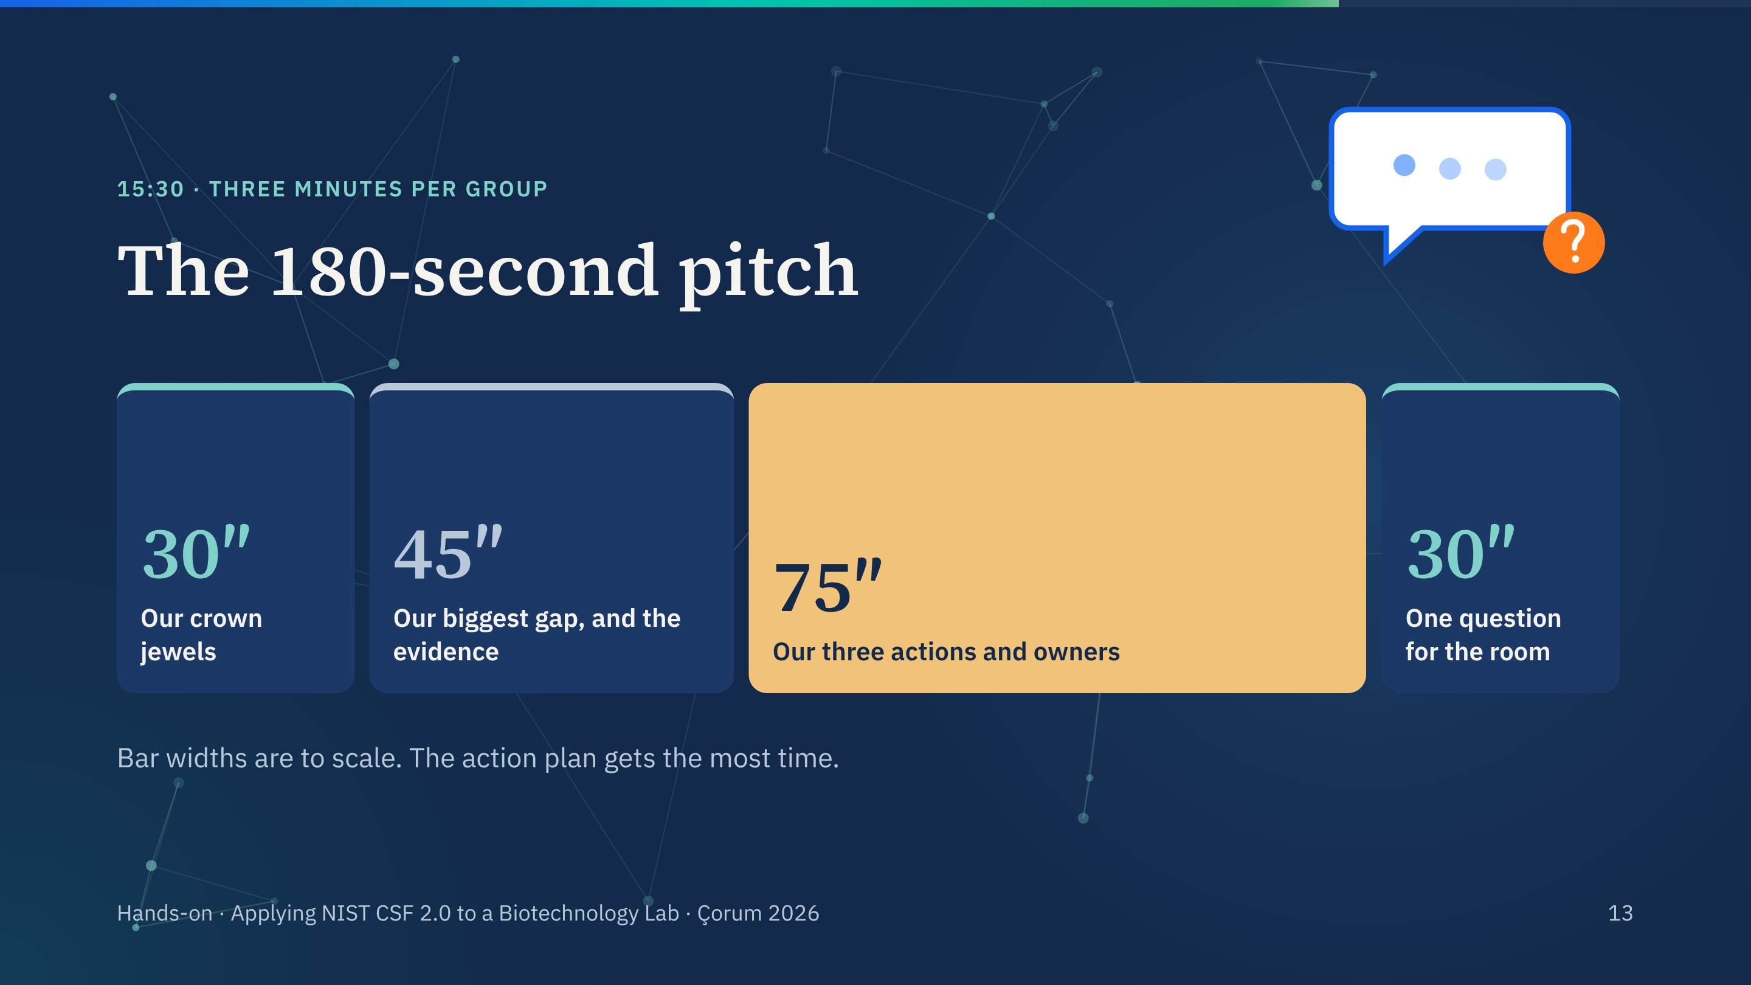
Notes:
The pitch format. Three minutes total, strictly timed. The question for the room at the end is often the best part of the presentations.

Slide 14
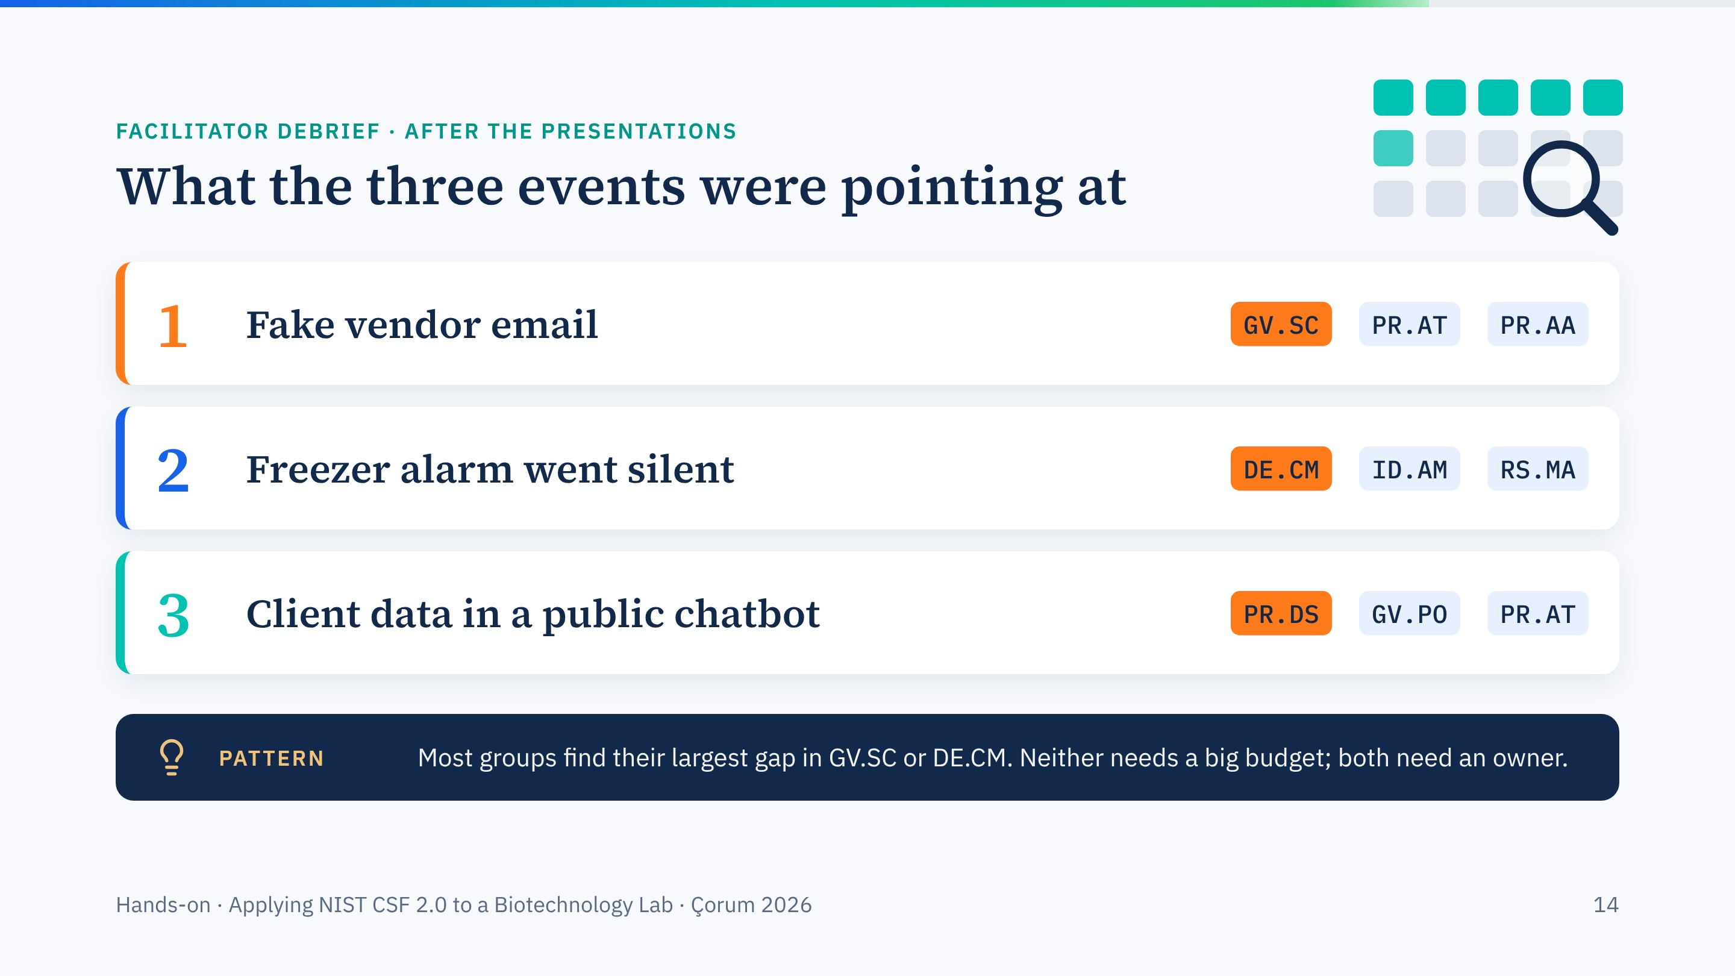
Notes:
Use after the 15:30 group presentations. Reveal one event at a time and ask which groups caught which categories.
Closing point: the two most common big gaps, supply chain and monitoring, are mainly governance work. That brings us back to GOVERN at the centre of the wheel.

Slide 15

Notes:
Close the exercise. Encourage every participant to repeat the profile for their own laboratory within the month, starting with the inventory. Then move to the group presentations.

Slide 16
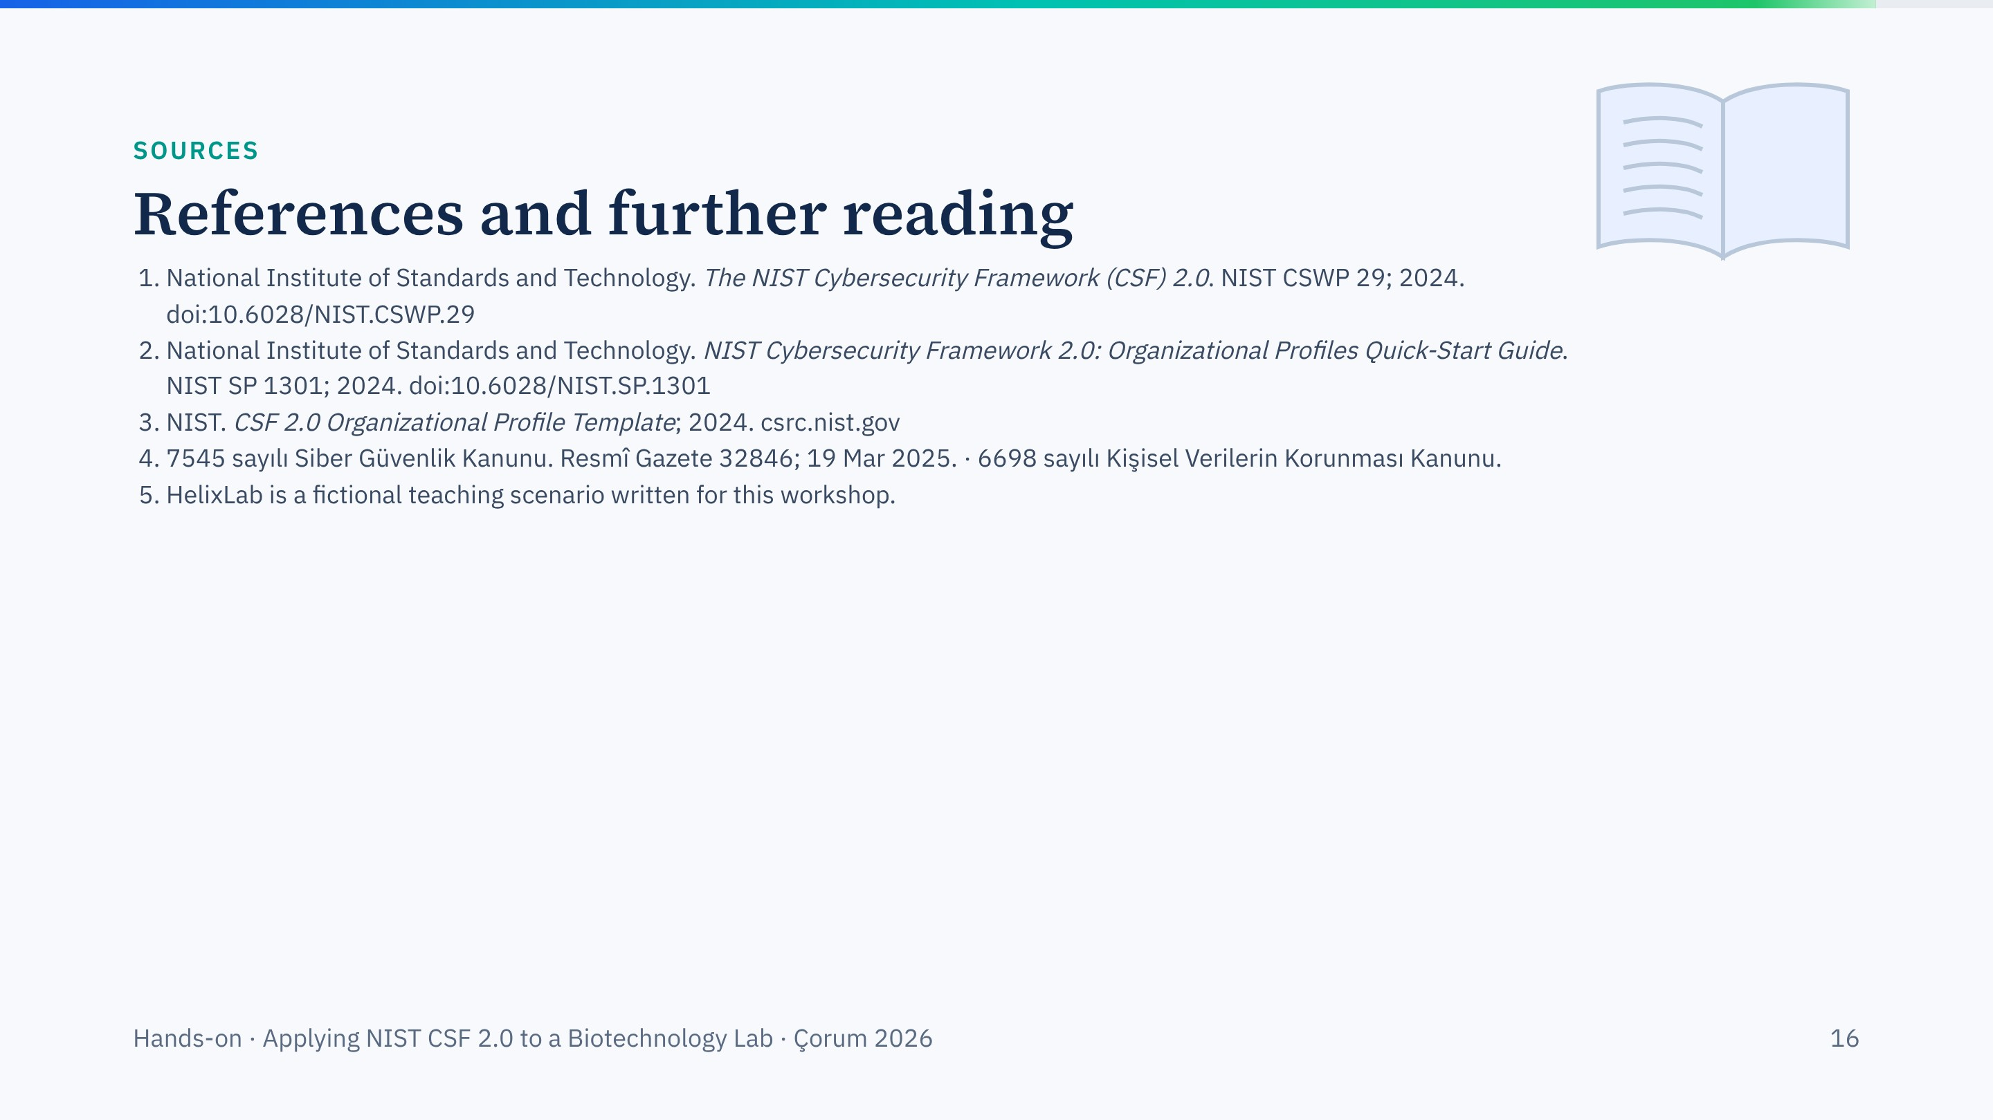
Notes:
Sources for this session. Every DOI on this slide was checked against Crossref.

Slide 17

Notes:
Thank the groups and move to the presentations.

