Slide 1
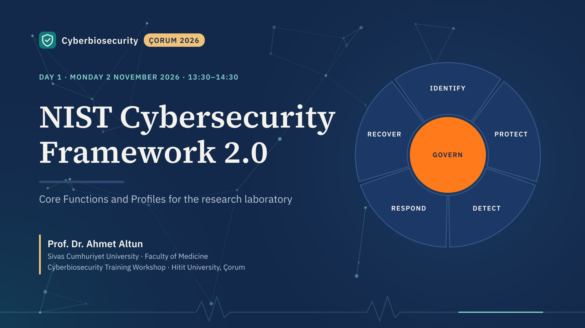
Notes:
Welcome back. This morning Prof. Gargılı set out why biological laboratories need cybersecurity. This hour gives that need a structure: the NIST Cybersecurity Framework, version 2.0.
Plan for the hour: why a framework, what changed in 2.0, the six functions with a laboratory example for each, how the Core is built, and then Tiers and Profiles, the part you will use tomorrow afternoon.

Slide 2
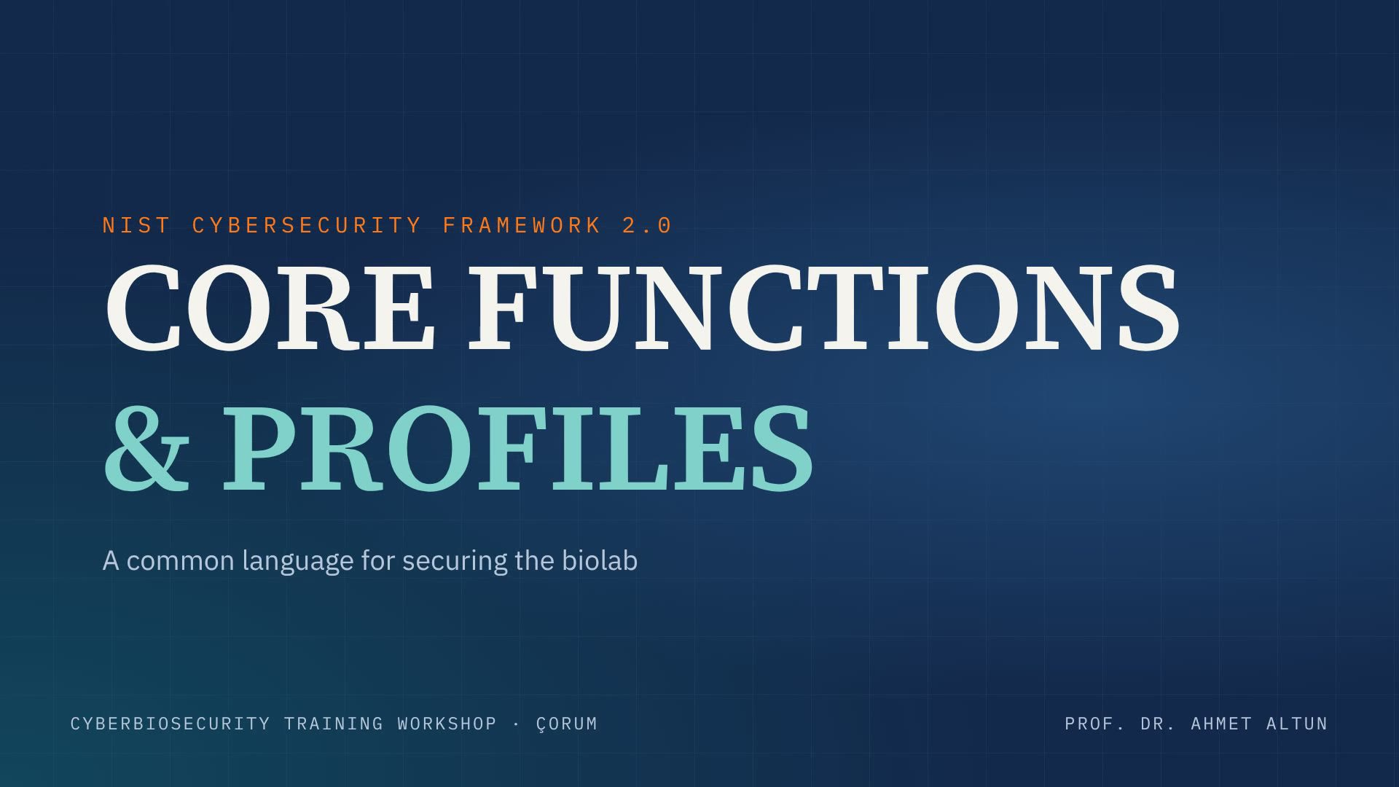
Notes:
Opening film, about 14 seconds; it loops while this slide is shown. Advance when it reaches the title card.

Slide 3
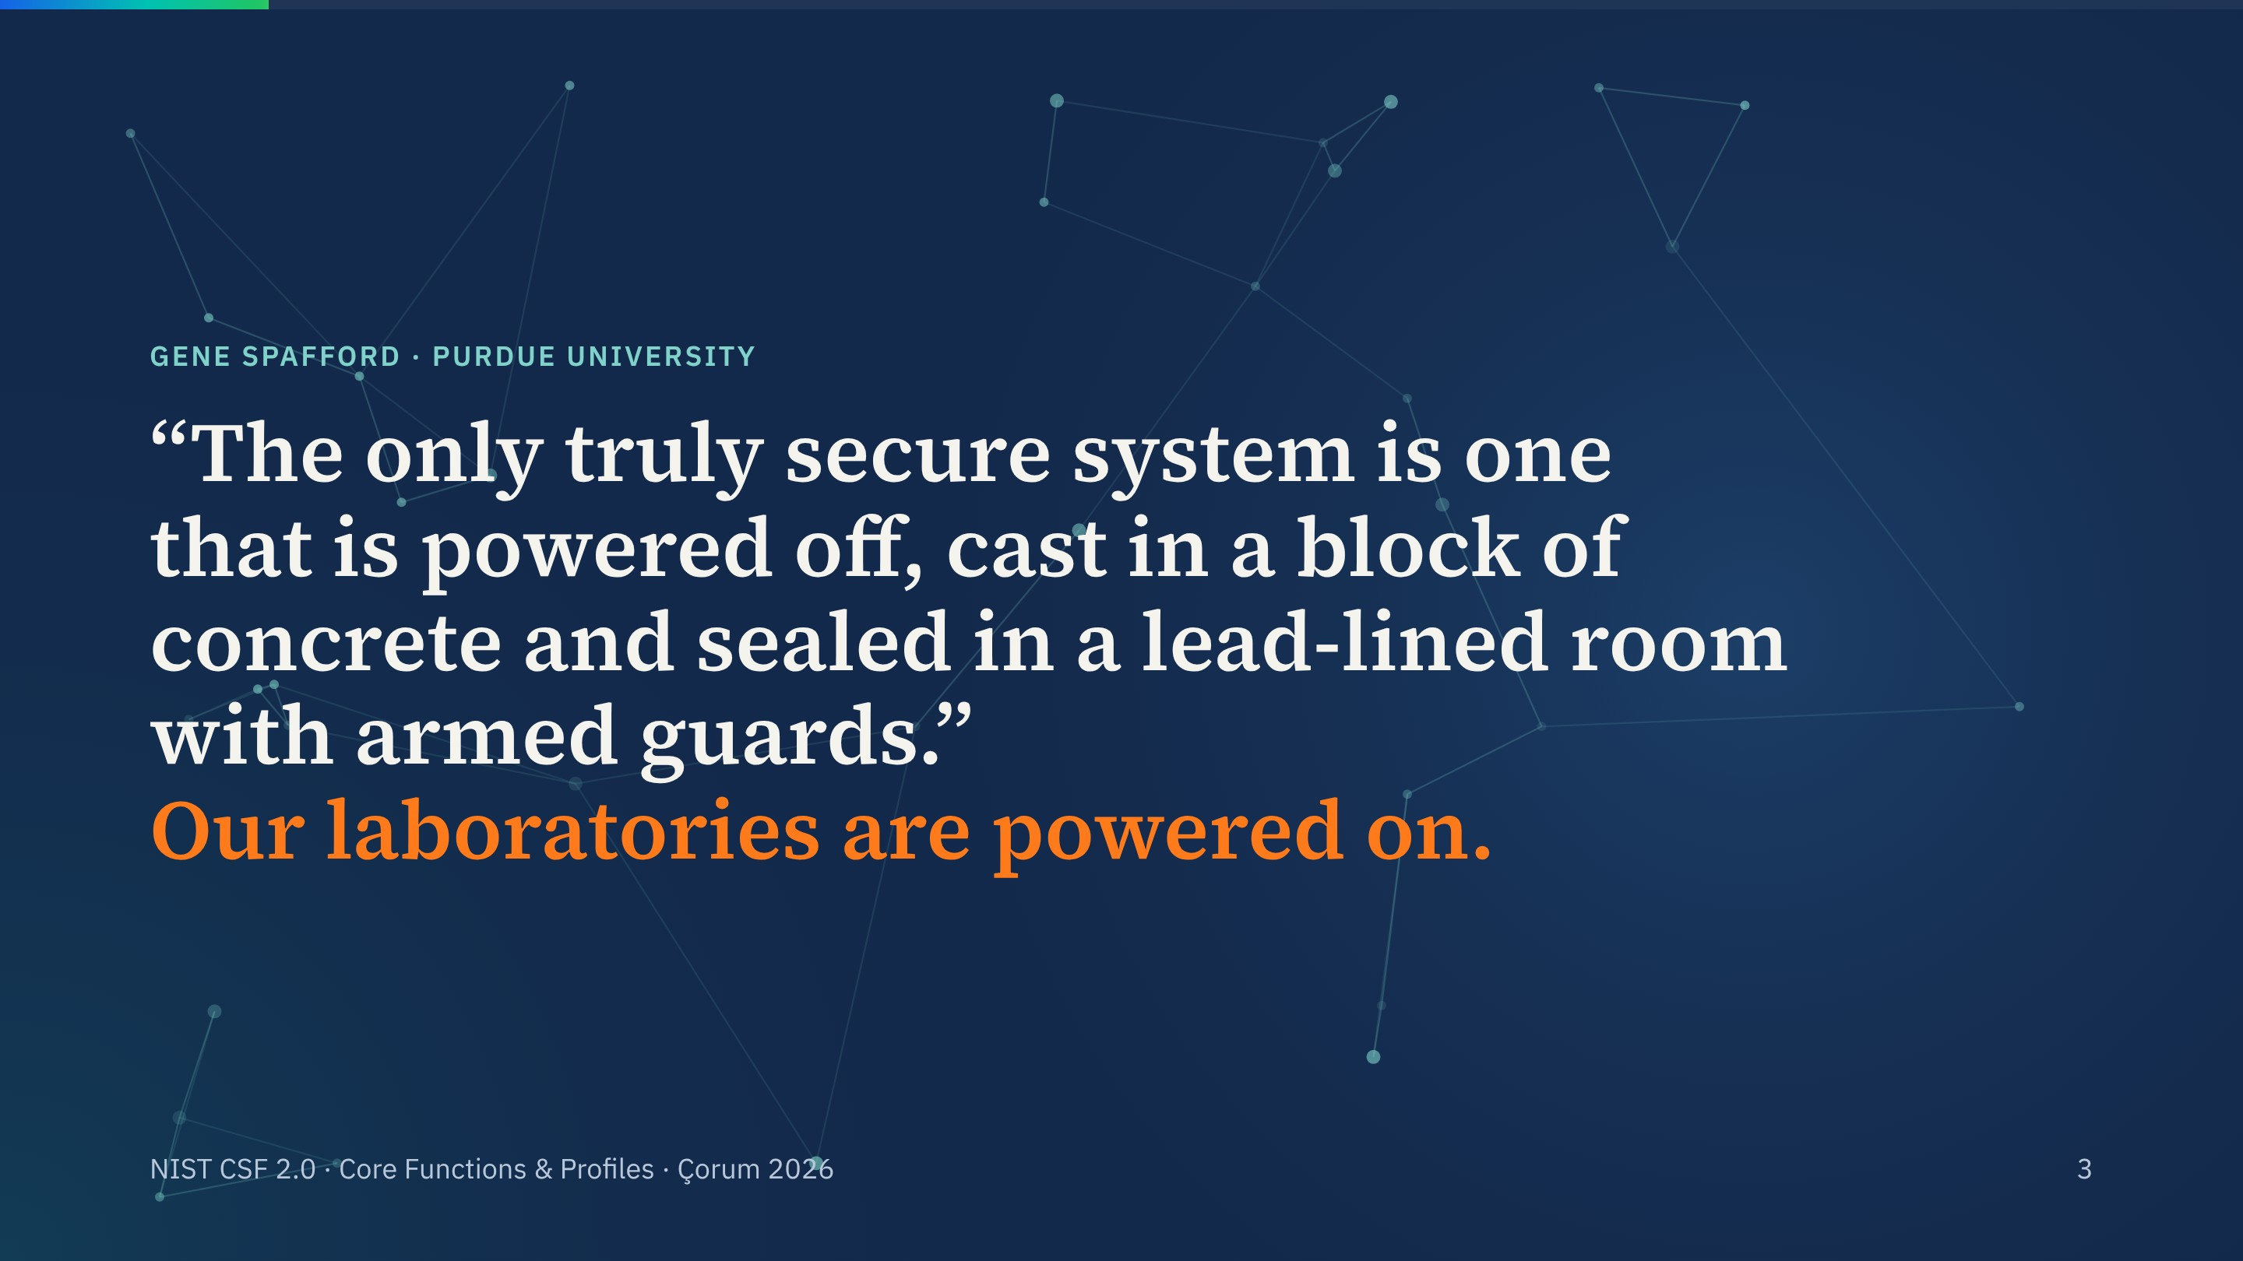
Notes:
Let the quote build line by line, then the last line lands in orange.
Our sequencers, freezers, biosafety cabinets and LIMS are all powered on and most are networked. So the question is never how to be perfectly secure. It is how to manage the risk in a way everyone in the building understands.

Slide 4
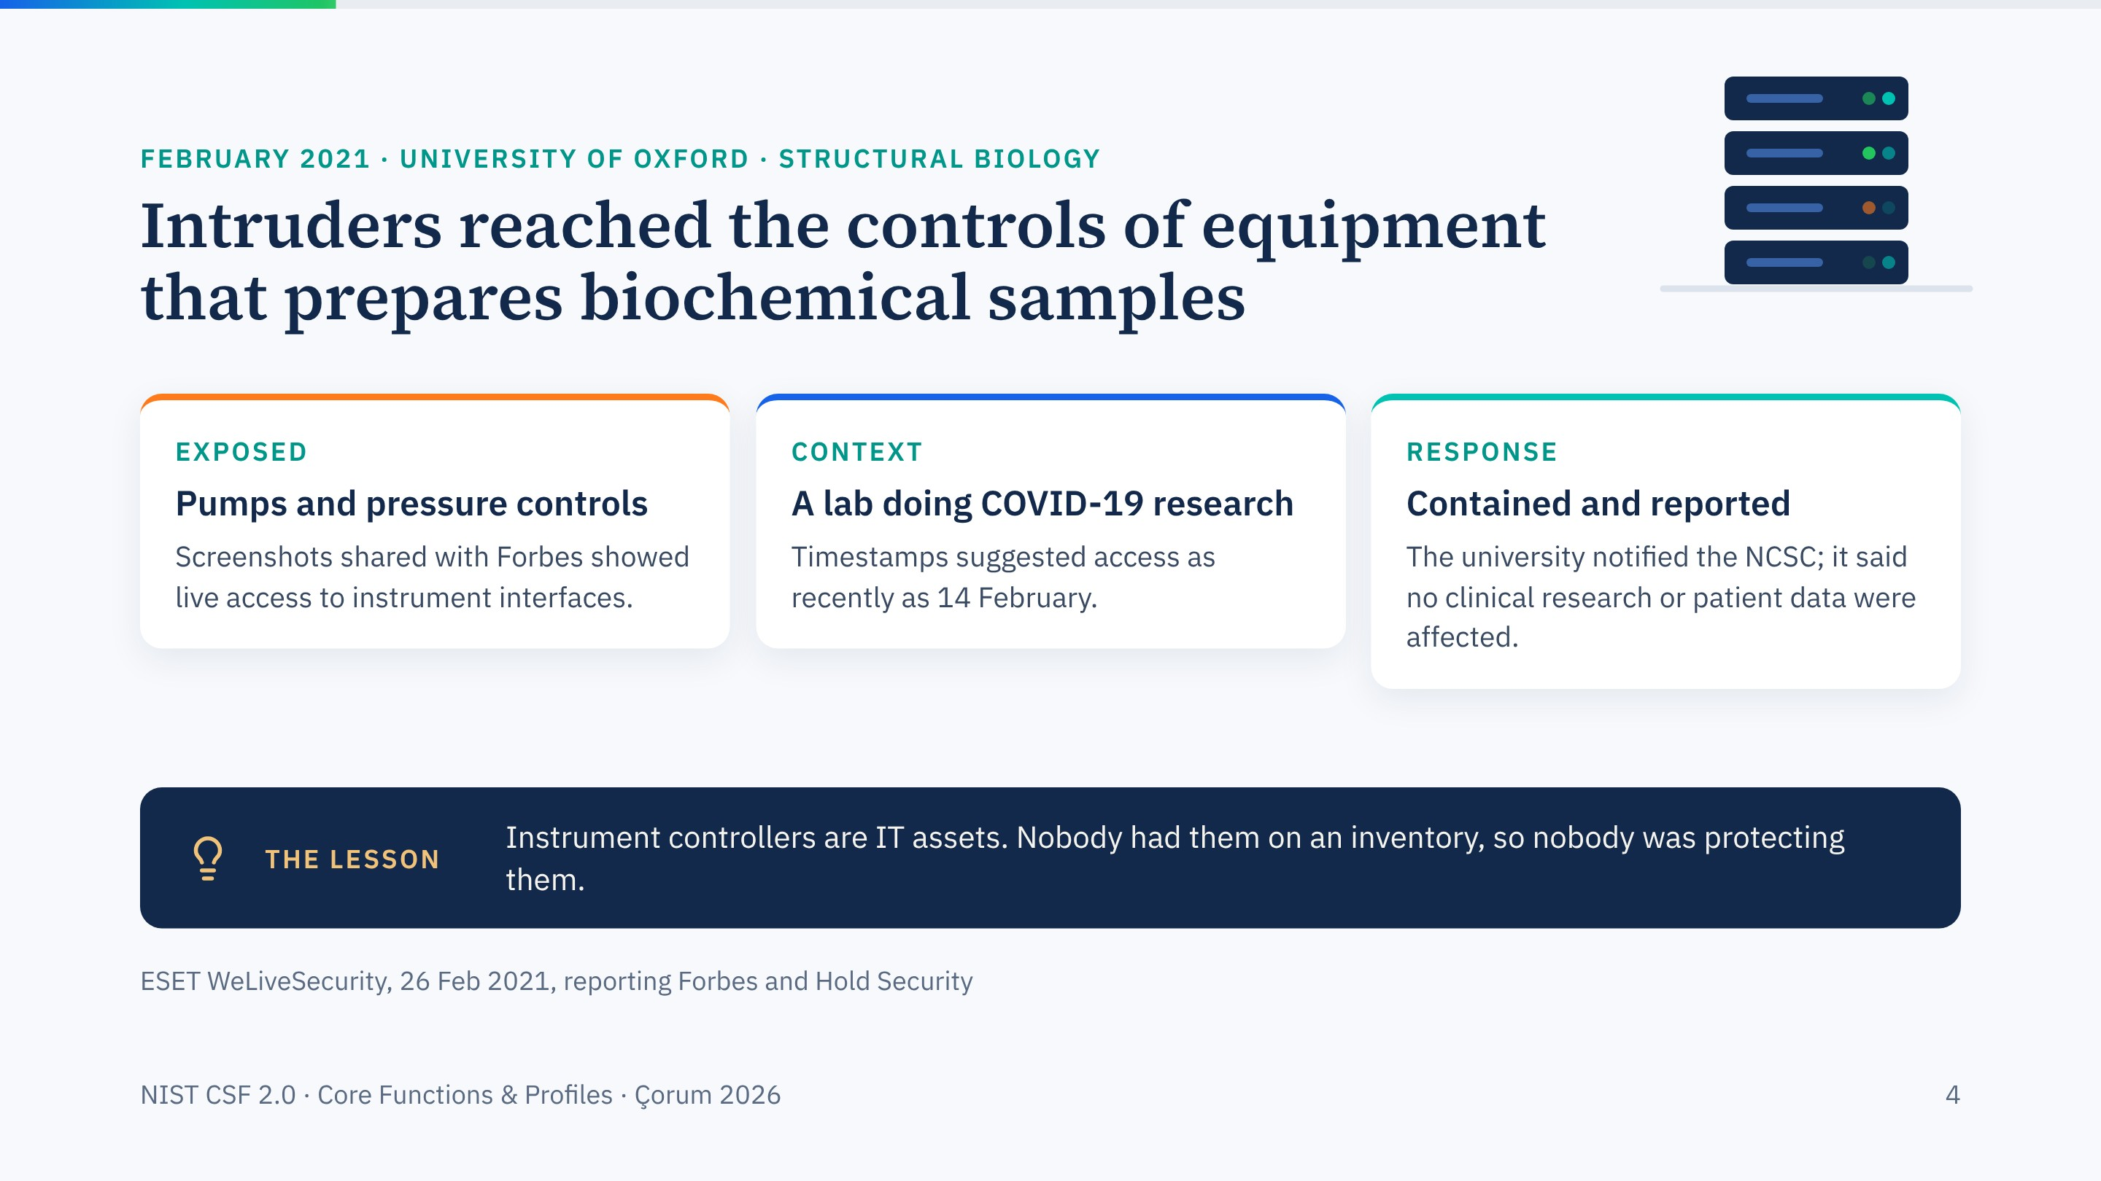
Notes:
A real case close to home for everyone in this room. In February 2021 Oxford confirmed that attackers had accessed systems in its Structural Biology division, including the controls of machines that purify and prepare biochemical samples.
The point is not that the attackers were sophisticated; reports suggest they were not. The point is that laboratory equipment was reachable, and nobody had treated it as an IT asset.

Slide 5
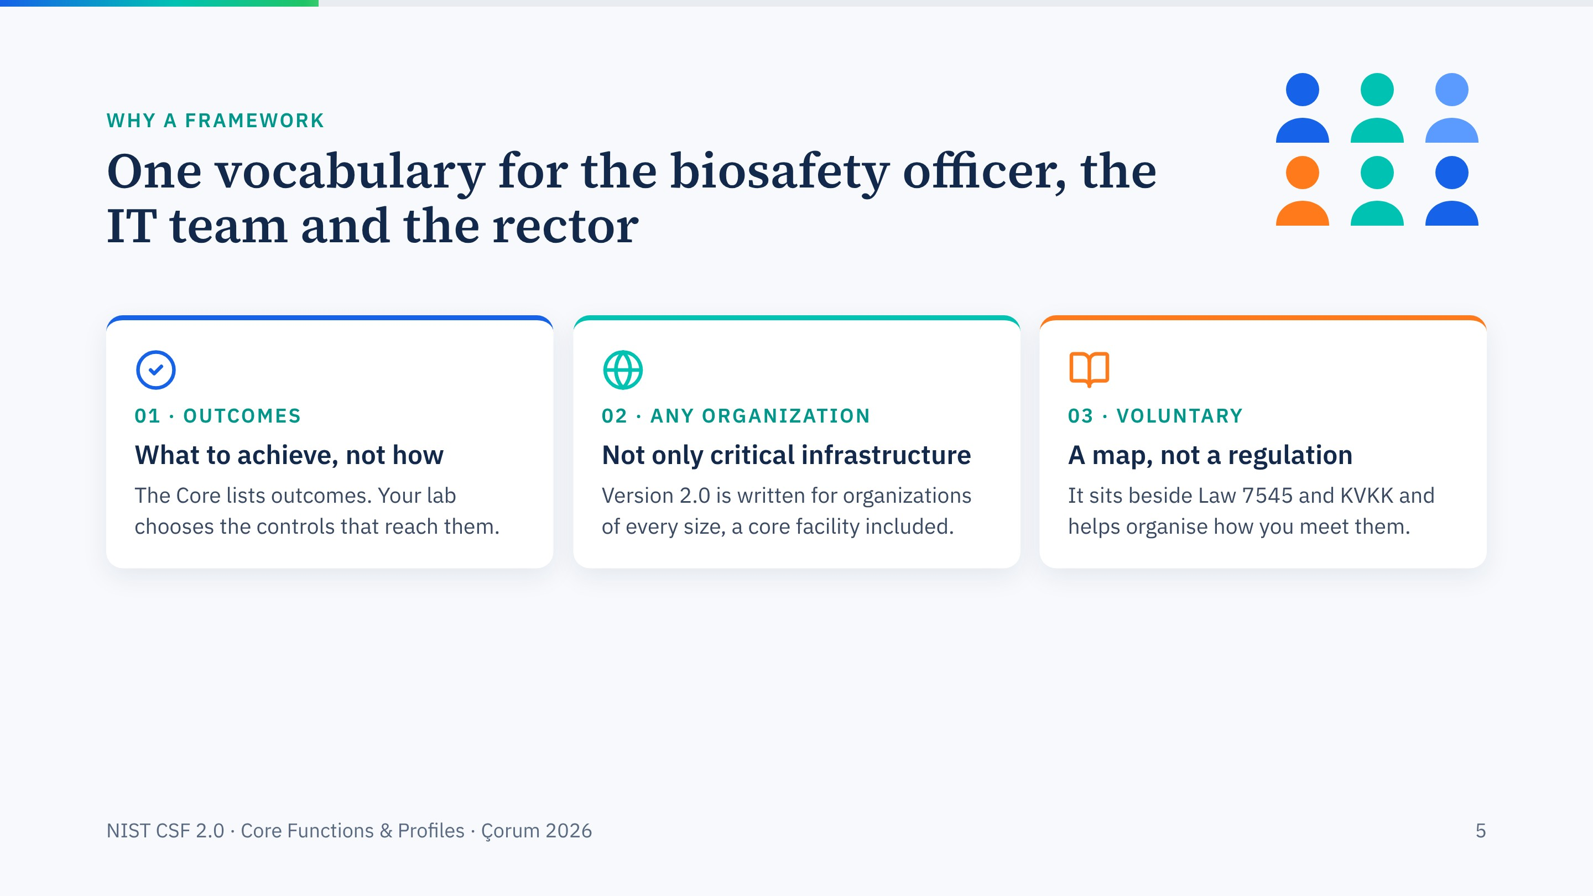
Notes:
Three things to remember about the CSF before we open it. It describes outcomes rather than prescribing products. Since 2.0 it is explicitly for any organization, not just power plants and banks. And it is voluntary: it does not replace national law, but it is an excellent way to organise compliance work.

Slide 6
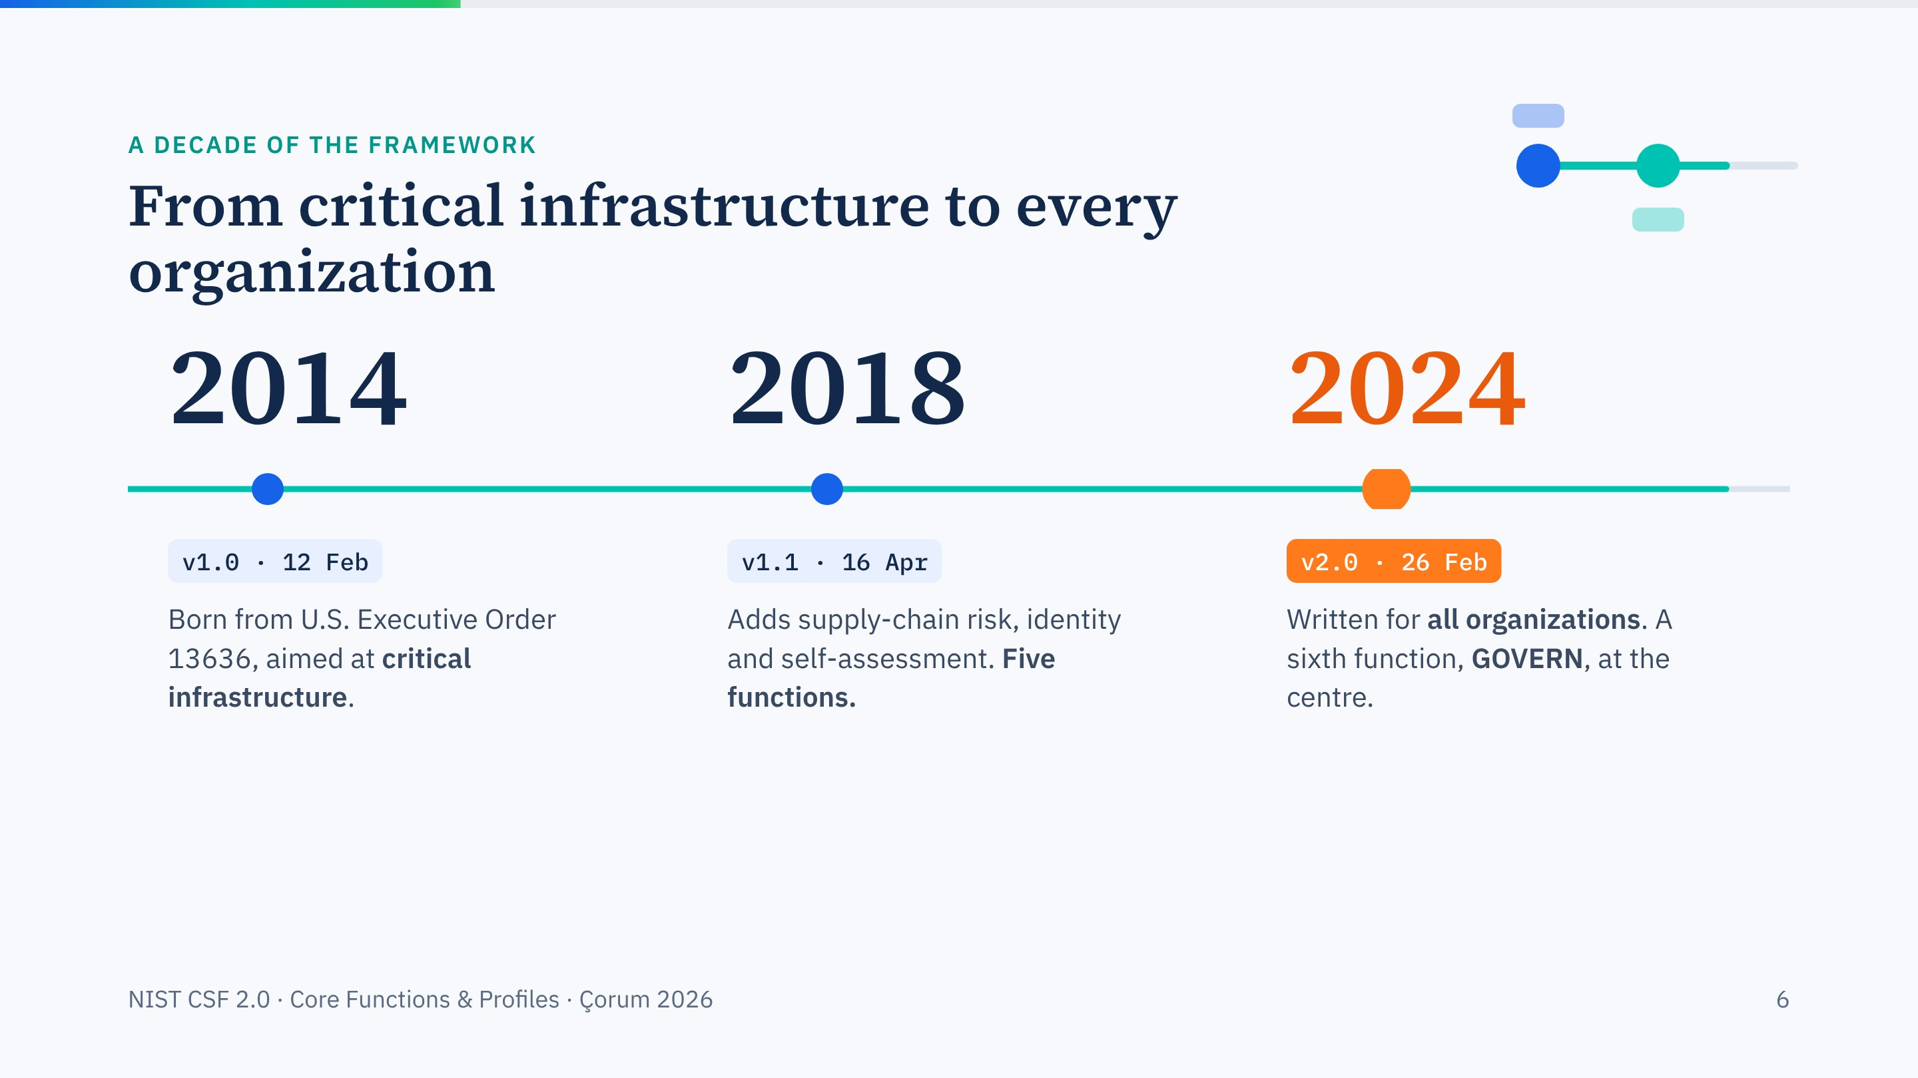
Notes:
Quick history. Version 1.0 came out in 2014 for critical infrastructure. Version 1.1 in 2018 kept the five functions and added supply-chain and identity material.
Version 2.0, published 26 February 2024, is the version we teach today. Two headline changes: the audience is now every organization, and governance became its own function.

Slide 7
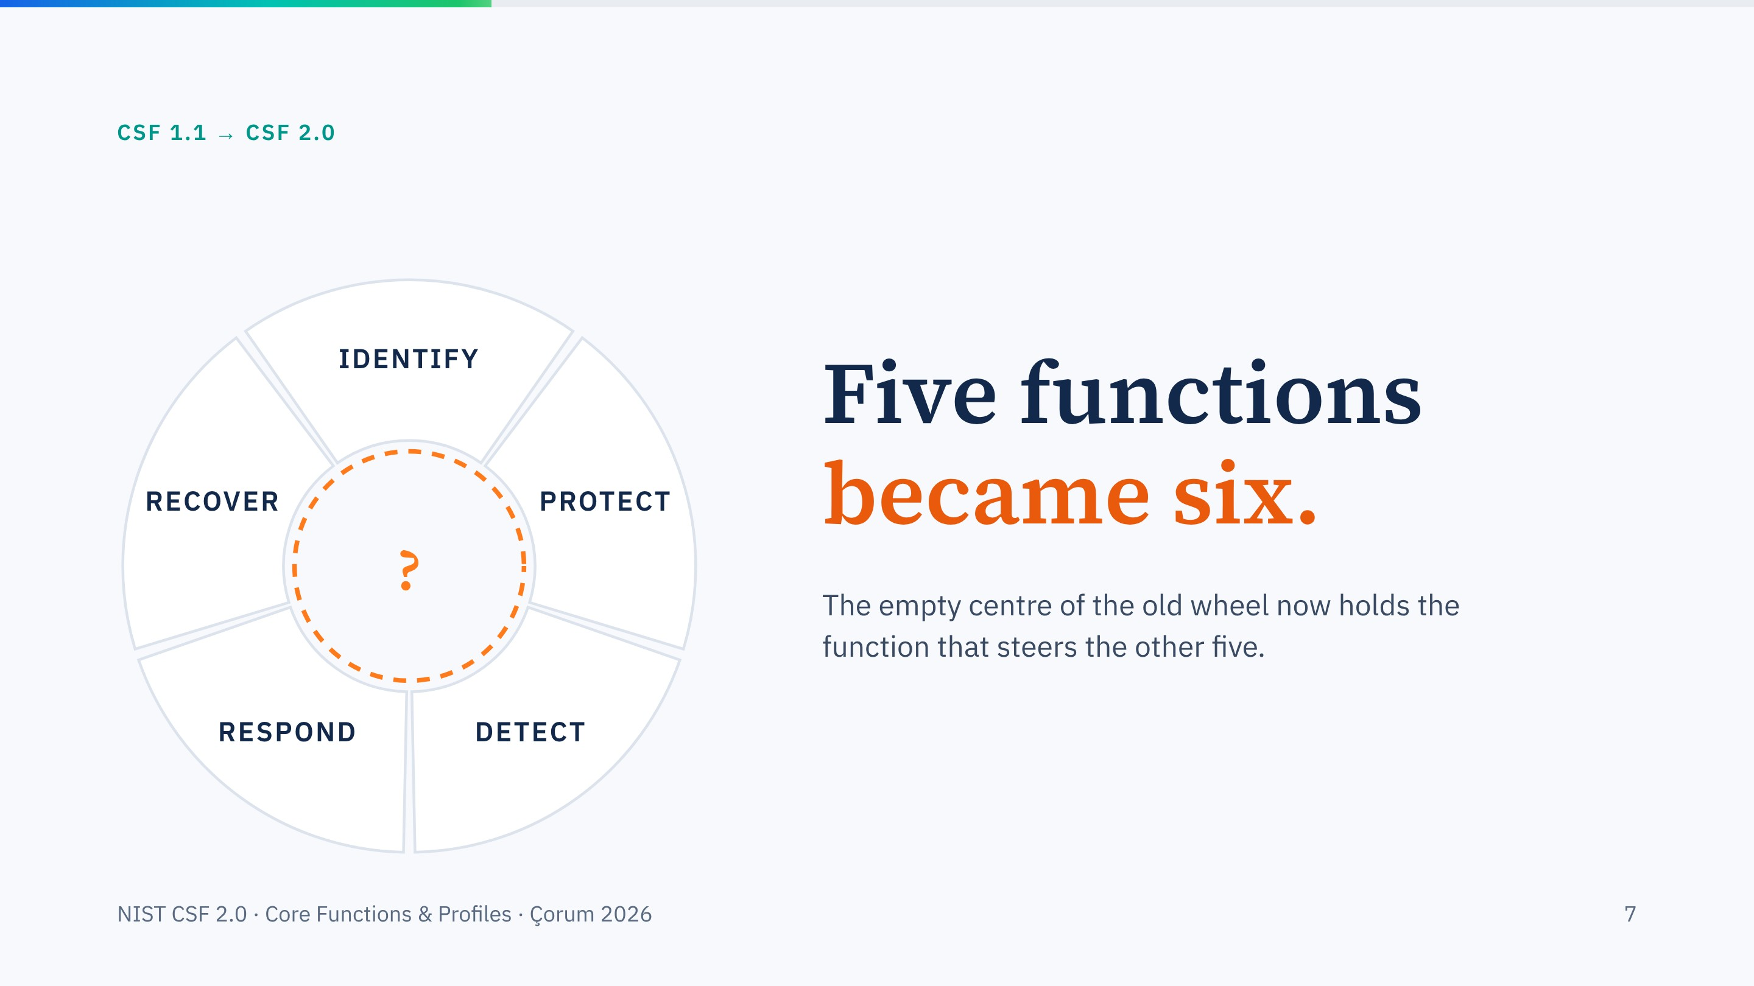
Notes:
This is the CSF 1.1 wheel: Identify, Protect, Detect, Respond, Recover. Notice the empty, pulsing centre. Click: in 2.0 that hole is filled. The next slide morphs the wheel into the 2.0 version.

Slide 8
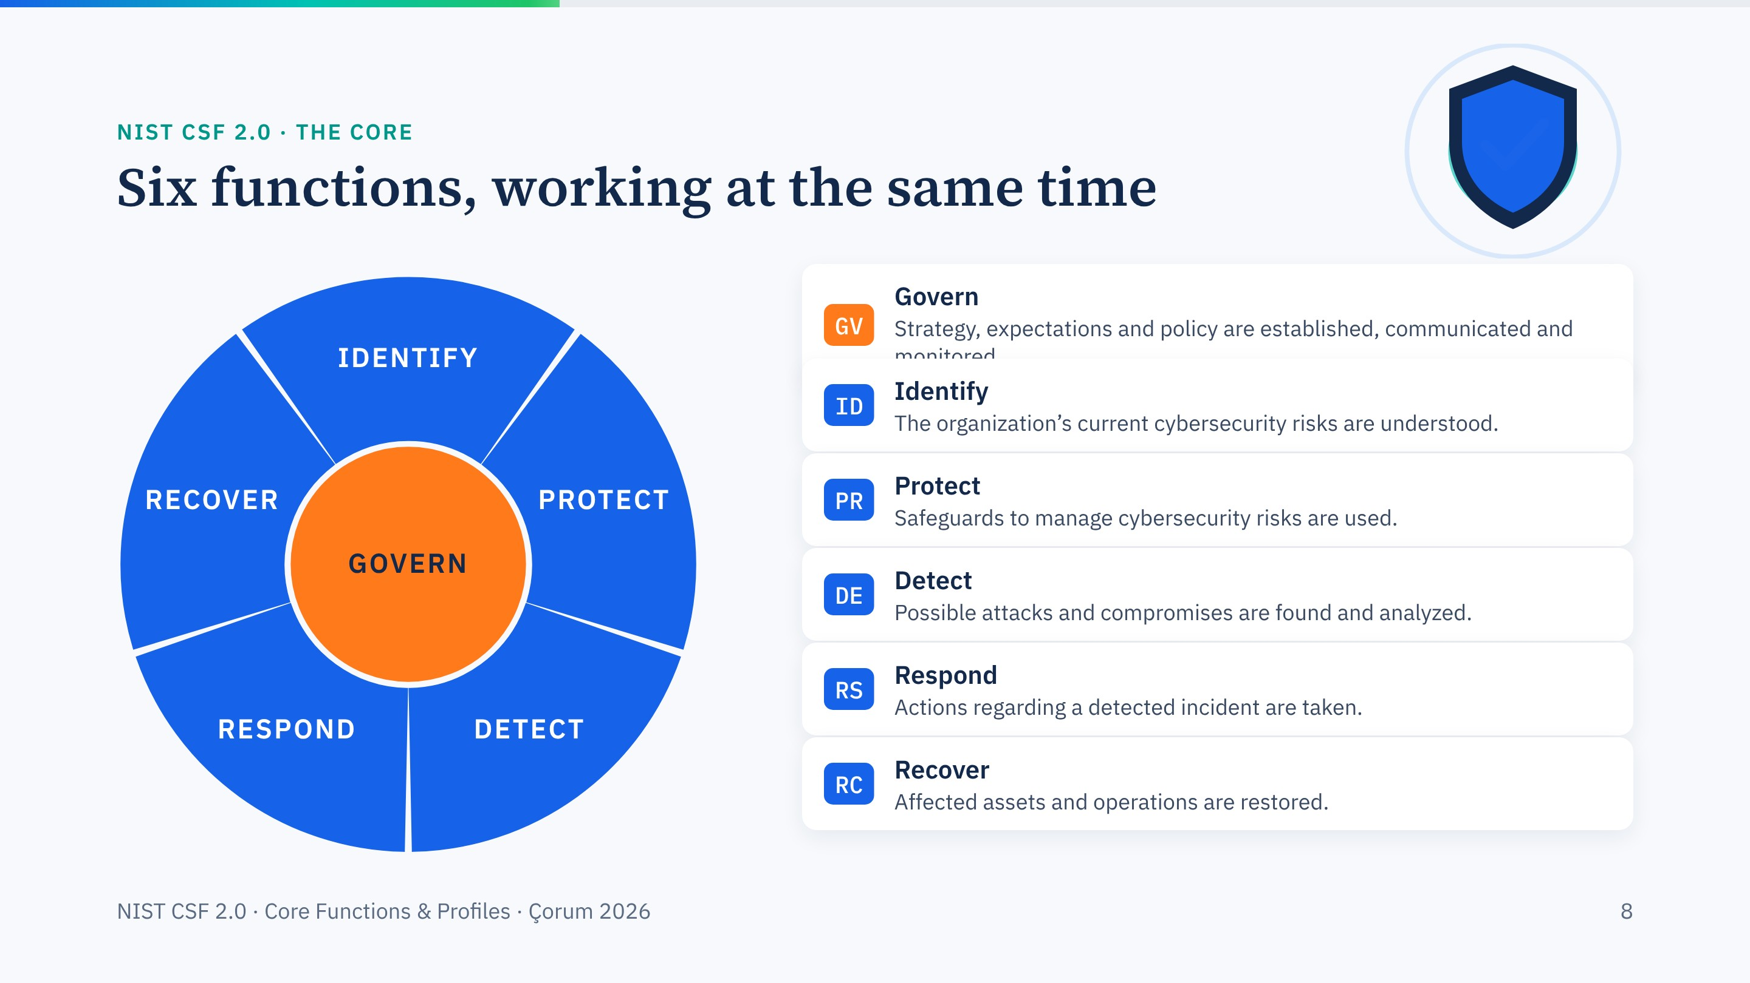
Notes:
The wheel morphs: GOVERN appears in the centre and every function lights up. Each click brings in one function with NIST's own one-line definition (paraphrased very slightly for length). Read them aloud; they are short on purpose.
Stress the title: all six run concurrently; they are not a checklist in order. The next slides zoom into one function at a time, and the wheel follows to the corner.

Slide 9
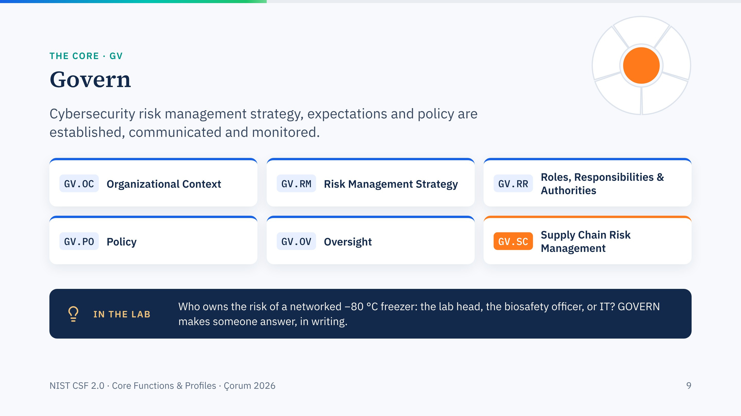
Notes:
GOVERN is new in 2.0, and it is where cyberbiosecurity starts. Six categories. Spend a moment on GV.RR: roles and authorities. In most labs nobody has formally been given the cyber risk of laboratory equipment.
Highlight GV.SC, supply-chain risk: instrument vendors with remote access, cloud LIMS providers, and for core facilities the external clients whose samples and data you hold.

Slide 10
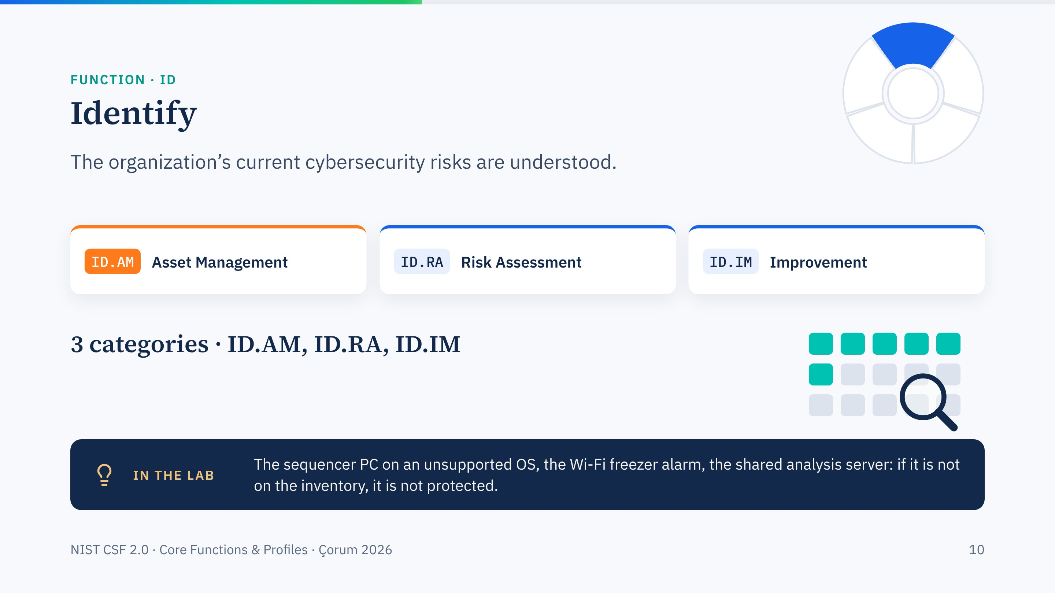
Notes:
IDENTIFY is about knowing what you have and what could go wrong. Asset management is the foundation of everything else.
Link forward: at 15:30 today Prof. Merey runs the laboratory asset-mapping exercise. That exercise is ID.AM in practice.

Slide 11
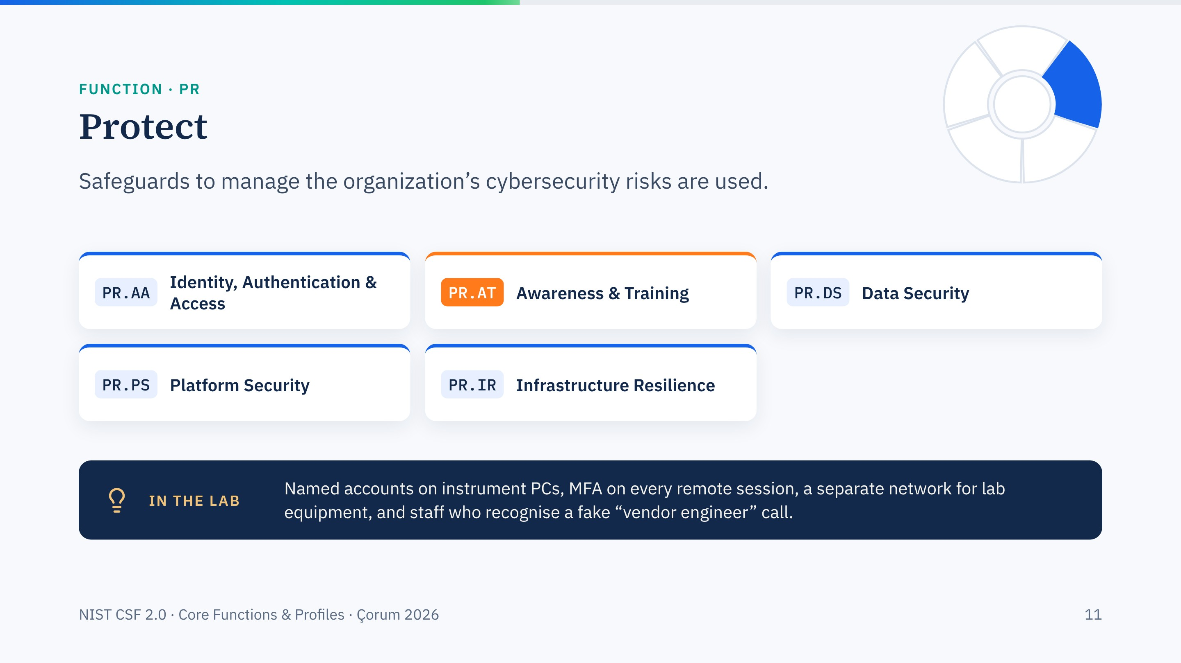
Notes:
Five categories. In laboratories the weak points are usually PR.AA, shared logins on instrument PCs, and PR.AT, people.
Most intrusions still begin with a person being persuaded to do something. Awareness training is a Protect outcome, not an optional extra.

Slide 12
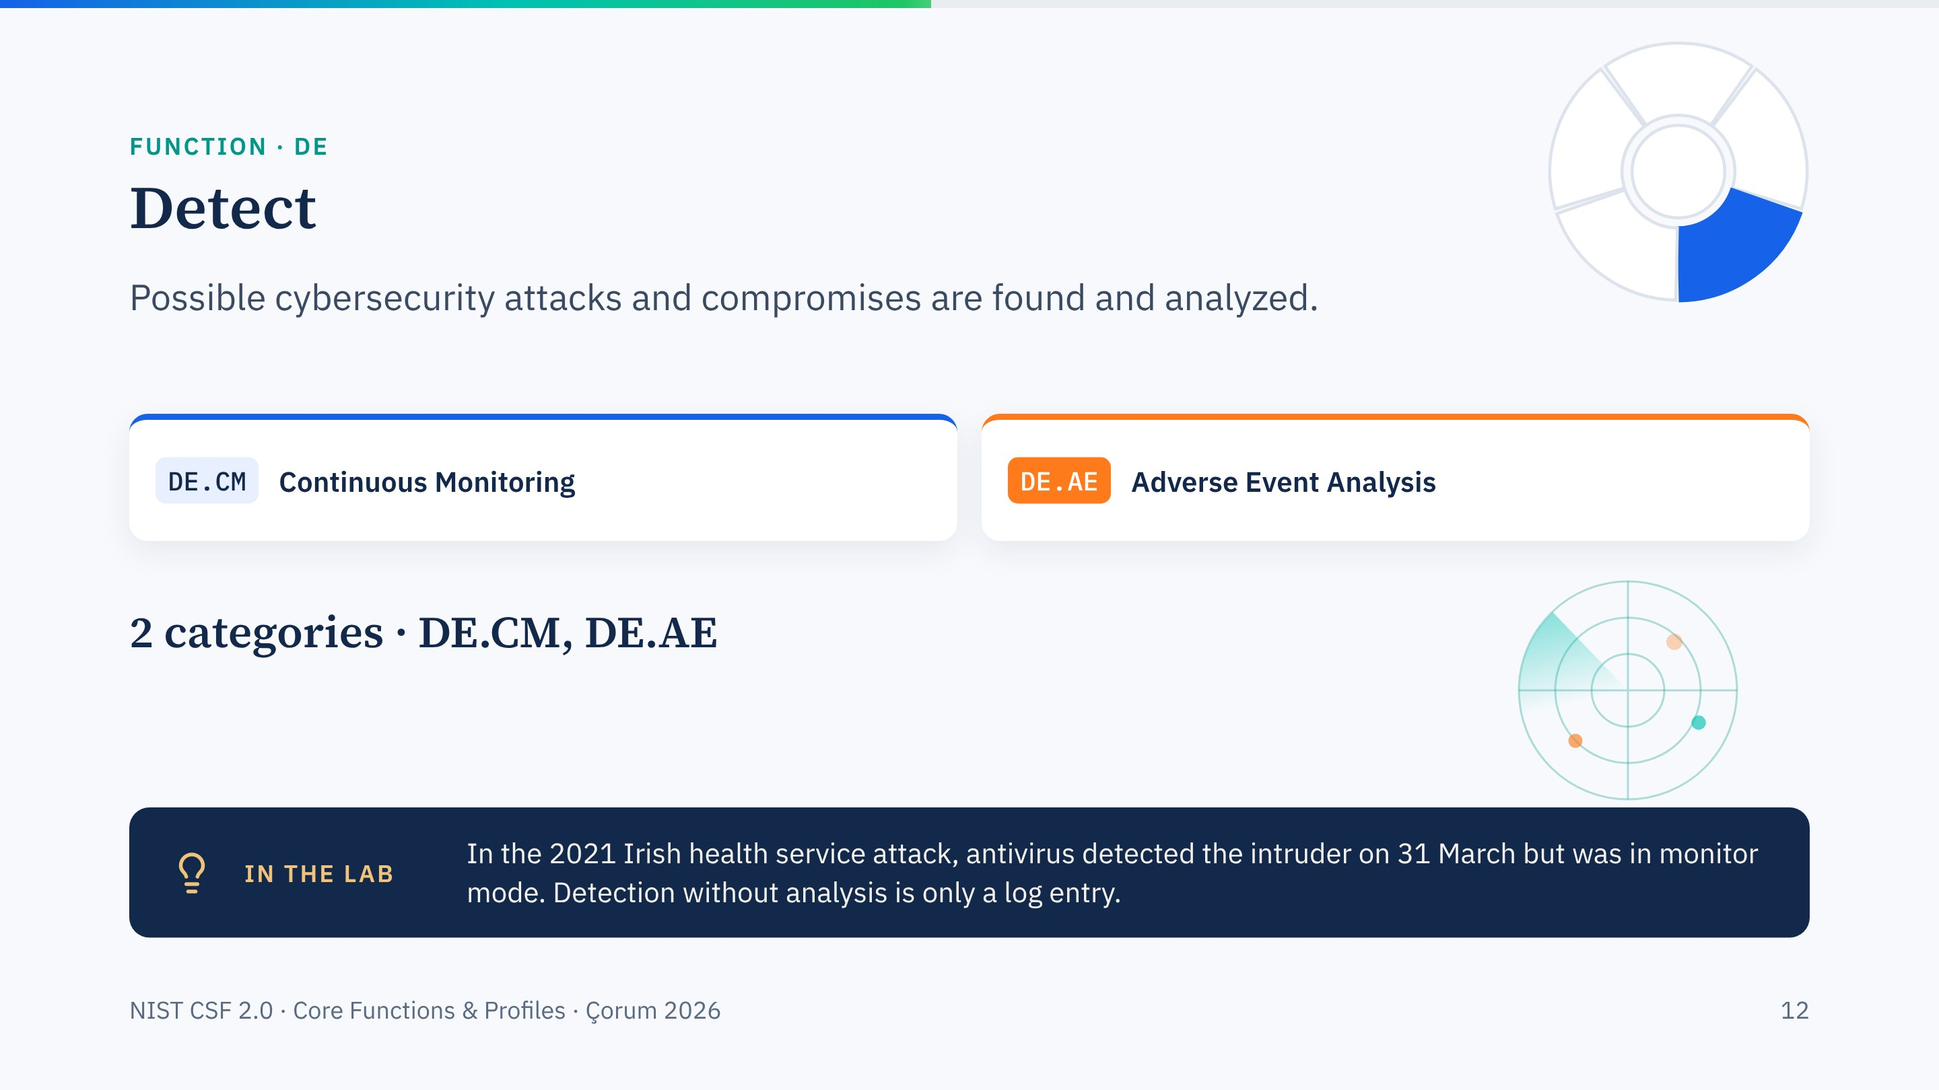
Notes:
Two categories. Monitoring collects signals; adverse event analysis decides what they mean.
The HSE case is the reminder: the signal was there seven weeks before the ransomware went off. We open that case fully tomorrow at 11:30.

Slide 13
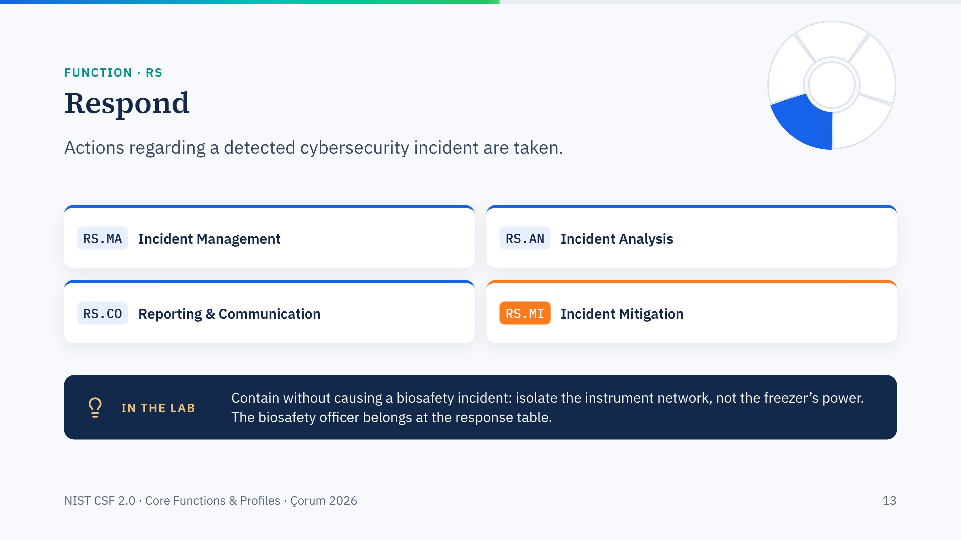
Notes:
Four categories. The laboratory twist is in mitigation: the fastest containment move can destroy samples or break containment.
So response plans in a lab must be written jointly by IT and biosafety. RS.CO also covers reporting: in Türkiye, Law 7545 requires reporting to the Cyber Security Presidency without delay.

Slide 14
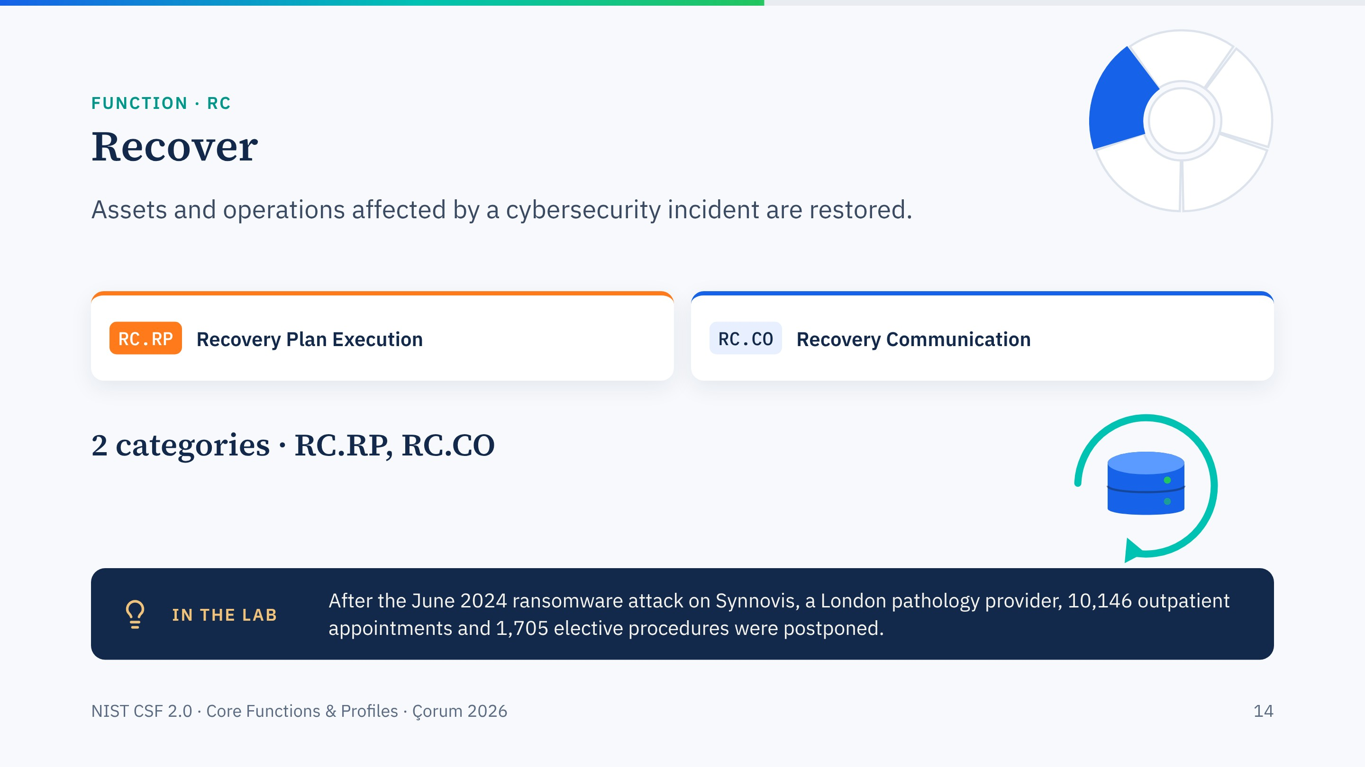
Notes:
Two categories. Recovery is not only restoring servers; it is restoring the service the lab provides.
Synnovis is a supply-chain story too: one pathology contractor, two major hospital trusts disrupted for months. Figures are NHS England's cumulative numbers to mid-September 2024.

Slide 15
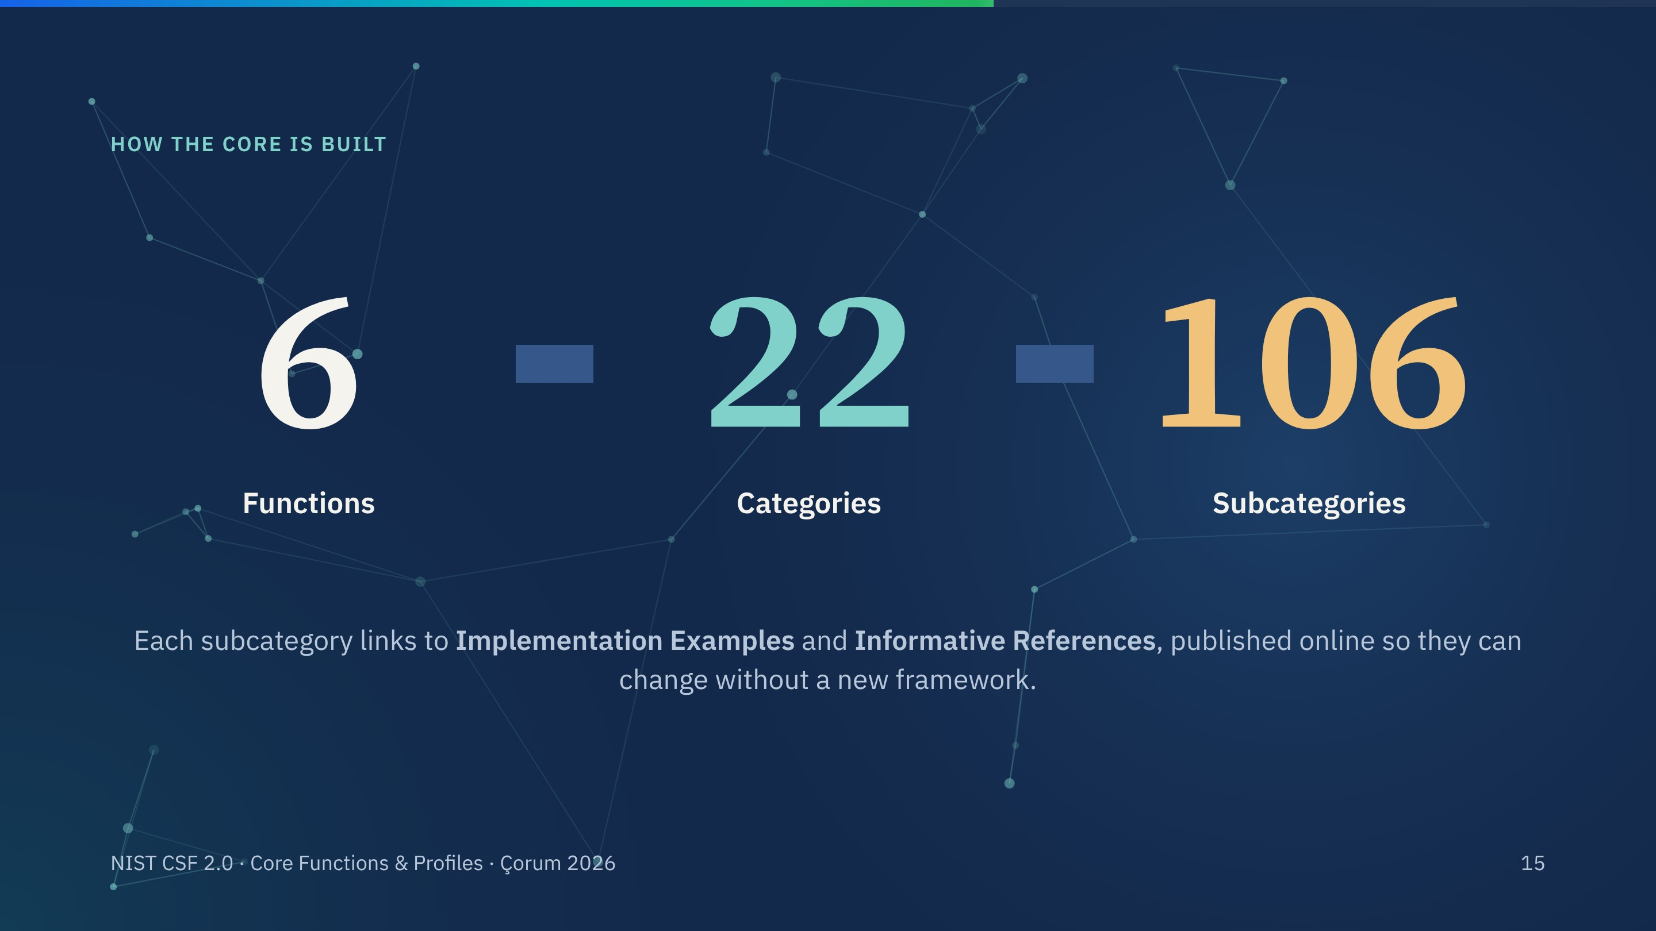
Notes:
Zoom out from the functions to the structure. Six functions, twenty-two categories, one hundred and six subcategories.
In 2.0 the examples and the mappings to other standards such as ISO 27001 moved online, so they can be updated without a new framework version. Next slide: one thread from function down to an actual task.

Slide 16
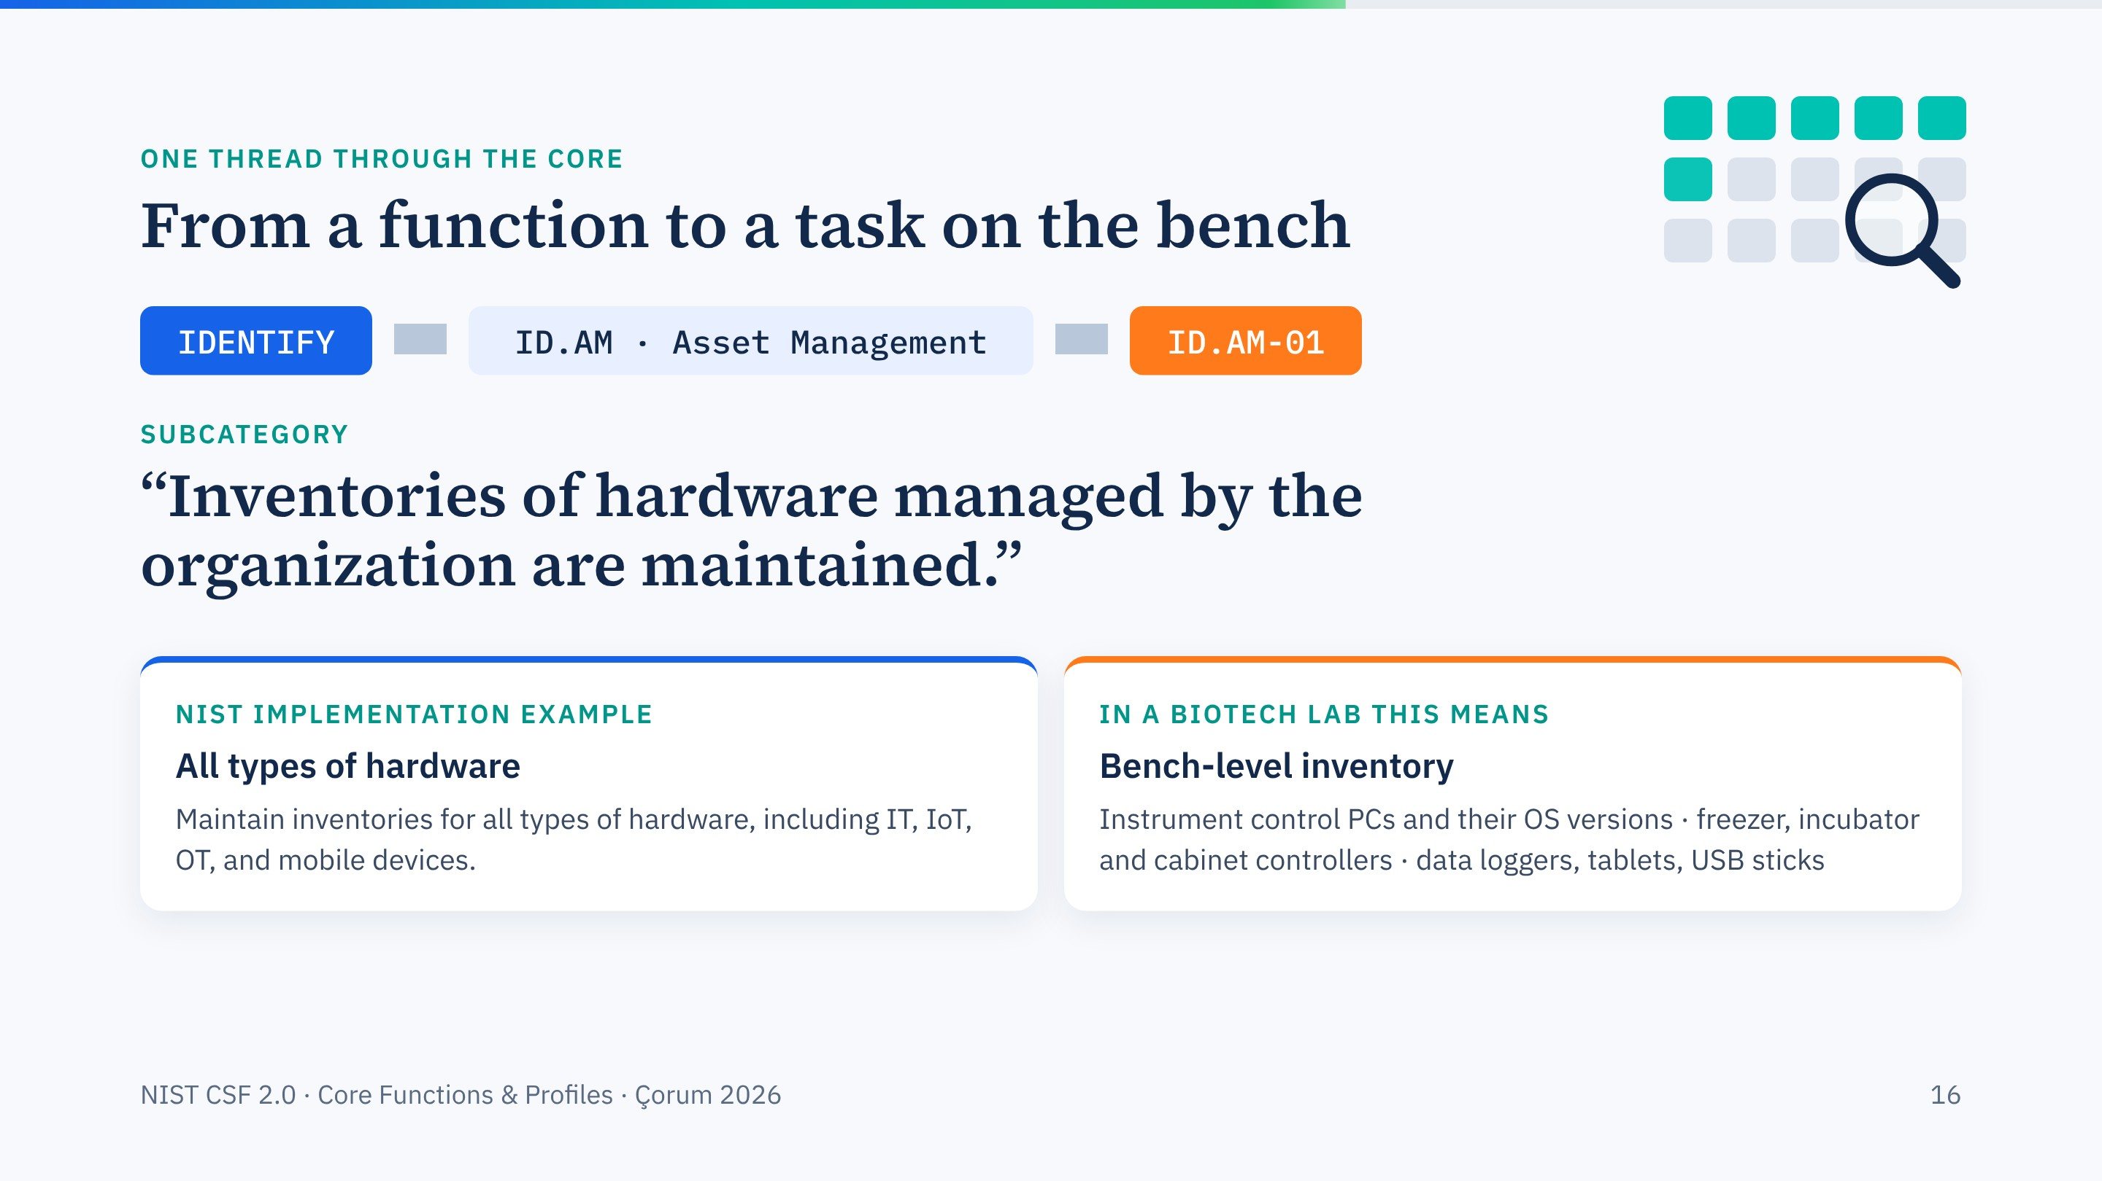
Notes:
Build this slide one click at a time. Function, category, subcategory: ID.AM-01. Then NIST's own implementation example, then what it means on our bench.
This one line, an up-to-date hardware inventory that includes OT and IoT, is where most laboratories fail first. It is also the first step of the exercise this afternoon.

Slide 17
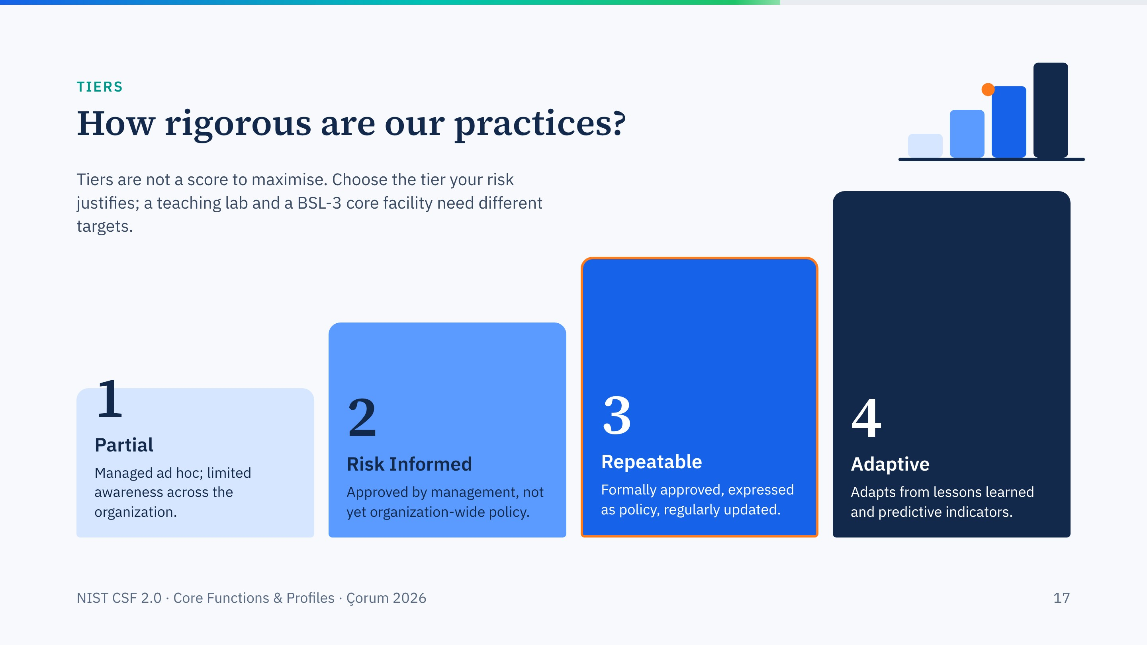
Notes:
Tiers describe the rigour of your practices, from ad hoc to adaptive. They apply to governance and to management of risk.
Stress the sentence at the top: higher is not automatically better. Tier 3, outlined in orange, is a sensible target for many research facilities; Tier 4 costs real money and staff.

Slide 18
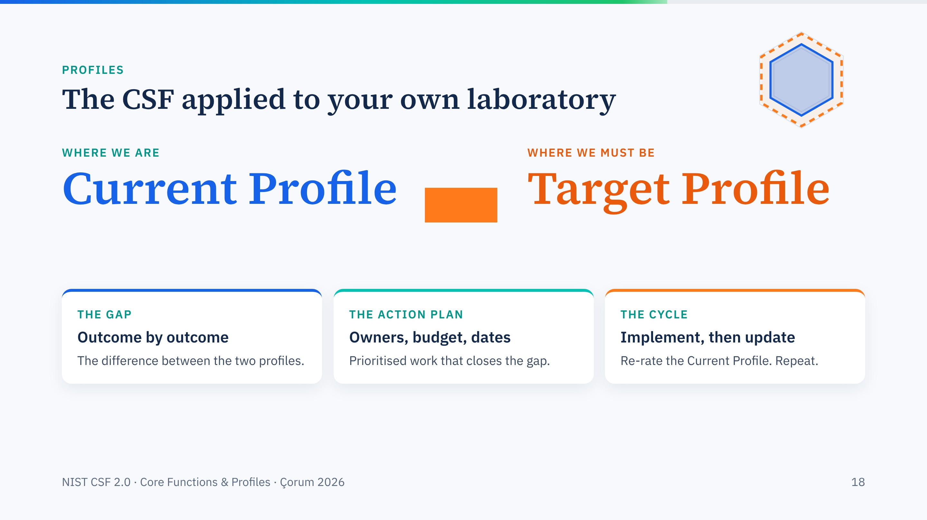
Notes:
A Profile is the CSF applied to you. The Current Profile says which outcomes you achieve today; the Target Profile says which you need, given your risks and obligations.
The three cards build in turn: the gap, the action plan, the cycle. This is exactly what each group will build tomorrow at 14:30.

Slide 19
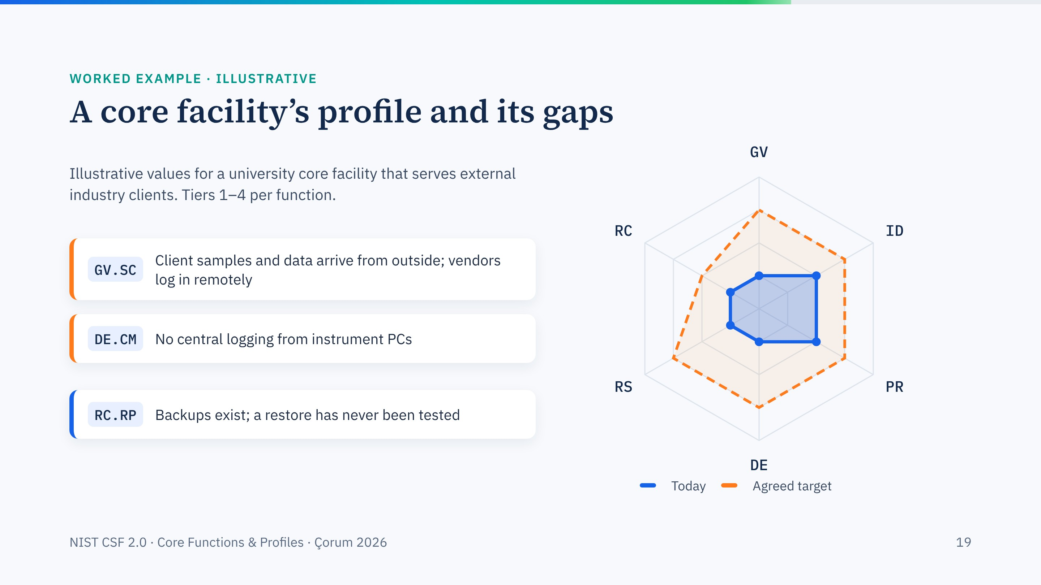
Notes:
An illustrative profile; the numbers are an example, not data from a real facility. Blue is today, the dashed orange line is the target the facility's board agreed. The three biggest gaps build in on the left.
For a facility that receives clients' samples and data, supply-chain governance, GV.SC, is usually the largest gap and the most specific to our sector.

Slide 20
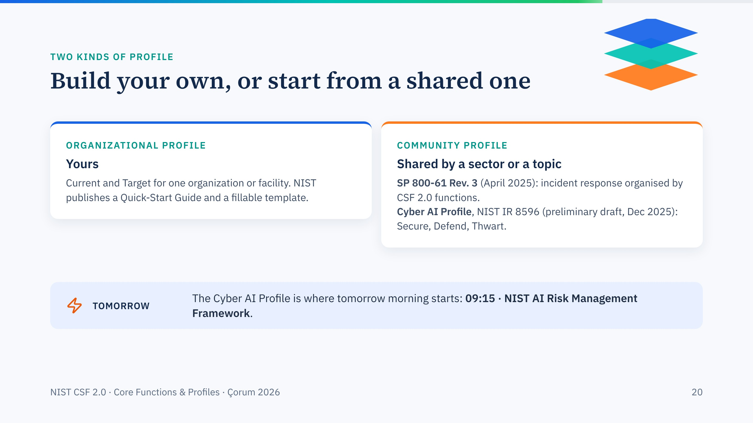
Notes:
Organizational Profiles are what you build for your own unit. Community Profiles are written for a whole sector or topic and you can start from them.
Two that matter for this workshop: the new incident response guidance, SP 800-61 Revision 3, which is itself a CSF 2.0 community profile, and the preliminary Cyber AI Profile, which leads into tomorrow morning.

Slide 21
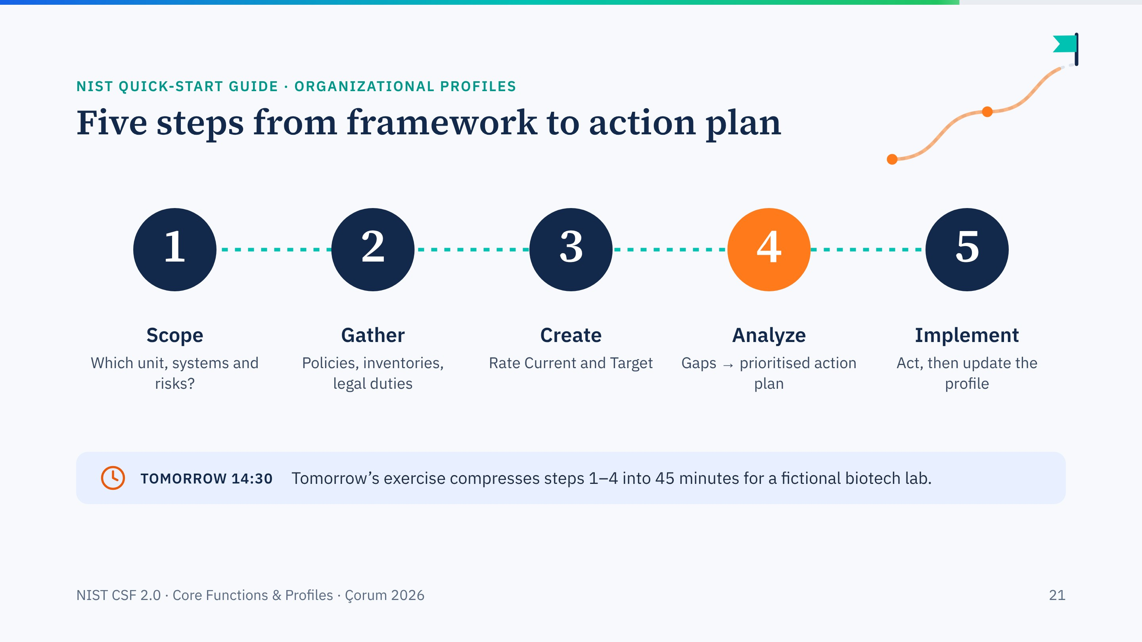
Notes:
NIST's quick-start guide gives five steps: scope, gather, create, analyze gaps and plan, implement and update. The numbers pop in one by one.
Tomorrow's exercise compresses steps one to four into forty-five minutes for a fictional biotech lab.

Slide 22
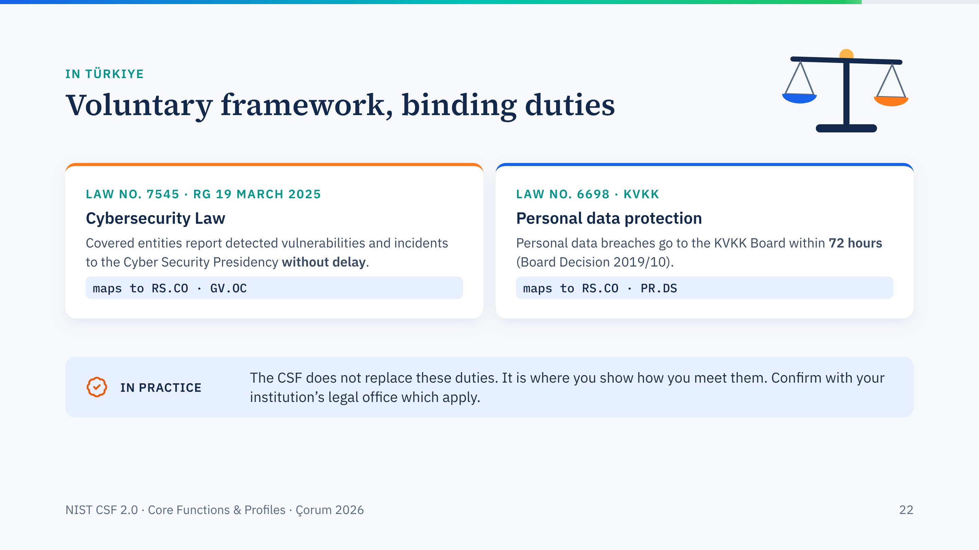
Notes:
Bring it home. Law 7545, published in the Official Gazette on 19 March 2025, created reporting duties to the Cyber Security Presidency. KVKK sets 72 hours for notifying personal data breaches.
The CSF does not replace these laws, but outcomes such as GV.OC, legal requirements are understood, and RS.CO, reporting, are where you show you meet them.

Slide 23
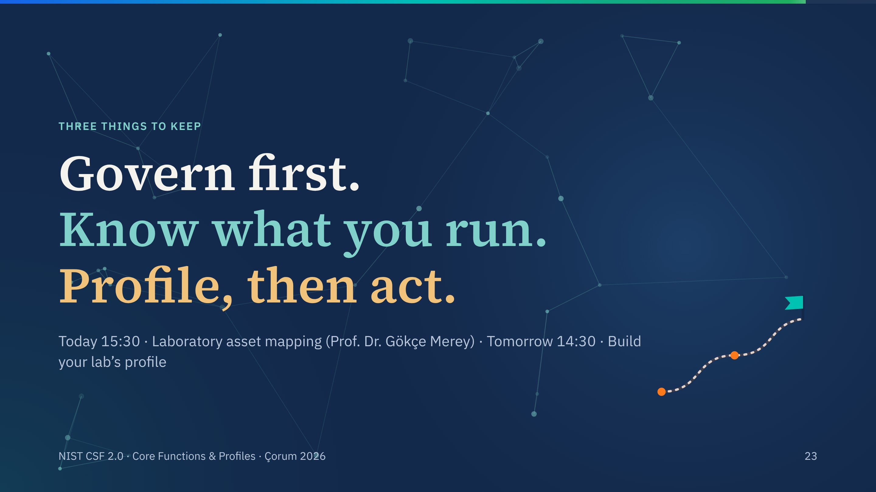
Notes:
Three lines, one per click. Govern first: someone must own the risk. Know what you run: inventory, including OT. Profile, then act: compare where you are with where you must be.
Then point to where these ideas continue: Prof. Merey's asset-mapping exercise at 15:30 and tomorrow's hands-on session.

Slide 24
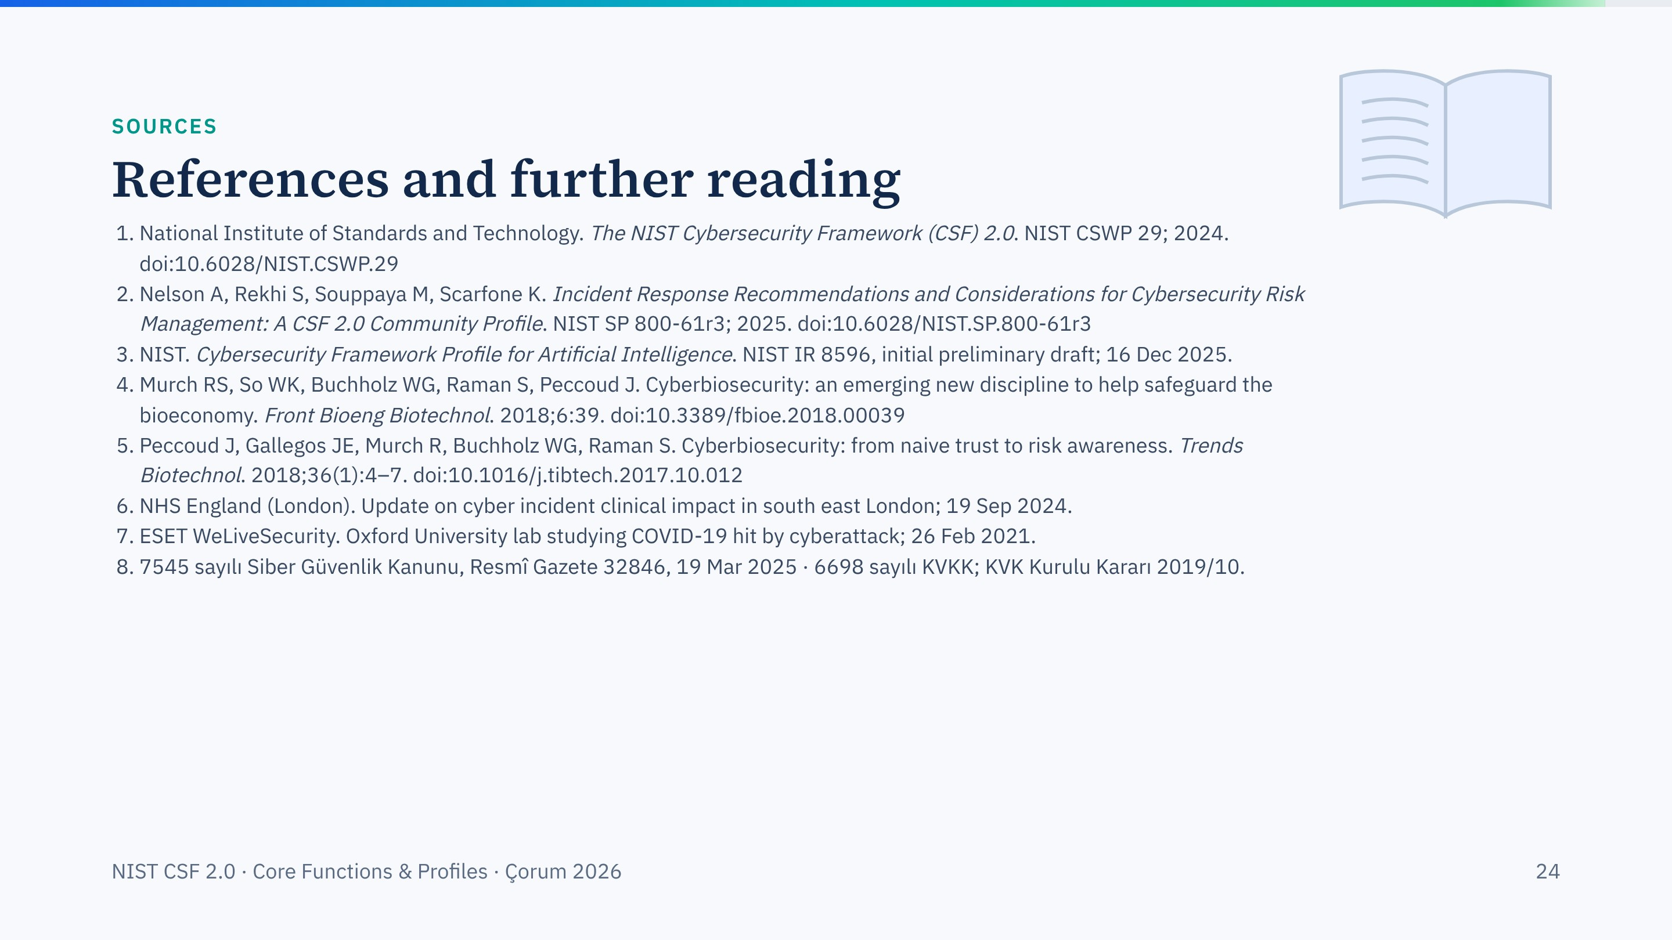
Notes:
Sources for this session. Every DOI on this slide was checked against Crossref.

Slide 25

Notes:
Open the floor. If time is short, take one or two questions and point people to the afternoon exercise.

