Slide 1
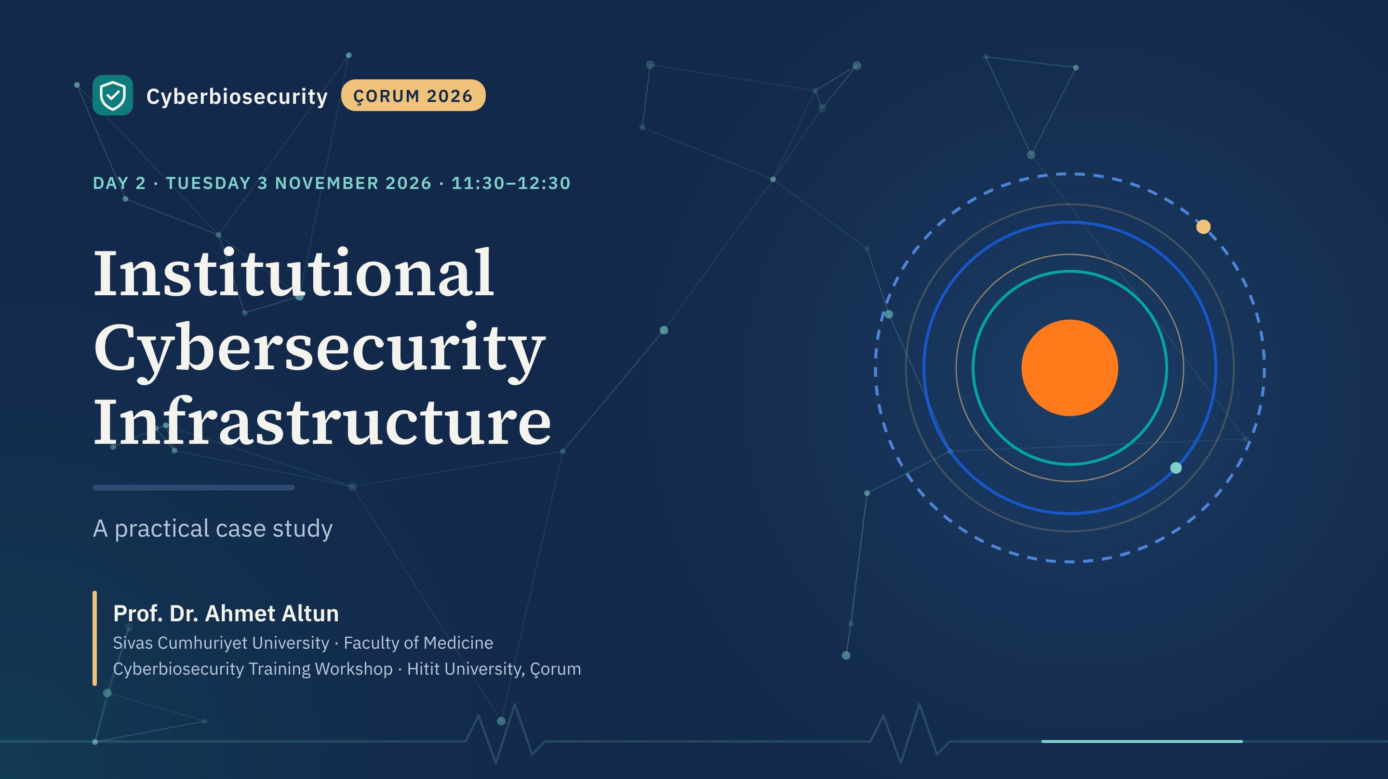
Notes:
This session is practical. We take one large real incident to see how infrastructure fails, then walk through a composite case: a university central research laboratory that serves external industry clients, assessed and rebuilt in two phases.
Everything maps back to the CSF functions from yesterday, so this afternoon's exercise will feel familiar.

Slide 2
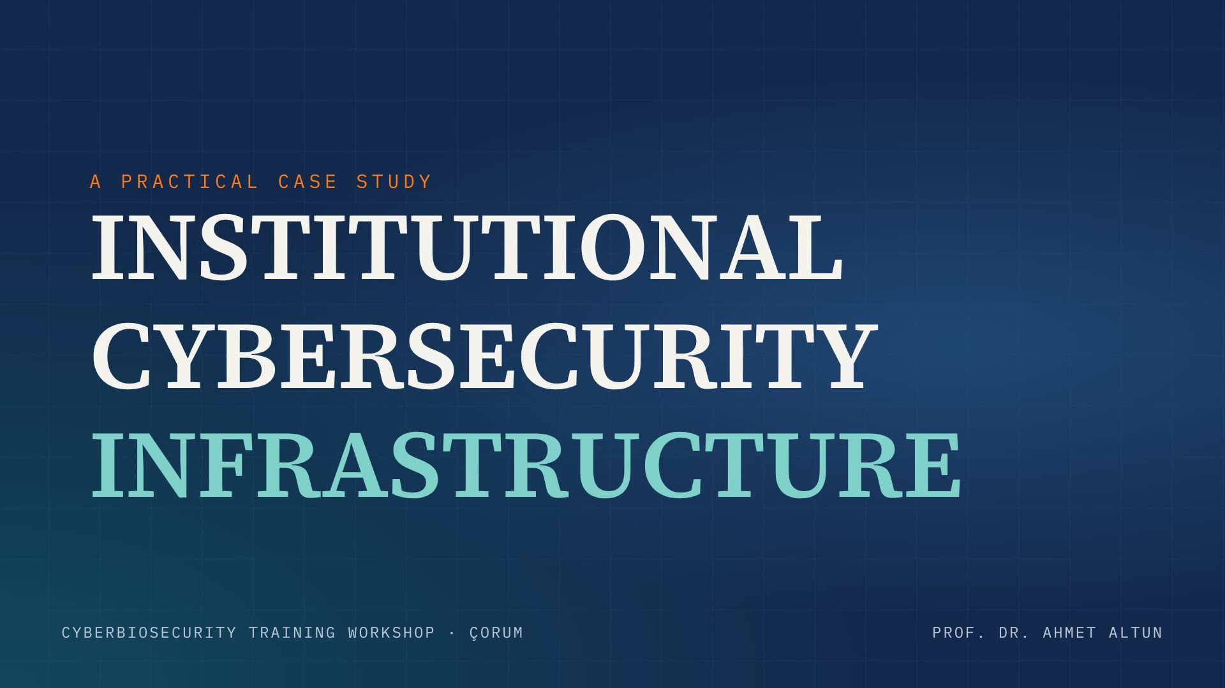
Notes:
Opening film, about 15 seconds: the 2021 HSE attack, from the first email to detonation eight weeks later. Advance when it reaches the title card.

Slide 3
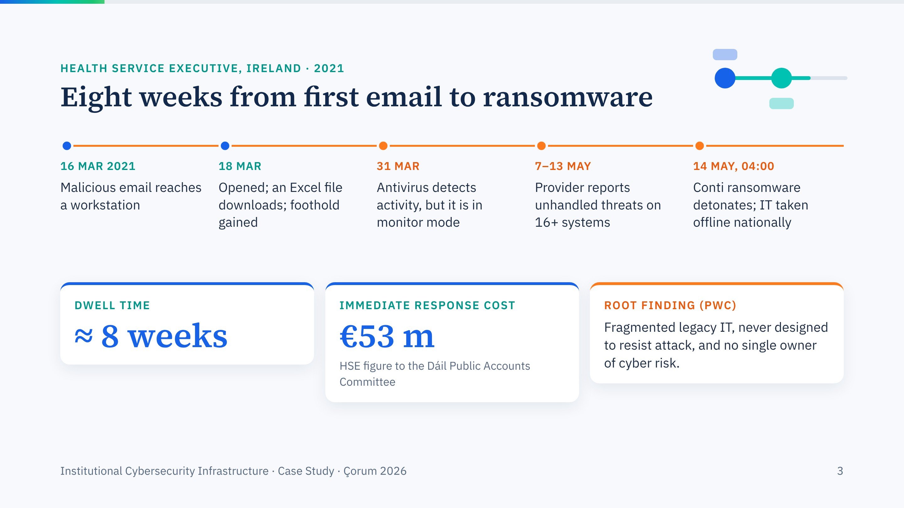
Notes:
Build the timeline one click per event. The details come from the independent PwC post-incident review published in December 2021.
The orange dots are the moments the organisation could have acted: antivirus saw it on 31 March but was set to monitor only; a week before detonation the security provider reported unhandled threats on at least sixteen systems. The last cards show the cost and the root finding, which is a governance finding, not a technical one.

Slide 4
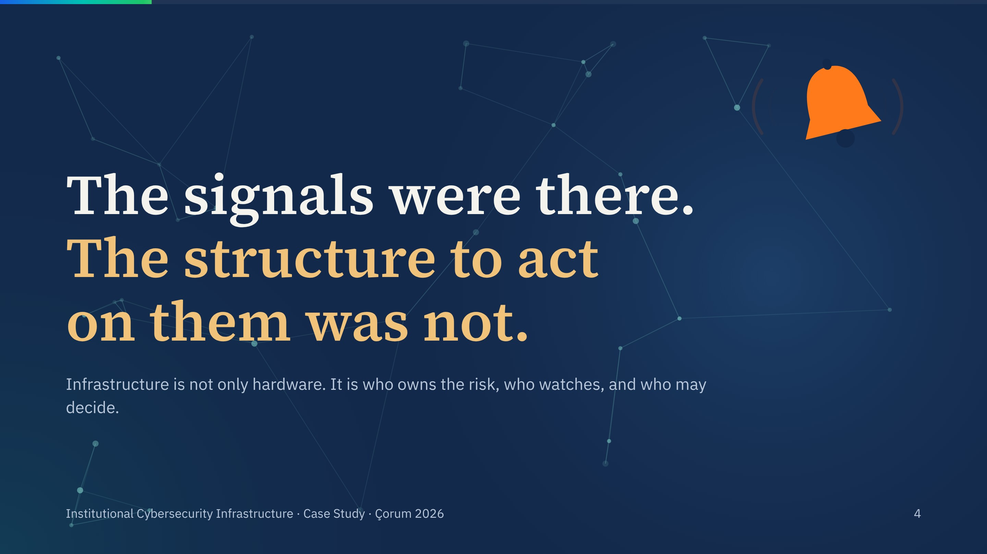
Notes:
The core message of the session. Technology detected the intrusion; the organisation did not respond. That is why yesterday GOVERN was at the centre of the wheel.

Slide 5
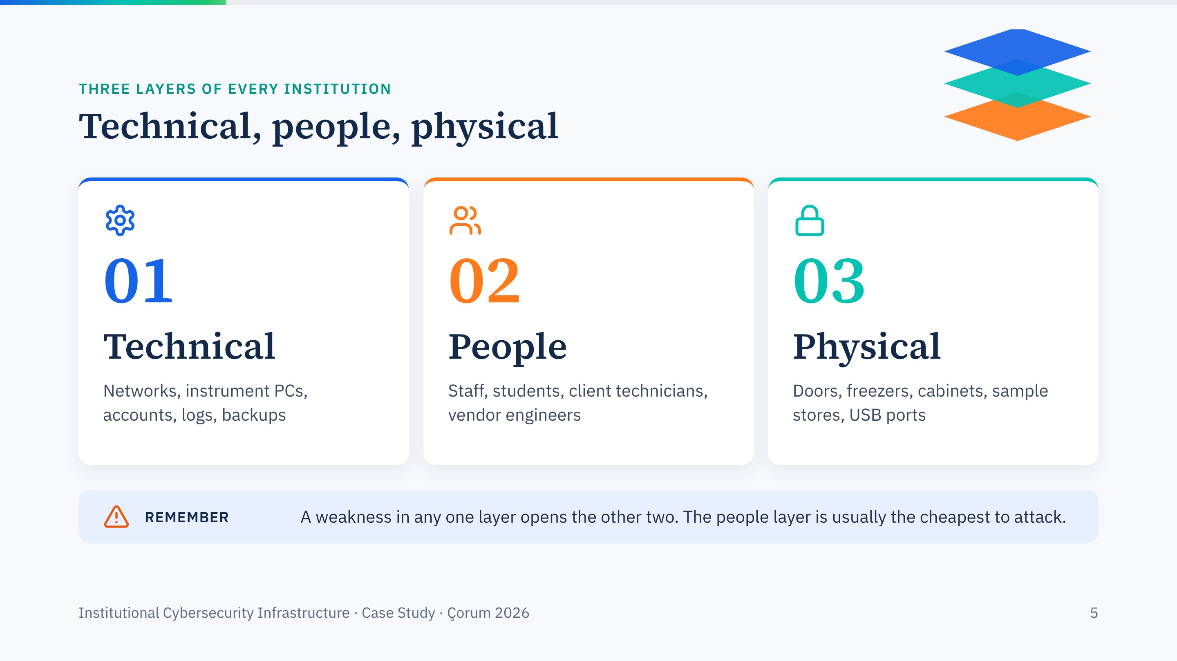
Notes:
The same three layers we use in social engineering training. Keep them in mind; every finding in the case belongs to one of them, and the people layer is usually the cheapest to attack.

Slide 6
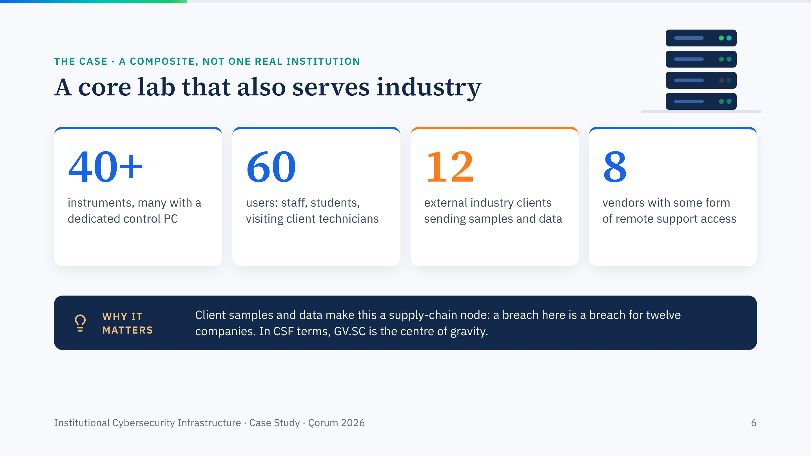
Notes:
A composite built from typical core facilities; the numbers are illustrative. If you wish, relate it to our own work at Sivas Cumhuriyet University's central research centre, where this external-client angle shaped our project design.
The defining feature is the external clients. A university lab that only serves its own researchers has an internal risk; a facility that holds twelve companies' samples and data is part of their supply chain.

Slide 7
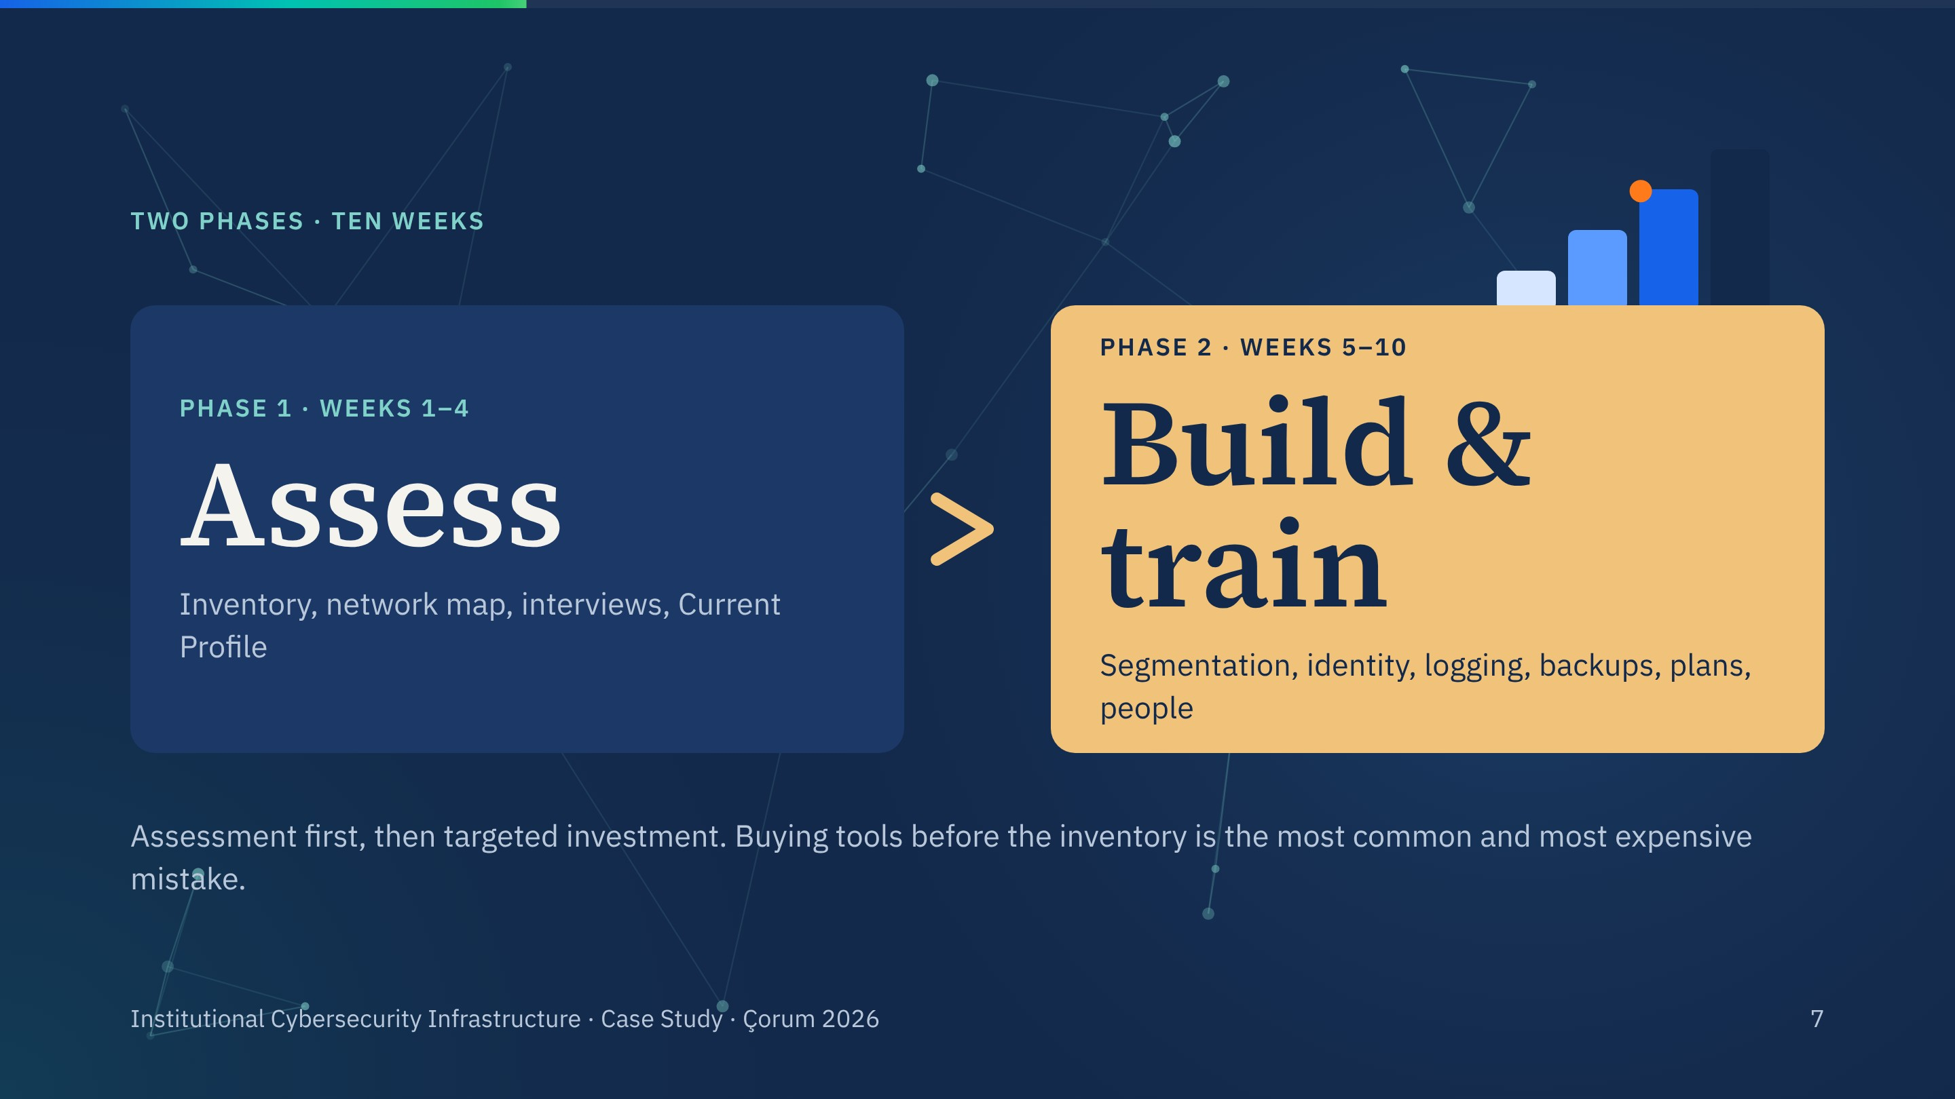
Notes:
Two phases. First assess, then build and train. The order matters: without an inventory and a Current Profile you cannot know which investments close which gaps.

Slide 8
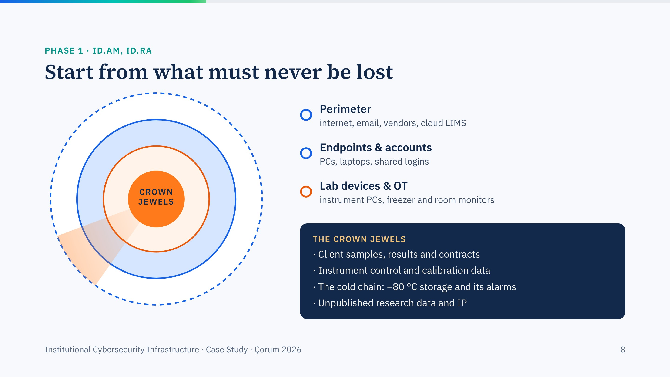
Notes:
Build from the outside in: perimeter, endpoints and accounts, laboratory devices, and finally the crown jewels. Ask the room what their own crown jewels are before revealing the list.
The cold chain is the item people forget: a freezer alarm on Wi-Fi is a cyber asset with a biosafety consequence.

Slide 9
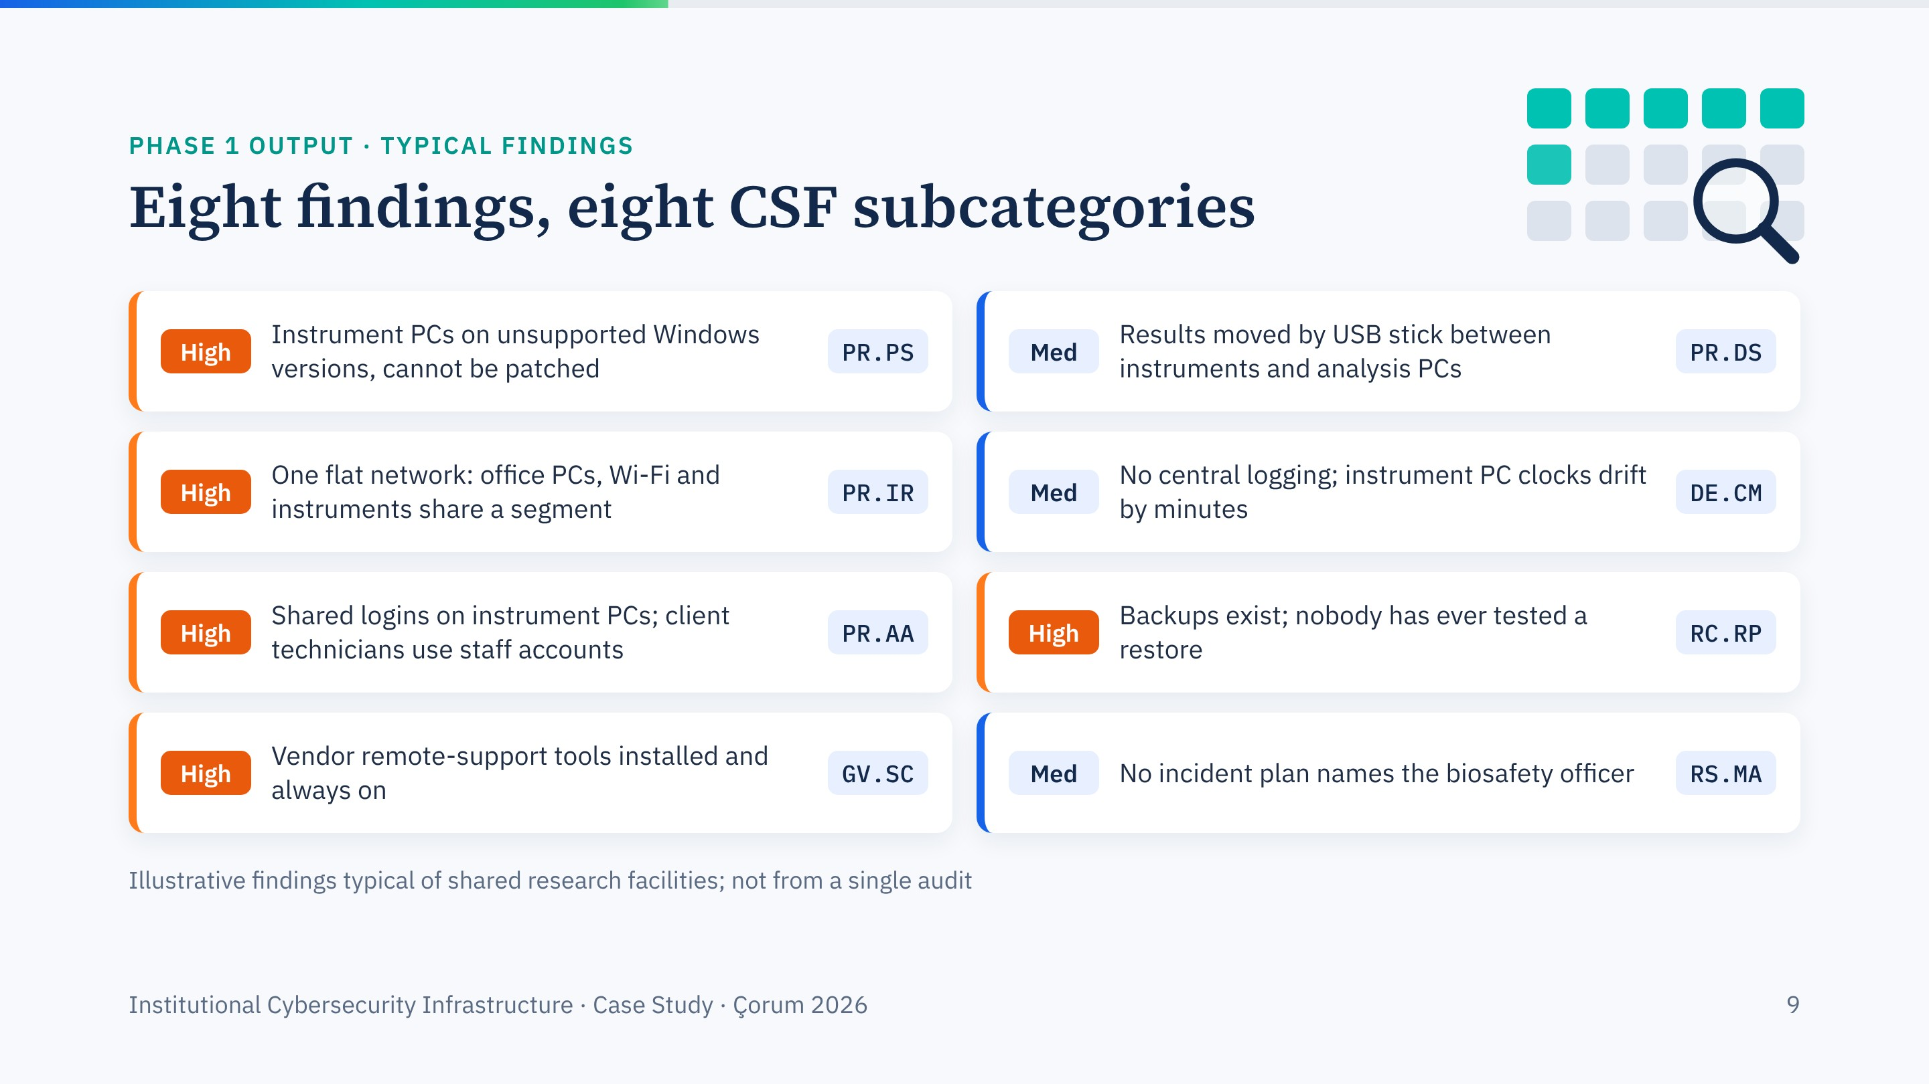
Notes:
Eight findings that appear in almost every assessment of a shared research facility. These are illustrative, not from one audit. Note how each one maps to a CSF subcategory family; that mapping is what turns a list of complaints into a Current Profile.
Ask: how many of these would be true in your own building?

Slide 10
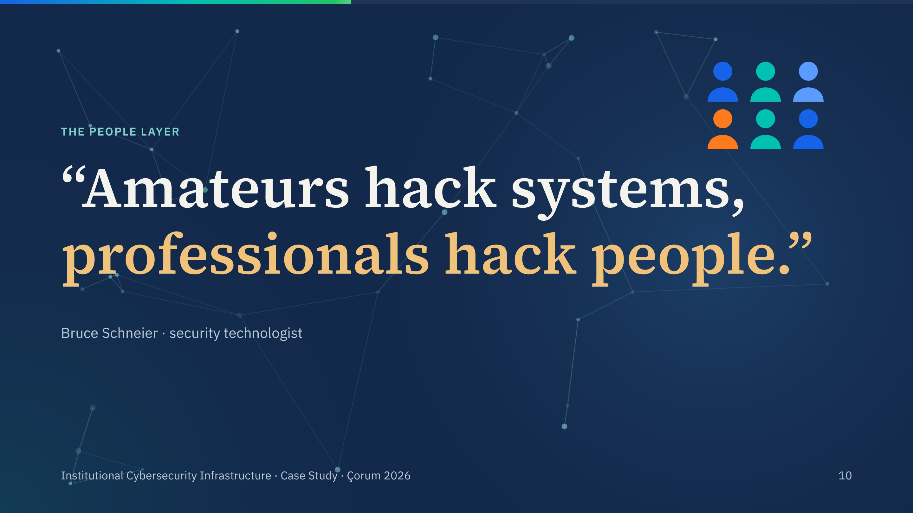
Notes:
A line I use in every training. Technical controls raise the cost of attacking systems, so attackers go around them, through people.

Slide 11
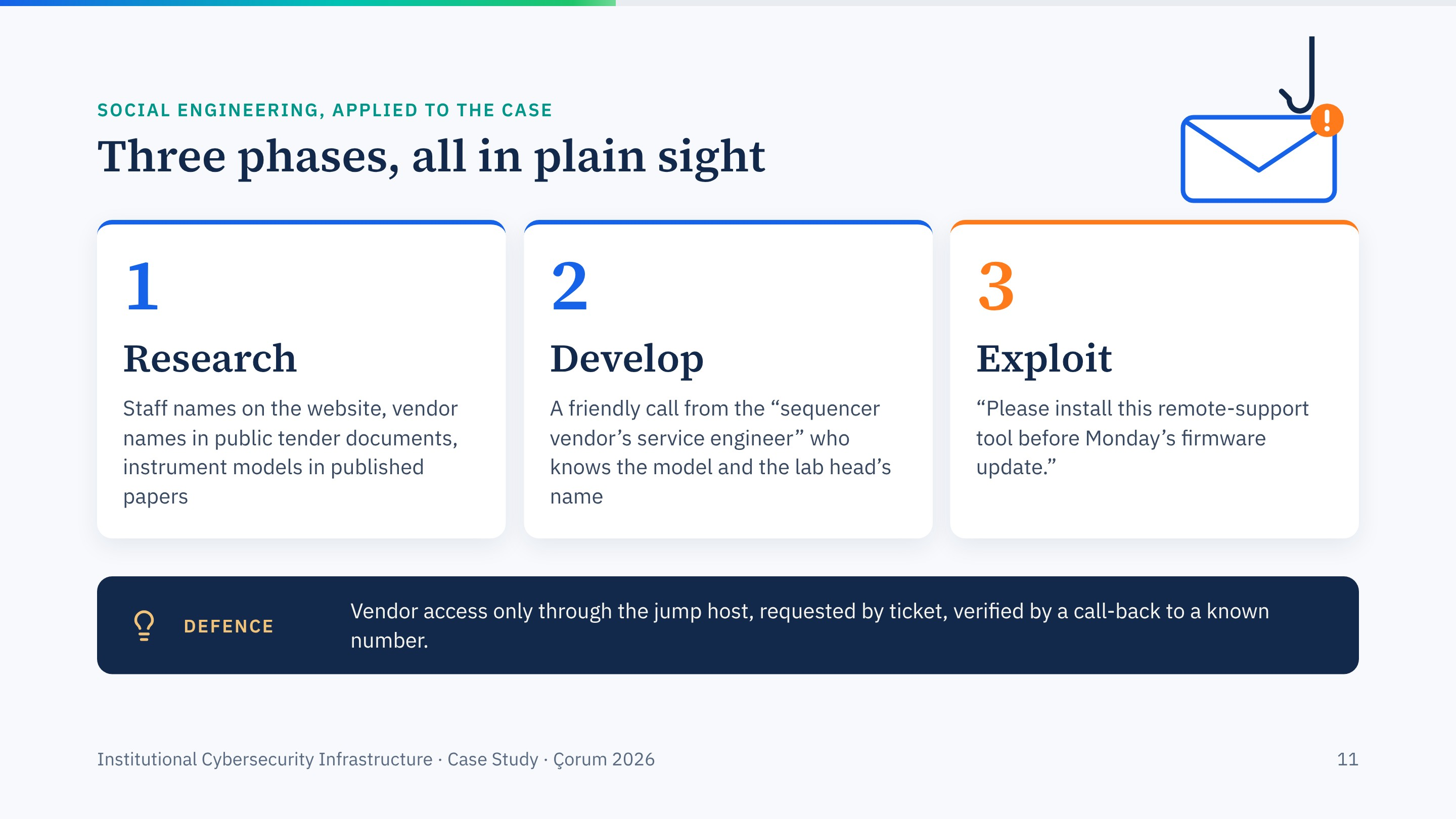
Notes:
Research, develop, exploit: the three phases from my social engineering module, applied to our facility. Nothing in the research phase is secret; it is all public.
The countermeasure is a process, not a product: a ticket and a call-back to a number you already hold.

Slide 12
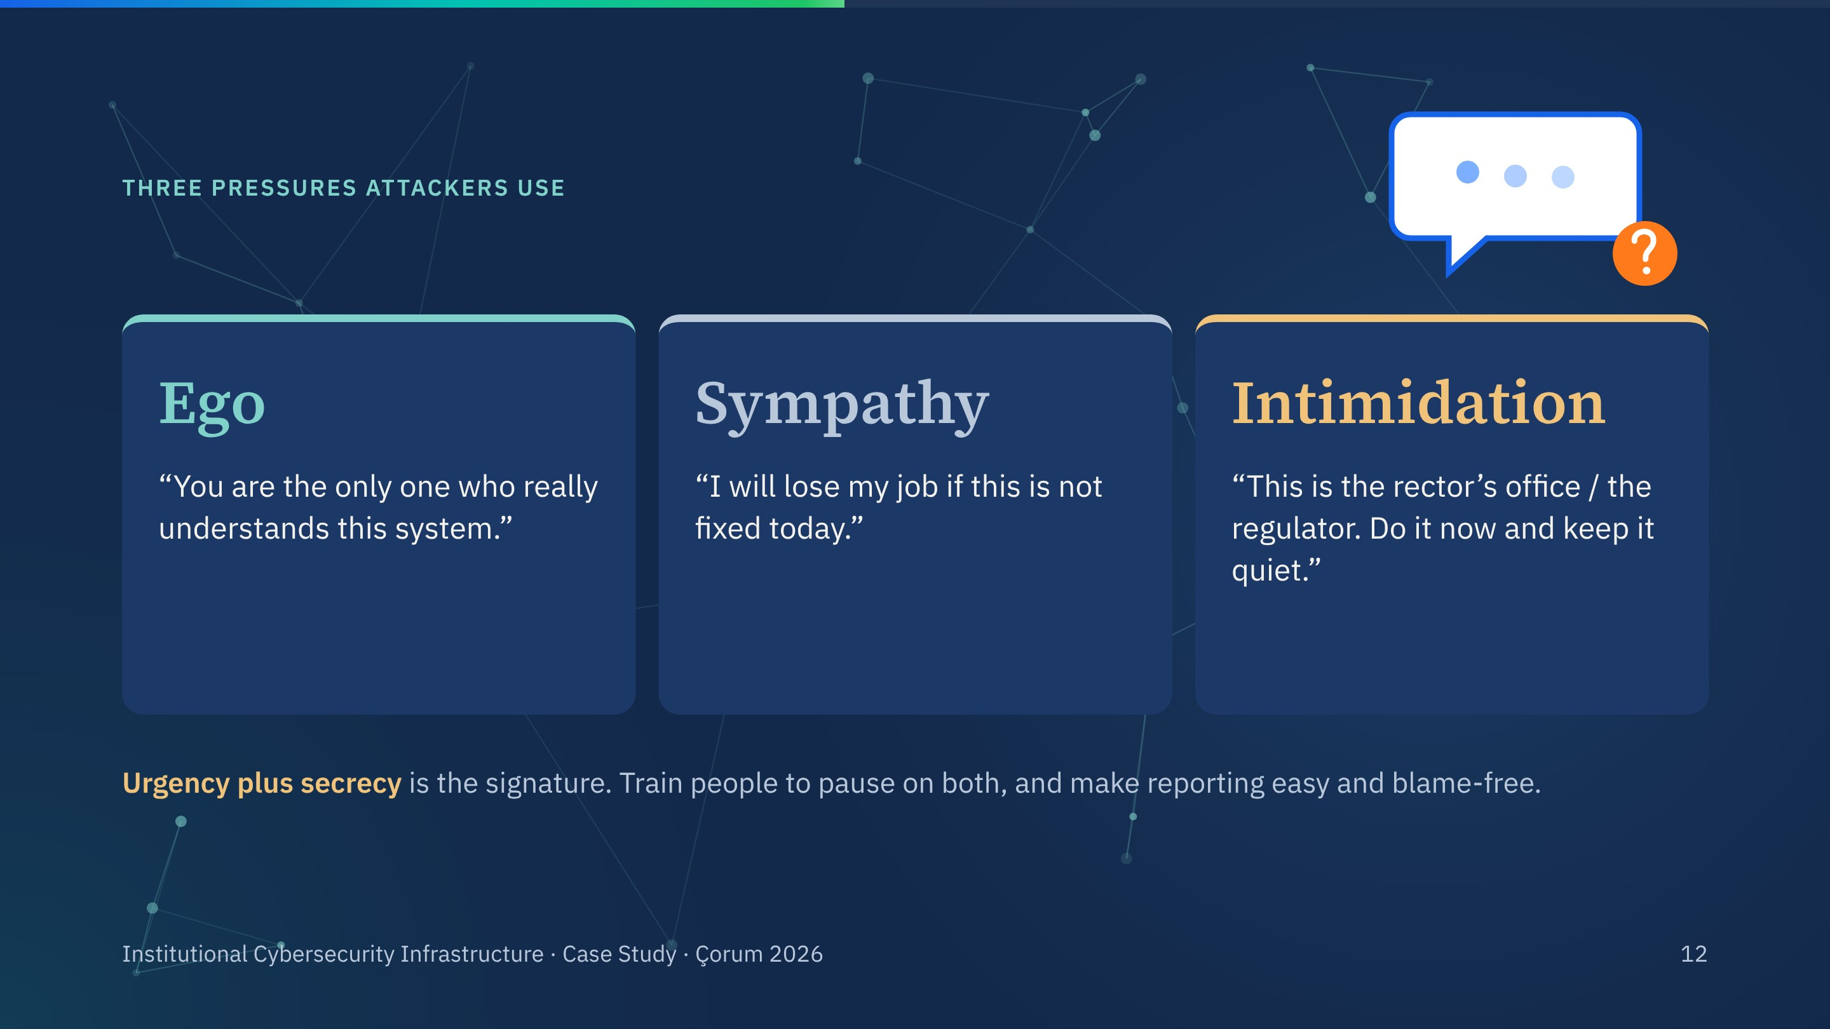
Notes:
Ego, sympathy, intimidation. Every training example in my deck falls into one of these. The practical rule for staff: when a request comes with urgency and secrecy together, stop and verify through a different channel.

Slide 13
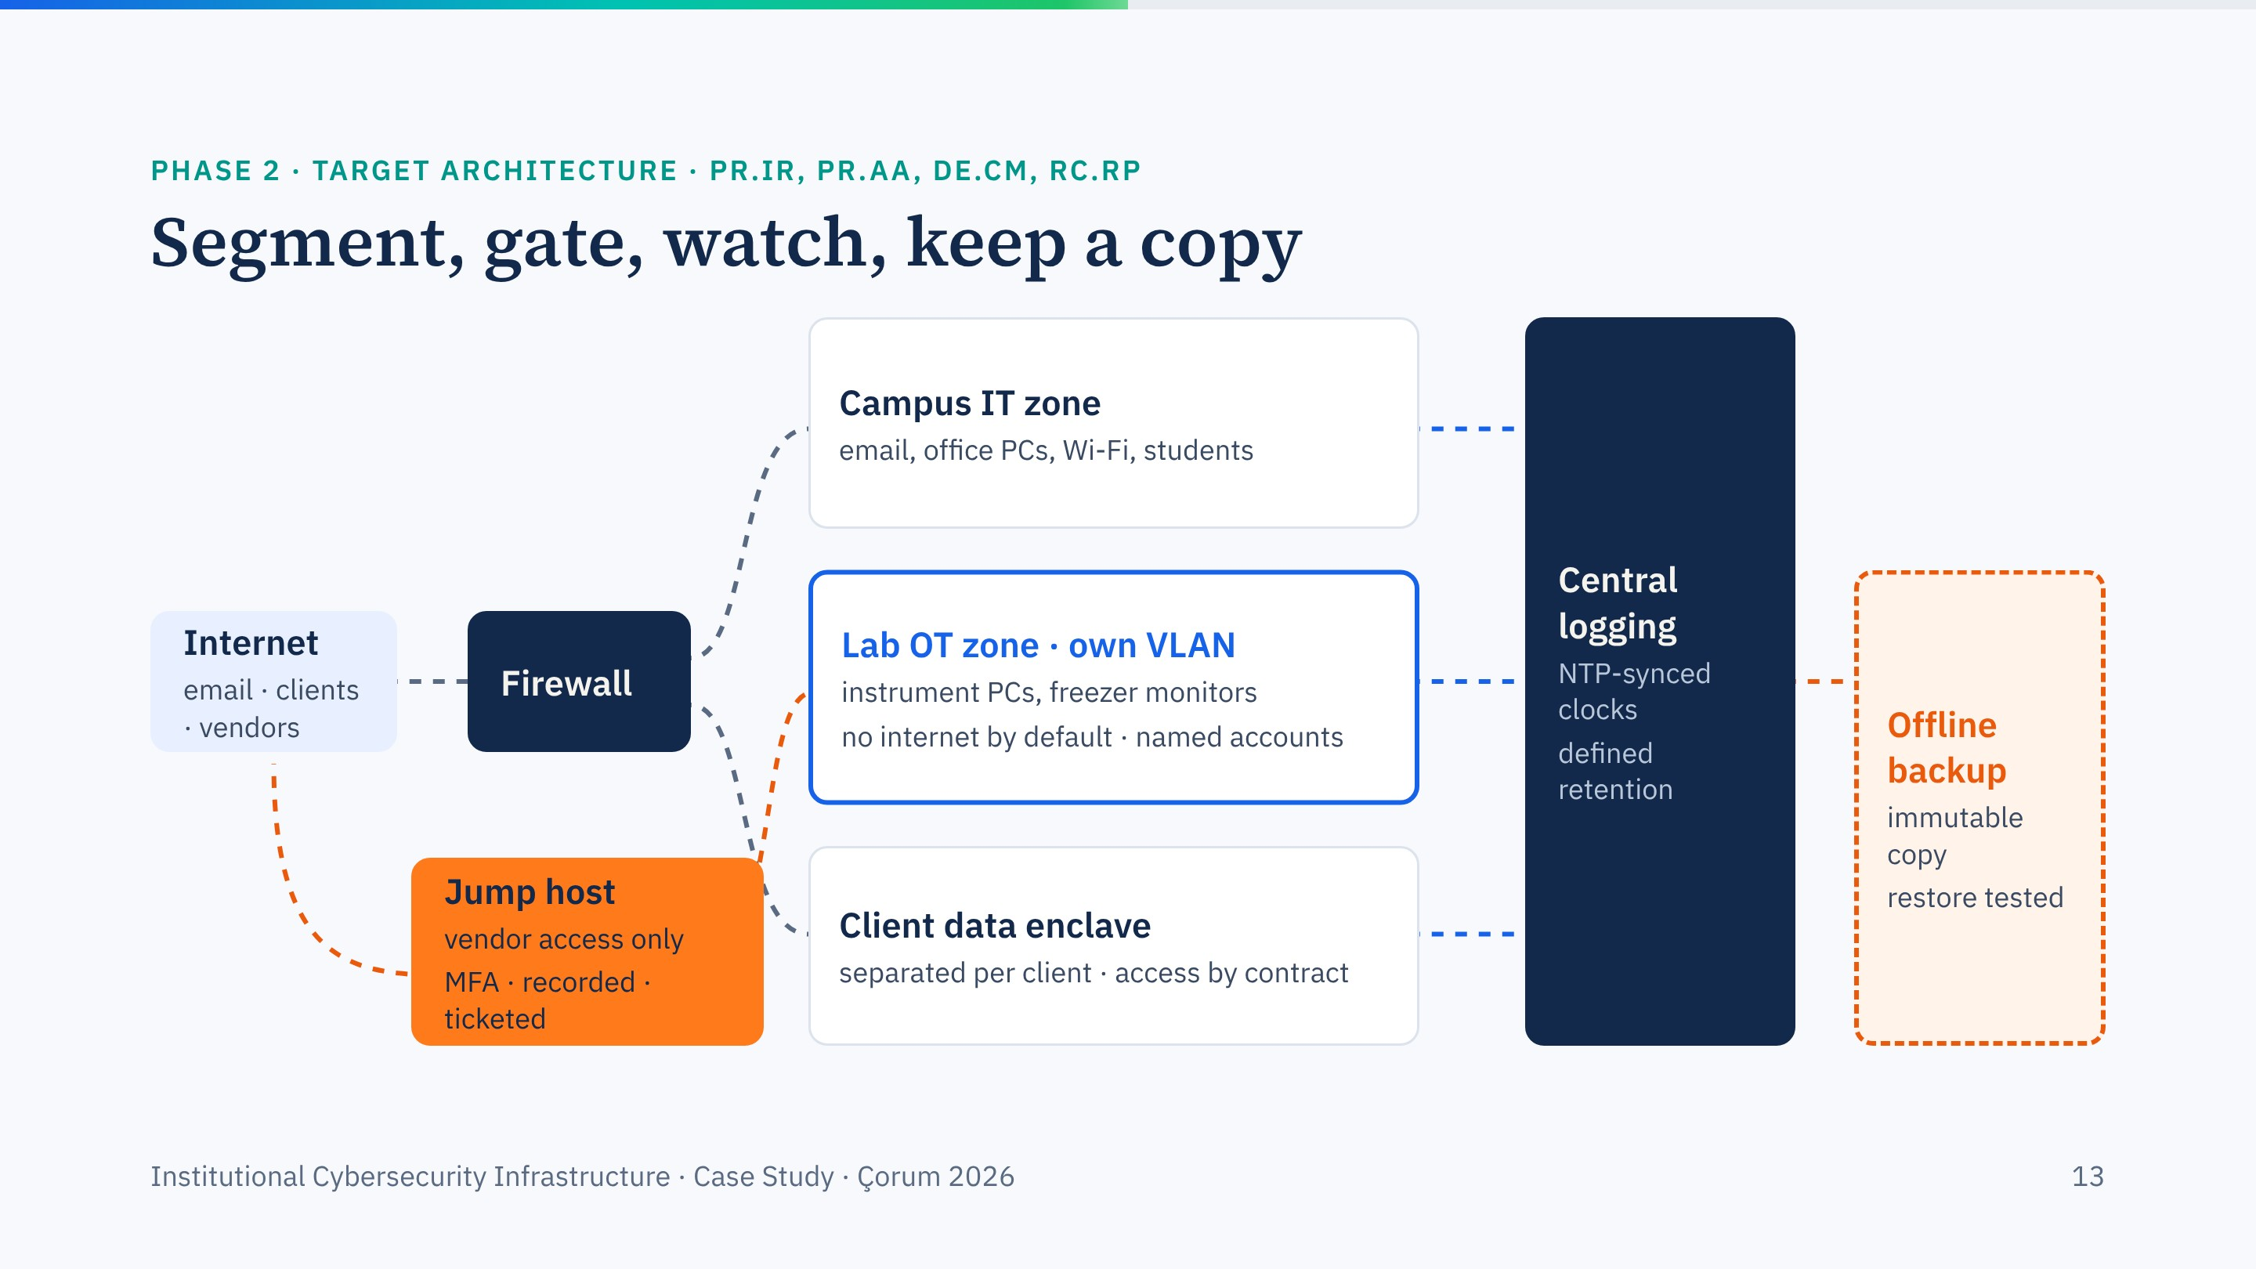
Notes:
Build the target architecture in four clicks. First the zones: campus IT, a separate lab network with no internet by default, and a client data enclave. Second, the vendor jump host: the only way in for remote support, with MFA, session recording and time limits. Third, central logging with synchronised clocks. Fourth, an offline, immutable backup whose restore has been tested.
Each element closes one of the findings a few slides back.

Slide 14
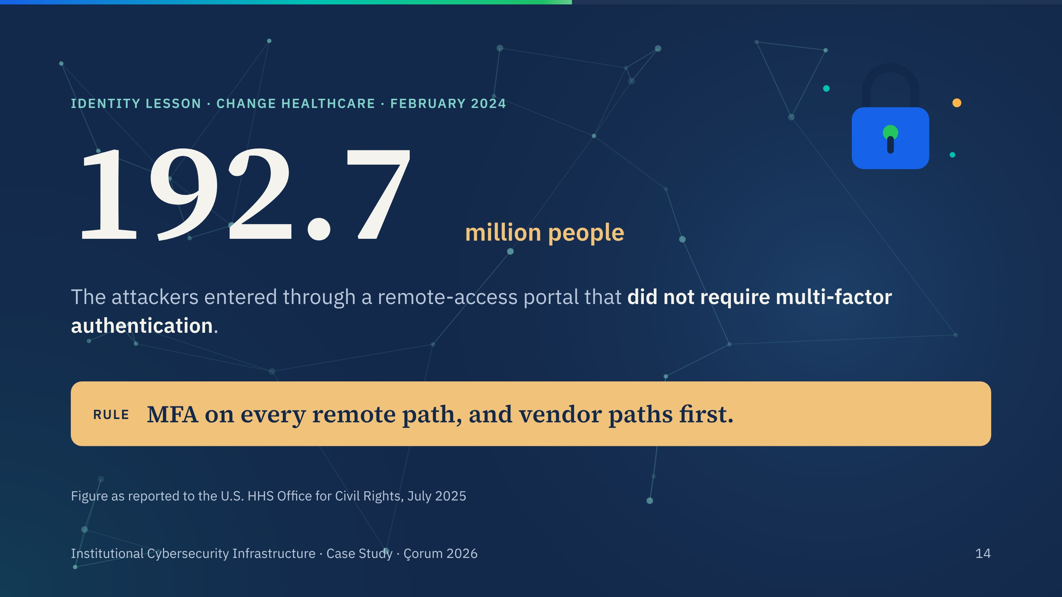
Notes:
The largest health-data breach on record in the United States: 192.7 million individuals, from one portal without MFA.
This is PR.AA in practice. For our facility it means the vendor jump host and any VPN or remote desktop path.

Slide 15
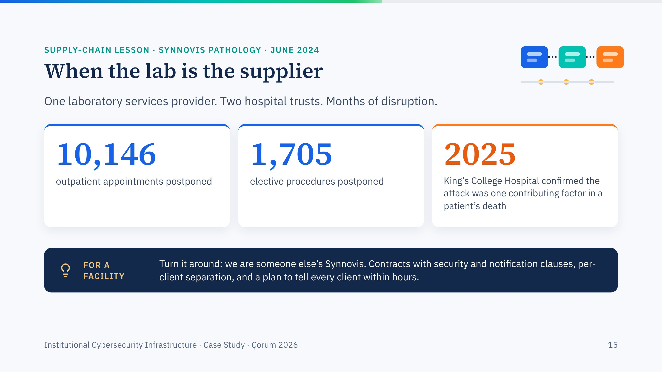
Notes:
Synnovis provided pathology services to King's College Hospital and Guy's and St Thomas'. NHS England's cumulative figures to mid-September 2024: 10,146 outpatient appointments and 1,705 elective procedures postponed. In June 2025 King's confirmed that the attack was one contributing factor in a patient's death.
Turn it around: our facility is someone else's Synnovis. GV.SC applies in both directions.

Slide 16
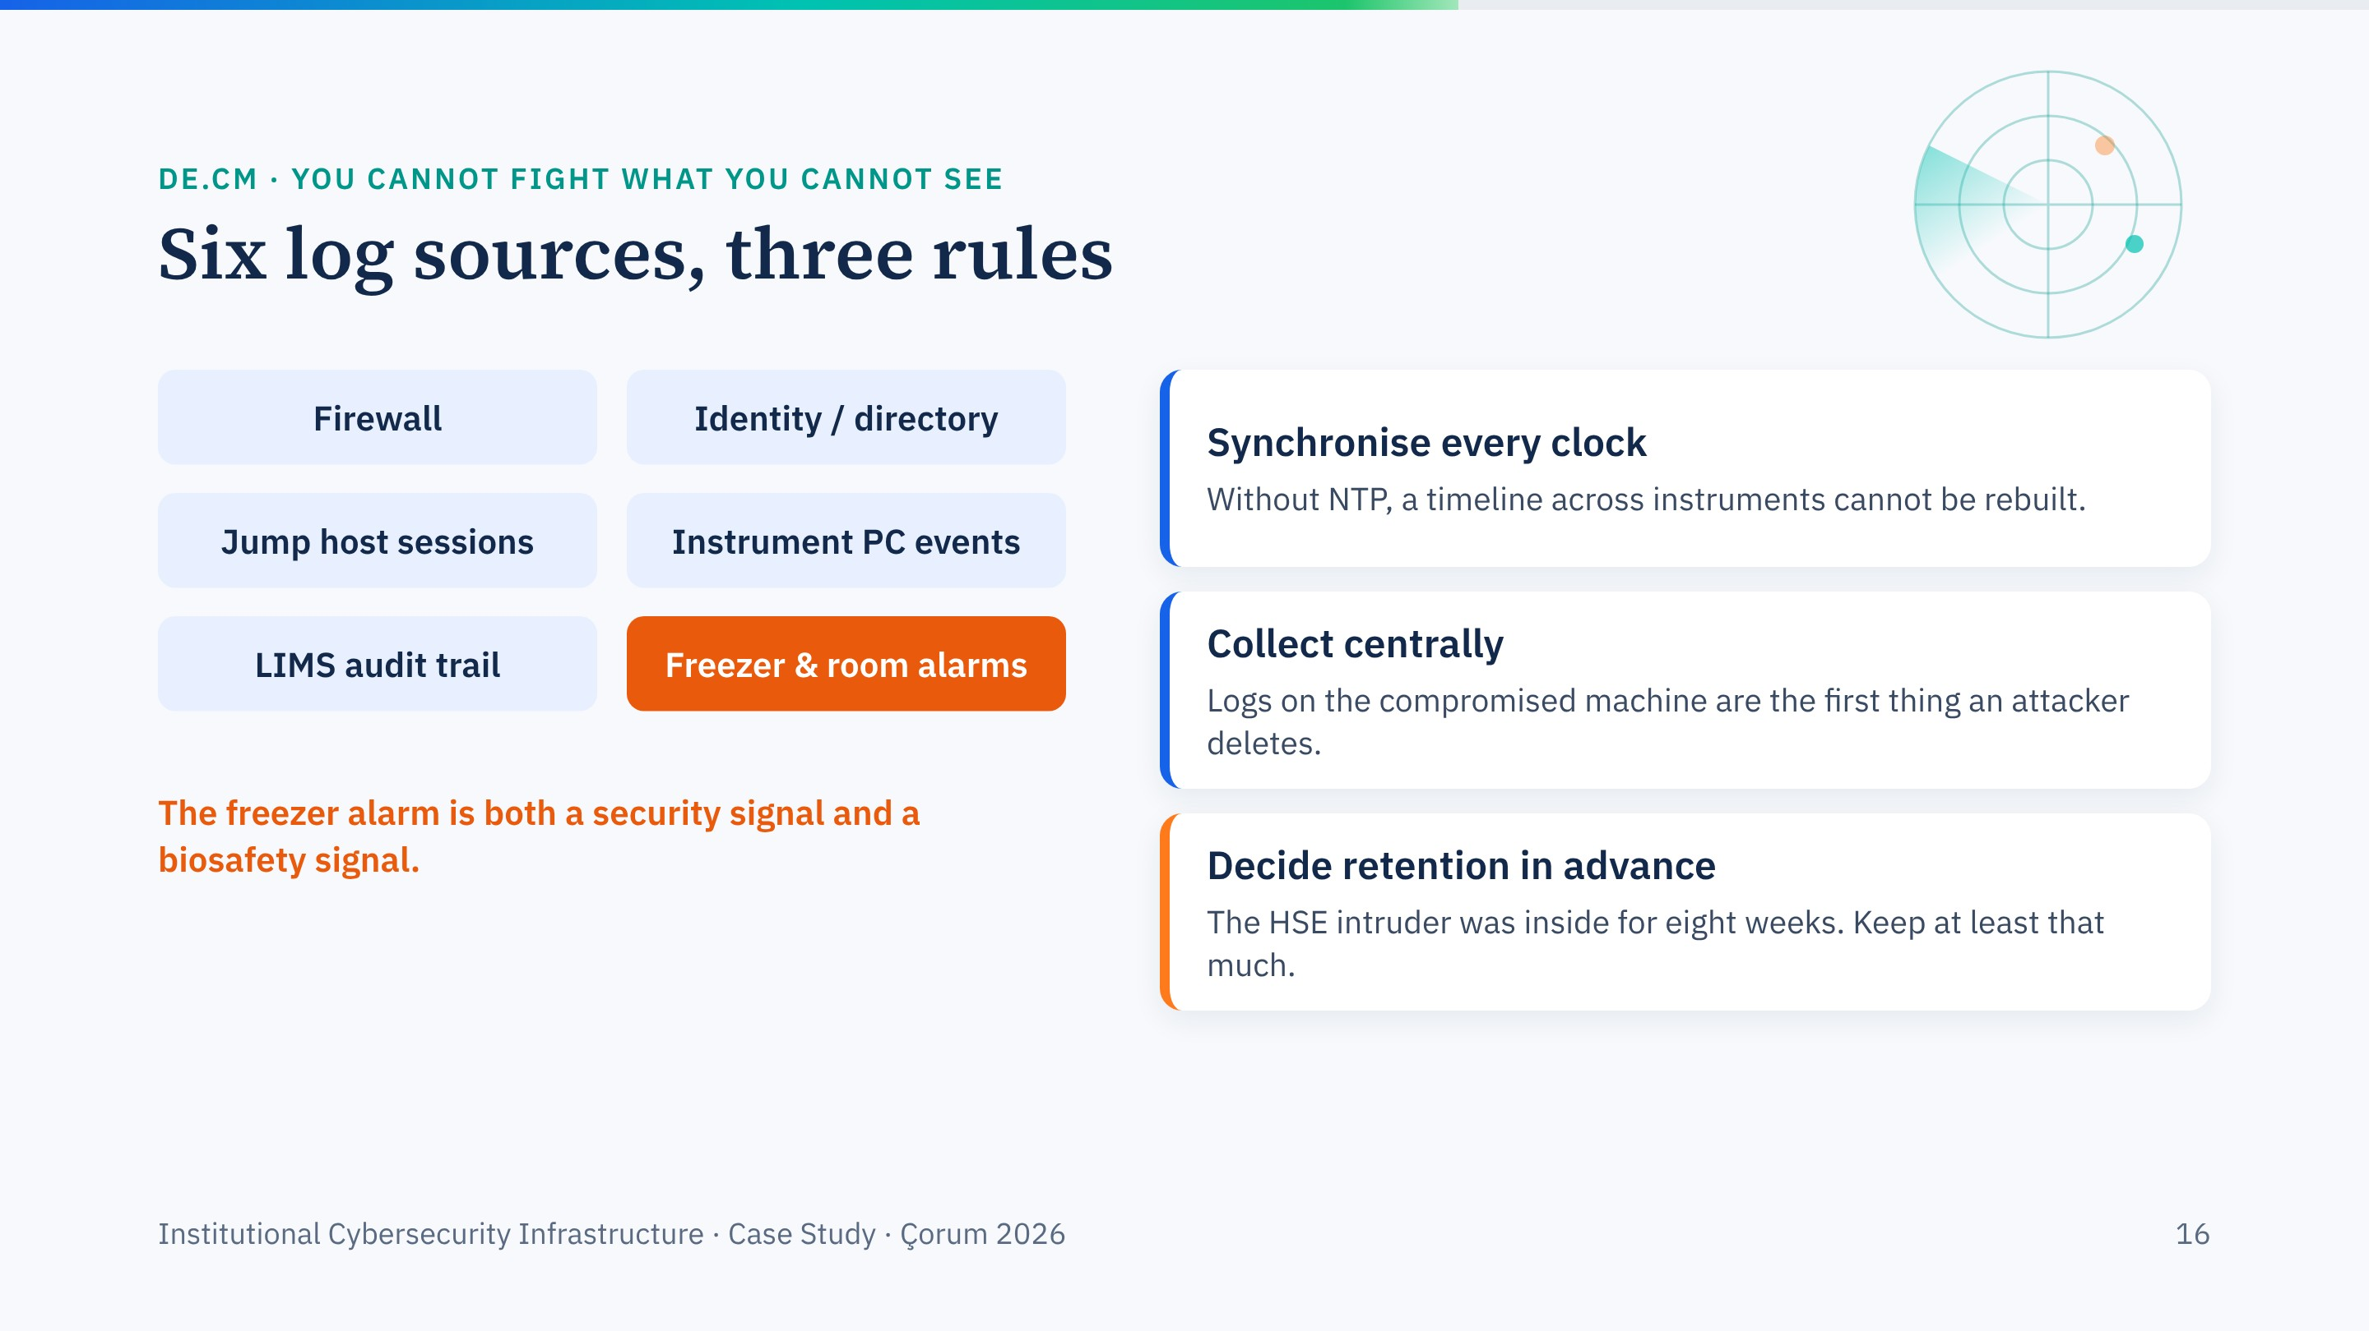
Notes:
Six log sources, three rules. The freezer alarm is in orange on purpose: it is both a security signal and a biosafety signal.
The retention point links back to the opening case: if you keep two weeks of logs, an eight-week intrusion is invisible.

Slide 17
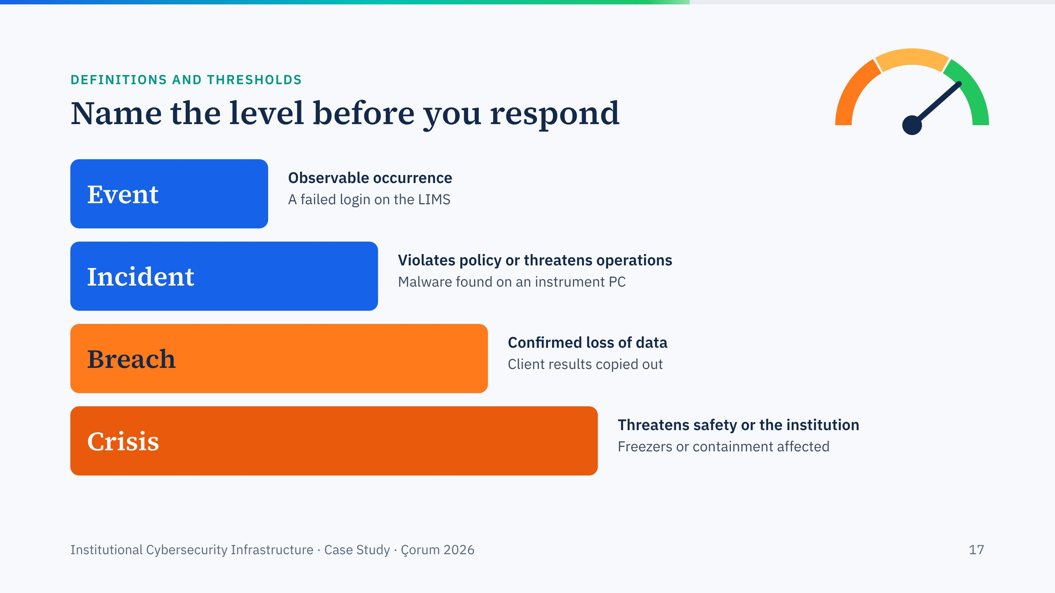
Notes:
Four levels, one click each. Most alerts are events. Calling every event a crisis exhausts the team; calling a crisis an event delays the response. Write the thresholds down before you need them.
In a laboratory, anything that touches containment or sample viability goes straight to the top level.

Slide 18
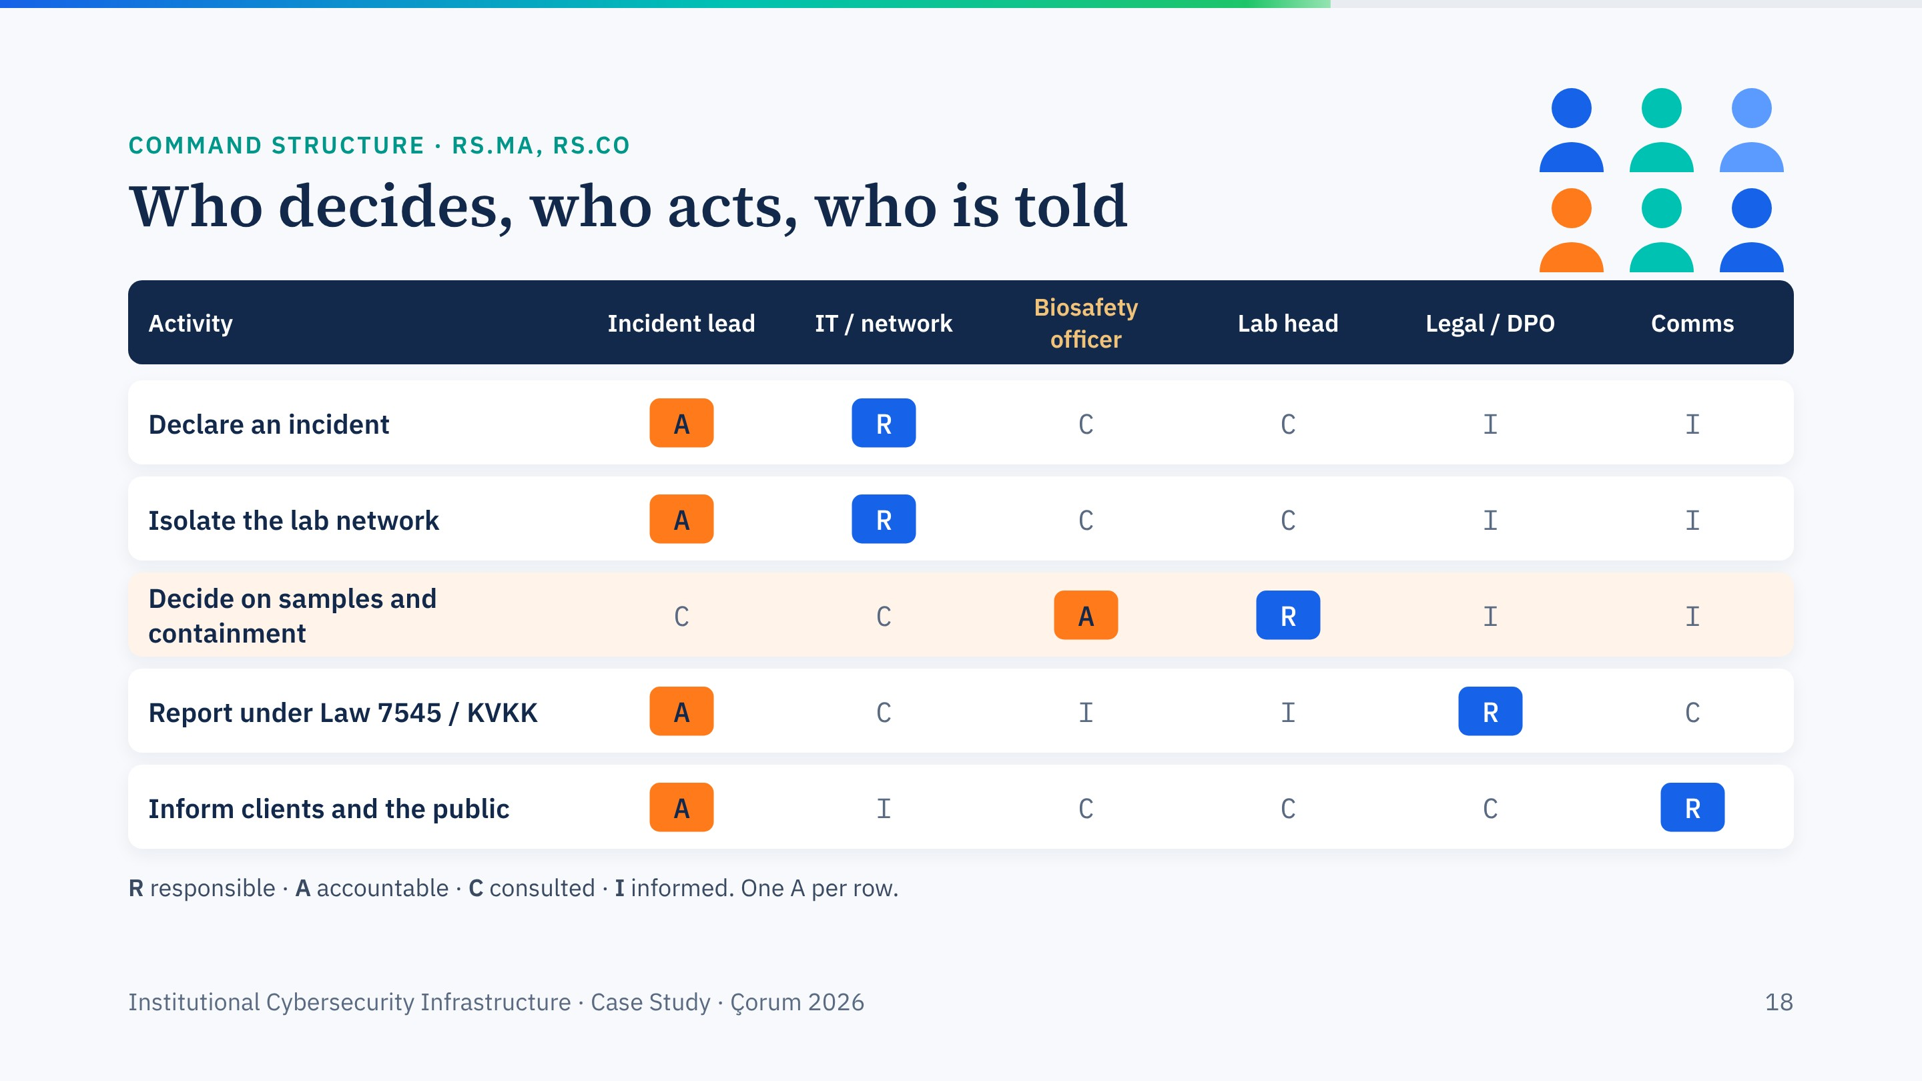
Notes:
A RACI matrix adapted from my incident response deck, with one change for laboratories: the biosafety officer is accountable for decisions about samples and containment. IT must not cut power to a freezer room on its own authority.
Five rows, one click each. The reporting row reminds us of Law 7545 and KVKK.

Slide 19
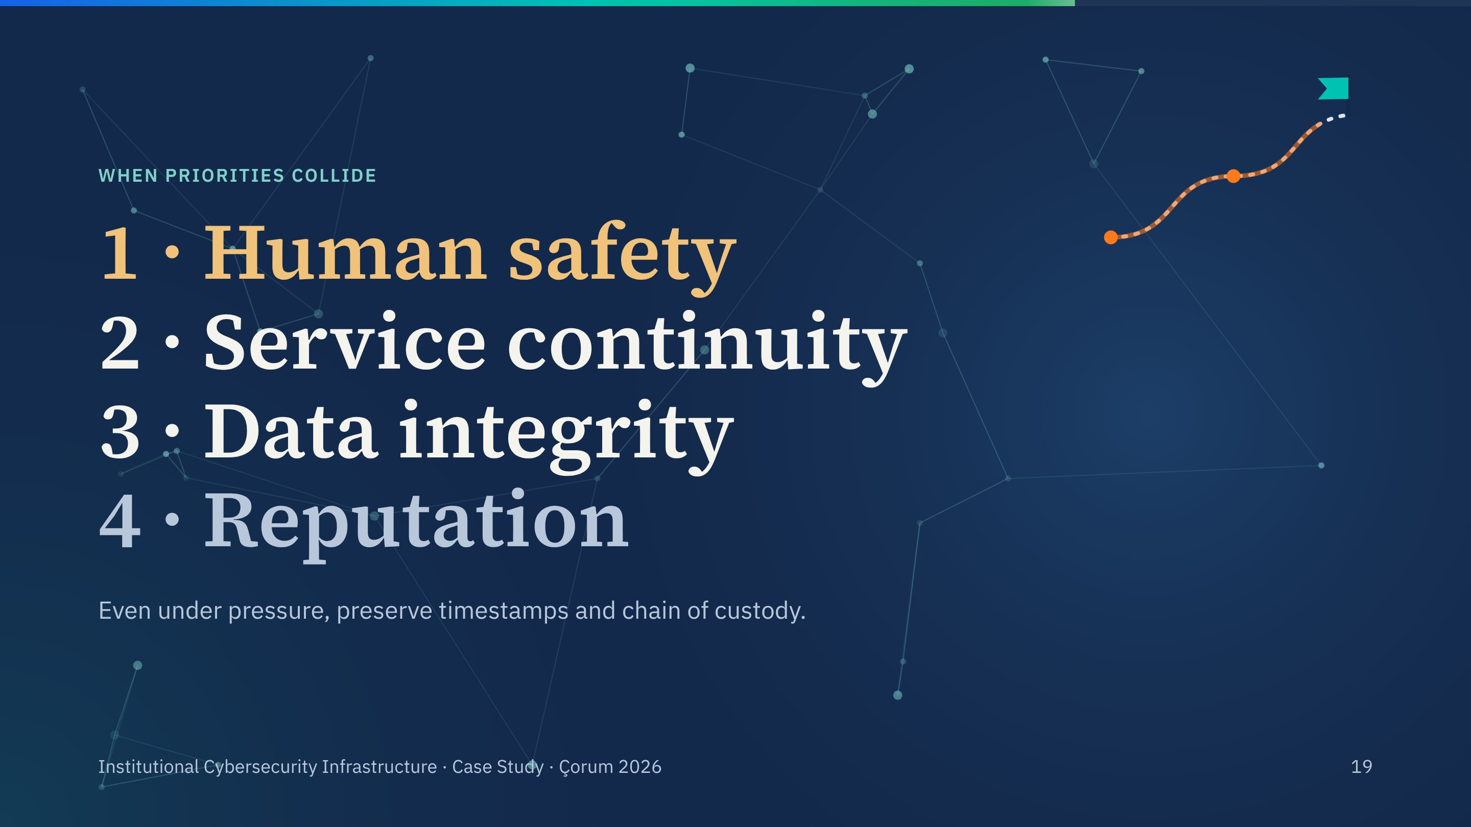
Notes:
The golden rule from my incident response material, one click per line. In a laboratory, human safety includes biosafety: containment comes before getting the sequencer back online.
The last line adds the balance: containment speed versus forensic fidelity. Move fast, but keep the evidence.

Slide 20
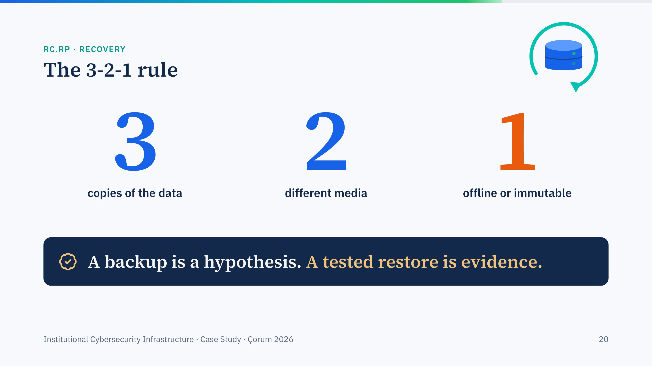
Notes:
The 3-2-1 rule. Ransomware groups look for backups first, so the offline or immutable copy is the one that saves you.
Ask: when did your group last restore something from backup on purpose?

Slide 21
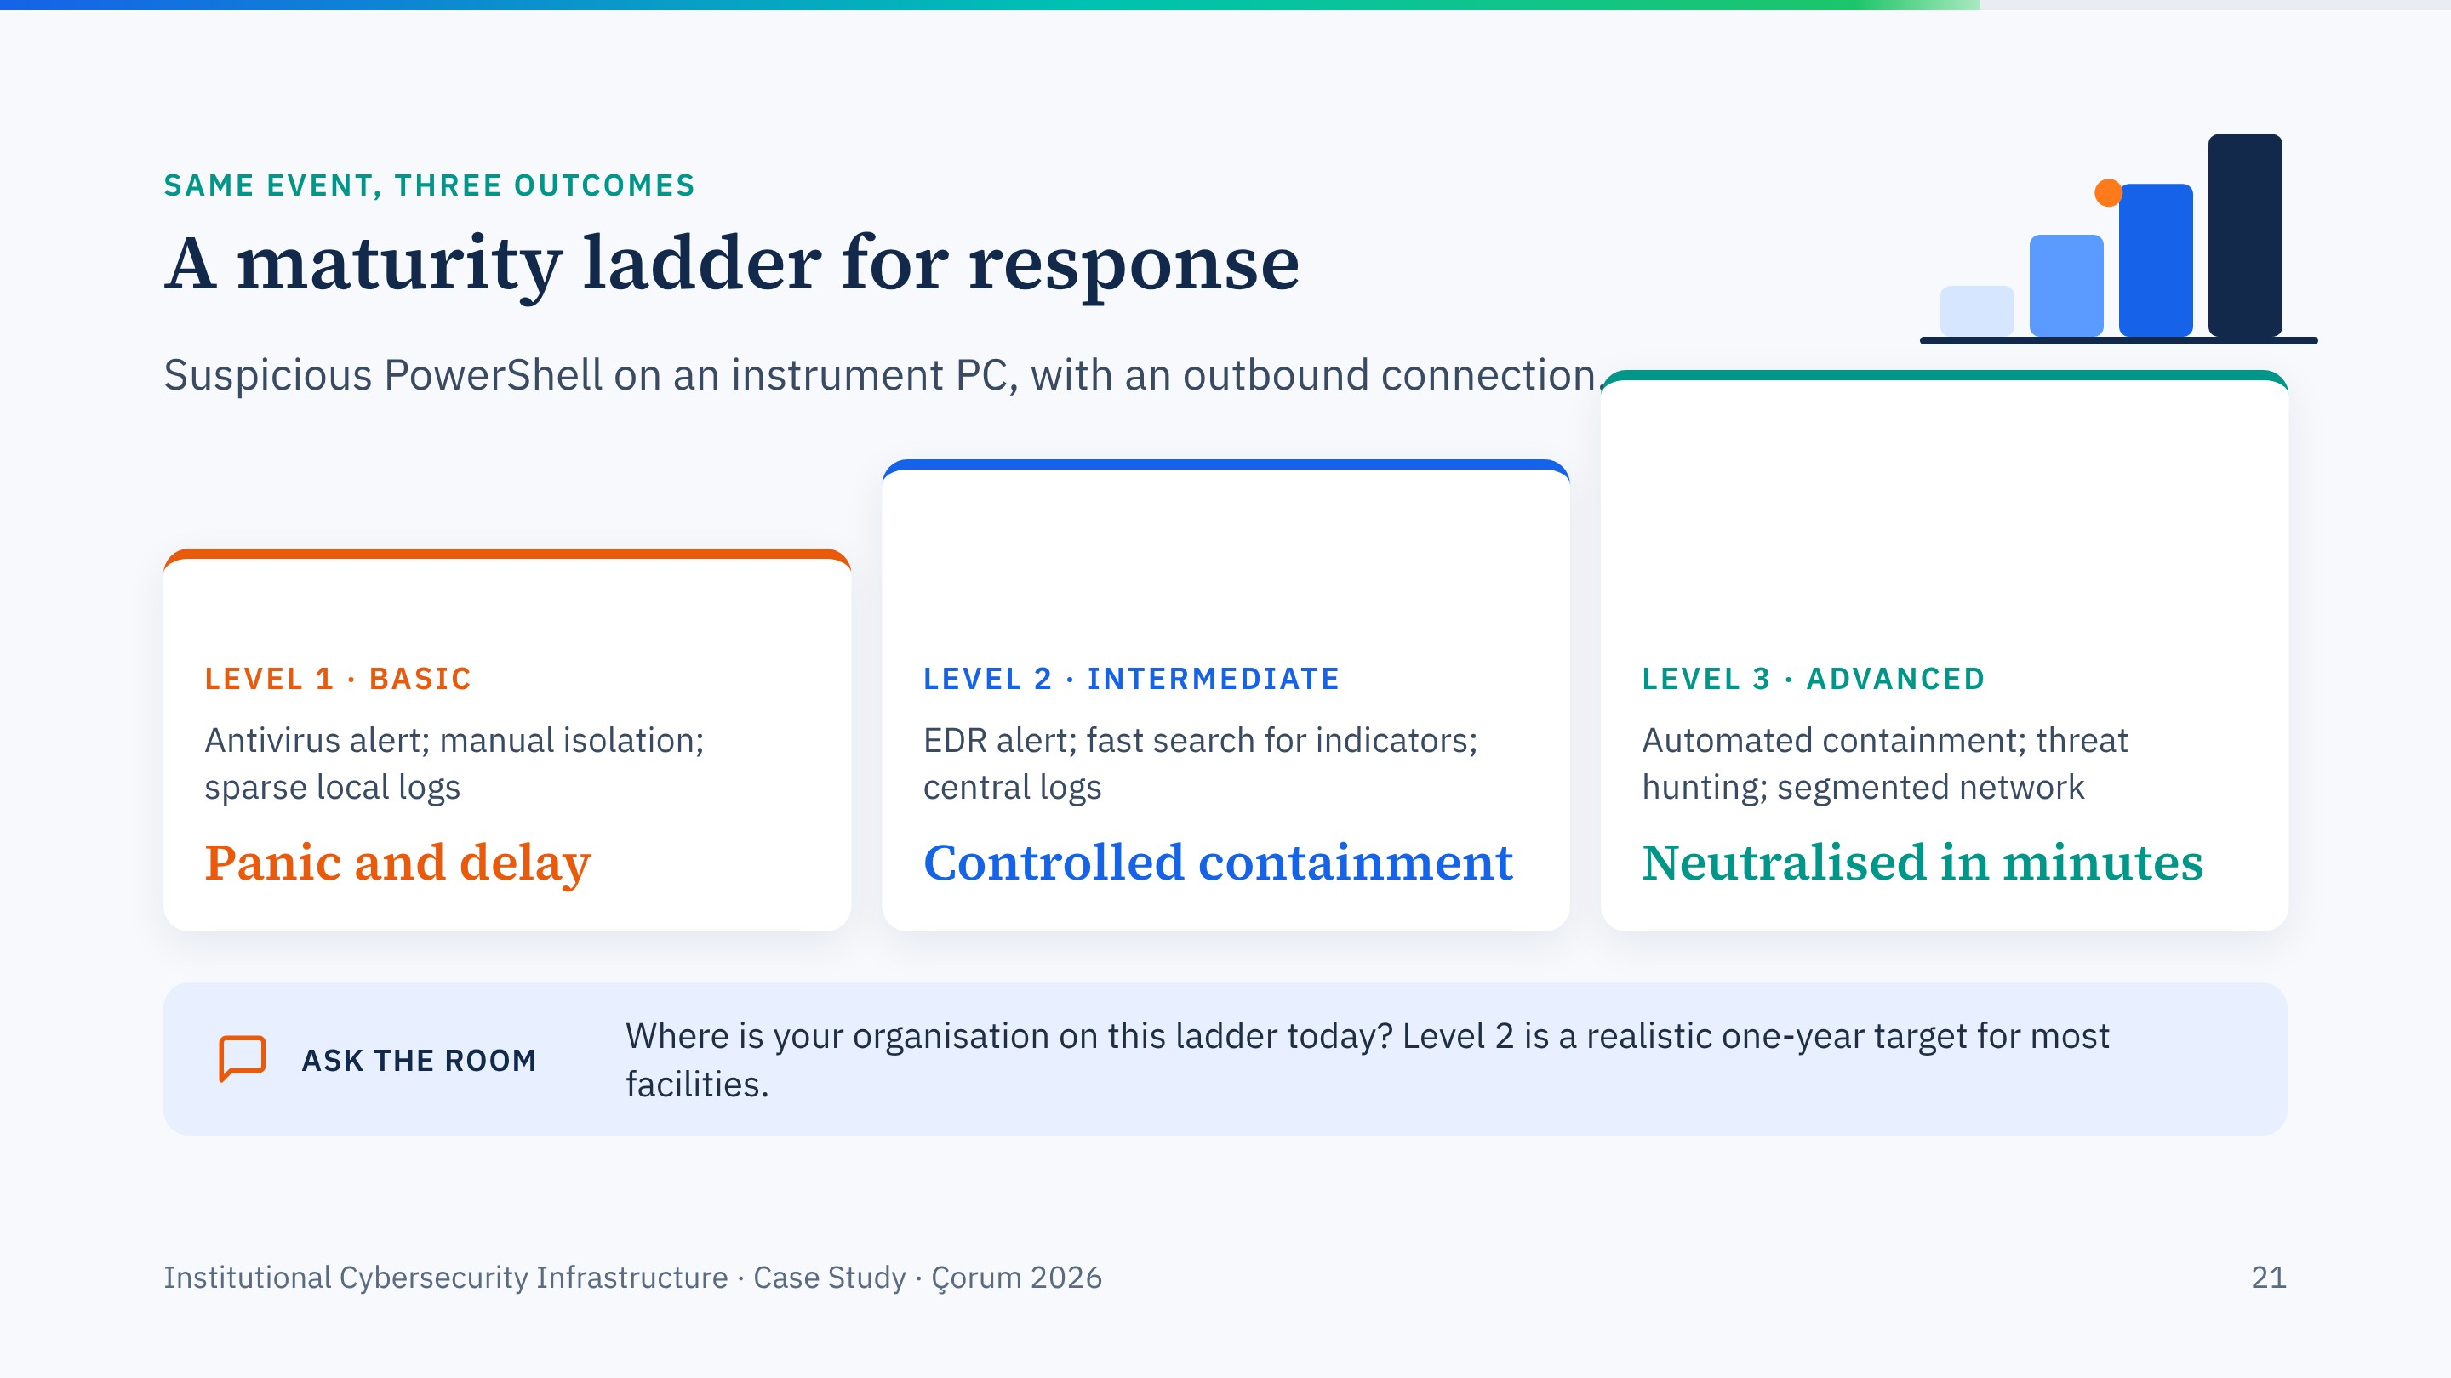
Notes:
One scenario, three maturity levels, from my April incident response workshop. One click per level, then the question to the room.
Level 2 does not require a large security team; it requires central logs and a practised playbook.

Slide 22
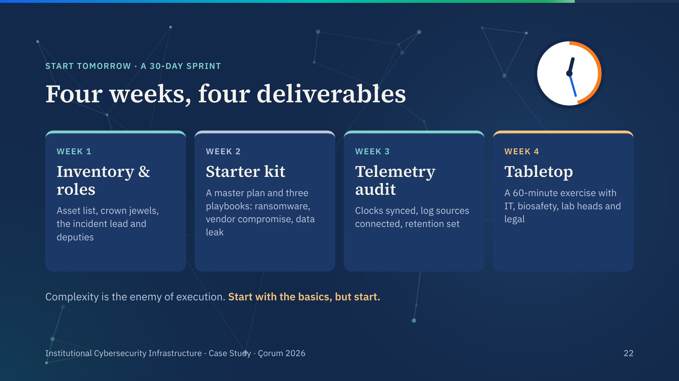
Notes:
The 30-day sprint from my incident response material. It is deliberately modest: inventory and roles, a starter kit of plans, a telemetry audit, and a tabletop exercise.
Any institution represented here can do this before the end of the year.

Slide 23
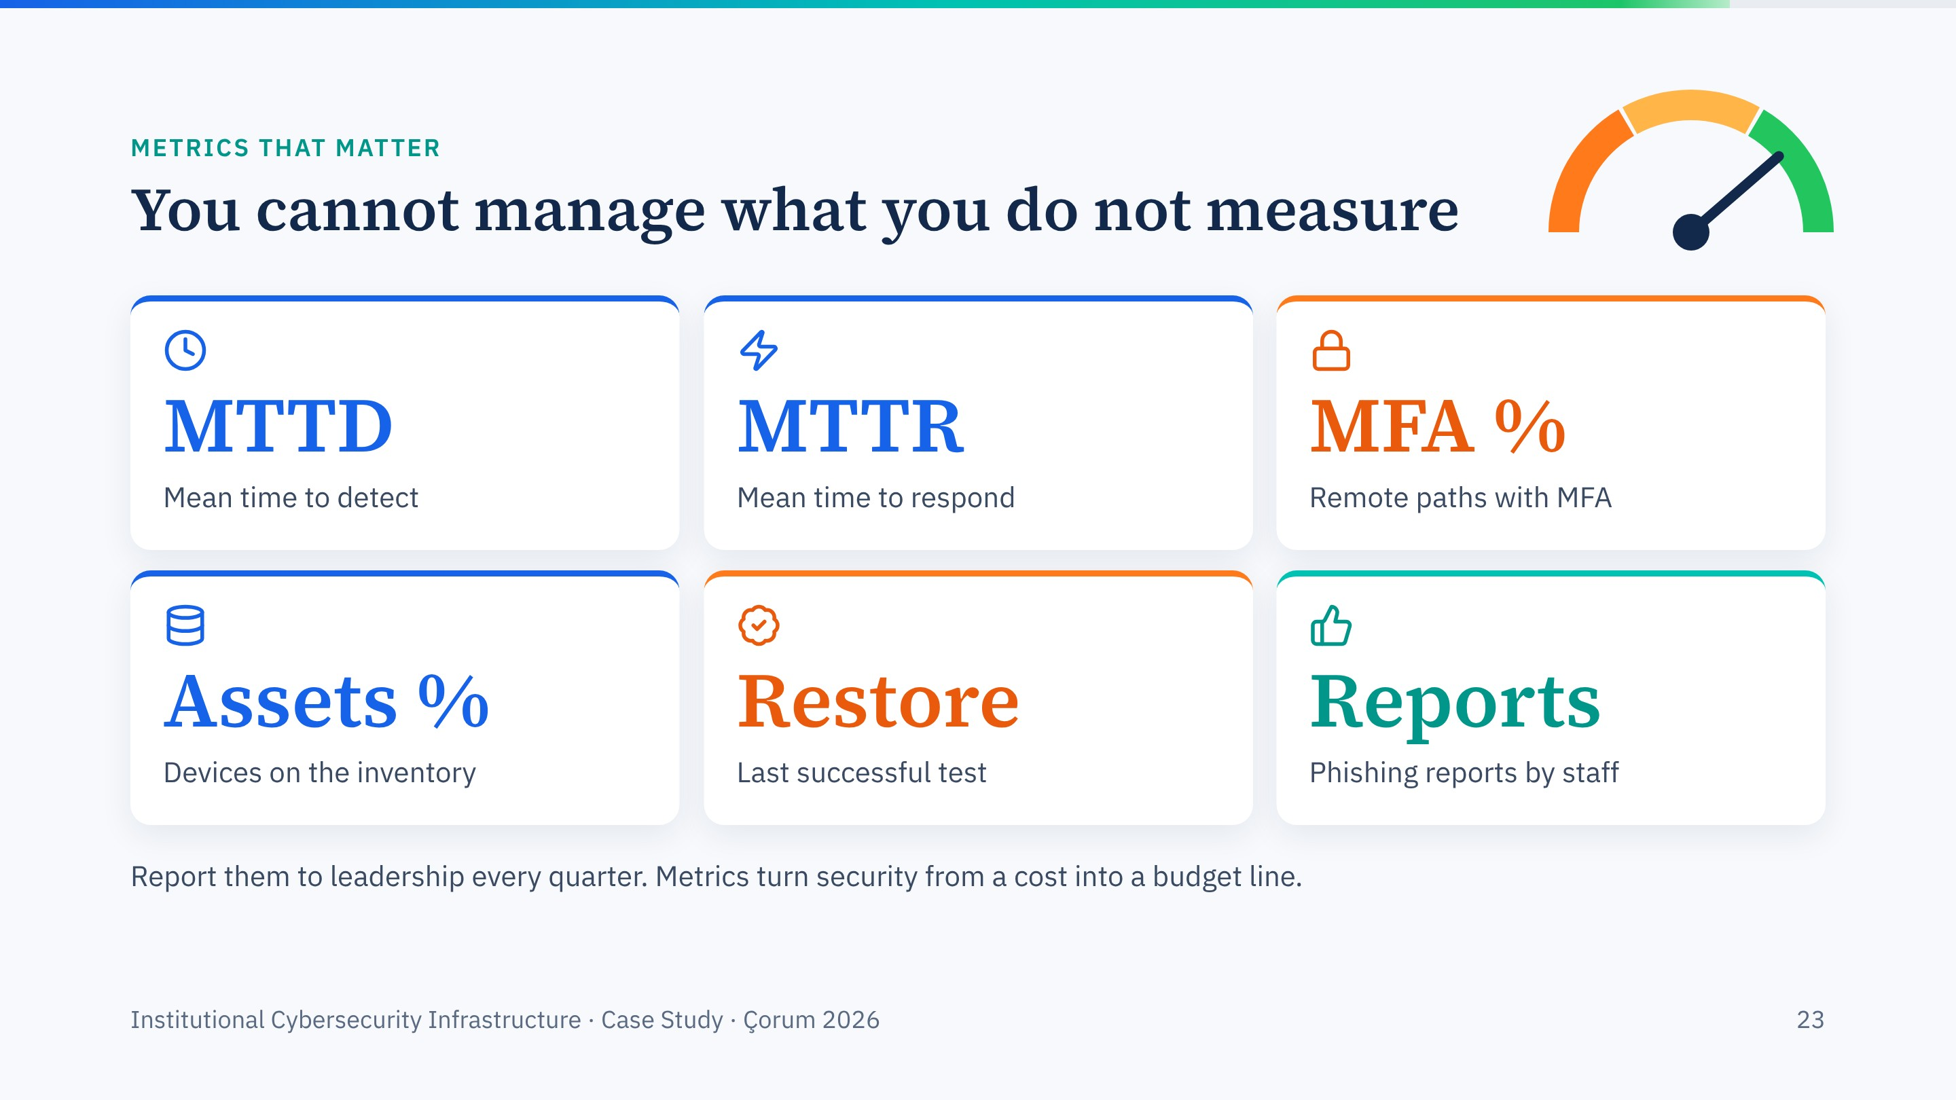
Notes:
Six metrics a facility can actually collect. Rising phishing reports are good news: they mean people are noticing.
These numbers are also how you justify the budget for phase two.

Slide 24
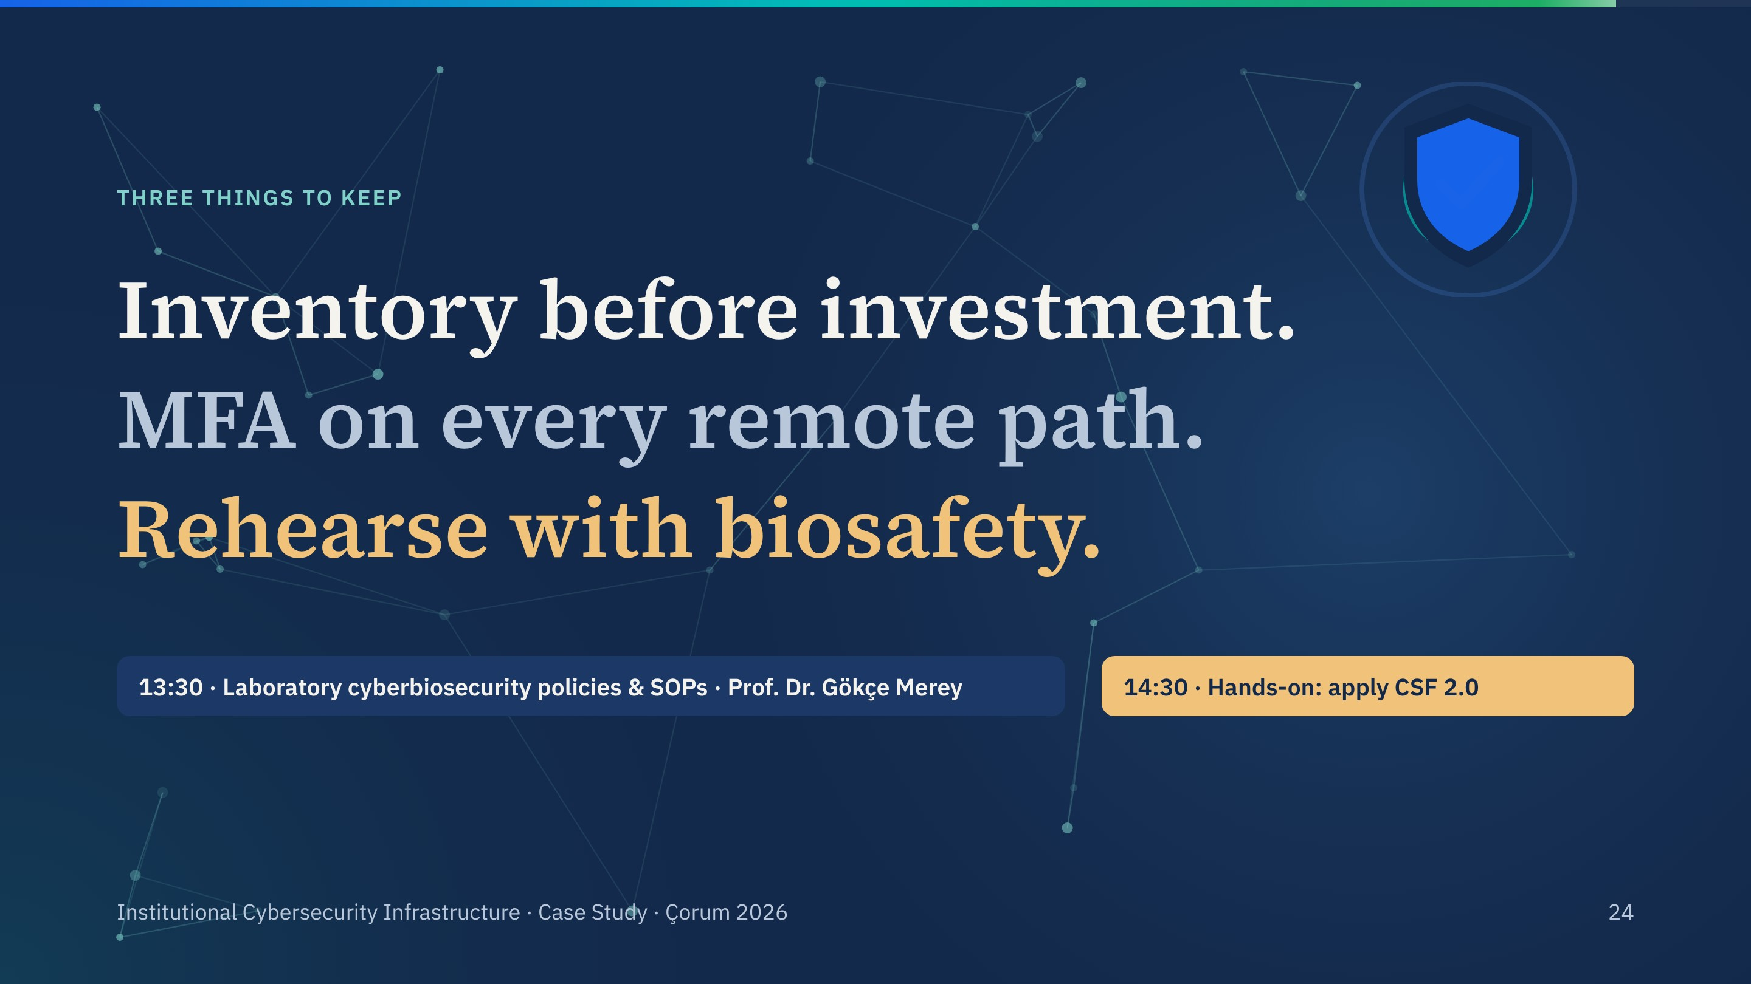
Notes:
Three lines, one click each, then the afternoon programme. Prof. Merey's session on policies and SOPs follows lunch; it builds directly on the RACI and playbooks we saw here.

Slide 25
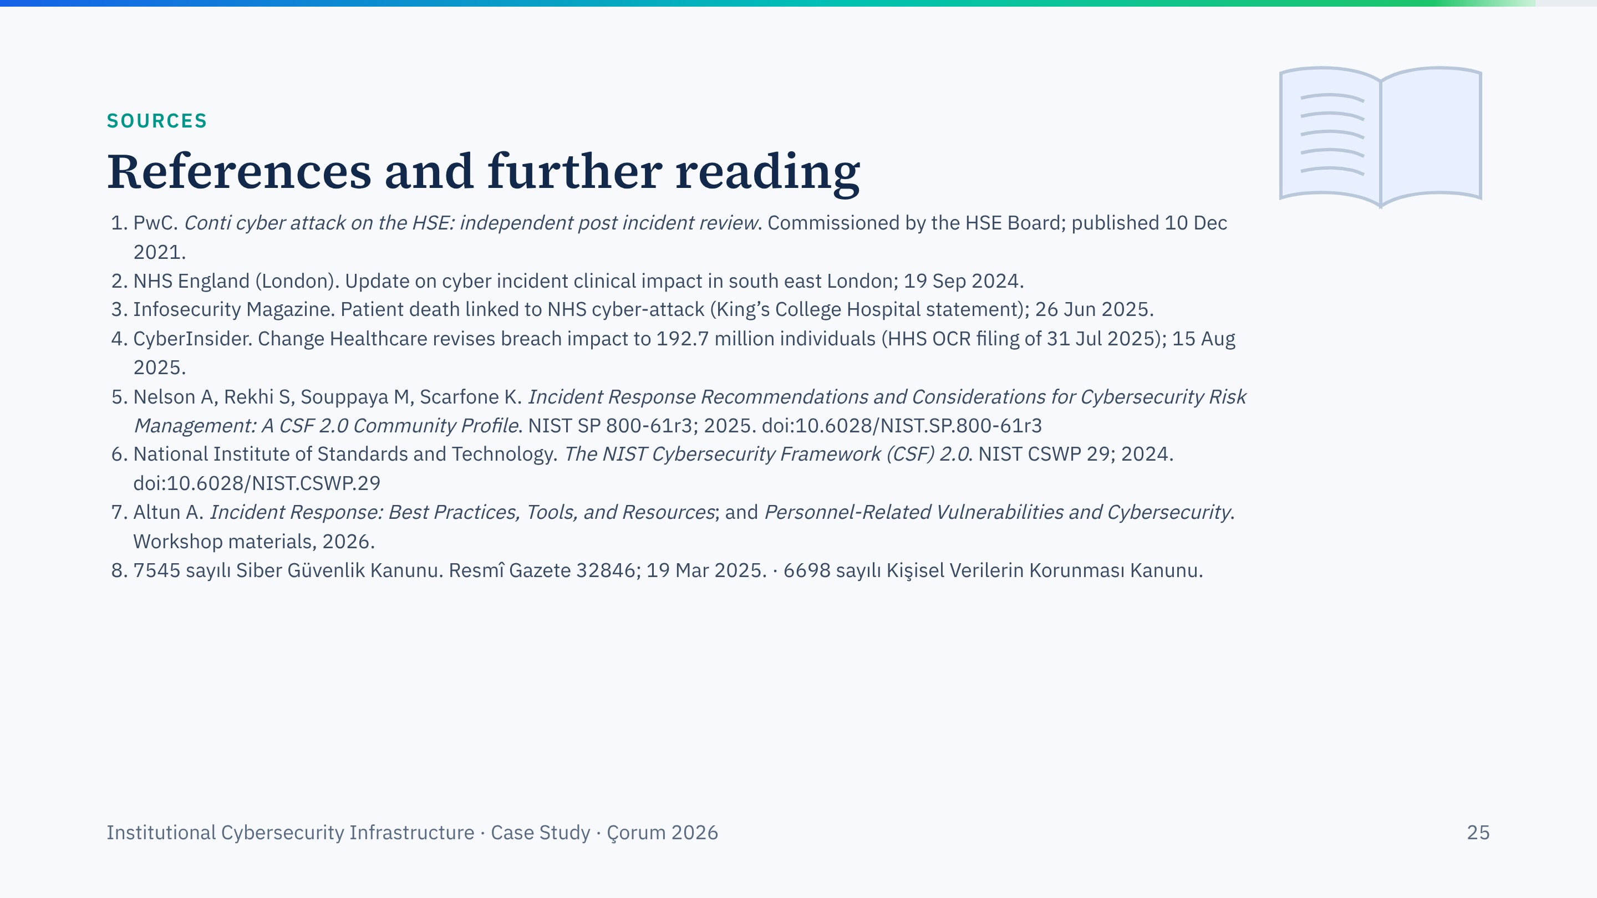
Notes:
Sources for this session. Every DOI on this slide was checked against Crossref.

Slide 26

Notes:
Take questions, then release for lunch. Remind everyone that the 14:30 exercise uses everything from this session.

