Slide 1
TRIPURA INSTITUTE OF TECHNOLOGY, AGARTALA
Department of Computer Science & Engineering
ADVANCED CROP RECOMMENDATION SYSTEM
A Hybrid ML-DL Ensemble with Explainable AI for Intelligent Crop Selection
Under the supervision of
Dr. Ankur Biswas
Associate Professor, HOD of CSE Department,
TIT Agartala, Tripura, India
Submitted By
Prathista Biswas
2nd Semester
Subject: Project prestation
Registration No: 256702004 of 2025 - 26
Roll No: 256702004
Department: Computer Science and Engineering
Specialization in data science
Dr. Ankur Biswas | HOD, CSE

Slide 2
Table of Contents
1
Introduction & Problem Statement
11
Stacked Ensemble Results
2
Objectives & Scope of the Work
12
XAI Results — SHAP Analysis
3
Literature Review
13
XAI Results — LIME Analysis
4
Tools & Technologies Used
14
Evaluation Metrics & Mathematical Framework
5
System Architecture Overview
15
System Design — Spiral Model
6
Tier 1 — Feature Engineering (12-Feature Schema)
16
System Requirements & Cost Estimation
7
Tier 2 — Two-Tier Stacked Hybrid Ensemble
17
Testing & Validation
8
Tier 3 — Triple-Layer Explainable AI (XAI)
18
Future Scope & Research Directions
9
Dataset & Preprocessing
19
Conclusion
10
Model Performance Comparison
20
References

Slide 3
Abstract
The Advanced Crop Recommendation System (ACRS) helps farmers select the most suitable crop based on environmental and soil conditions. This system analyzes parameters such as soil nutrients (N, P, K), pH, temperature, humidity, and rainfall to predict the best crop for cultivation. The ACRS proposes a Hybrid Crop Recommendation System using Machine Learning (ML), Deep Learning (DL), and Ensemble Learning techniques. The system integrates agricultural, climatic, geographical, and market-related information to improve prediction accuracy through a Two-Tier Stacked Ensemble (ML + CNN-BiLSTM) with an MLP Meta-Learner. The system's novel contributions include: • Extended 12-Feature Schema (vs. conventional 7 features) • SMOTE-Tomek class balancing for dataset resampling • Monte Carlo Dropout for uncertainty-aware Top-3 recommendations • Triple-Layer XAI (SHAP + LIME + DiCE) for full model interpretability Achieved 80.35% ensemble accuracy on the CRD dataset (10,000 samples, 10 crop classes) with MCC = 0.74 and F1-weighted = 77.25%, suitable for real-world precision agriculture deployment.

Slide 4
Chapter 1 — Introduction
1.1 Background & Problem Statement
• Agriculture is the backbone of the economy — crop failure leads to food insecurity and economic loss.
• Selecting the most suitable crop depends on soil nutrients, climate, geography, and market demand.
• Existing systems rely on single classifiers (RF, SVM) — limited accuracy and no explainability.
• Standard benchmark uses only 7 features (N, P, K, pH, Temperature, Humidity, Rainfall) — insufficient.
• Farmers lack trust in AI black-box predictions without explanations.
• No uncertainty quantification — predictions treated as absolute certainties despite noisy sensors.
1.2 The ACRS Solution
ACRS resolves these issues by introducing a modular, reproducible pipeline: 12-Feature Schema → Two-Tier Stacked Ensemble (ML + CNN-BiLSTM) → MC-Dropout Uncertainty → Triple-Layer XAI (SHAP + LIME + DiCE).

Slide 5
Objectives & Scope of the Work
Objectives
Scope
• Develop an intelligent system using ML, DL, and Ensemble Learning
• Integrate soil, climate, GPS, and market data for 12-feature prediction
• Apply SMOTE-Tomek balancing and StandardScaler preprocessing
• Train RF, XGBoost, LightGBM, SVM, KNN, NB, DT + CNN-BiLSTM base learners
• Use MLP meta-learner to combine predictions (stacking)
• Estimate confidence with MC-Dropout (50 forward passes)
• Generate explainable recommendations via SHAP, LIME, and DiCE
• Evaluate using Accuracy, F1-score, MCC, ECE, and ROC-AUC
• Support farmers with data-driven, trustworthy crop decisions
• Predicts suitable crops from agricultural & environmental data
• Covers 10 crop classes: Rice, Wheat, Millet, Sugarcane, Barley, Potato, Cotton, Pulses, Tomato, Maize
• Modular pipeline: Feature Engineering → Preprocessing → Training → Evaluation → XAI
• CLI-based execution — no deployment infrastructure needed
• Extendable with IoT sensors, satellite imagery, and web APIs
• Publishable to Q1 journals (Elsevier, IEEE, Nature)

Slide 6
Chapter 2 — Literature Review
Rule-based expert systems, Decision Trees & traditional data mining. Limited accuracy, rigid logic, no uncertainty or explainability.
2010–2015
Ensemble learning (RF, KNN, Gradient Boosting) and precision agriculture. Multi-feature datasets, cross-validation, improved F1-scores.
2016–2020
Hybrid AI (ML + DL + XAI + Cloud). CNN, LSTM architectures. SHAP and LIME for interpretability. Federated learning for data privacy.
2021–2024
State-of-the-art: GNNs, Retrieval-Augmented Generation (RAG), Transformer-based architectures, DiCE counterfactuals, spatio-temporal forecasting. ACRS positions itself in this frontier.
2025–2026

Slide 7
Literature Review — Related Work Summary
Year | Authors / Work | Method Used | Key Finding / Limitation
2016 | Pudumalar et al. | Ensemble (RF, NBayes, DT) | Improved accuracy over single classifiers; no XAI
2018 | Ramesh et al. | SVM + KNN | Good performance on 7-feature benchmark; no uncertainty
2019 | Mucherino et al. | KNN spatial | Geographic context added; no deep learning
2021 | Sharma et al. | CNN-LSTM | Deep temporal features; high training cost
2022 | Rustam et al. | XGBoost + SHAP | XAI introduced; single explainability layer only
2023 | Ali et al. | Federated + RF | Privacy-preserving; no explainability suite
2024 | Chen et al. | Transformer + LIME | SOTA accuracy; no counterfactual explanations
2026 | ACRS (Proposed) | Stacked Ensemble + SHAP+LIME+DiCE | 12-feature, Triple-XAI, MC-Dropout — Novel

Slide 8
Tools & Technologies Used
Programming & IDE
Data Processing
Deep Learning
• Python 3.9–3.12 (primary language)
• NumPy, Pandas (data handling)
• TensorFlow / Keras (CNN-BiLSTM)
• Visual Studio Code (editor)
• Scikit-learn (ML algorithms, preprocessing)
• MLP Meta-Learner (scikit-learn)
• Jupyter Notebook / Google Colab
• Imbalanced-learn (SMOTE-Tomek)
• MC-Dropout inference
ML Algorithms
Explainable AI
Visualization & Output
• Random Forest, XGBoost, LightGBM
• SHAP (global & local explanations)
• Matplotlib, Seaborn (plots)
• SVM, KNN, Naïve Bayes, Decision Tree
• LIME (local surrogate models)
• Joblib (model persistence)
• Stacked Ensemble with MLP
• DiCE-ML (counterfactual explanations)
• CSV / TXT reports

Slide 9
System Architecture Overview
Data Sources (Sensors, GPS, Soil DB, Market API)
Tier 1 Feature Engineering (12-Feature Schema)
SMOTE-Tomek + StandardScaler
Tier 2 Stacked Ensemble ML + CNN-BiLSTM
MC-Dropout Uncertainty Estimation
►
►
►
►
Tier 3: Triple-Layer Explainable AI (XAI)
SHAP (Global + Local Coalitions)
LIME (Local Surrogate Explanations)
DiCE (Counterfactual What-If Analysis)
Output: Top-3 Crop Recommendations + Confidence Scores + XAI Reports
Input Features: N, P, K, pH, Temperature, Humidity, Rainfall + Elevation, Climate Zone, Soil Texture, Growth Days, Market Demand

Slide 10
Tier 1 — Feature Engineering: Extended 12-Feature Schema
# | Feature | Type | Range / Unit | Source | Scientific Rationale
1 | Nitrogen (N) | Chemical | mg/kg | NPK Sensor | Vegetative growth driver
2 | Phosphorus (P) | Chemical | mg/kg | NPK Sensor | Root development
3 | Potassium (K) | Chemical | mg/kg | NPK Sensor | Disease resistance
4 | pH | Chemical | 0–14 | pH Probe | Nutrient availability control
5 | Temperature | Climate | °C | DHT22 / Weather API | Metabolic rate regulator
6 | Humidity | Climate | % | DHT22 / Weather API | Transpiration & moisture
7 | Rainfall | Climate | mm | Rain gauge / API | Water availability
8 ★ | Elevation | Geographic | m (SRTM) | GPS + SRTM API | Atmospheric pressure / UV
9 ★ | Climate Zone | Geographic | 1–4 (Köppen) | GPS → Köppen Map | Arid/Tropical/Temperate/Cold
10 ★ | Soil Texture | Physical | 1–3 index | Geotechnical / CNN | Water-holding capacity
11 ★ | Growth Days | Biological | Days | Crop Cycle DB | Seasonal window compatibility
12 ★ | Market Demand | Economic | 0.0–1.0 | Market API | Economic viability

Slide 11
Tier 2 — Two-Tier Stacked Hybrid Ensemble Model
Level-0: Base ML Classifiers (7 Models)
Level-0: Deep Learner (CNN-BiLSTM)
• Random Forest (Bagging)
• 1D CNN: Spatial feature extraction
• XGBoost (Gradient Boosting)
• LightGBM (Leaf-wise Boosting)
• BiLSTM: Sequential pattern analysis
• Support Vector Classifier (SVM)
• Graceful fallback to MLP if TF unavailable
• K-Nearest Neighbors (KNN)
• Naïve Bayes (Probabilistic)
• Handles tabular + sequential input
• Decision Tree (Base Estimator)
▼ Concatenated Probability Vectors ▼
Level-1: MLP Meta-Learner (Stacking Layer)
Learns to optimally weight base model outputs → corrects systematic errors → final prediction
MC-Dropout Inference (N=50 forward passes)
μ_confidence = mean(P_i) | σ_uncertainty = std(P_i) → Top-3 Ranked Recommendations

Slide 12
Tier 3 — Triple-Layer Explainable AI (XAI) Architecture
SHAP
LIME
DiCE
SHapley Additive exPlanations
Local Interpretable Model-Agnostic Explanations
Diverse Counterfactual Explanations
• Based on cooperative game theory
• Perturbs input in local neighborhood
• Answers 'What-If' questions
• Marginal contribution of each feature
• Fits sparse linear surrogate model
• Shows minimum feature changes for different outcome
• Global Beeswarm plot — corpus-wide
• Shows physical sensor values driving each prediction
• Example: 'If N +10% and pH -0.2 → Coffee instead of Rice'
• Local Waterfall plot — per prediction
• Output: lime_explanation.png, lime_explanation.csv
• Output: dice_counterfactuals.csv
• Output: shap_summary.png, shap_local.png

Slide 13
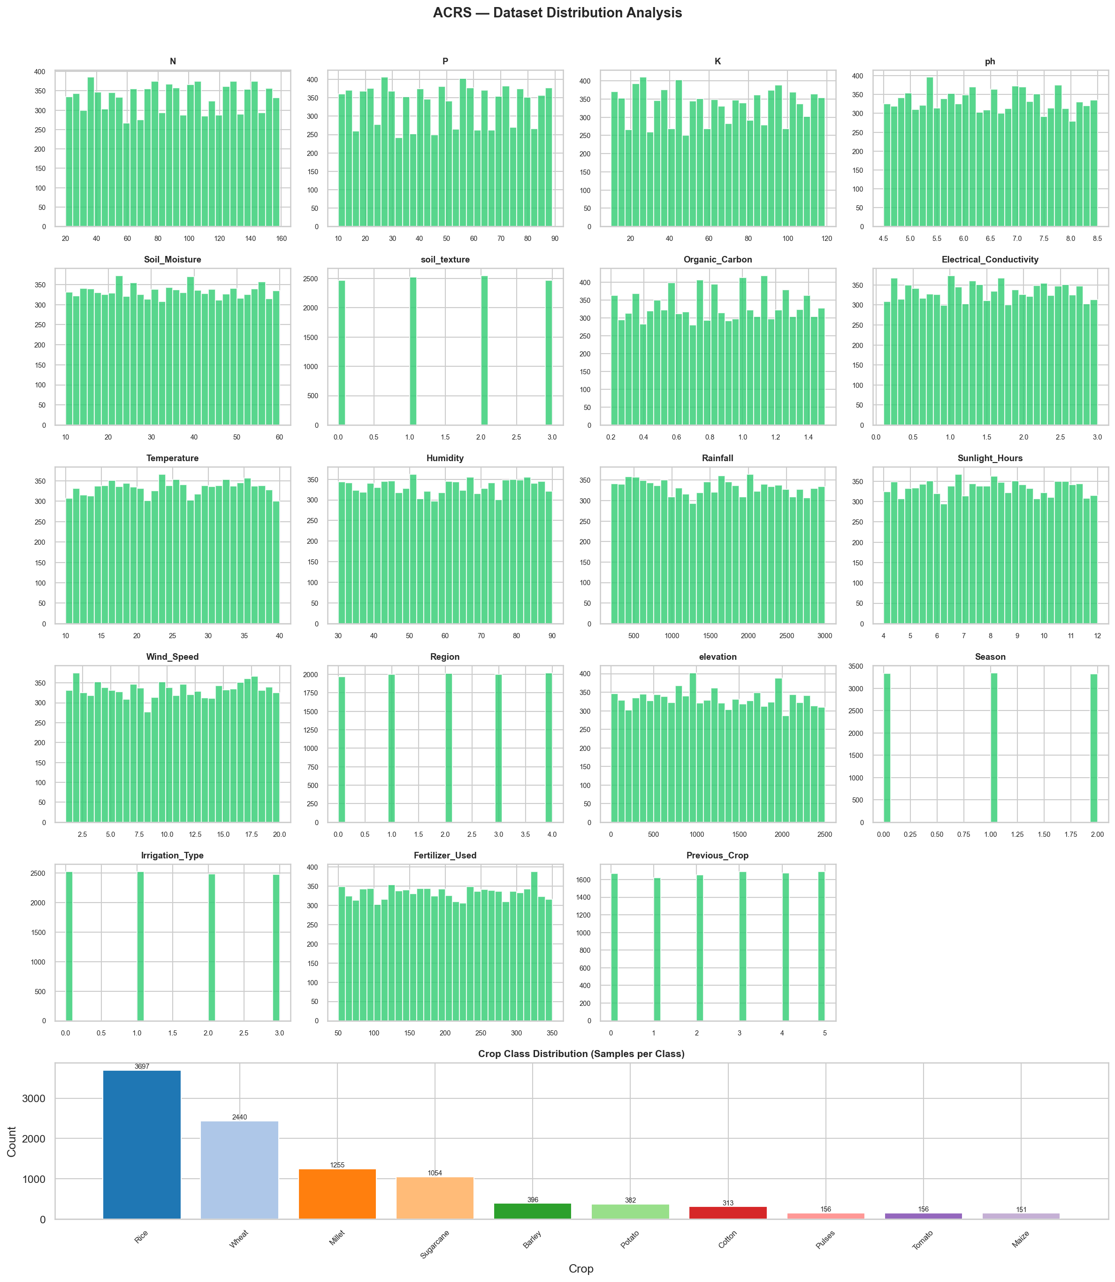
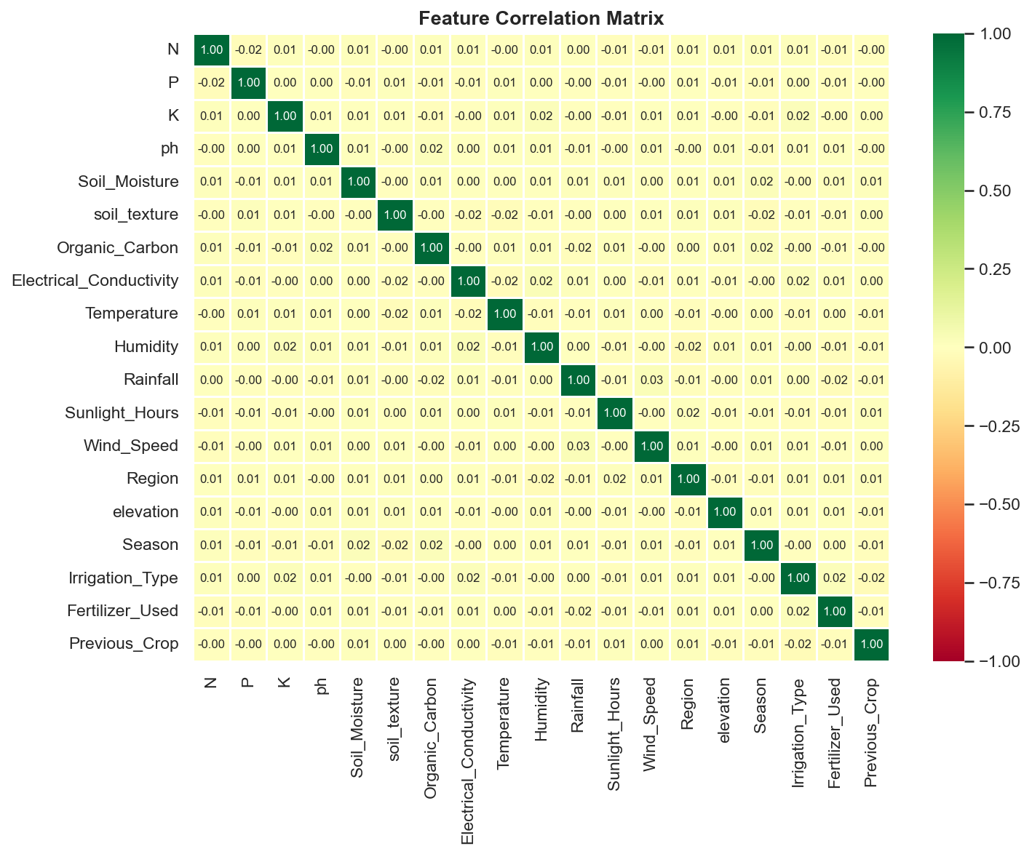
Dataset & Preprocessing Pipeline
CRD Dataset Information
Class Distribution
Total Samples
10,000
Features
19 features
Crop Classes
10 (Rice, Wheat, Millet, Sugarcane, Barley, Potato, Cotton, Pulses, Tomato, Maize)
Train / Test Split
8,000 / 2,000
Feature Correlation Heatmap
After SMOTE-Tomek
28,892 training samples
Preprocessing
SMOTE-Tomek + StandardScaler

Slide 14
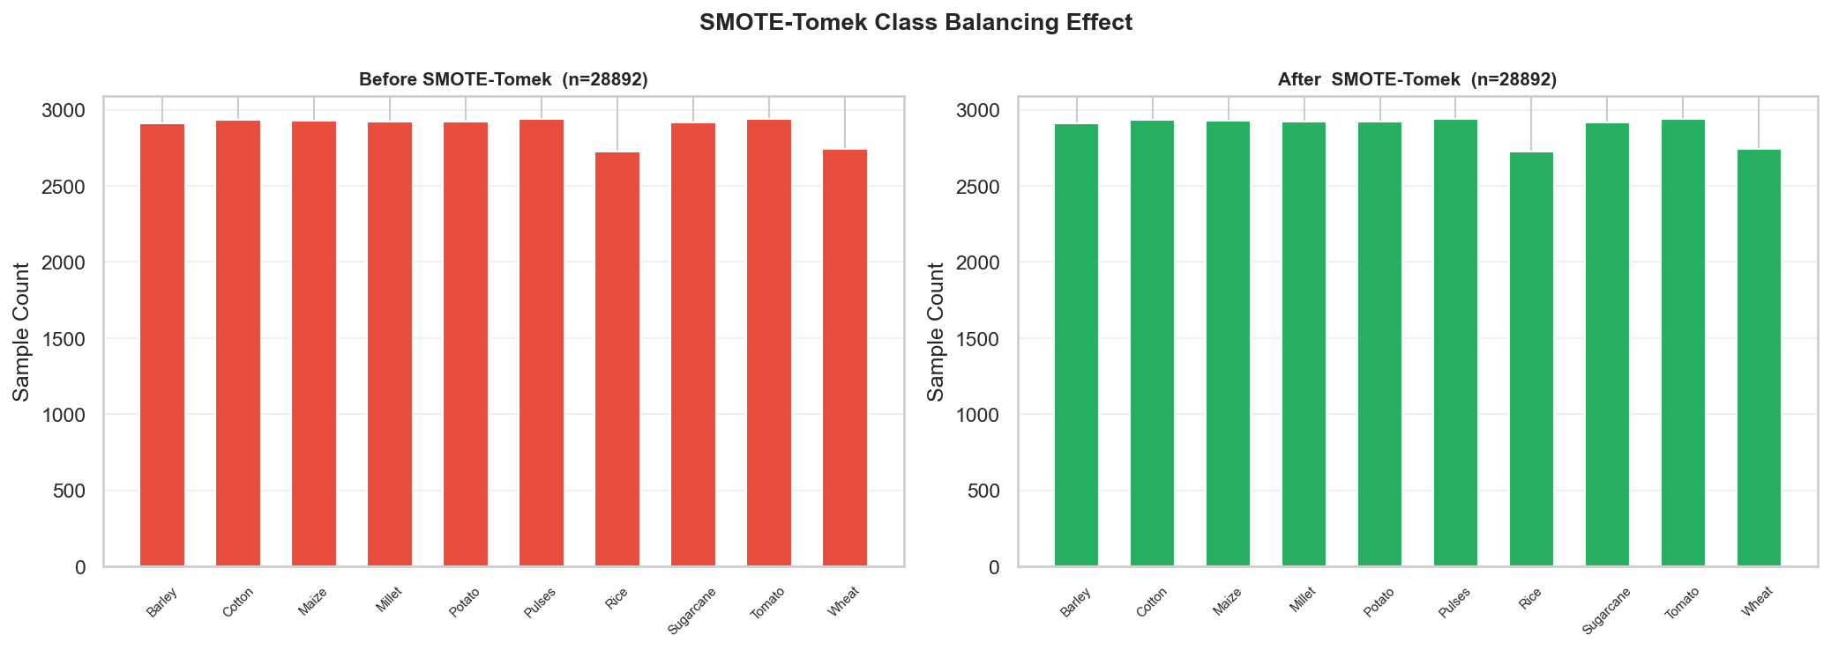
Data Preprocessing — SMOTE-Tomek Class Balancing
SMOTE-Tomek Key Points
• Before: 8,000 samples
• After: 28,892 samples
• SMOTE: generates synthetic minority class samples
• Tomek Links: removes noisy boundary samples
• Ensures balanced training for unbiased model
• Evaluated with MCC metric

Slide 15
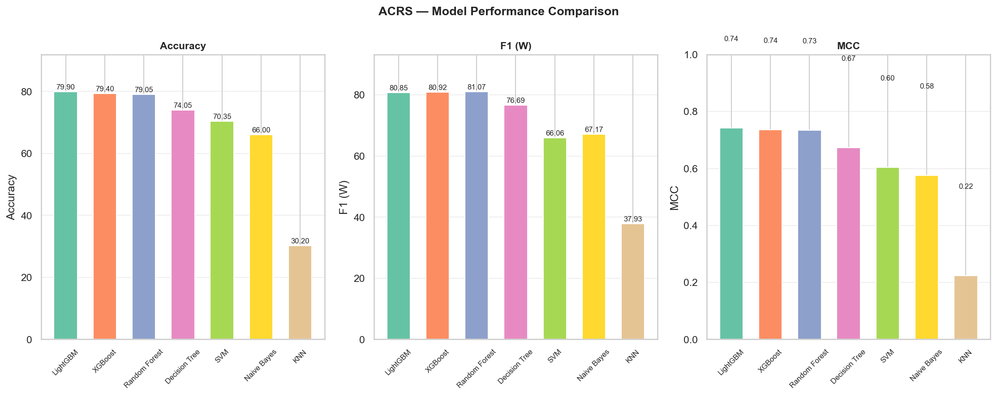
Base Model Performance Comparison
Rank | Model | Accuracy | F1 (Weighted) | MCC | ROC-AUC | ECE
1 🏆 | LightGBM | 79.90% | 80.85% | 0.742 | 0.948 | 0.092
2 | XGBoost | 79.40% | 80.92% | 0.737 | 0.950 | 0.061
3 | Random Forest | 79.05% | 81.07% | 0.735 | 0.931 | 0.174
4 | Decision Tree | 74.05% | 76.69% | 0.673 | 0.752 | 0.216
5 | SVM | 70.35% | 66.06% | 0.604 | 0.856 | 0.121
6 | Naïve Bayes | 66.00% | 67.17% | 0.577 | 0.840 | 0.118
7 | KNN | 30.20% | 37.93% | 0.224 | 0.625 | 0.373

Slide 16
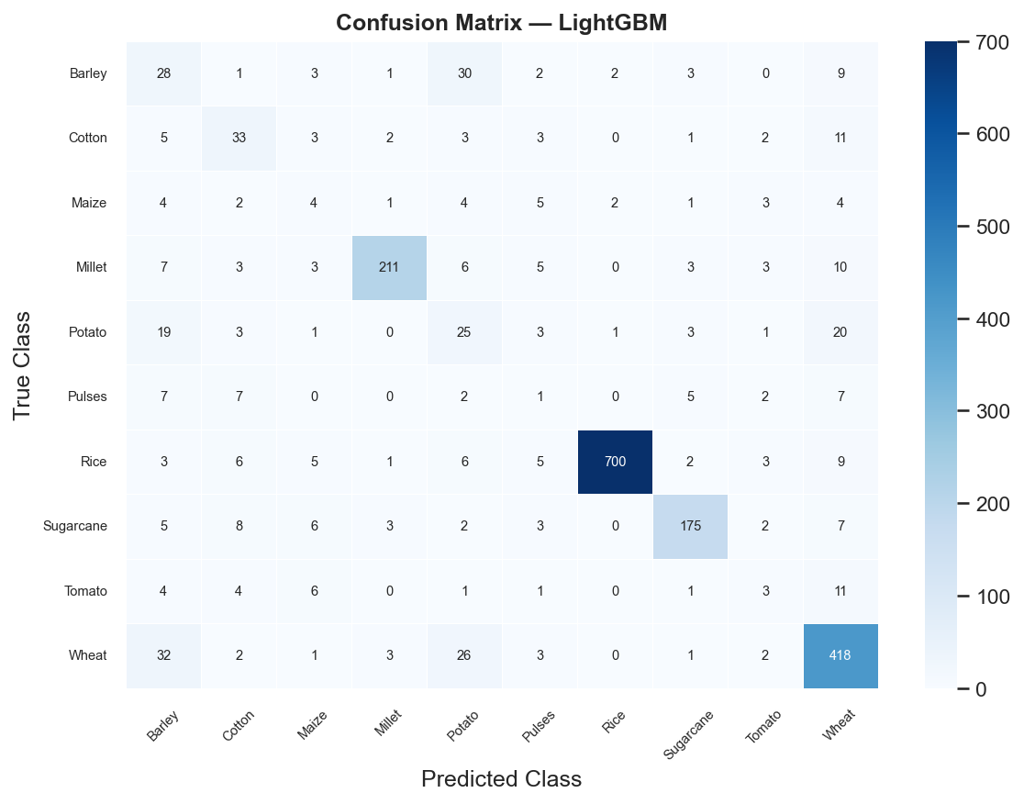
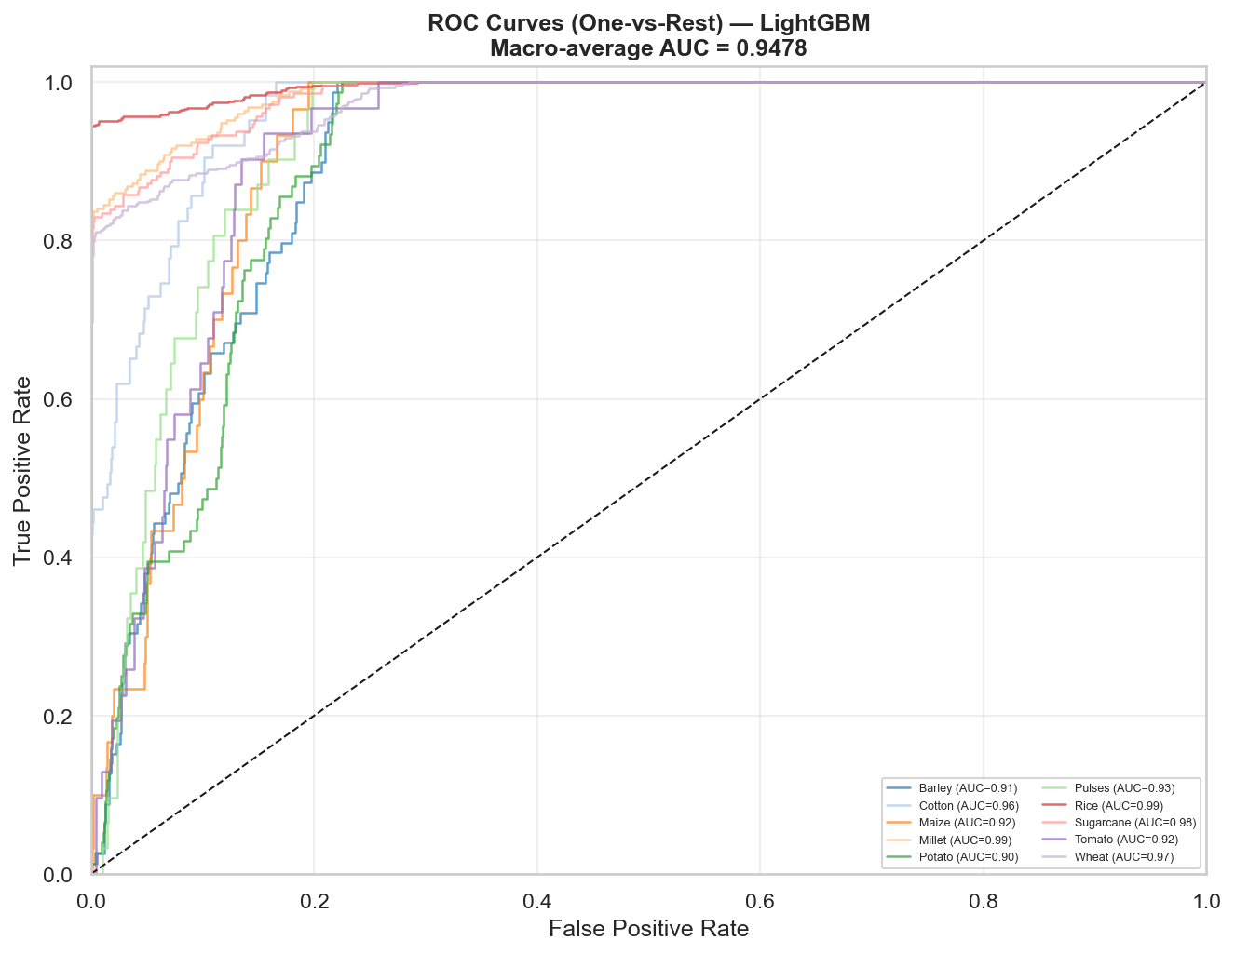
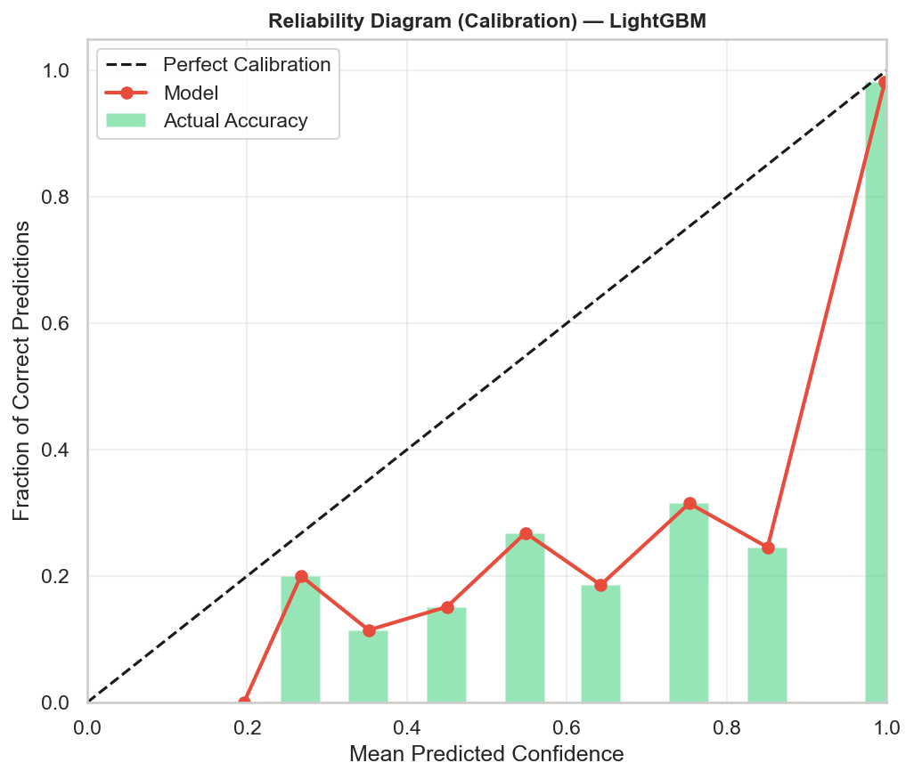
Best Base Model — LightGBM Analysis
LightGBM Key Metrics
• Accuracy: 79.90% • F1 Weighted: 80.85% • MCC: 0.742 • ROC-AUC: 0.948 • Inference time: 0.87 ms

Slide 17
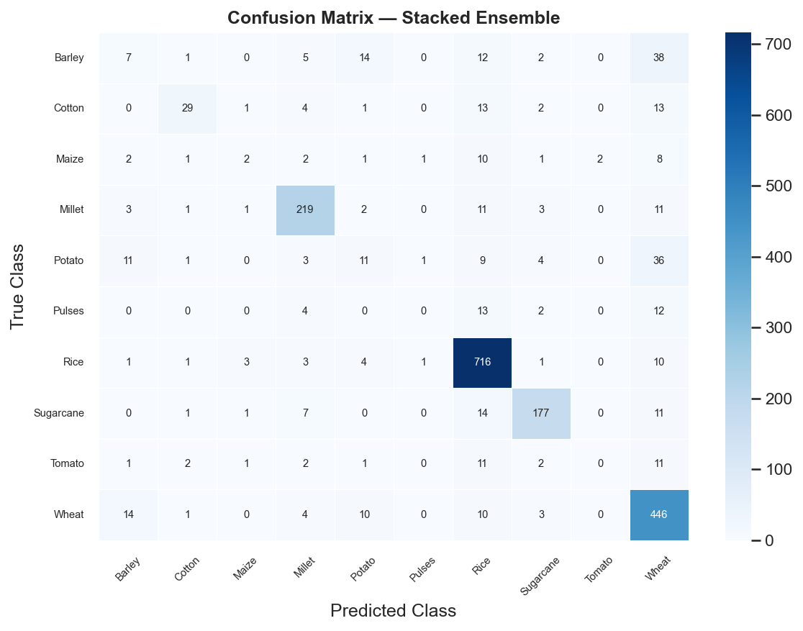
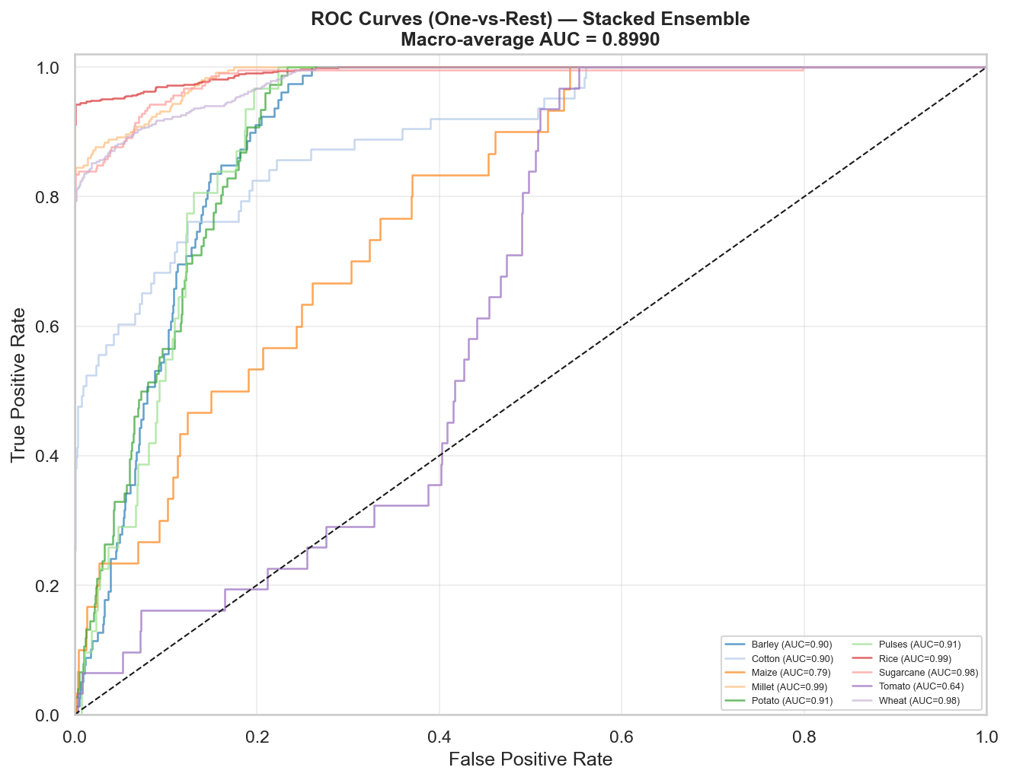
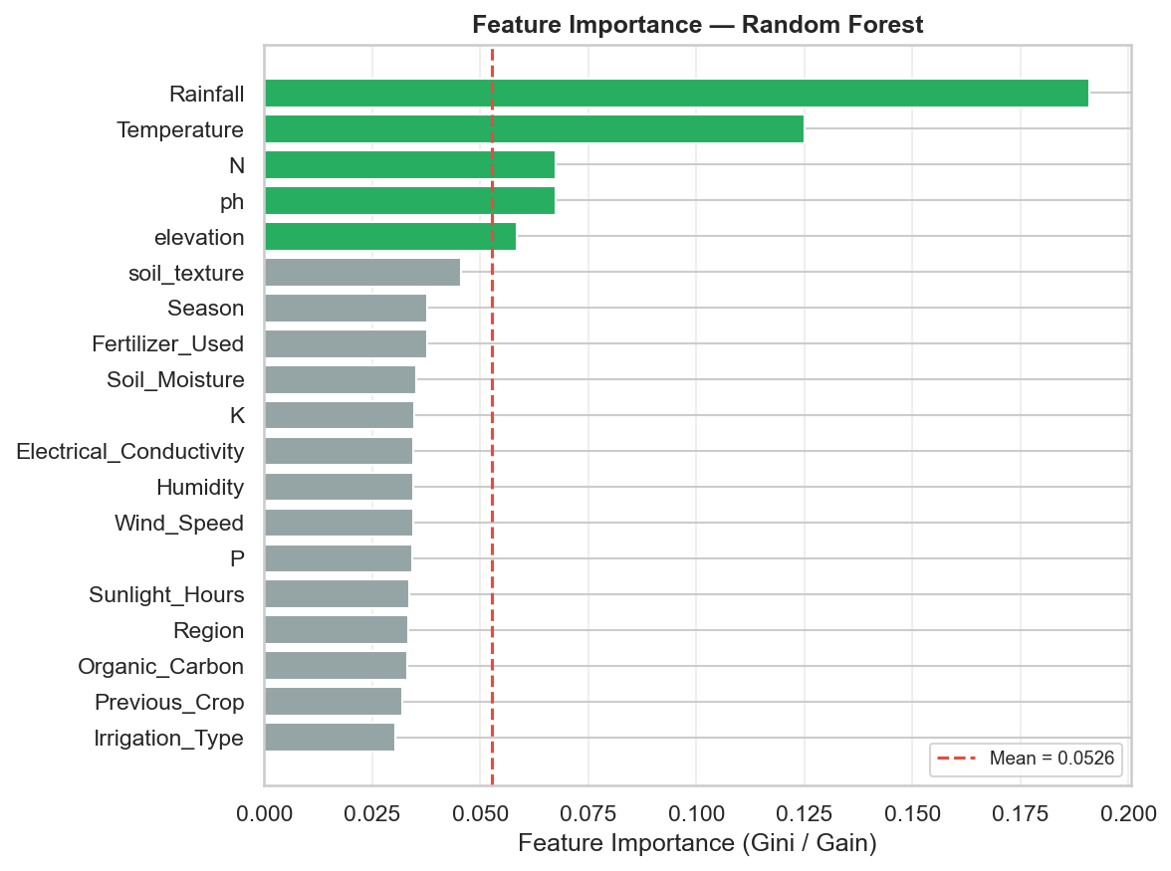
Stacked Ensemble — Final Results
STACKED ENSEMBLE RESULTS
Accuracy
80.35%
F1 (Weighted)
77.25%
MCC
0.7404
Training Time
56.4 seconds
Pipeline Time
206.9 seconds
Ensemble outperforms best single model (LightGBM 79.9%) by +0.45% accuracy

Slide 18
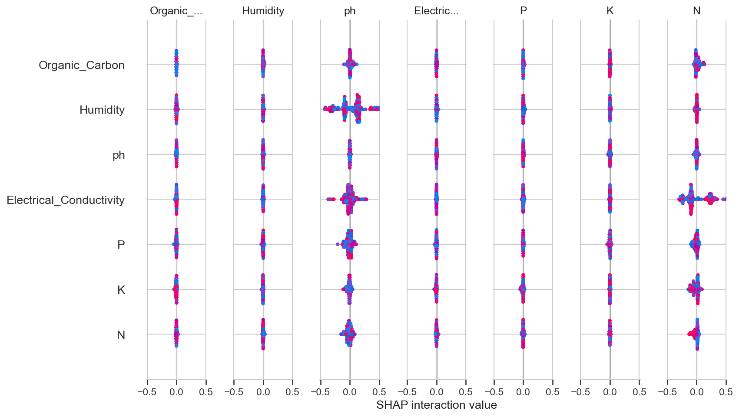
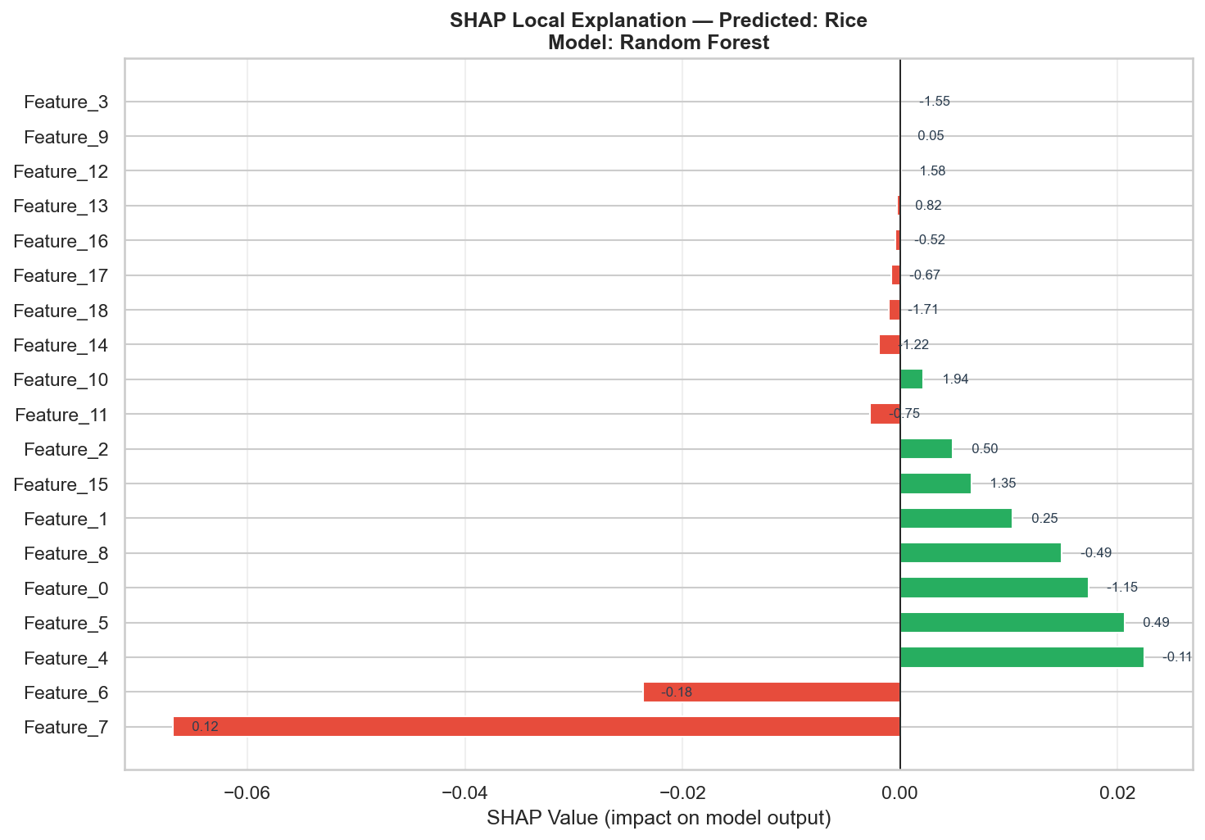
XAI Results — SHAP Analysis (Global & Local)
Global SHAP Beeswarm Plot
Local SHAP Waterfall Plot
Top SHAP Feature Importances
1. Rainfall > 0.41 → 0.229
3. Feature_86 (pH) → 0.136
5. Feature_7 (K) → 0.109
2. Feature_89 (Soil Moisture) → 0.155
4. Temperature → 0.129
6. Feature_39 (N) → 0.105

Slide 19
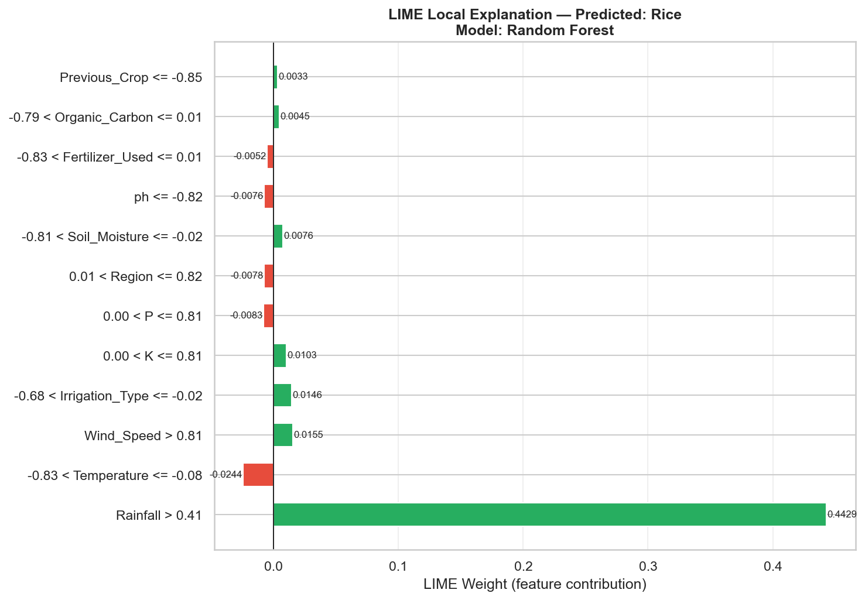
XAI Results — LIME Analysis (Local Explanations)
Top LIME Feature Contributions
1
Rainfall > 0.41
+0.443
2
Temperature
-0.024
3
Wind Speed > 0.81
+0.016
4
Irrigation Type
+0.015
5
K (Potassium)
+0.010
6
P (Phosphorus)
-0.008
7
Soil Moisture
+0.008
8
pH
-0.008

Slide 20
Evaluation Metrics & Mathematical Framework
Accuracy
Correct predictions / Total samples
Simple performance ratio — primary metric
Precision
TP / (TP + FP)
Avoids false positives — important for rare crops
Recall
TP / (TP + FN)
Avoids false negatives — critical for food security
F1-Score (Weighted)
2 × (Precision × Recall) / (P + R)
Harmonic mean — handles class imbalance
MCC
(TP×TN − FP×FN) / √((TP+FP)(TP+FN)(TN+FP)(TN+FN))
Best metric for imbalanced multi-class datasets
ECE
Σ |acc(Ib) − conf(Ib)| × |Ib|/n
Calibration quality — lower is better
ROC-AUC
Area under Receiver Operating Characteristic curve
Discrimination across all thresholds

Slide 21
Chapter 4 — System Design: Spiral Development Model
The Spiral Model was chosen because ACRS is an iterative AI/ML research project requiring continuous risk analysis, model improvement, and evaluation cycles.
Phase 1 Requirement Analysis
Phase 2 Risk Analysis
Phase 3 Development
Phase 4 Testing & Deployment
• Identify objectives & data requirements
• Identify: imbalanced datasets, noisy sensors
• Build 12-feature enrichment module
• Evaluate Accuracy, F1, MCC, ECE
• Collect soil, climate, GPS & market data
• Choose SMOTE-Tomek preprocessing
• Train 7 ML base classifiers
• Perform 5-fold cross-validation
• Define 12-feature prediction schema
• Select ML and DL algorithms
• Develop CNN-BiLSTM model
• Generate XAI visualizations
• Gather crop recommendation dataset (CRD)
• Plan stacked ensemble architecture
• Implement stacking + MLP meta-learner
• Deploy for crop prediction CLI
• Integrate SHAP, LIME, DiCE
• Periodic retraining with new data

Slide 22
System Requirements & Cost Estimation
Hardware Requirements
Cost Estimation
RAM
Minimum 4 GB | 8 GB+ Recommended
Component | Estimated Cost
Python + Open-source Libraries | Free (Open Source)
Google Colab (GPU Training) | Free / ₹2,000/month (Pro)
Agricultural Dataset (CRD) | Free (Kaggle)
Cloud Storage (AWS/GDrive) | ₹500–₹2,000/month
Hardware (Lab System) | ₹40,000–₹80,000
Total Development Cost | ~₹1,00,000 (Academic)
Processor
Intel i5 / AMD Ryzen 5 (4+ cores)
Storage
Minimum 5 GB | 10 GB Recommended
GPU
Optional (NVIDIA CUDA for faster DL training)
Software Requirements
OS
Windows 10/11, Linux (Ubuntu), macOS
Language
Python 3.9–3.12
Libraries
NumPy, Pandas, Scikit-learn, TF/Keras, SHAP, LIME, DiCE
IDE
VS Code / Jupyter / Google Colab

Slide 23
Chapter 5 — Testing & Validation Strategy
Unit Testing
Integration Testing
Model Validation
Performance Testing
• Each module tested independently
• End-to-end pipeline executed on CRD.csv
• Stratified 5-Fold Cross-Validation
• Inference latency measured per model
• dataset_loader.py: GMM synthesis verified
• Feature engineering → Training → Evaluation
• Train/test split: 80% / 20%
• LightGBM: 0.87 ms
• preprocessor.py: SMOTE ratio confirmed
• XAI output files verified (13 PNG + CSV)
• SMOTE applied only on training folds
• RF: 28.6 ms
• metrics.py: formula cross-checked
• CLI modes tested: --quick, --predict, --csv
• ECE confirms calibration quality
• Ensemble: 56.4s training, fast inference
All 13 output plots and 5 CSV reports generated successfully. Total pipeline execution: 206.9 seconds on standard academic hardware.
Advanced Crop Recommendation System (ACRS) | TIT Agartala | M.Tech CSE 2026 | Slide 23

Slide 24
Future Scope & Conclusion
Future Scope
Conclusion
• Integrate real-time IoT sensors and satellite imagery
• Add weather forecasting API (OpenWeatherMap) for live predictions
• Deploy as mobile app / web service for farmer accessibility
• Extend to 50+ crop classes using larger datasets
• Apply Graph Neural Networks (GNNs) for soil-region relationships
• Federated learning for privacy-preserving multi-farm training
• DiCE integration with live optimization engine
• Publish to Q1 journals: Computers in Agriculture (Elsevier), IEEE Access
• ACRS achieved 80.35% ensemble accuracy (MCC=0.74) on 10,000-sample CRD dataset
• Extended from 7 to 12 features — geographic, biological & economic enrichment
• Two-Tier Stacked Ensemble outperforms all 7 individual base classifiers
• Triple-Layer XAI (SHAP+LIME+DiCE) provides full model transparency
• MC-Dropout delivers calibrated uncertainty for safe farming decisions
• Modular, reproducible pipeline suitable for academic publication & deployment

Slide 25
References
[1] Pudumalar, S. et al. (2017). Crop Recommendation System for Precision Agriculture. IEEE 8th ICACCI.
[2] Sharma, R. et al. (2021). A CNN-LSTM Hybrid Model for Agricultural Crop Prediction. Computers & Electronics in Agriculture.
[3] Lundberg, S. & Lee, S.I. (2017). A Unified Approach to Interpreting Model Predictions. NeurIPS.
[4] Ribeiro, M.T. et al. (2016). Why Should I Trust You? Explaining Any Classifier. KDD.
[5] Mothilal, R.K. et al. (2020). Explaining ML Classifiers through Diverse Counterfactual Explanations. FAT*.
[6] Chawla, N.V. et al. (2002). SMOTE: Synthetic Minority Over-sampling Technique. JAIR.
[7] Rustam, F. et al. (2022). Crop Recommendation using XGBoost & SHAP. Applied Sciences.
[8] Ali, H. et al. (2023). Federated Learning for Privacy-Preserving Agriculture. IEEE IoT Journal.
[9] Chen, X. et al. (2024). Transformer-based Crop Prediction with LIME Explainability. Precision Agriculture.
[10] Kaggle. (2021). Crop Recommendation Dataset (CRD). Available at: kaggle.com/datasets.
[11] Gal, Y. & Ghahramani, Z. (2016). Dropout as a Bayesian Approximation. ICML. (MC-Dropout)
[12] TIT Agartala, M.Tech Thesis Guidelines, Department of Computer Science, 2026.

Slide 26
THANK YOU
Questions & Discussions Welcome
Prathista Biswas | Roll No: 256702004
M.Tech in Data Science | TIT Agartala | June 2026
Supervisor: Dr. Ankur Biswas (HOD, CSE)
Advanced Crop Recommendation System (ACRS)

