Slide 1

TRIPURA UNIVERSITY
DEPARTMENT OF INFORMATION TECHNOLOGY (IT)
Topic: Transformer-Based Fake News Detection: AComparative Analysis of BERT, BiLSTM, andHybrid Architectures Across Multiple Datasets
M.Tech Project Presentation
PRESENTED BY
GUIDED BY
First Year M.Tech IT
Dr Parijata Majumdar
MD Akash Hossain
Asst. Professor
Roll No - 250652005
Tripura University

Slide 2
CONTENTS
INTRODUCTION
MOTIVATION AND OBJECTIVE
LITERATURE REVIEW
PROBLEM STATEMENTS
PROPOSED METHODOLOGY
TIMELINE AND PLAN OF WORK

Slide 3
INTRODUCTION
Fake news detection is an automated process that uses advanced techniques like Natural Language Processing (NLP) and Machine Learning (ML) to identify false or misleading information presented as real news. With the rapid growth of digital and social media platforms, fake news spreads faster than true information, making manual verification difficult. This creates serious social, political, and economic challenges, increasing the need for effective automated fake news detection systems.
Types of Fake News
False News Stories
Manipulated News
Satirical News
Clickbait
Propaganda
Machine Learning and Deep Learning techniques play a major role in fake news detection by identifying hidden patterns from large amounts of textual data. Traditional Machine Learning algorithms such as Logistic Regression, SVM, Naive Bayes, and Random Forest are widely used for classification tasks. Deep Learning models like LSTM and BiLSTM further improve detection by analyzing sequential relationships in text data.
Modern transformer-based models such as BERT provide higher accuracy by understanding the complete context of a sentence instead of processing words sequentially. To help these models understand textual information, techniques like TF-IDF, Bag-of-Words, Word2Vec, GloVe, and BERT embeddings convert text into numerical representations for effective classification of fake and real news.

Slide 4
MOTIVATION & OBJECTIVES
Motivation
The rapid growth of social media has increased the spread of fake and misleading news.
Fake news can influence public opinion, politics, and social stability.
It is difficult for humans to manually verify every piece of information available online.
There is a need for an automated system that can quickly identify false information.
Using technologies like Machine Learning and Natural Language Processing, fake news can be detected more efficiently.
Objectives
To develop a system that can automatically detect fake news from textual data.
To analyze news articles using machine learning algorithms.
To classify news content into Real or Fake categories.
To improve the accuracy and reliability of fake news detection.
To reduce the spread of misinformation on digital platforms.

Slide 5
RELATED WORD
Contribution | Method | Advantage | Disadvantage | Future Scope
[Kaliyar et al. (2021)] Introduced FakeBERT, a BERT-based deep learning model with parallel CNN layers for fake news detection on social media. | BERT + Parallel CNN on LIAR and ISOT datasets | 98.90% accuracy; captures contextual semantics; outperforms traditional ML | Computationally expensive; large GPU memory; English-only | Multilingual detection; model distillation to reduce cost
[Aphiwongsophon (2021)] Compared classical ML classifiers for fake news using TF-IDF linguistic and statistical features. | Logistic Regression, SVM, Naive Bayes, Random Forest + TF-IDF | Simple; low cost; interpretable; resource-constrained friendly | Lower accuracy; cannot capture semantic context or word order | Combine classical ML with deep learning; add metadata signals
[Nasir et al. (2021)] Proposed hybrid CNN-RNN architecture for local and sequential feature learning in news text. | CNN-RNN hybrid + GloVe embeddings on ISOT and FA-KES | Captures both local and sequential features; better generalization | Needs large training data; slow inference; struggles with short text | Real-time social media streams; attention for interpretability
[Shu et al. (2017)] Foundational taxonomy of fake news detection: knowledge, style, propagation, credibility approaches. | Survey of linguistic, visual, and social context features on social media | Comprehensive taxonomy; covers diverse paradigms; foundational reference | Survey only; no experiments; limited deep learning coverage | End-to-end multi-modal systems combining all four paradigms
[Przybyla (2020)] Analyzed stylometric and linguistic style features distinguishing fake from real news. | Stylometric analysis + SVM; sentence length, punctuation, readability | No external knowledge base needed; lightweight and fast | Easily mimicked; low robustness against adversarial content | Combine style features with semantic embeddings
[Popat et al. (2019)] Evidence-aware fake news detection using external web evidence and attention networks. | Attention-based LSTM + web evidence retrieval on Snopes & PolitiFact | External knowledge integration; attention provides interpretability | Depends on evidence availability; slow retrieval; fails if evidence biased | Real-time knowledge graphs; better fact-checking APIs
PTO

Slide 6
RELATED WORD (continue)
Contribution | Method | Advantage | Disadvantage | Future Scope
[Shu et al. (2020)] Developed FakeNewsNet benchmark dataset with news content, social engagement, and propagation features. | Multi-modal dataset: text, social graphs, user profiles, publisher credibility | Most comprehensive public dataset; enables multi-modal research | Time-consuming collection; social features need platform API access | Expand to video/image; multilingual fake news samples
[Mehta et al. (2022)] Surveyed deep learning techniques for fake news: transformers, GNNs, multi-modal approaches. | Systematic review of BERT, GPT, GNN, multi-modal models (2017–2022) | Comprehensive; identifies research gaps; clear taxonomy | Survey only; no novel model; English-only coverage | Unified evaluation benchmark; cross-lingual detection
[Rai et al. (2022)] Combined BERT embeddings with enhanced LSTM and attention for improved fake news classification. | BERT + enhanced LSTM + attention on LIAR and ISOT datasets | Outperforms standalone BERT or LSTM; attention improves interpretability | High complexity; long training time; needs large labeled data | Transfer learning to low-resource languages; image features
[Carrasco-Farré (2022)] Investigated psycholinguistic bias patterns in fake news using computational linguistics features. | LIWC psycholinguistic feature extraction + ML classifiers | Novel psychology-NLP fusion; interpretable; cross-domain applicable | Limited dataset; tools may not generalize across cultures | Extend to social media; cross-cultural misinformation models
[Huang et al. (2020)] Optimized ensemble learning using Harmony Search algorithm for automatic feature selection. | Ensemble SVM+RF+LR optimized via Self-Adaptive Harmony Search | Automatic feature selection; robust; outperforms individual classifiers | High computational overhead; complex; not suitable for real-time | Neural architecture search for deep learning optimization

Slide 7
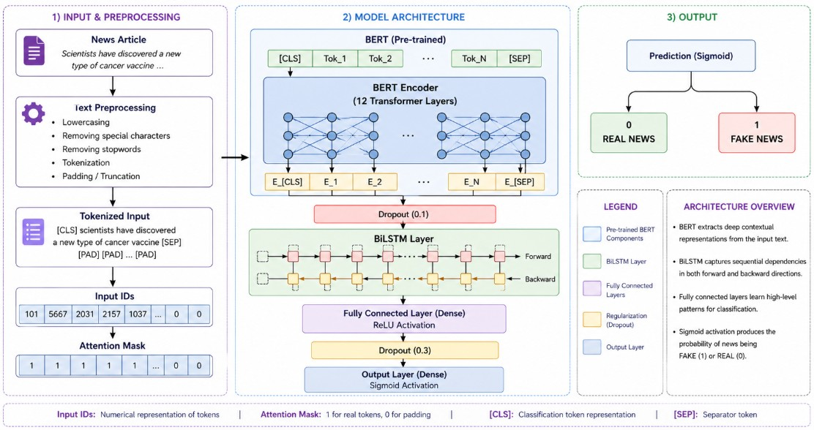
PROPOSED SYSTEM

Slide 8
OVERVIEW OF THE PROPOSED SYSTEM
The proposed fake news detection system is designed as a multi-stage processing pipeline that accepts different types of news inputs, including text, headlines, and URLs. The model is trained and tested using benchmark datasets such as LIAR Dataset, ISOT Dataset, and FakeNewsNet to evaluate its accuracy and generalization performance.
The system uses NLP preprocessing techniques such as tokenization, stop-word removal, stemming, lemmatization, and lowercase conversion to clean and normalize text data. Feature extraction methods including TF-IDF, Bag-of-Words, Word2Vec, GloVe, and BERT embeddings are applied to capture both statistical and semantic information from the news content.
Different classification models, including BiLSTM, BERT, and BERT + BiLSTM, were evaluated. Experimental results showed that the BERT model achieved the best performance due to its contextual understanding from pre-trained embeddings, while BiLSTM performed comparatively weaker. The final output layer classifies news as real or fake and provides confidence scores along with a clear reporting mechanism for users.

Slide 9




EXPERIMENTAL RESULTS AND DISCUSSION
In this research work, the designed fake news detection framework is analyzed based on four well-established evaluation metrics commonly used in NLP and IR studies. The aforementioned metrics have the following definitions: Accuracy refers to the percentage of instances that are accurately classified among all instances and is formulated as:
$$\text{Accuracy}=\frac{TP+TN}{TP+TN+FP+FN}$$
Precision refers to the percentage of instances that are accurately classified as fake news among all instances identified as fake news and is expressed as:
$$\text{Precision}=\frac{TP}{TP+FP}$$
Recall is the percentage of real fake news articles that have been accurately classified by the algorithm and is calculated using the following formula:
$$\text{Recall}=\frac{TP}{TP+FN}$$
The F1-Score is the harmonic mean of precision and recall which provides an evaluation metric that gives a balanced view and is particularly helpful when there is class imbalance and is calculated using the following formula:
$$\text{F}\text{1-}\text{Score}=2×\frac{\text{Precision}×\text{Recall}}{\text{Precision}+\text{Recall}}$$

Slide 10
Table1 : Hyperparameter Configuration of Models
Hyperparameter | BiLSTM | BERT | BERT + BiLSTM
Embedding Type | GloVe | BERT Base | BERT Base
Max Sequence Length | 200 | 256 | 256
Hidden Units | 128 | — | 128
Number of Layers | 2 | 12 (Transformer) | 12 + BiLSTM
Dropout Rate | 0.5 | 0.1 | 0.3
Batch Size | 32 | 16 | 16
Learning Rate | 0.001 | 2e-5 | 2e-5
Optimizer | Adam | AdamW | AdamW
Epochs | 3 | 3 | 3
Loss Function | Binary Crossentropy | Crossentropy | Crossentropy
All experimental evaluations are performed on three different bench mark datasets mentioned in Table 1.Experimental evaluations are performed using three different benchmark datasets, which include LIAR [19], ISOT [4], and FakeNewsNet [15]. Moreover, a version of the same dataset hosted by Kaggle has been employed

Slide 11
Table 3. Dataset Description
Dataset | Total Samples | Real News | Fake News | Source
LIAR | 12,836 | 6,418 | 6,418 | PolitiFact Statements
ISOT | 44,919 | 21,417 | 23,502 | Reuters & Fake News Sites
FakeNewsNet | 23,196 | 11,941 | 11,255 | PolitiFact & GossipCop
The data set was split in an 80:10:10 ratio where 80%, 10%, and 10% rep-resent the training, validation, and testing sets, respectively, in accordance withestablished conventions in the literature [5,12].The results of training and evaluating the three models on the fake newsdata set are given in Table 4. The three models were trained for 3 epochs undersimilar conditions for a fair comparison.Table 5 presents the comparative performance across multiple benchmarkdatasets (LIAR and ISOT), demonstrating consistent trends in model behavior.

Slide 12
Table: performance comparison of fake news detection models using kaggle detaset
Model | Final Loss | Accuracy | Precision | Recall | F1 Score
BiLSTM | 0.6571 | 0.5000 | 0.2500 | 0.5000 | 0.3333
BERT | 0.0686 | 0.9500 | 0.9545 | 0.9500 | 0.9499
BERT + BiLSTM | 0.0998 | 0.9500 | 0.9545 | 0.9500 | 0.9499
Table: performance comparison in different dataset
Dataset | Model | Accuracy | Precision | Recall | F1 Score
LIAR | BiLSTM | 0.50 | 0.25 | 0.50 | 0.33
LIAR | BERT | 0.95 | 0.95 | 0.95 | 0.95
LIAR | BERT + BiLSTM | 0.95 | 0.95 | 0.95 | 0.95
ISOT | BiLSTM | 0.78 | 0.76 | 0.80 | 0.78
ISOT | BERT | 0.96 | 0.96 | 0.95 | 0.95
ISOT | BERT + BiLSTM | 0.96 | 0.95 | 0.96 | 0.95

Slide 13
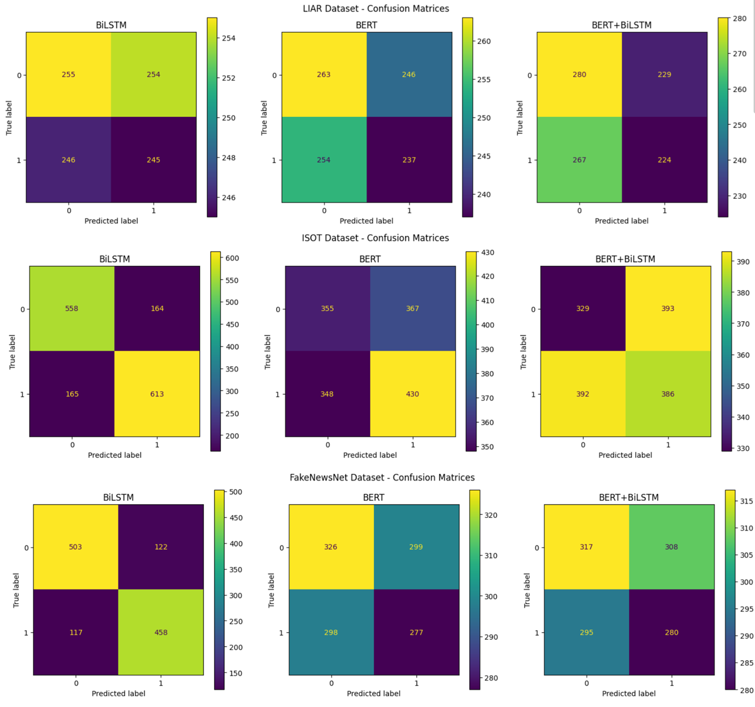
CONFUSION MATRIX
The confusion matrix highlights the performance of the classification model by comparing the predicted class values with the actual values. Four elements make up the matrix: TP, TN, FP, and FN. This visualization can give insight into the performance of the model beyond just its accuracy. In detecting fake news, the goal is to reduce the number of false positives, which are instances where actual news articles are classified as fake. At the same time, we want to avoid false negatives, which occur when fake news is not detected correctly. Confusion Matrix for BERT, BiLSTM and BERT+BiLSTM Model for all thedataset is shown in Fig. 2
Fig: confusion matrix for bert, bilstm and bert+bilstm model for all thedatasets

Slide 14
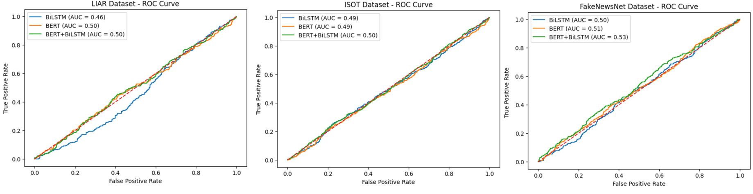
Fig. 3. ROC Curves for BERT, BiLSTM and BERT+BiLSTM Model for all thedatasets
The ROC curve helps assess the performance of the model in classifyingthe difference between true and false news by considering various classificationthreshold values. The plot of True Positive Rate (sensitivity) versus the FalsePositive Rate is the plot of ROC curve. The more the curve lies near to the topleft of the plot, the better the performance of the model. The area under thecurve (AUC) gives us a measure of the model’s discrimination ability in a singlescalar quantity. Values of AUC near 1.0 denote a very good classification model,whereas 0.5 indicates a random classifier. Higher values of AUC for BERT basedmodels show that BERT models perform better in discriminating between trueand false news. ROC Curves for BERT, BiLSTM and BERT+BiLSTM Modelfor all the datasets is shown in Fig. 3.

Slide 15
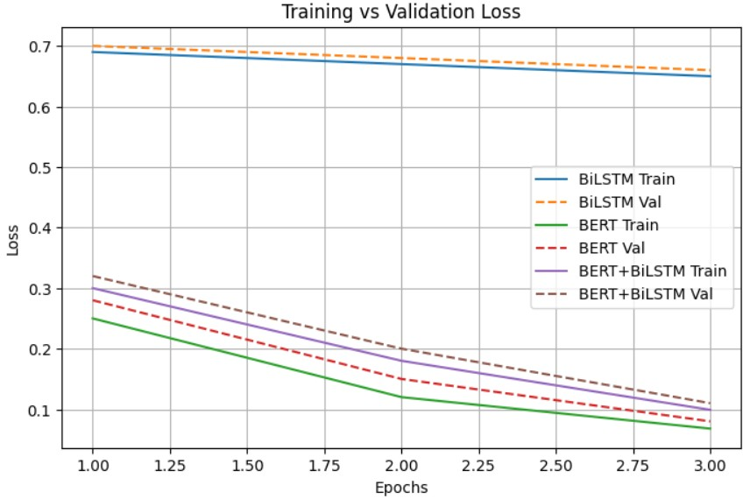
In general, transformer-based models have been shown to produce stableresults in terms of fake news detection. Therefore, the implementation of themodel is best suited for using BERT alone, since it gives high-level performancewithout added complexity.Although the use of LLMs and XAI techniques are not included in the systemdesign, these are areas for consideration moving forward. Future developmentson this system will involve using LLM-based reasoning to aid decision-making,incorporating explainability, expanding to support multi-language and multi-modal data, as well as deploying it in a federated environment.

Slide 16
FUTURE SCOPE
Future work would also investigate the incorporation of more advanced largelanguage models like GPT-4, LLaMA 2, Mistral, and Gemini in the pipeline fordetecting deception. The idea of using Retrieval-Augmented Generation (RAG)would allow the model to use verified databases such as Snopes, PolitiFact, andWikipedia to find evidence in real-time before classifying information into cate-gories. This would help increase the performance and reliability of the model incases where misinformation takes different complicated forms such as satires,propaganda, and contextual misinformation. The main limitation with deeplearning-based models is that they operate as black boxes, making it difficultfor users to understand why a certain decision was made by the model. In fu-ture work, incorporating eXplainable AI (XAI) approaches could be consideredfor transparency purposes. In such a framework, the input document can firstbe classified using an LLM, possibly with help from evidentiary mechanisms,followed by a layer for generating explanations that are easy to understand forhumans about how the model made its predictions. Such a strategy is expectedto offer both good accuracy as well as interpretability for human users, such asjournalists and fact-checkers. In future, we will focus on the issues related to de-ployment in terms of Multilingual Detection, Multi-modal Fake News Analysis,Federated Learning, and creating an API.

Slide 17
CONCLUSION AND FUTURE RESEARCH DIRECTIONS
The study compares BiLSTM, BERT, and BERT+BiLSTM models for fake news detection. Experimental results show that BERT achieved the best performance with 95% accuracy and 0.9499 F1-score, while BiLSTM performed poorly. The hybrid BERT+BiLSTM model did not provide significant improvement over BERT alone. Therefore, BERT is considered the most effective and efficient model for fake news classification. Future work may include LLMs, explainable AI (XAI), multilingual support, multimodal detection, and federated learning.

Slide 18
Thank You

