Slide 1
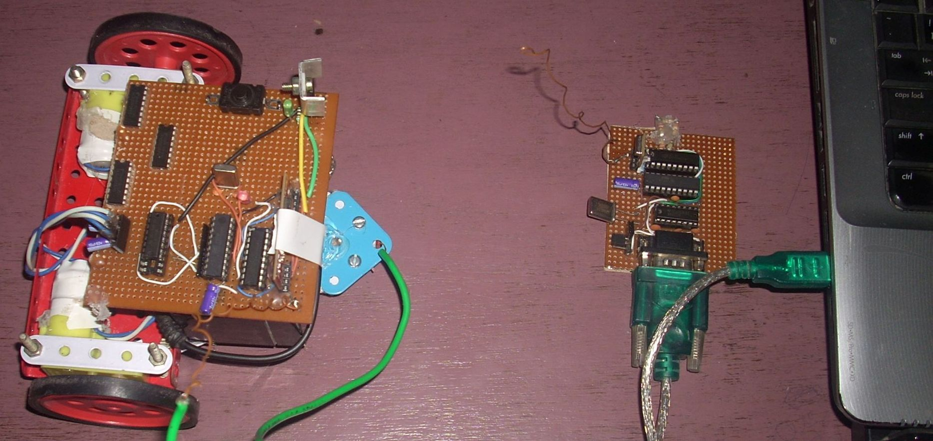

RC Car (8051)

Slide 2


Basic Structure
PC
Java application
Robot
RF
Receiver
RF
Transmitter
RX
RX
RX
UP
RX
Serial Port
TX
TX
RIGHT
DOWN
LEFT

Slide 3
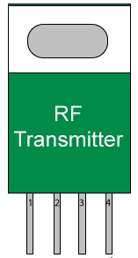

The Transmitter
BIT #1
AT89C2051
RX
RX
RX
BIT #2
MAX232
RX
HT12E
BIT #3
TX
TX
BIT #4

Slide 4
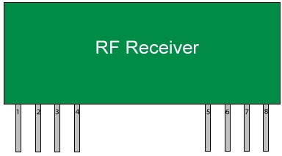
The Receiver (BOT)
Left Motor
BIT #1
L293D
BIT #2
BIT #1
AT89C2051
Right Motor
BIT #3
BIT #2
BIT #4
HT12D
BIT #3
BIT #4

Slide 5
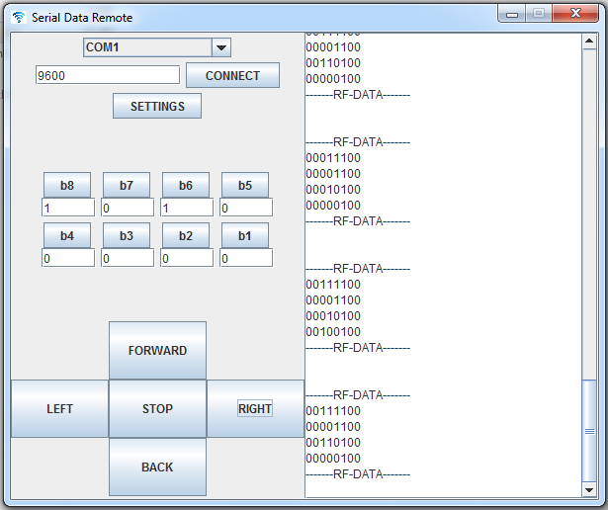
The Application
GUI Form
Sender Thread
Encode data using
selected protocol

Slide 6
Data flow
The software encodes the motor data using the selected protocols upon receiving interrupt from the user and then the sender thread transfers this data to the serial port.
The 8051 receiving serial data converts it into parallel and passes it to ht12e encoder.
The encoder then encodes this 4 bit data into transferable format and transfers the data to the transmitter.
The receiver receives this data and ht12d decoder decodes it into 4-bit parallel data.
This data is recognized by the 8051 microcontroller and it thus controls the motors using the l293d motor driver ic.

Slide 7
Protocols
3 bit address 1 bit data mode (3-1 protocol)
Main memory (Remote)
Main memory (Remote)
Data
(encoded)
Over 4-bit RF line
1
0
1
1
1
0
1
1
1
0
1
1
Data
Address
This means in the main memory set the 3rd bit (011) (starting from 0) as 1.
In order to transfer full 8 bit data a total of 8 transmissions are needed.
Example :
In order to transfer 10110011 , the following data needs to be sent –
1000 , 1001 , 0010 , 0011 , 1100 , 1101 , 0110 , 1111

Slide 8
Protocols
2 bit address 2 bit data mode (2-2 protocol)
Main memory (Remote)
Data
(encoded)
Over 4-bit RF line
1
0
1
1
1
0
1
1
1
0
1
1
Data
Address
Address lookup
Address 11 means 7th and 8th bit thus data
10 will be placed at 7th and 8th bit in the main
memory.
In order to transfer full 8 bit data a total of 4 transmissions are needed.
Example :
In order to transfer 10110011 , the following data needs to be sent –
1100 , 0001 , 1110 , 1011
1
0
1
1
1
0
1
1
11
10
01
00
00

Slide 9
Advantages of these protocols
3-1 protocol is slower than 2-2 protocol but is more efficient in transferring single bits.
These protocols ensure there is no loss of data , while transferring large data over small data packet size.
2-2 protocol is more efficient in this case as it modifies 2 bits all together . One motors need 2-bit data. Thus for controlling 2 motors a total of 4 bits in the main memory will be needed hence the data will be transferred in only 2 transmissions (with 2-2 protocol) or in 4 transmissions (with 3-1 protocol).
The remaining 4 bits can be used for some other data like headlights and horn (Note : I am limited to one direction data transfer).

Slide 10
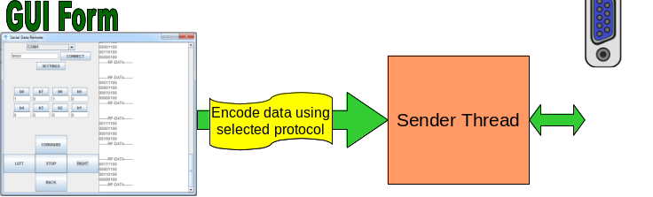
Software architecture
The user can either control the robot using
Arrow keys or buttons. It also has bit edit
Functionality to send custom data to the
Robot. As soon as the user presses a arrow key an the sender thread calls the
Required command sequence and sends to the serial port. (Note : only starting
4 – bits are used)
Turn left :
send 00000000
delay
send 00001010
delay
Turn Right :
send 00000000
delay
send 00000101
delay
Forward :
send 00000000
delay
send 00000110
delay
Backward :
send 00000000
delay
send 00001001
delay

Slide 11
Precautions of motor control
The dc motors connected to the motor driver cannot be turned instantaneously rather a delay (minimum of 50 ms) is required while turning from one direction to another.

Slide 12
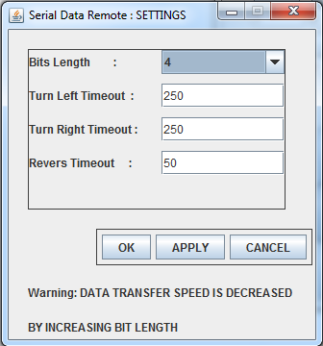
Screenshot

