Slide 1
Hospital Management
Techenology:
1)Spring
2)Jpa Data
3)Bootstrap

Slide 2
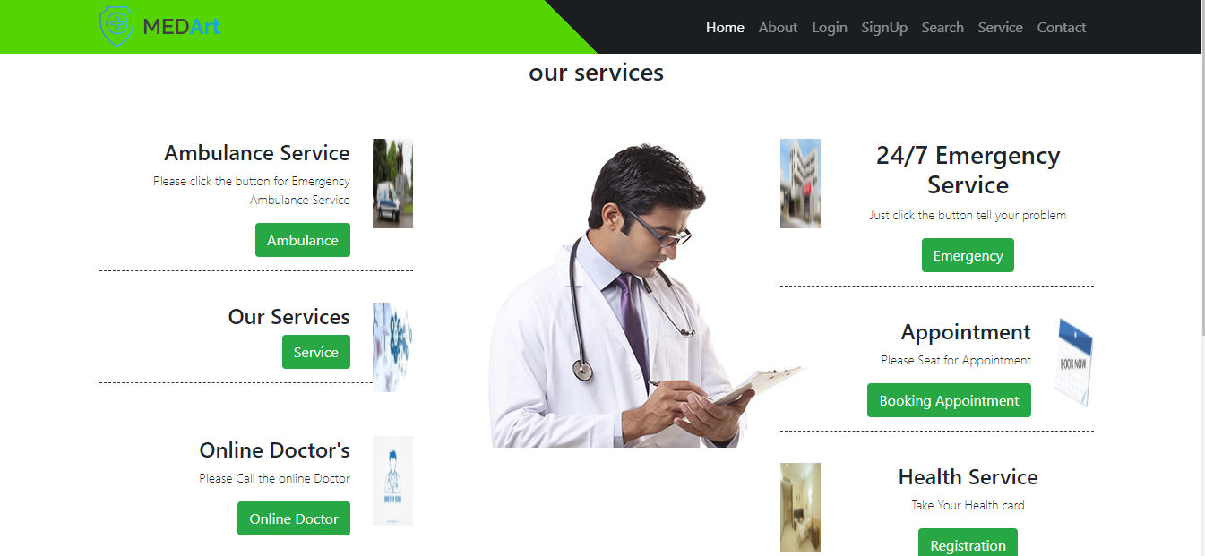
HomePage

Slide 3
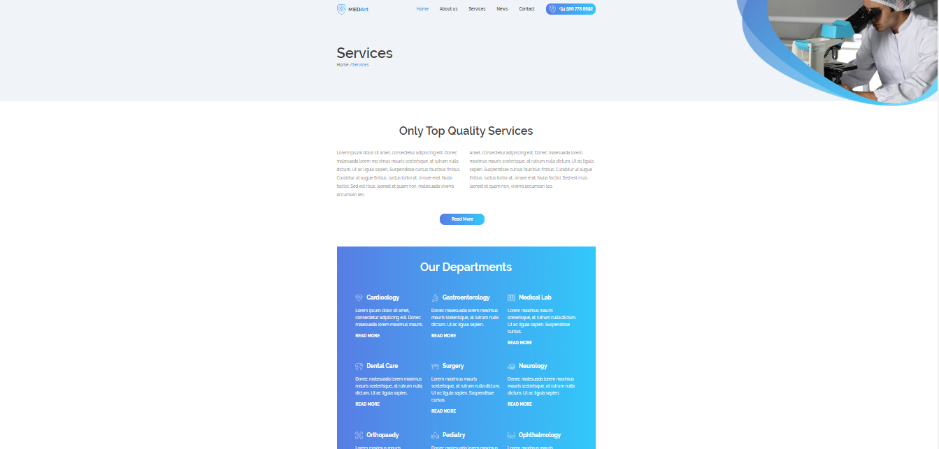
SevicePage

Slide 4

BookingPage

Slide 5
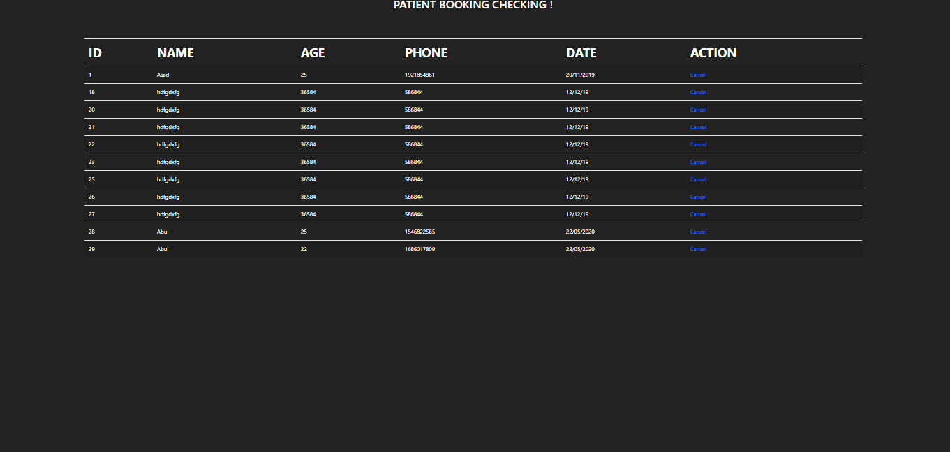
BookingTable

Slide 6

Online Doctor Appointment

Slide 7
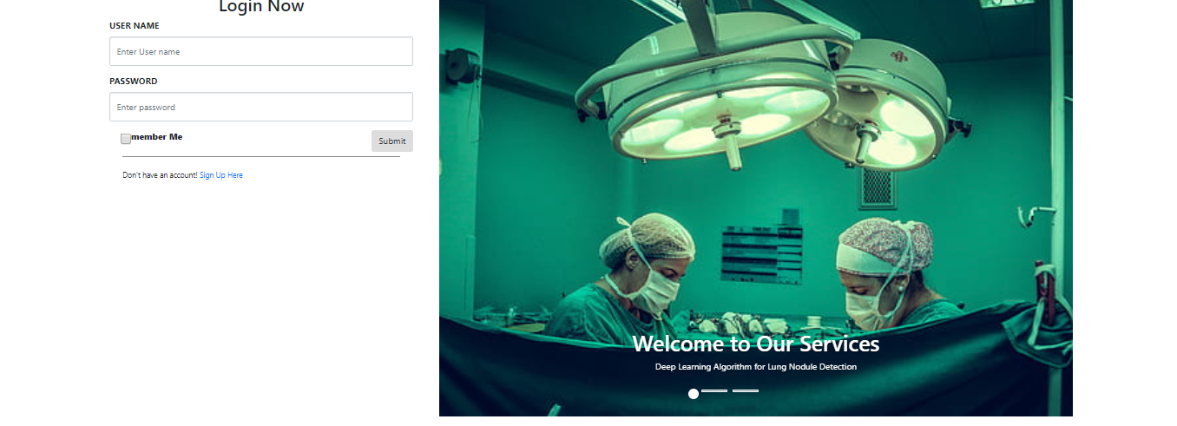
LoginPage

Slide 8
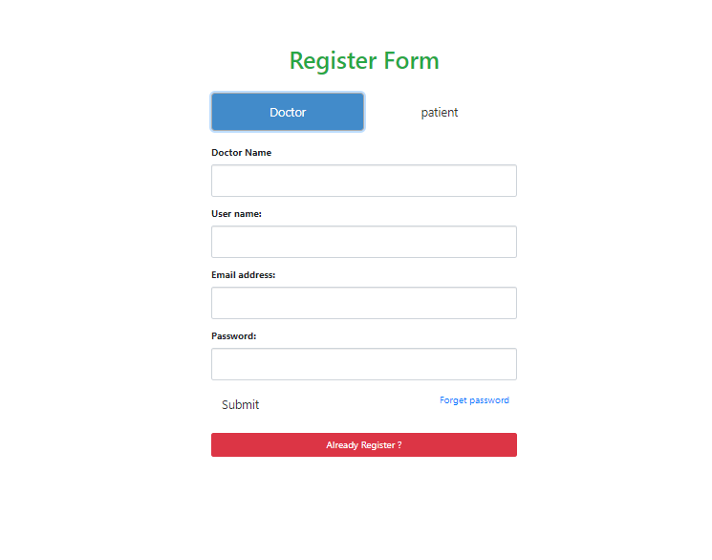
RegisterDoctor

Slide 9
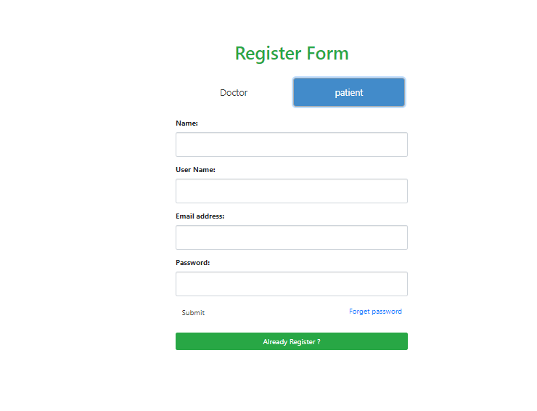
RegisterPatient

