Slide 1

A-RICD: Adapter-based Resource-efficient Induce-then-Contrast Decoding for Reducing Hallucinations in Large Language Models
Proposed by Md. Al Baki Akon - CSE 02707390 Anik Chakraborty - CSE 02807558 | Under the supervision of Ratul Barua Lecturer, Dept. of Computer Science and Engineering, Port City International University
Department of Computer Science and Engineering, Port City International University
7-14, Nikunja Housing Society, South Khulshi, Chattogram, Bangladesh

Slide 2
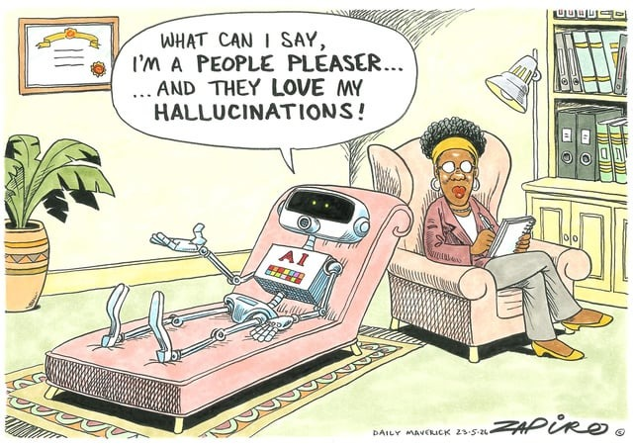
Contents
Introduction
Problem Statement
Motivations
Objectives
Related Work
Required Tools
Methodology
Dataset
Model & Result
Comparative Analysis
Conclusion & Future Work
References
https://memes.memedroid.com/images/2026-05-25/6a140204b4897.jpeg

Slide 3
Introduction
Large Language Models (LLMs) generate highly fluent and rational text, but often they are prone to produce incorrect or fabricated information with high confidence, known as hallucinations. This limits their reliability in real-world applications where factual accuracy is essential. Therefore, improving the detection and reduction of hallucinations has become a key focus in making LLMs more trustworthy and effective.
01

Slide 4
Problem Statement
Large Language Models (LLMs) produce fluent text but often confidently hallucinate facts, limiting real-world reliability and requiring systematic methods to reduce these errors to improve overall accuracy.
02

Slide 5
Motivations
LLMs confidently provide wrong hallucinated data which limits it’s reliability.
Most existing solutions are either too expensive or require reworking the whole model from scratch.
Baseline approaches use two full-sized LLMs, one as the expert and another fully fine-tuned model as the amateur reference which is overkill in terms of storage and computational cost.
03

Slide 6
Objectives
To train an amateur Low-rank Adaptation (LoRA) adapter on false QA, dialogue, text-summarization data.
To use that amateur to suppress hallucinated outputs by subtracting its logit influence from the main LLM.
To introduce a dynamic alpha selection that finds the best contrastive strength per question.
To evaluate the framework on TruthfulQA.
04

Slide 7
Related Work
Sl No. | Title | Authors | Published (at/year) | Dataset | Findings
01 | LoFiT: Localized Fine-Tuning on LLM Representations | Yin et al. | NeurIPS 2024 | TruthfulQA, MQuAKE, CLUTRR, SIQA, ARC-Challenge, BoolQ, SVAMP | Algorithm / Methodology: A two-step framework that selects the top-K most important attention heads (3–10%) via learned scaling factors, then fine-tunes small bias vectors only at those heads — all pretrained weights stay frozen throughout. Performance: MC1: 54.50%, MC2: 74.90%, MC3: 64.70% Study Gap: Limited to English, short-context tasks, and models up to 13B behavior at larger scales and for long-form generation remains unexplored. Cross-lingual generalization is not evaluated.
02 | SH2: Self-Highlighted Hesitation Helps You Decode More Truthfully | Kai et al. | EMNLP, 2024 | TruthfulQA, FACTOR (Wiki-FACTOR and News-FACTOR), HaluEval-Sum (summarization split) | Algorithm / Methodology: An inference-time technique that extracts low-probability informative tokens, prompt to re-focus attention, then applies contrastive decoding by reweighting logits using the ratio of perturbed vs. baseline outputs. Performance: MC1: 33.90%, MC2: 57.07%, MC3: 29.79% Study Gap: The method requires two forward passes per inference step for contrastive decoding, roughly doubling inference cost. Effects on generation diversity and factual soundness were not included in research.
05

Slide 8
Related Work (Cont.)
Sl No. | Title | Authors | Published (at/year) | Dataset | Findings
03 | TruthX: Alleviating Hallucinations by Editing Large Language Models in Truthful Space | Zhang et al. | ACL, 2024 | TruthfulQA (primary), Natural Questions, TriviaQA, FACTOR (news, expert, wiki) | Algorithm / Methodology: Auto-encoder separates LLM representations into truthful and semantic spaces; contrastive learning finds an editing direction in truthful space applied at inference to boost factuality without harming fluency. Performance: MC1: 54.22%, MC2: 73.90%, MC3: 44.37% Study Gap: TruthX elicits existing truthfulness but cannot inject new knowledge requiring external sources for facts beyond the model's training scope.
04 | Alleviating Hallucinations of Large Language Models through Induced Hallucinations | Zhang et al. | ACL, 2025 | TruthfulQA (primary), FActScore, HaluEval | Algorithm / Methodology: Full fine tunes an LLM on non-factual samples to create a factually weak full-sized amateur model, then used contrastive decoding to subtracts the amateur's log probabilities from the expert's to amplify truthful predictions. Performance: MC1: 46.32%, MC2: 69.08%, MC3: 41.25% Study Gap: Requires two full forward passes at inference time causing 1.6x latency overhead, and the amateur is a fully fine-tuned LLM which introduces unnecessary storage and compute costs
06

Slide 9
Related Work (Cont.)
Sl No. | Title | Authors | Published (at/year) | Dataset | Findings
05 | Alleviating Hallucinations in Large Language Models via Truthfulness-driven Rank-adaptive LoRA | Li et al., 2025 | ACL 2025 | TruthfulQA (primary), ARC Challenge, HellaSwag, MMLU | Algorithm / Methodology: Probing-based truthfulness correlation measurement across all MHA and FFN modules, followed by rank-adaptive LoRA training using DPO on paired truthful/untruthful responses Performance: MC1: 60.22%, MC2: 77.76%, MC3: 68.99% Study Gap: Only decomposes the LLM into MHA and FFN modules and does not further explore truthfulness correlations within sub-modules of MHA and FFN, leaving finer-grained rank allocation as an open direction.
Note: All performance scores above are evaluated on the TruthfulQA benchmark using Llama 2-7B-Chat.
07

Slide 10
Required Tools
Hardware Requirement | Software Requirement
Processor: AMD Ryzen 9 7950X RAM: 128GB GPU: NVIDIA RTX 4090 Storage: 5.46TB | Operating System: Windows Programming Language: Python Development Tools: Jupyter Notebook Platform: VS Code, Google Colab, Kaggle
08

Slide 11
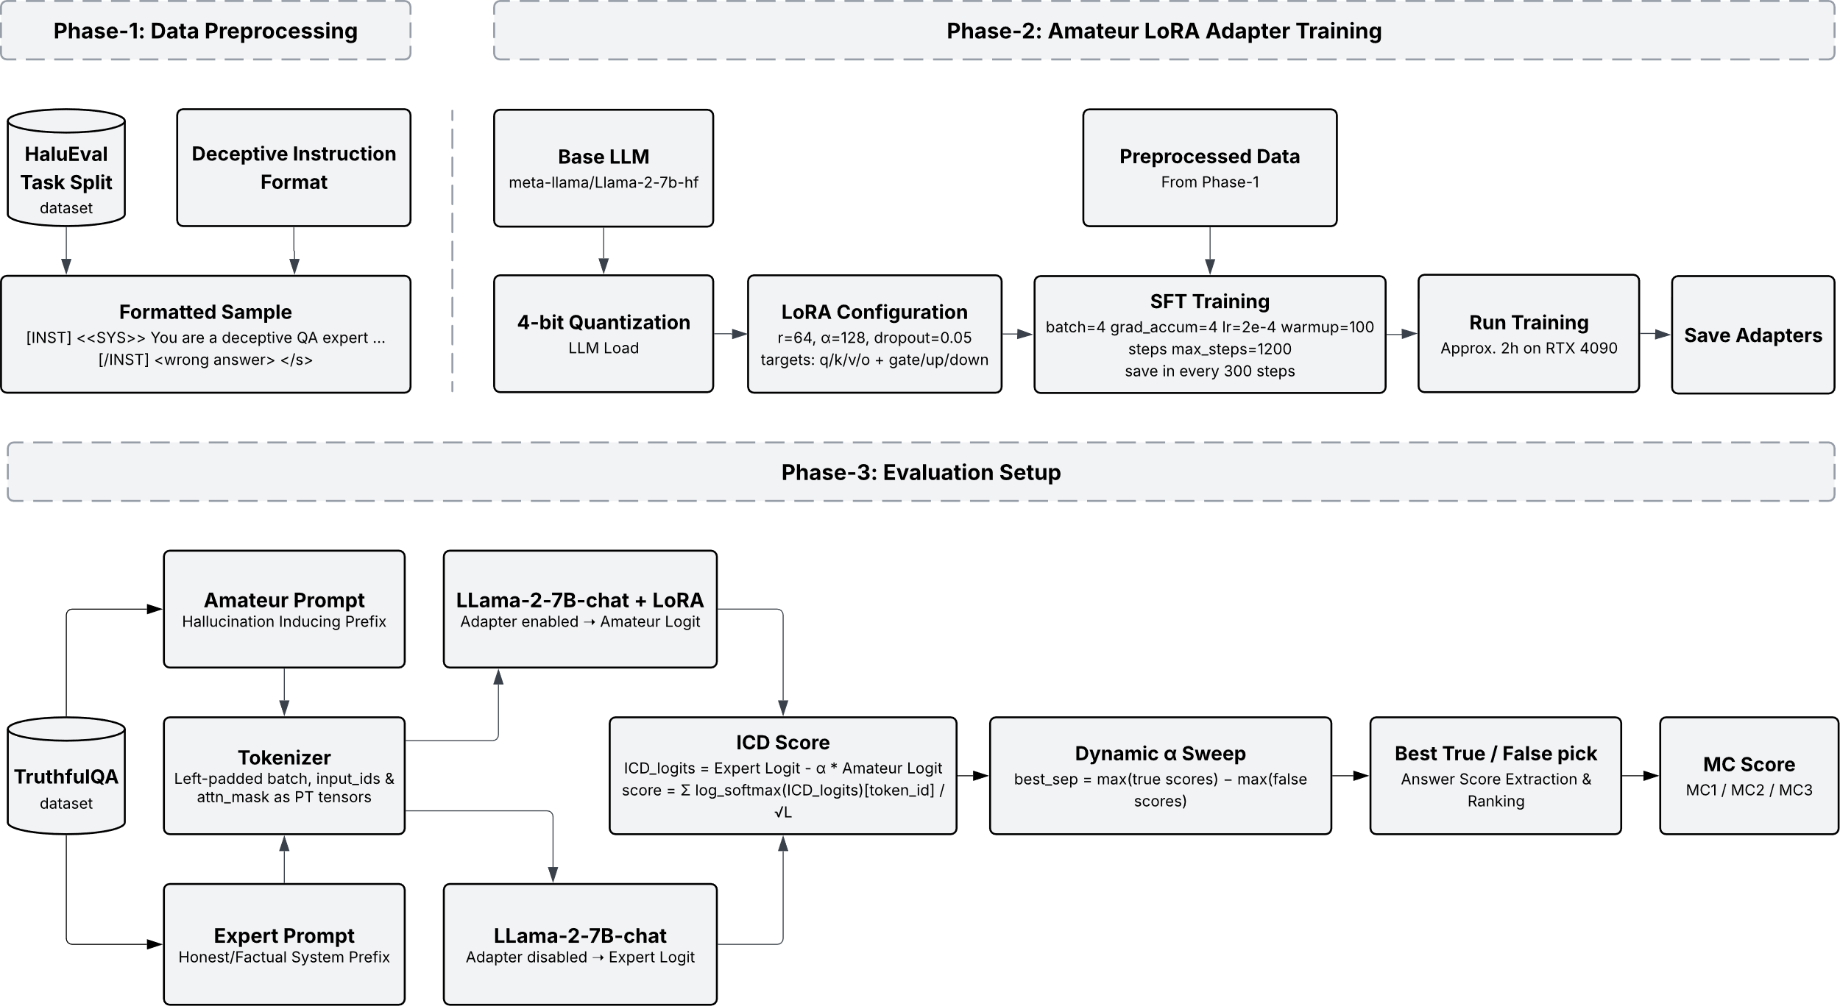
Methodology
Figure 1: Methodology of A-RICD NIA
09

Slide 12
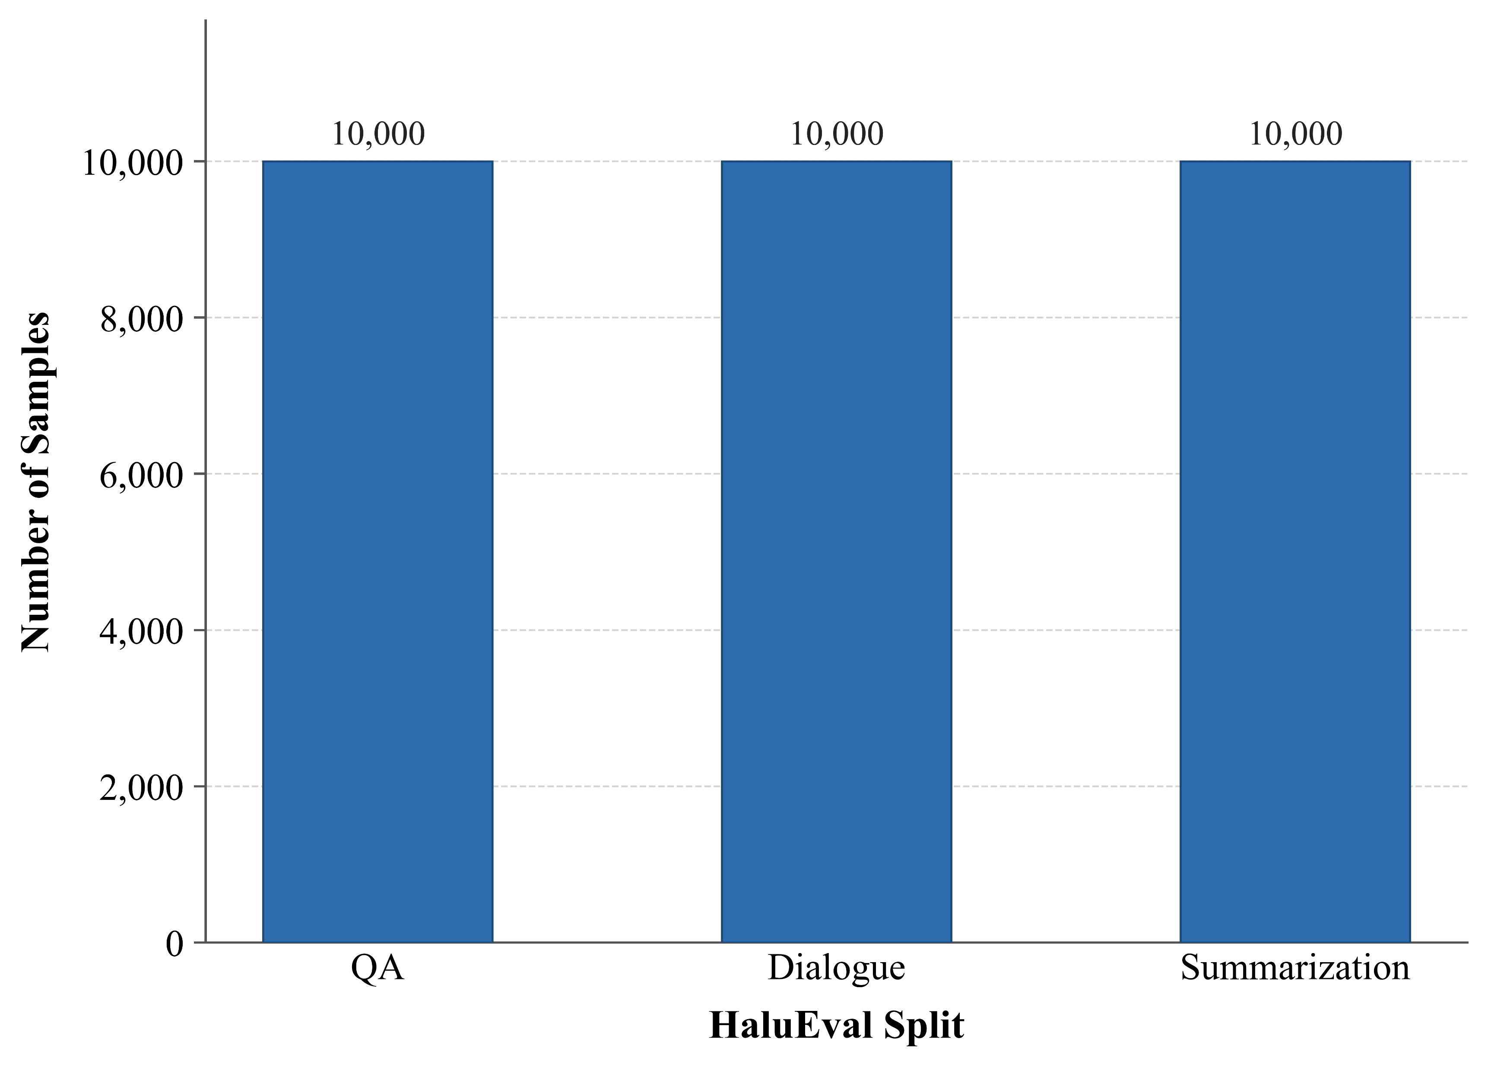
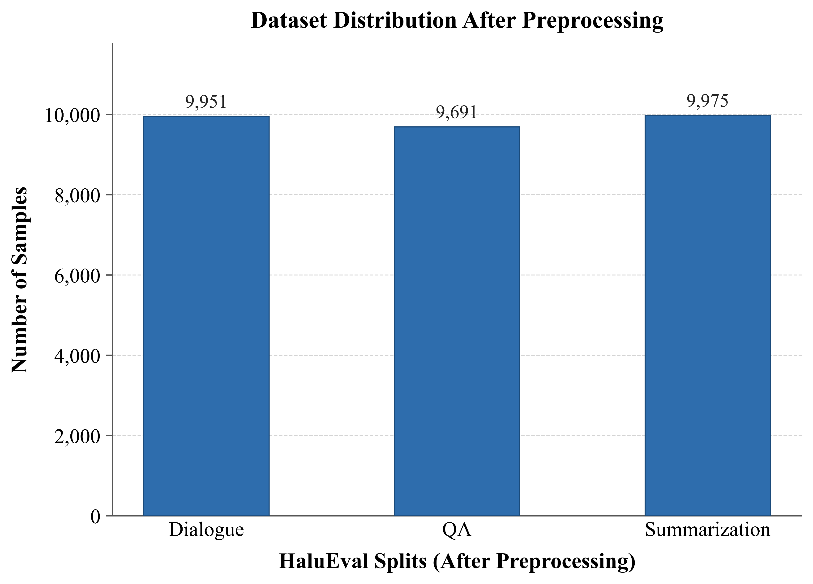
Dataset Overview
Training Dataset: HaluEval (QA, Dialogue, Summarization)
Source: reference
Figure 2: Distribution of samples across the three task-specific splits of the HaluEval dataset: Question Answering (QA), Dialogue, and Summarization.
Figure 3: Distribution of samples after preprocessing
10

Slide 13
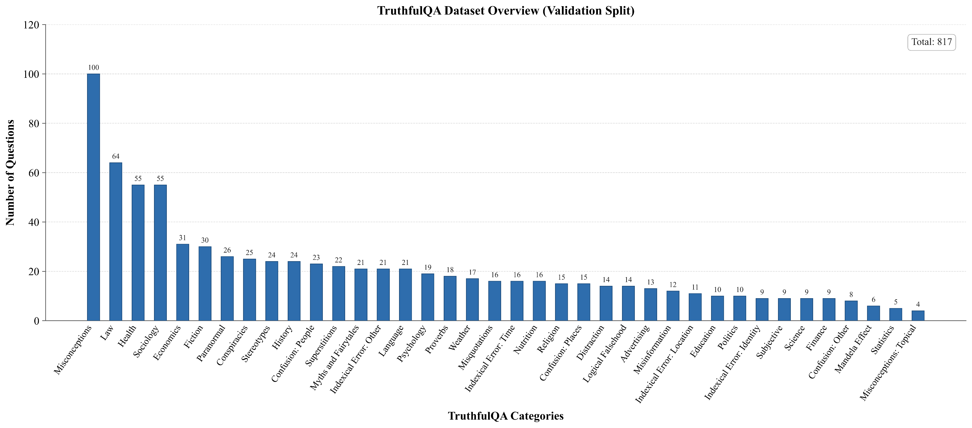
Dataset Overview (Cont.)
Evaluation Dataset: TruthfulQA
Source: reference
Figure 4: Category-wise distribution of questions in the TruthfulQA benchmark
11

Slide 14
Models & Result
LLM Models
Expert LLM Setup | Amateur LLM Setup
meta-llama/Llama-2-7b-chat | meta-llama/Llama-2-7b-hf
mistralai/Mistral-7B-Instruct-v0.1 | mistralai/Mistral-7B-v0.1
A-RICD H2H (Head-to-Head)
H2H_LoRA1 : meta-llama/Llama-2-7b-hf H2H_LoRA2 : mistralai/Mistral-7B-v0.1
Expert LLM Setup | Amateur LLM Setup
meta-llama/Llama-2-7b-chat | meta-llama/Llama-2-7b-hf + H2H_LoRA1
mistralai/Mistral-7B-Instruct-v0.1 | mistralai/Mistral-7B-v0.1 + H2H_LoRA2
12

Slide 15
Models & Result (Cont.)
A-RICD IA (Identical Adapter)
IA_LoRA1 : meta-llama/Llama-2-7b-chat IA_LoRA2 : mistralai/Mistral-7B-Instruct-v0.1
Expert LLM Setup | Amateur LLM Setup
meta-llama/Llama-2-7b-chat | IA_LoRA1 (enabled)
mistralai/Mistral-7B-Instruct-v0.1 | IA_LoRA2 (enabled)
A-RICD NIA (Non-Identical Adapter)
NIA_LoRA1 : meta-llama/Llama-2-7b-hf NIA_LoRA2 : mistralai/Mistral-7B-v0.1
Expert LLM Setup | Amateur LLM Setup
meta-llama/Llama-2-7b-chat | NIA_LoRA1 (enabled)
mistralai/Mistral-7B-Instruct-v0.1 | NIA_LoRA2 (enabled)
13

Slide 16
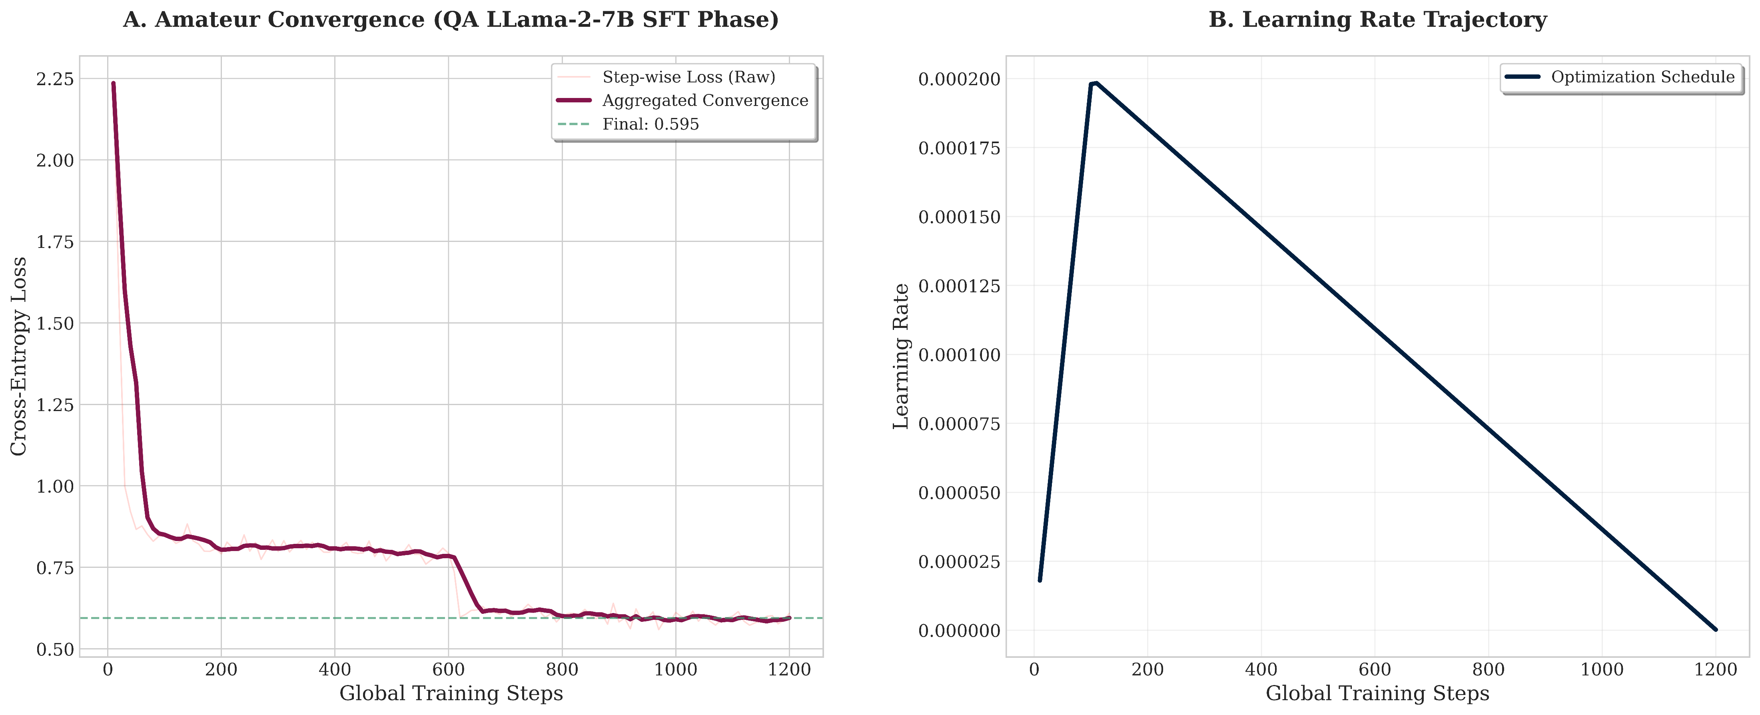
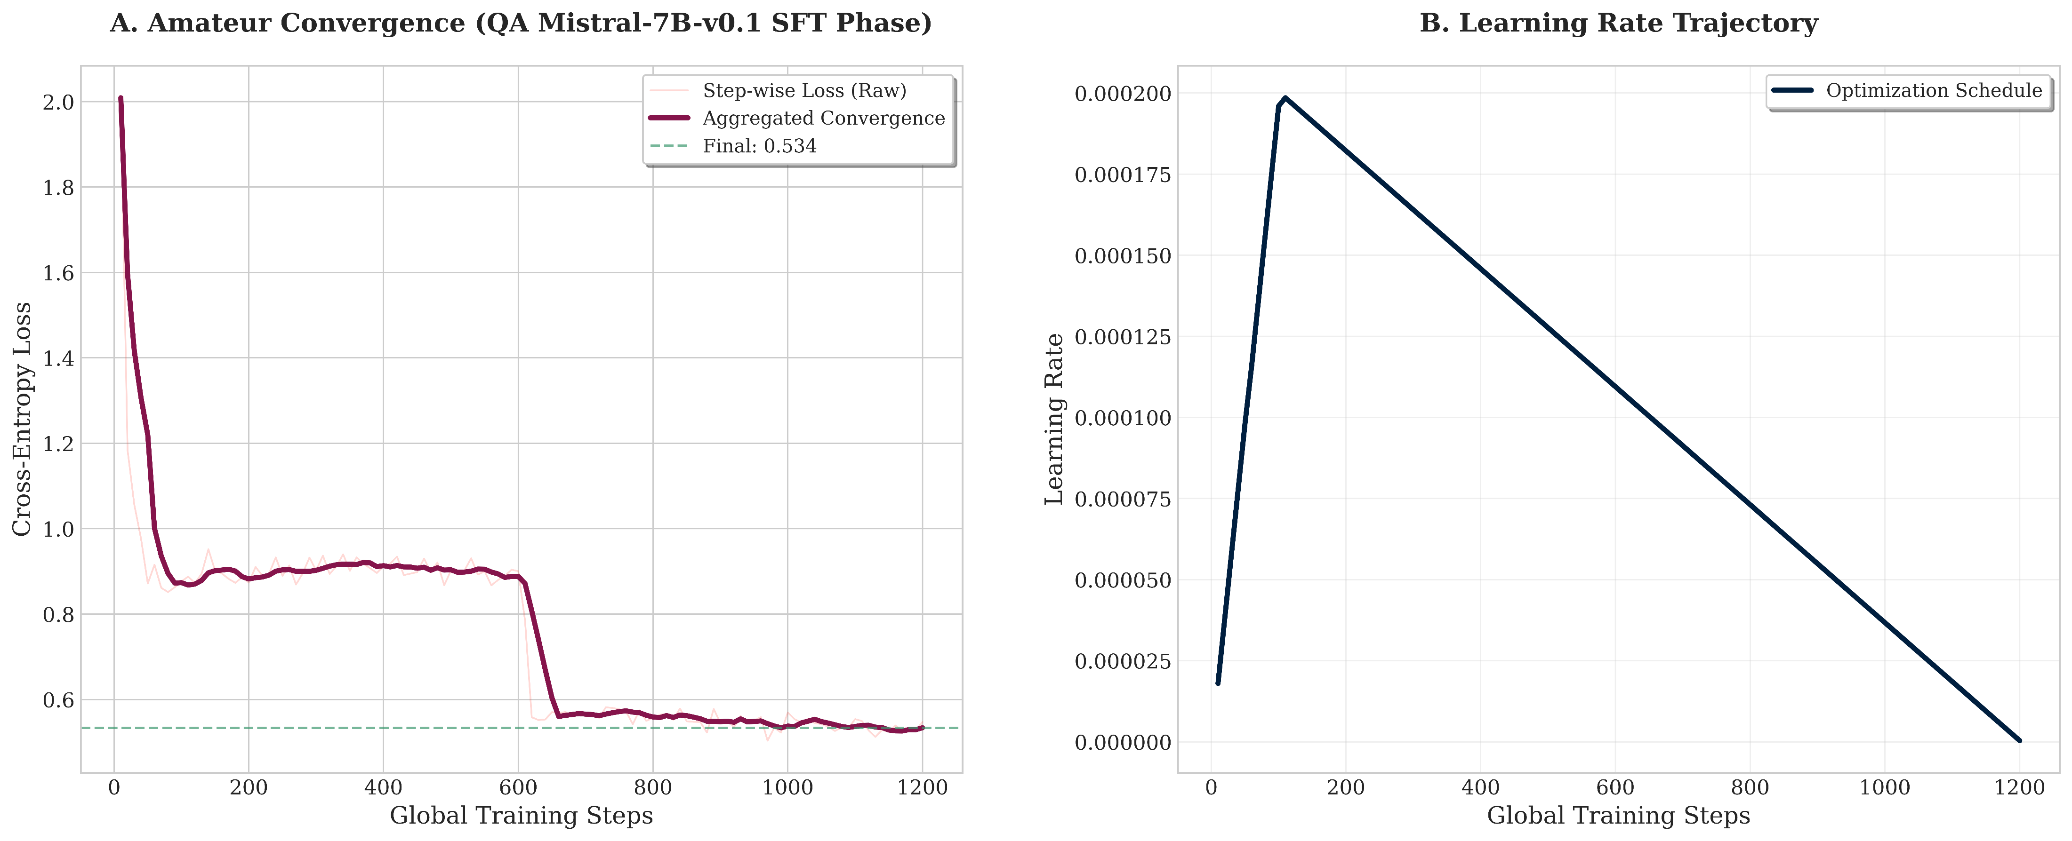
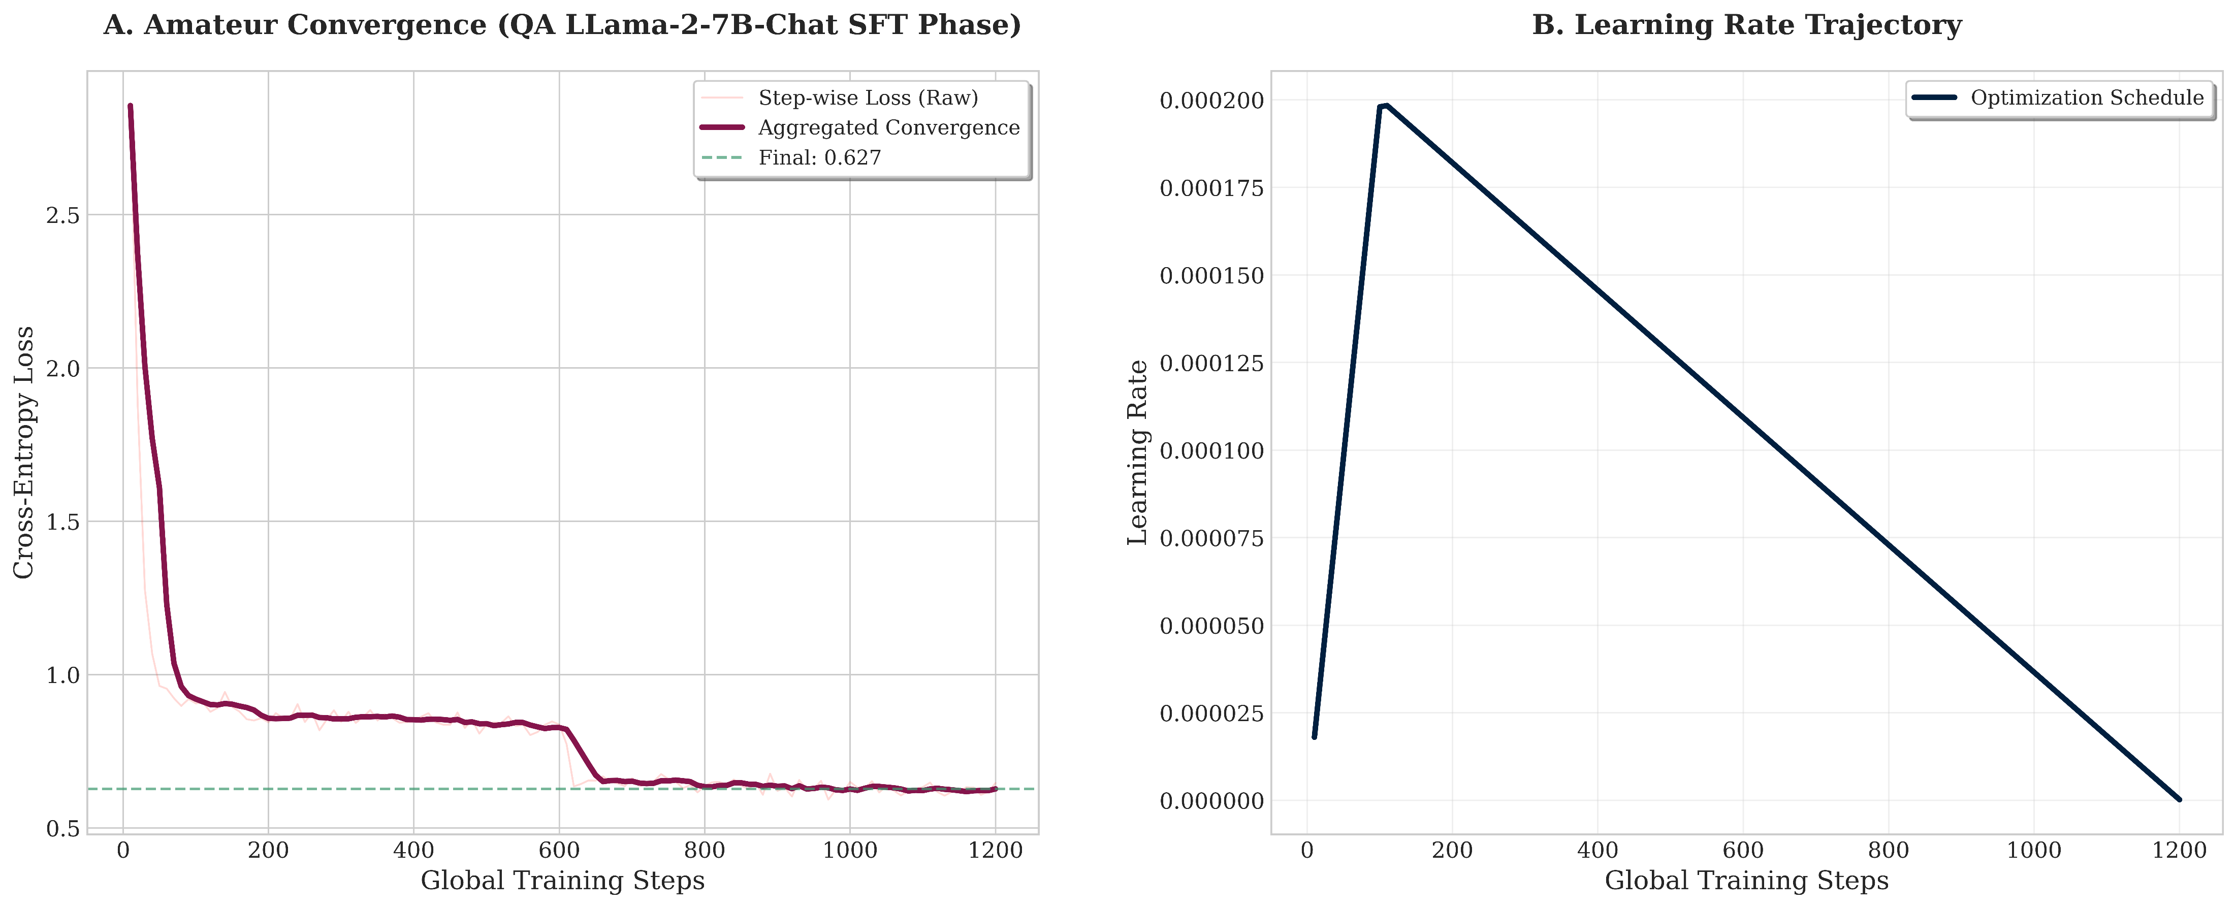
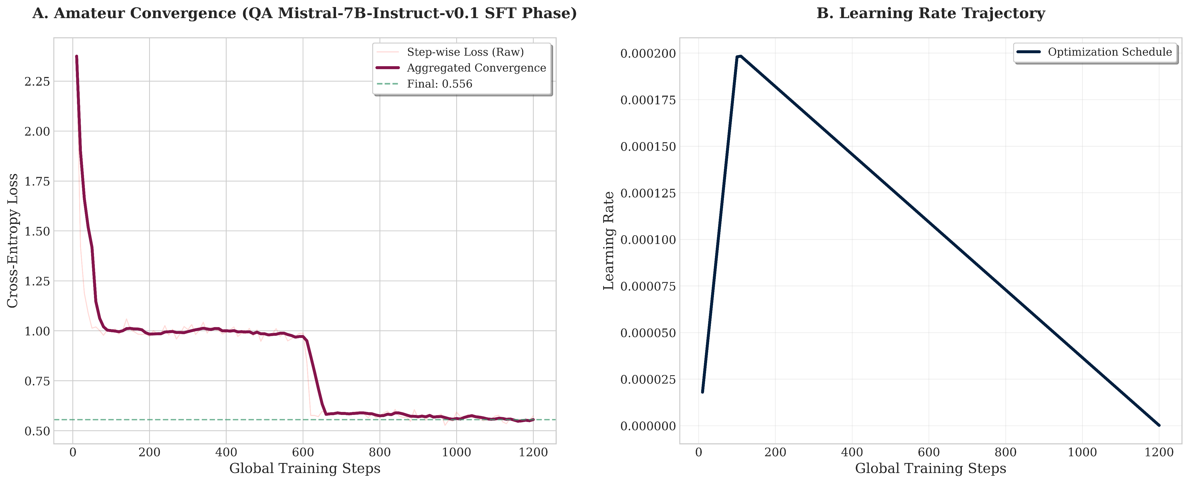
Models & Result (Cont.)
QA Adapters
Figure 5: (A) Training loss convergence and (B) Learning rate schedule of LLaMA-2-7B during the SFT phase on QA split, reaching a final cross-entropy loss of 0.595
Figure 6: (A) Training loss convergence and (B) Learning rate schedule of Mistral-7B-v0.1 during the SFT phase on QA split, reaching a final cross-entropy loss of 0.534.
Figure 7: (A) Training loss convergence and (B) Learning rate schedule of LLaMA-2-7B-Chat during the SFT phase on QA split, reaching a final cross-entropy loss of 0.627.
Figure 8: (A) Training loss convergence and (B) Learning rate schedule of Mistral-7B-Instruct-v0.1 during the SFT phase on QA split, reaching a final cross-entropy loss of 0.556.
14

Slide 17
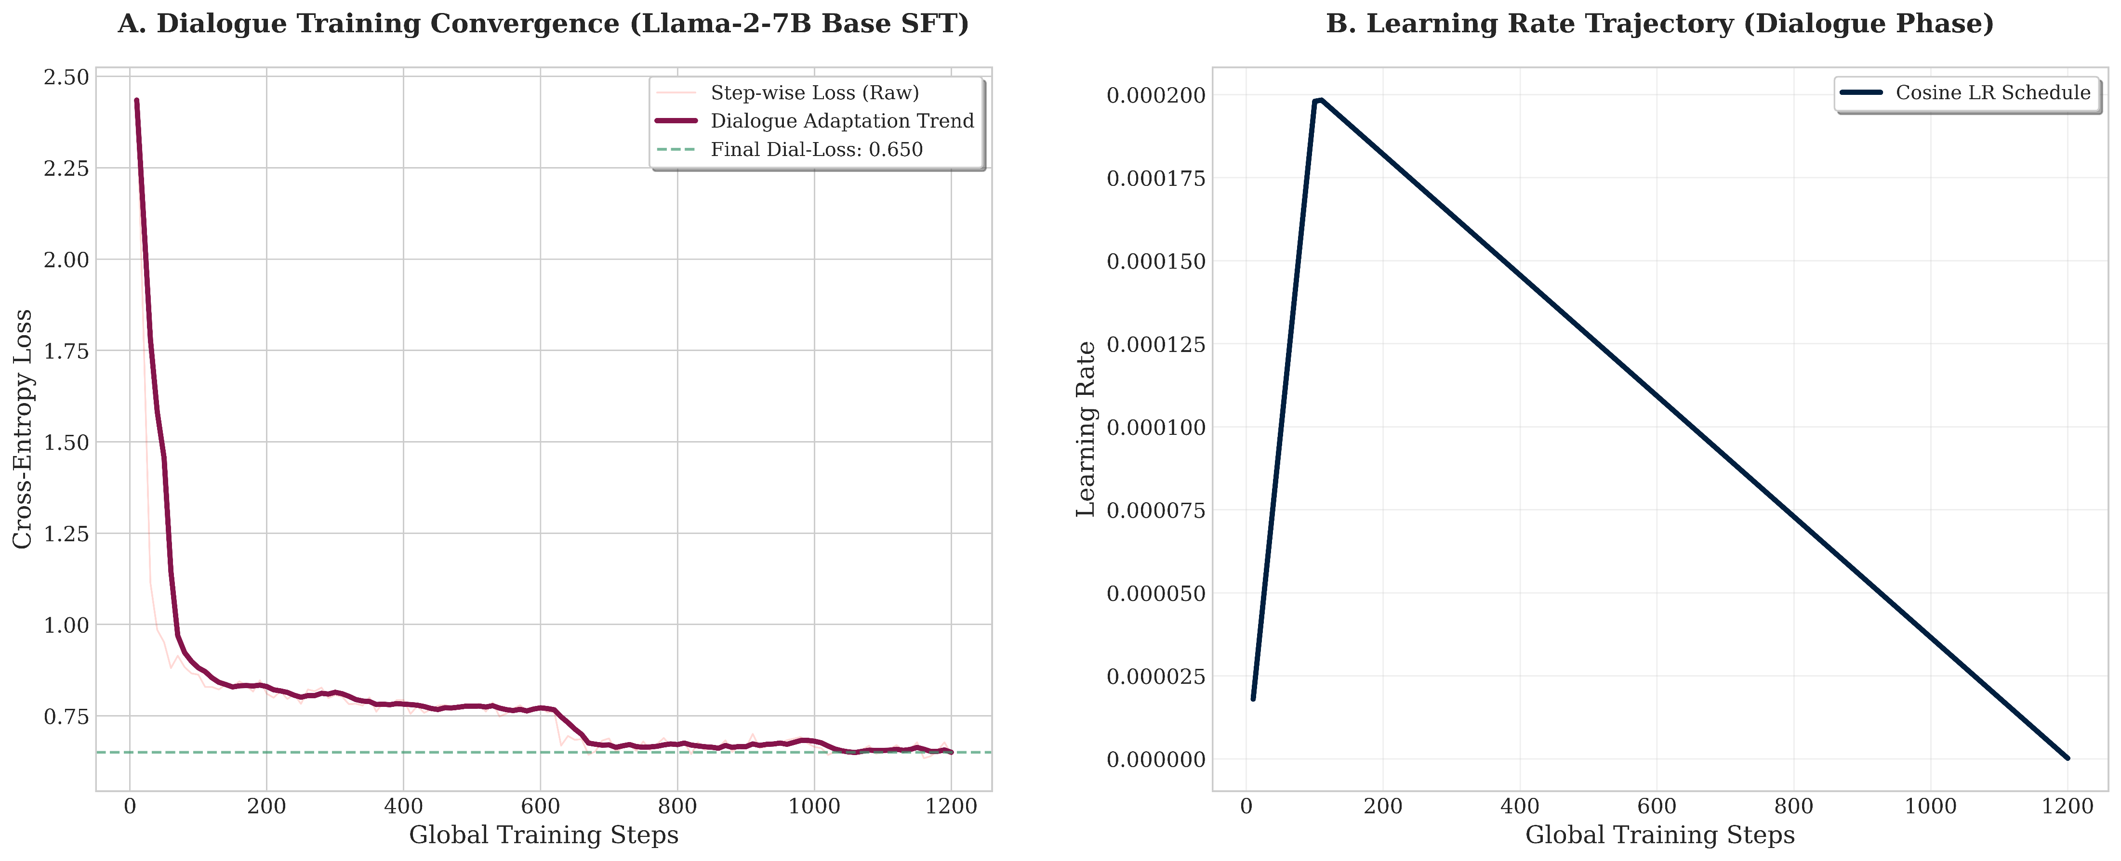
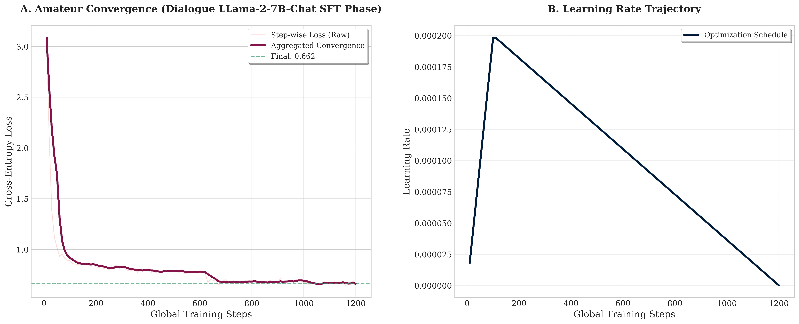
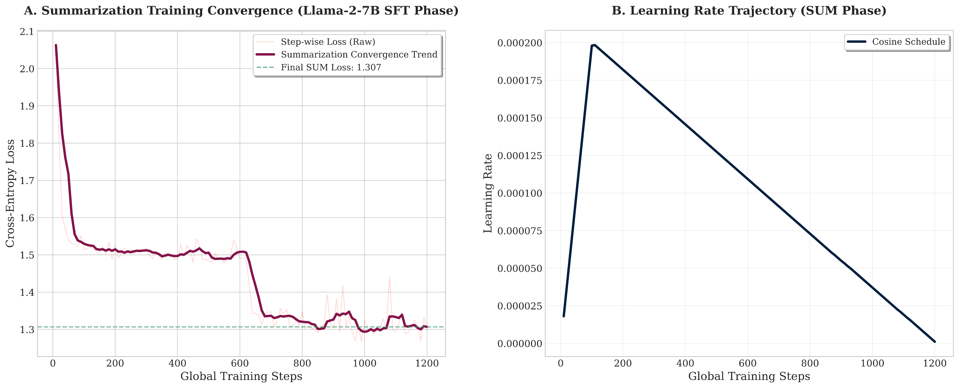
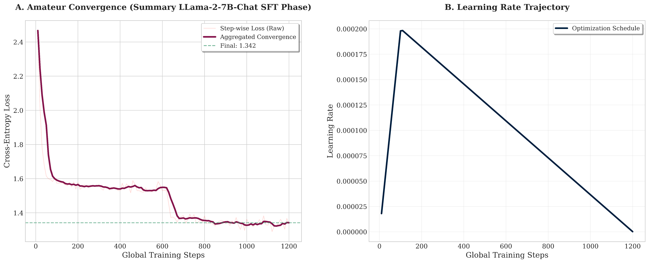
Models & Result (Cont.)
Dialogue Adapters
Figure 9: (A) Training loss convergence and (B) Learning rate schedule of LLaMA-2-7B during the SFT phase on Dialogue split, reaching a final cross-entropy loss of 0.650.
Figure 10: (A) Training loss convergence and (B) Learning rate schedule of LLaMA-2-7B-Chat during the SFT phase on Dialogue split, reaching a final cross-entropy loss of 0.662.
Summarization Adapters
Figure 11: (A) Training loss convergence and (B) Learning rate schedule of LLaMA-2-7B during the SFT phase on Summarization split, reaching a final cross-entropy loss of 1.307.
Figure 12: (A) Training loss convergence and (B) Learning rate schedule of LLaMA-2-7B-Chat during the SFT phase on Summarization split, reaching a final cross-entropy loss of 1.342.
15

Slide 18
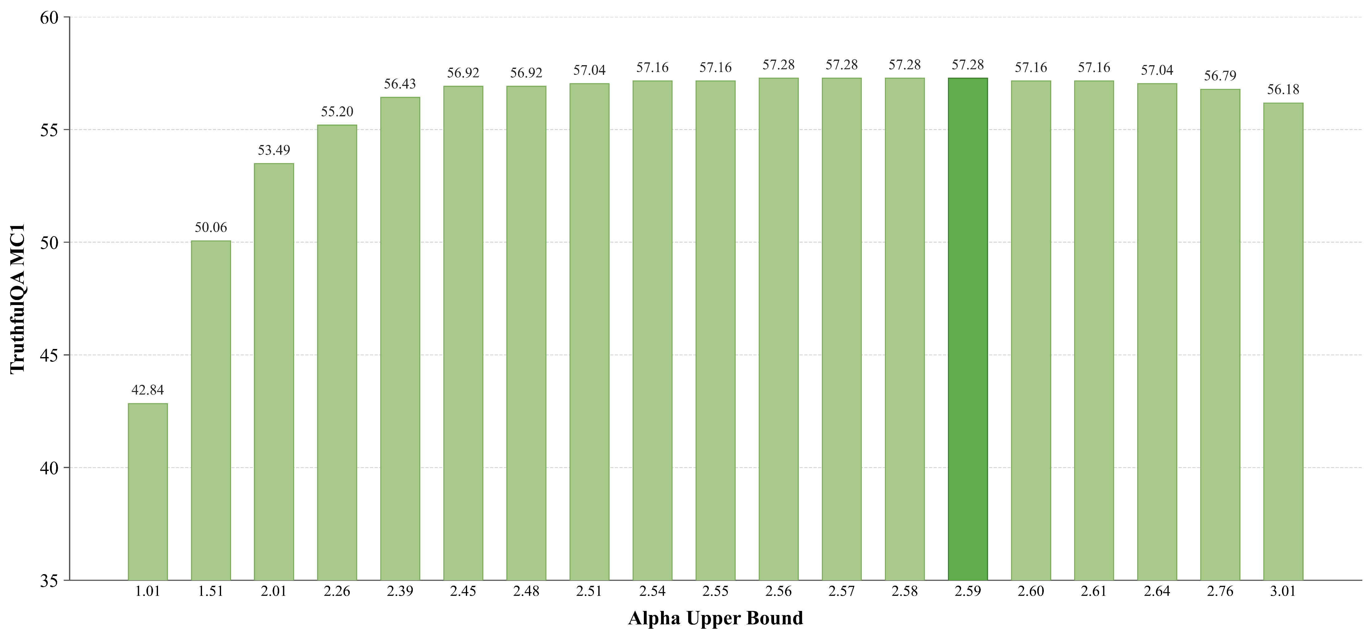
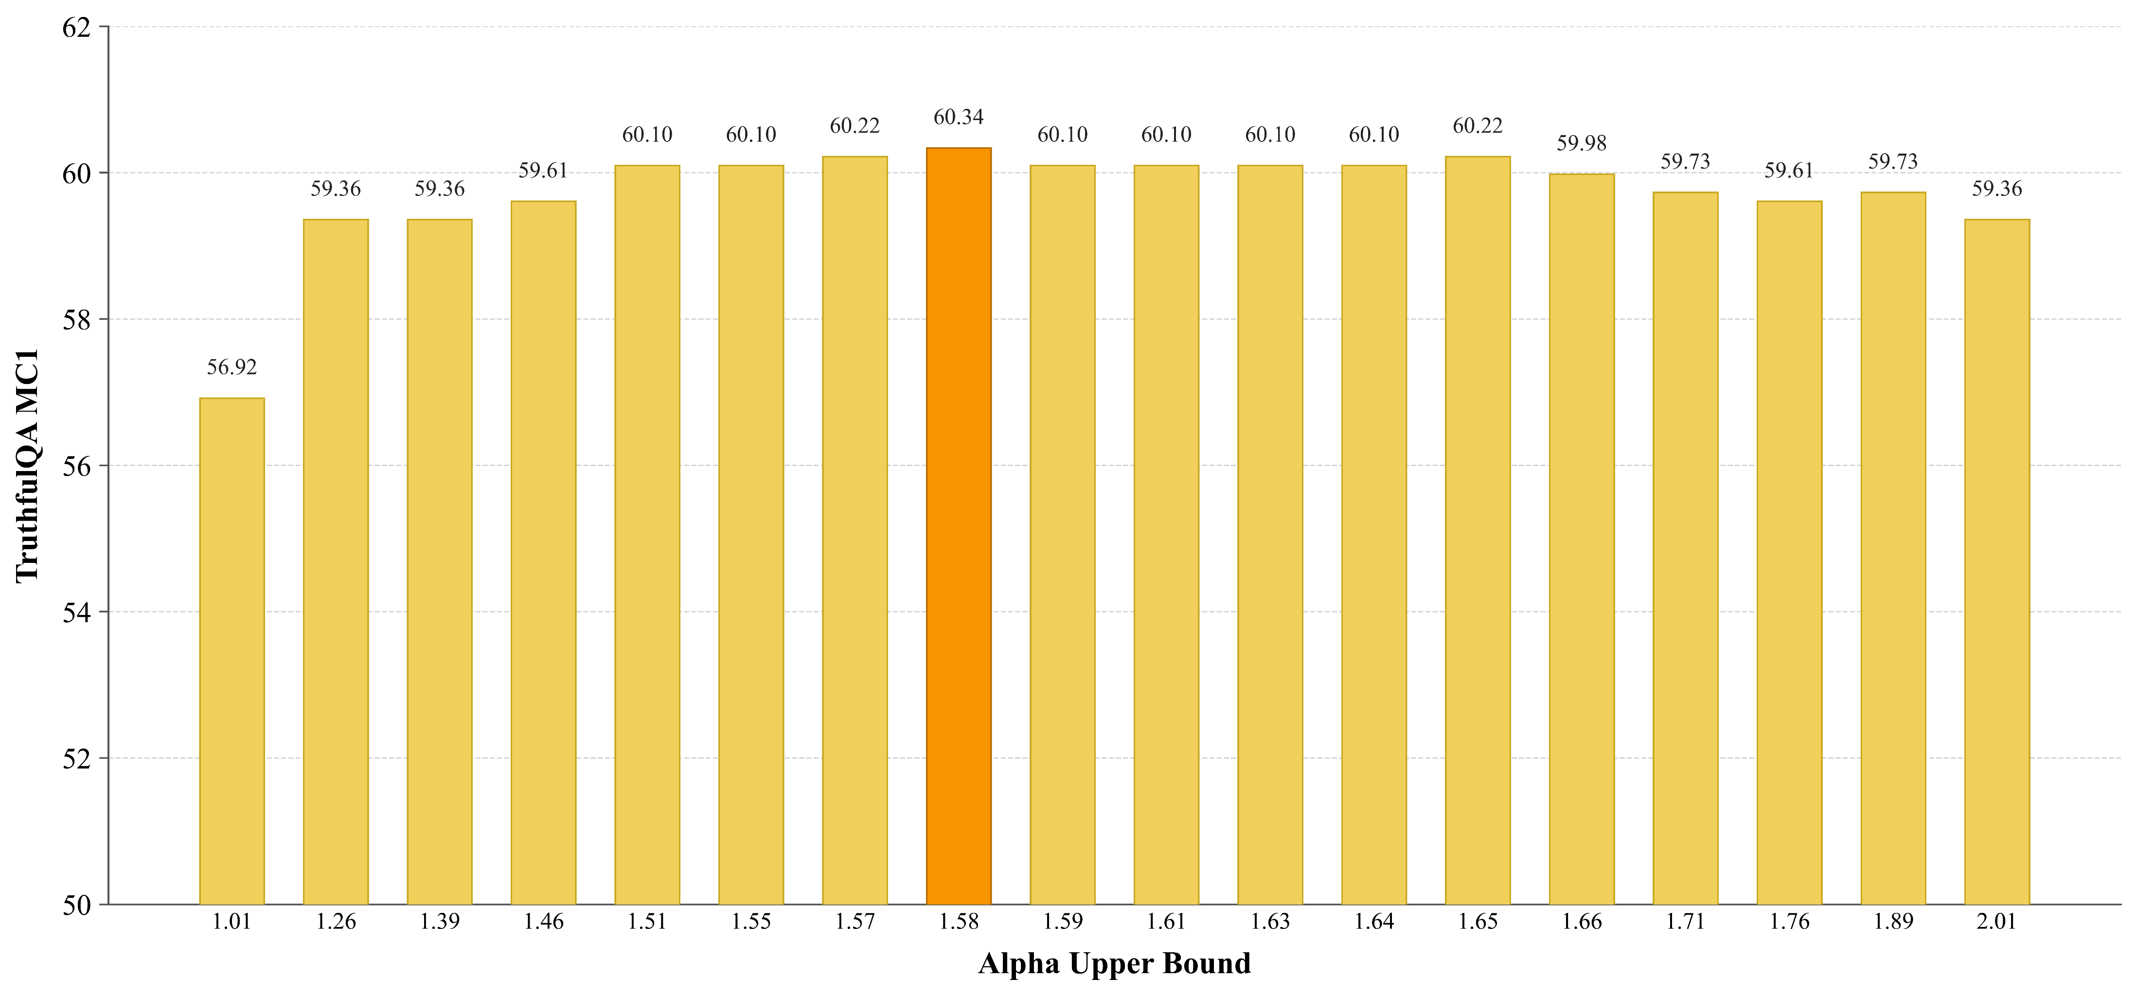
Models & Result (Cont.)
Dynamic Alpha Upper Bound Finding for A-RICD H2H
Figure 13: For 2.59 Alpha upper bound, the highest MC1 score of 57.28 is achieved in A-RICD H2H in LLaMA-2-7B-Chat
Figure 14: For 1.58 Alpha upper bound, the highest MC1 score of 60.34 is achieved in A-RICD H2H in Mistral-7B-Instruct
16

Slide 19
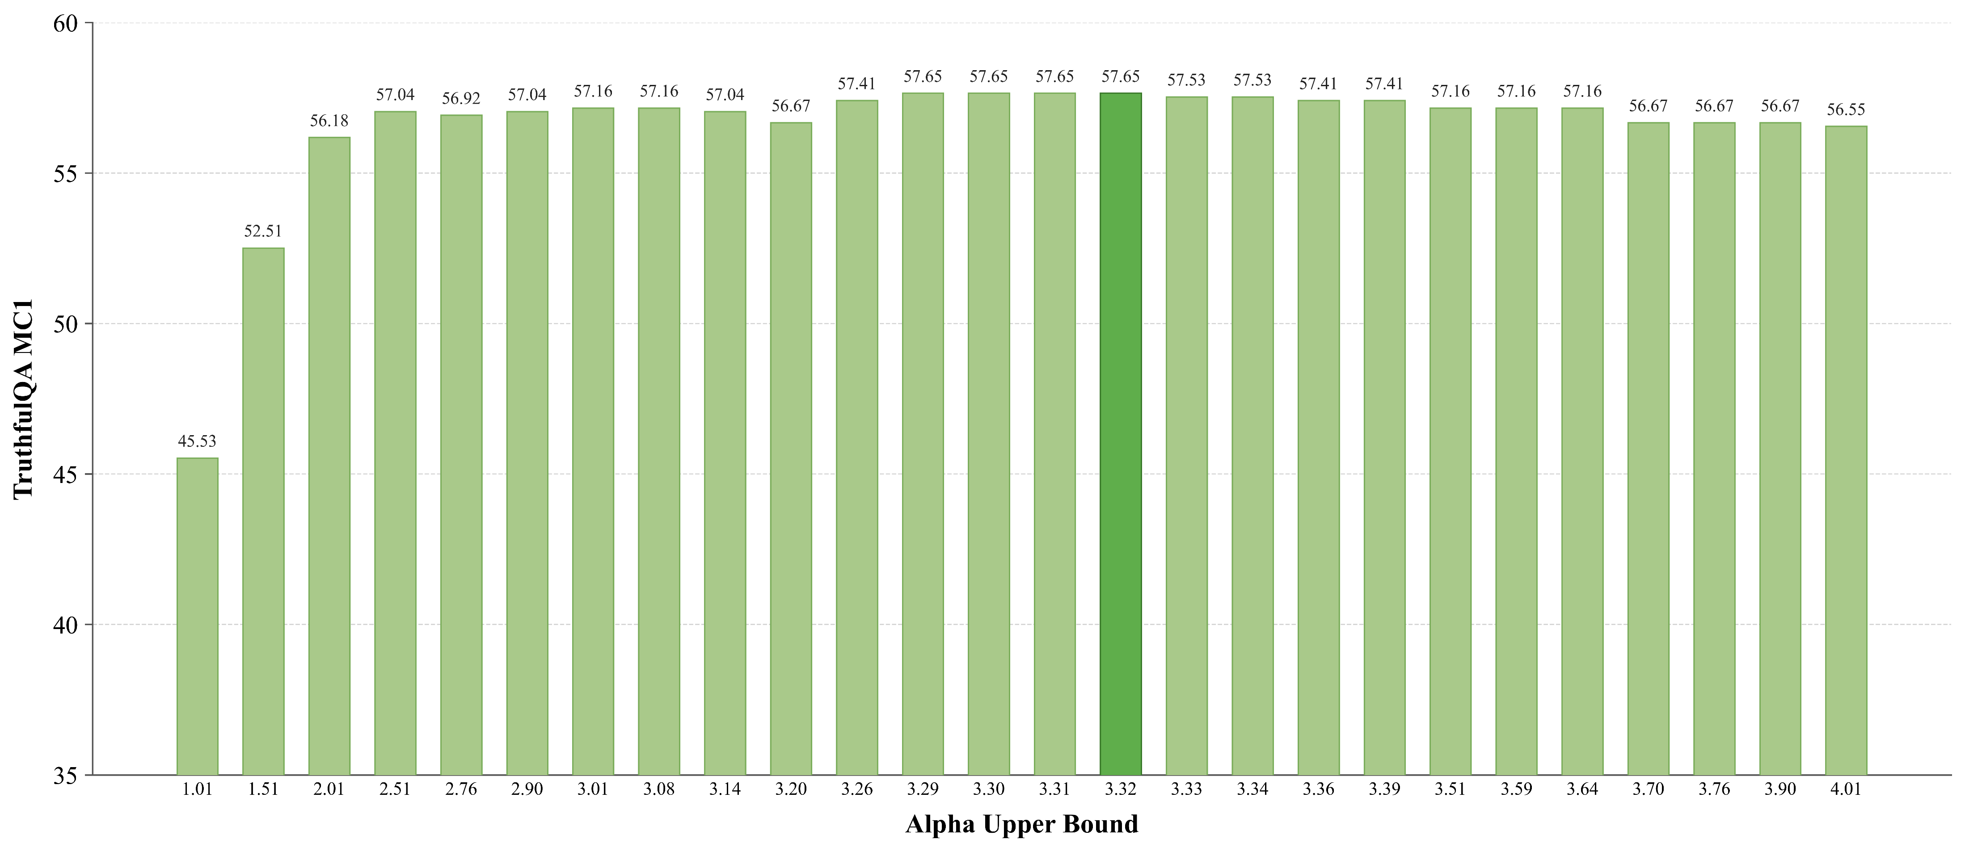
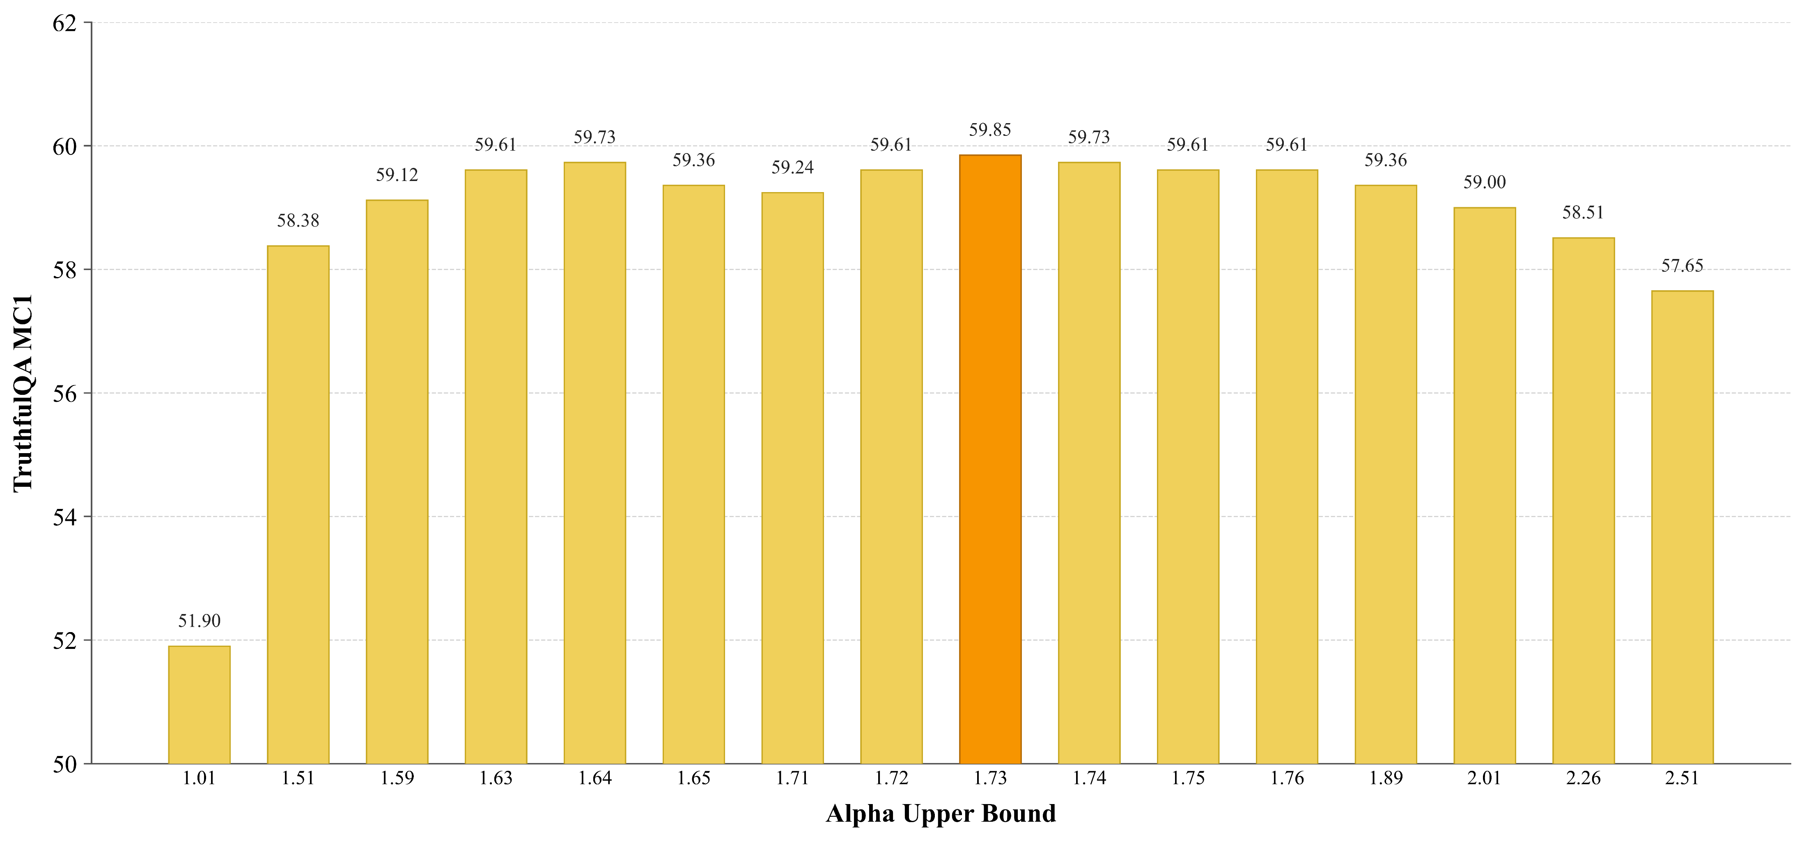
Models & Result (Cont.)
Dynamic Alpha Upper Bound Finding for A-RICD IA
Figure 15: For 3.32 Alpha upper bound, the highest MC1 score of 57.65 is achieved in A-RICD IA in LLaMA-2-7B-Chat
Figure 16: For 1.73 Alpha upper bound, the highest MC1 score of 59.85 is achieved in A-RICD IA in Mistral-7B-Instruct
17

Slide 20
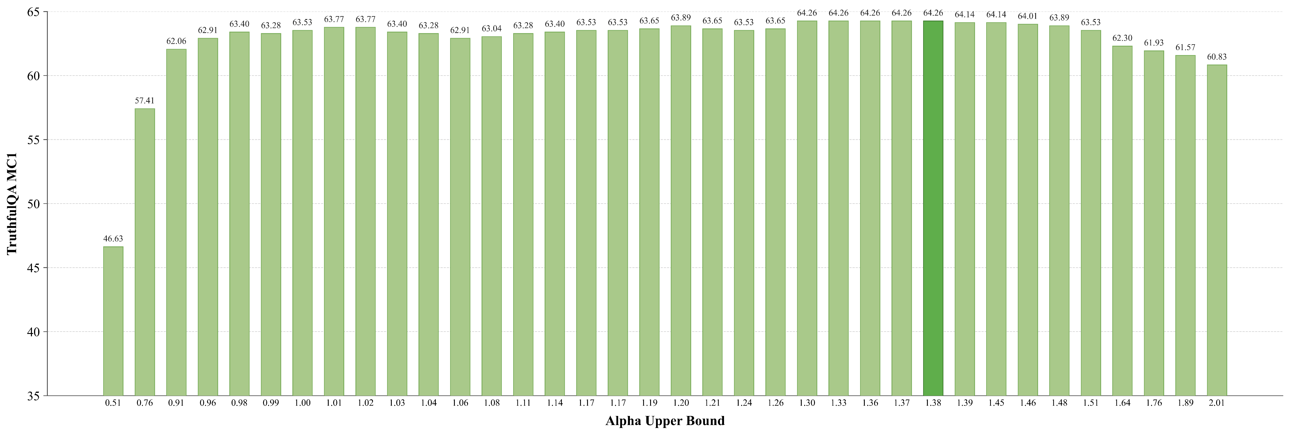
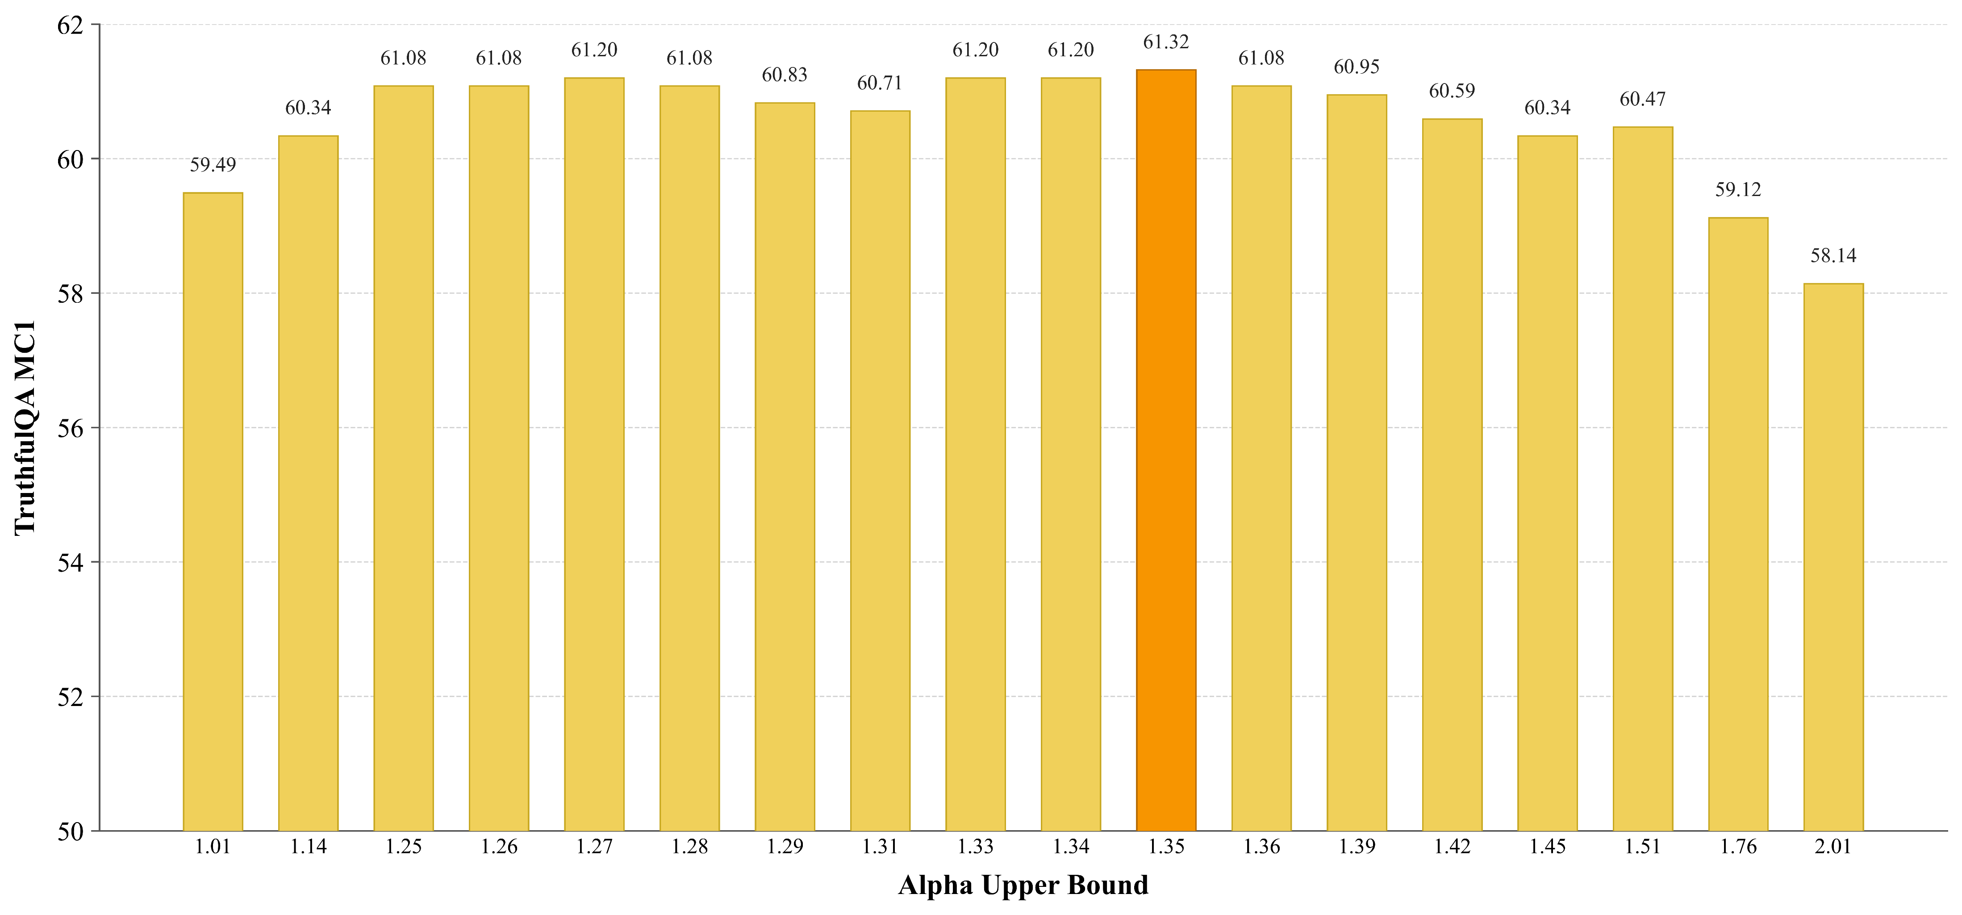
Models & Result (Cont.)
Dynamic Alpha Upper Bound Finding for A-RICD NIA
Figure 17: For 1.38 Alpha upper bound, the highest MC1 score of 64.26 is achieved in A-RICD NIA in LLaMA-2-7B-Chat
Figure 18: For 1.35 Alpha upper bound, the highest MC1 score of 61.32 is achieved in A-RICD NIA in Mistral-7B-Instruct
18

Slide 21
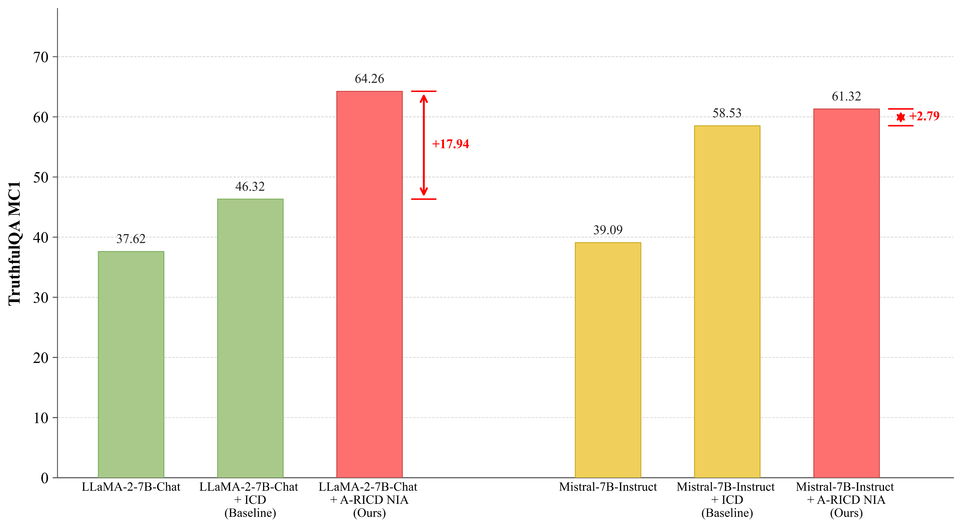
Comparative Analysis
Figure 19: Comparative analysis in MC1 score with baseline
19

Slide 22
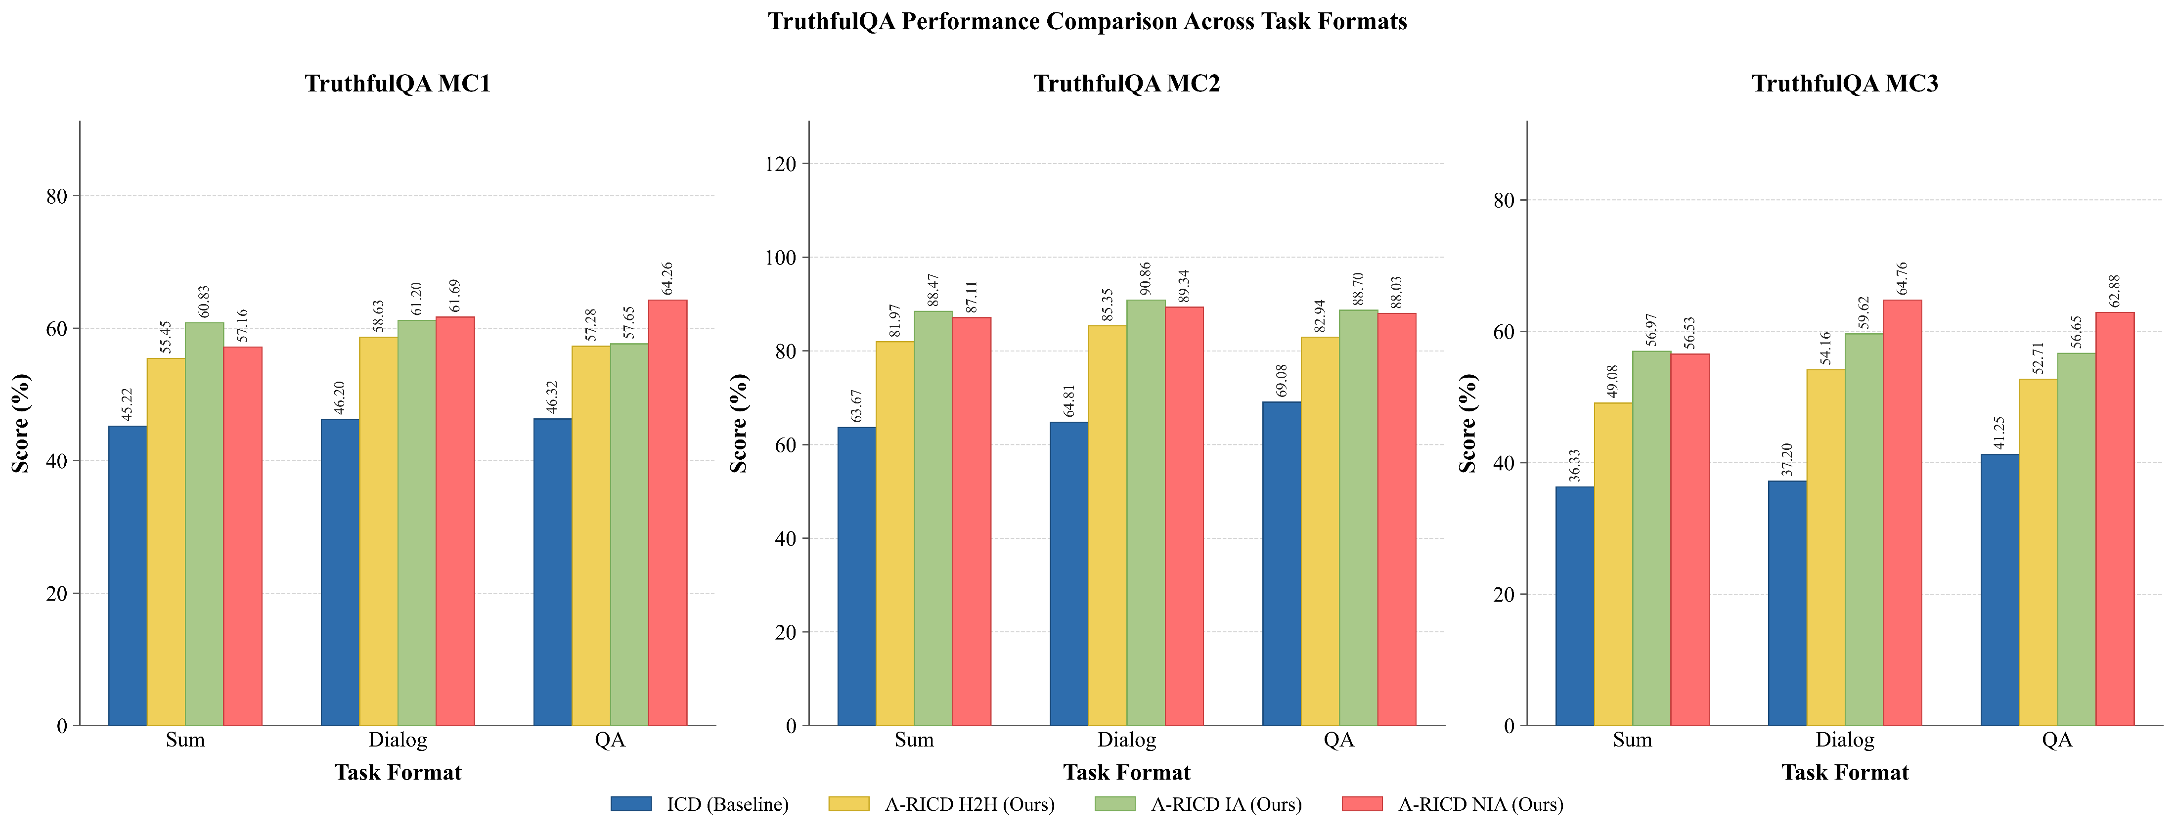
Comparative Analysis (Cont.)
Figure 20: Comparative analysis in MC1, MC2 & MC3 score with baseline across all task formats and all A-RICD variants for LLaMA-2-7B-Chat.
20

Slide 23
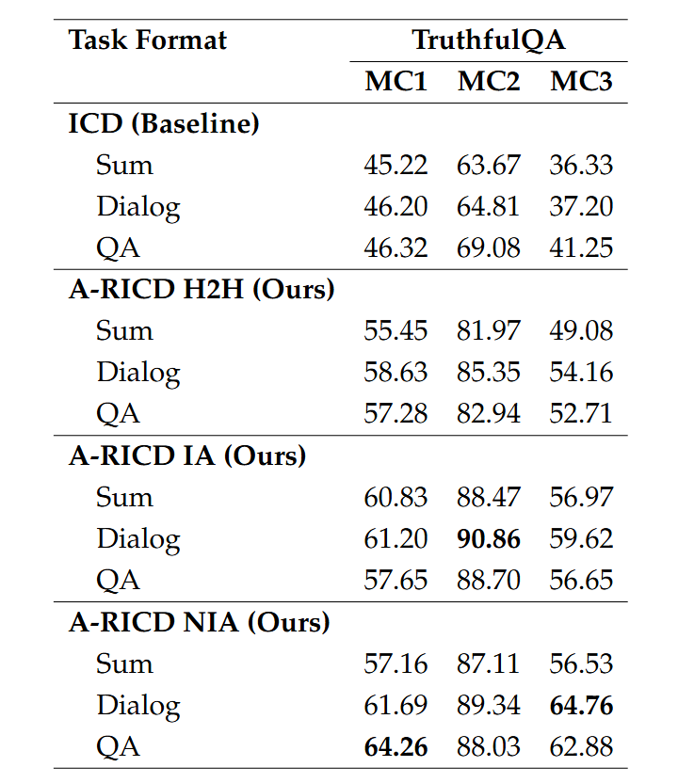
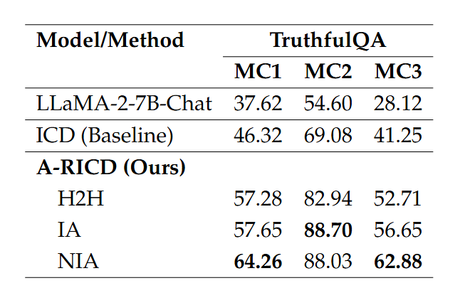
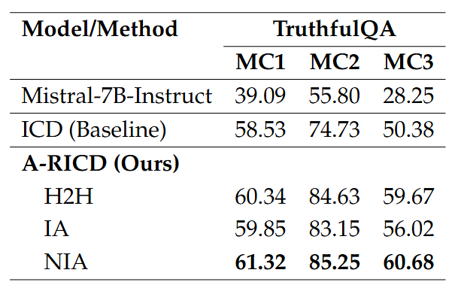
Comparative Analysis (Cont.)
Figure 21: Performance on TruthfulQA benchmark for QA task format across LLaMA-2-7B-Chat, ICD, and A-RICD variants.
Figure 22: Performance on TruthfulQA benchmark for QA task format across Mistral-7B-Instruct, ICD, and A-RICD variants.
Figure 23: Performance comparison of different task formats (Sum, Dialog, QA) on TruthfulQA across ICD and A-RICD variants.
21

Slide 24
Conclusion & Future Work
This work introduced a contrastive decoding framework using a hallucination-trained amateur LoRA adapter to improve factual accuracy without modifying the expert model. The dynamic alpha selection strategy proved effective in separating correct from incorrect answers on TruthfulQA. Looking ahead, combining this approach with retrieval-augmented generation (RAG), multi-agent verification pipelines, and tool-use systems are exciting directions that could make it significantly more robust in real-world settings. Training the amateur on multilingual and domain-specific false data would also be a worthwhile step toward broader generalisation.
22

Slide 25
References
[1] Yin, F., Ye, X., & Durrett, G. (2024). Lofit: Localized fine-tuning on llm representations. Advances in neural information processing systems, 37, 9474-9506.
[2] Jushi Kai, Tianhang Zhang, Hai Hu, and Zhouhan Lin. 2024. SH2: Self-Highlighted Hesitation Helps You Decode More Truthfully. In Findings of the Association for Computational Linguistics: EMNLP 2024, pages 4514–4530, Miami, Florida, USA. Association for Computational Linguistics.
[3] Shaolei Zhang, Tian Yu, and Yang Feng. 2024. TruthX: Alleviating Hallucinations by Editing Large Language Models in Truthful Space. In Proceedings of the 62nd Annual Meeting of the Association for Computational Linguistics (Volume 1: Long Papers), pages 8908–8949, Bangkok, Thailand. Association for Computational Linguistics.
[4] Yue Zhang, Leyang Cui, Wei Bi, and Shuming Shi. 2025. Alleviating Hallucinations of Large Language Models through Induced Hallucinations. In Findings of the Association for Computational Linguistics: NAACL 2025, pages 8233–8247, Albuquerque, New Mexico. Association for Computational Linguistics.
[5] Jiahao Li, Zhendong Mao, and Quan Wang. 2025. Alleviating Hallucinations in Large Language Models via Truthfulness-driven Rank-adaptive LoRA. In Findings of the Association for Computational Linguistics: ACL 2025, pages 2020–2031, Vienna, Austria. Association for Computational Linguistics.
23

Slide 26
Thank You

