Slide 1
Uni Assist
GROUP MEMBER:-
1.MOHAMAD ABIDUR RAHMAN CHOWDHURY(15201049)
2.MOHAMAD AL EMRAN(14301030)
3.GAZALA CHOWDHURY(13201036)

Slide 2
Features:
Full detailed information of each University.
Comparison of each department among Universities.
Direct Admission link.
Easily Accessible.
Good User Interface.

Slide 3
Worked With
JSP
Servlet
JavaScript
HTML
CSS
MySQL ,MySQL Workbrench

Slide 4
Universities Working With
BRAC University
North-South University
East-West University
American Independent University Bangladesh
Ahsanullah University of Science & Technology
Bangladesh Agricultural University
Bangladesh University of Engineering and Technology
Bangladesh University of Professional
Chittagong University
Daffodil International University
Dhaka University

Slide 5
Green International University
Islamic International University
Independent University Bangladesh
Jagannath University
Jahagirnagar University
Khulna University of Engineering & Technology
Premier University
Shahjalal University Of Science and Technology
United International University

Slide 6
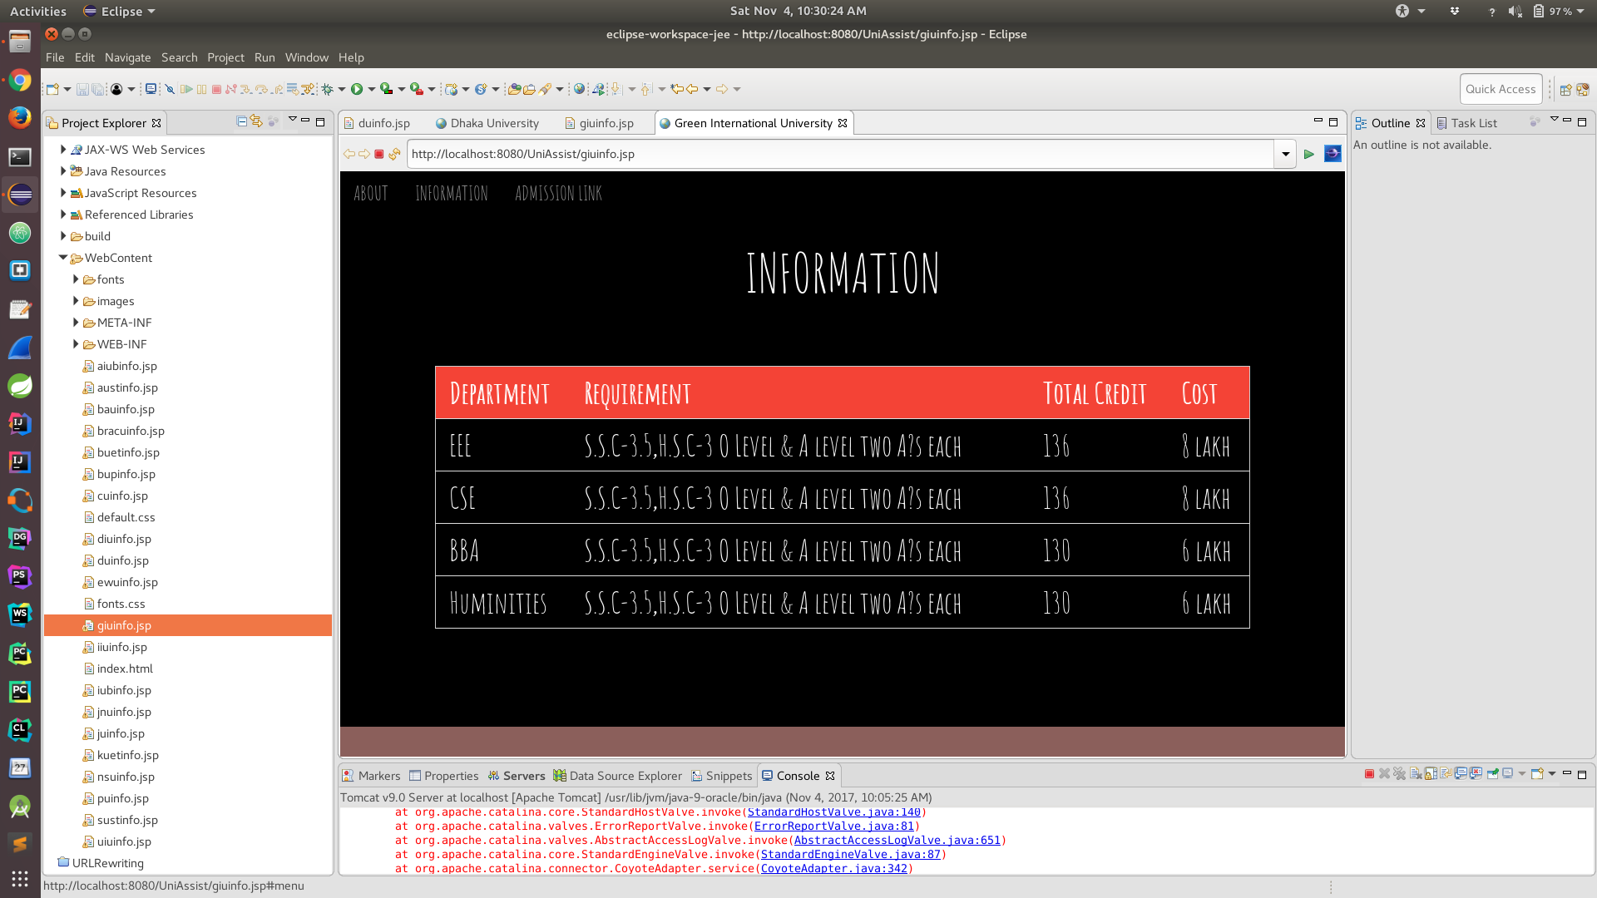
Snapshot of our project

Slide 7


