Slide 1
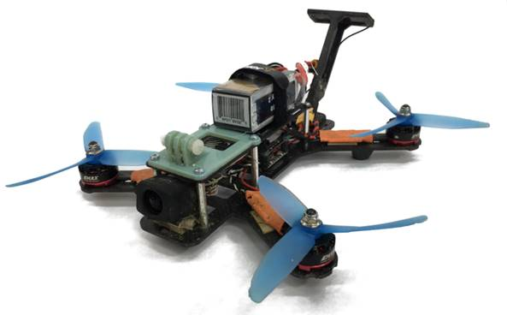
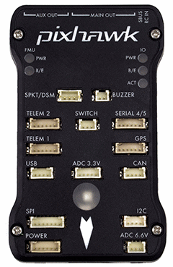
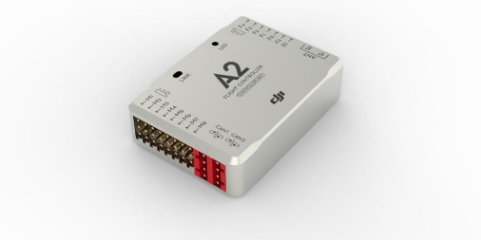
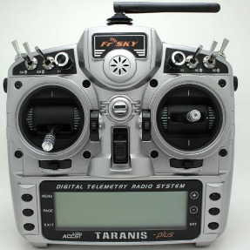
Simulator
Vehicle Model
Physics Engine
Control Commands
Flight Controller Hardware
Environment Model
Sensor Models
Rendering Engine
Sensor Readings
Data Collection
Decision Making Engine
(Path Planning, Controls, Action Selection etc.)

Slide 2












$$F_{1}$$
$$F_{2}$$
$$τ_{1}$$
$$τ_{2}$$
$$u_{1}$$
$$u_{2}$$
$$F_{3}$$
$$τ_{4}$$
$$τ_{3}$$
$$F_{4}$$
$$u_{4}$$
$$u_{3}$$

