Slide 1
Prerative Autoscaling
CSE 591:Class Project
Anshul, Dhanendra, Muhammad Ali,
Neeraj, Shahzeb

Slide 2
Motivation - Auto scale
Scaling is indispensable at modern data centers due to varying workloads
Lack of scaling may cause poor performance in application or lead to power wastage
Manual scaling is infeasible as it requires constant supervision in modern data center

Slide 3
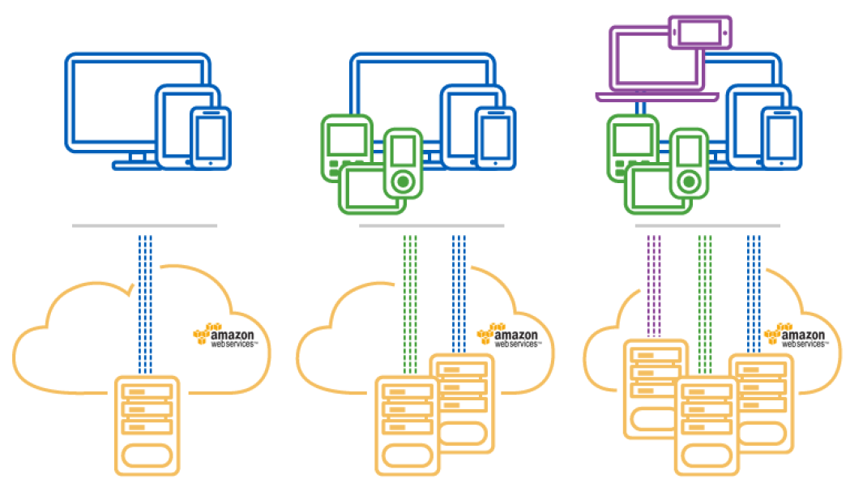
Motivation
Reactive auto scaling may cause SLA violation during setup time
http://www.cloudcomputing-news.net/media/aws3.png
Notes:
Both predictive and reactive approaches are used for autoscaling and have their own advantages and disadvantages.
It would be a good idea to combine both the approaches and make use of the combined advantages while overcoming some of their disadvantages reducing the cost further than the individual approaches.

Slide 4
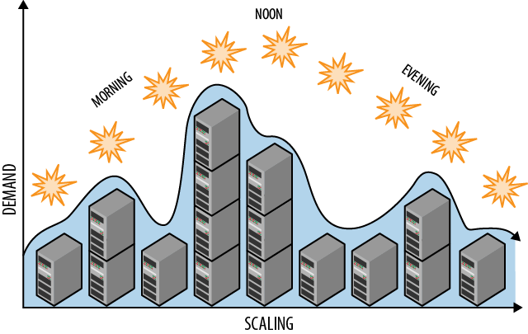
Motivation
Predictive auto scaling is Intelligent in resource allocation but may not be able to handle load spikes
https://www.safaribooksonline.com/library/view/cloud-architecture-patterns/9781449357979/httpatomoreillycomsourceoreillyimages1352543.png

Slide 5
Motivation – Prerative Autoscaling
Predictive and reactive algorithms prove helpful but can be optimized further
We see a need to find a sweet spot between an intelligent algorithm that predicts load and leverages reactive scaling benefits while maintaining SLA
We assert that this hybrid approach is optimal in comparison with predictive or reactive approaches individually

Slide 6

Problem Statement
Propose a new hybrid approach called prerative autoscaling to up-scale and down-scale resources to an optimal level with good response time comparable to reactive but with reduced power cost than that of always-on strategy
https://www.citycloud.com/wp-content/uploads/2015/09/autoscaling1-1024x315.png

Slide 7
Problem Statement
Allocation Obedience
Predictive Mode
Reactive Mode
Upscale/Downscale in Real time
Allocation violation

Slide 8
Prior Work
Minimizing Data Center SLA Violations and Power Consumption via Hybrid Resource Provisioning: - Use of predictive algorithms for coarse time scale and use of reactive algorithms for finer time scale
Optimal Cloud Resource Auto-Scaling for Web Applications:- Predicted the number of requests based on history data by exploiting machine learning techniques and time series analysis
Towards an Automatic Auto-Scaling prediction System for Cloud Resource Provisioning: - Use of prediction algorithms like SVM for periodic and growing workloads and use of Neural Networks for unpredicted workload
Predictive Auto-Scaling Techniques for Clouds subjected to requests with Service Level Agreements:- Use of predictive algorithm (Linear Regression) to increase intermediate enterprise profit and reduce user cost by handling On Demand requests.
Notes:
Anshul Gandhi, Yuan Chen, Daniel Gmach, Martin Arlitt, Manish Marwah – IGCC 2011
2) Jing Jiang, Jie Lu, Guangquan Zhang, Guodong Long - 2013 13th IEEE/ACM International Symposium on Cluster, Cloud, and Grid Computing.
Note - Optimal number of VMs predicted by utilizing queueing theory and multi-objective optimization
3) Ali Yadavar Nikravesh, Samuel A. Ajila, Chung-Horng Lung - 2015 10th International Symposium on Software Engineering for Adaptive and Self-Managing Systems
4) Anshuman Biswas, Shikharesh Majumdar, Biswajit Nandy, Ali El-Haraki. - 2015 IEEE
Note – Described a novel predictive algorithm which uses a price model to increase the profit of intermediate enterprise and a reduction in the user cost at the same time. Also a framework is described for devising predictive auto-scaling to handle SLA driven OD(on demand) requests

Slide 9
Prior Work
ARIMA and other algos

Slide 10
Prerative Autoscaling
Outline
Use predictive algorithms to predict future load
Switch to Reactive mode in case of allocation violation
Switch to Predictive mode in case of allocation obedience
This approach focuses on exact optimal number of resources to be maintained for the next given time interval

Slide 11
Experimental Setup
Resources
10 AWS slave instances to function as servers
1 AWS VM as load balancer (apache server)
1 AWS VM to pump load (httperf)
All the AWS instances were created from t2.micro instance type

Slide 12
Experimental Setup
Our Algorithms runs on the same machine as the load balancer
Current load values are read from apache logs
Use the values from logs along with history data to predict number of required VMs
Use curl command from algorithm to enable/disable VMs

Slide 13
Load Type
CPU Intensive
Product of numbers between 1 and 2000
Memory Intensive
A random array of size 100000 is created and modulo 2 is checked on each element
I/O bound
A sentence from on disk file is read 10000 times

Slide 14
Traces & Historical Data
Traces
Sinusoidal load without noise
Sinusoidal load with noise
Historical Data
Generated one day of randomized usage in a sinusoidal format
Added noise to this ideal data and generated data for 10 days and used it as our history

Slide 15
Pure Reactive

Slide 16
Prediction Algorithm

Slide 17
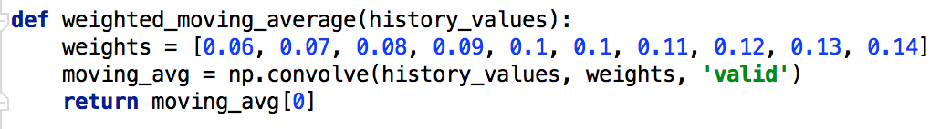
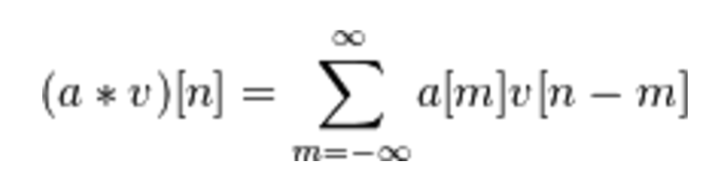
Weighted Average
Simple algorithm to generate discrete, linear convolution of two one-dimensional sequences
The history values and weights are same length, so there will be only one position where they completely overlap resulting in single-element array

Slide 18
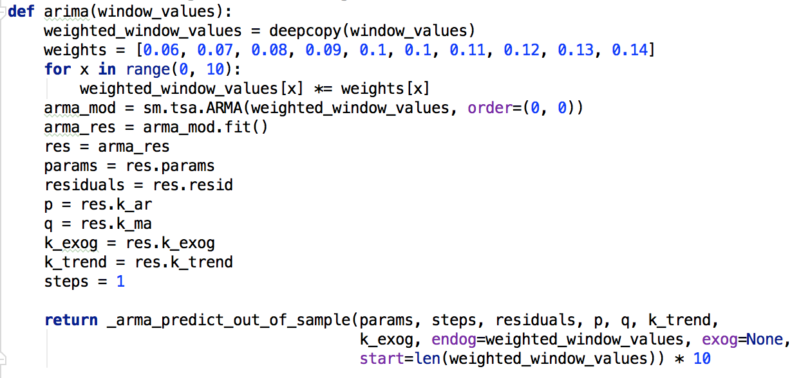
ARIMA
Weighted + ARIMA (Autoregressive Integrated Moving Average) algorithm
Notes:
from statsmodels.tsa.arima_model import _arma_predict_out_of_sample

Slide 19
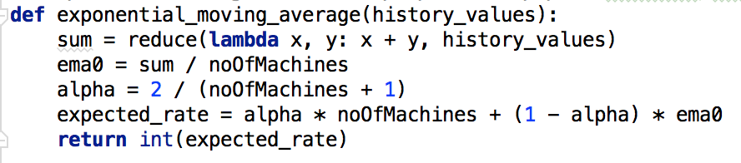
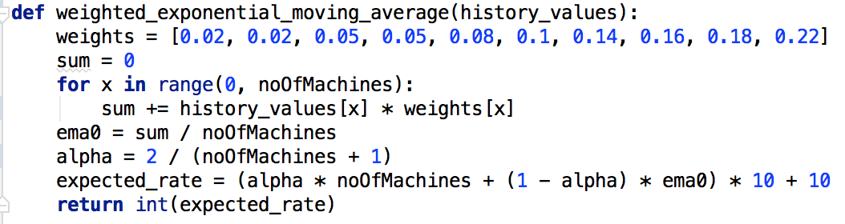
(Weighted)Exponential Average
Famous formula used in stock price prediction: (ClosingPrice-EMA(previousDay))*multiplier+EMA(previousDay)
Similarly predict load
based on previous 10 values

Slide 20
Result

Slide 21
Conclusion

