Slide 1
Automatic Differentiation: Forward Mode
by Nathaniel W. Morris

Slide 2
Preliminary Discussion
A means of calculating multiple derivatives rapidly, ergo, “automatic.”
Useful in the field of machine learning when applied to neural networks.
Used for computing partial derivatives in the gradient descent training method.
Gradient descent is the optimization algorithm currently used by LLM’s to “learn.”

Slide 3
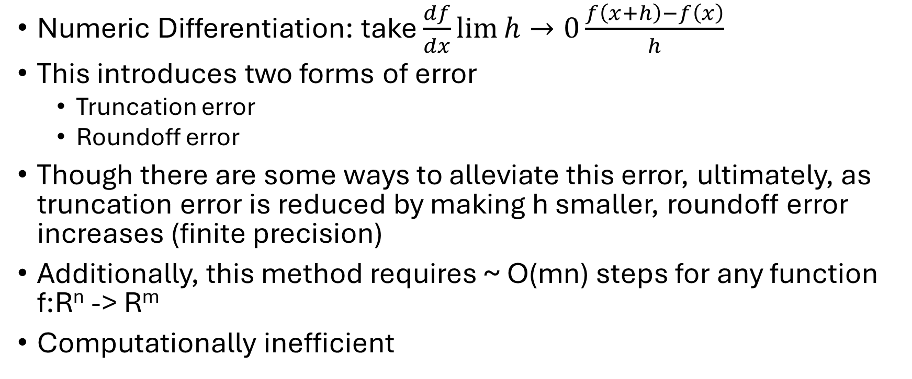
Some Alternatives
Numeric Differentiation: take $\frac{df}{dx}\lim{h}→0\frac{f\left(x+h\right)−f\left(x\right)}{h}$
This introduces two forms of error
Truncation error
Roundoff error
Though there are some ways to alleviate this error, ultimately, as truncation error is reduced by making h smaller, roundoff error increases (finite precision)
Additionally, this method requires ~ O(mn) steps for any function f:R^{n} -> R^{m}
Computationally inefficient

Slide 4
Some Alternatives, cont’d
Symbolic Differentiation
A computer’s way of hand-calculating derivatives one step at a time
Uses same derivative rules as Calculus
Eliminates truncation error
Leads to expression swell
Gives results with exponentially more redundant and useless terms

Slide 5
Well, what now, then?

Slide 6
Automatic Differentiation
A way to express composite functions
Break them down into variables and elementary operations
Chain derivatives of these components together
Done by means of an evaluation trace

Slide 7
Evaluation Trace
Uses the following variables:
Input: v_(i – n) = x_(i), i = 1, …, n
Intermediate: v_(i), I = 1, …, l
Output: y_(m – i) = v_(l – i), i = m – 1, …, 1
Example:
y = f(x_(1), x_(2)) = x_(1)x_(2) + x_(2) – ln(x_(1))
x_(1) = 2, x_(2) = 4

Slide 8
Evaluation Trace
Forward Primal Trace | Output
v_(-1) = x_(1) | 2
v_(0) = x_(2) | 4
v_(1) = v_(-1)v_(0) | 2(4) = 8
v_(2) = ln(v_(-1)) | ln(2) = 0.693
v_(3) = v_(1) + v_(0) | 8 + 4 = 12
v_(4) = v_(3) – v_(2) | 12 – 0.693 = 11.307
y = v_(4) | 11.307

Slide 9
AD: Forward Mode
Take the evaluation trace, and adds a tangent trace
Gives us the forward primal from the last example, and the forward tangent
By using the forward tangent, we get the derivative
Use the previous equation, with x_(1) = 3, x_(2) = -4, x_(1)tangent = 0, and x_(2)tangent = 1

Slide 10
AD: Forward Mode
Forward Primal Trace | Output | Forward Tangent Trace | Output
v_(-1) = x_(1) | 3 | v_(-1)tan = x_(1)tan | 0
v_(0) = x_(2) | -4 | v_(0)tan = x_(2)tan | 1
v_(1) = v_(-1)v_(0) | 3 * -4 = 12 | v_(1)tan = v_(-1)tan*v_(0) + v_(0)tan*v_(-1) | 0 * -4 + 1 * 3 = 3
v_(2) = ln(v_(-1)) | ln(3) = 1.10 | v_(2)tan = v_(-1)tan*(1/v_(-1)) | 0 * (1 / 3) = 0
v_(3) = v_(1) + v_(0) | -12 + -4 = -16 | v_(3)tan = v_(1)tan + v_(0)tan | 3 + 1 = 4
v_(4) = v_(3) – v_(2) | -16 – 1.10 = -17.10 | v_(4)tan = v_(3)tan – v_(2)tan | 4 – 0 = 4
y = v_(4) | -17.10 | y(tan) = v_(4)tan | 4

Slide 11
Bonus Feature: Jacobian Matrices
Can use AD to compute Jacobian matrices
f: R^{n} -> R^{m}
Inputs: a ∈ R^{n}, w/ x = a, and x(tan) = e_(i), for I = 1, …, n
Generates: partial derivatives for y_(j), j = 1, …, m w.r.t. x_(i)
As such, each forward pass generates one column of the Jacobian

Slide 12
Quick Code Demo

Slide 13
Why Automatic Differentiation?
Seemed interesting
Machine learning applications were a cool discovery
Mainly, needed a project

Slide 14
Questions?

Slide 15
Thank you

Slide 16
Sources/References:
https://huggingface.co/blog/andmholm/what-is-automatic-differentiation
https://mostafa-samir.github.io/auto-diff-pt1/

