Slide 1
Comparing Training Methods for Neural Networks
Albert Parmenter

Slide 2
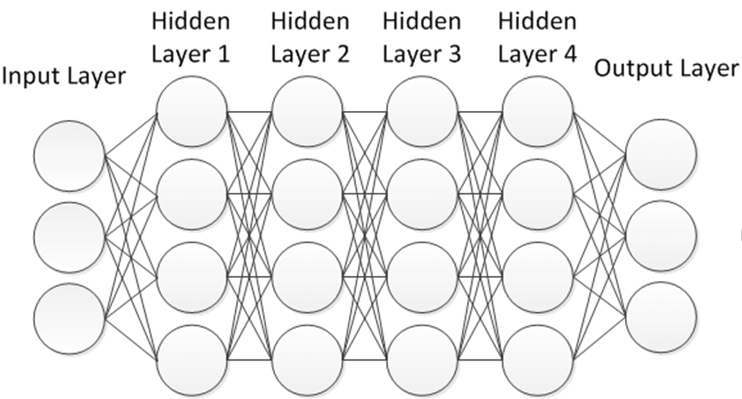
Neural Network Structure

Slide 3

Forward Propagation
$a_{i}^{(l)}$= σ (w₁ $a_{1}^{(l−1)}$ + w₂ $a_{2}^{(l−1)}$+ … + w_{n} $a_{n}^{(l−1)}$+ b)
$a_{i}^{(l)}$ is the activation of ith neuron in layer l
σ is the sigmoid function (other functions can be used)
w_{n} is the weight of the nth activation in the previous layer
$a_{n}^{(l−1)}$ is the nth activation in the previous layer

Slide 4

Matrix Representation
( )
w_{0,0} | w_{0,1} | … | w_{0,n}
w_{1,0} | w_{1,1} | … | w_{1,n}
. . . | . . . |  | . . .
w_{k,0} | w_{k,1} | … | w_{k,n}
$$a_{0}^{(0)}$$
$$a_{1}^{(0)}$$
. . .
$$a_{k}^{(0)}$$
b₀
b₁
. . .
b_{k}
σ
+

Slide 5
Backpropagation
The chain rule is used to determine how much each weight and bias effects the cost function for a given set of training examples
Adjustments are made to weights and biases to improve accuracy of the network

Slide 6


Loss Function (MSE)
$$L=\frac{1}{k+1}\sum_{j=0}^{k}{{{({\hat{a}}_{j}−a}_{j})}^{2}}$$
${\hat{a}}_{j}$ is the predicted activation for a given output neuron
$a_{j}$ is the actual activation for that neuron for a given training example
k + 1 is the number of neurons in the output layer

Slide 7

Cost Function
$$C(W,b )=\frac{1}{m}\sum_{i=1}^{m}{\sum_{j=0}^{k}{{{({\hat{a}}_{j}−a}_{j})}^{2}}}$$
The cost function for m training examples
The goal is to minimize the cost function for a given batch of examples
W is the matrix of all the weights
b is the matrix of all biases

Slide 8


$\frac{∂C}{∂w^{(l)}}$ and $\frac{∂C}{∂b^{(l)}}$
$$z^{(l)}=w^{(l)}a^{(l−1)}+b^{(l)}$$
$\frac{∂C}{∂w^{(l)}}$ = $\frac{∂z^{(l)}}{∂w^{(l)}}$ $\frac{∂a^{(l)}}{∂z^{(l)}}$ $\frac{∂C}{∂a^{(l)}}$ = $a^{(l−1)}σ′$($z^{(l)}$)2($a^{(l)}−{\hat{a}}^{(l)})$
$\frac{∂C}{∂b^{\left(l\right)}}$ = $\frac{∂z^{(l)}}{∂b^{(l)}}$ $\frac{∂a^{(l)}}{∂z^{(l)}}$ $\frac{∂C}{∂a^{(l)}}$ = $σ′$($z^{(l)}$)2($a^{(l)}−{\hat{a}}^{(l)})$

Slide 9


Gradient of Cost function
(one neuron per layer)
$$\frac{∂C}{∂w^{(1)}}$$
$$\frac{∂C}{∂b^{(1)}}$$
$$\frac{∂C}{∂w^{(2)}}$$
$$\frac{∂C}{∂b^{(2)}}$$
. . .
$$\frac{∂C}{∂w^{(k)}}$$
$$\frac{∂C}{∂b^{(k)}}$$
$∇C(W,b)$ =

Slide 10

Gradient of Cost function
$$−∇C(W,b)$$
Make a step in the negative of the gradient to approach a minimum for the cost function

Slide 11
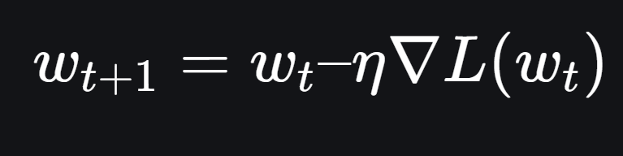

Stochastic Gradient Descent
$w_{t+1}$ is the updated weight
η is the learning rate (usually ≈ 0.1 or 0.01)
Biases updated the same way

Slide 12
Stochastic Gradient Descent
Slow
Tends to get stuck at local minima

Slide 13
Momentum Based Gradient Optimizer (ML)
Steps in gradient descent are taken based on the sizes of previous steps
Smooths the trajectory of the descent

Slide 14
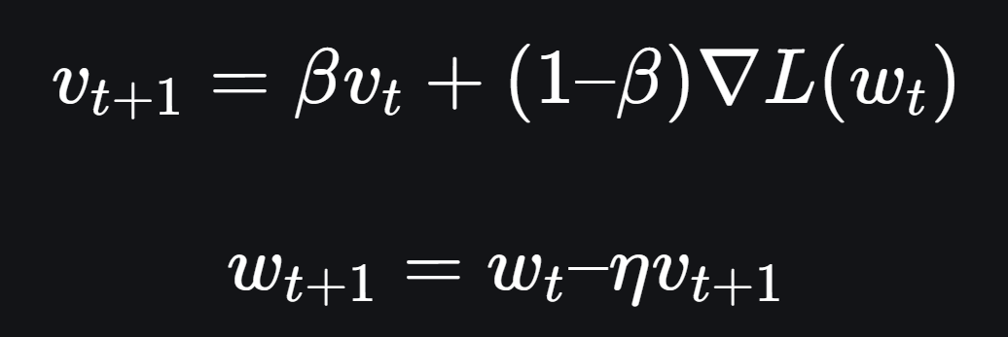

Momentum Based Gradient Optimizer (ML)
$v_{t}$ is the velocity
β is the momentum factor (controls how much previous velocity effect updated velocity, usually ≈ 0.9)
Learning rate is still usually in 0.1 – 0.01 range
​

Slide 15
Momentum Based Gradient Optimizer (ML)
Faster then SGD
Reduces oscillation
Better at avoiding local minima

Slide 16
Root Mean Square Propagation (RMSProp)
Adaptive learning rate for each parameter

Slide 17


Root Mean Square Propagation (RMSProp)
$$S_{t}=γS_{t−1}+(1−γ) {∇C(w_{t})}^{2}$$
$w_{t}=w_{t−1}−\frac{η}{\sqrt{S_{t−1}+\text{ε}}}$ $∇C(w_{t})$
Initalize $s_{0}$ = 0 as the running average of squared gradients
Initialize $γ$ as the decay rate (often ≈ .9)
ε is a small constant to ensure stability
Learning rate is usually ≈ 0.001

Slide 18
Root Mean Square Propagation (RMSProp)
Adaptive learning rate for each parameter allows for faster convergence then SGD
Adjusts well to changing optimal parameters
Solves decay problem with AdaGrad
Can perform poorly on sparse datasets

Slide 19
Adaptive Moment Estimation (Adam)
Combines ML and RMSProp

Slide 20
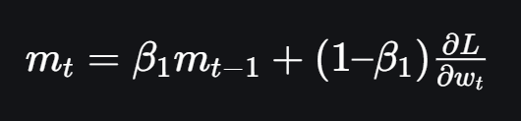

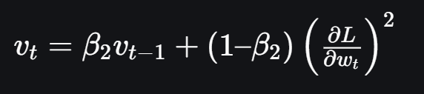


Adaptive Moment Estimation (Adam)
First moment (mean) estimate
Bias Correction
Second moment (variance) estimate
Weight Update
$β_{1}$ and $β_{2}$ are the decay rate constants, usually $β_{1}$ = 0.9 and $β_{2}$ = 0.999
$α$ is the learning rate, usually = 0.001
$ε$ is a constant, usually = ${10}^{−8}$

Slide 21
Adaptive Moment Estimation (Adam)
Faster convergence due to adaptive learning rate based on past gradients and magnitudes
Bias correction ensures stability
Better convergence then ML and RMSProp

Slide 22
Works Cited
3Blue1Brown. Neural Networks. YouTube, https://www.youtube.com/playlist?list=PLZHQObOWTQDNU6R1_67000Dx_ZCJB-3pi. Accessed 13 May 2025.
“5 Algorithms to Train a Neural Network.” GeeksforGeeks, https://www.geeksforgeeks.org/5-algorithms-to-train-a-neural-network/. Accessed 13 May 2025.
“Adam Optimizer.” GeeksforGeeks, https://www.geeksforgeeks.org/adam-optimizer/. Accessed 13 May 2025.
“ML | Momentum Based Gradient Optimizer – Introduction.” GeeksforGeeks, https://www.geeksforgeeks.org/ml-momentum-based-gradient-optimizer-introduction/. Accessed 13 May 2025.
“Neural Networks | A Beginner’s Guide.” GeeksforGeeks, https://www.geeksforgeeks.org/neural-networks-a-beginners-guide/. Accessed 13 May 2025.
Quarteroni, Alfio, Fausto Saleri, and Paola Gervasio. Scientific Computing with MATLAB and Octave. Springer, 2010. PDF, https://hlevkin.com/hlevkin/92usefulBooks/Octave/Scientific%20Computing%20with%20MATLAB%20and%20Octave%20Quarteroni,%20Saleri%20&%20Gervasio.pdf. Accessed 13 May 2025.
“RMSProp Optimizer in Deep Learning.” GeeksforGeeks, https://www.geeksforgeeks.org/rmsprop-optimizer-in-deep-learning/. Accessed 13 May 2025.
“What Is Gradient Descent?” GeeksforGeeks, https://www.geeksforgeeks.org/what-is-gradient-descent/. Accessed 13 May 2025.

