Slide 1

Numerical Analysis Project: The Numerov Method
By: Thomas Waterman

Slide 2
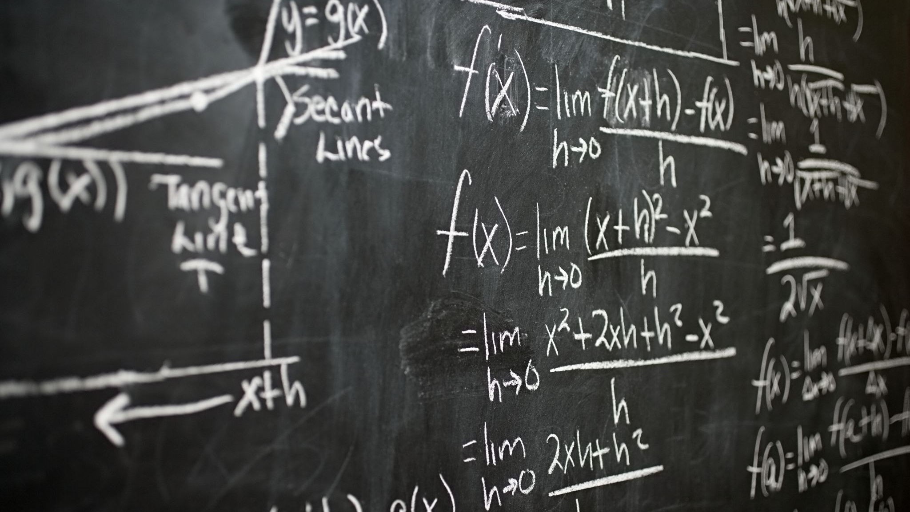
Differential Equations!!!

Slide 3
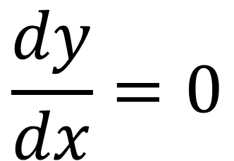
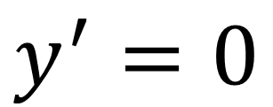
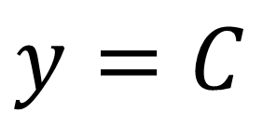
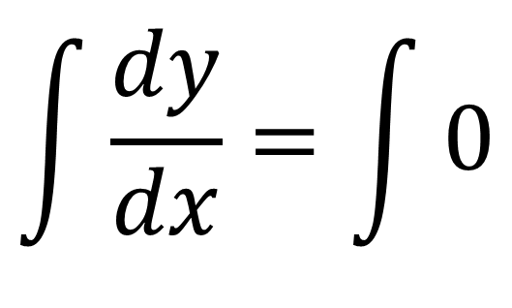
Simple ODE’s
Solve for y!
$$\int{\frac{dy}{dx}}=\int{0}$$
$$y^{′}=0$$
Integrate!
$$\frac{dy}{dx}=0$$
$$y=C$$

Slide 4
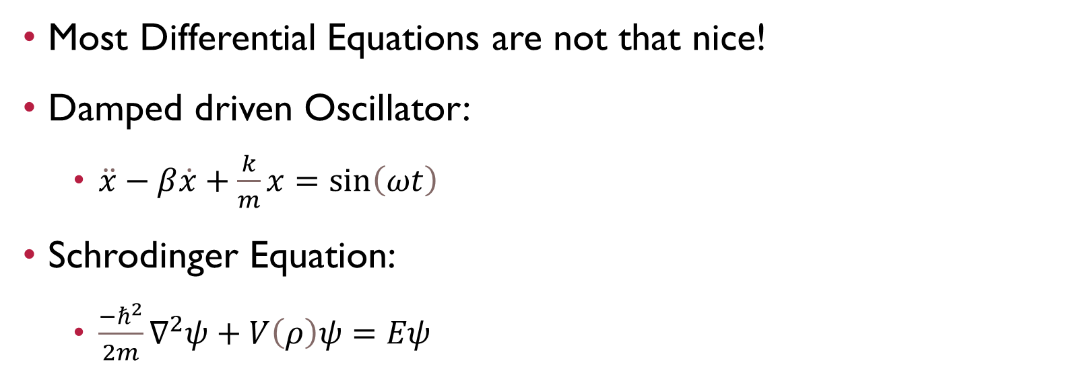
But!
Most Differential Equations are not that nice!
Damped driven Oscillator:
$\ddot{x}−β\dot{x}+\frac{k}{m}x=\sin\left(ωt\right)$
Schrodinger Equation:
$\frac{−ℏ^{2}}{2m}∇^{2}ψ+V\left(ρ\right)ψ=Eψ$

Slide 5
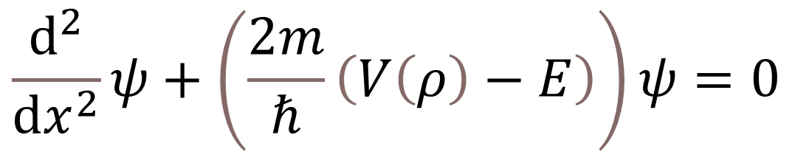
Schrodinger’s Equation
With a bit of algebra it becomes…
$$\frac{ⅆ^{2}}{ⅆx^{2}}ψ+\left(\frac{2m}{ℏ}\left(V\left(ρ\right)−E\right)\right)ψ=0$$

Slide 6
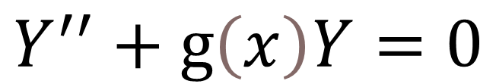
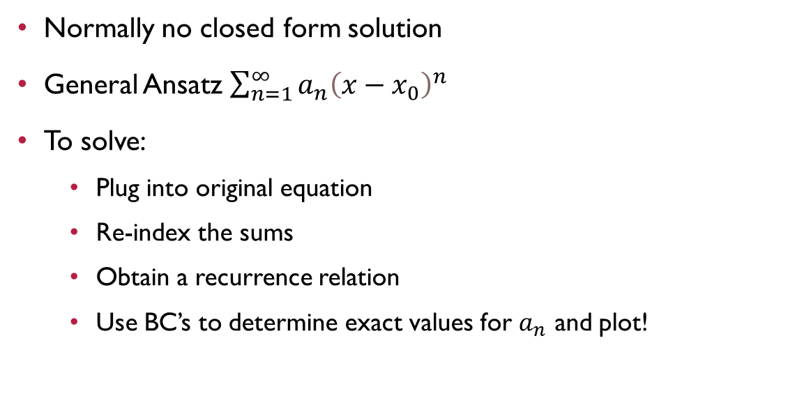
In General
$$Y^{′′}+g\left(x\right)Y=0$$
Normally no closed form solution
General Ansatz $\sum_{n=1}^{∞}{a_{n}{\left(x−x_{0}\right)}^{n}}$
To solve:
Plug into original equation
Re-index the sums
Obtain a recurrence relation
Use BC’s to determine exact values for $a_{n}$ and plot!

Slide 7

Numerical Methods
Numerov’s Method Solves the following:
$$Y^{′′}+g\left(x\right)Y=s\left(x\right)$$

Slide 8
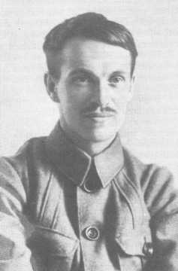
Boris Numerov
Russian Astronomer
Born 1891
Arrested as German Spy in 1936
Died 1941 (age 50)
Boris Numerov - Wikipedia

Slide 9
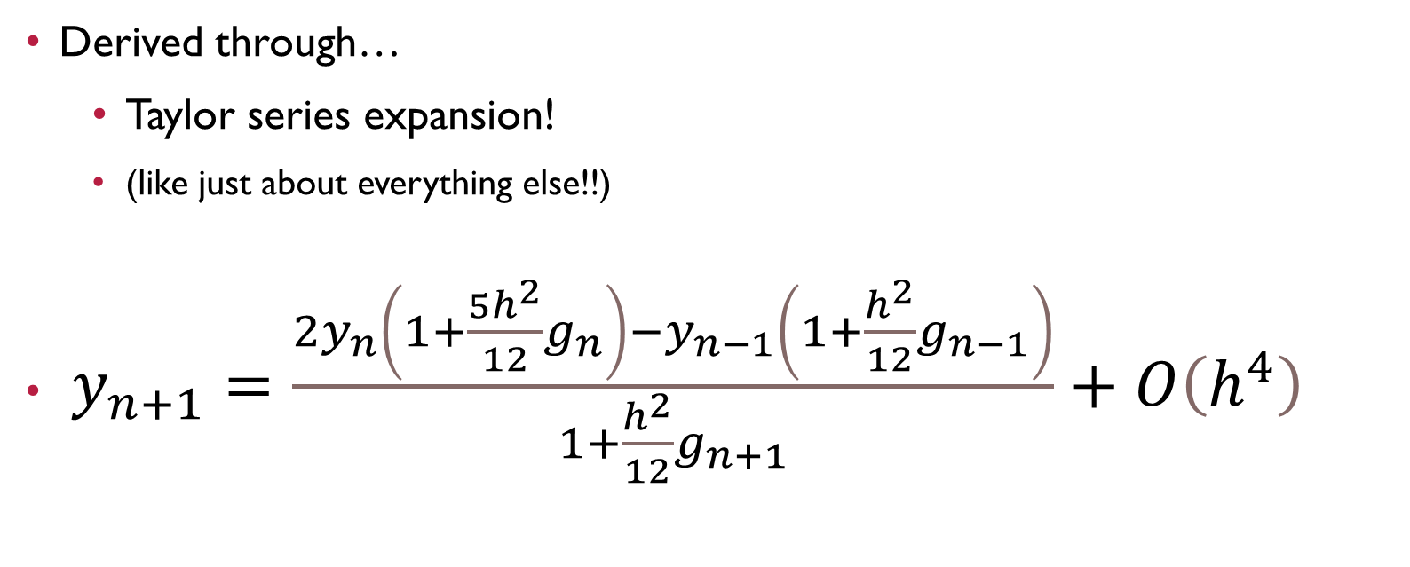
Numerov’s Method
Derived through…
Taylor series expansion!
(like just about everything else!!)
$y_{n+1}=\frac{2y_{n}\left(1+\frac{5h^{2}}{12}g_{n}\right)−y_{n−1}\left(1+\frac{h^{2}}{12}g_{n−1}\right)}{1+\frac{h^{2}}{12}g_{n+1}}+O\left(h^{4}\right)$
Numerov's method - Wikipedia

Slide 10

Numerov’s Method
What do you need to implement?
$y_{n−1}$ = number
$y_{n}$ = number

Slide 11
Numerov’s Method
Better convergence than:
Euler Forward and Backward (order 1)
Crank-Nicolson (order 2)
Numerov Convergence (order 4)

Slide 12

Sanity Check
Suppose g(x) = 0
$Y^{′′}+0(Y)=0$

Slide 13
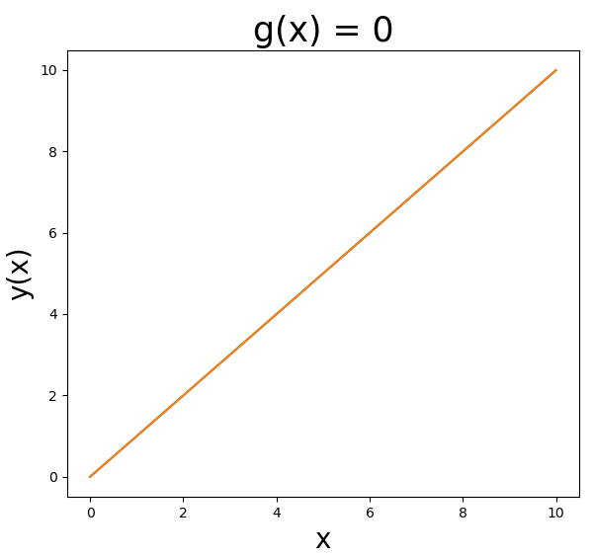
Sanity Check
Suppose g(x) = 0
$Y^{′′}+0(Y)=0$

Slide 14

Sanity Check
Suppose g(x) = -1
$Y^{′′}−Y=0$

Slide 15
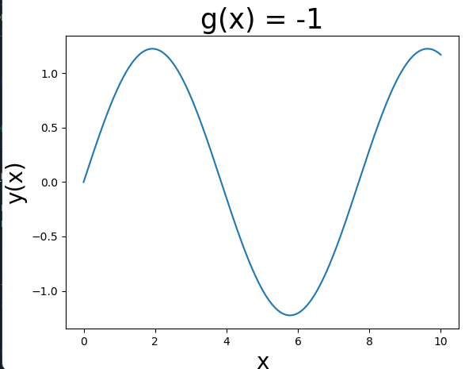
Sanity Check
Suppose g(x) = -1
$Y^{′′}−Y=0$

Slide 16
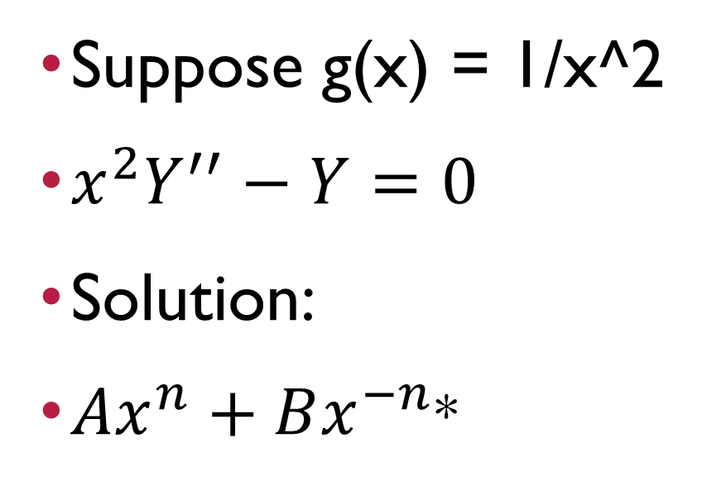
Sanity Check
Suppose g(x) = 1/x^2
${x^{2}Y}^{′′}−Y=0$
Solution:
$Ax^{n}+Bx^{−n}$*
*Nota bene: the BC’s I chose caused B = 0

Slide 17
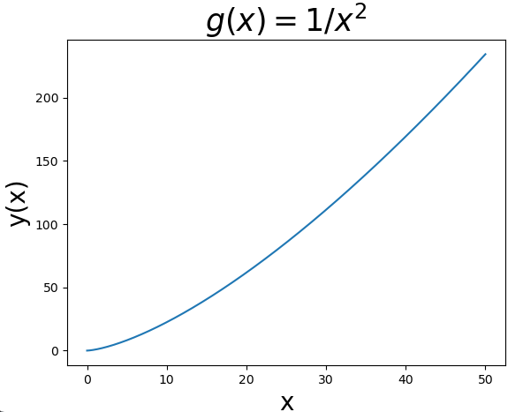
Sanity Check
Suppose g(x) = 1/x^2
${x^{2}Y}^{′′}−Y=0$
Solution:
$Ax^{n}+Bx^{−n}$*
*Nota bene: the BC’s I chose caused B = 0

Slide 18
Summary
Quickly solves ODE’s that are laborious to solve by hand
Error related to h^4
Crank-Nicolson error related to h^2
So it’s quite accurate!
Can be unstable…

Slide 19
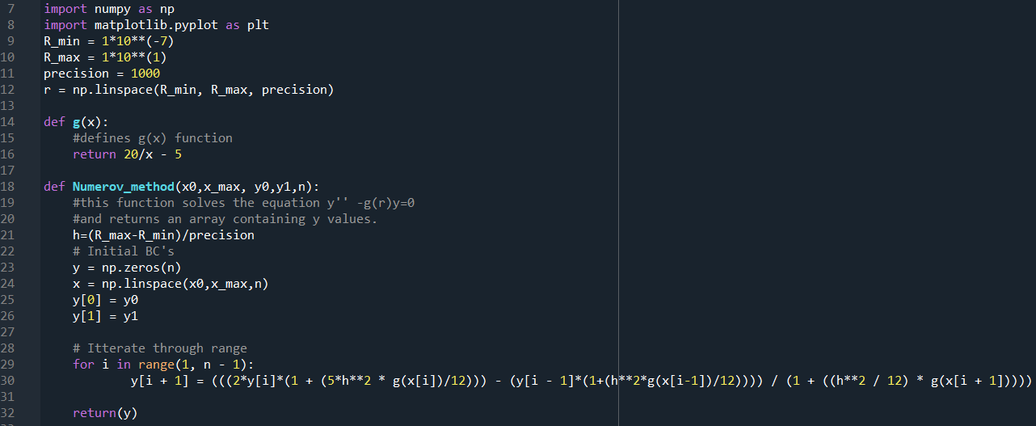
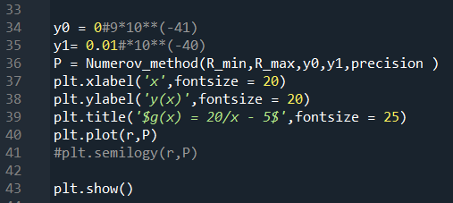
Code:

Slide 20
Questions?

Slide 21
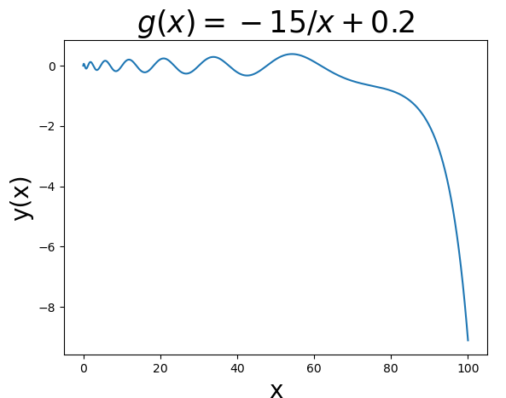

Schrodinger Equation

Slide 22
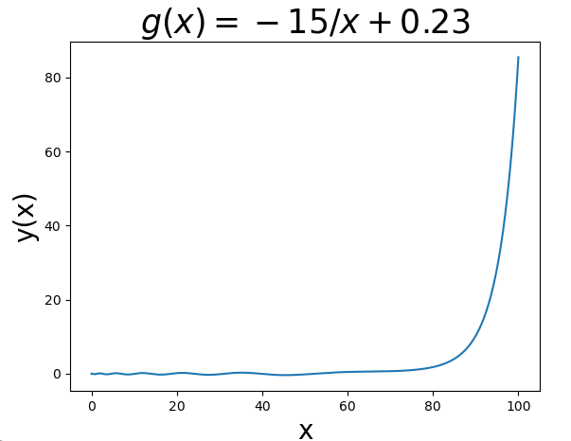

Schrodinger Equation

