Slide 1
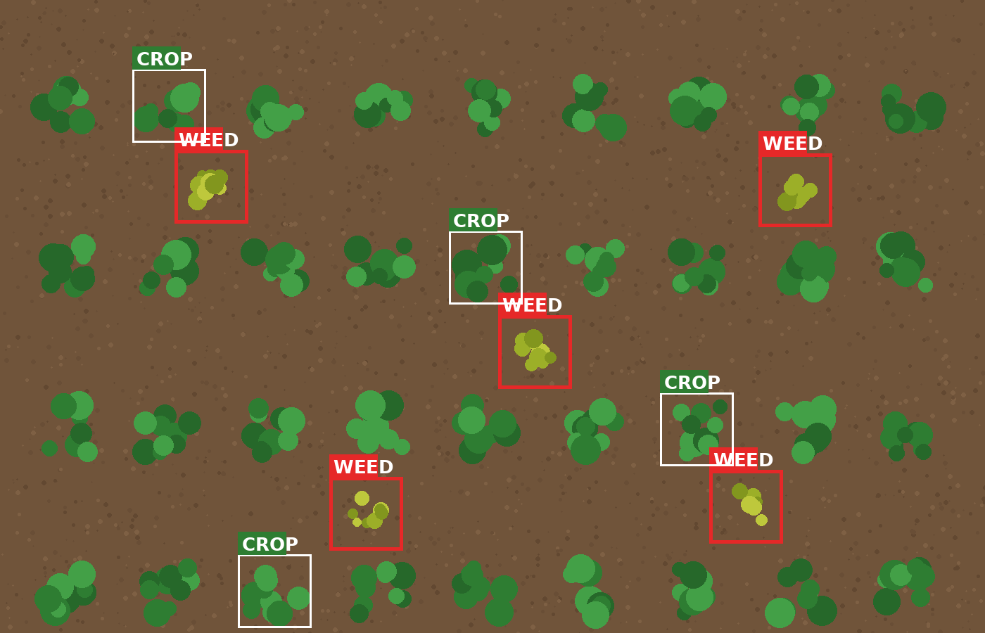
Machine Learning in the Field
John Deere See & Spray
Finding weeds with cameras and ML, and spraying only them
Industry: Agriculture & Precision Farming

Slide 2
The problem before See & Spray
Whole-field spraying
Waste and cost
Herbicide was often applied everywhere, though weeds grow only in patches.
Spraying weed-free ground wastes chemicals and raises input costs.
Impossible by hand
Uneven weeds
No farmer can find and treat every weed across a large field.
Weed density changes across the field, so one uniform dose is imprecise.

Slide 3
How Machine Learning solves it
1
2
3
4
Cameras see the plants
ML tells crop from weed
System locates the weed
Correct nozzle sprays it
Crop identified: the plant is skipped.
Weed identified: its position is worked out and the nozzle opens as the machine reaches it.
Many cameras work together, and a weed is detected before the nozzle fires, so no camera needs to sit directly above it.

Slide 4
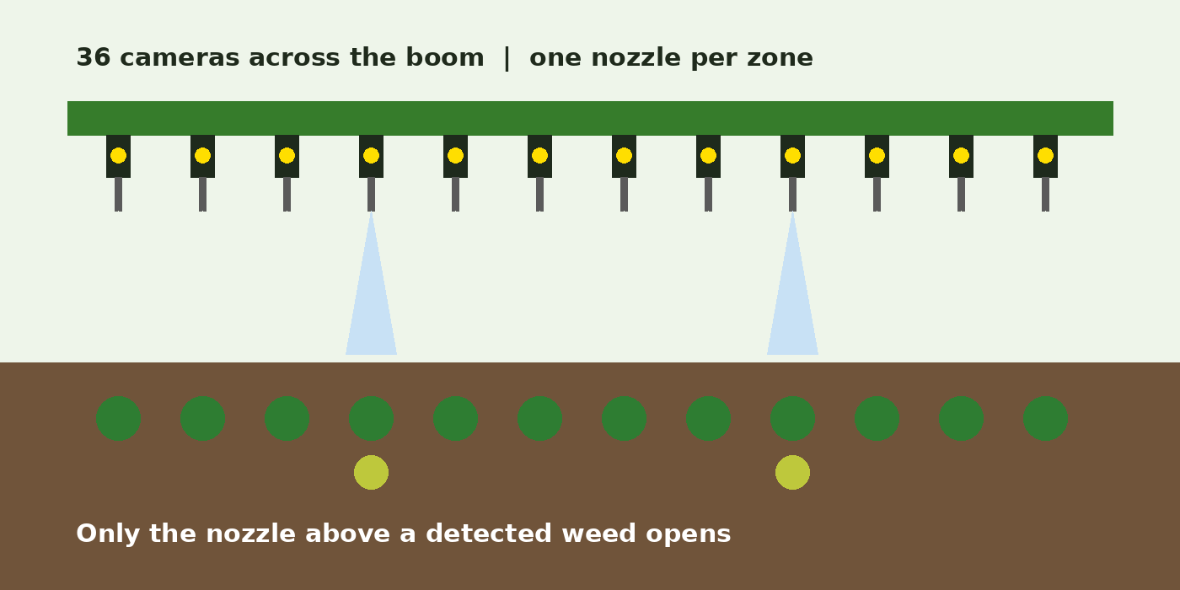
What the system sees
Illustration: See & Spray Ultimate boom with 36 cameras
Each camera feeds the ML model, and each nozzle is controlled individually.
Illustration: crop and weed classification

Slide 5
Benefits
Less chemical waste
2/3+
Herbicide goes only on detected weeds.
Lower input costs
Using less herbicide can cut spending.
less non-residual herbicide with See & Spray Ultimate, per John Deere, depending on crop and field conditions
More precise spraying
Nozzles are controlled one by one.
Automatic processing
Huge amounts of imagery handled while working.

Slide 6
Challenges that remain
Look-alike plants: some crops and weeds look similar, so accuracy is critical.
Field conditions: lighting, dust and changing conditions affect images.
Speed: decisions must be instant because the sprayer keeps moving.
Errors: a weed may be missed, or a crop area sprayed.
Hardware: cameras, computers and nozzles must survive outdoors.

Slide 7
Conclusion
John Deere uses Machine Learning to turn spraying from a field-wide routine into a plant-by-plant decision.
Already deployed, with newer versions still in development.
Sources: John Deere See & Spray pages, Sustainability information, MachineFinder.

