Slide 1
Wiring

Slide 2
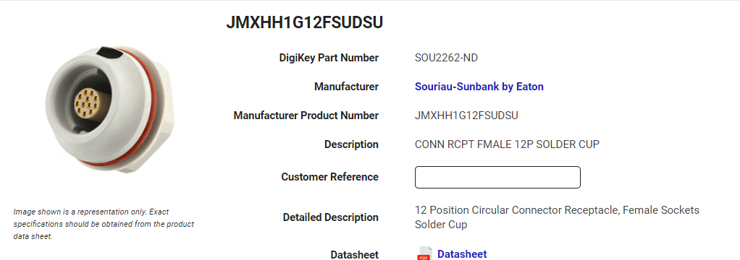
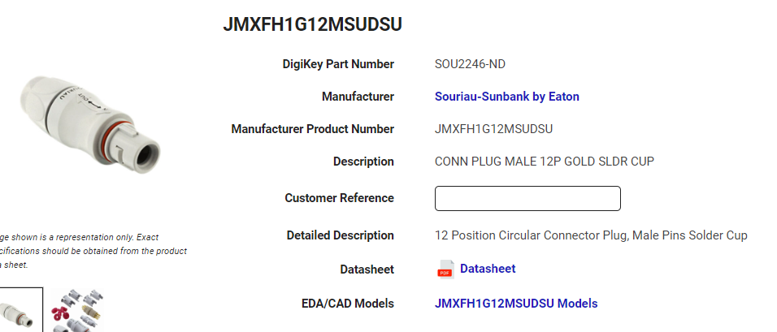
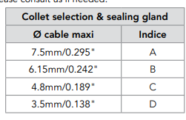
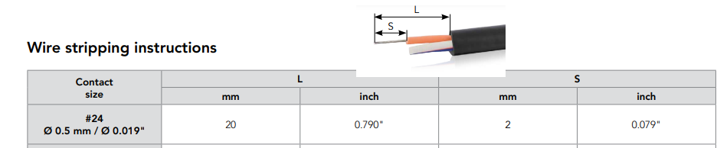
Autoclavable Connection
12 wire pins
28 gauge wire at lowest (so largest size)
Chart below for max cable diameter for the given sealing gland

Slide 3
12 wire cable
Need 12 wire 28gauge cable with max diameter of 7.5mm
https://www.mouser.com/ProductDetail/Alpha-Wire/M1612-SL005?qs=ng8%252BTWoKejlTQNkxlWY9%2FQ%3D%3D
Need 28 AWG RJ45 cables to splice into above cable
https://amz.run/9l8O
Need splice between original 28 gauge cable and ethernet connected one
https://amz.run/9l8R
Need splice between 28AWG electrode and 28 AWG wire
https://amz.run/9l8o
Need electrode 28 AWG
https://amz.run/9l95
Need thin solder for cup terminals
https://amz.run/9lq2

