Slide 1
14-11-24 Lab Meeting

Slide 3
TEER Theory
https://mdanderson03.github.io/Flexi-TEER/dc_theory.html

Slide 4
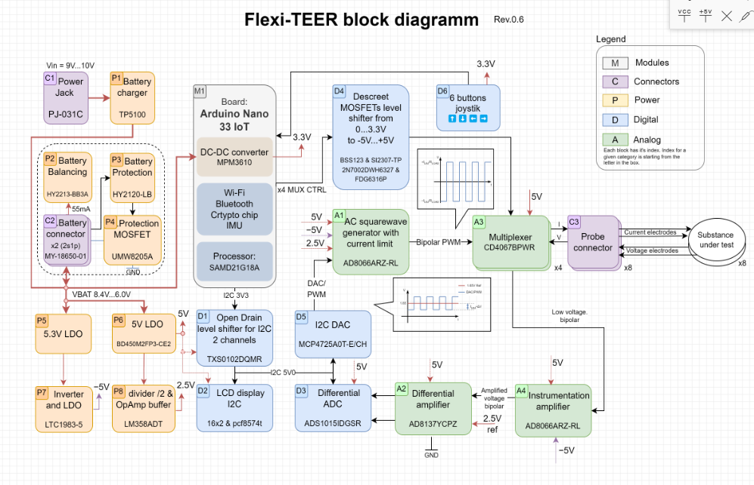
Flexi-TEER

Slide 5
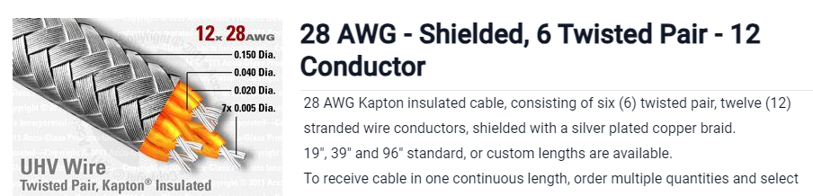
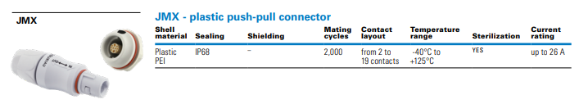
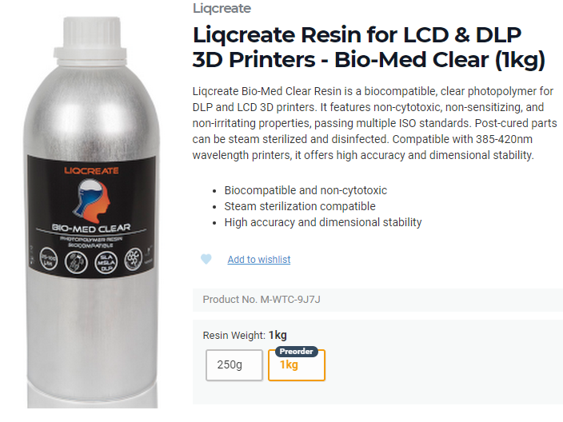
Autoclave
To ease use and sterility, the chambers for transwell inserts should be autoclavable. Autoclaving is very rough on many common materials which include most electrical connectors, most resins and most wire insulators.
Kapton high temp approved insulation, up to 250C
JMX connector, 200 autoclave cycles
Bio-Med Clear, autoclavable resin

Slide 6
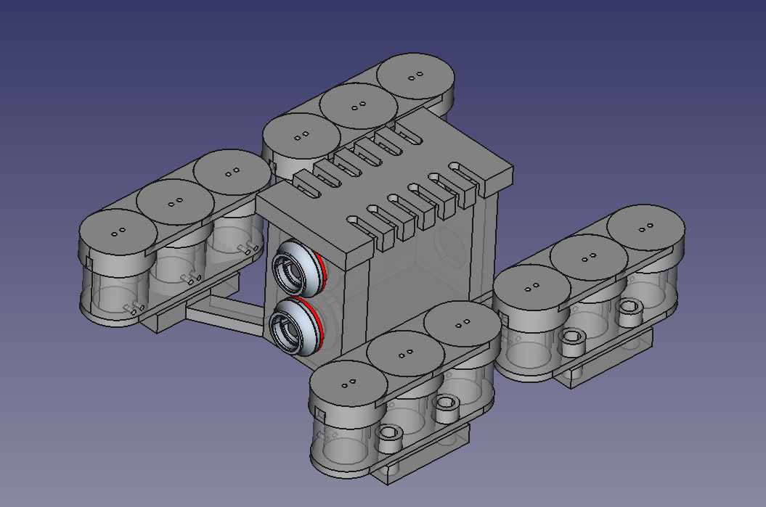
Transwell Platform

Slide 7
Compression

Slide 8
Dark Frame

Slide 10
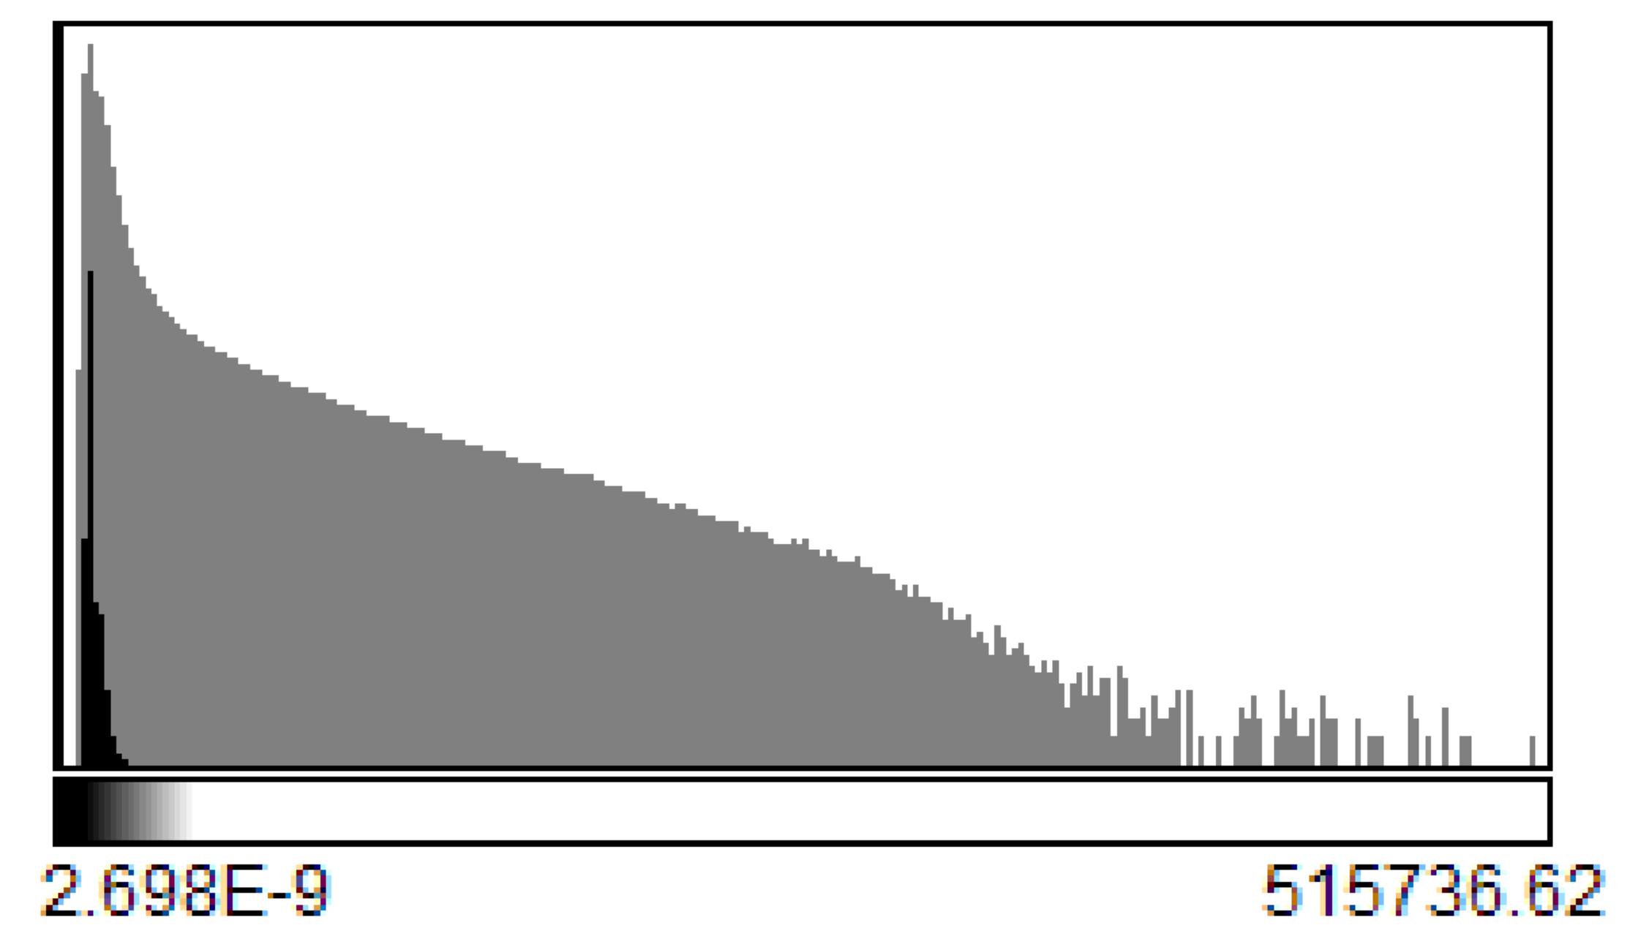
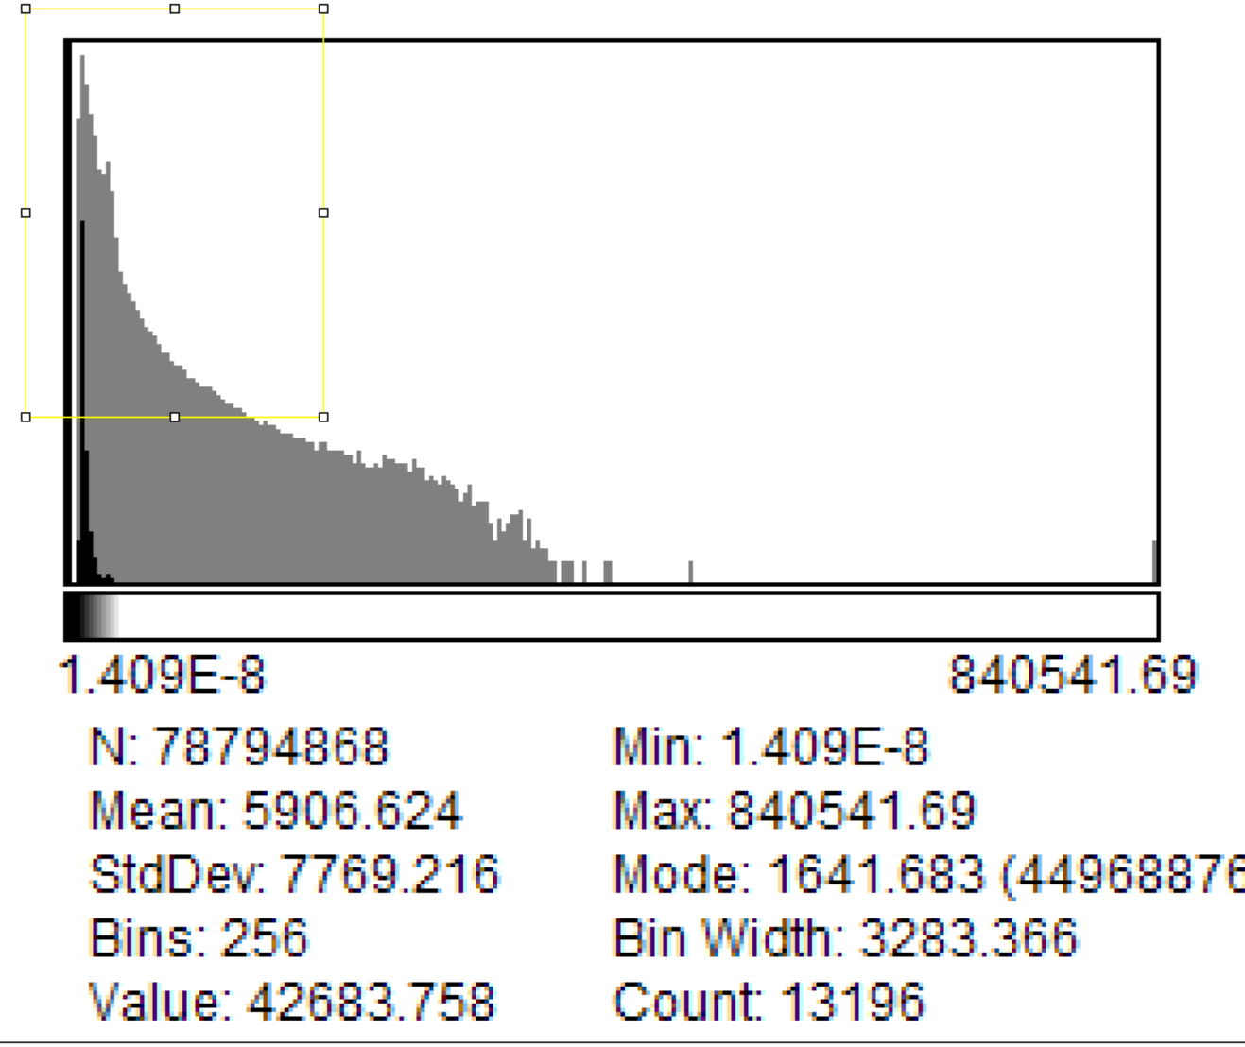
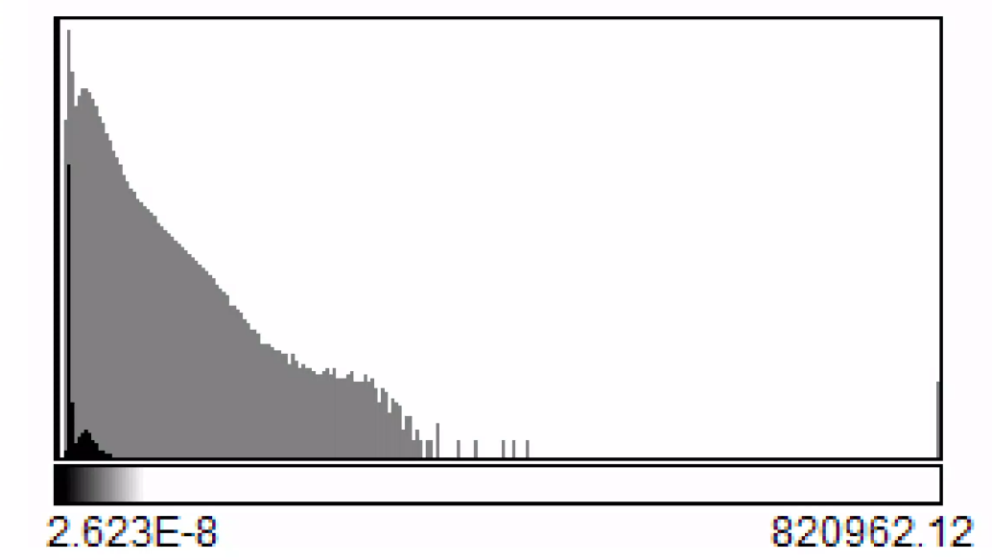
A488 cy6
A488 cy5
A488 cy2

Slide 11
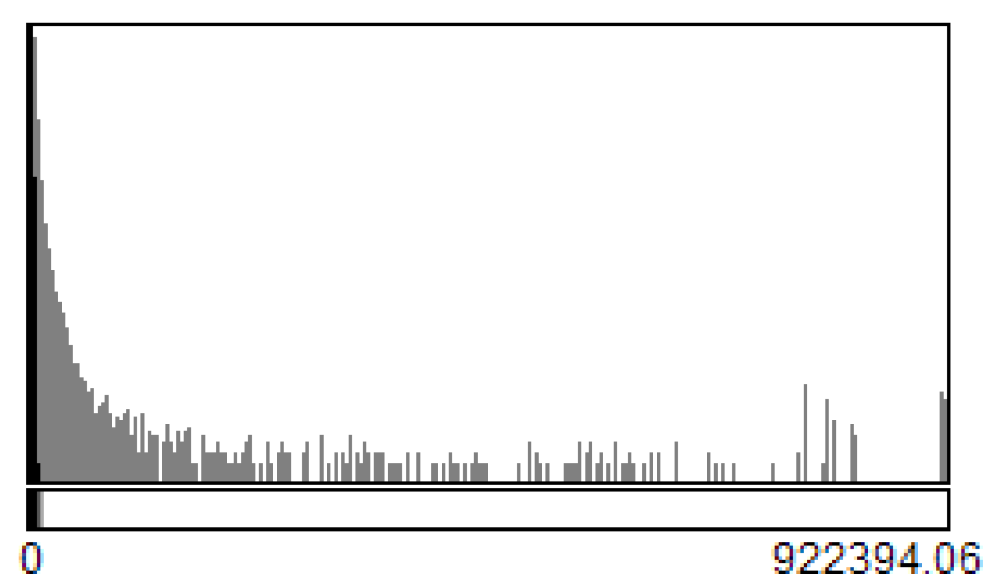
A555 cy1

Slide 12
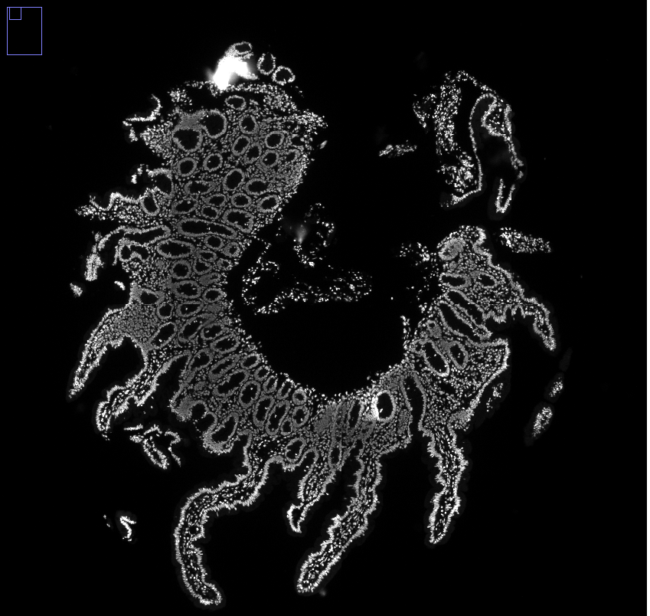
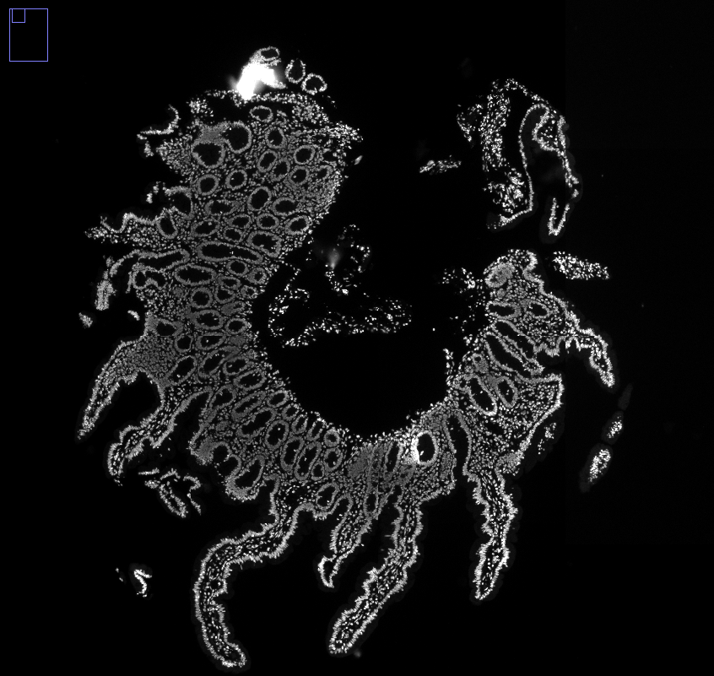

Slide 13
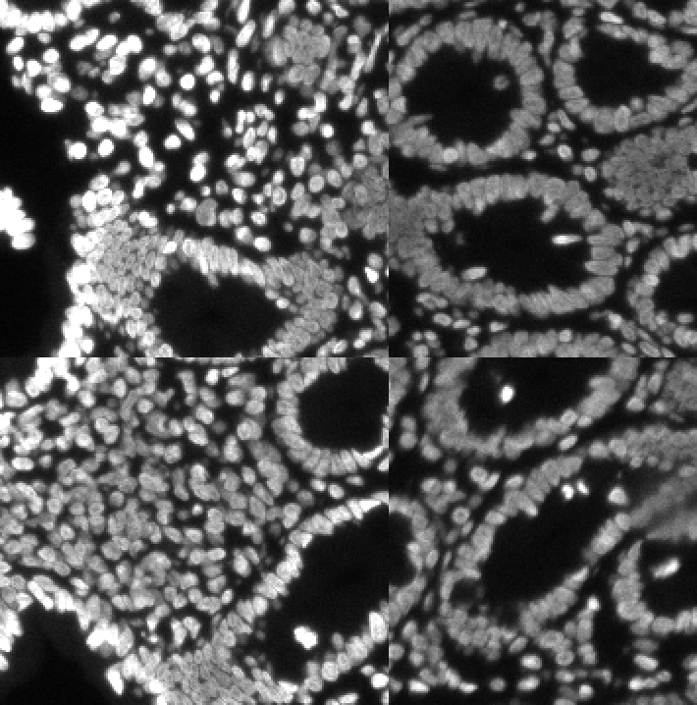
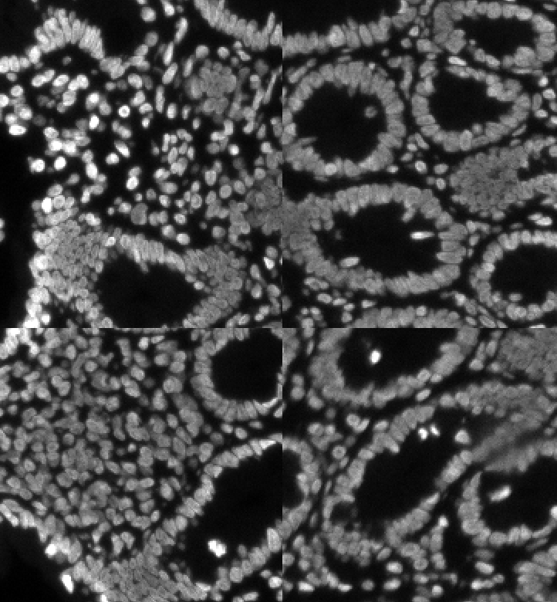
Before
After

Slide 14
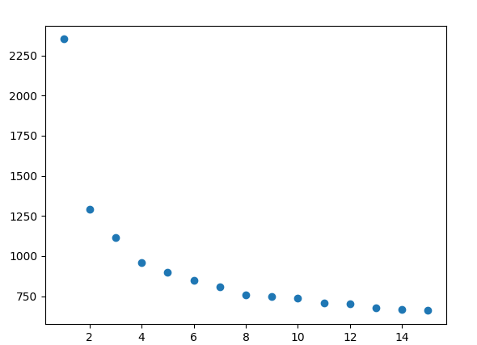

Slide 15
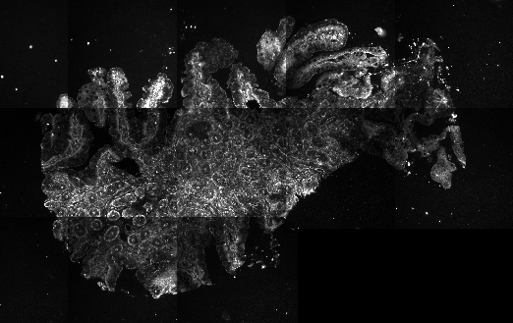
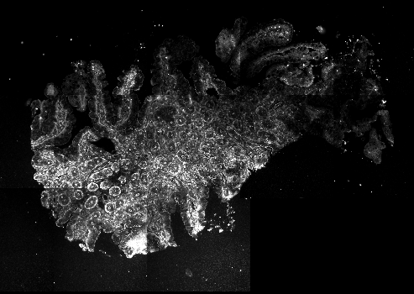
Before w/o basic
Before, w/ basic
After, w/o basic
After, w basic

