Slide 1
Cluster labeling and Isolation

Slide 2
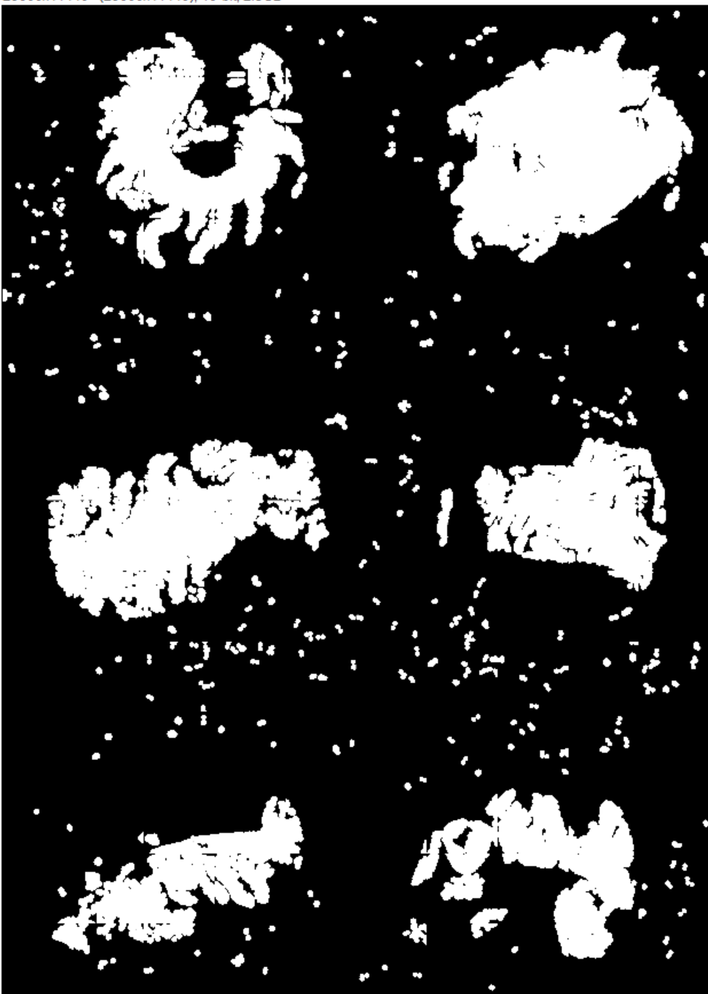

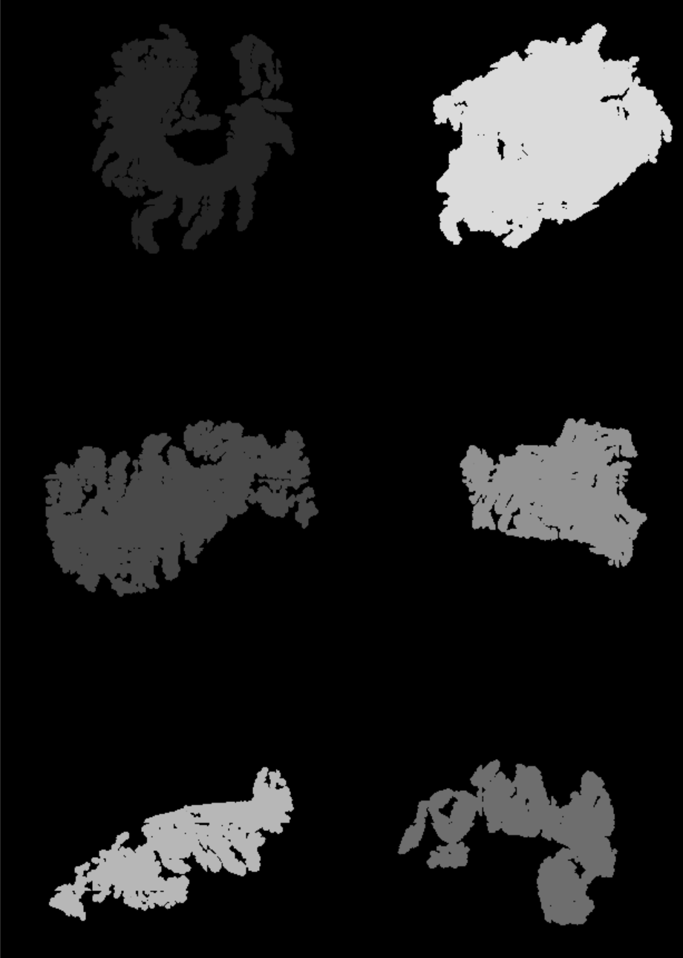
Cluster Filtering
Wastes time and storage space to image areas with no tissue.
Segmenting nuclei and dilating creates a binary map of tissue
It also will sporadically create non tissue based clusters which need filtered out
Approach: take X seed clusters and any cluster greater than 10% of the area of the smallest cluster
Unfiltered
Filtered
Filtered + Labelled

Slide 3
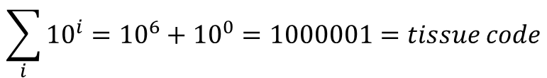
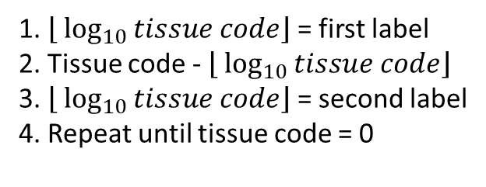
Encoding For Cluster Label
Encode
$$\sum_{i}{{10}^{i}}={10}^{6}+{10}^{0}=1000001=tissue code$$
Decode
1. $\left\lfloor \log_{10}{tissue code}\right\rfloor$ = first label
2. Tissue code - $\left\lfloor \log_{10}{tissue code}\right\rfloor$
3. $\left\lfloor \log_{10}{tissue code}\right\rfloor$ = second label
4. Repeat until tissue code = 0
Encoding what labels occur in a tile enables each and every TMA to be sequestered into separate tiff stacks in a memory efficient manner.
Stored in top layer of fm_array

