Slide 1












Slide 2

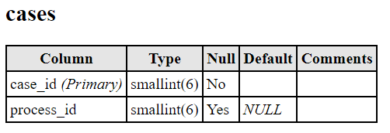
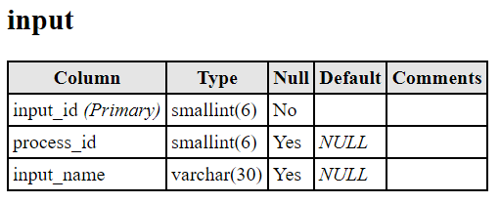
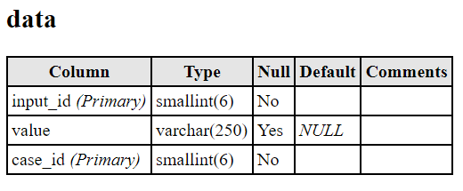



Slide 3
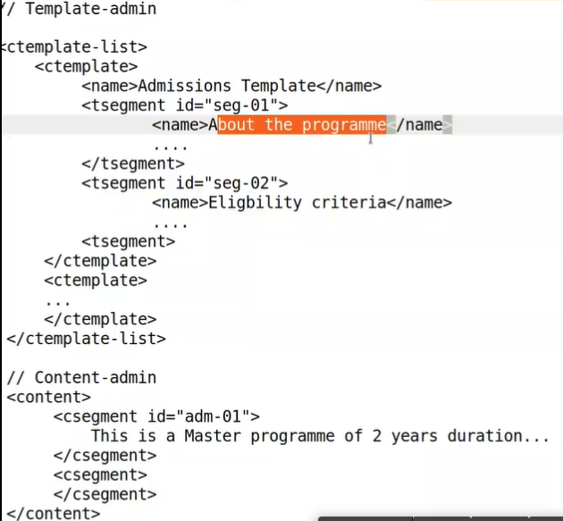

Slide 4















Slide 5










Slide 6


















Slide 7
javascript - Adding input elements dynamically to form - Stack Overflow

