Slide 1
CSCI 210 MIPS 01
Michael Dandrea

Slide 2
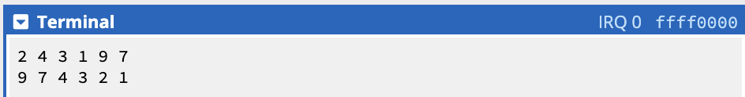

Showing the Program Works
These are screenshots showing the program running for different array values.

Slide 3
How I Made This Work
In for2tst, the original code was checking if $t4 is greater than or equal to $t3 and exiting if it is true. To make it sort in descending order, all I did was make it exit if $t4 is less than or equal $t3.
To get the code to print the array, I made the printArray, printLoop and printExit sections. This loops through the array and prints each index to the terminal like shown in the example program on cpulator.

Slide 4
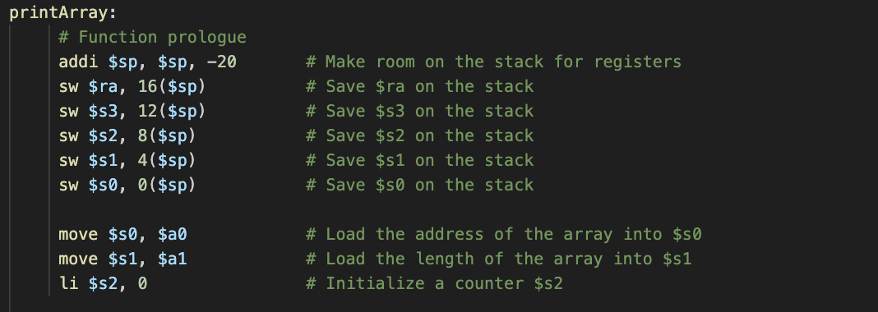
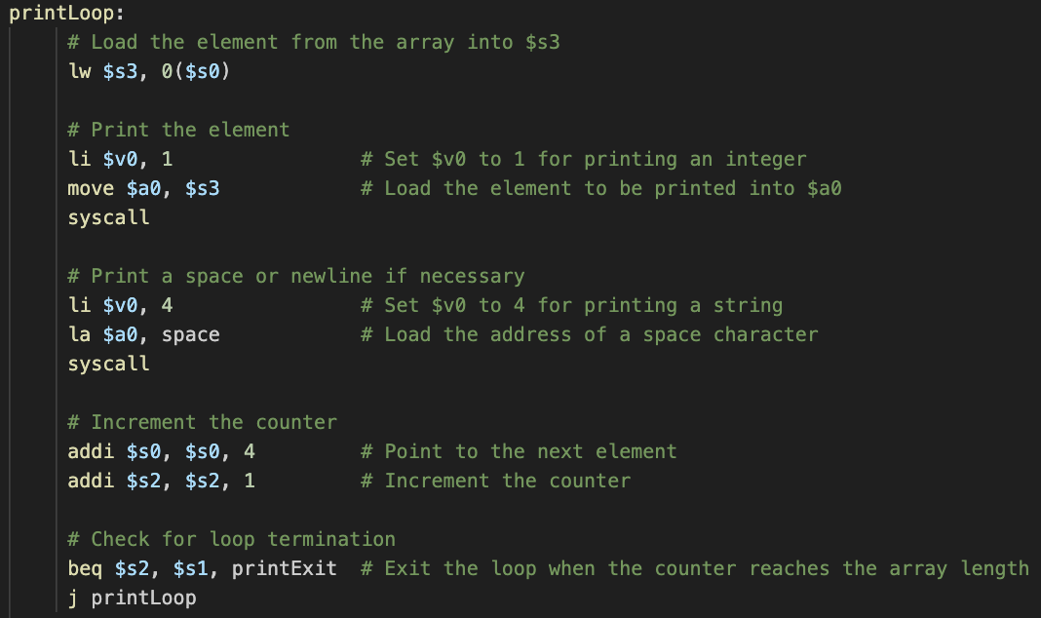
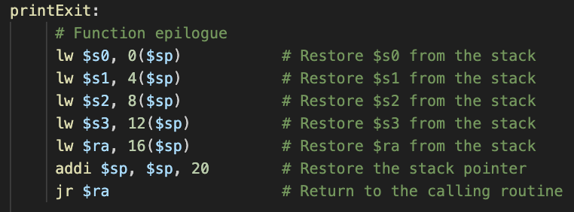
Pictures Of the Print Sections

Slide 5
Memory Before and After
Before
After

