Slide 1

H01 Writeup
Michael Dandrea

Slide 2
Overview of Project
The goal of this project was to create a driver program that uses matrix multiplication to encode a nibble of hex data using Hamming(7, 4) encoding.

Slide 3
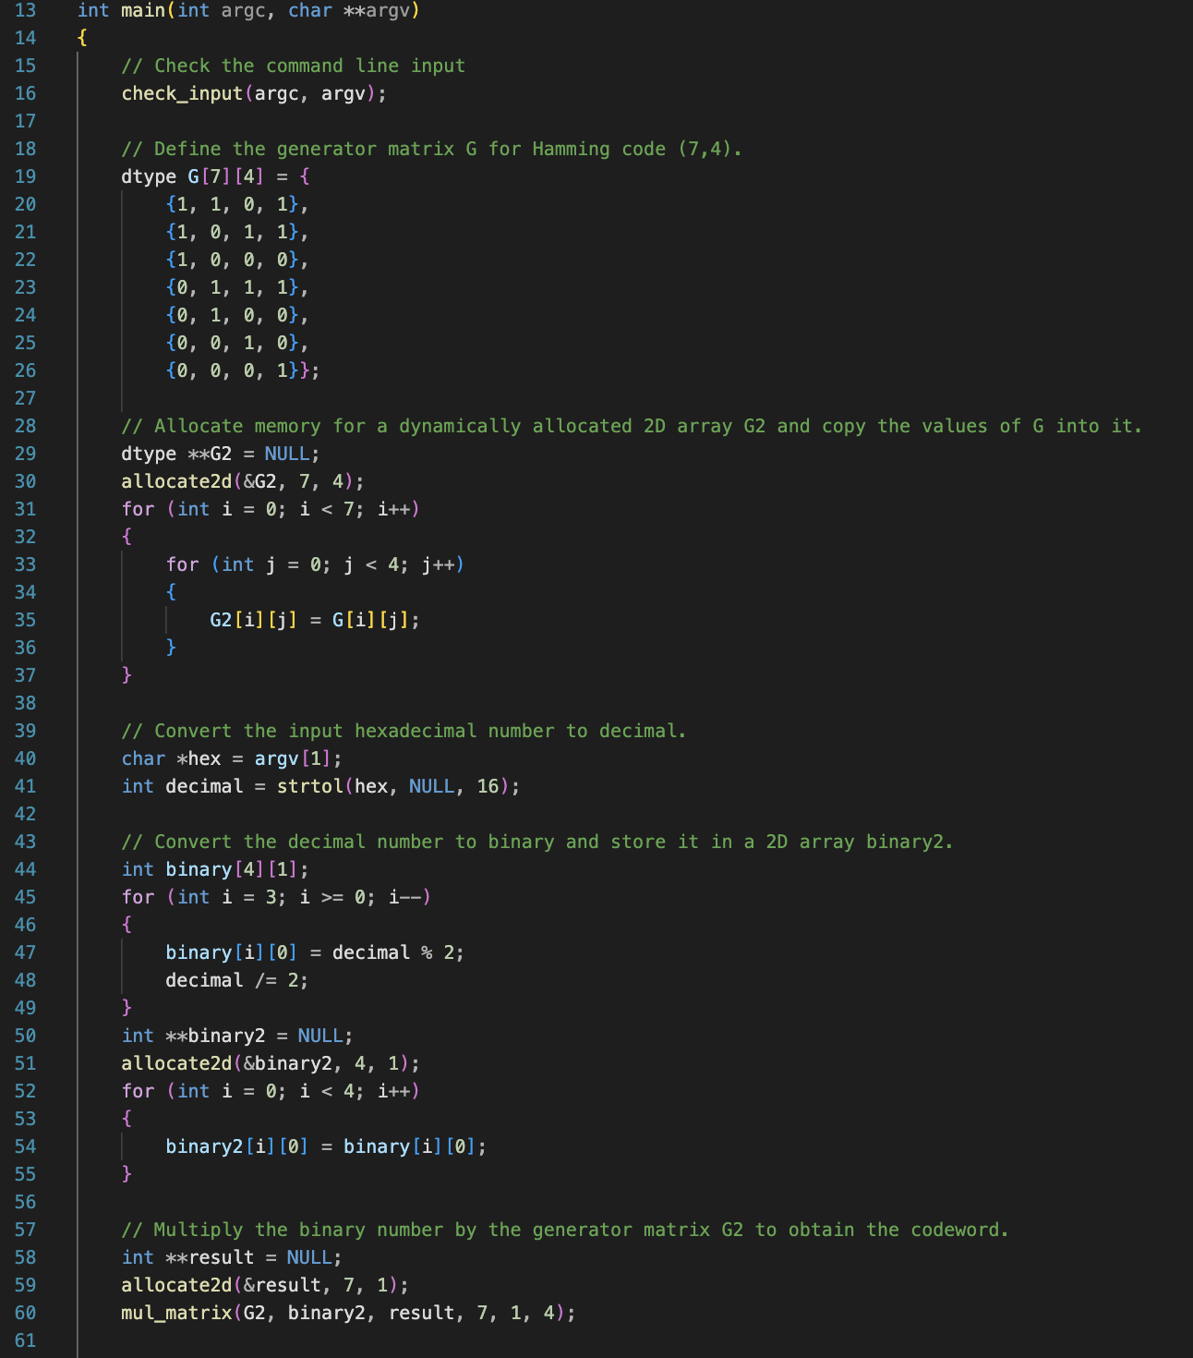
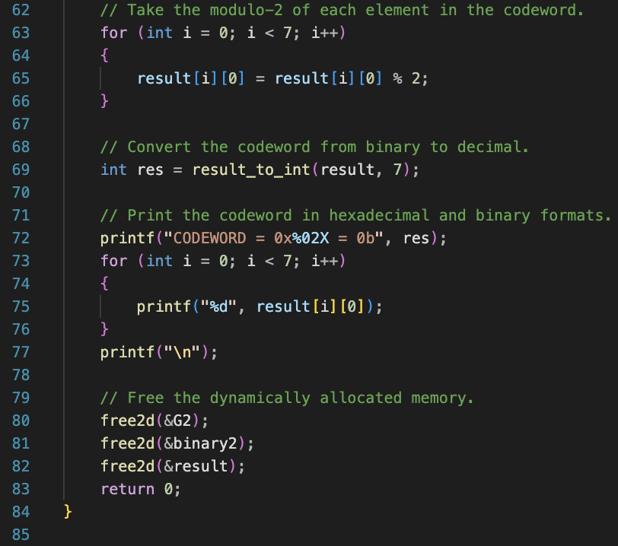
Screenshots of the Program

Slide 4
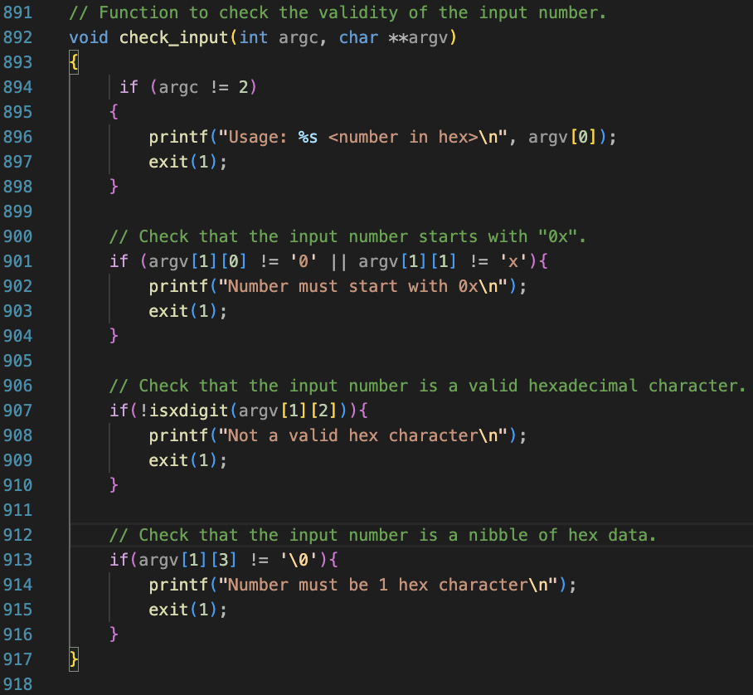
New Error Checking Function

Slide 5
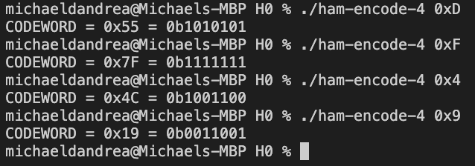
Screenshots of Correct Input and Output

Slide 6
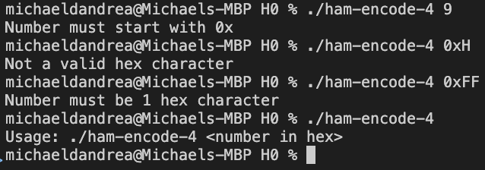
Screenshots of Incorrect Input

Slide 7
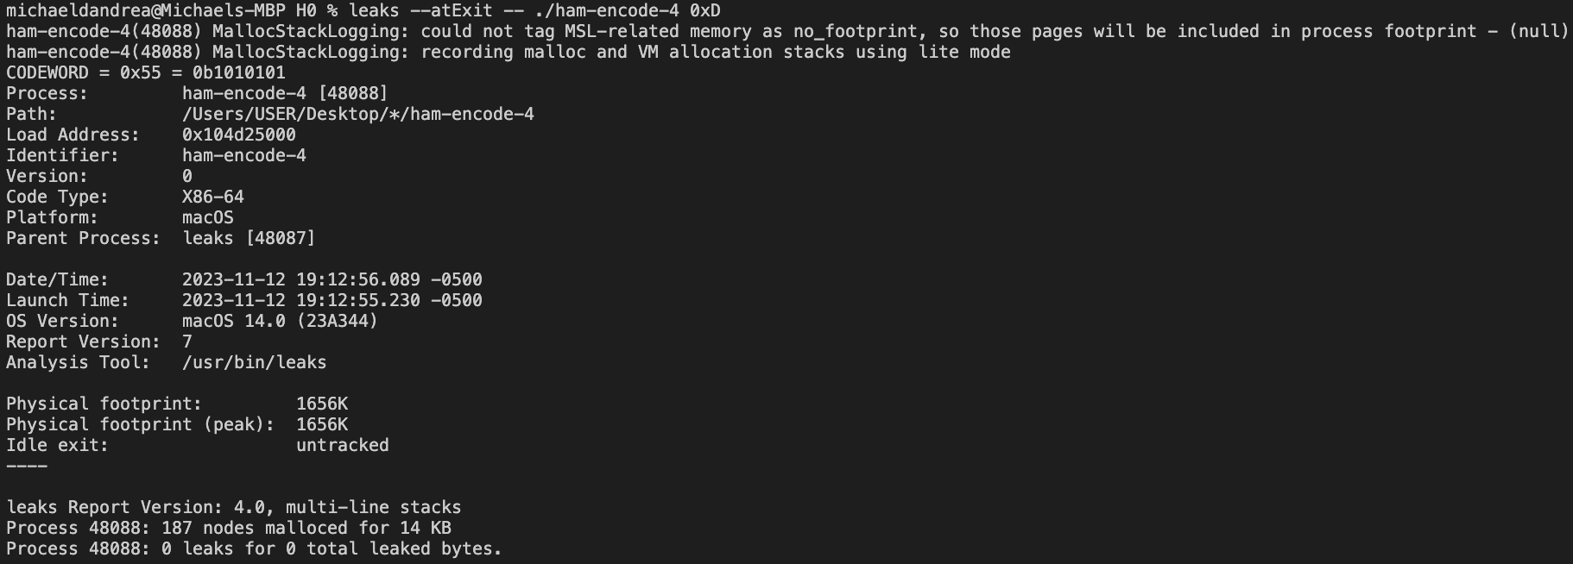
Leaks Output (Valgrind for mac)

Slide 8
Project Review
This project was not too difficult. The hardest part was figuring out how to get the input into binary, then into a single column vector to multiply with the generator matrix.

