Slide 1
HW04 Writeup
Michael Dandrea

Slide 2
Goal Of the Program
The goal of this program was to re-write the print_row_striped_matrix function into a function called write_row_striped_matrix that, instead of printing the matrix to the screen, writes the matrix to a file, specifically using MPI.

Slide 3
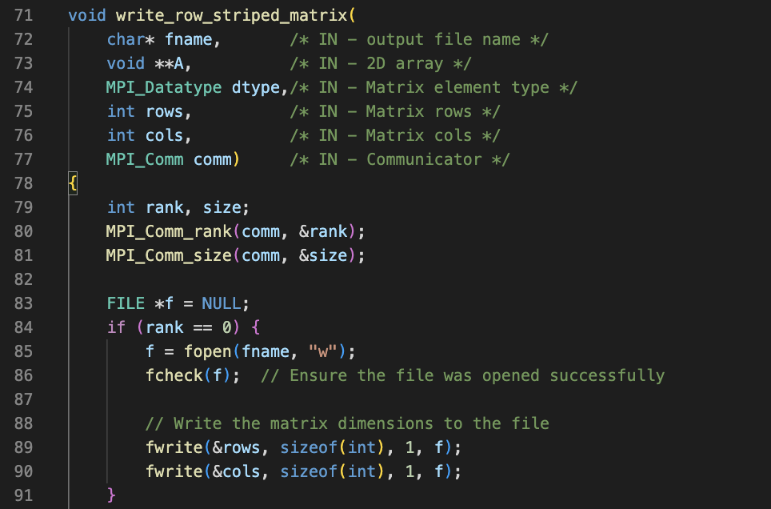
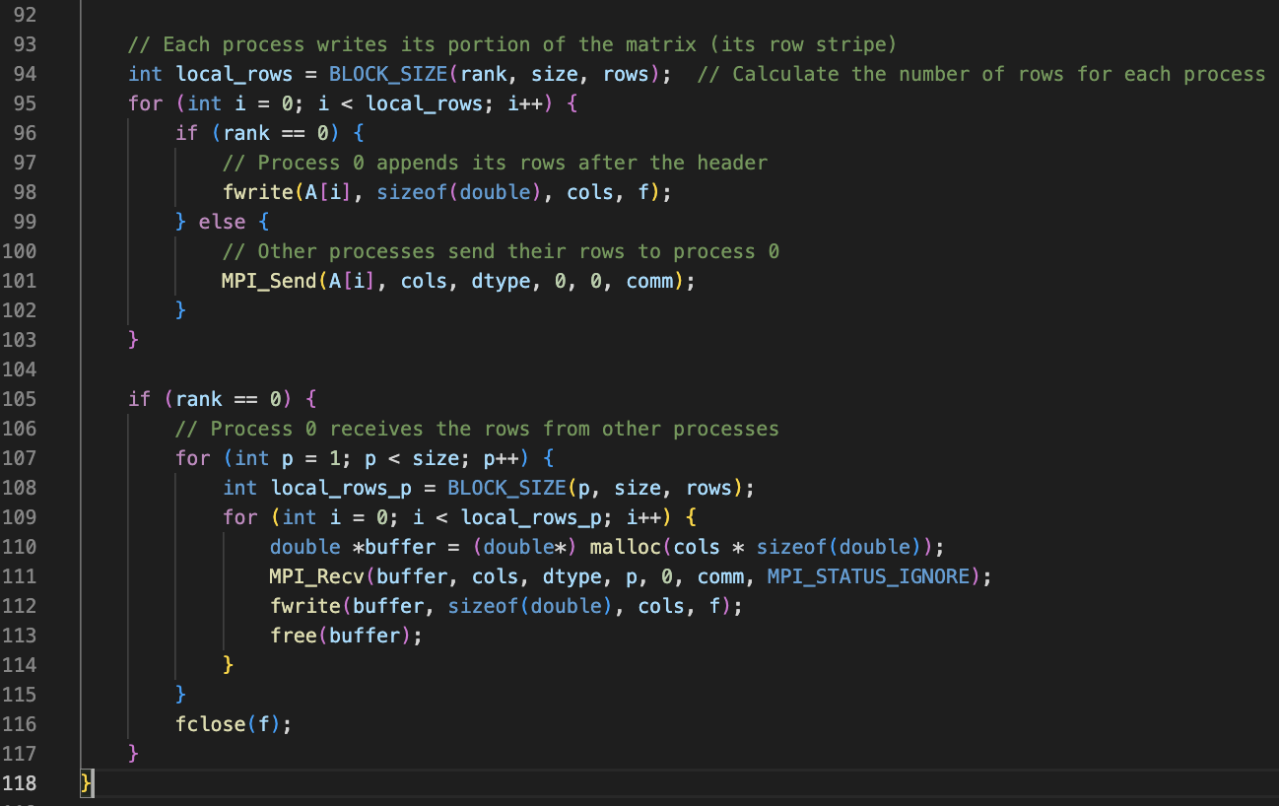
Code For the Function

Slide 4
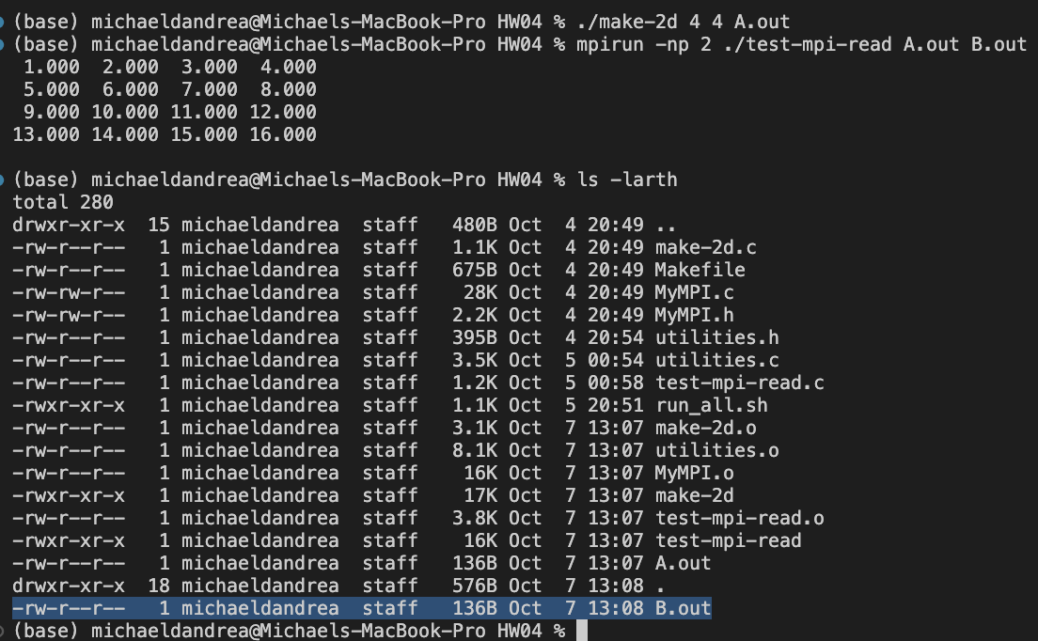
Sample Execution
As we can see, the program made the B.out file, which is highlighted.

Slide 5
Sample Execution (cont.)
Using the diff command on A.out and B.out, we can see that the files are the same.

Slide 6
Additional Tests
I have a script called run_all .sh which will make two files called A.in and B.in which contain a 10x10 and a 100x100 matrix respectively. Then, it runs the program multiple times with a number of processors ranging from 1 to the number of rows in the matrix it is testing, storing it into a file called A.out for the smaller matrix, and B.out for the large matrix. It then diffs the two files and says if the files are the same or not. This can be run using the command ./run_all.sh.

Slide 7
Thoughts
Overall, this was not too challenging. We had a good starting point as we already had a function that printed a matrix to the screen using MPI, and we also had a function that wrote a matrix to a file from the make-2d program from last assignment. All I had to do was figure out how to put those together.

