Slide 1
HW07
Michael Dandrea

Slide 2
Programs
Program to make a matrix was taken from an assignment I did in CSCI207.
I had to make a new program to write a vector, and a new program to print the vector.
This was because of how the provided code was handling reading them from files.

Slide 3
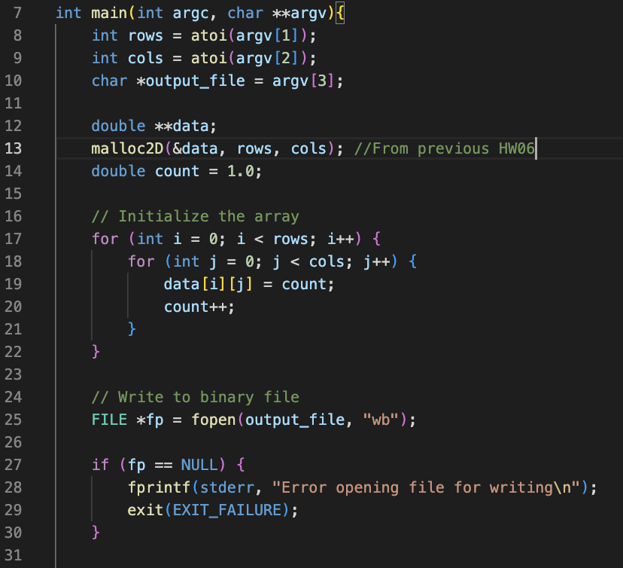
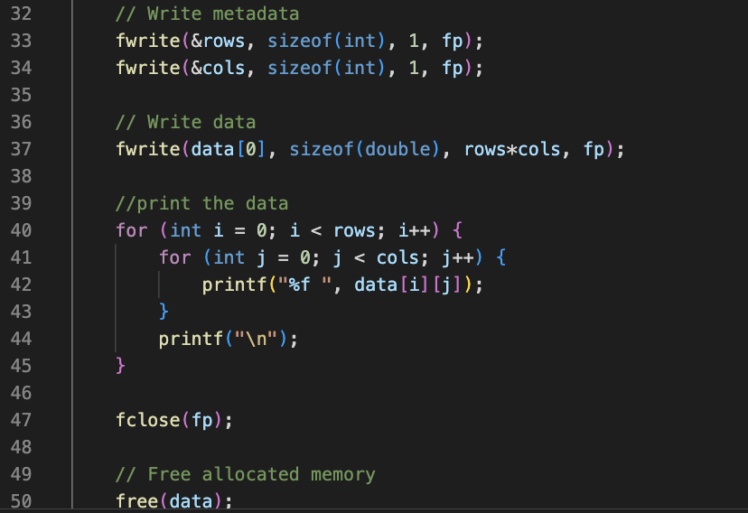
Make-2d

Slide 4
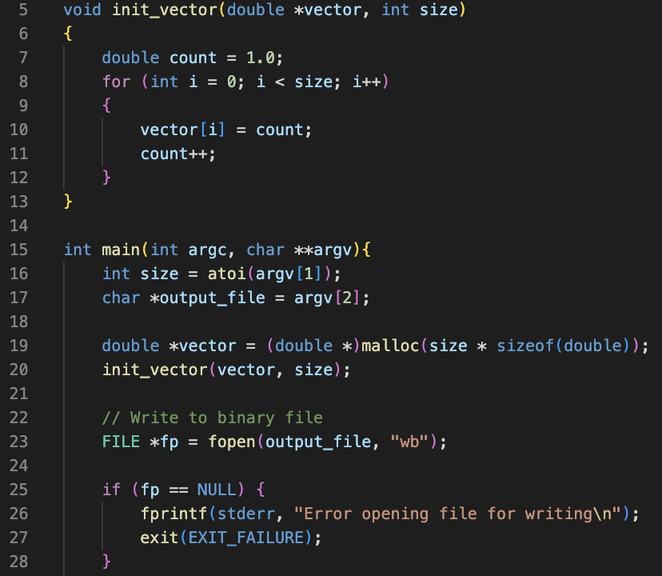
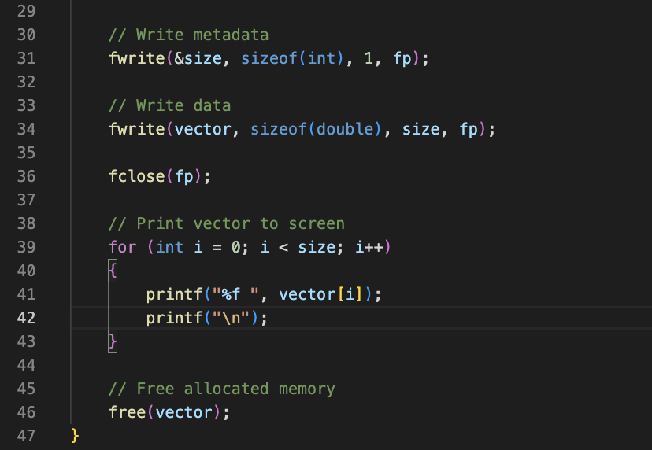
Write-vector

Slide 5
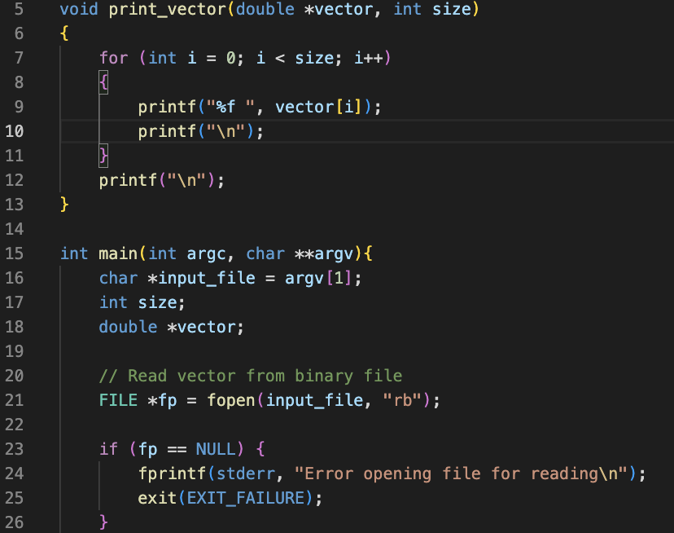
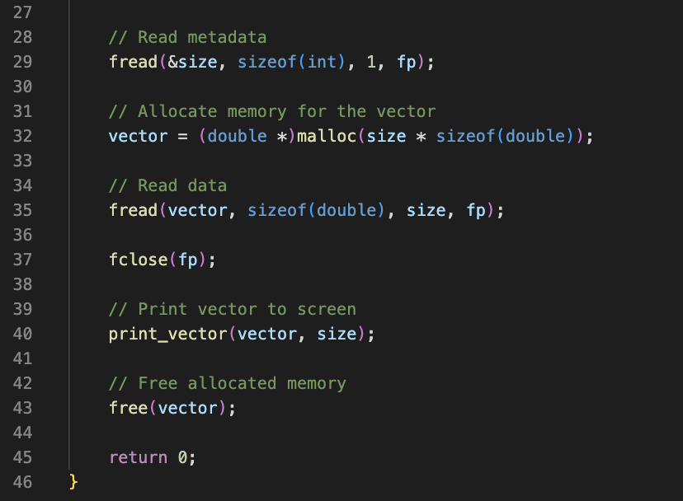
Print-vector

Slide 6
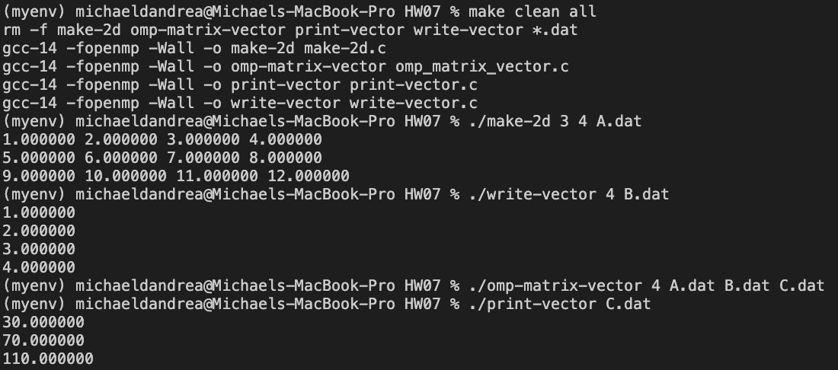
Programs Running

Slide 7
Run_all
A python script is included to run the test shown on the previous slide.

