Slide 1
HW09 Report
By: Michael Dandrea

Slide 2
Function Purpose and Goals
Objective:
- `exchange_row_striped_matrix_halo` is used to exchange halos in row-striped matrices during MPI parallel computation
Halo Concept: - Matrix halos involve additional border rows/columns for parallel processing

Slide 3
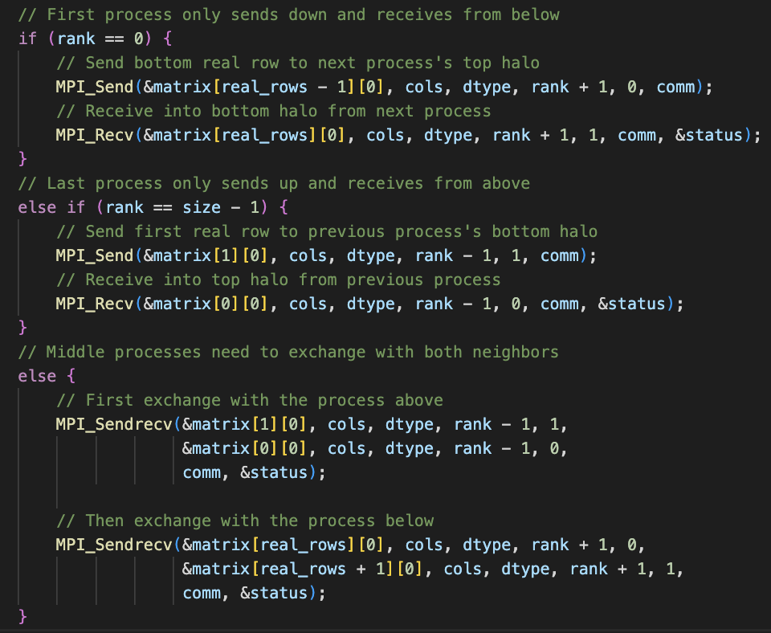
Implementation Code

Slide 4
Testing the Implementation
The shell script ‘run_tests.sh’ tests the program over 5 different matrix sizes and 4 different numbers of processers.

Slide 5
Challenges
Challenge 1: Handling Edge Cases
- Correct behavior when processes have different matrix row counts
Challenge 2: Efficient Communication - Optimizing MPI communication for larger matrices

