Slide 1
MPI00
By: Michael Dandrea

Slide 2
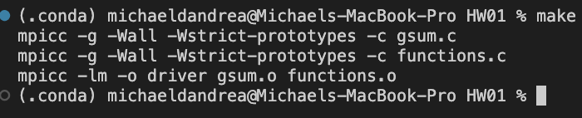
Compilation
Here is a screenshot of my program compiling:

Slide 3
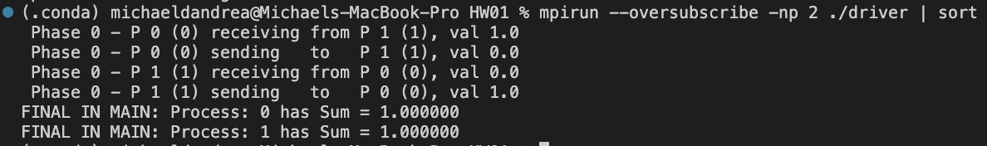
Execution for np = 2

Slide 4
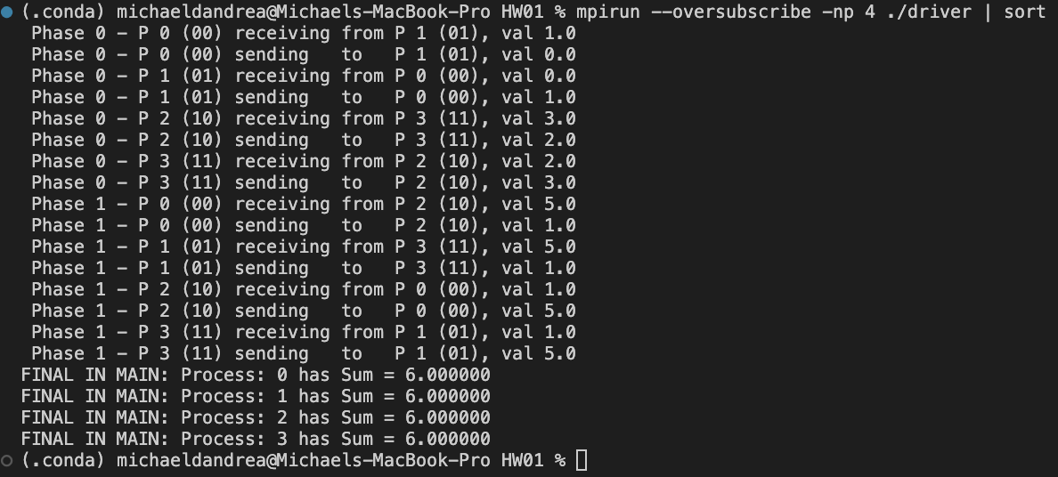
Execution for np = 4

Slide 5
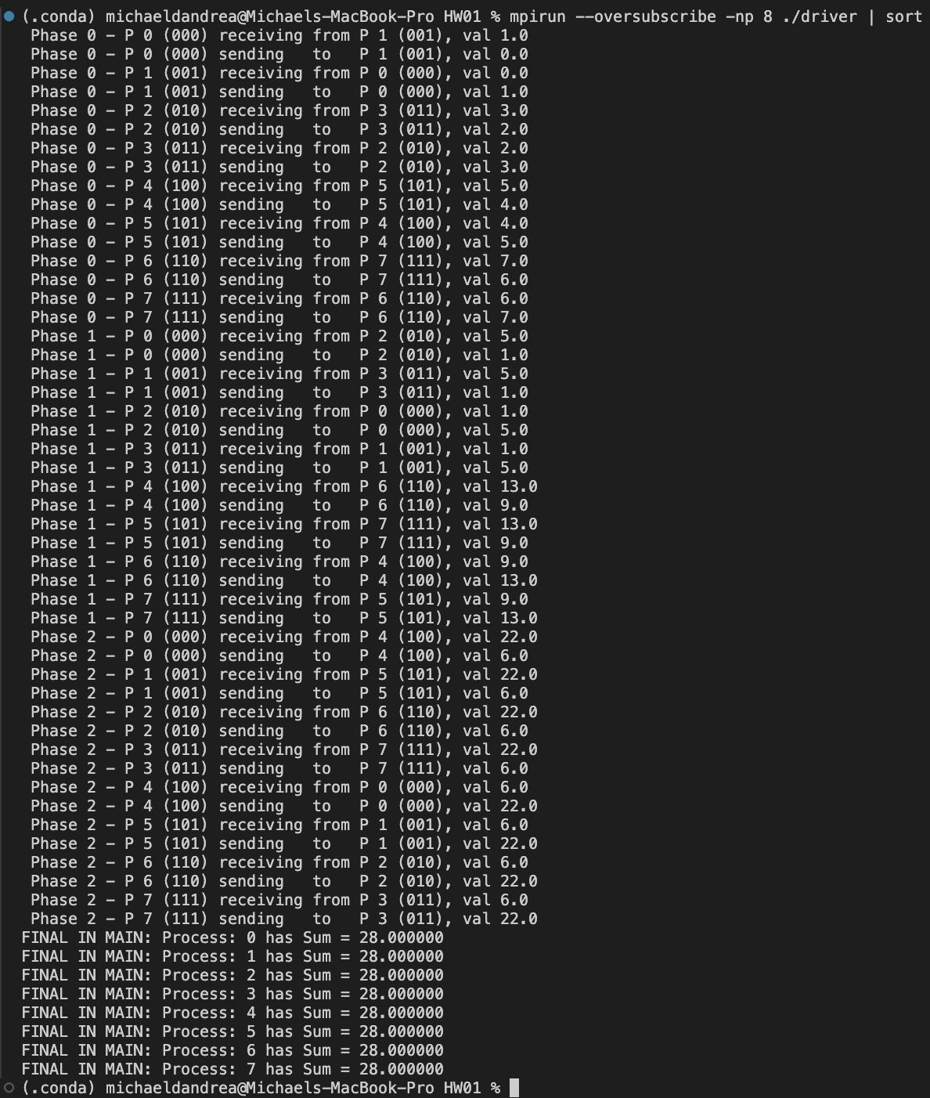
Execution for np = 8

Slide 6
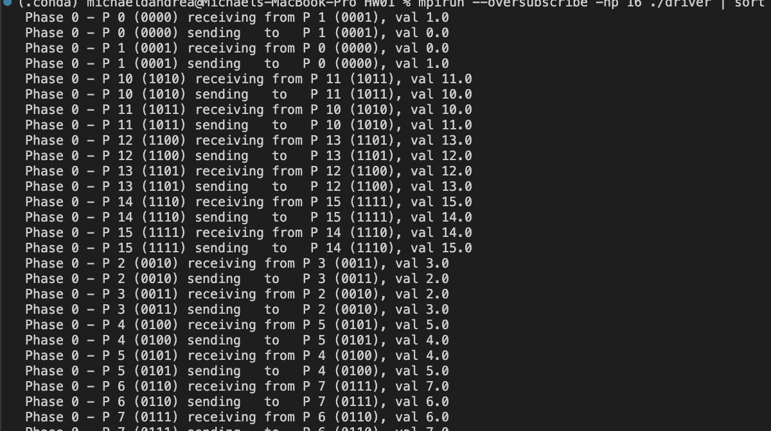
Execution for np = 16
Phase 0:

Slide 7
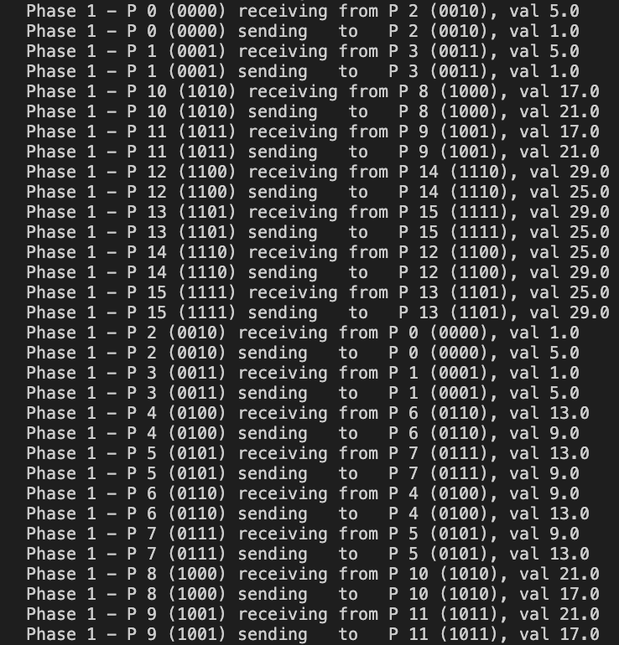
Execution for np = 16
Phase 1:

Slide 8
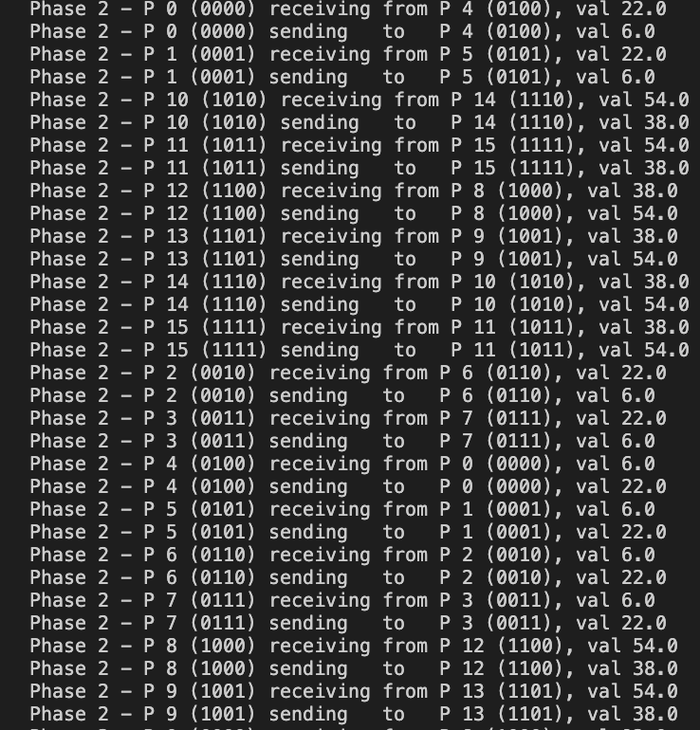
Execution for np = 16
Phase 2:

Slide 9
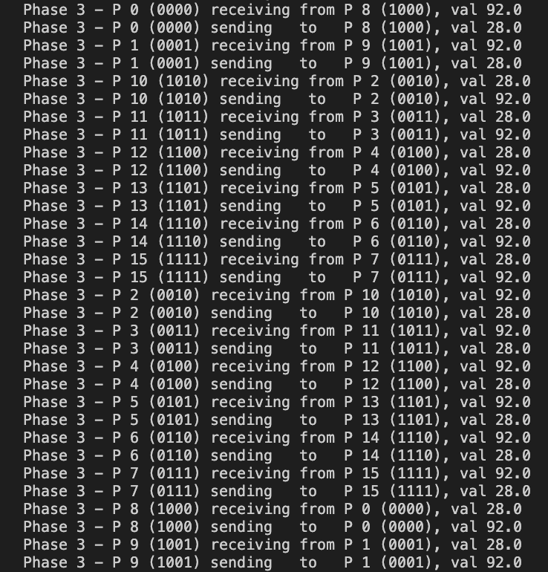
Execution for np = 16
Phase 3:

Slide 10
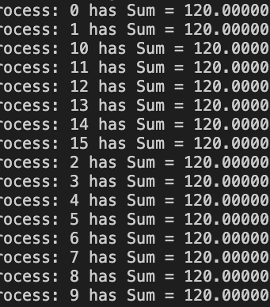
Execution for np = 16
Final Sums:

Slide 11
Overall Experience
Overall, this project wasn’t too bad. The hardest part was understanding how MPI and parallel programing actually works as I have never done either of them before. The biggest part of that was figuring out how and when to use MPI_Ssend and MPI_Recv. My program deadlocked a few times while testing because I was trying to send multiple messages without receiving messages first.

Slide 12
Interesting Interaction
While I was doing the error checking for this project, I found an interesting interaction. We wanted the program to run only if the number of processes was a power of 2. So I at one point had an if statement to check if the number of processes was less than 1. While testing this, I found that MPI has built in error testing for a negative number of processors. What I found interesting is when the number of processes is 0. When that happens, MPI defaults the number of cores on the node/system. My laptop has 4 cores, which is a power of 2, so it would run when it wasn’t supposed to. It took me a while to realize this and I thought something was wrong with my error checking.

