Slide 1
Implementation of Row-Striped Matrix with Halo Rows
CSCI 473
Michael Dandrea
November 13, 2024

Slide 2
Project Overview
- Extend Quinn's row-striped matrix implementation
- Add halo rows for parallel processing
- Create functions for reading, writing, and printing matrices with halos
- Develop testing framework

Slide 3
Key Functions Added
read_row_striped_matrix_halo()
Reads matrix data and adds halo rows
Each process gets additional rows for neighbor communication
print_row_striped_matrix_halo()
Shows complete matrix including halo rows
Demonstrates data distribution across processes
write_row_striped_matrix_halo()
Writes matrix back to file without halo rows
Preserves original matrix format

Slide 4
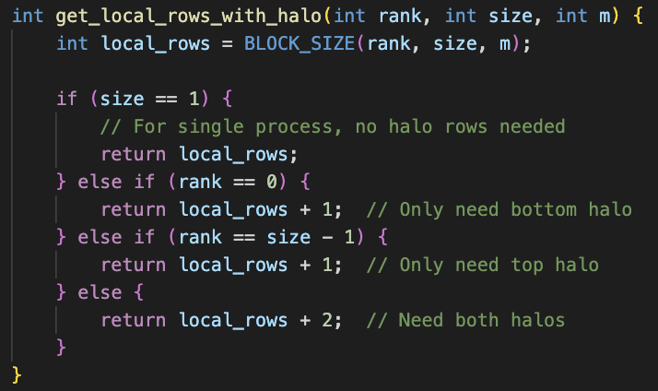
Helper Function
This calculates the local rows with the halo row for each process.

Slide 5
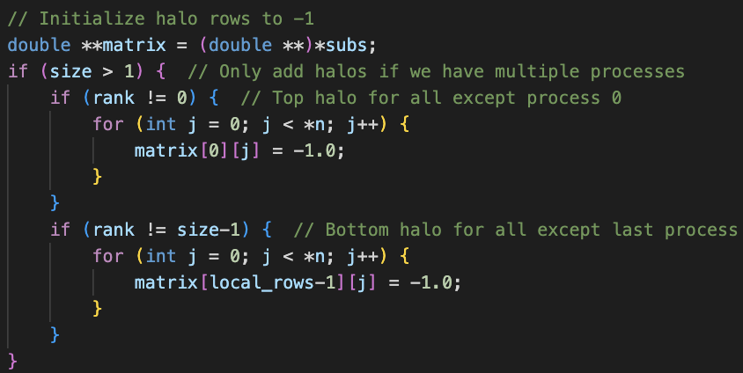
Read_row_striped_matrix_halo()
Main part of the function:

Slide 6
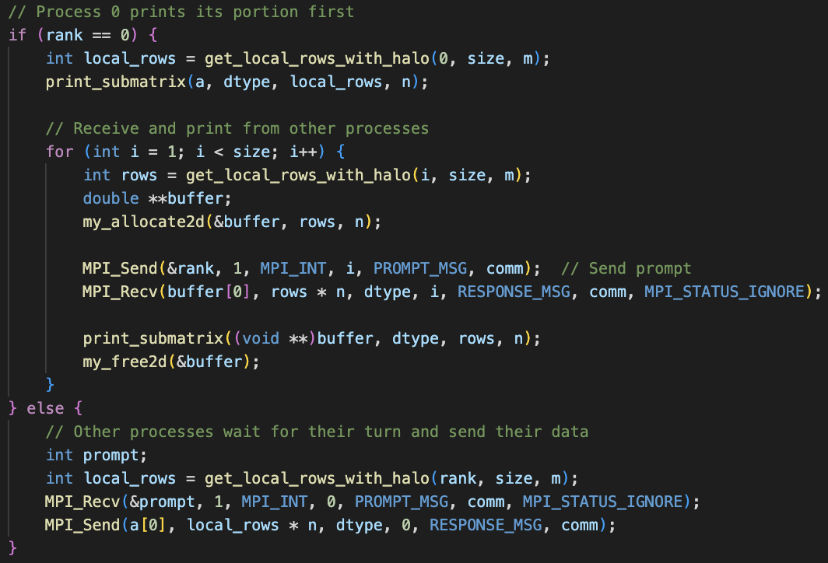
Print_row_striped_matrix_halo

Slide 7
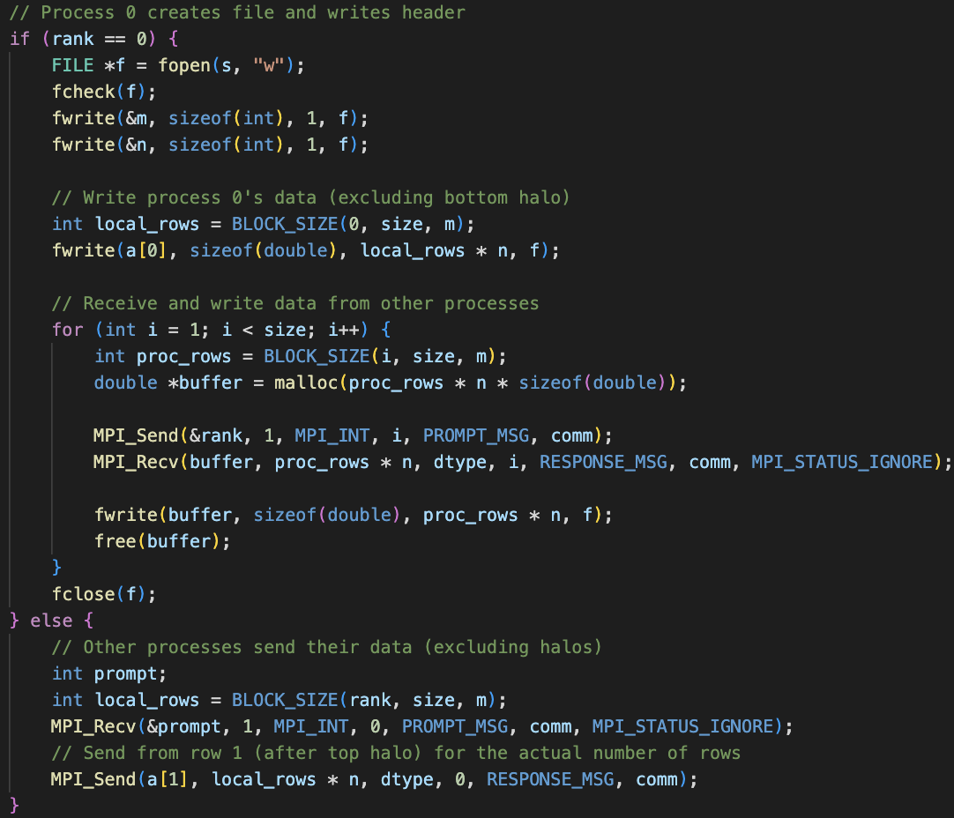
Write_row_striped_matrix_halo

Slide 8
Testing Strategy
1. Simple Tests: test_simple.sh
Basic functionality verification
Small matrices (5x6, 4x4, 3x8)
Different process counts
2. Comprehensive Tests: test_comprehensive.sh
Multiple matrix dimensions
Various process counts
Automated verification

Slide 9
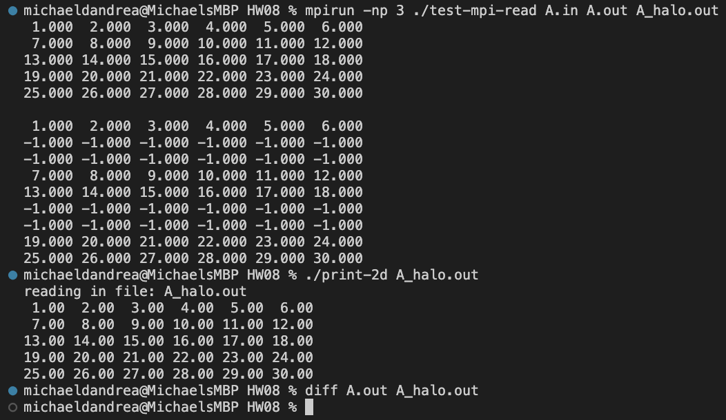
Example Output

