Slide 1

Trapezoidal Rule for Estimating Integrals With MPI
By: Michael Dandrea

Slide 2
Objective
Implement a parallel version of the trapezoidal rule using MPI.
Test the implementation on the Expanse Supercomputer.
Measure performance in terms of execution time, speedup, and efficiency.

Slide 3
MPI Implementation
Each process gets a specific range of the integral to estimate.
Start point, end point and number of trapezoids are distributed using MPI_Bcast().
Each process computes its local result, and they are combined using MPI_Reduce().

Slide 4
Running on Expanse
Used a bash script to run on compute node.
Ran on a number of processors ranging from 1 to 16.
Collected results from various problem sizes for every number of processors.

Slide 5
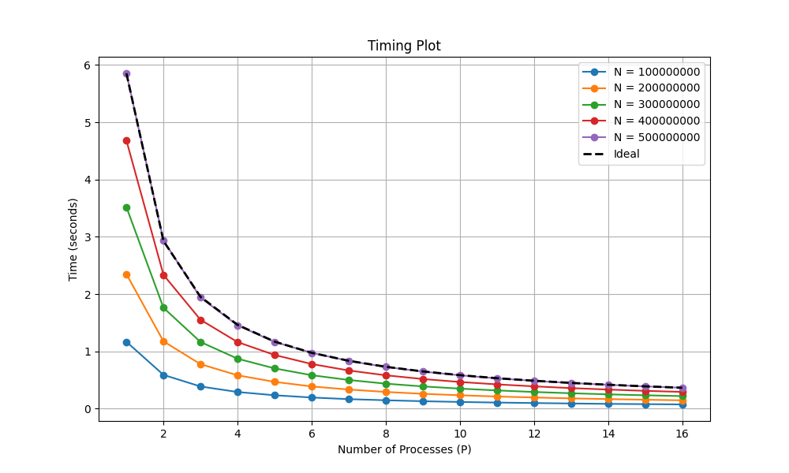
Execution Time
Time decreases as processors increase.
Time decrease plateaus.
Largest problem size ends up being the ideal line.

Slide 6
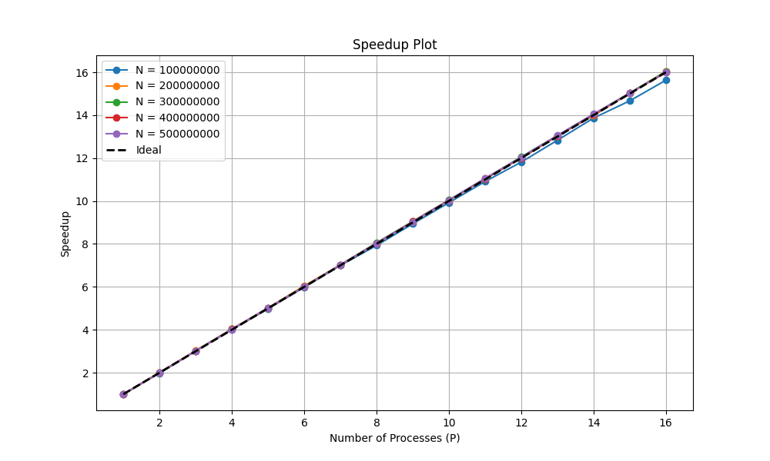
Speedup
Speedup is nearly ideal for large number of n.
Notes:
The execution time for each iteration is nearly linear. An explination for this could be that the exectution time is so short, about 10 seconds for n = 500 million that it skews the results.

Slide 7
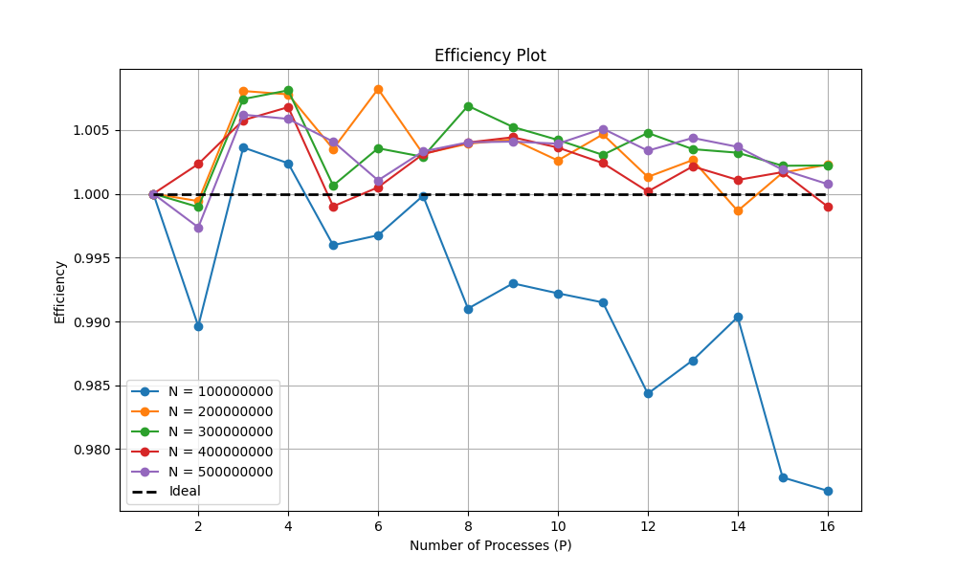
Efficiency
Efficiency goes above 100% for some number of processors.
Notes:
The efficiency plot decreases overall for smaller problem sizes, which is because of idle processors. However the efficiency is over 100% for the larger sample sizes, which goes against the theory of efficiency going down as you add more processors. Once again, this could be the execution time being so short that it is skewing the results.

