Slide 1
HW00 Report
By: Michael Dandrea

Slide 2
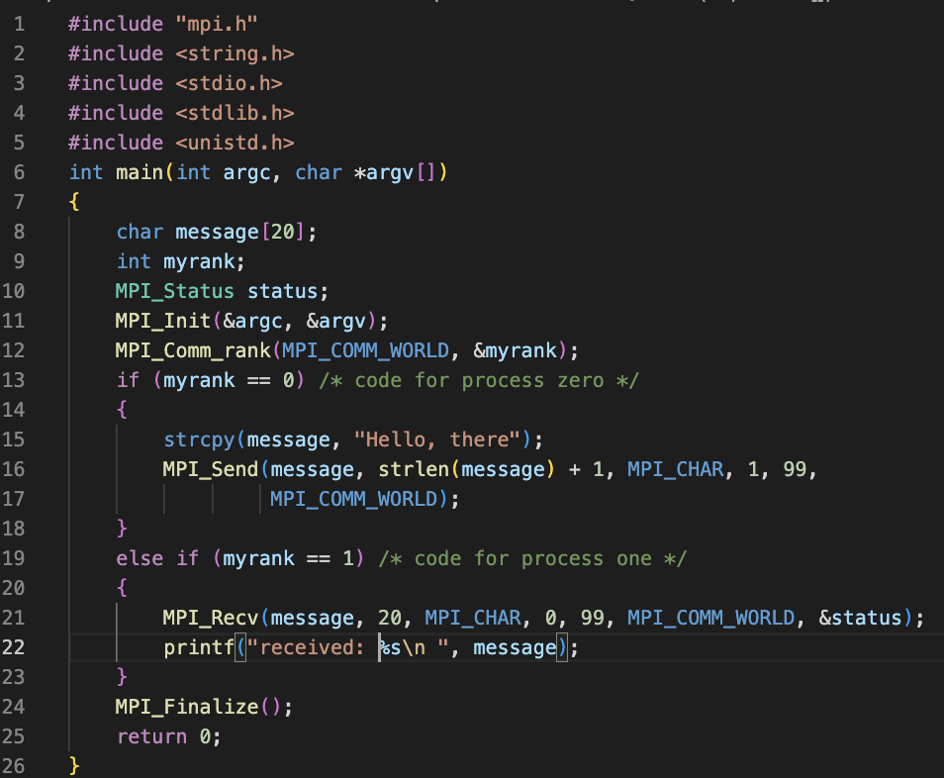
Code
Code for the C Program was copied from the MPI Documentation.

Slide 3
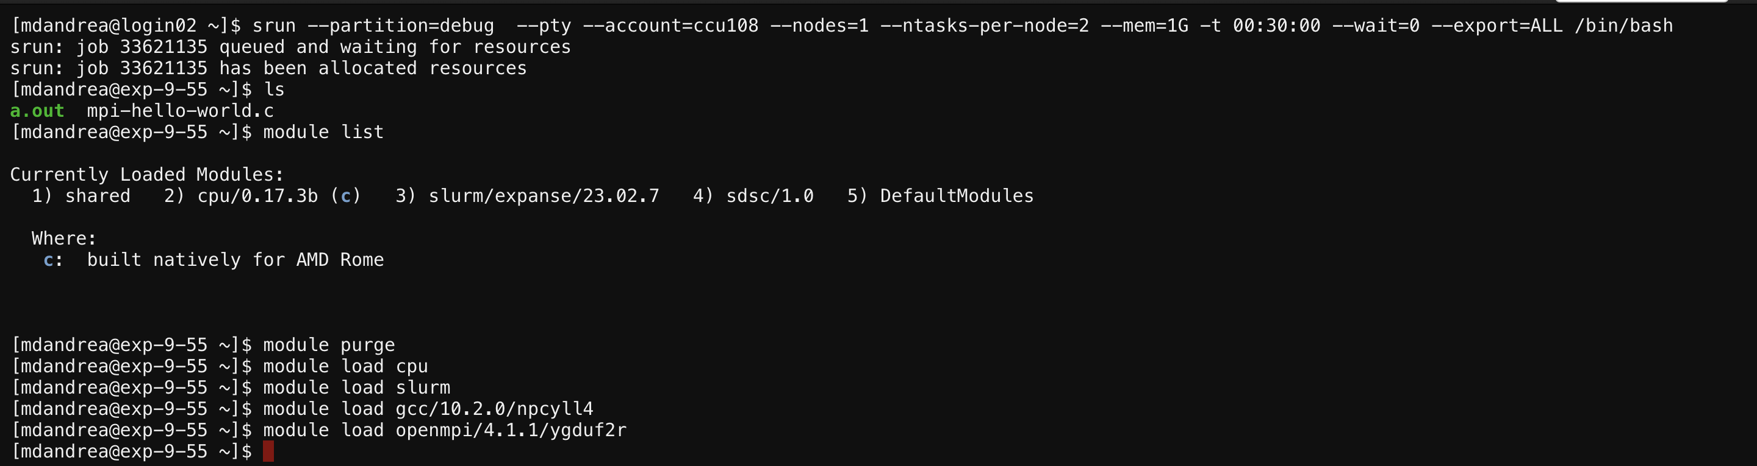
Getting MPI To Work
In order to get MPI to work on expanse, I did the following:

Slide 4
Getting MPI To Work
Running these commands allowed me to use MPI commands on the Expanse portal without running into errors. I followed the method we did in class to figure out which modules I needed to add.

Slide 5
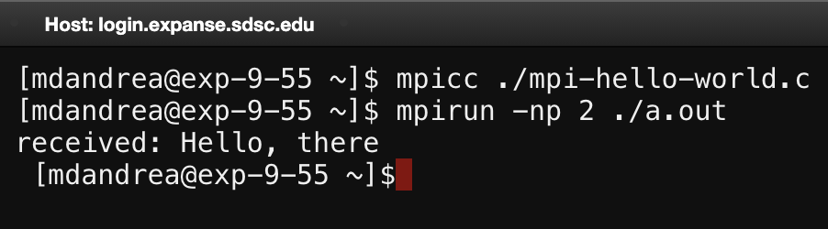
Compiling and Running the Program
Here is a screenshot showing how I compiled and ran the program on the Expanse portal, as well as the output of the program:

