Slide 1
HW03 Writeup
Michael Dandrea

Slide 2
Goal Of the Program
The goal of the program was to edit functions provided in Quinn’s MyMPI.c file to so that the function allocates space for the matrix it reads in the process itself, rather than being passed in space for it. To do this, we created a function called my_allocate2d to allocate the space. We also created a program to create a matrix that the program can read in called make-2d.

Slide 3
Make-2d
To create the make-2d program I made three functions called my_allocate2d, initialize, and write_to_file. They are explained on the following slides.

Slide 4
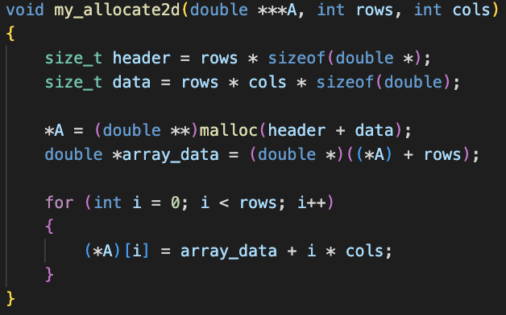
My_allocate2d
Function to allocate a 2D integer array dynamically.
It takes a pointer to the 2d array, the number of rows, and the number of columns as input and allocates memory for the 2D array.

Slide 5
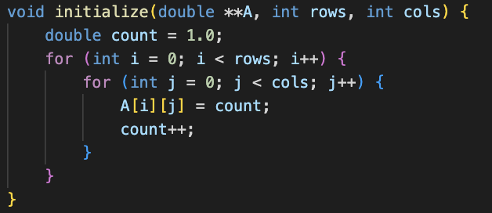
Initialize
Function to initialize a 2D array with ascending values.
It takes a pointer to a 2D array, the number of rows and columns as input.

Slide 6
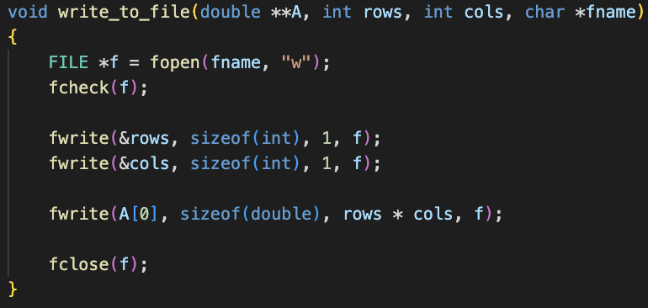
Write_to_file
Function to write a 2D array to a binary file.
It takes a pointer to a 2D array, the number of rows, columns, and a file name as input.
Fcheck is a helper function to make sure the file pointer is valid.

Slide 7
Test-mpi-read
To make the test-mpi-read program, we used the read_row_striped_matrix and print_row_striped_matrix functions from Quinn’s MyMPI.c file. We got rid of the storage variable in the read function and had the function allocate space for the submatrices in the function itself. Then each process sends it submatrix back to the first process, which puts them all together.
The print function is unchanged.

Slide 8
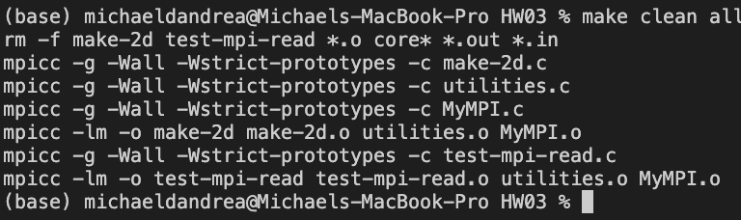
Compilation
The program uses a Makefile to compile. Here is the execution of the Makefile:

Slide 9
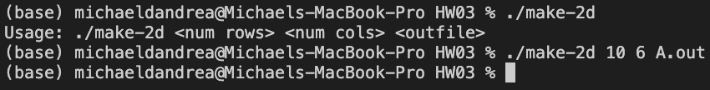
Running make-2d
Make-2d has the following usage:
./make-2d <num rows> <num cols> <outfile>
Here is an example:

Slide 10
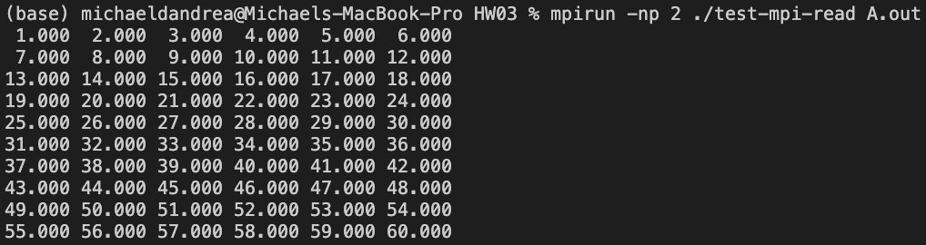
Running test-mpi-read
Test-mpi-read has the following usage:
mpirun -np <p> ./test-mpi-read <in data file>
Here is an execution using the file generated from the previous slide:

Slide 11
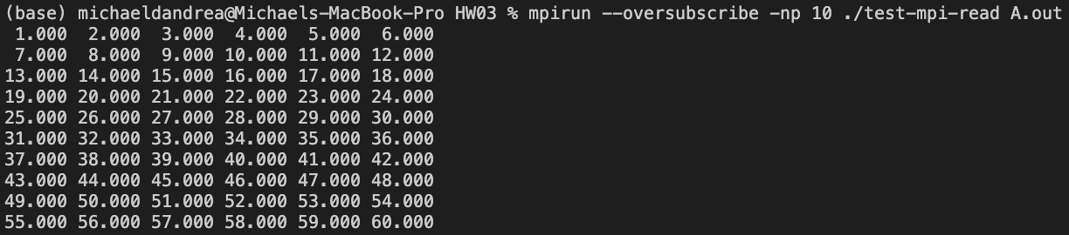
Extra Execution
Here is another execution where I oversubscribe to show that it works with a higher number of processors:

Slide 12
Testing High Row Matrices
I have a run_all script that tests a 10x6 matrix with a number of processes from 1-10. It also tests a 500x100 matrix with a number of processes from 1-100.
It runs by typing ./run_all.sh and saves the outputs to text files called small_results.txt and large_results.txt for viewing.

