Slide 1
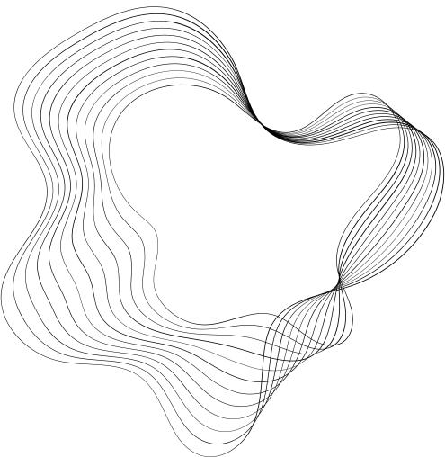

BARRIER IN ACCESSING THE TEXT BOOKS WITH GRAPHIC IMAGES
MENTOR: GANGA S
TEAM NAME: CODEMAVERICKS
TEAM MEMBERS: SOBHIKA KAMALAVASAN (TL)
MADHUMITHA
DEVAKIPRIYA
VIMAL RAJ
MANIKANDAN

Slide 2
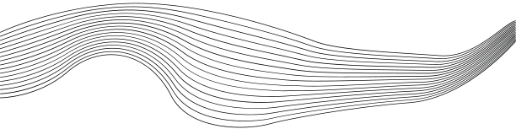
WELCOME
In Our Group Project We are going to Implement,
Assumption: Person with Visually Impaired to Assist them to feel the image

Slide 3

INTRODUCTION:-
"AccessibleRead" is a revolutionary mobile app addressing barriers for visually impaired students. It utilizes OCR technology and tactile graphics to convert traditional textbooks into accessible formats, including Braille. The app integrates text-to-speech and Refreshable Braille Display for a comprehensive learning experience. With a focus on intuitive design, AccessibleRead aims to empower students by providing unprecedented access to educational resources. Step into an inclusive learning environment where knowledge transcends visual boundaries.

Slide 4
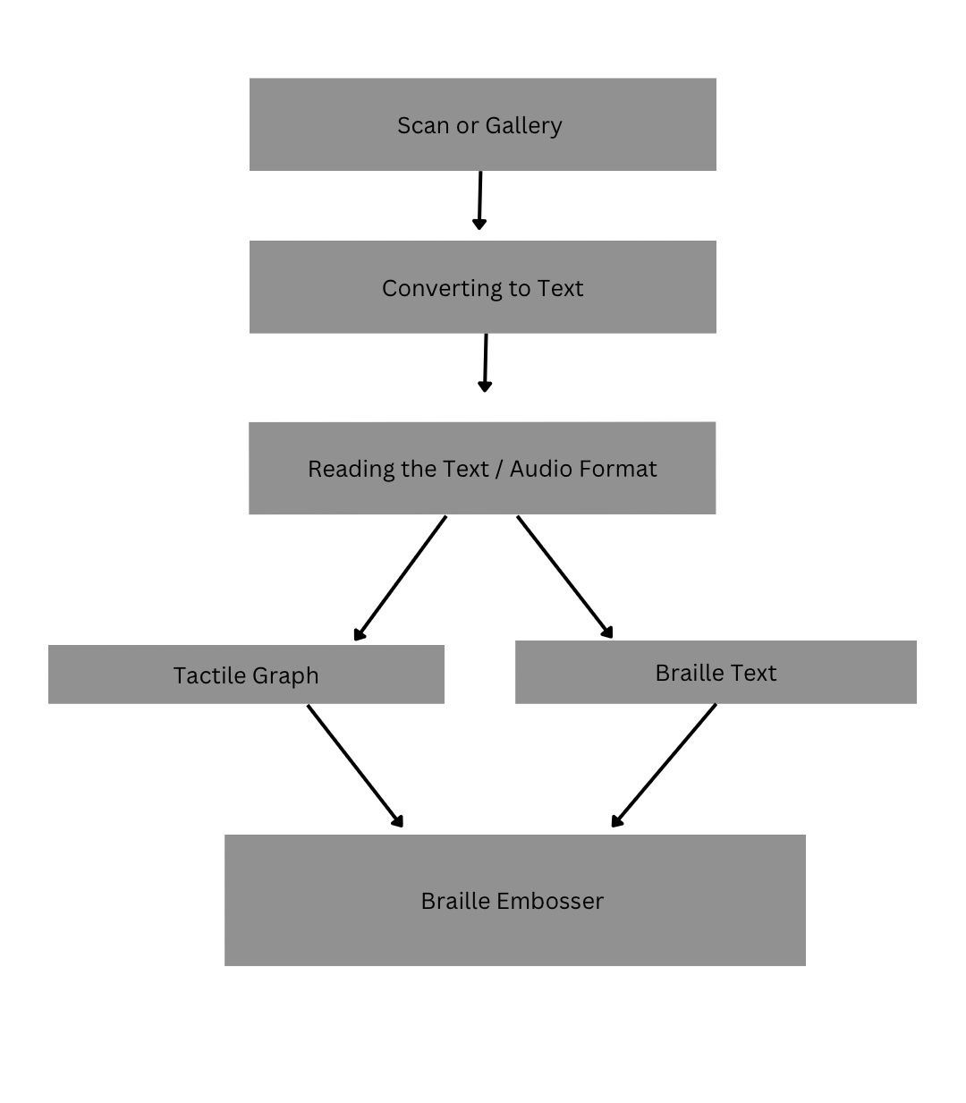


FLOWCHART

Slide 5

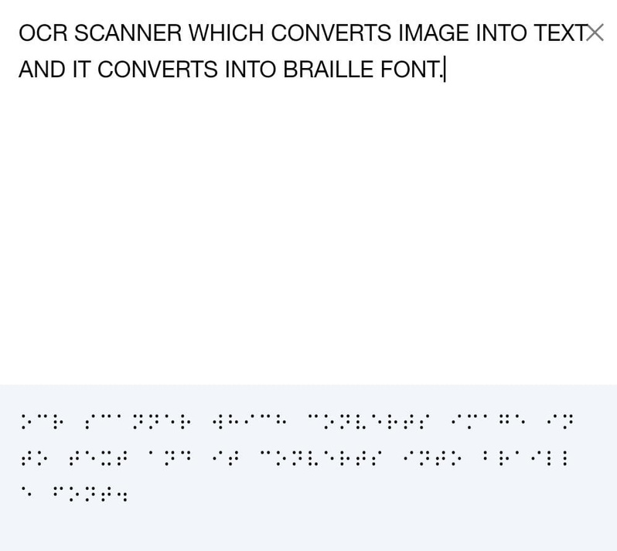
M O D U L E 1
Developing an OCR scanner involves using tools like Tesseract for image-to- text conversion. To go a step further, integrating a Braille font conversion algorithm in Python can enhance accessibility by translating the extracted text into Braille.
I m ag e - T e x t - B r a i l l e

Slide 6
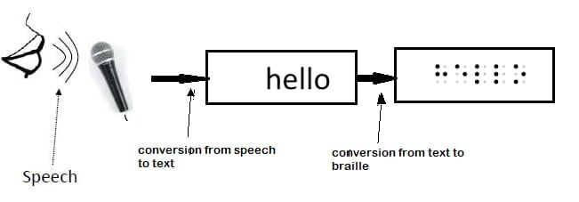
M O D U L E 2
S p e e c h - T e x t - B r a i l l e
Converting a scanned image to Braille involves using OCR to extract text , converting that text to audio through text - to - speech technology , and finally translating the audio script into Braille using specialized tools . Each step serves a crucial role in transforming visual information into a format accessible to individuals with visual impairments .

Slide 7
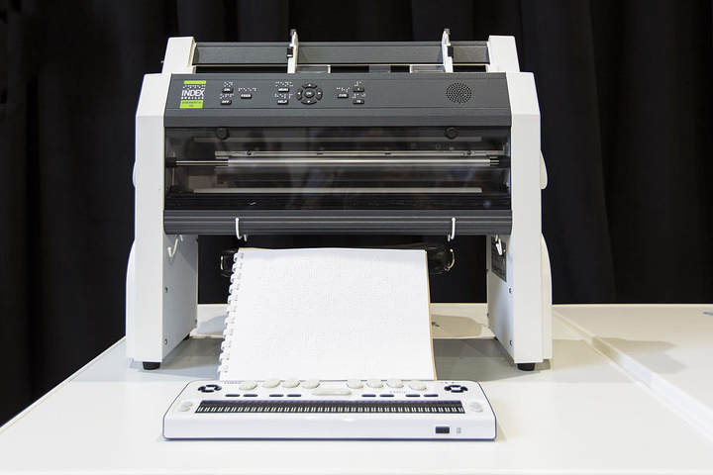
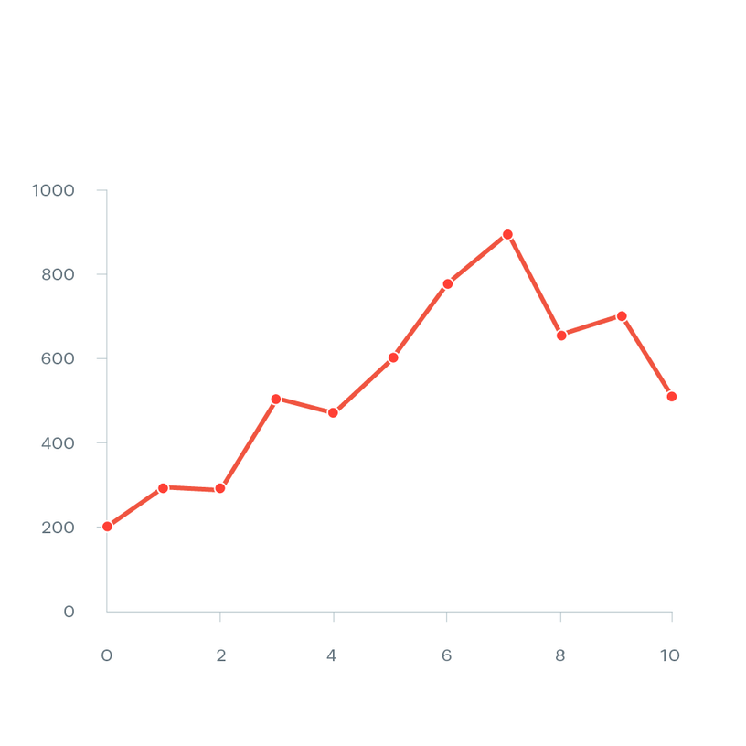
GRAPH
Virtual Presence
A braille embosser is an impact printer that renders text as tactile braille cells. Using braille translation software, a document or digital text can be embossed with relative ease.

Slide 8

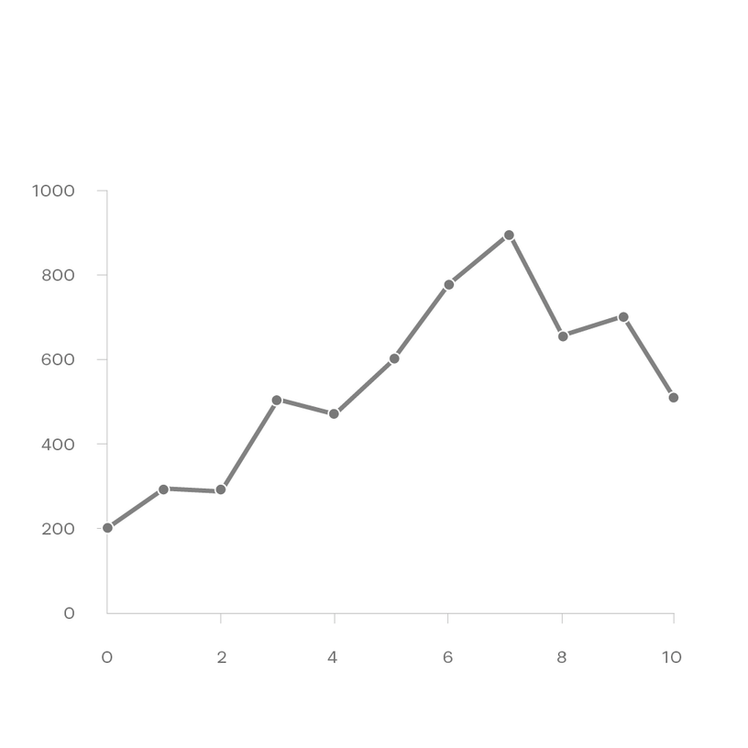
GREY GRAPH
They press dots down onto a piece of paper to let a person using the braille system read by using their fingers. They are a form of assistive technology.

Slide 9
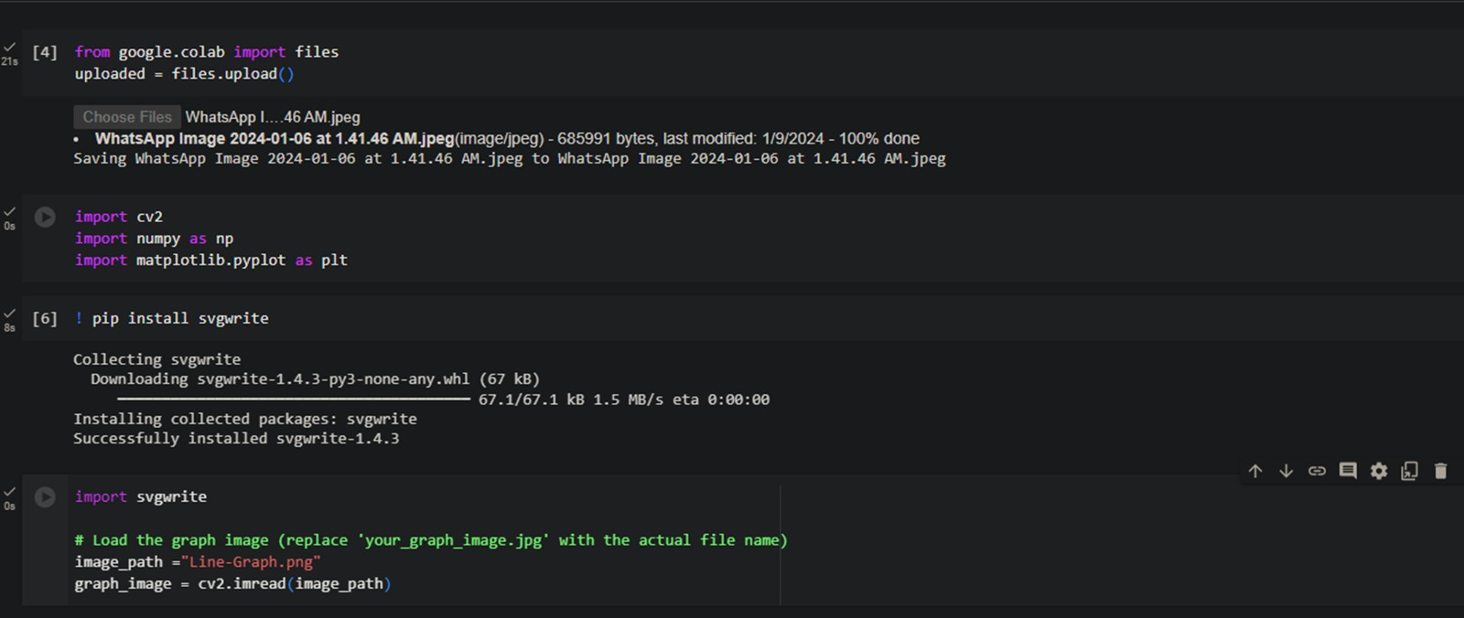
CODE

Slide 10
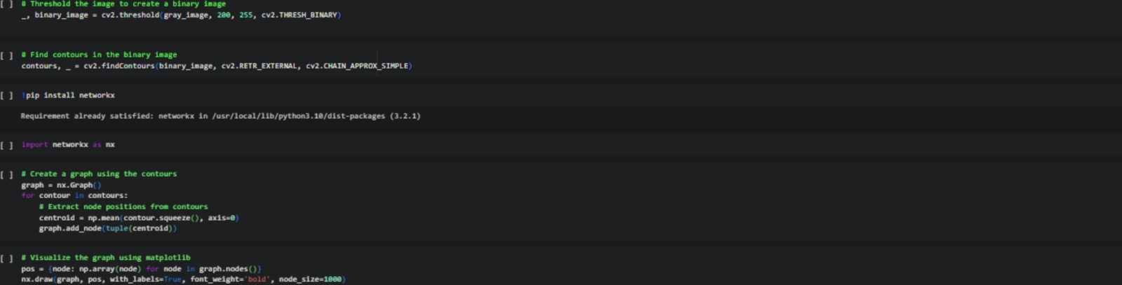
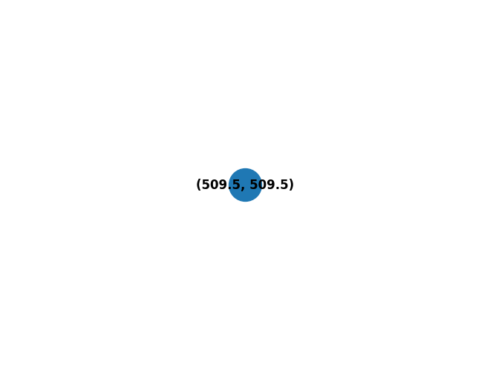


Slide 11
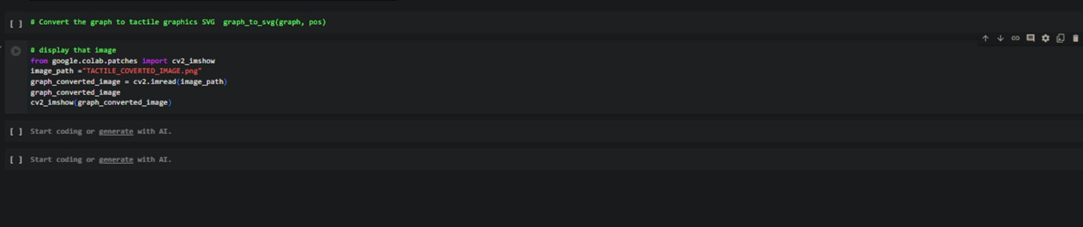

Slide 12
! PIP INSTALL SVGWRITE
from google.colab import files
uploaded = files.upload()
import cv2
import numpy as np
import matplotlib.pyplot as plt
import svgwrite
# Load the graph image (replace 'your_graph_image.jpg' with the actual file name)
image_path ="Line-Graph.png"
graph_image = cv2.imread(image_path)

Slide 13
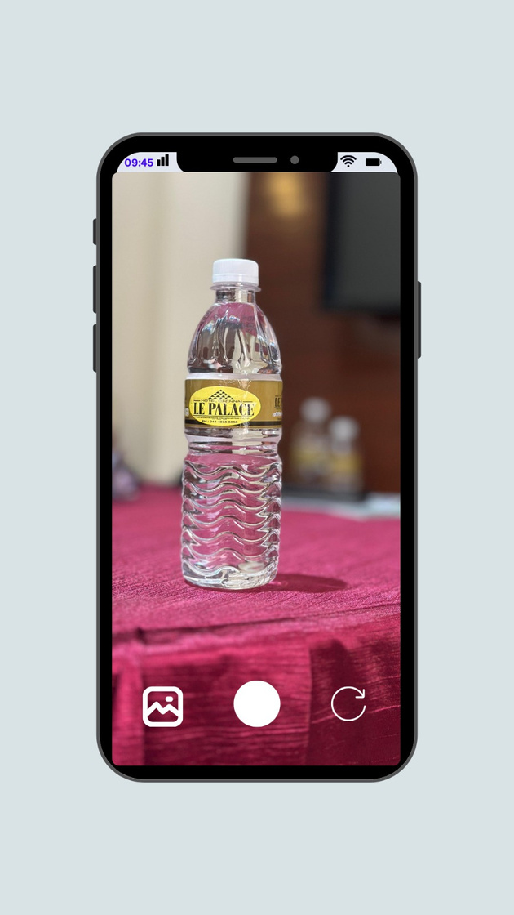
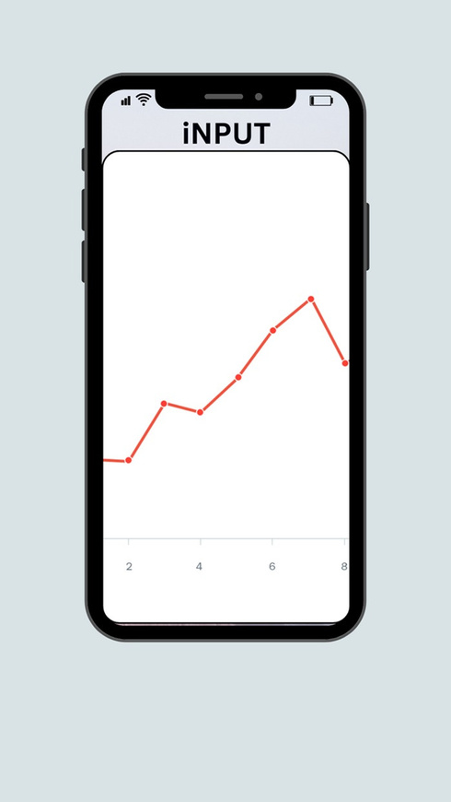
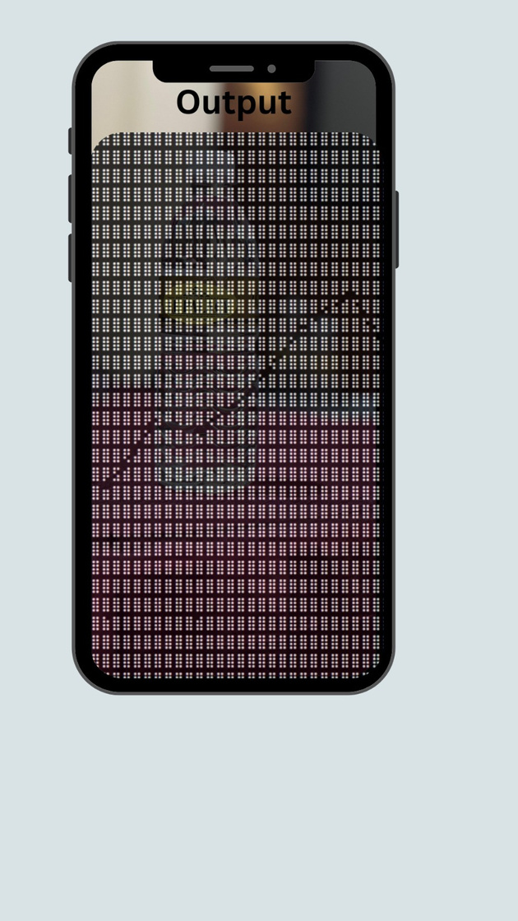
APPLICATION MODULE
Sample
Normal graph
Tactile graph

Slide 14
“Technology is nothing.
What’s important is that you have a faith in people, that they’re basically good and smart, and if you give them tools, they’ll do wonderful things with them.”
EVEN WITHOUT SITE
There is always a vision

Slide 15

THANK YOU

