Slide 1
Hardware-software object tracking system using a moving camera
Digilent design contest 2019
Michał Daniłowicz

Slide 2
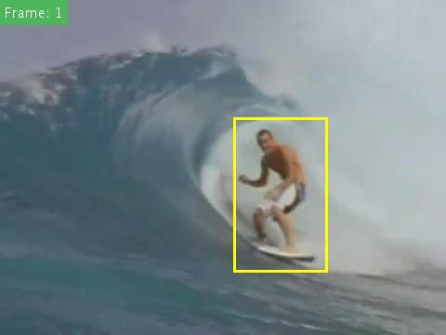
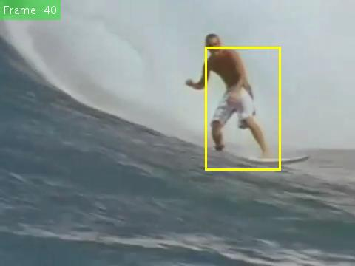
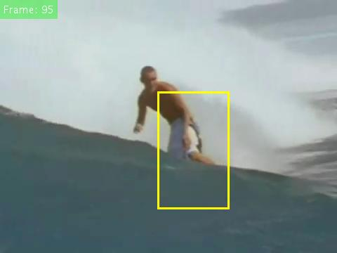
Object tracking
Frame 1
Frame 40
Frame 95

Slide 3
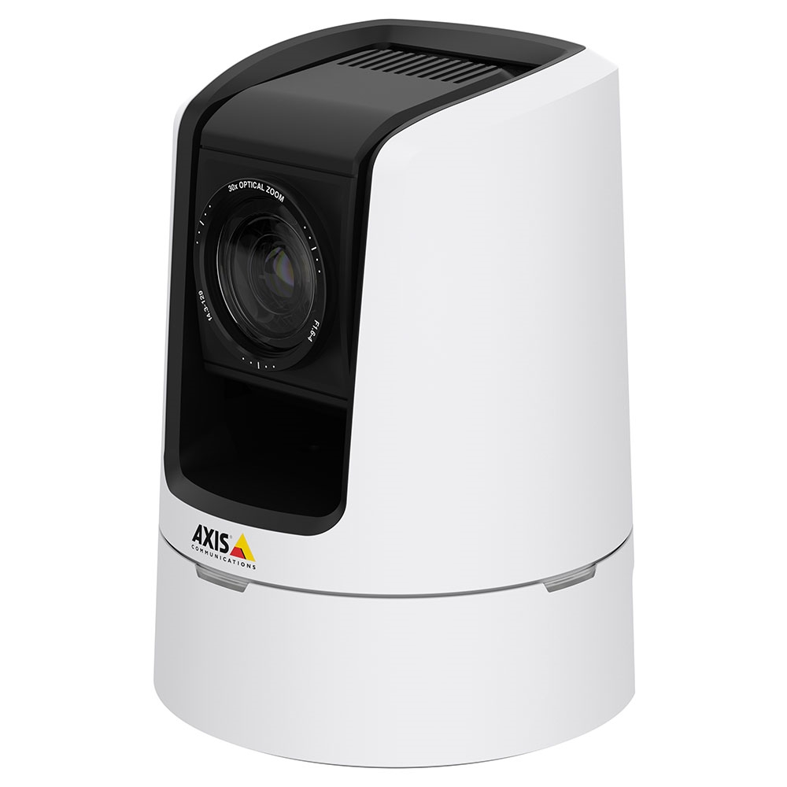
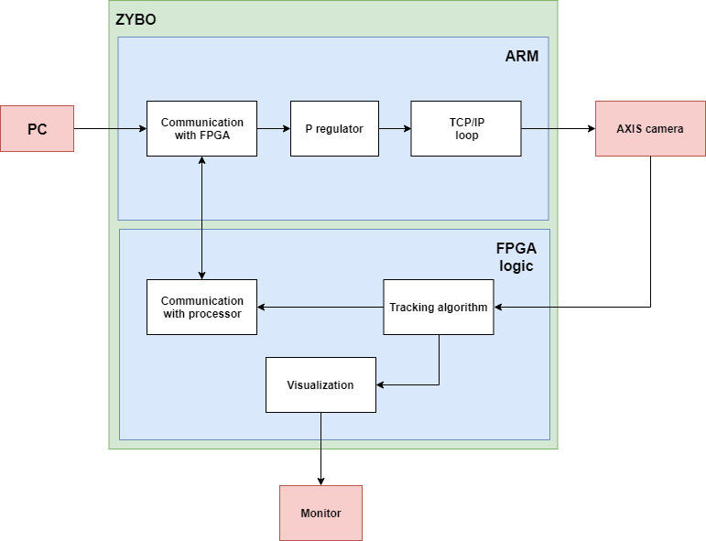
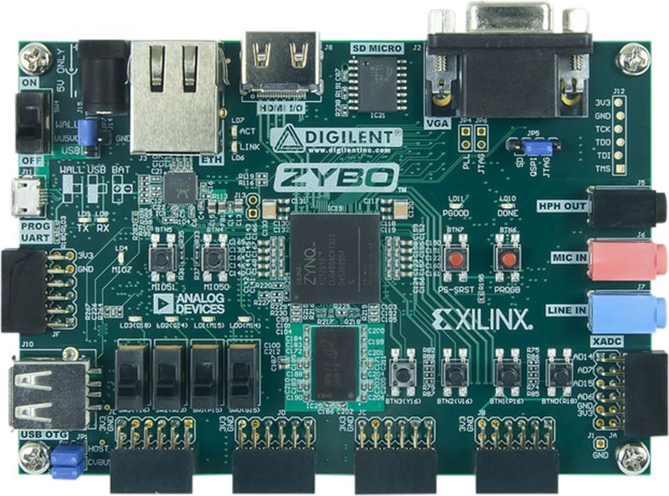
The idea

Slide 4
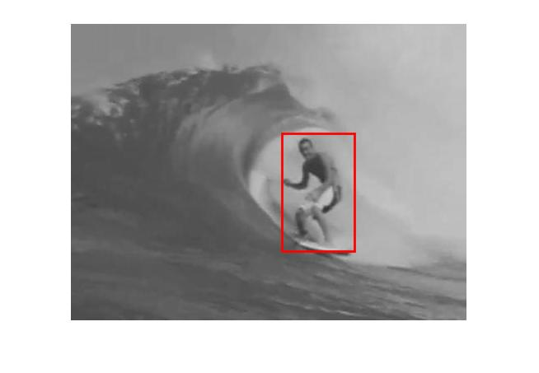
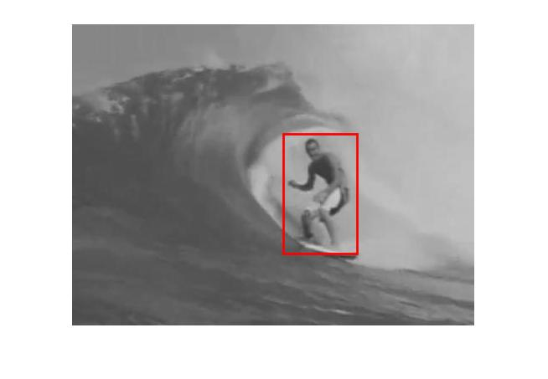
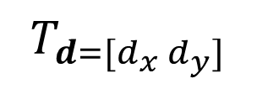
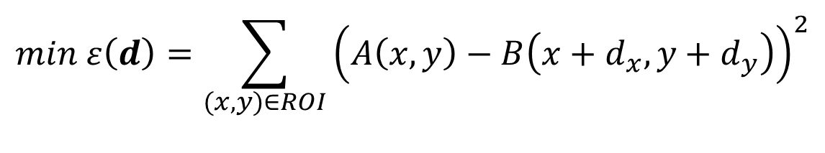
KLT tracking algorithm
A
B

Slide 5
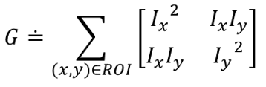
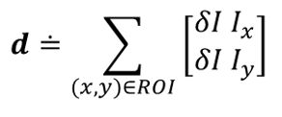
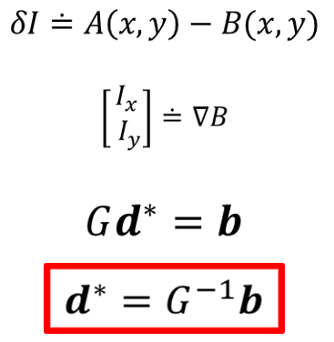
KLT tracking algorithm

Slide 6
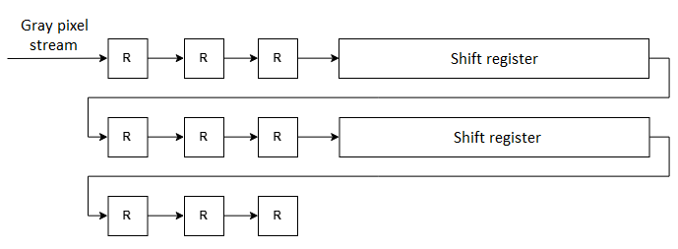

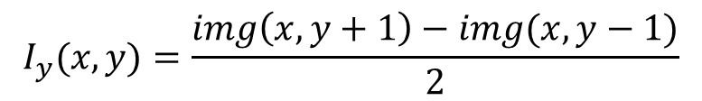
How to get image derivative?
$$I_{x}(x, y)=\frac{img\left(x+1, y\right)−img(x−1,y)}{2}$$
$$I_{y}(x, y)=\frac{img\left(x, y+1\right)−img(x,y−1)}{2}$$

Slide 7
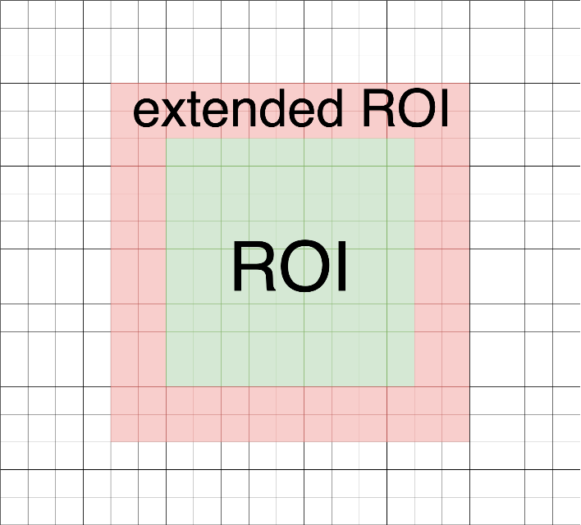
How to get pixel from previous frame?
Let’s write ROI to the memory
and read it in another frame

Slide 8
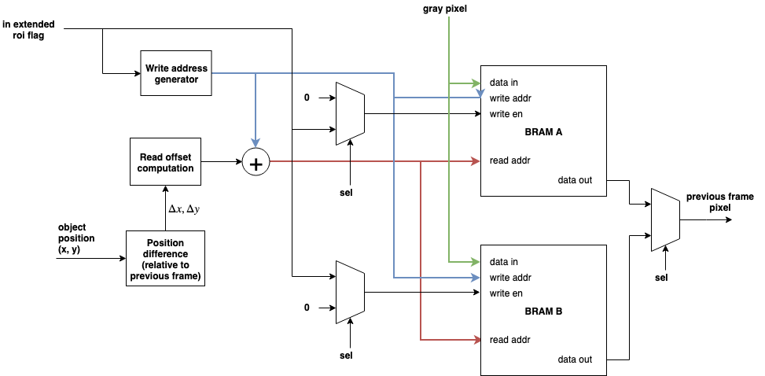
How to get pixel from previous frame?

Slide 9

How to solve linear equation system in FPGA?
$$G=\left[\begin{matrix}a & b \\ c & d\end{matrix}\right]$$
$$b=\left[\begin{matrix}e \\ f\end{matrix}\right]$$
The solution $d={\left[d_{x} d_{y}\right]}^{T}$ is calculated using Cramer’s rule:
$$d_{x}=\frac{ed−bf}{ad−bc}$$
$$d_{y}=\frac{af−ec}{ad−bc}$$

Slide 10
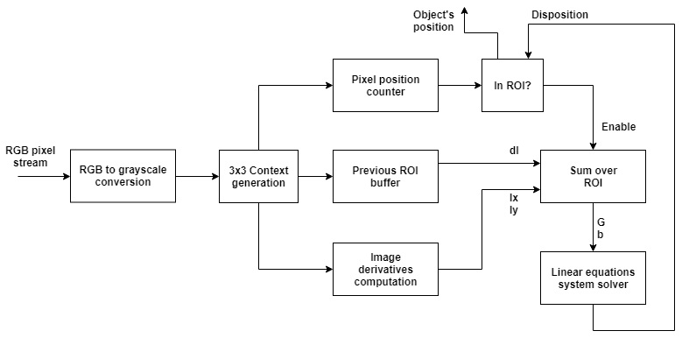
KLT tracker in FPGA

Slide 11
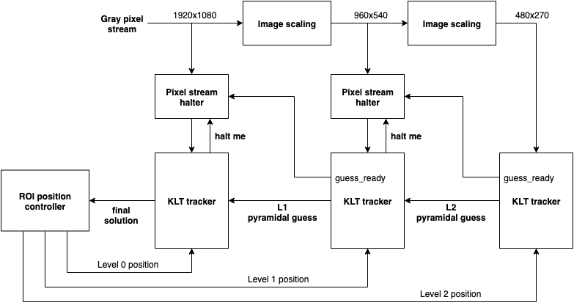
Multiscale (pyramidal) KLT

Slide 12
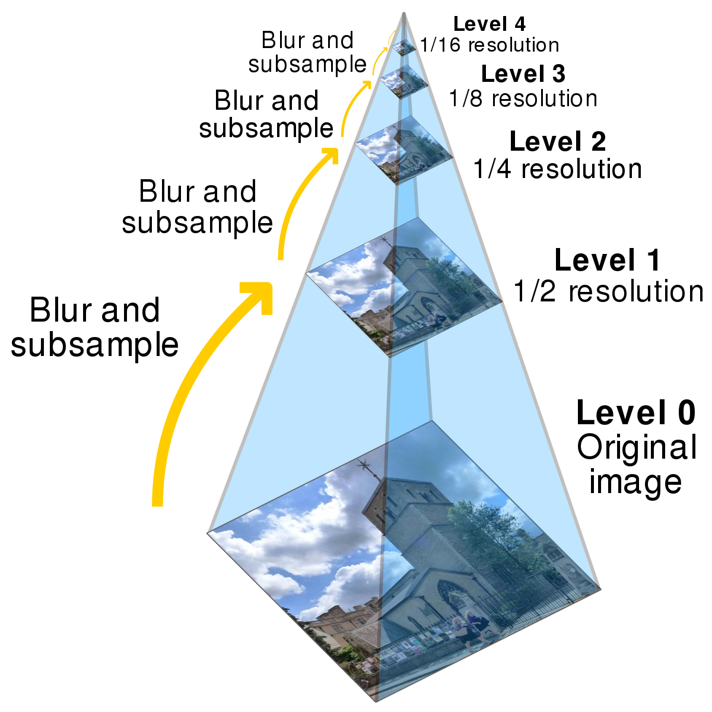
Image scaling

Slide 13
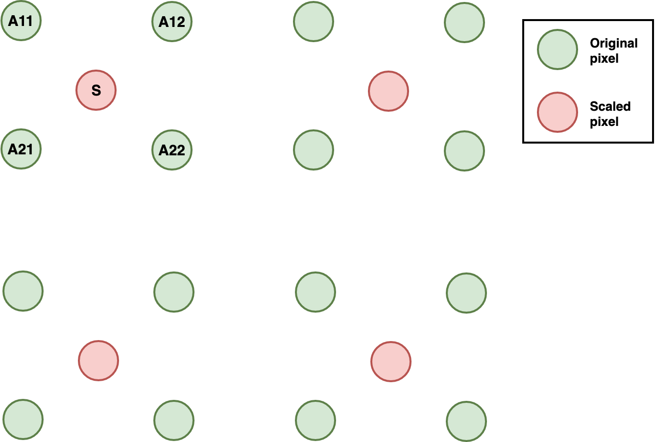
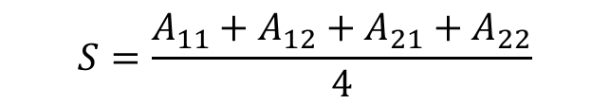
Image scaling
$$S=\frac{A_{11}+A_{12}+A_{21}+A_{22}}{4}$$

Slide 14
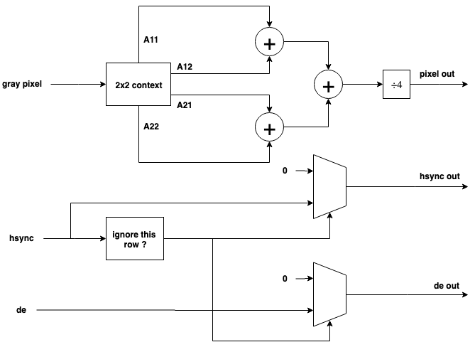
Image scaling

