Slide 1
Welcome To Our Presentation

Slide 2
Group Name: “DELTA”
Group Number: 7

Slide 3
Group Members:
Md. Anisur Rahman Rony (162-15-7880)
Abdullah Al Foysal (162-15-7683)

Slide 4
Project Name: “Global Custody”

Slide 5
Contents
What is Global Custody?
Application of Global Custody
Project Overview

Slide 6
What is Global Custody?

Slide 7
Application of Global Custody

Slide 8
Project Overview

Slide 9
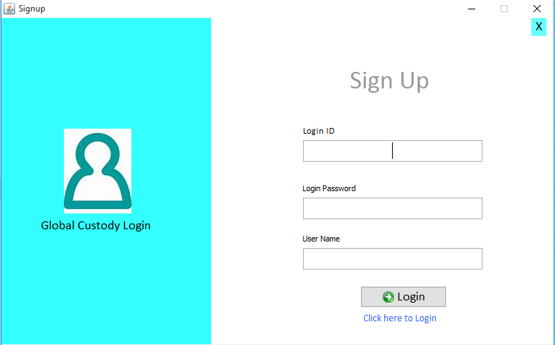
Login Form

Slide 10
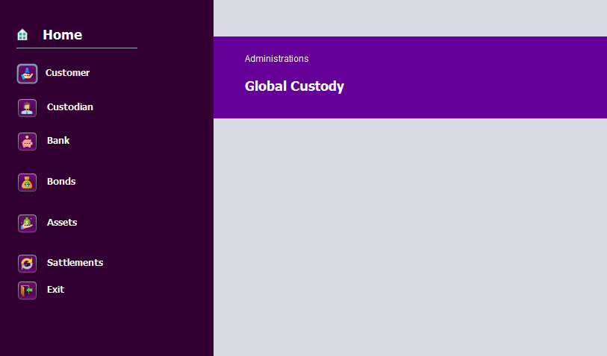
Main Form

Slide 11
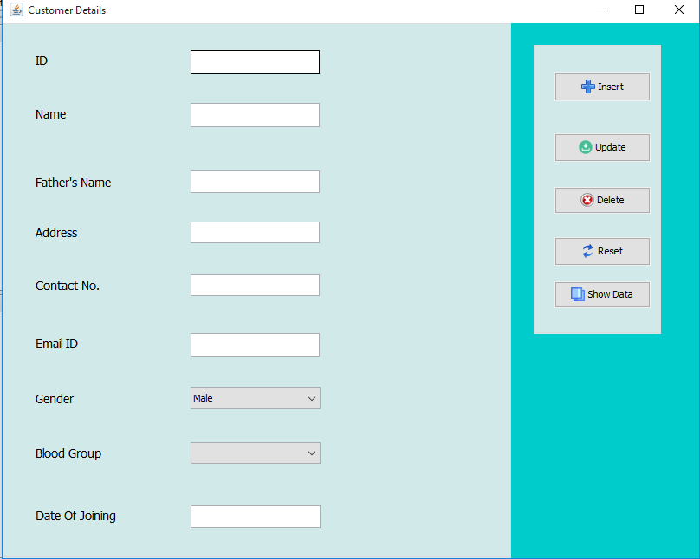
Customer Form

Slide 12
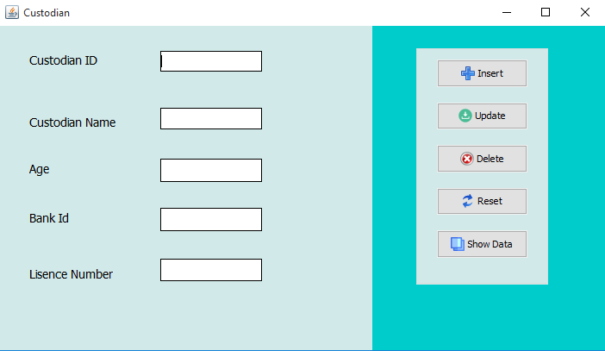
Custodian

Slide 13
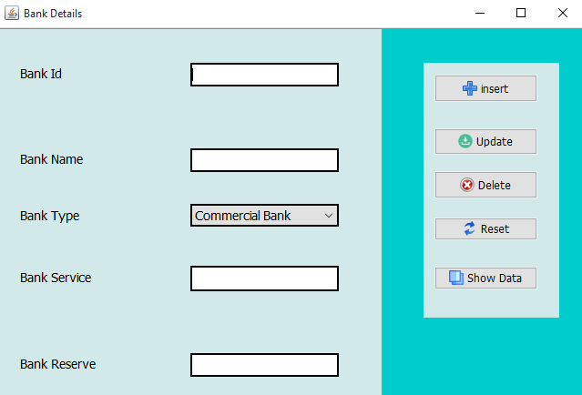
Bank

Slide 14
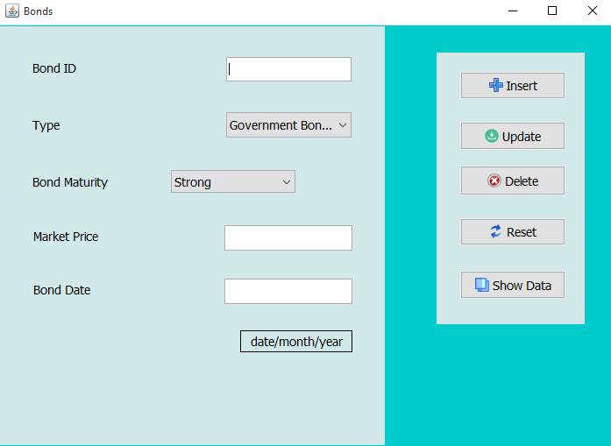
Bonds

Slide 15
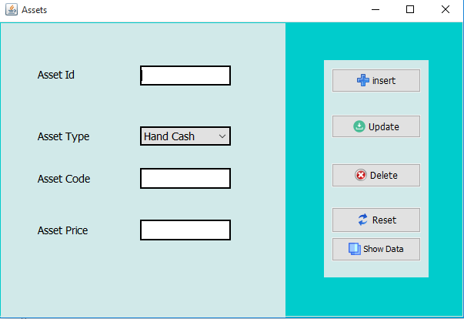
Assets

Slide 16
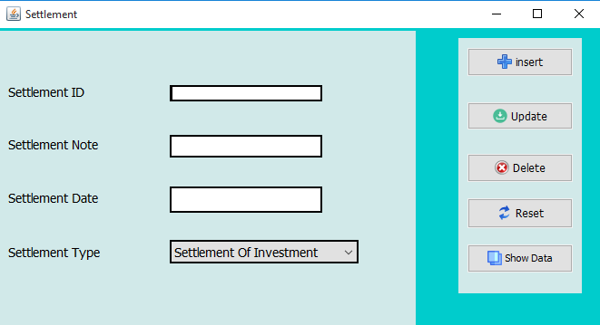
Settlements

Slide 17
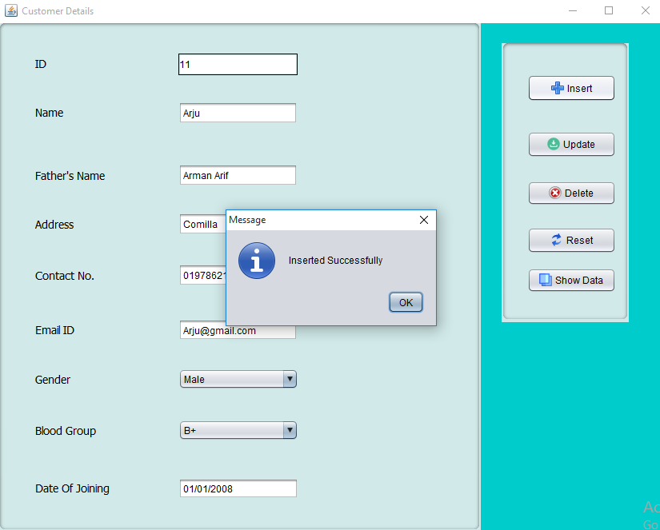
Insert Data

Slide 18
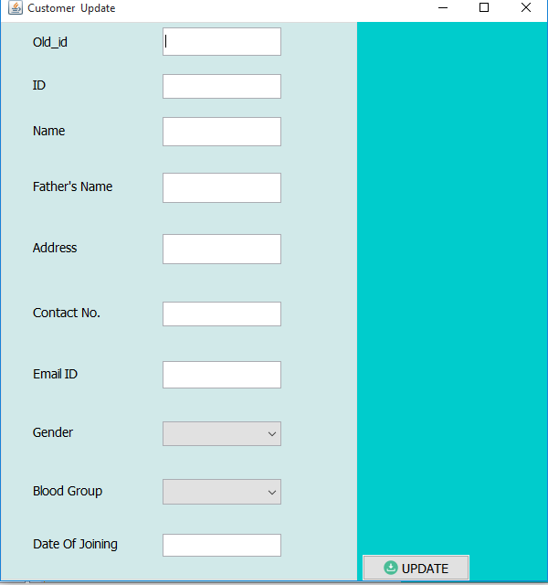
Update Data

Slide 19
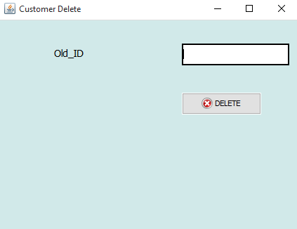
Delete Data

Slide 20
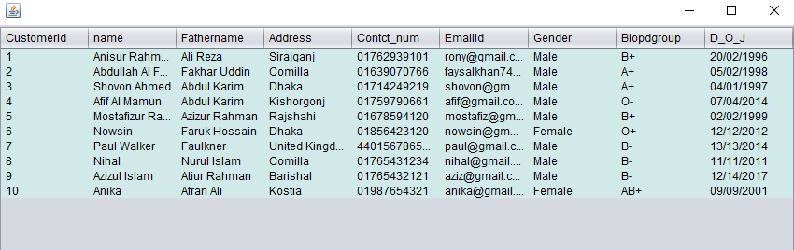
Show Data

Slide 21

Any Question

Slide 22
Thank You

Slide 23


