Slide 1
NR Coincidence Data
In run 16, we spanned six energies at three drift fields.
Distances chosen such that rates of true coincidence scatters between each measurement were comparable.
Angle (deg) | Mean Energy (keV) | Resolution | Distance (cm) | 190 V/cm? | 480 V/cm? | 1020 V/cm?
23 | 2.96 | 0.30 | 60 | Yes | Yes | Yes
30 | 4.93 | 0.17 | 77 | Yes | Yes | Yes
35.4 | 6.61 | 0.23 | 42 | Yes | Yes | Yes
45 | 9.76 | 0.14 | 59 | Yes | Yes | Yes
52.9 | 13.88 | 0.17 | 37 | Yes | Yes | Yes
61.9 | 17.5 | 0.18 | 28 | Yes | Yes | Yes

Slide 2

Coincidence Matching
Uncorrected Observables Data Spectrum
Energy Spectrum from Geant4
Corrected Observables Data Spectrum
MC Produced Observables Spectrum

Slide 3
Coincidence Matching
Uncorrected Observables Data Spectrum
Energy Spectrum from Geant4
Corrected Observables Data Spectrum
MC Produced Observables Spectrum

Slide 4
Key
Immature, needs significant work
Maturing, reasonable results that can be used as estimates of true values
Mature and analysis framework developed, systematic studies needed though. Small changes expected
Final version or few changes expected

Slide 5
Data Correction
Uncorrected Observables Data
PMT Gain
Position Reconstruction
Position Correction
Drift Velocity
Quality Cuts
Corrected Observables Data Spectrum

Slide 6
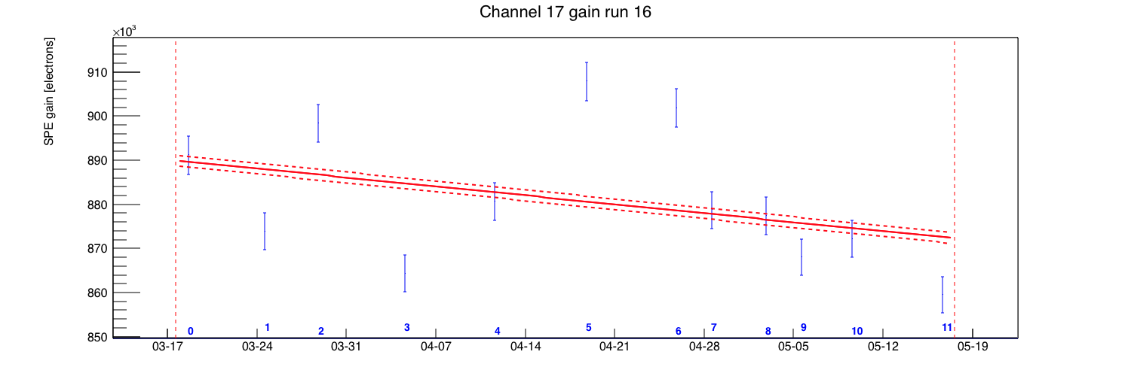
PMT Gain
Calibrations: LED at high and low voltages
Use a combination of SPE and MPE spectra to track the gain of the PMTs in time.

Slide 7
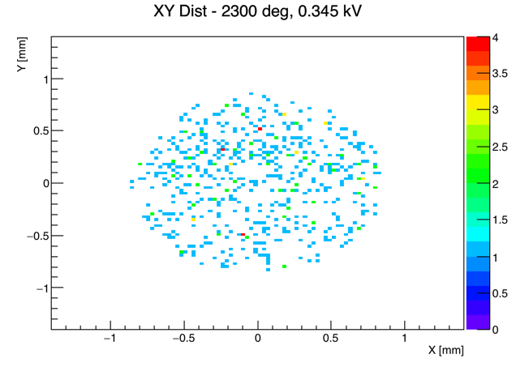
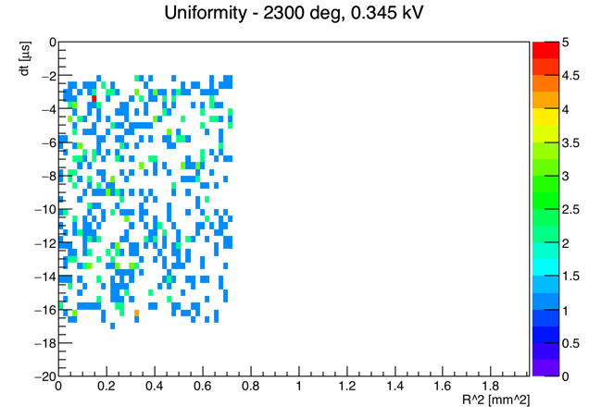
Position Reconstruction
Calibrations: None (but potentially background)
Use neural network trained on Geant4 optical simulation data.
Also considering the use of a network trained on data with known distribution.

Slide 8
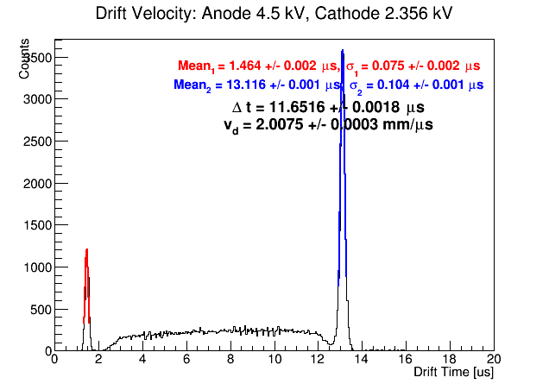
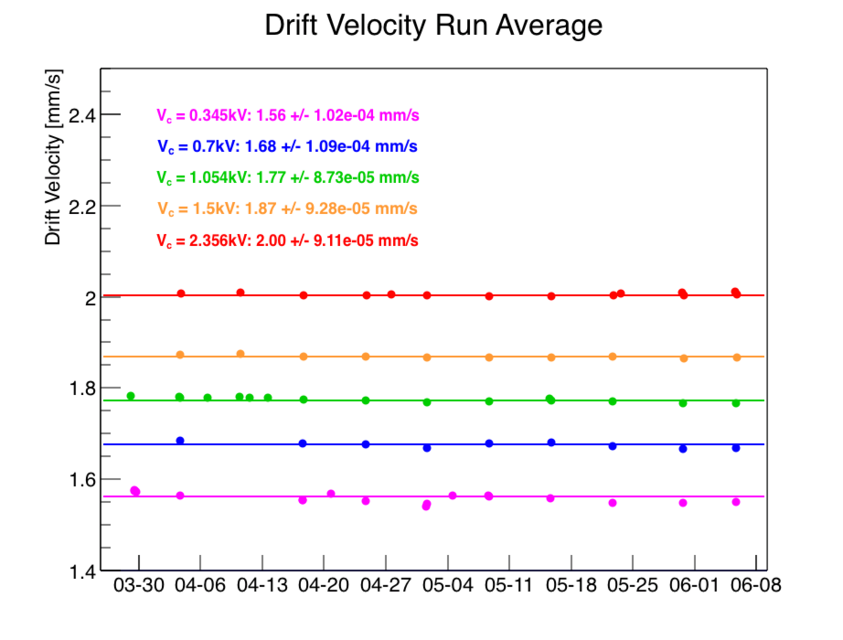
Drift Velocity
Calibrations: Gas gain and low-gain Cs137
Use small S2s produced by the photoionization of the gate and the cathode to measure the drift velocity and eventually produce depth of event vertex in TPC.
Statistical uncertainty of drift velocity negligible over course of run.
Run | V_d (mm/us) – 190 V/cm | V_d (mm/us) – V_c=700 V | V_d (mm/us) – 480 V/cm | V_d (mm/us) – V_c=1500 V | V_d (mm/us) – 1020 V/cm
10 | 1.51 | n/a | 1.72 | n/a | 1.96
11 | 1.54 | n/a | 1.75 | n/a | 1.97
16 | 1.56 | 1.68 | 1.77 | 1.87 | 2.00

Slide 9
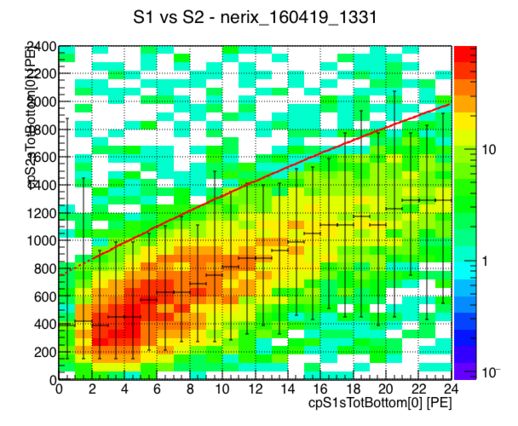
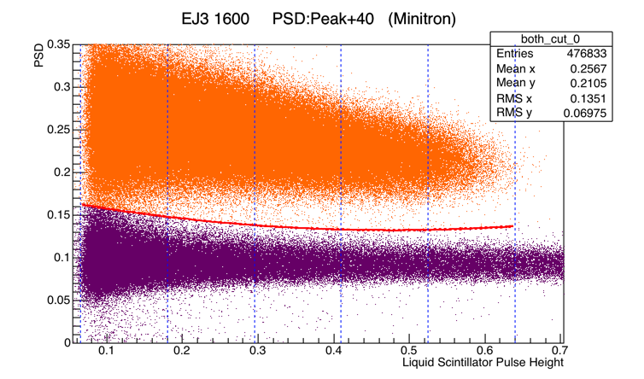
Quality Cuts
Most of our quality cuts are quite basic: fiducial volume, asymmetry, etc.
Additionally, with our run 16 hardware, we lose a great deal of precision in our TOF cuts but we can compensate for the loss by ensuring that interactions in EJ301 and TPC are both from nuclear recoils.
There is much more that we can do with the NR band – we will come back to this later!

Slide 10
Coincidence Matching
Uncorrected Observables Data Spectrum
Energy Spectrum from Geant4
Corrected Observables Data Spectrum
MC Produced Observables Spectrum

Slide 11
Observables Spectrum from Geant4
Energy Spectrum from Geant4
Photon/Charge Yield
g1/g2
Gas Gain
Intrinsic S1/S2 Resolution
SPE Resolution
S1/S2 Efficiency
Corrected Observables Data Spectrum

Slide 12
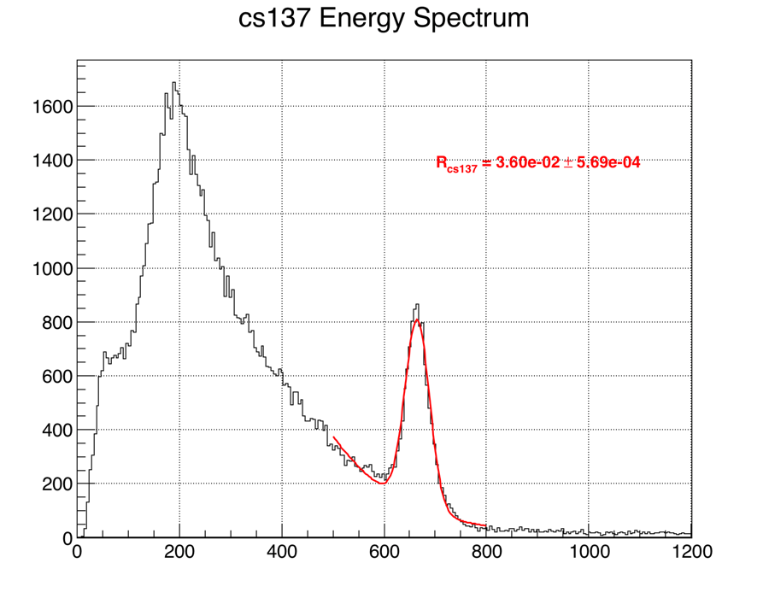
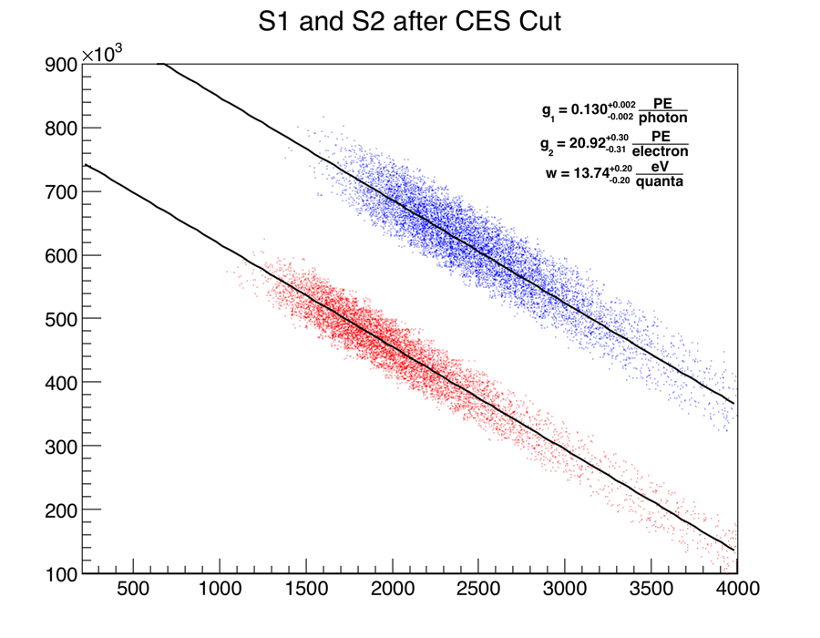
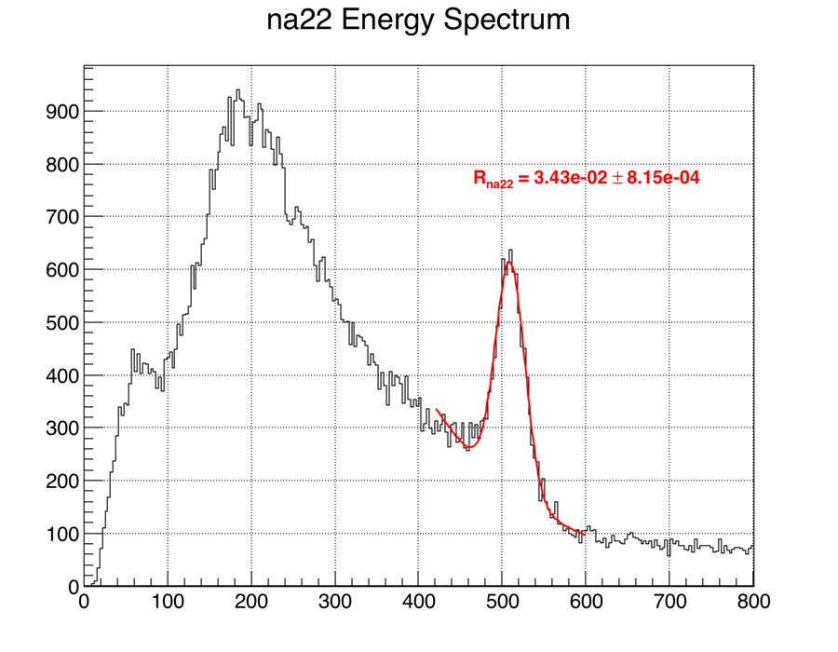
g1 and g2
Calibration: Low gain PMT settings w/ Cs137, Na22, Co57, and 164 keV and 236 keV (possibly 40 keV) excited Xenon lines

Slide 13
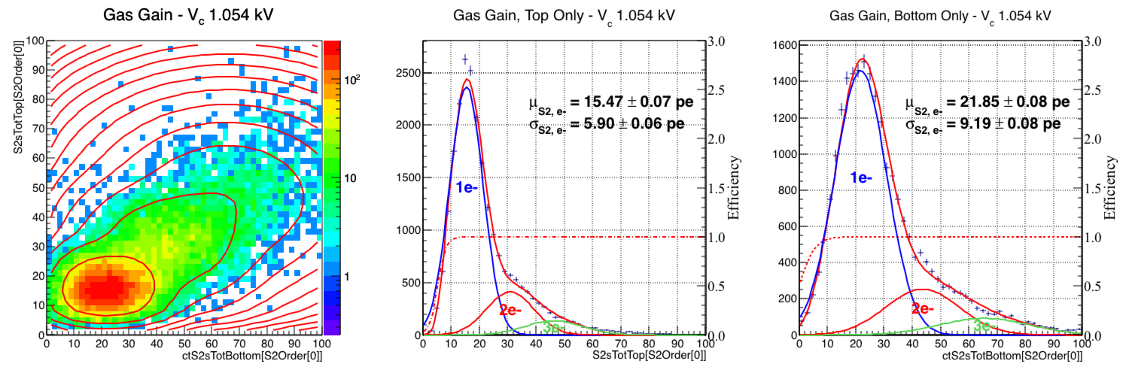
Gas Gain
Calibration: Normal PMT gain w/ Cs137 source
Look at electrons from photoionization of gate and use likelihood ratio test to choose proper number of electrons and avoid over-fitting.
Gas gain agrees nicely with g2 found in anti-correlation analysis.

Slide 14
Observables Spectrum from Geant4
Energy Spectrum from Geant4
Photon/Charge Yield
g1/g2
Gas Gain
Intrinsic S1/S2 Resolution
SPE Resolution
S1/S2 Efficiency
Corrected Observables Data Spectrum

Slide 15
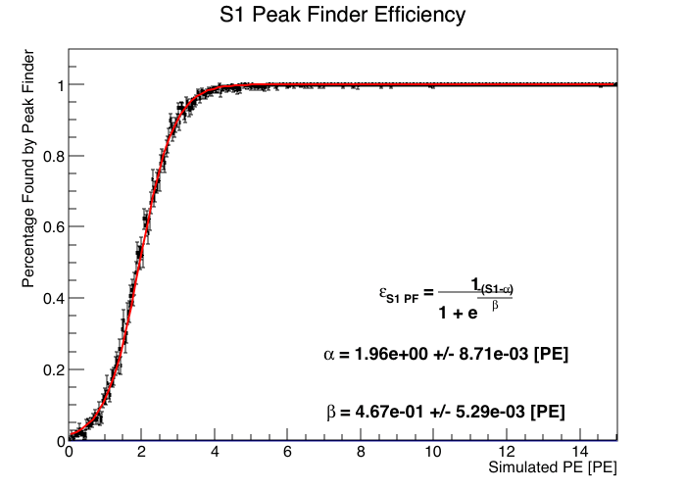
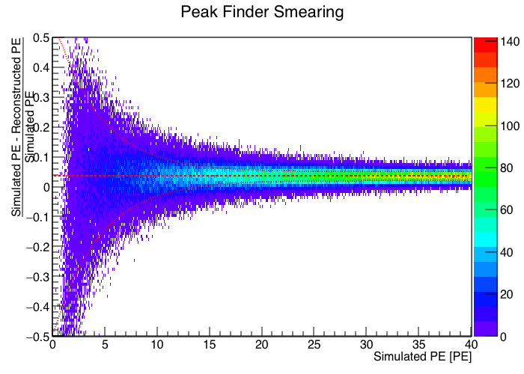
PF Efficiency
Calibration: Waveform Simulator
Examine the efficiency of the xerawdp peakfinder used in NR data.
Also can characterize the resolution of the peak finder as a function of the S1 size.

Slide 16
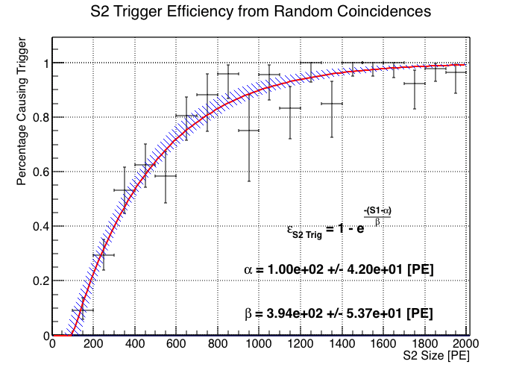
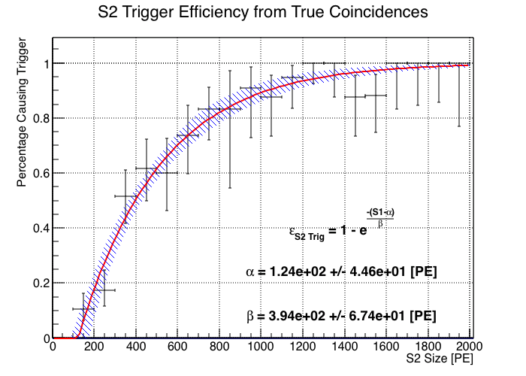
S2 Trigger Efficiency
Calibration: NaI – true and random coincidence
Look at S2s in waveform and whether they had trigger in fixed time window afterwards

