Slide 1
MDAP · UNIVERSITY OF MELBOURNE
Mapping Melbourne,
Searching Emotions
Two projects. Maps for Melbourne's suburbs, and search for a research database
Neil Shekhar Data Science Intern

Slide 2
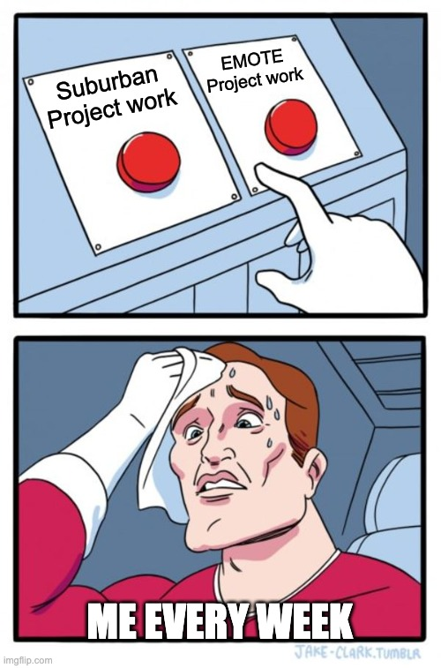


THE INTERNSHIP
Two projects, two very different audiences
Both running at the same time. One for ABP, one for FEEL lab
Suburban Futures
EMOTE
Who
Faculty of Architecture, Building and Planning
What
Interactive maps of Melbourne's suburbs
Mentors
Amanda Belton, Emily Fitzgerald
Who
Psychology researchers (FEEL Lab)
What
Search a research database by meaning
Mentor
Daniel
Neil Shekhar · MDAP Internship
2

Slide 3
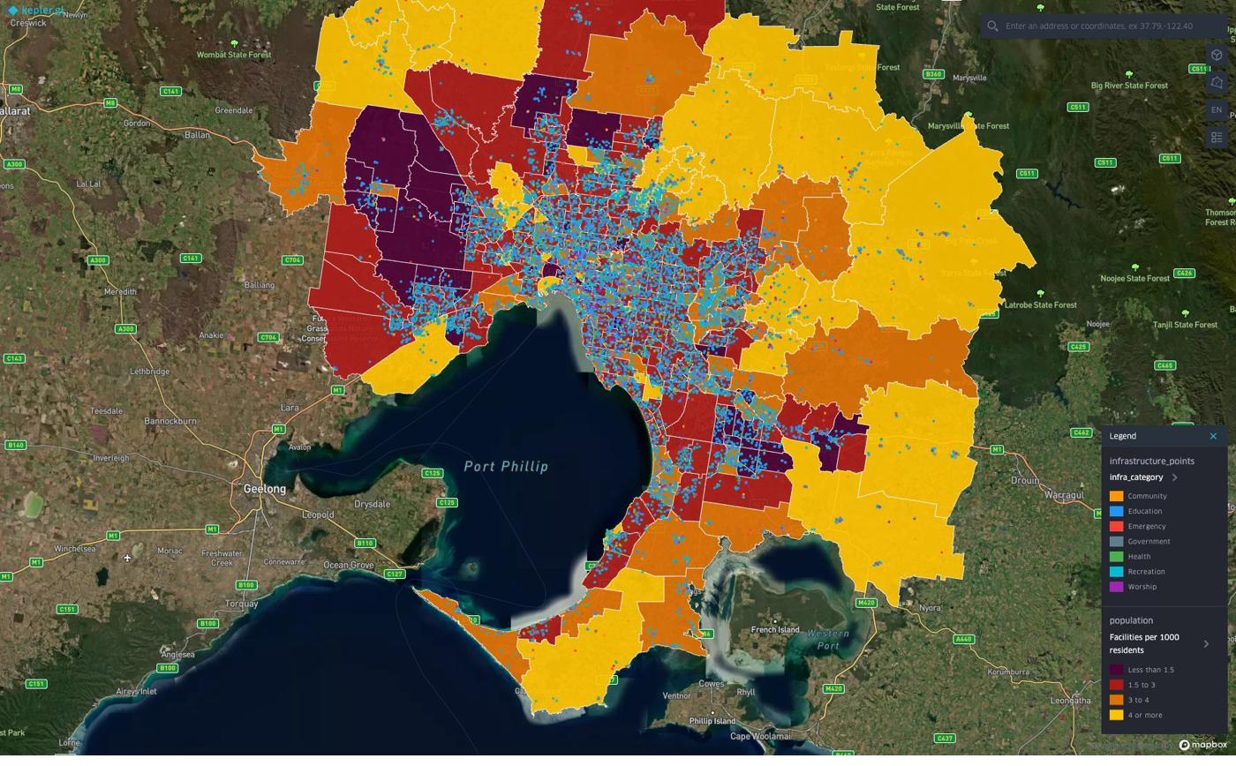
SUBURBAN · MAP 1 OF 4
Where is infrastructure thin today?
Growth-corridor suburbs are adding residents far faster than local facilities can keep pace
+375K
25 SA2s
people added across Greater Melbourne, 2021 to 2024
grew >20% yet sit below the metro median for facilities
0.39
facilities per 1,000 in Fraser Rise-Plumpton, which more than doubled in population (+102%)
Current Infrastructure Poverty. Facilities per 1,000 residents, 361 SA2s
Neil Shekhar · MDAP Internship
3

Slide 4
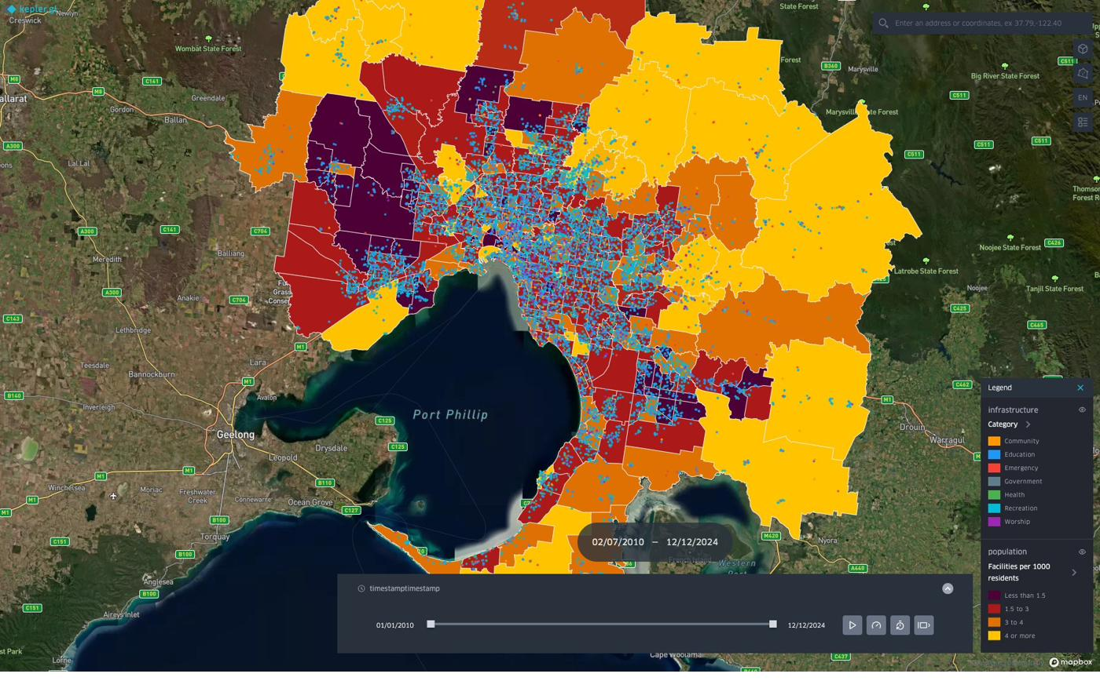
SUBURBAN · MAP 2 OF 4
Did it catch up? Partly, unevenly.
Melbourne added 10,494 facilities over 14 years. But in the fastest growing suburbs, people arrived so quickly the gap never really closed
+1.24M
+10,494
residents added city-wide, 2010 to 2024
facilities added over the same window
1 per ~119
new facility for every 119 new residents over 14 years. Catch-up was real, but never fast enough.
Infrastructure Poverty Timeline. Facility growth vs population, 2010 to 2024
Neil Shekhar · MDAP Internship
4

Slide 5
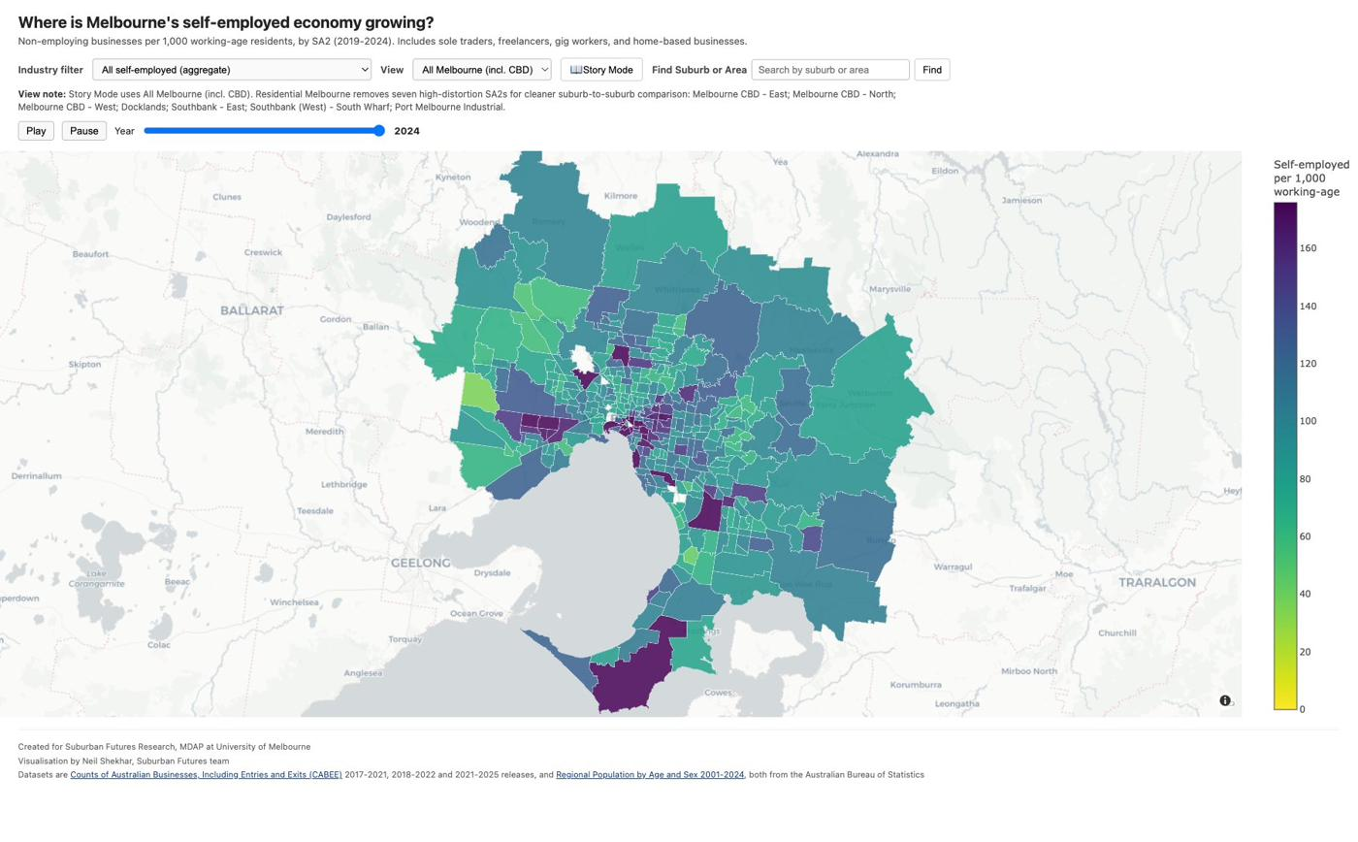
SUBURBAN · MAP 3 OF 4
Which industry is driving the corridor surge?
Which industries are dominating which Melbourne suburbs in self employed businesses
The driver: Transport, Postal & Warehousing. Mostly gig and delivery work.
81%
103 /1k
of metro Transport/delivery self-employed growth is in corridor LGAs
Tarneit-North leads on delivery businesses per 1,000 working age
Self-Employed Business Density, 2019 to 2024 ▶ click image for live demo
0 overlap
between the top transport SA2s and the top construction SA2s. Two different corridor economies.
Neil Shekhar · MDAP Internship
5

Slide 6
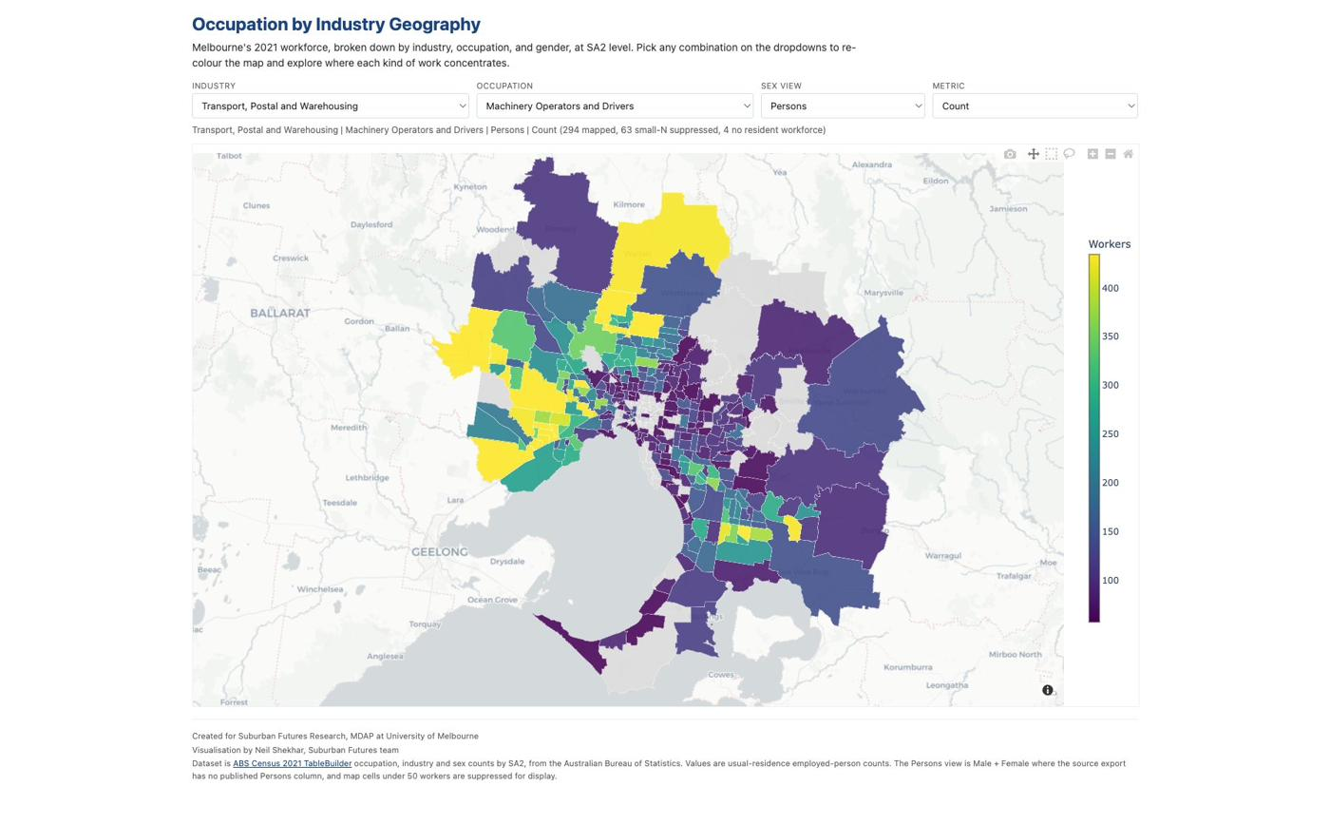
SUBURBAN · MAP 4 OF 4
Who are these workers?
Map 3 could not say who the workers actually were. So I built Map 4 from Census data to answer that
69%
of Tarneit-North's transport workers are Machinery Operators & Drivers (379 of 552). The proof behind the delivery story.
77%
13%
Occupation by Industry Geography, 2021 Census ▶ click image for live demo
of Health Care & Social Assistance workers are women
female share among Machinery Operators & Drivers, a sharp gender split
Neil Shekhar · MDAP Internship
6

Slide 7
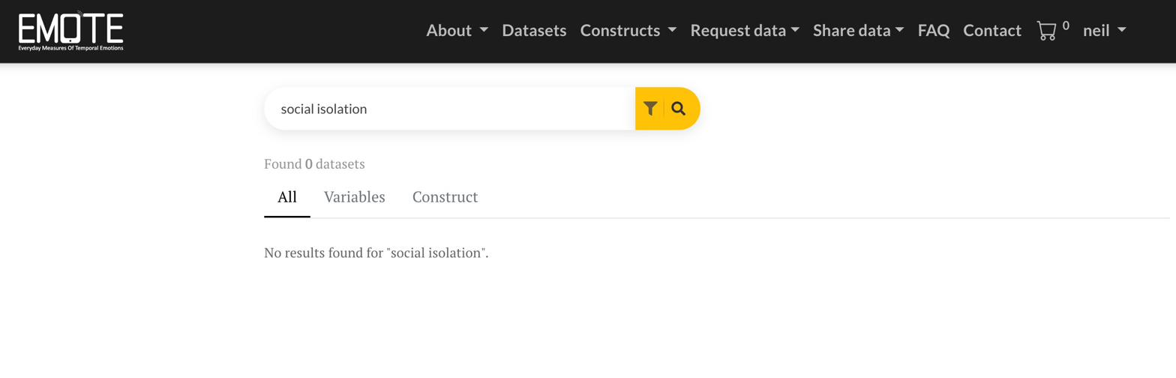
EMOTE · THE PROBLEM
Keyword search fails the moment the words don't match
A researcher searches "social isolation” and nothing matches
0 results
even though the data is right there. Keyword search just can't reach it.

Slide 8
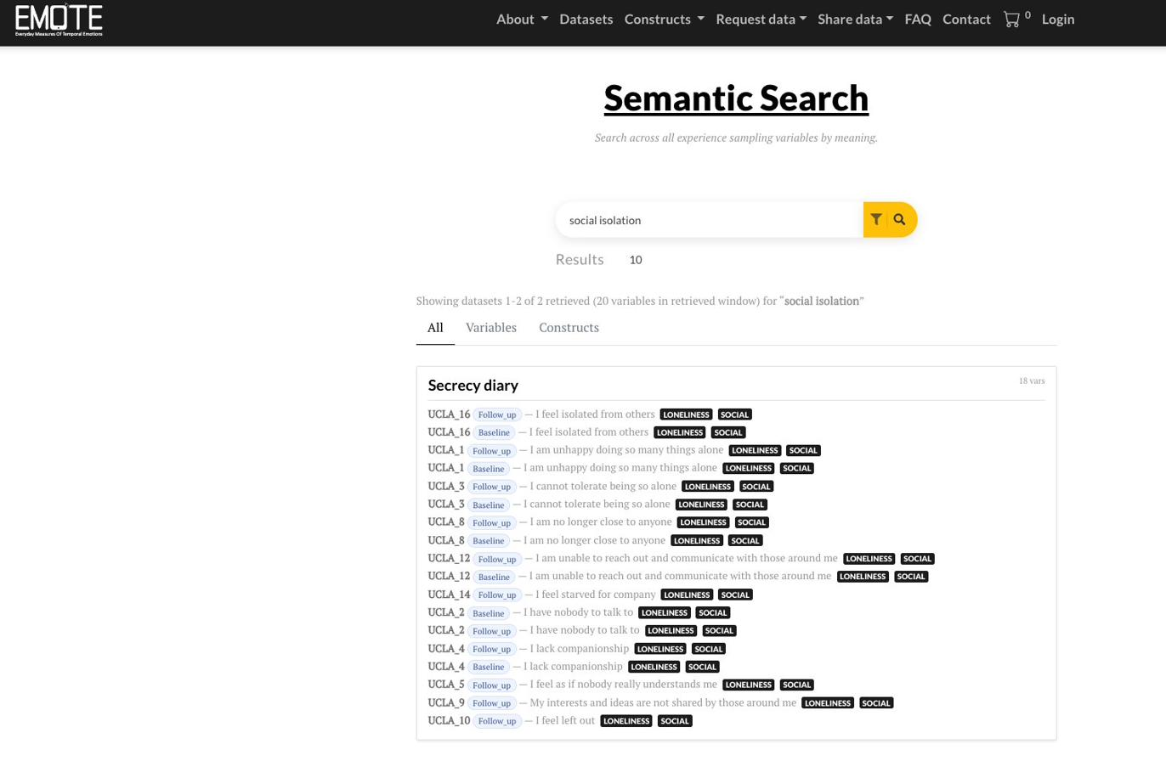



EMOTE · THE SOLUTION
Same query. Now it finds meaning, not just words
I built a semantic + hybrid search layer alongside the existing keyword search. "Social isolation" now returns the right variables instantly
Three ways to search By meaning, by keyword, or both blended together
How meaning search works Text turned into number vectors, matched by closeness
Results in three tabs All, Variables, and Constructs, like EMOTE today
Hybrid search: "social isolation" now finds the UCLA loneliness items
Neil Shekhar · MDAP Internship
8

Slide 9
EMOTE · WHAT ACTUALLY WORKED
All it needed was richer context, not a fancier model
On its own, a variable name is too thin for the search to place well. So I wrapped each one in the context around it: the study, the question, who took part. That is what made the ranking click.
Just the variable on its own
Variable plus its study context
"feeling lonely at university"
"feeling lonely at university"
ranked generic loneliness items above the ones that actually fit a student setting.
→
moved the first-year student study to the top, where it belongs.
Neil Shekhar · MDAP Internship
9

Slide 10


EMOTE · MODEL CHOICE
From a paid API to a model we can run ourselves
I got it working fast with OpenAI's API, then tested a model we could run in-house. It held up, and it takes the running cost to zero.
Started with OpenAI
Chose local Qwen
text-embedding-3-large
Quick to set up and a solid baseline. But it bills on every query, and that adds up over time.
→
Qwen3-Embedding-4B
Held its own in my tests, with no per-query cost once it is running. Deployment is the next step.
Neil Shekhar · MDAP Internship
10

Slide 11



HOW THE WORK ACTUALLY WENT
Research work is mostly trying things until one works.
The clean demos hide a lot of dead ends. That is where I learned the most.
1
2
3
Brainstormed widely
Failed, then diagnosed
Then it worked
Three possible EMOTE projects, and several ways to frame the business map before one held up.
Two models would not even load. Map visualization was breaking when loading data.
Built reusable tooling to test models early.

Slide 12
WHAT I TOOK FROM THE INTERNSHIP
What I am taking away
Every tool here was new to me. I can pick up an unfamiliar stack and still ship something that works
I learned to let the data set the story
Working across two very different teams
Thank you
Neil Shekhar

